Slide 1

BUOYANCY
BALANCE
The 4 Bs
BODY POSITION
BREATH CONTROL

Slide 2
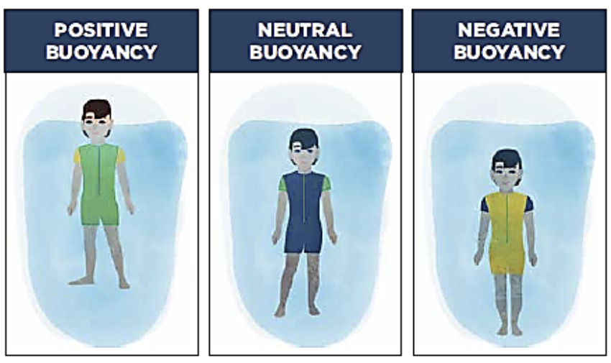
BUOYANCY
The ability to find how to use your body and the water to hold yourself at the surface

Slide 3
BUOYANCY
Affects everyone differently
Instructors/Coaches should be able to...
explain and demonstrate buoyancy positions in the water
vertical buoyancy test
prone position (face up and face down)
understand the relationship between Buoyancy, Balance, Body Position, and Breath Control
good inhale
relaxed body

Slide 4
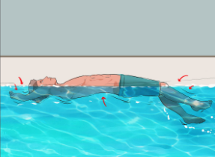
BALANCE
Uses buoyancy and body position to maintain position in the water

Slide 5
BALANCE
Dryland exercises that help teach balance
standing balance
use of center of gravity shift
roll overs
In-Water balance drills
front balance
back balance
side balance
roll overs

Slide 6
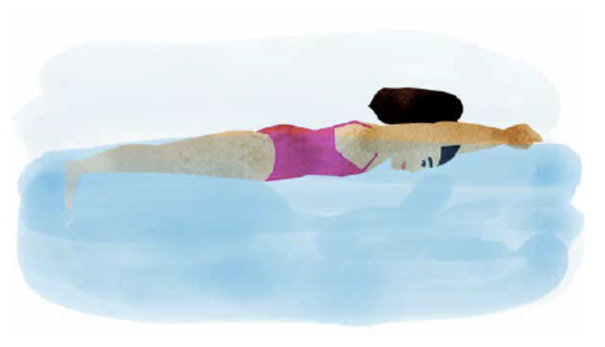
BODY POSITION
Streamline is the ready position for each stroke

Slide 7
BODY POSITION
Front streamline
dryland: lower body superman
Back streamline
dryland: back hip lift
Side balance with kick
dryland: positioning on front quad

Slide 8
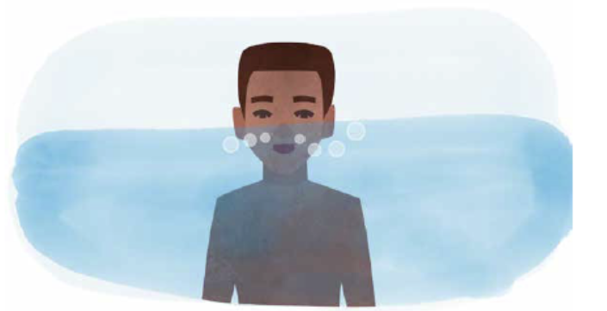
BREATH CONTROL
The ability to comfortably breathe when in the water

Slide 9
BREATH CONTROL
In through your mouth and out your nose
think humming
relaxed
no puffy cheeks
no rushing
In-Water breath control practice
controlled bobbing
floor push-offs / vertical floats

