Slide 1
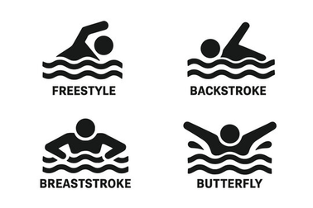

BREASTSTROKE
A swimming stroke executed in a prone position by coordinating a kick in which the legs are brought forward with the knees together and the feet are turned outward and whipped back with a glide and a backward sweeping movement of the arms.
Key World Aquatics Rules
7.1: After the start and after each turn, the swimmer may take one arm stroke completely back to the legs during which the swimmer may be submerged...The head must break the surface of the water before the hands turn inward at the widest part of the second stroke.
7.4: During each complete cycle, some part of the swimmer’s head must break the surface of the water. All movements of the legs shall be simultaneous without alternating movement.
7.5: The feet must be turned outwards during the propulsive part of the kick.
7.6: At each turn and at the finish of the race, the touch shall be made with both hands separated and simultaneously at, above, or below the water level. Separated means that the hands cannot be stacked one on top of the other.
Common Disqualifications
Touching wall with one hand at turn and/or finish
Incorrect breaststroke kick action or swimmer does not demonstrate turning feet out during kick
Breaststroke kick action not simultaneous
Arms extending below hip line
False start

Slide 2

BREASTSTROKE DRILLS
Kick-Kick-Pull
Swim two breaststroke kicks followed by 1 pull.
The pull should be small with hands pulling out slightly beyond the shoulders and elbows coming in sharply below the chin and then the fingers shooting forward.
Single-Double-Single
Execute a single arm pull with the opposite arm outstretched for support, then a normal stroke, followed by a single with the other arm.
Helps reinforce a fast pull and forces a small pull with the single arm.
Long Glide
Pause with hands stretched forward and count to 3, giving feet enough time to come together completely.
Clap feet together and then begin counting.
Helps swimmers learn to finish each “cycle” completely before beginning the next.
Dolphin Pull
Execute a full arm cycle of breaststroke, and use a dolphin kick.
An advanced drill that teaches rhythm and undulation of breaststroke.
You may use one or two dolphin kicks per stroke focusing on how to use arm correctly.
Scan to find out more about the Michael Phelps Foundation

