Slide 1
Fitness Coach Training - Notes for the Facilitator
The intended facilitators for this workshop are Special Olympics Program staff who are leading Fitness Coach recruitment and implementation, however it is up to the discretion of the Program lead to identify a suitable facilitator.
Preparation: familiarize yourself with the supporting resources, including the Fitness Coach Activation Guide, Program Staff Guidance, and Sport Coach Guidance materials, as well as reviewing the PowerPoint training and speaking notes ahead of time.
Note that there are a few slides that require customization - Slides 2, 8,11, 46, 49.
If possible, you are encouraged to open links to review the key resources and/or provide the participants with links so they can view them on their own device
90 minutes is the recommended time allotment for this workshop. This will ensure ample time to cover the material with time for questions and discussion.
This workshop is designed to be taken AFTER the Fitness Coach trainee has reviewed the Fitness Coach Activation Guide and completed the Fitness Coach trainings, as outlined in the Activation Guide and on Slide 12.
Recommend participants to have the Activation Guide in print or electronic version as a reference.
In person delivery is recommended, however this session can also be delivered virtually if necessary.
For support with Fitness Coach training please reach out to SOI Fitness at fitness@specialolympics.org

Slide 2
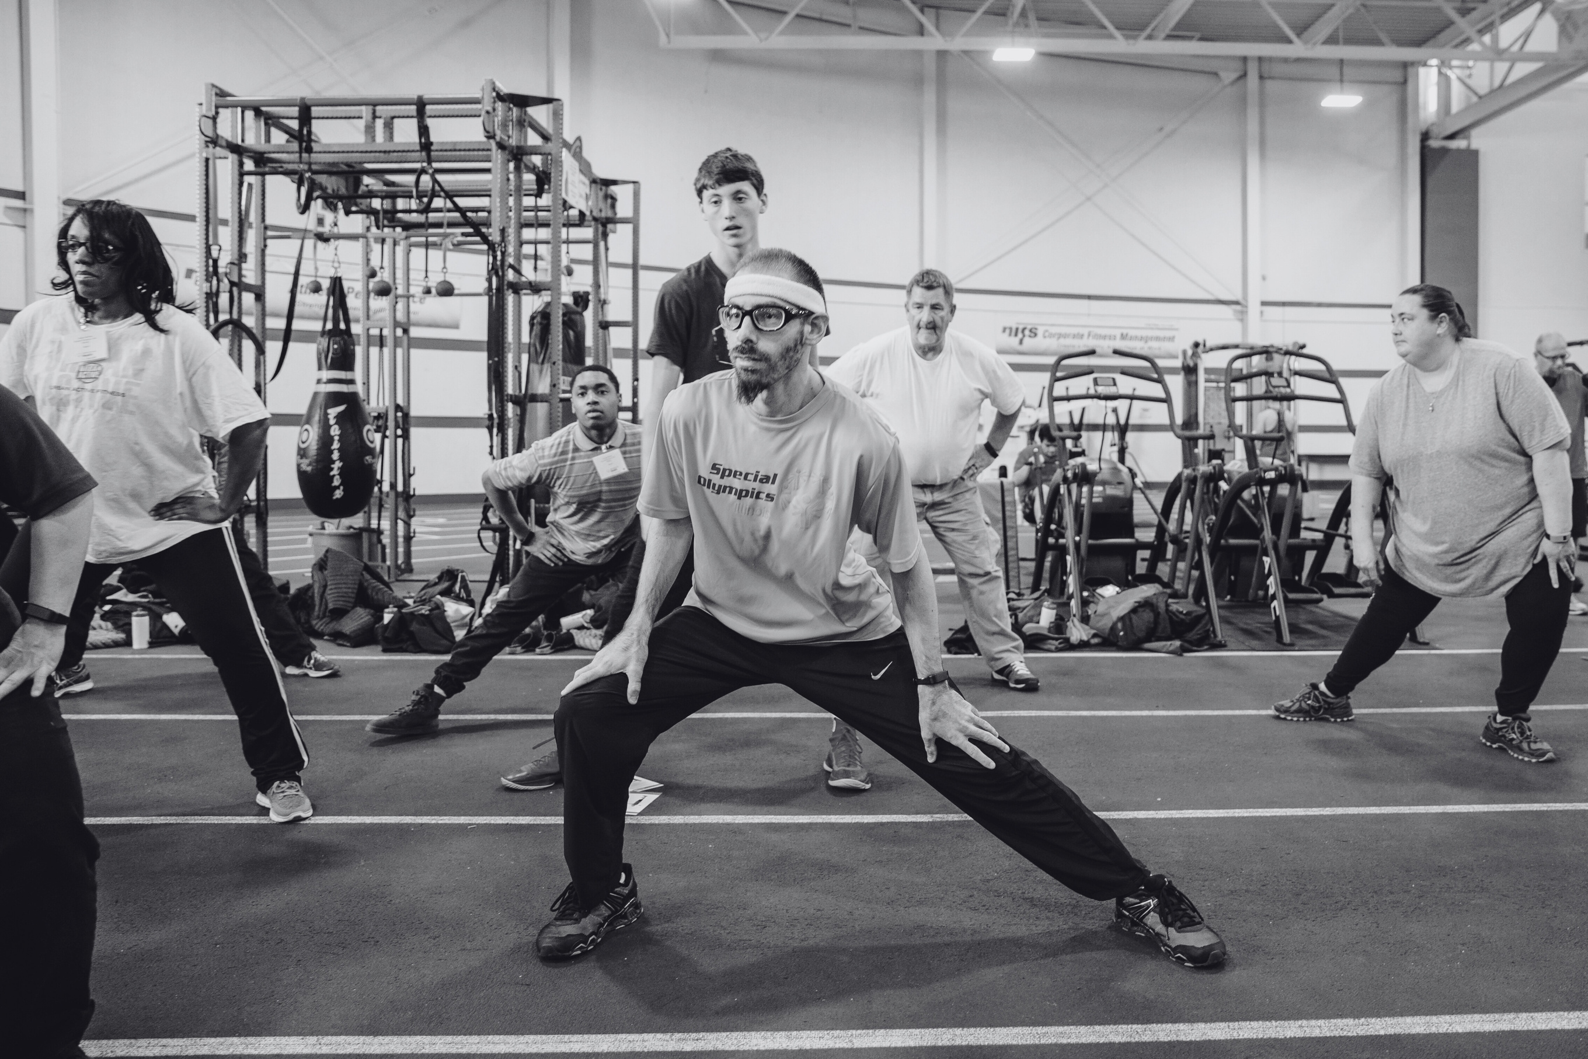


FITNESS COACH
TRAINING
Facilitated By:
Date:
Notes:
(add your name and the date to the slide)
(have this slide showing as participants arrive)
Welcome to the Fitness Coach Training. My name is _________________________ and I will be facilitating the workshop
(add any additional information specific to your site or the context of the workshop)

Slide 3

Special Olympics Health activities are supported by many sources, including in the United States by Grant Number NU27DD000021 from the Centers for Disease Control and Prevention of the U.S. Department of Health and Human Services, with $18.1 M (64%) financed with U.S. Federal funds and $10.2 M (36%) supported by non-federal sources.
These contents are solely the responsibility of the authors and do not necessarily represent the official views of the Centers for Disease Control and Prevention or the Department of Health and Human Services.
Notes:
This workshop is made possible through funding from the Golisano Foundation.

Slide 4

AGENDA
  Introductions
  Special Olympics Overview
  Your Journey to Becoming a Fitness Coach
  Fitness Coach Roles
  Working With Your Coaching and Support Team
  Leadership Skills: Motivation, Communication and Connection
  Next Steps in Your Journey as a Fitness Coach
Notes:
Here are the topics we will be covering today
(review the agenda)

Slide 5
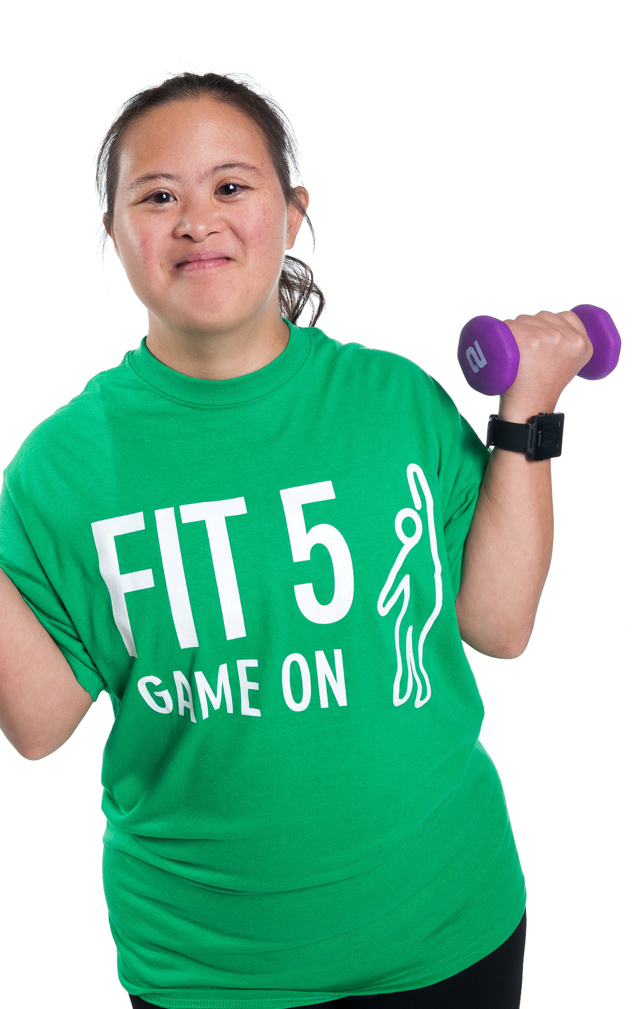

INTRODUCTIONS
Share a bit about yourself, any experience with Special Olympics, and why you want to become a Fitness Coach
Notes:
(share a bit about yourself )
Now I’d like to get to know each of you. Please share your name, a bit about your background, any experience you have with Special Olympics and why you are interested in becoming a Fitness Coach.

Slide 6
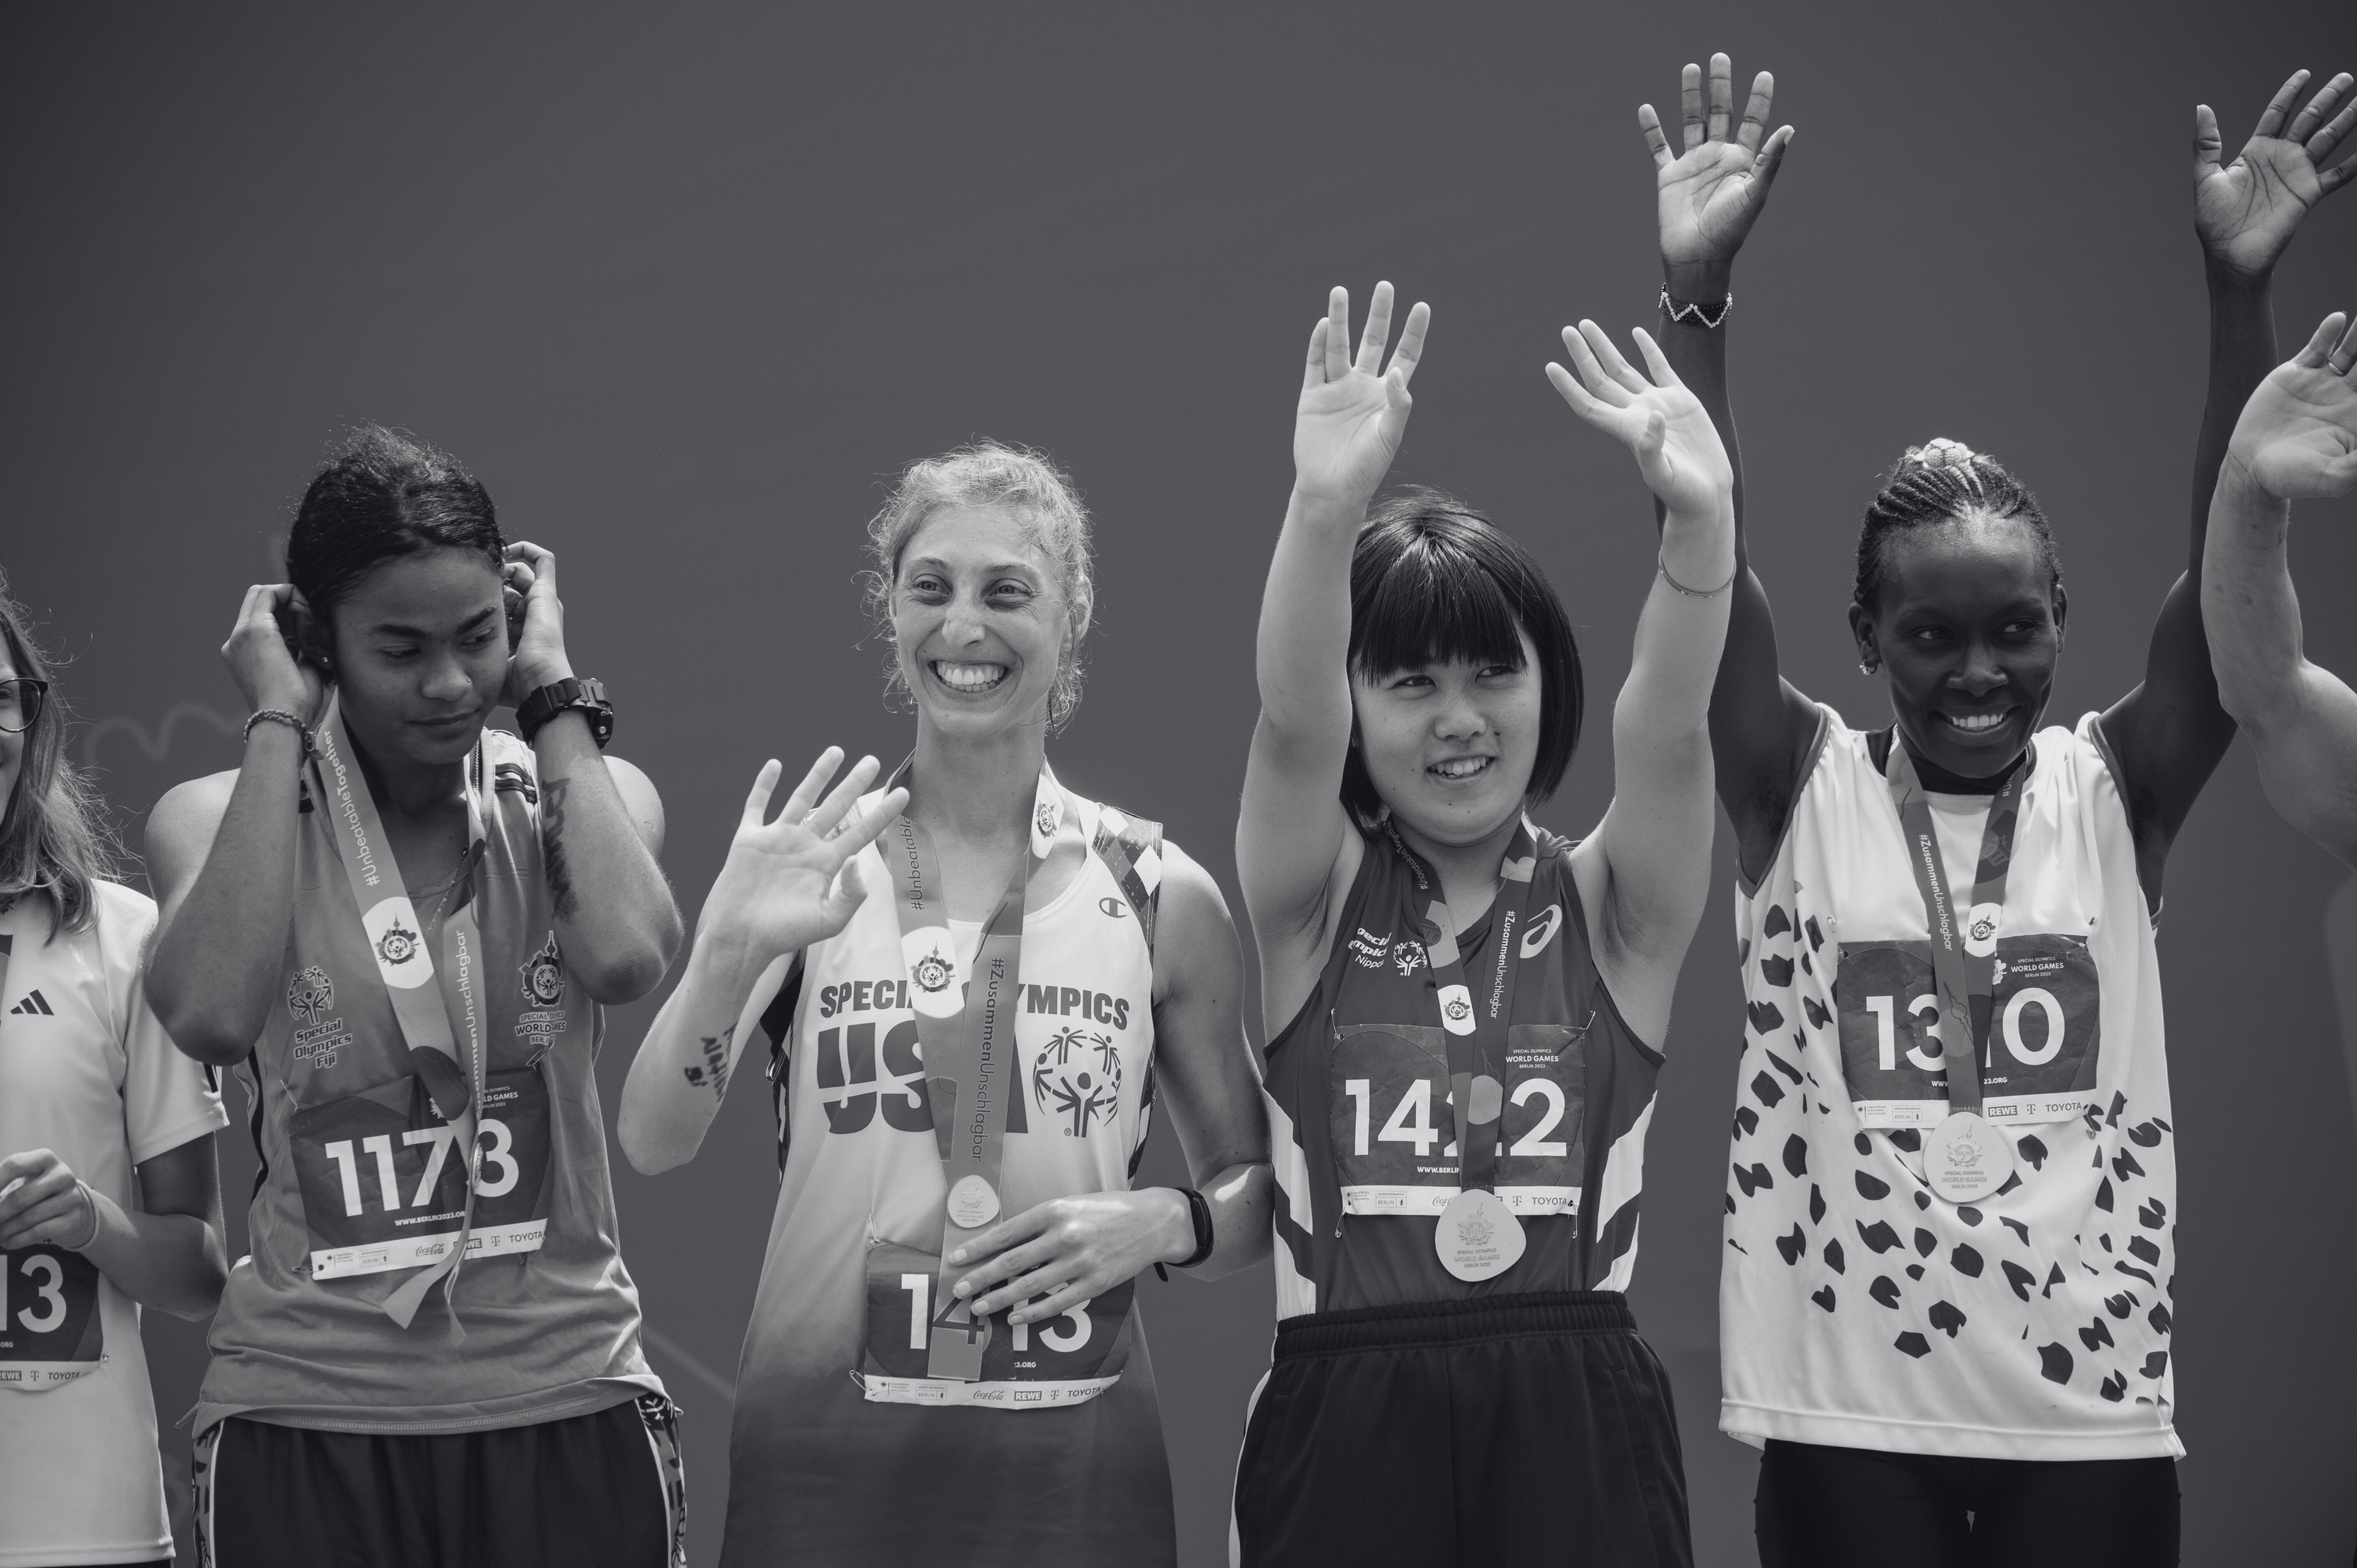
SPECIAL OLYMPICS OVERVIEW
Notes:
Our first section will provide an overview of Special Olympics – this should be familiar from the training you have already done.

Slide 7
SPECIAL OLYMPICS MISSION
Provide year-round sports training and athletic competition in a variety of Olympic-type sports for children and adults with intellectual disabilities, giving them continuing opportunities to develop physical fitness, demonstrate courage, experience joy and participate in a sharing of gifts, skills and friendship with their families, other Special Olympics athletes and the community.
Notes:
Here is a reminder of the mission of Special Olympics.
(Review the mission, highlighting the bolded text)
(Spend more time if most participants are new to Special Olympics)

Slide 8
SPECIAL OLYMPICS REACH
  5 million athletes in more than 172 countries with year-round training and 100,000+ annual competitions
  [Add in Program-specific reach data such as number of athletes, Unified partners, coaches, sports, etc./ what your most proud of or what is a priority]
Notes:
(Add Program-specific data that would be valuable for the Fitness Coaches to know)
(Review the information)

Slide 9
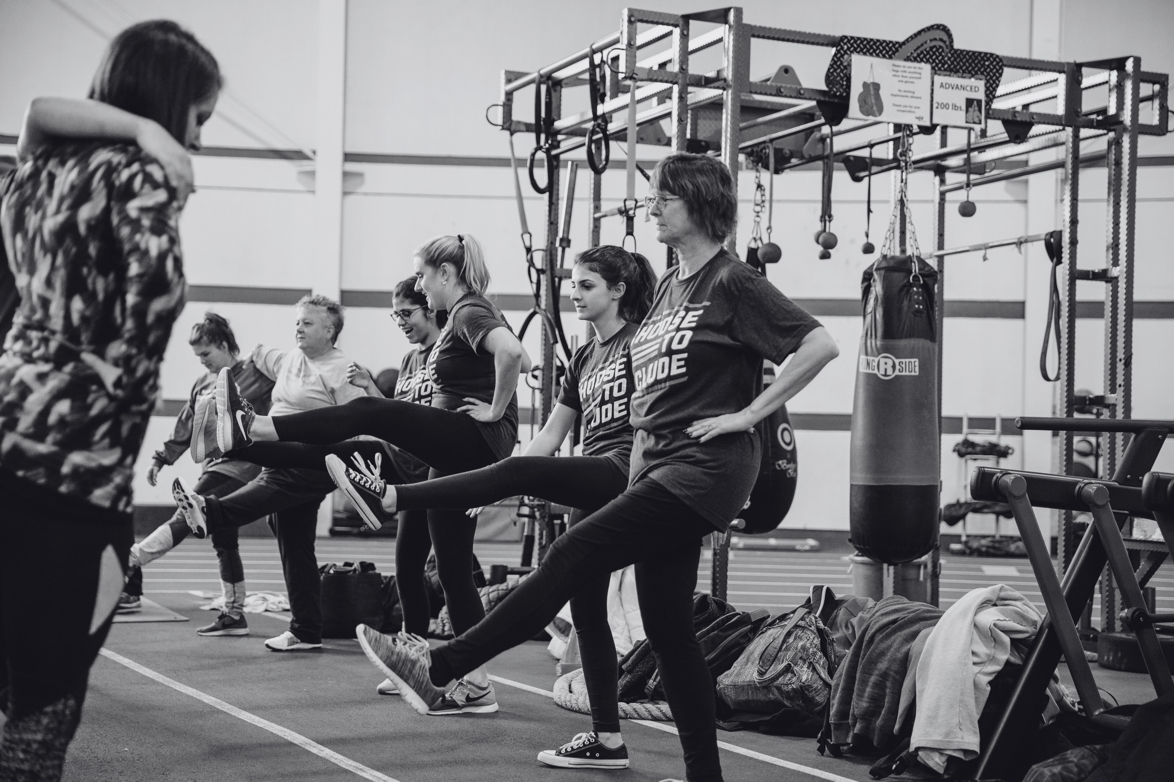
YOUR JOURNEY TO BECOMING A FITNESS COACH
Notes:
Our next section will review the steps to becoming a Fitness Coach.

Slide 10
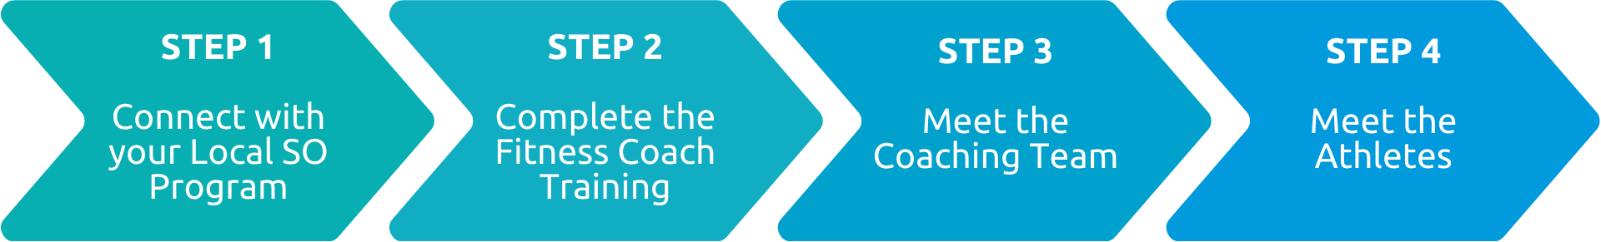
YOUR JOURNEY SO FAR...
Notes:
Here are the steps as outlined in the Activation guide. Let’s go through them and clarify any steps you’re unsure of and answer any questions you may have.
​

Slide 11
STEP 1: PROGRAM REQUIREMENTS
Training and Screening Requirements completed to date:
  [List Program requirements here]
Share your preferences and availability:
  Time and frequency
  In-Person or virtual
  Practice, competitions or special events
  Sports
  One or multiple teams
Notes:
(Add your Program-specific requirements to the slide
(Review them and ask Fitness Coaches if they have completed these)
Now, let’s review your preferences and availability as a Fitness Coach.
Take a few moments to jot down your answers and then we can discuss
(Review the questions and add or edit based on your program/coach needs)
How much time do you have to offer? How often could you attend training sessions (e.g., weekly, bi-weekly, periodic)​
Do you prefer in-person, virtually, or a mix​ (more suited to health, nutrition professionals)
Do you envision your involvement mostly at practices, competitions or special events (if applicable)​
Could you be available for brief check-ins outside of training sessions​?
Are there specific sports or types of athletes (age, community, regional, etc.) that you are more interested in working with? (check the program website for a list of sports and programs offered)​
Would you be interested in working with one or multiple teams?​
(Depending on the number of participants you could have them each share a summary of their responses, provide a list of teams that are looking for a Fitness Coach, or any other information about how team assignment works)
​

Slide 12
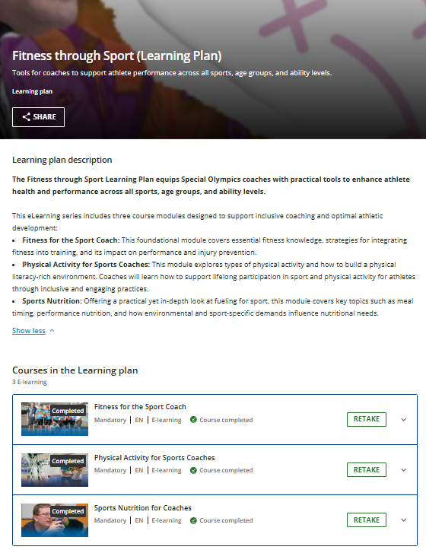
STEP 2: TRAINING
  Fitness through Sport eLearning Plan
    Fitness for the Sports Coach
    Sports Nutrition for Coaches
    Physical Activity for Sports Coaches
  Inclusive Fitness eLearning module (optional)
  Complete a Fitness Coach training session with your Program (today!)
Notes:
This is the list of additional training courses that you have completed – has anyone not had a chance to complete these yet?
(Verify this has been completed and congratulate them or create a timeline for when they will be completed )​

Slide 13
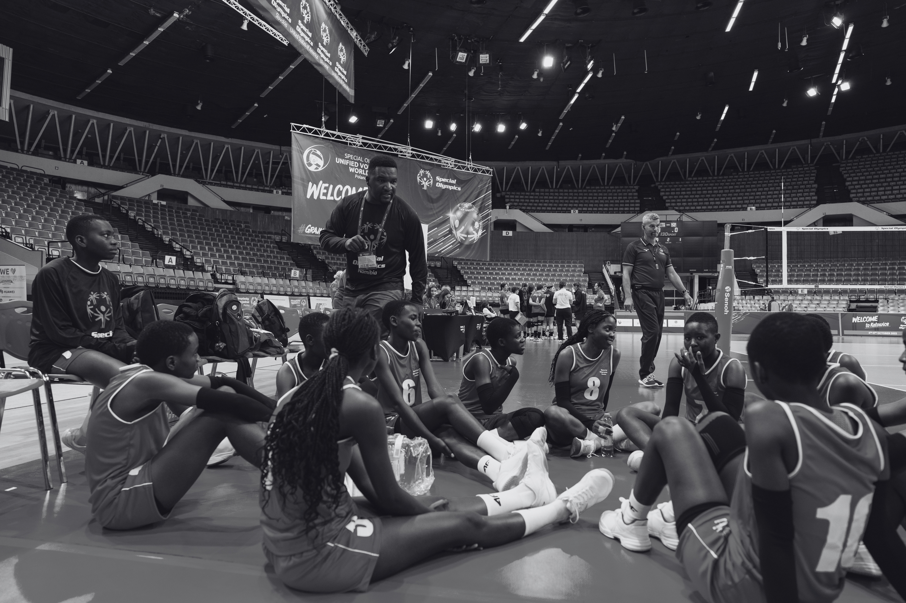
TRAINING SUMMARY
Notes:
You’ve had a lot of information to go through with the materials and training, so let’s just summarize some of the key points so it’s fresh in your mind as we go through the specific roles of a fitness coach.

Slide 14
KEY POINTS FROM TRAINING SO FAR:
  Special Olympics (SO) defines fitness as optimal health and performance through adequate physical activity, nutrition, and hydration
  SO athletes are more likely to experience obesity, be less physically active, and face higher risks for health conditions, such as heart disease and diabetes.
  Some athletes may also have challenges with balance, coordination, and fine motor skills.
The Fitness through Sport (FTS) initiative expands the reach of health and fitness programming through a focus on three connected outcomes:
    Performance: endurance, speed, strength, flexibility
    Health: energy, healthy weight, fewer injuries
    Wellbeing: reduced disease risk, improved quality of life
Notes:
(Review the key points)
(Option to share a story or example of a fitness initiative that has benefited athletes in performance, health or well-being)

Slide 15
FITNESS COACH ROLES
Notes:
Since there can be several individuals supporting a team or an athlete, it is important to clarify the roles of a Fitness Coach

Slide 16
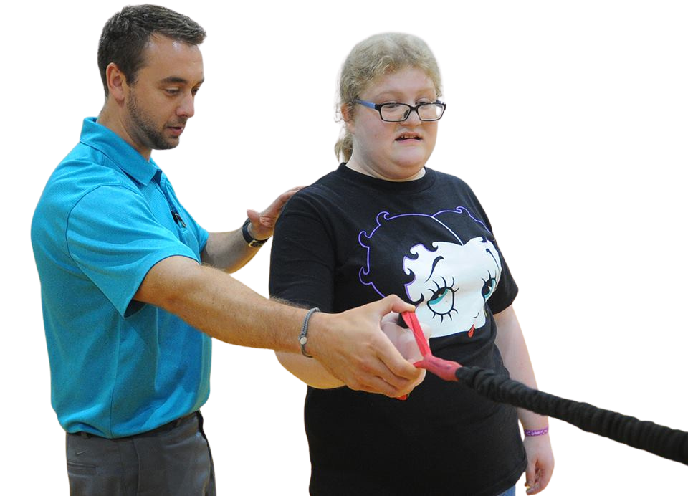
FITNESS COACH OVERVIEW
Fitness Coaches play a vital role in athlete development by:​
  Integrating fitness activities and education into all phases of the sport experience​
  Supporting athlete health and performance through physical activity, nutrition, and hydration​
  Working collaboratively with coaches and volunteers as part of the sport team​
  Support Head Coach capacity to focus on sport-specific skills and strategy
Notes:
You may recall from the Activation Guide that:
A Fitness Coach is a volunteer who partners with Head Coaches across one or multiple teams within a Program to integrate fitness activities and education into all phases of the sport experience.
(Briefly summarize the content on the slide) ​
​

Slide 17
MAIN AREAS OF SUPPORT
Achieve the Minimum Fit Practice Standards
Promote Healthy Habits
Support Goal Setting
Notes:
There are 3 main areas that a Fitness Coach provides support to. Fitness Coaches helps teams:
Achieve the Minimum Fit Practice Standards
Promote Healthy Habits
And Set Goals for the sports season and practice sessions
It is important to note that Fitness Coaches do not need to take on all of these roles. Depending on your background and comfort, you are encouraged to take on roles that you feel confident in. Over time you may take on more roles as you gain more knowledge and experience.
For areas that you are not as comfortable with, you are encouraged to simply observe, learn and be open to opportunities to support the head coach and athletes.

Slide 18

ACHIEVE THE MINIMUM FIT PRACTICE STANDARDS
Notes:
Let’s start with the Minimum Fit Practice Standards

Slide 19
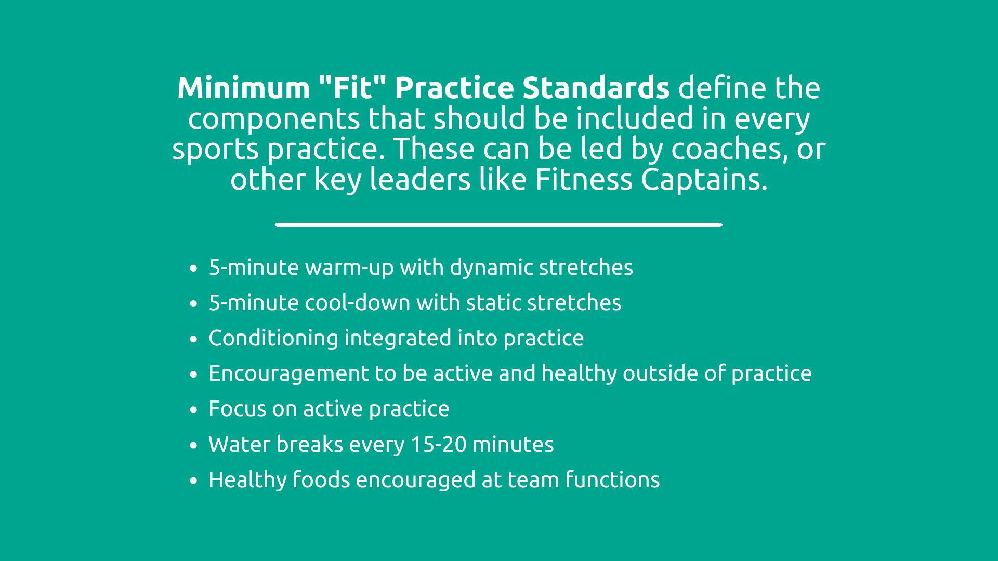
MINIMUM FIT PRACTICE STANDARDS
Notes:
The purpose of the Minimum Fit Practice Standards is to enhance the quality of a sports practice to support the performance, health and wellbeing of athletes. Embedding fitness into sports experiences is as easy as including these components!
(Review the list and pause after first 2 bullets)
ASK: Can anyone explain the difference between Dynamic and Static stretching? (pause for reply)
Dynamic stretching involves active, motion-based movements to warm up muscles before exercise, while static stretching involves holding fixed positions to improve flexibility afterward. Use dynamic stretches (e.g., leg swings) pre-workout to boost performance, and static stretches (e.g., hamstring stretch) post-workout for recovery and long-term flexibility
Other components of the Minimum Fit Practice Standards are:
Conditioning
Encouraging athletes to be active and healthy outside of practice
Have an active practice by keeping movement time high, and sedentary time low
Taking water breaks every 15-20 minutes
And offering healthy foods at team functions
(Link to Resource: https://media.specialolympics.org/resources/sports-essentials/fitness-for-sports-coaches/Minimum-Fit-Practice-Standards.pdf?_gl=1*u88i3w*_gcl_au*ODU3MDA4MzMwLjE3Njg4NDMxMjA.*_ga*MTY0ODYxMDYwOC4xNzIwNTQ3MjY4*_ga_KTMLJ70DKD*czE3NzA4NTExMTckbzQ5OSRnMSR0MTc3MDg1MTEyMSRqNTYkbDAkaDA.)

Slide 20
ACHIEVE THE MINIMUM FIT PRACTICE STANDARDS
Roles:
Plan with the Head Coach to incorporate conditioning and active practice strategies in accordance with the Minimum Fit Practice Standards.
  Focus on promoting fitness inside and outside of practice.
  Support Fitness Captains to lead warm-ups and cool-downs. Lead if there are no Fitness Captains available.
  Lead skill-based training that incorporates dynamic movement and injury prevention strategies.
  Design individual or team workouts for off-days or the off-season.
Key Resources:
  Active Practice Overview
  Active Practice Organizer
  Fit 5 Guide
Notes:
(Review the roles and add any specific examples you are aware of)
If in doubt, ask the head coach before adding an activity – ensure that you are both on the same page as far as when and how fitness activities will be incorporated. We have some slides at the end that outline how roles are divided on a team
(Note the resources and highlight that they are also linked at the back of the Activation Guide)
​

Slide 21
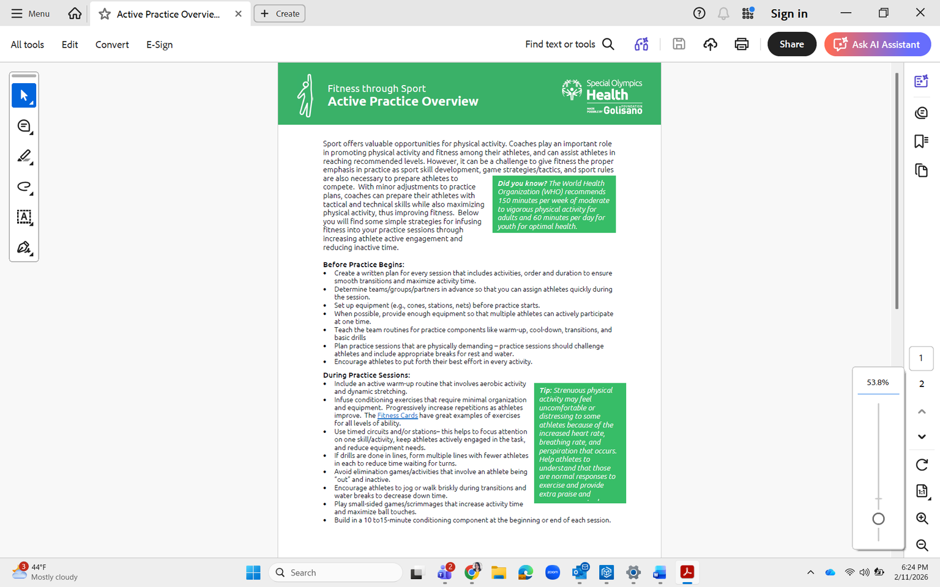
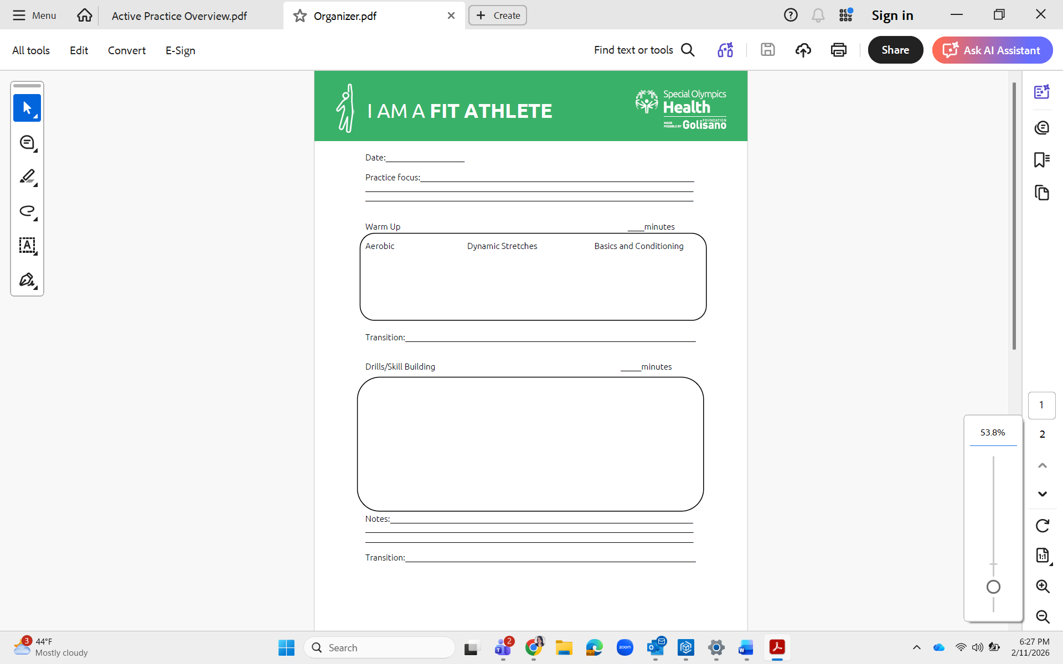
KEY RESOURCE:
ACTIVE PRACTICE OVERVIEW AND PRACTICE ORGANIZER
The Active Practice Overview provides strategies for infusing fitness into practice sessions through increasing athlete active engagement and reducing inactive time.
Work with the coach to build the strategies into the Practice Organizer.
https://resources.specialolympics.org/health/fitness/fitness-through-sport/coach-education
Notes:
https://resources.specialolympics.org/health/fitness/fitness-through-sport/coach-education
The Active Practice Overview provides strategies for infusing fitness into practice sessions through increasing athlete active engagement and reducing inactive time.
Work with Head Coach to embed fitness into the Practice Organizer.
Let’s take a look at the Active Practice Organizer together.

Slide 22
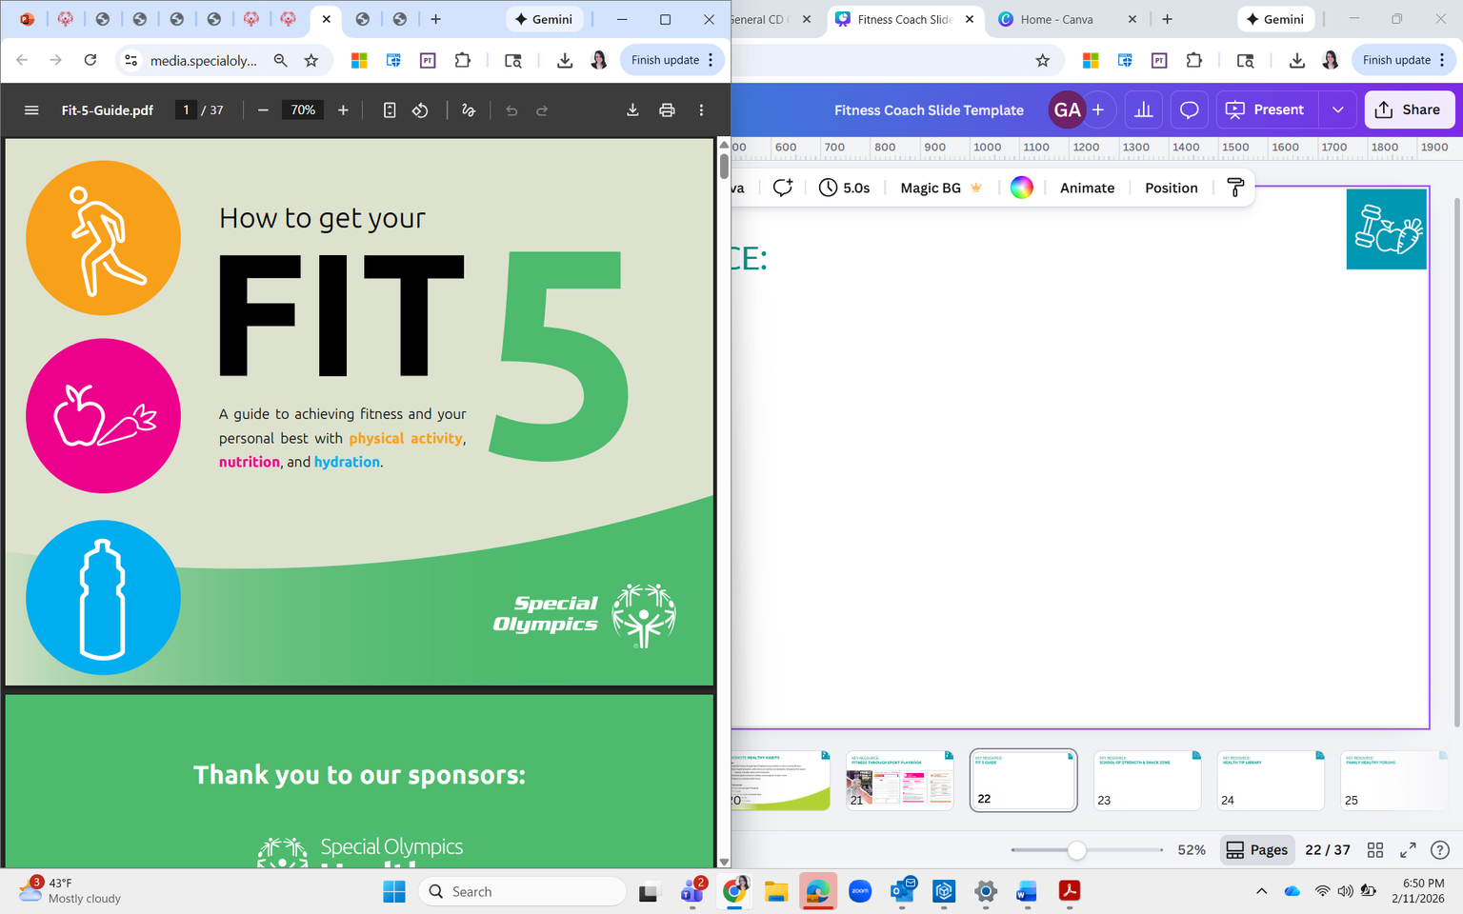
KEY RESOURCE:
FIT 5 GUIDE
Fit 5 is based on the three simple goals of exercising 5 days per week, eating 5 total fruits and vegetables per day, and drinking 5 water bottles of water per day.
Print and video resources available.
https://resources.specialolympics.org/health/fitness/fit-5
Notes:
Fit 5 is a resource of Special Olympics, designed for easy use for athletes and coaches alike. It is based on the three simple goals of exercising 5 days per week, eating 5 total fruits and vegetables per day and drinking 5 water bottles of water per day.
Let’s take a look!
https://resources.specialolympics.org/health/fitness/fit-5

Slide 23
PROMOTE HEALTHY HABITS
Notes:
The second role of Fitness Coaches is Promoting Healthy Habits

Slide 24
PROMOTE HEALTHY HABITS
Roles:
Lead the Fitness through Sport Playbook lessons before or after training sessions.
  Share nutrition and hydration strategies for before, during, and after training or competition, utilizing resources like Fit 5.
  Involve caregivers and families in supporting healthy eating and hydration routines.
  Offer or coordinate education sessions and resources on wellness topics throughout the season.
  Encourage the team to use the Special Olympics Fitness App to track healthy behavior goals, like water, fruit, and vegetable intake.
Key Resource:
  Fitness through Sport Playbook
Notes:
As with the Minimum Fit Practice Standards, it is important to plan with the Head Coach how and when you will include the healthy habit activities.
(Review roles list)

Slide 25
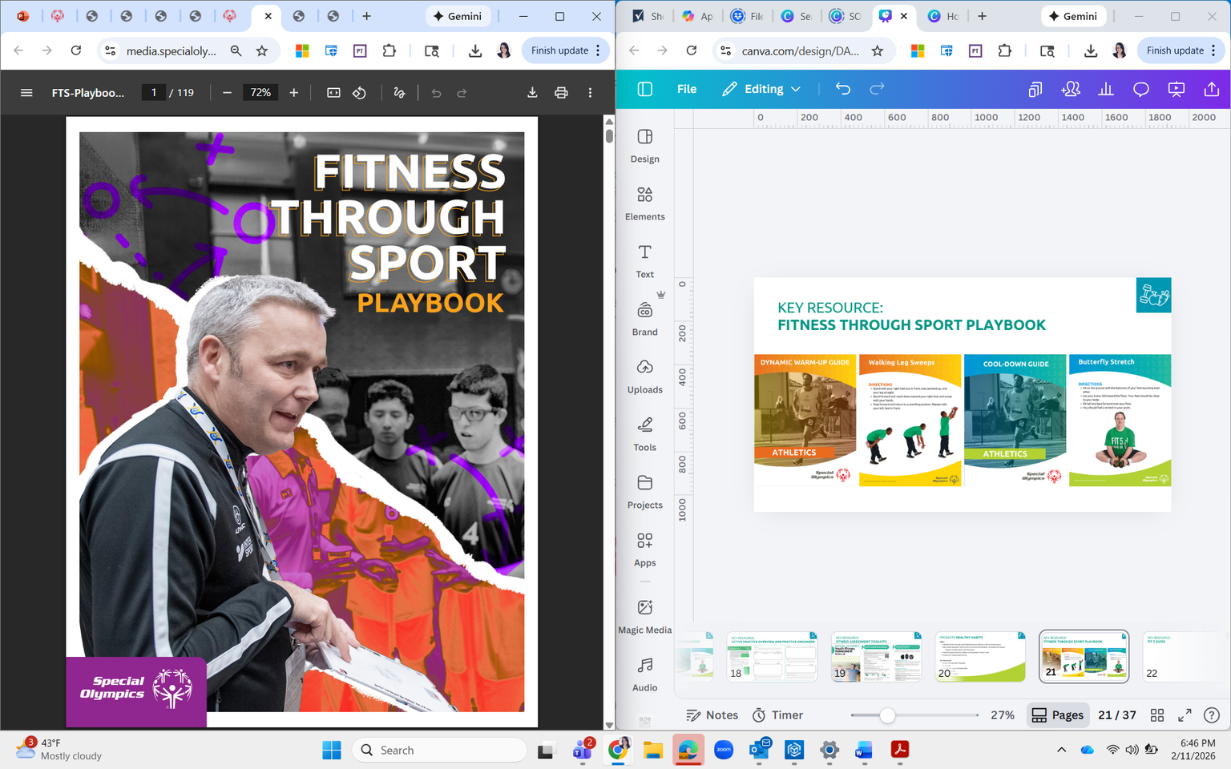
KEY RESOURCE:
FITNESS THROUGH SPORT PLAYBOOK
The Fitness through Sport Playbook is designed to help Special Olympics coaches introduce fitness concepts to athletes in fun and accessible ways. It includes:
Information to support and track healthy habits in your athletes
12 lesson plans in 4 topic areas: Introduction to Healthy Habits, Physical Activity and Exercise, Nutrition and Hydration, and Game Day Minds.
https://resources.specialolympics.org/health/fitness/fitness-through-sport/playbook
Notes:
Let’s take a look at the Fitness through Sport Playbook.
The Fitness through Sport Playbook is designed to help Special Olympics coaches introduce fitness concepts to athletes in fun and accessible ways. It includes:
Information to support and track healthy habits in your athletes
12 lesson plans in four topic areas: Introduction to Healthy Habits, Physical Activity and Exercise, Nutrition and Hydration, and Game Day Minds.
Each of the 12 lessons have a corresponding “Homeplay” activity for athletes and their caregivers to continue the learning at home. These typically require more discussion, action-planning to support the development of new healthy habits/behaviors
A library of supporting resources and training for coaches, athletes, and parents/caregivers
Each lesson is about 20-25 minutes long and uses minimal equipment. The Playbook offers flexible ways to use the content.
https://resources.specialolympics.org/health/fitness/fitness-through-sport/playbook

Slide 26
SUPPORT GOAL SETTING
Notes:
Finally, let’s look at Goal Setting as the final key role for a Fitness Coach

Slide 27
SUPPORT GOAL SETTING
Roles:
  Collaborate with the Head Coach to create team and individual health and fitness goals for the season.
  Conduct fitness assessments to support goal setting and tracking athlete progress throughout the season.
  Support athletes in monitoring progress towards these goals.
  Offer recommendations on ways to achieve their goals.
Key Resource:
  Adult and Youth Fitness Assessment Toolkit
Notes:
Goal setting can be highly motivating to Special Olympics athletes as they work to improve in their sport.
(Review roles list)
If you do not have experience with goal setting, this may be an activity you can work with the Head Coach.
Taking the time to guide your athletes through the goal setting process allows them to create meaningful and more attainable goals.

Slide 28
STEPS FOR GOAL SETTING
Step 1: Make Time for Goal Setting
Step 2: Teach about Goal Setting
  The difference between short and long-term goals
  Process and outcome goals
  Individual and team goals
  Creating actionable steps and progress tracking
Step 3: Help Your Athletes Set Goals
Step 4: Provide Ongoing Support
Notes:
Let's look closer at the steps for effective goal setting.
Step 1: Make Time for Goal Setting
Organize a dedicated meeting with the athletes to discuss and set goals, making sure the environment is comfortable and open for athletes to express their goals and aspirations freely.
Step 2: Teach about Goal Setting
Help your athletes understand goals. Teach them about the difference between:
Short-term and long-term goals
Process and outcome goals
Individual and team goals
Breaking goals down into actionable steps
The importance of regular check-ins on goals and progress
Step 3: Help Your Athletes Identify Goals
Help your athletes set individual and team goals and write them down. Discuss and schedule good times to review goals throughout the training season (for example, monthly).
Step 4: Provide Ongoing Support
Ensure ongoing communication, keep athletes encouraged, give advice, and change goals if necessary during their training and competitions.

Slide 29
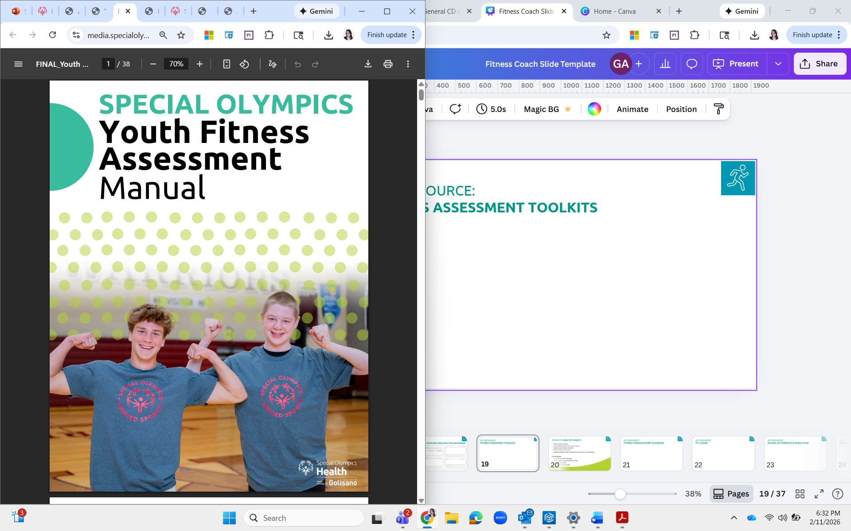
KEY RESOURCE:
FITNESS ASSESSMENT TOOLKITS
There are toolkits for Adult and Youth athletes. Both toolkits offers three key resources to support athlete fitness and program evaluation:
A Standardized Fitness Assessment Manual
A Lifestyle Survey
Guidance on using physical activity wearables
You can choose one, two, or all three tools to evaluate your athletes’ fitness journey and its impact on their health.
https://resources.specialolympics.org/health/fitness/fitness-through-sport/
fitness-assessment
Notes:
Let’s take a look at the Fitness Assessment Toolkits!
Special Olympics athletes strive for their personal best on and off the field of play. Completing fitness assessments can provide insights to help coaches, athletes, and families celebrate current abilities, target improvements, and guide practice plans and at-home activities—supporting smarter training, better health, and improved performance.
There are toolkits for Adult and Youth athletes. Both toolkits offers three key resources to support athlete fitness and program evaluation: a standardized Adult Fitness Assessment Manual, an Adult Lifestyle Survey, and guidance on using physical activity wearables. You can choose one, two, or all three tools to evaluate your athletes’ fitness journey and its impact on their health!
If you do not have a background in physical activity or fitness, this may feel intimidating - start by familiarizing yourself with the tools and observe testing sessions. Over time you can get more involved to support the team with assessment if that is an area of interest or need.
https://resources.specialolympics.org/health/fitness/fitness-through-sport/fitness-assessment

Slide 30
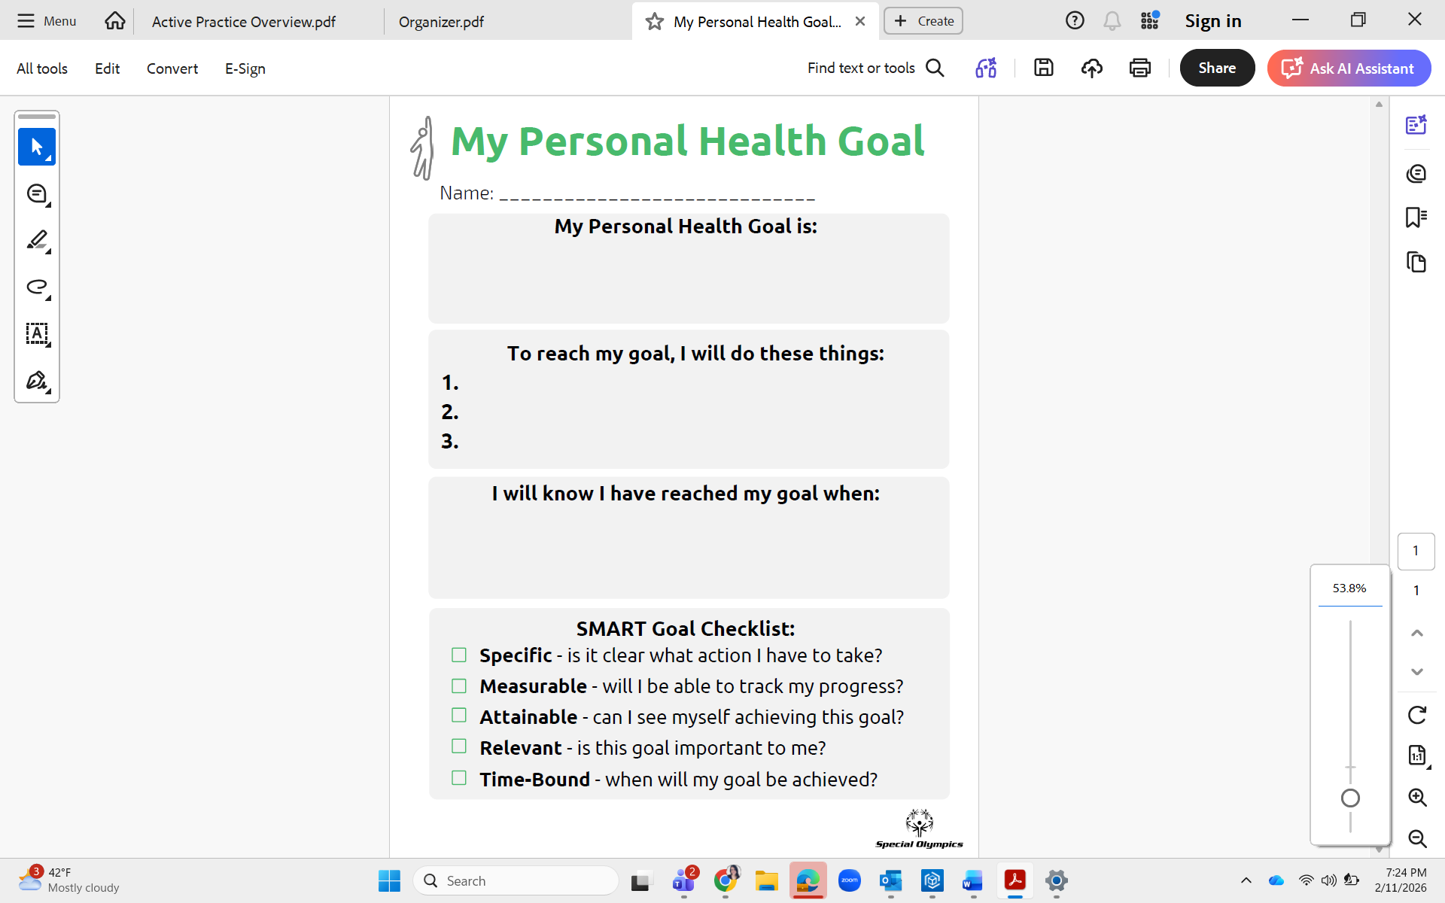
KEY RESOURCE:
MY PERSONAL HEALTH GOAL TEMPLATE
A simple tool that you can use to support goal setting
Goal setting can range from more specific such as improving a fitness assessment result, or more general and based on discussions with the athletes such as wanting to adopt a healthy habit.
https://www.dropbox.com/scl/fi/c5i158fuyeedsejpyxofb/My-Personal-Health-Goal.pdf?rlkey=9ra1qfn03cyai8e6unuboctdw&st=5ybx3uvr&dl=0
Notes:
https://www.dropbox.com/scl/fi/c5i158fuyeedsejpyxofb/My-Personal-Health-Goal.pdf?rlkey=9ra1qfn03cyai8e6unuboctdw&st=5ybx3uvr&dl=0
Let’s take a look!
This is a simple tool that you can use to support goal setting – goal setting can range from more specific such as improving a fitness assessment result, or more general and based on discussions with the athletes such as wanting to adopt a healthy habit.
This template has been used at Performance Stations, in the Fitness through Sport Playbook, and many fitness challenges (health education) so it is widely adaptable.

Slide 31
RESOURCE REVIEW
Notes:
We have covered a lot of information so far! As a reminder, this training and the Activation Guide are resources you can continue to refer to as your journey as a Fitness Coach progresses.
Now, let’s take a working break and independently review some fitness resources.

Slide 32
TAKE A FEW MINUTES TO REVIEW
Identify a few resources that you feel you would use in your role as a Fitness Coach:
Active Practice Guidance
Fit 5 Guide, Exercise Cards and Videos
Fitness Assessment Toolkits
Fitness through Sport eLearning Plan
  Fitness for the Sport Coach
  Sports Nutrition
  Physical Activity for Sports Coaches
Fitness through Sport Playbook
Health Tip Library
Inclusive Fitness eLearning Module
Minimum “Fit” Practice Standards
My Personal Health Goal template
School of Strength
  Snack Zone
Special Olympics Fitness App
  Apple Store
  Google Play Store
Sport-Specific Warm-Up and Cool-Down Guides
  Dynamic Warm-up and Cool-Down Videos
Coach Education - Fitness Resources
Notes:
Let’s take a bit of a working break.
Here are links to more resources that we wanted you to be aware of. The ones we already covered are here, as well as others. Take a few minutes to review a few of these and make a note of the ones you would like to return to.
(Give them 5-10 minutes which can also serve as a break – when they return, spend a few more minutes asking each participant to share one resource they looked at and share a bit about it with the group.)

Slide 33
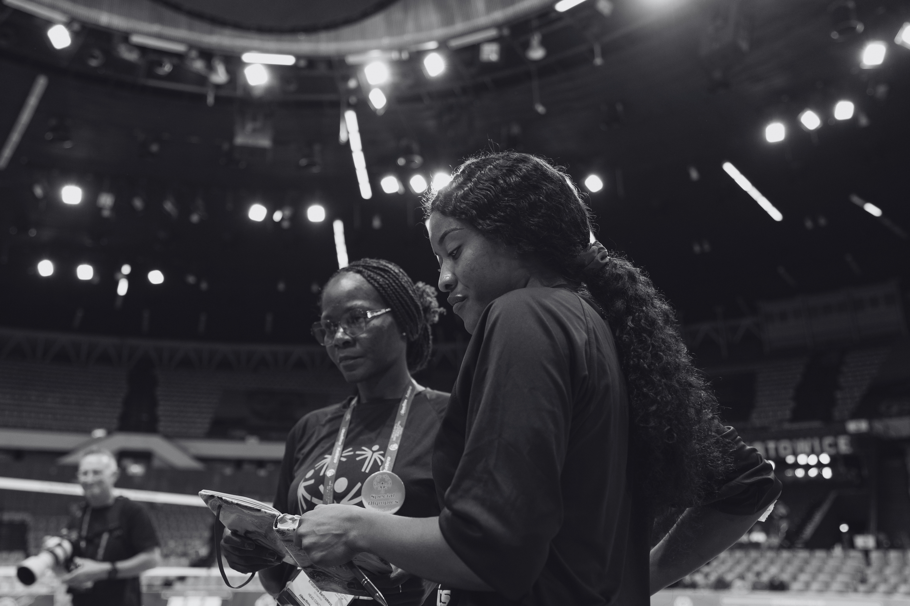
WORKING WITH YOUR COACHING AND SUPPORT TEAM
Notes:
As a Fitness Coach you will be part of a special community of caring and trained volunteers who work together to ensure a safe, quality sport experience for all athletes. ​
​

Slide 34
UNDERSTANDING THE
VARIOUS ROLES ON A TEAM
Head Coach (Lead) | Coaching Assistant | Sport Assistant | Fitness Captain
Responsible for planning the overall season and individual practices Leads the planning and delivery of each practice Develops and leads the coaching team Supports the engagements of Fitness Captains and provision of sport leadership opportunities Coaches sport skills and drills, adapting to the needs of each athlete Addresses issues and challenges (e.g. behavior misconduct) Holds sport-specific coaching certification | Also known as Assistant Coach Supports Head Coach with practice planning and delivery Assists with technical and tactical coaching Provides individualized coaching support to athletes (e.g. instruction, feedback, etc.) May support with practice organization and logistics Holds a SO Coach certification, and may progress to sport-specific coaching certifications | A non-coaching sport volunteer who assists the coaching team. They may: Support with sport equipment set-up and clean up before and after practice Support individual athletes when needed with demonstrations, 1:1 support, Fitness Captain support | Special Olympics Athlete Leader who’s completed Fitness Captain training Helps lead the warm-up and cool-down Shares a Health Tip at each practice Role model for their teammates
Notes:
Clear roles, mutual respect and clear communication are essential for the various team leaders to work well together
This role comparison was included in your Activation Guide. Take a moment to review this again.
ASK: Are you clear on the distinction between the roles? What questions can I answer for you?
​

Slide 35
SHARING ROLES:
WARM-UPS
Head Coach | Develops the overall practice plan, including the timing and structure of the warm-up Ensures the warm-up aligns with team goals and the focus of the practice​ Oversees the flow of the session and transitions smoothly into sport-specific activities
Fitness Coach | Supports the Fitness Captain to lead warm-ups by:​ Helping plan the order and progression of exercises​ Suggesting modifications or progressions based on athlete ability​. May provide 1:1 support to athletes who need extra support​ Monitors movement quality and safety during the warm-up​ If the team does not have a Fitness Captain, the Fitness Coach can lead the warm-up
Fitness Captain | Leads the team warm-up. Demonstrates exercises clearly and confidently Shares a short Health Tip Works with the coaching team to help keep athletes engaged and moving safely
Coach Assistant | Reinforces instructions and demonstrations​ and provides individualized coaching cues or feedback​ Helps athletes stay focused and engaged​ Assist with organizing athletes and transitioning into the next activity
Sport Assistant | Provide on-site support during the warm-up by:​ Assisting with equipment set-up Helping with athlete check-in or attendance​ Ensure the space is safe, organized, and ready for the next activity
Notes:
Here are a few examples of how the different support roles interact with one another.
First, let’s look at warm-ups. You’ll see your role at a Fitness Coach highlighted in a thicker box.
(Review content. Depending on the group, you could choose to give time for participants to read through on their own and then ask if there is anything they are unclear on)

Slide 36
SHARING ROLES:
GOAL SETTING
Head Coach | Sets overall team goals aligned with the sport season and competition pathway​ Works with athletes to establish individual athlete goals (sport, fitness, and participation-focused)​. Integrates goals into practice planning and seasonal training plans​ Reviews progress with the coaching team and adjusts goals as needed
Fitness Coach | Supports team and individual fitness-specific goal setting after discussion with the Head Coach​ Assists athletes in​ understanding fitness goals, why they matter​, and tracking progress. Communicates success, observations, or concerns back to the Head Coach Leads fitness activities and shares health education that supports agreed-upon goals​
Fitness Captain | Supports team and individual goal progress by: Sharing Health Tips that support healthy behaviors and encouraging teammates to practice habits outside of practice​ Acts as a positive role model by demonstrating commitment to personal goals​ Helps build team motivation and accountability in a peer-to-peer way
Coach Assistant | Reinforces team and individual goals during practices​. Provides feedback that connects effort and performance to stated goals. Helps athletes understand how drills and activities relate to their goals​ Share observations on athlete progress or challenges with the Head Coach
Sport Assistant | Distribute any goal setting forms or resources for the coaches, if requested​ Observe and be prepared to assist when needed​ Provide encouragement to athletes
Notes:
Now, let’s look at goal setting.
(Review content. Depending on the group, you could choose to give time for participants to read through on their own and then ask if there is anything they are unclear on)

Slide 37
SHARING ROLES:
TEAM COMMUNICATION
Head Coach | Initiates communication with athletes, families or caregivers, and the coaching team​ Serves as the main point of contact unless otherwise specified​ Communicates key information such as:​ Practice and competition details, schedules, changes, and cancellations​ Team goals, priorities, and reminders​ Coordinates messaging across roles to ensure consistent and clear communication
Fitness Coach | Communicates with athletes and their caregivers through predetermined channels, processes, and frequencies​ Shares information related to fitness both on and off the field of play Aligns all communication with the Head Coach to ensure consistency and appropriateness
Fitness Captain | Requests time from the Head Coach to share Health Tips during practice Communicates peer-to-peer with teammates to encourage participation and healthy habits Models respectful and inclusive communication​
Coach Assistant | Reinforces key messages, provides feedback and encouragement throughout practice. Share observations or concerns with the Head Coach
Sport Assistant | Assists with athlete check-in and attendance​, reinforces coach instructions Share observations or concerns with the Head Coach
Notes:
Lastly, let’s look at team communication.
(Review content. Depending on the group, you could choose to give time for participants to read through on their own and then ask if there is anything they are unclear on)

Slide 38
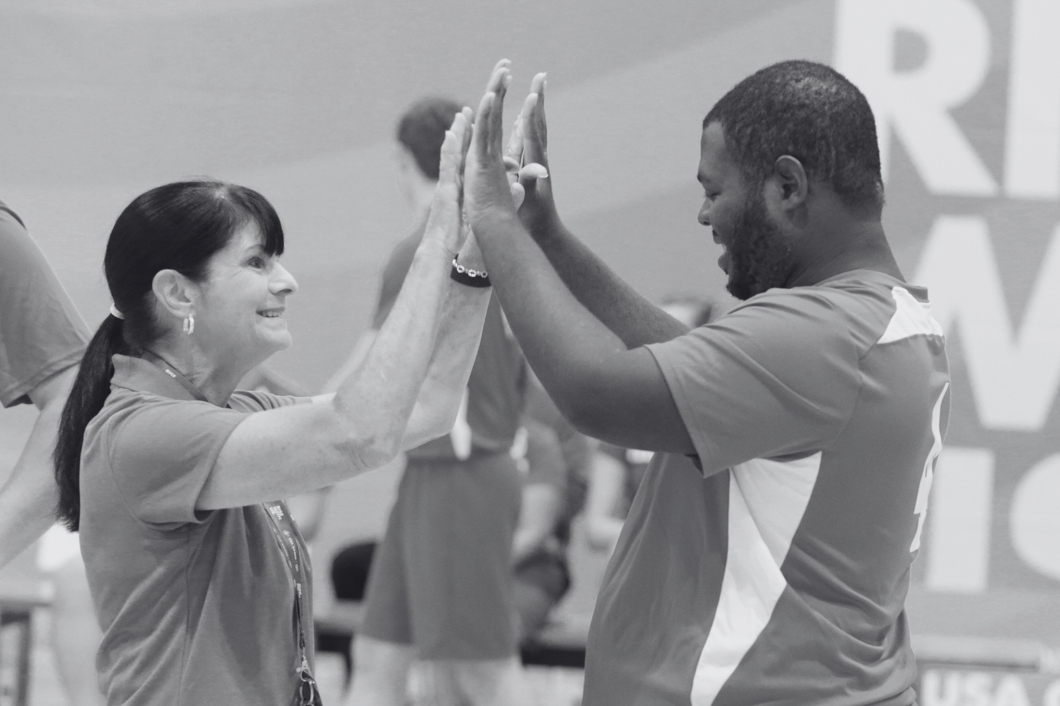
LEADERSHIP SKILLS:
MOTIVATION, COMMUNICATION AND CONNECTION
Notes:
Before we finish this training, let’s discuss key leadership skills you’ll use as a Fitness Coach. In your role, communication and connection are essential when working with Special Olympics athletes

Slide 39

PHYSICAL LITERACY
Physical Literacy is having the motivation, confidence, physical competence (or skills), and knowledge and understanding to value and take responsibility for engagement in physical activities for life. (International Physical Literacy Association).
​
Physical
Literacy
Notes:
As you learned in the Physical Activity for Sport coaches eLearning module, Special Olympics supports a physical literacy approach to working with athletes.​
The term ‘Physical Literacy’ has been used for over a hundred years to describe how movement can enhance quality of life, physical health and movement vocabulary. Developing physical literacy is a responsibility shared by many people, including coaches, educators, caregivers and more! ​
The International Physical Literacy Association defines physical literacy as having the motivation, confidence, physical competence (or skills), and knowledge and understanding to value and take responsibility for engagement in physical activities for life ​
Whenever you are planning consider how your involvement can support the skills, confidence, motivation, knowledge and understanding of sport, movement and empowering athletes to take responsibility to engage in physical activity for life. ​

Slide 40

A PHYSICAL LITERACY APPROACH
A “Physical Literacy Approach” may help you be aware of how your activities and coaching strategies support athlete development in four skill areas:
Physical
Social
Feeling (psychological)
Thinking (cognitive)
Physical
Literacy
Notes:
As a Fitness Coach, a “Physical Literacy Approach” may help you be aware of how your activities support physical skills, as well as the athletes’ social, thinking (cognitive), and feeling (psychological) skills to engage in physical activity for life.
A “Physical Literacy Approach” may help you be aware of how your activities and coaching strategies support athlete development in four skill areas:
Physical: ability to coordinate and apply movement skills
Social: Ability to interact with others and create social connections
Feeling: Attitudes and emotions towards movement and physical activity
Thinking: Understanding of how, when and why to move

Slide 41
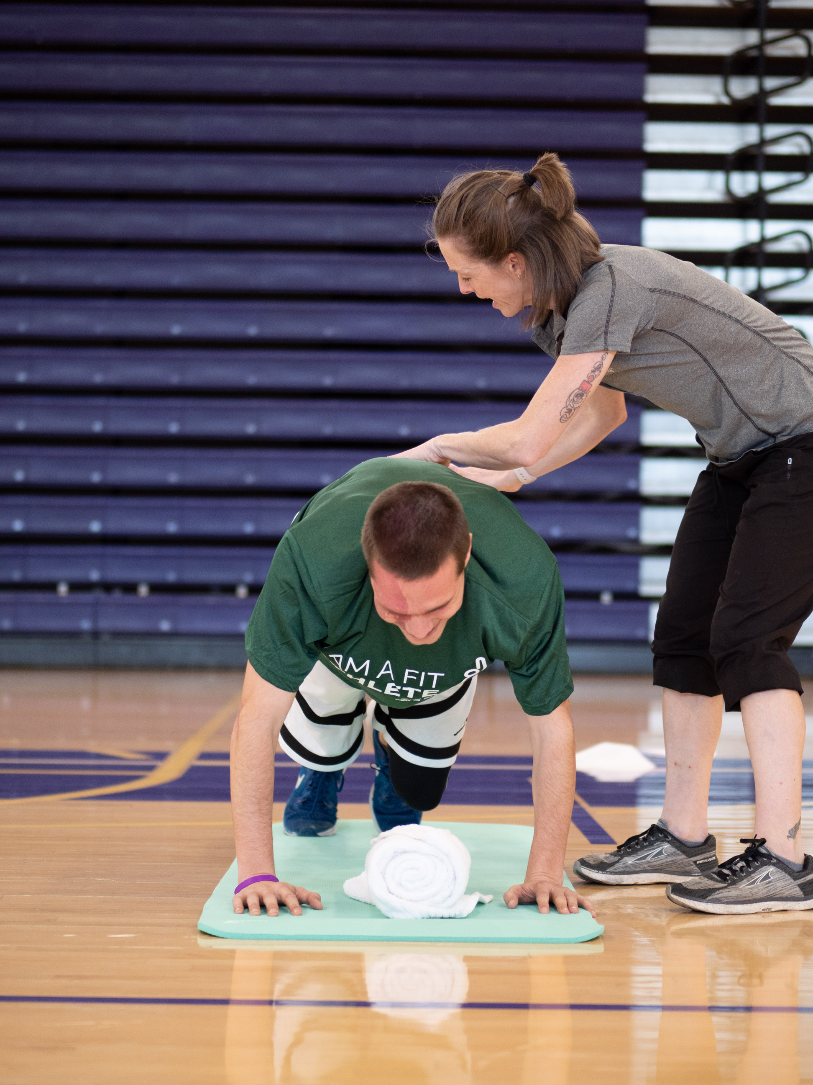
MOTIVATING ATHLETES
Each athlete has their own unique motivations. Some of the most common reasons that Special Olympics athletes play sport are: ​
Personal excellence​
Health and wellness
Social interaction​
A sense of belonging, and​
Winning medals​
Notes:
(review list)
​
Fitness Coaches should connect with athletes to be aware of their motivations and how to support this. If motivation is not nurtured, sustained engagement in physical activity will be difficult.​
​
​

Slide 42
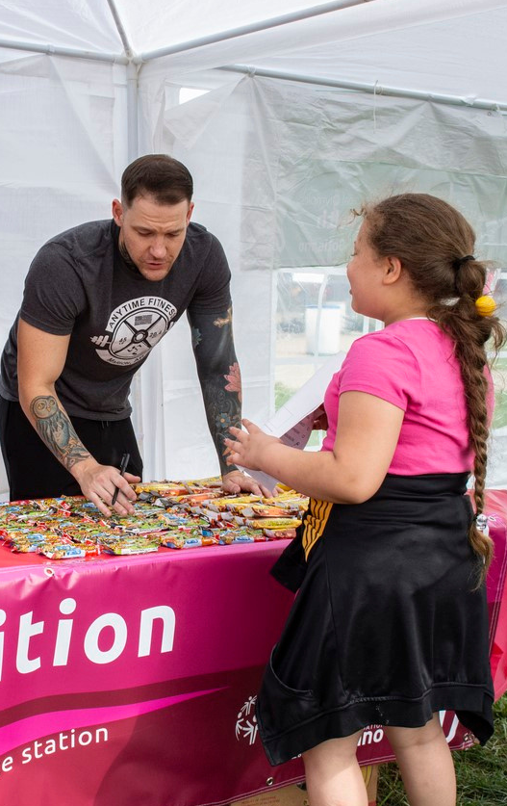
COMMUNICATING WITH ATHLETES
  Do not call them kids​
  Use clear, simplified language; speak slower, not louder​
  Set clear expectations​
  Treat them as you would your peers​
What other ideas do you have for effective communication with athletes?​
https://www.specialolympics.org/about/intellectual-disabilities/
how-to-speak-with-people-with-intellectual-disabilities​
Notes:
Take a look at this excerpted list from Special Olympics for tops on communicating with Special Olympics athletes.
(Review list.)
ASK: What other ideas do you have for effective communication with Special Olympics athletes?​
(Pause to ask for input from participants – use the list below to prompt/add)
Draw boundaries​
Ask their thoughts and allow them to answer​
Ask if you can help​
Expect lots of questions​
Have fun and enjoy their candor​
Be enthusiastic, upbeat, and professional​
You can find more information and tips on the Special Olympics webpage. There is a resource on how to talk to people with IDD:
https://www.specialolympics.org/about/intellectual-disabilities/how-to-speak-with-people-with-intellectual-disabilities​
​

Slide 43
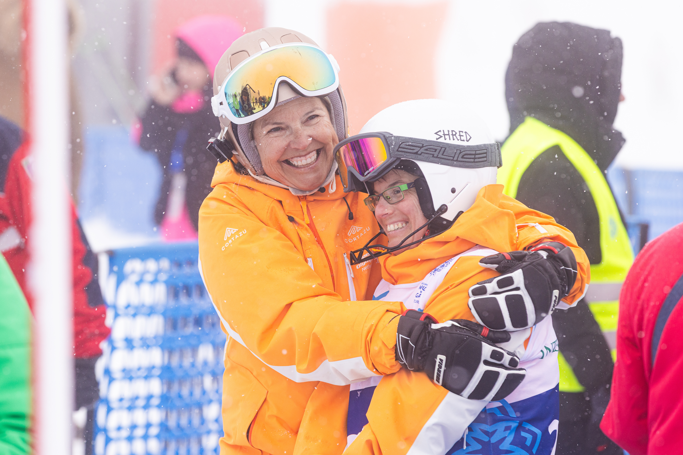
CONNECTING WITH ATHLETES
Create meaningful connections with your athletes and coaching team by: ​
  Establishing a routine​​
  Finding out each athlete likes​​
  Incorporating preferences and interests
  Sharing about yourself​​
  Participating with the athletes​
  Making it fun!​​
What other ideas do you have for connecting with athletes?
​
​
Notes:
Meaningful connection is needed to build trust and a relationship with the athletes.
You can create connection with the athletes and coaching team by:
Establishing a routine​​
Finding out each athlete likes​​
Incorporating preferences and interests
Sharing about yourself​​
Participating with the athletes​
Making it fun!​​
ASK: What other ideas do you have for connecting with athletes?
(Pause to ask for input from participants – use the list below to prompt/add)
​

Slide 44
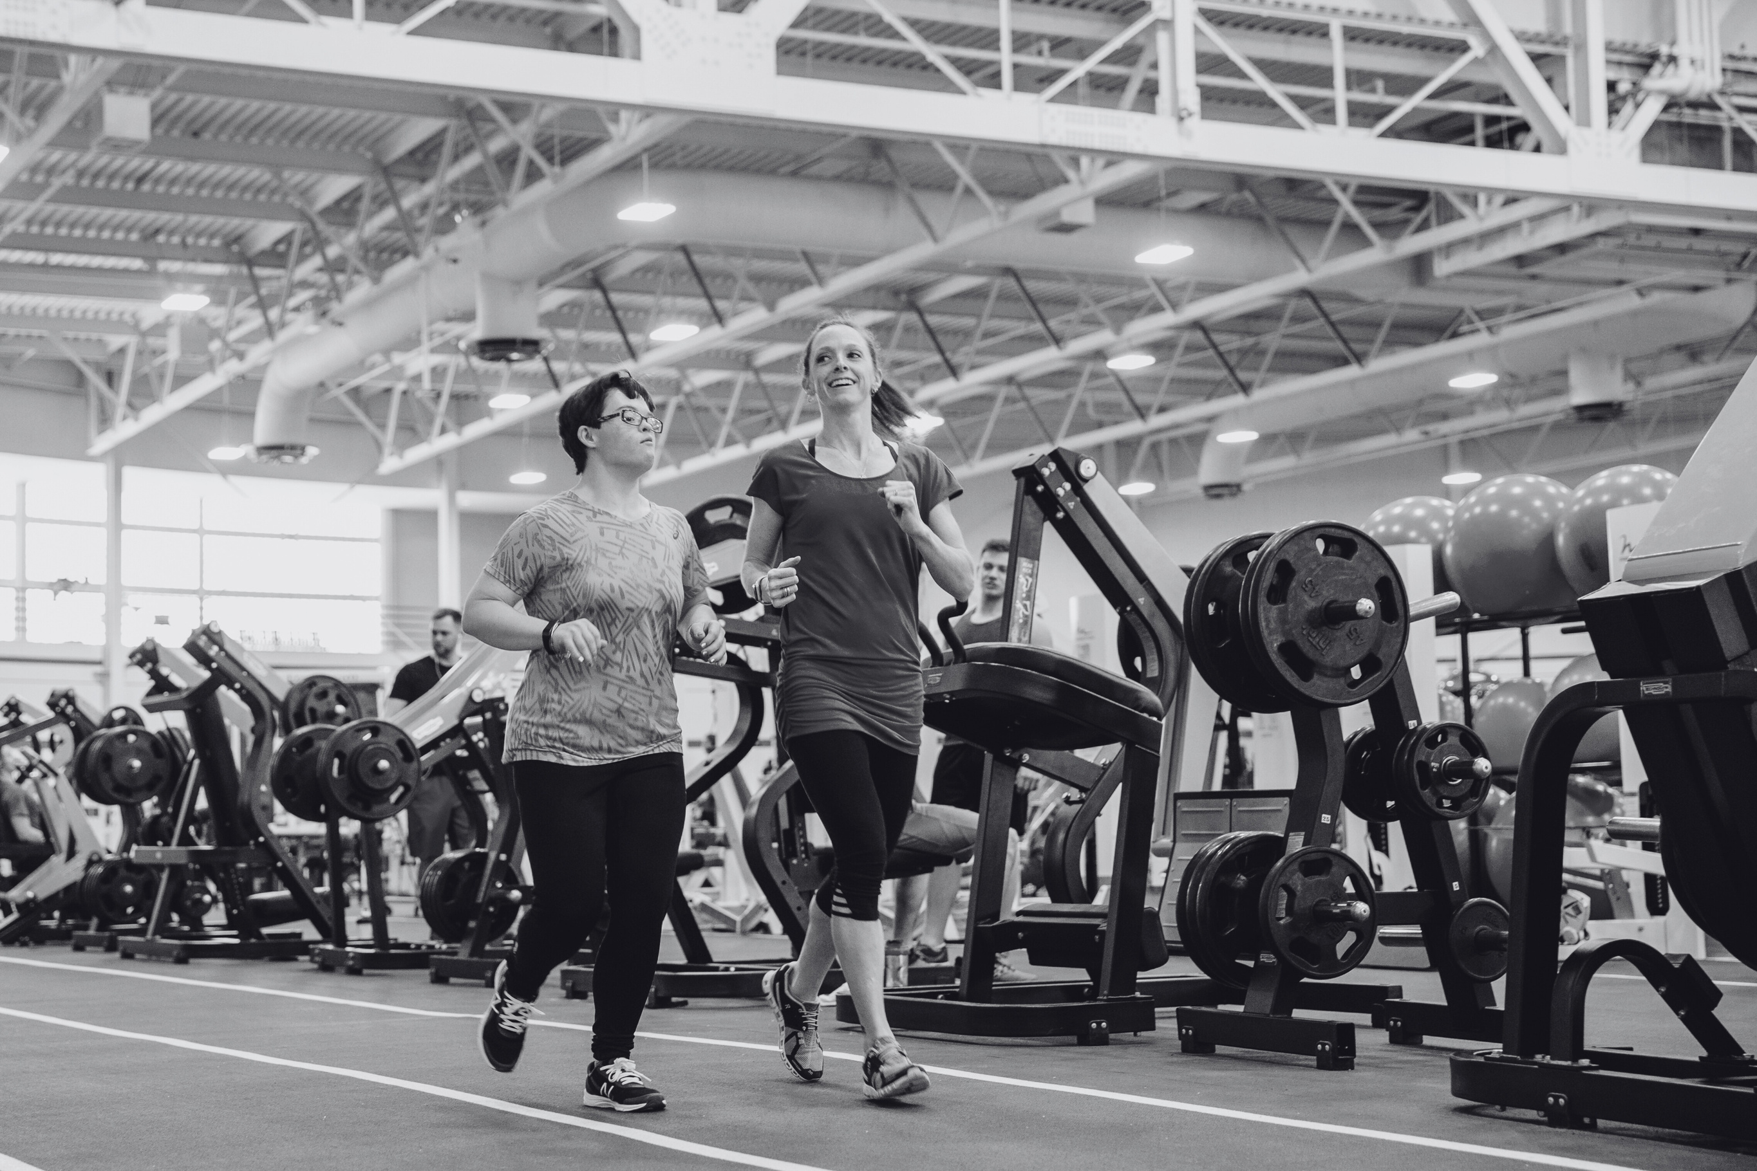
NEXT STEPS IN YOUR JOURNEY AS A FITNESS COACH
Notes:
You’re almost done with your training! Let’s finish by summarizing next steps.

Slide 45
YOUR JOURNEY SO FAR...
Notes:
Now that you’ve completed Steps 1 and 2 in your Fitness Coach journey, it’s time to meet the coaching team!
(Modify/add information based on whether they know who their coaching team is.)

Slide 46
STEP 3: MEET THE COACHING TEAM
  First meeting
  Define your role and responsibilities
    Ensure fitness activities relate directly to athlete and team goals​
    Leave sport skills, tactics, and playing time to the coach
    Check-in with the Head Coach before adding or changing any of your plans
  Seek ways to be collaborative and supportive ​​
  Communicate early and often
[If you know the team/coach they will be working with, or how you’d like that
process to go, please share those details here]​
Notes:
Once you know what coach(es) and team(s) you’ll be working with, schedule a meeting with the coaching team.
Use this meeting to get to know the coaches, learn the goals for the season, discuss roles and responsibilities, and understand logistics.
As you get to know the coach, here are some helpful tips:
Respect the preferences of the coach - they have a lot on their plate! They are managing athletes, schedules, parents, and competitions. Always be kind, respectful and patient.
Be adaptable! Things don’t always go as planned so it’s important to be flexible and willing to adapt​.
​
​

Slide 47
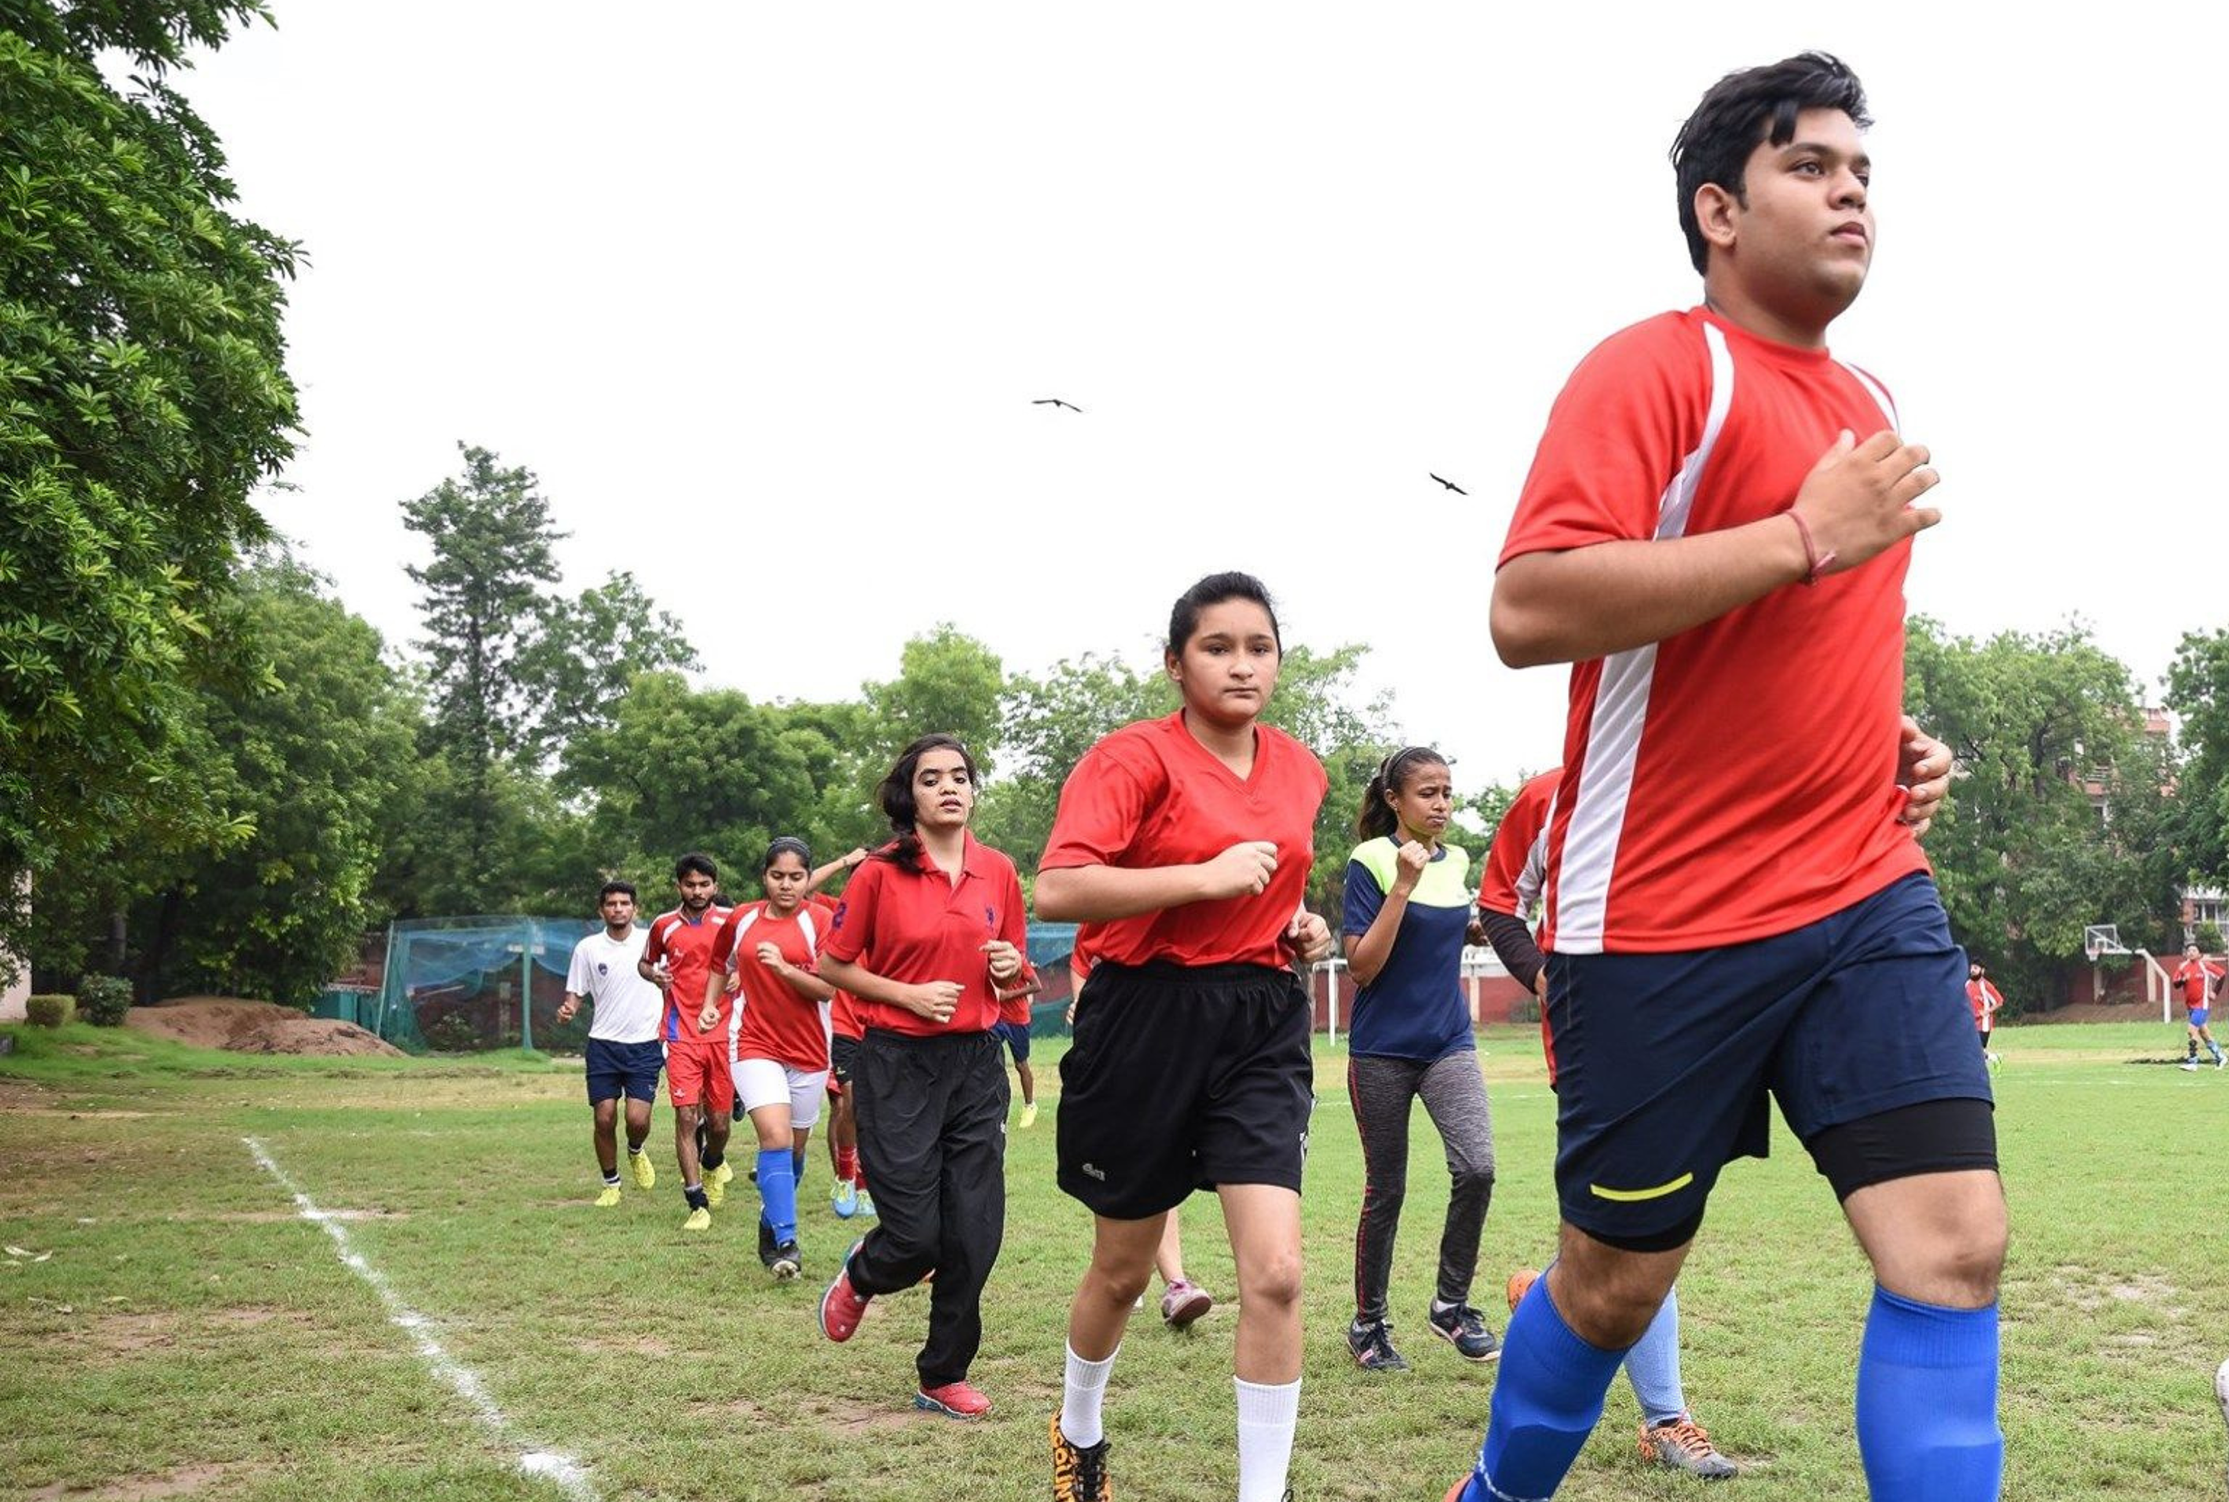
SEASON PLANNING
Collaborate with the Head Coach to develop:​
  Practice plans
  Team goals and individualized athlete goals
  Goal monitoring process
  Additional team events and activities, particularly for health education and fitness programming
  Pathways to connect athletes and their supporters to community supports
    Other health professionals, partners, local programming, etc.
Notes:
Following your initial meeting, collaborate with the Head Coach to plan the season.
(Review list. Adapt to the context, as needed.)
It’s essential to plan ahead and communicate these plans with the athletes and supporters as early as possible so they know what to expect throughout the season.​
​

Slide 48
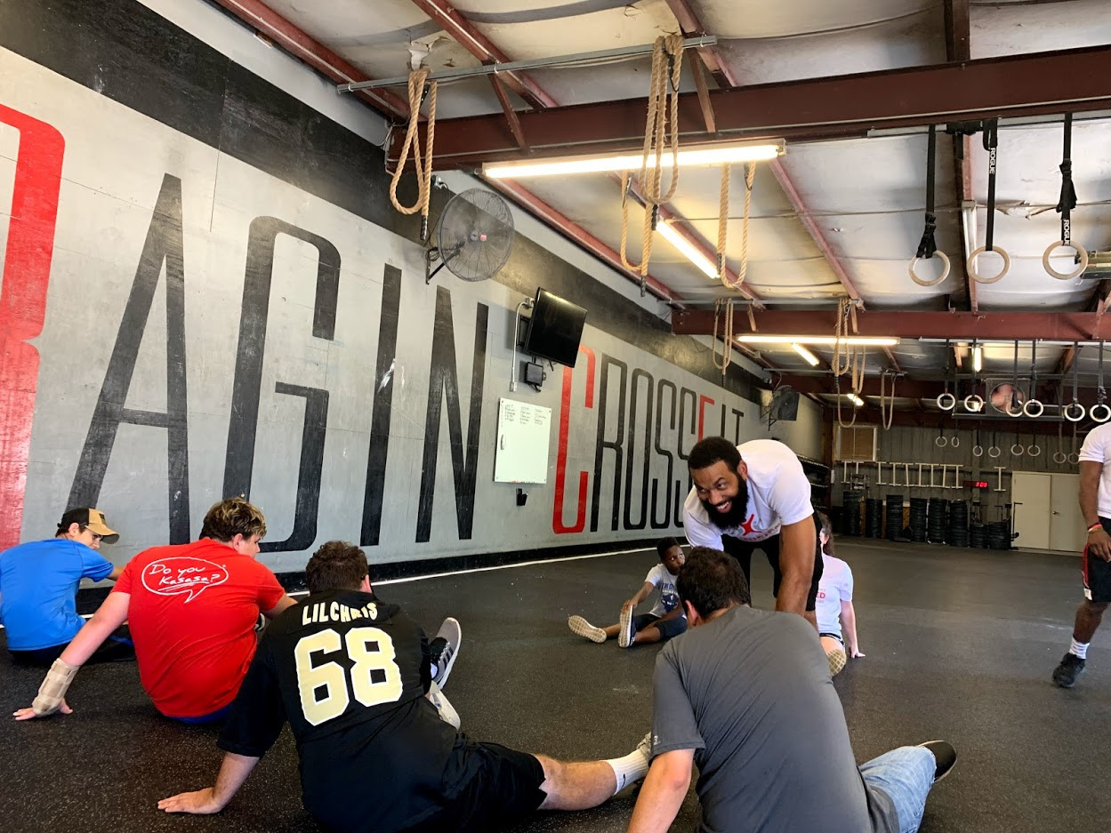
STEP 4: MEET THE ATHLETES
Introduction​
  Coordinate with the Head Coach on when and how to be introduced​
First Practice ​
  Share the fitness plan to build buy-in and excitement​
  Ask athletes what their interests are and areas they want to improve in or learn more about​
Tips​
  Share your attendance plan with the athletes so they know when to expect you​
  Connect, encourage, listen and observe​
Notes:
The last step is to meet the athletes! Coordinate with the Head Coach on when and how to be introduced.
(Review Content. Reference the Fitness Coaches: Guidance for Sport Coaches resource, as needed)
(Add any additional information that is specific to your Program/coaches)

Slide 49
SUMMARY AND NEXT STEPS
[Review any key details
Share your role as the Program, where they can go to for support, and the process to accomplishing the next steps]

Slide 50
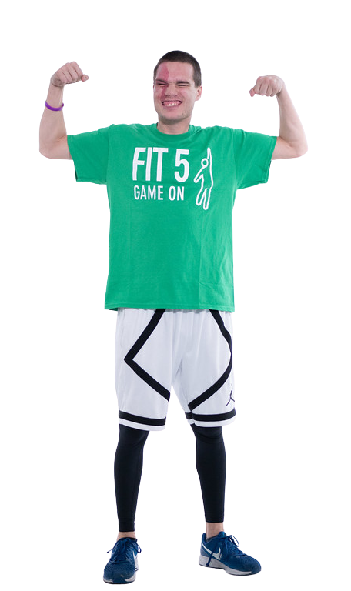
QUESTIONS?

Slide 51
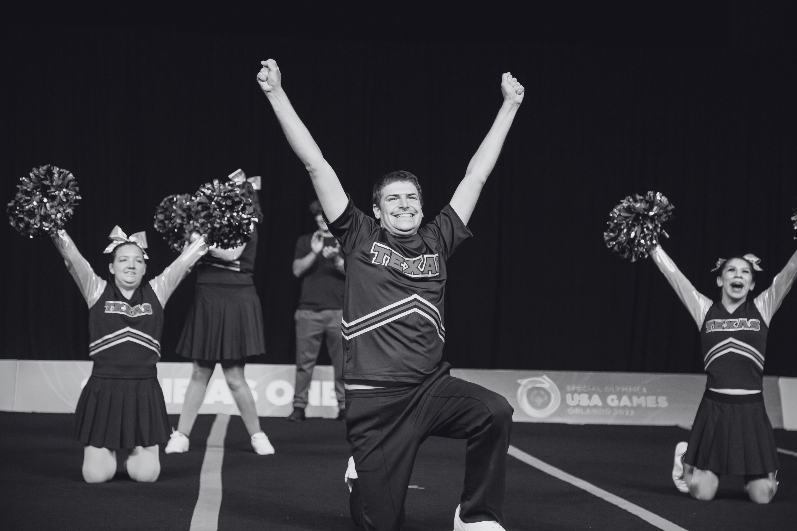
CONGRATULATIONS!
THANK YOU FOR COMPLETING
FITNESS COACH TRAINING

