Slide 1
Olimpiadas Especiales
Censo
2017
Notes:
Target Audience – people new and familiar to Census system
Goal: cover the most common issues with Census:
- Difference between M1 / M2
- Difference between Individual Total and Total Participation
- Cover things new in 2017 Census

Slide 2




El valor de su tiempo
IMPORTANCIA: Entender la importancia del Censo en nuestro Movimiento
RECETA PARA EL ÉXITO: Aprender 3 pasos sencillos que asegurarán un proceso de Censo exitoso
ERRORES QUE EVITAR: Aprender sobre los errores mas comunes en el Censo y cómo evitarlos
NUEVO EN 2017: Aprender lo nuevo del Censo en el 2017
Notes:
Every change is made with Programs in mind, we all share the idea of simplifying definitions, making them more understandable, easy to follow,
Census is not the 1 way street, it’s a “boomerang”, the numbers you submit to us go back to you in the form of Reports, Program Specific, Regional and Global
Each Program is a puzzle piece, and for us to see the big picture, the correct picture, we need to ensure that every puzzle piece is correct

Slide 3


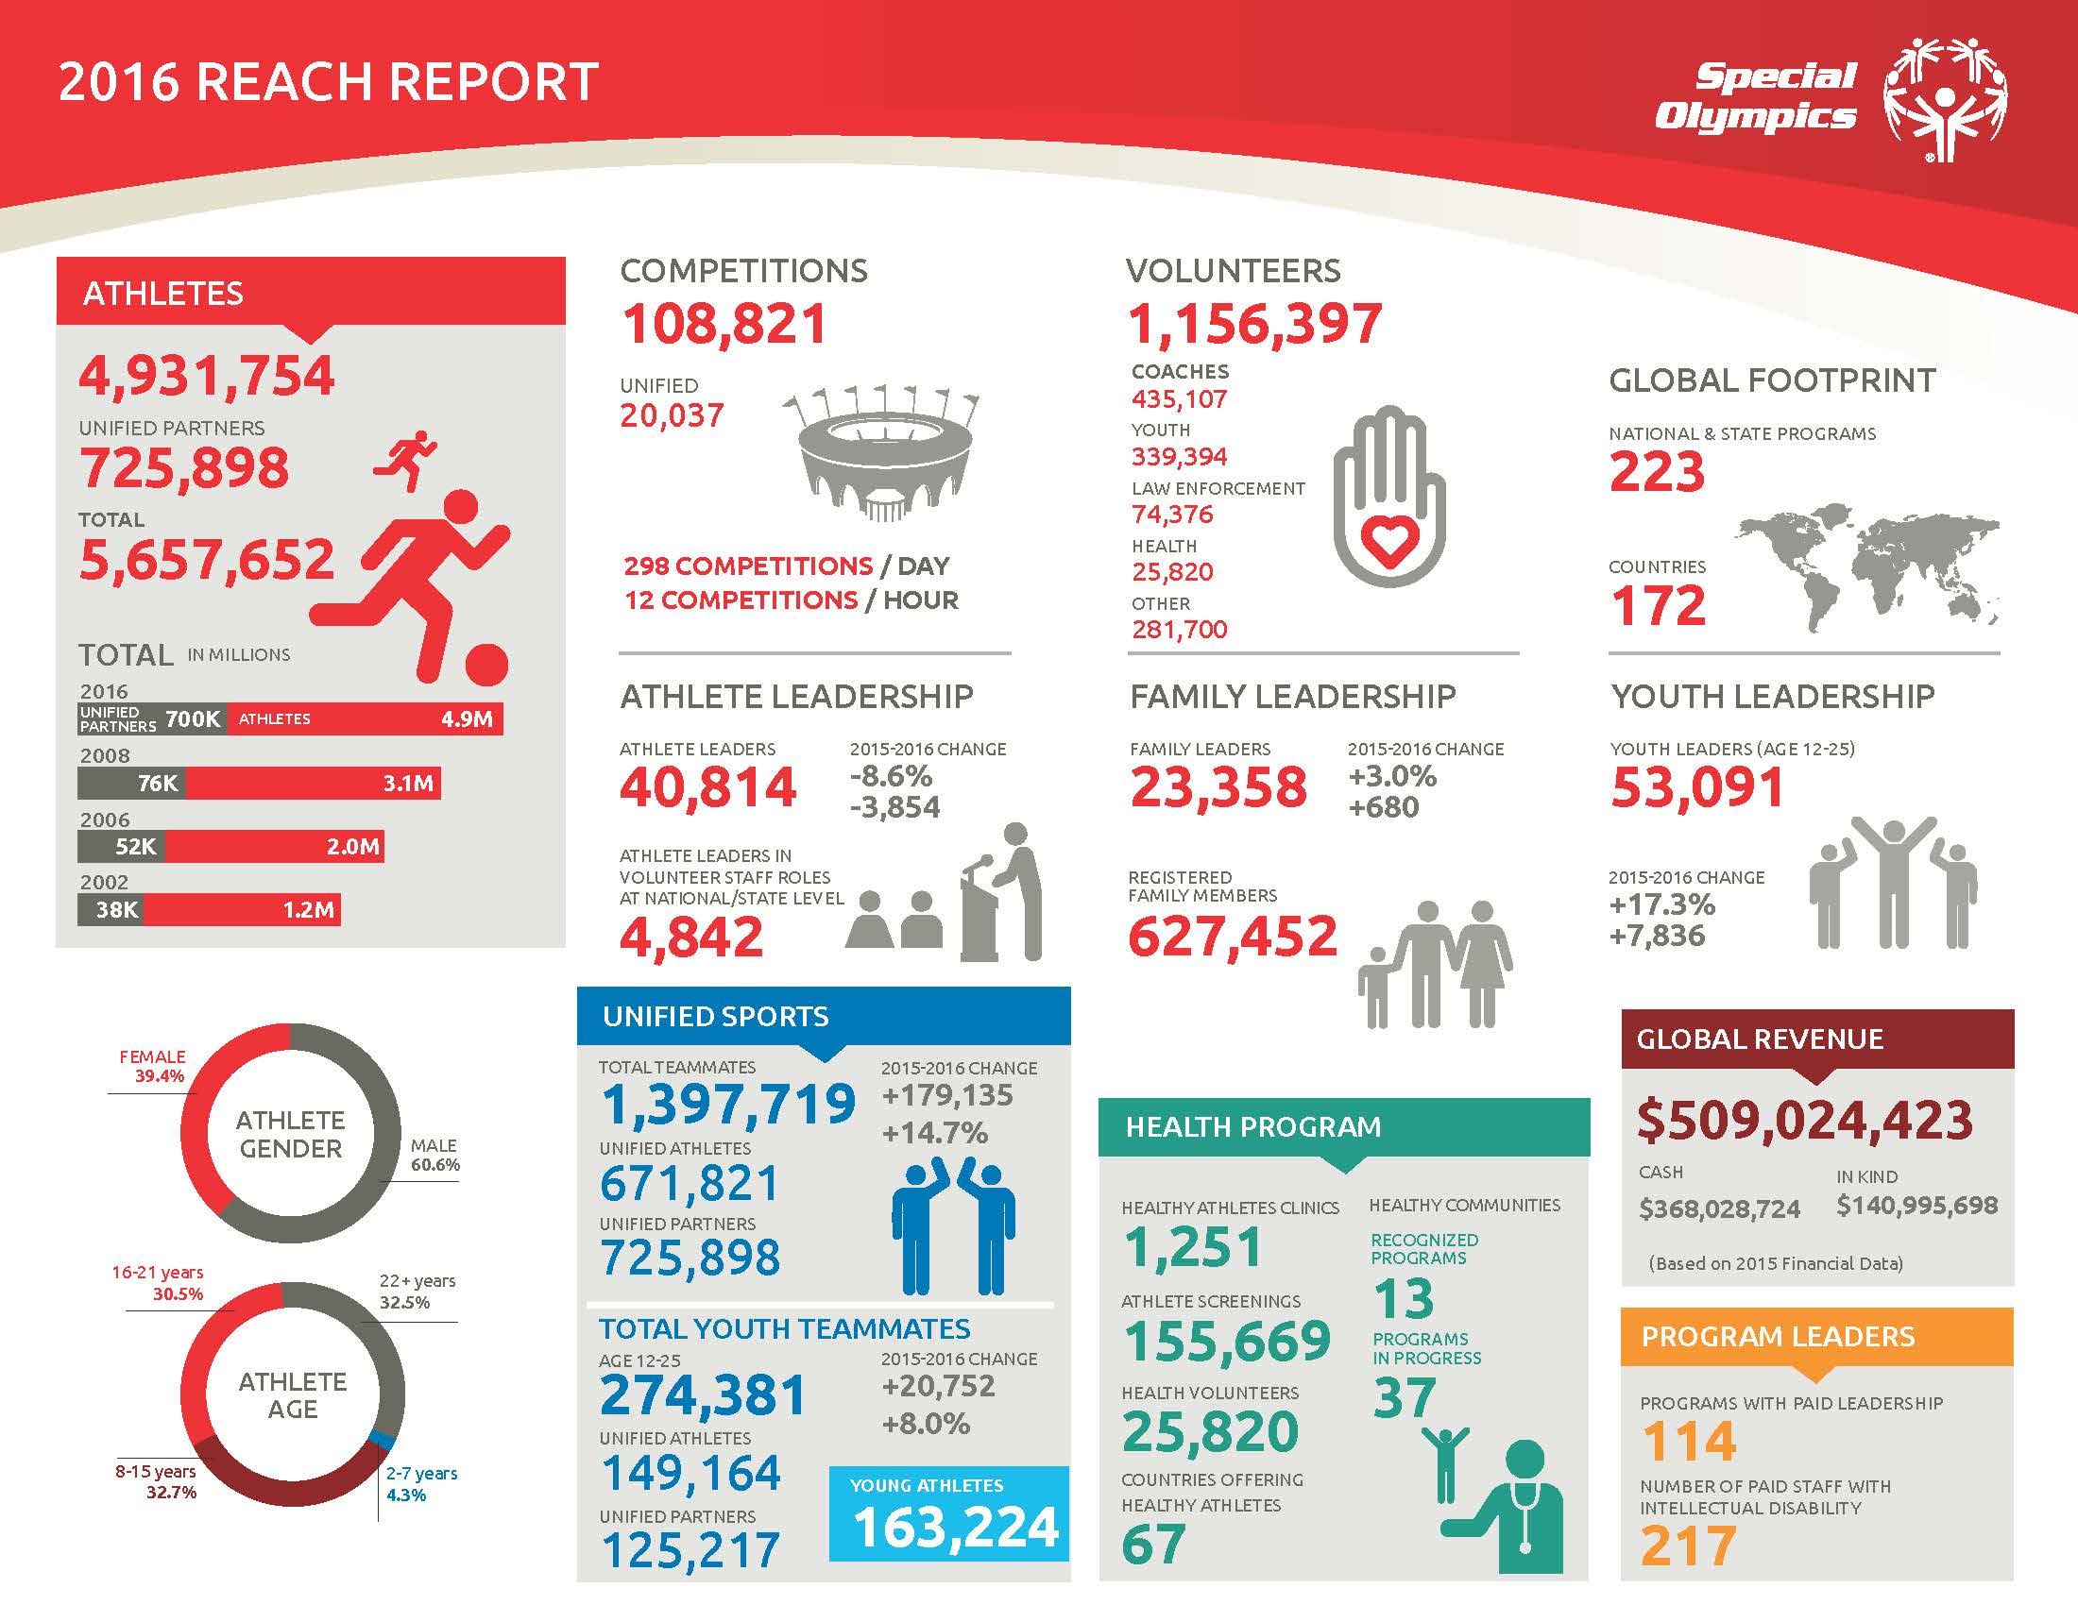
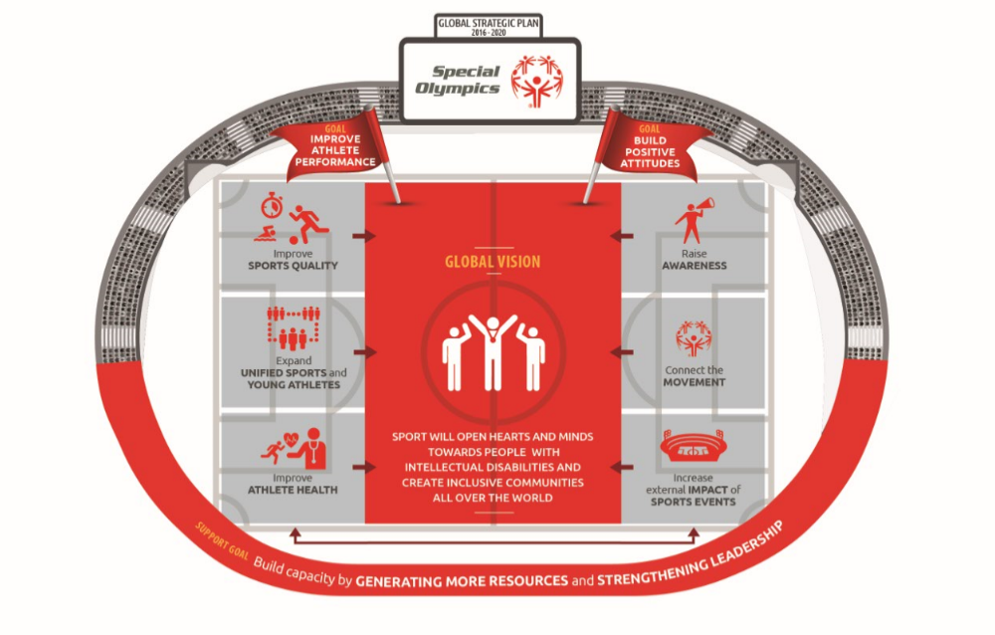
¿Por qué es importante el Censo?
TOMAR DESICIONES ESTRATÉGICAS Y CONSEGUIR ALIADOS
ENTENDER NUESTRO ALCANCE GLOBAL
CREAR UN HISTORICO DE TENDENCIAS
REGLAS GENERALES/ REQUERIMIENTOS DE ACREDITACIÓN/
QUOTAS DE LOS JUEGOS
Notes:
First off, Census is not a nice thing to do, or another thing thrown on your “overflowing plates.” Census is a requirement
SOI Accreditation Requirement 5: Registered Athletes Requirement. The Program registers Special Olympics athletes in accordance with General Rules Section 2.02 and submits athlete census data to SOI as required in accordance with General Rules Section 2.06. Purpose. Athlete registration is necessary for health, legal and data collection purposes. Census information is important for program evaluation, planning, and marketing.
It is the Program audit
Spelled in Section 2.06 of the General Rules “Counting and Reporting Participating Athletes”
Also…
Census provides a critical context for evaluating the reach of our Programming year to year. Understanding our impact and member engagement helps propel the movement internally and build external partnerships. For example, consistent, accurate data on the level of coach certification and a number of competition opportunities helps us invest in coach education tools, driving higher quality of sports experiences for our athletes and finding ways to engage external sponsors and stakeholders.
Critical context for evaluating the reach of Special Olympics programming
Building continuous historic data
Understanding our impact and member engagement – critical for donor engagement
Make strategic decisions and build external partnerships - What strategic decisions should we make based on our Census data to drive higher quality of sports experiences for our athletes, and broader inclusion for people with I.D.
Games quotas are informed by numbers submitted in Census, the case when quotas can be met, whereas high number of athletes in a sport is reported in the Census
With the advent of Connect system, our capabilities for correctly counting number of participants in the Programs will increase, and to avoid any big surprises we should commit to collecting clean data starting now
Only viable and relevant is correct data is reported from year to year

Slide 4


Clave del éxito
Seguir Guía & Definiciones del Censo
Pide ayuda
censushelp@ specialolympics.org
Ingresar Censo antes de
VIERNES 9 DE FEBRERO, 2018
LAS COSAS HAN CAMBIADO
Notes:
We do know that is a significant lift on our Programs, that’s why we invest time in creating tools and training to assist you in this process.
There are 3 important components that could determine success:
Census Guidance and Definitions in your holy script, follow it carefully as you fill out census. Before filling out Census read through changes to 2017 Census. We are conscious that changes are painful, but our reality and strategic focus evolves, and Census has to be adopted to that
Ask for help
Note: your numbers will be cross-referenced with Grant numbers

Slide 5
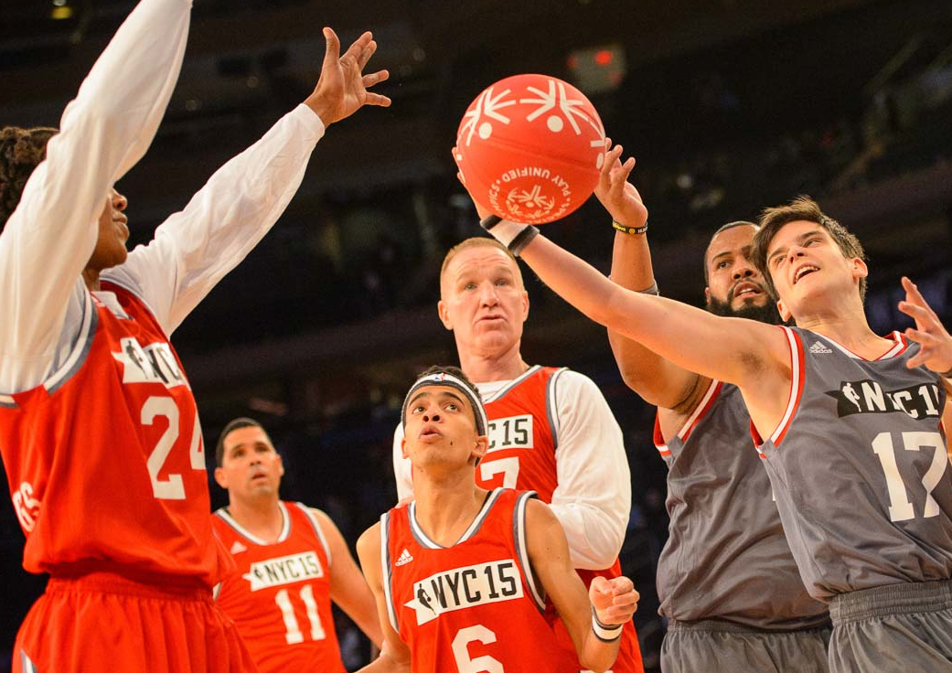
A picture paints a thousand words
INFORMACIÓN GENERAL
Todos los años
La información enviada en cada categoría deberá cubrir el año calendario, 1 de enero - 31 de diciembre de 2017.
Sistema en línea y excell
Use the Picture and Caption format to create strong compelling slide like this. Don’t’t forget to caption where possible. For best effect crop the image to fill the placeholder.
3 / Special Olympics
Notes:
We need to awaken the joyous rebellion at the core of our movement.

Slide 6
Cómo accedemos
https://census.specialolympics.org/index.html.

Slide 7
¿Como está diseñado?
Información Estadística: M01-M06
Deportes Tradicionales (Atletas y entrenadores).
Deportes Unificados (Atletas y entrenadores).
Información general del Programa.

Slide 8
¿Como está diseñado?
M01: Entrenan y compiten
M02: Entrenan pero no compiten
M03: Entrenadores TOTAL
M04: Modelo DU Recreación
M05: Modelo DU Desarrollo de Jugadores
M06: Modelo DU Competencia

Slide 9
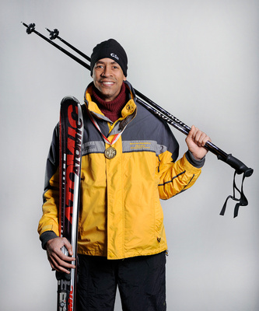
Instrucciones Generales Importantes:
Total de Participación versus Total Individual
Jorge Mendez, OE Argentina, 30 años de edad entrena y/o compite en 5 deportes:
Ski Alpino (solo entrena)
Atletismo (entrena y compite)
Baloncesto (solo entrena)
Bolos (entrena y compite)
Natación (entrena y compite)
Total de Participación: a Jorge es contado automáticamente 3 veces en M01 / masculino / 22+ y 2 veces en M02 / masculino / 22+
Total Individual: deben reportar a Jorge como 1 atleta en M01 / masculino / 22+ – entrena y compite.
Notes:
2 important points here:
Difference between M1 and M2 – the athletes who trained and competed, and those who just trained in a given sport
Difference between Total Participation and Individual Total
These are very common mistakes we see in the reporting

Slide 10
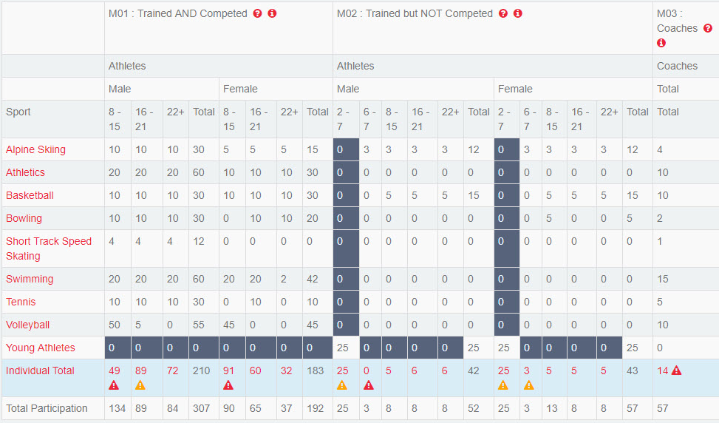
Instrucciones Importantes:
Total de Participación versus Total Individual
Debe reportarse como 1 ATLETA
Contado 3 veces automáticamente
Contado 2 veces automáticamente
Notes:
We compare total participation to Individual total it gives us the ratio of how many sports on average every athlete participates in in a Program
Most critical for our reporting is ensure that Terrel is counted only once, in the Individual Total of M1 in 22+ years old male athletes category. If an athlete trains and competes in at least 1 sport, no matter how many other sports it trains in, it has to be counted only once in M1.

Slide 11
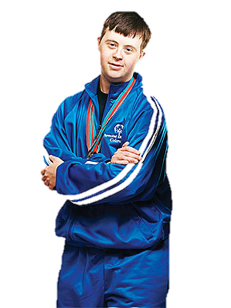
QUIZ
Total de Participación versus Total Individual
Juan Perez, OE Chile, 17 años de edad
Entrena y/o compite en 4 deportes:
Bolos (entrena y compite)
Tenis (entrena y compite)
Ski Alpino (solo entrena)
Baloncesto (solo entrena)
Total de Participación: ¿Cuántas veces será JP contado automáticamente en Participación Total?
Total Individual: ¿Cuántas veces debo reportar a JP en Total Individual?

Slide 12
RESPUESTA:
Total de Participación versus Total Individual
Debe ser reportado como1 ATLETA
Contado 2 veces automáticamente
Contado dos veces automáticamente

Slide 13



Instrucciones Generales Importantes:
Total de Participación versus Total Individual
Total Individual < Total de Participación | Correcto. Significa que cada atleta individual en su Programa participa en múltiples deportes.
Total Individual = Total de Participación | Poco probable, a menos que sea un Programa pequeño. Significa que cada atleta entrena y compite en un solo deporte.
Total Individual > Total de Participación | Error. Reportas más Atletas individuales que la suma automática de todos los deportes en esa categoría de edad y sexo. Revisa tus números.
Total Individual > o = El Conteo más alto de deporte individual | Si usted reporta 15 Atletas mujeres entre 16-21 años de edad que entrenan y compiten en atletismo, tu Total Individual para M01 (entrena y compite) /en categoría femenina de 16-21 debe ser por lo menos 15.
!
Notes:
Individual total v/s total participation in a given age / gender category
Difference / ratio between Individual Total and Total Participation gives us the idea of how many sports on average each athlete participates in
Individual total has to be equal or larger than the largest number reported in any sport category for this age / gender

Slide 14
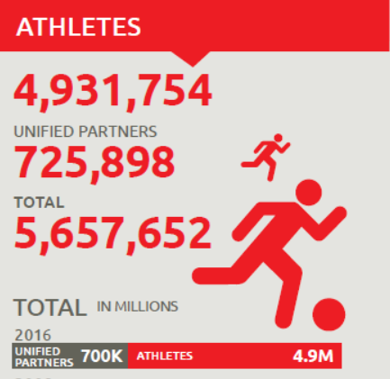
Total de Atletas Reportados
M01 Total Individual Atletas que Entrenan y Compiten (8+ años de edad, masculino/femenino)
M02 Total Individual Atletas que entrenaron PERO NO COMPITIERON (AJ, 6-7 años, registrados de más de 7 años, masculino/femenino)
Notes:
M1
M2 – mainly YA, 6-7 years old (according to general rules can’t compete in a sport) + other registered athletes age 7+ that do not compete in any sports
To look back at slide 6, it’s the sum of Individual Total across gender / age categories, M1 and M2 all the numbers in red color
YA – EXCEPTION Category: at early age hard to diagnose, so we know they might be some “partners”
can’t compete in any sport, can’t be included in the Unified, partners are counted in M2

Slide 15

Entrenadores y Competencias
Si hay Atletas reportados en un deporte – reporta entrenadores en ese deporte.
Incluir entrenadores de Atletas Jóvenes.
Competencias
Total de Competencias
(Tradicional y Unificadas)
M03A Entrenadores Certificados
Competencias Unificadas
Entrenadores
Competencias Multi-día:
  Cada deporte= una competencia
Juego de Ligas:
  Cada juego de liga= una competencia
Competencias Multi-deporte:
  cada deporte= una competencia
M03 - Total de Entrenadores (Certificados y No Certificados
Tradicional y Unificados)
Notes:
Important Instructions:
Certified Coaches – we know we don’t have a good definition or consistent training for certified coaches, but we want to start gathering the numbers to understand where we are by sport, M03 < M03A – error flag; if you say there are 10 Unified Coached in Athletics, and 9 in Total Coaches in Athletics – error flag – capability to detect errors across sections
Same rules for Individual Total v/s Total Participation apply for coaches as for athletes
Multi-day competition: each sport = one competition
League play: each league match = one competition
If a sport (e.g. Football) is offered in Traditional and Unified, count as 2 competitions
Include Unified Competitions in the total count of competitions
Multi-sport competition (single/multiple day) : each day = one competition

Slide 16



Involucramiento Escolar
Escuelas Unificadas Realiza deporte unificado mínimo 2 veces al año
Escuelas Unificadas Campeonas (NUEVO)
Ofrece los 3 componentes
Escuelas Involucradas con Olimpiadas Especiales Tradicional/ Deporte Unificado, investigación, recaudación de fondos, campañas de concientización.
Escuela que ofrece muchas oportunidades= 1 escuela
Escuela no inclusiva como aliada de escuela inclusiva = 2 escuelas
Deportes Unificados
Liderazgo Juvenil Inclusivo
Involucramiento de Toda la Escuela
Escuela: preescolar, kínder, primaria, secundaria, bachillerato, técnico, educación especial, educación vocacional, Universidad.

Slide 17
Programación de Olimpiadas Especiales en un nivel básico
Racional de las nuevas métricas:
Meta Estratégica– Mejorar la Calidad de la Experiencia Deportiva.
Desglose de guía de programas locales.
Saber adonde mas (a parte de escuelas) se realiza Deporte Unificado para replicar en otros Programas
Instrucciones importantes:
No incluir Escuelas Unificadas en el conteo de programas locales.
Asegura que el reporte de programas locales sea mayor a la suma de Escuelas Unificadas y programas locales hacienda deporte unificado.
Número total de programas locales/ Programas (NUEVO)
Número de Escuelas Unificadas
Número e Escuelas Unificadas Campeonas (NUEVO)
Número de programas locales / Programas haciendo Deporte Unificado – los 3 modelos (excluyendo Deporte Unificado) (NUEVO)
Notes:
Rationale: as we are rolling out the Local Program Club and Program Guide, need to capture growth, also based on our Strategic Goals - improve quality of sports experience and attract more supporters - need to get the baseline, we want to know the scope of our programming on a local level
Need to collect where Unified Sports take place for scaling purposes , replicating across Programs

Slide 18

NUEVO 2017

Slide 19
Nuevo en el Censo 2017
Censo 2016
Censo 2017
“Numero de Atletas Líderes en roles de Staff Voluntario a nivel nacional o estatal”
Compañeros Unificados Jóvenes / Jóvenes Líderes/ Jóvenes Voluntarios Edad de 12 a 25
Renombrado a“Número de Staff no pagado con Discapacidad Intelectual”
Compañeros Unificados Jóvenes / Jóvenes Líderes/ Jóvenes Voluntarios Edad de 8 a 25
Se agregaron más ejemplos de roles de liderazgo para Jóvenes (ver Census Guidance & Definitions)
Una dirección de correo electrónica válida es necesaria para entrar al Sistema en línea.
Notes:
In the light of changes, we expect that the numbers reported in 2017 will be different:
for youth categories will be higher (rationale for increasing the age range is to send the message of inclusion, we have evidence of people taking on leadership roles at earlier age – so want to highlight it)
number of Competitions – may increase as well (went from “Record multi-day competition as one competition opportunity” to “In a multi-sport competition (single/multiple day)– each sport offered should be counted as one competition”
Number of Unified Schools may be less, as we clarified that Unified programming must be conducted at least 2 times a year
Real / valid address is required for census
Why this change?
- Increase security of the Census website: generic logins are easily sharable, using real email addresses adds a level of security. Previously, Census users in Programs were assigned generic logins and passwords.
- Contact information: having actual email addresses for those completing Census will allow us communicate directly if we have any minor comments or questions.

Slide 20
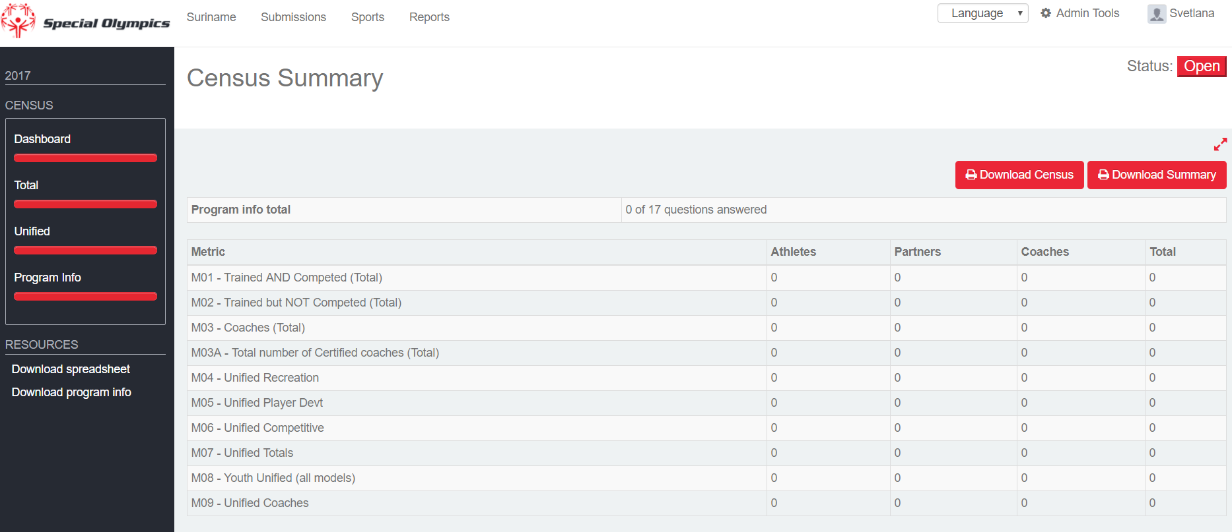
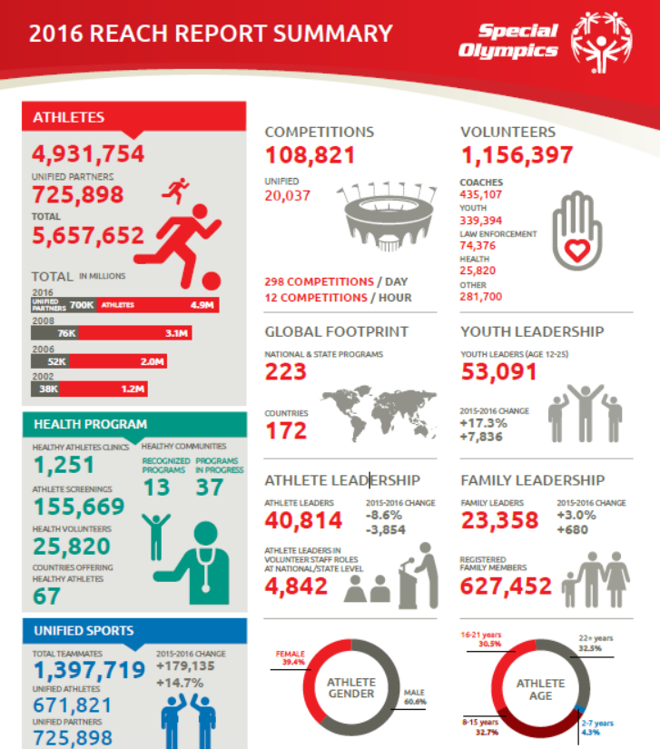
¡GRACIAS!
GRACIAS POR SU COMPROMISO CON LA EXCELENCIA Y HACER DEL CENSO 2017 UN ÉXITO.

