Slide 1
PROJECT MANAGEMENT
TRAINING FOR ATHLETE LEADERS

Slide 2


Project Management Training for Athlete Leaders
PART 1 | Welcome and Project Idea Building
2 hours | Define key words to know Introduce five phases of Project Management Utilize “Building Your Project Idea Assessment” to select a Project best for you and your community.
PART 2 | Planning and Managing your Project
2 hours | Develop achievable project goals Apply the five phases of project management to your goals Gain skills to tell your project story

Slide 3
PART 1:
WELCOME AND PROJECT IDEA BUILDING

Slide 4

Goal and Objectives of the Training
The Objectives of this training are:
Learn how to identify a problem or gap in your Program or community and design a project to address it.
Review key words of project management.
Learn and understand the five phases of project management.
Explore tools to use during each phase of project management.
Develop a project plan that outlines clear steps, resources, and timelines to bring your idea to life.

Slide 5
Key words and definitions

Slide 6

Introduction and Welcome
Why Project Management Training?
Project management empowers you to turn big ideas into action and make a lasting impact in your program or your community. By learning to plan, organize, and execute effectively, you’ll gain the skills to lead with confidence, inspire people around you, and create meaningful change in your community.

Slide 7

Key words and definitions
Project
What is a Project?
A project is a temporary activity with a definite beginning and end. It creates or produces a unique product, service or result.
A project is NOT a task that you do regularly like attend practice, fill out a timesheet at work, etc.

Slide 8

Key words and definitions
Project
What is a Project?
Project examples
Project idea #1
Create a project to recruit, train, and engage athletes under the age of 25, increasing the percentage of this age group from 35% to 50% in 5 years.
Notes:
Ask learners to think of any projects they’ve been involved in—at school, work, or in their personal lives—and invite a few to share. Encourage mentors to do the same to set an example. Then, ask learners to think about projects related to Special Olympics, like events or initiatives, and discuss how planning and teamwork played a role. Invite participants to share a few examples and then share the examples on the screen:
Project idea #1: Your Special Olympics Program notices that only 35% of their athletes are under the age of 25. They research why by talking to people in their Program and people in other sports organizations for people with disabilities to understand what their Program is missing. They want to increase the number of athletes under the age of 25 and create a project to recruit, train, and engage younger athletes and find coaches to work with them.

Slide 9
Key words and definitions
Project
What is a Project?
Project examples
Project idea #1
Create a project to recruit, train, and engage athletes under the age of 25, increasing the percentage of this age group from 35% to 50% in 5 years.
Project idea #2
Create a project to increase the number of volleyball teams by 50% to 40 teams over the next 3 years.
Notes:
Project idea #2: Your Special Olympics Program used to have more than 50 teams that competed in volleyball during the season, but that number has shrunk to only 20 teams that still compete over the past 5 years. Your SO Program asks former SO volleyball athletes and coaches why they have stopped playing and creates a project to increase the number of volleyball teams by 50% to 40 teams over the next 3 years.

Slide 10

Key words and definitions
Project Management
What is Project Management?
The application of knowledge, skills, tools, and techniques to project activities to meet the project requirements.

Slide 11
Key words and definitions
Project Management
What is Project Management?
The application of knowledge, skills, tools, and techniques to project activities to meet the project requirements.
Let’s break that down:
Using what you know, the right tools, and helpful skills to get things done and reach what you want to achieve in the project.

Slide 12
Key words and definitions
Team roles and responsibilities
What is a
Project Manager?

Slide 13

Key words and definitions
Team roles and responsibilities
An individual who is responsible for ensuring the project is completed on time, within budget, and on schedule.
This is YOU!
What is a
Project Manager?

Slide 14
Key words and definitions
Team roles and responsibilities
What is a
Team Member?

Slide 15

Key words and definitions
Team roles and responsibilities
What is a
Team Member?
People who work together to complete project tasks.
People who have diverse skills and talents to complete tasks. It is important to recognize the strengths of your team members and assign tasks according to talents.

Slide 16
Key words and definitions
Team roles and responsibilities
People who work together to complete project tasks.
People who have diverse skills and talents to complete tasks. It is important to recognize the strengths of your team members and assign tasks according to talents.
What is a
Team member?
Good project managers give tasks to their team members and trust them to do the work, supporting them along the way.

Slide 17
Key words and definitions
Team roles and responsibilities
What is a Sponsor?

Slide 18

Key words and definitions
Team roles and responsibilities
An individual or organization that provides support and funding for a project.
What is a Sponsor?

Slide 19
Key words and definitions
Team roles and responsibilities
Examples of sponsors include:
Board of Directors
Local businesses
School administrators
Stakeholders
What is a Sponsor?

Slide 20
Key words and definitions
Team roles and responsibilities
What is a Stakeholder?

Slide 21

Key words and definitions
Team roles and responsibilities
What is a Stakeholder?
People or organizations that have an interest in the project

Slide 22
Key words and definitions
Team roles and responsibilities
Examples of stakeholders include:
Customers
Suppliers
Vendors
Team members
Project sponsors
What is a Stakeholder?

Slide 23






Project Management Phases
FIVE PHASES OF PROJECT MANAGEMENT
INITIATING
PLANNING
EXECUTING
MONITORING, CONTROLLING & EVALUATION
CLOSING
Notes:
More notes in facilitator guide:
In this training, we'll cover the five key phases of project management. These phases help guide a project from start to finish:
Initiating: This is where we define the project, its goals, and get approval to move forward.
Planning: Here, we create a detailed plan, outlining how the project will be carried out, including tasks, deadlines, and resources.
Executing: This is where the project gets done! Tasks are carried out, and team members work together to achieve goals.
Monitoring & Controlling: Throughout the project, we keep an eye on progress, checking for any issues or changes needed to stay on track.
Closing: Once everything is complete, we review the project to make sure all goals were met and officially close it.
We will walk through these phases one-by-one, starting with initiating…next…

Slide 24
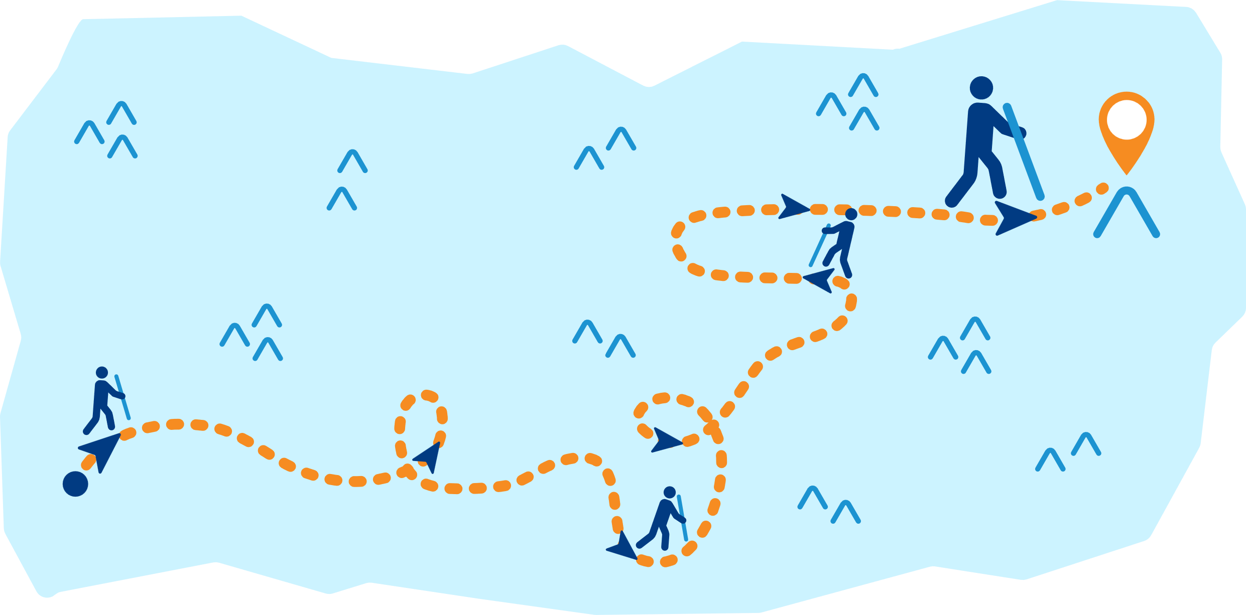
Project Management Phases
Progress is not linear

Slide 25
Project Management Phases
FIVE PHASES OF PROJECT MANAGEMENT
INITIATING
PLANNING
EXECUTING
MONITORING, CONTROLLING & EVALUATION
CLOSING
Notes:
More notes in facilitator guide:
In this training, we'll cover the five key phases of project management. These phases help guide a project from start to finish:
Initiating: This is where we define the project, its goals, and get approval to move forward.
Planning: Here, we create a detailed plan, outlining how the project will be carried out, including tasks, deadlines, and resources.
Executing: This is where the project gets done! Tasks are carried out, and team members work together to achieve goals.
Monitoring & Controlling: Throughout the project, we keep an eye on progress, checking for any issues or changes needed to stay on track.
Closing: Once everything is complete, we review the project to make sure all goals were met and officially close it.
We will walk through these phases one-by-one, starting with initiating…next…

Slide 26

Enjoy a 15-minute break.

Slide 27

Project Management Phases
Initiating
FIVE PHASES OF PROJECT MANAGEMENT
This is where we define the project, its goals, and get approval to move forward.
INITIATING
PLANNING
EXECUTING
MONITORING, CONTROLLING & EVALUATION
CLOSING

Slide 28
Project Management Phases
Initiating
This is where we define the project, its goals, and get approval to move forward.
INITIATING
Notes:
Let’s start with phase 1: Initiating

Slide 29
Project Management Phases
Initiating
During the Initiating Phase of project management, you will:
Determine the need your project will address or try to fix
Decide what product or service you want to create
INITIATING
Notes:
Initiating Phase
-----------
During the Initiating Phase of project management, you will:
Determine the need your project will address
Decide what you product or service you want to create
Assign a project manager
Many of you have already begun exploring the need to address in your community, but don’t worry we’ll go through 3 steps here, together, to help you determine a project that works for you and your community. Let’s go…
(Ask everyone to take out their completed assessment so the group can review the findings together. Walk through the questions, guiding pairs to complete or update their assessments as needed.)

Slide 30

Project Idea
Initiating
Step 0
Know Your Strengths and Interests
What are you passionate about? Be specific
(For example: helping others, education, sports, the environment, inclusion in schools, etc.)
What skills or strengths do you have? Be specific.
(For example: problem-solving, leadership, creativity, communication, teamwork, etc.)
INITIATING

Slide 31

Project Idea
Initiating
Step 1
Look at your community
Which area did you choose to study and think about improving?
» Special Olympics Program? » Community?
What positive things did you notice?
What problems or challenges did you see?
How did what you saw connect with the strengths, interests, and skills you wrote down in Step 0?
What did you see or experience that made you think this is a need or issue?
INITIATING

Slide 32
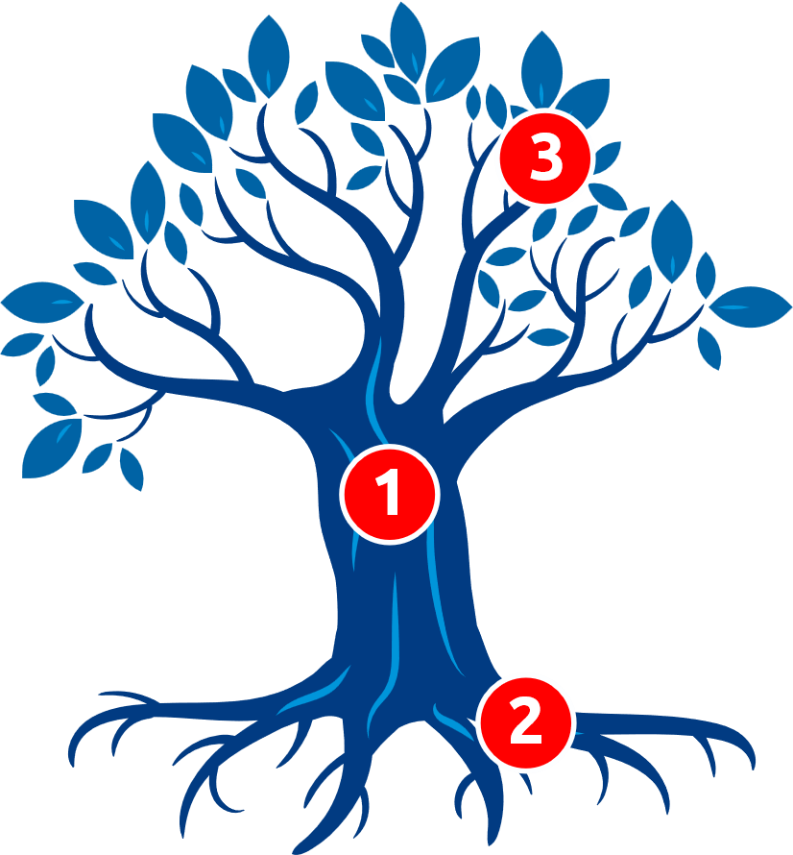
Project Idea
Initiating
 | Effects of problem | What happens because of the problem?
 | Problem | What is the main problem?
 | Causes of problem | Why does the problem exist?
INITIATING

Slide 33
Project Idea
Initiating
 | Effects of problem
 | Problem
 | Causes of problem
INITIATING

Slide 34
Project Idea
Initiating
 | Effects of problem
 | Problem | There are no Special Olympics activities in schools near me or in my area.
 | Causes of problem
INITIATING

Slide 35
Project Idea
Initiating
 | Effects of problem
 | Problem | There are no Special Olympics activities in schools near me or in my area.
 | Causes of problem | School administrators don’t understand the benefits of Special Olympics programming. Teachers already have a lot to handle and don’t have time to take on another role.
INITIATING

Slide 36
Project Idea
Initiating
 | Effects of problem | The school is not inclusive toward people with I/DD. Students with I/DD at this school have a negative school experience where teachers and students without I/DD have low expectations of them.
 | Problem | There are no Special Olympics activities in schools near me or in my area.
 | Causes of problem | School administrators don’t understand the benefits of Special Olympics programming. Teachers already have a lot to handle and don’t have time to take on another role.
INITIATING

Slide 37

Pre-Training: “Building your Project Idea” Assessment
Building my project idea
› I want to… (What do you want to do?)
› Because… (Why is it important to you?)
› I can do this through… (How will you do it?)
INITIATING

Slide 38

Pre-Training: “Building your Project Idea” Assessment
Building my project idea
› I want to… (What do you want to do?)
› Because… (Why is it important to you?)
› I can do this through… (How will you do it?)
I want to increase the number of Special Olympics athletes under the age of 25.
Right now, only 35% of our athletes are under 25. This is a problem because I know how much Special Olympics meant to me when I was younger and I want the next generation to experience the joy of Special Olympics at a young age.
I will recruit younger athletes by partnering with schools, community centers, and other sports programs.
INITIATING

Slide 39

Pre-Training: “Building your Project Idea” Assessment
Building my project idea
› I want to… (What do you want to do?)
› Because… (Why is it important to you?)
› I can do this through… (How will you do it?)
Workbook Activity
15 minutes
INITIATING

Slide 40
Project Idea Questions
Are you sure?
Do you have the resources, skills, and knowledge to handle this project?
Do you feel this project would be easy to track and measure success?
Are you confident you can tackle this project and help solve a community need?
Can you easily explain this need and project to others?
Does this need truly matter to your community?
Is completing this project realistic for you to complete?
“Are you sure” Project Idea Questions:
INITIATING

Slide 41
Project Idea Questions
Are you sure?
Write your Community Project Here: _ _ _ _ _ _ _ _ _ _ _ _ _ _
Workbook Activity
“Are you Sure” Project Idea Questions |  | Yes or no?
1. Do you have the resources, skills, and knowledge to handle this project?
2. Do you feel this project would be easy to track and measure success?
3. Are you confident you can tackle this project and help solve a community need?
4. Can you easily explain this need and project to others?
5. Does this need truly matter to your community? 6. Is this project realistic for you to complete?
15 minutes
INITIATING

Slide 42


Project Ideas Presentation
Share your Project Ideas
Get Feedback
INITIATING

Slide 43


Homework between Part 1 and Part 2
Steps 2-3 in the “Building Your Project Idea Assessment” require you to interview people in your Program or your community, sharing your project idea with them and asking them for feedback.
Complete those two steps now between Part 1 and Part 2 of this training. This should be your first priority.
Summarize your project idea by answering a series of questions under the “Finalizing my project idea” section on the previous page of the workbook.
Come to Part 2 of the training ready to share your project idea, and any updates and insights you learned during the break. Be ready to receive feedback and suggestions from your fellow athlete leaders.
We will reconvene on:
(date)
INITIATING

Slide 44
PART 2:
PLANNING AND MANAGING YOUR PROJECT

Slide 45

Project Idea
Initiating
Step 2
Ask Around
Who did you talk to?
What challenges did they mention?
Did they share any solutions or past experiences?
INITIATING

Slide 46

Project Idea
Initiating
Step 3
Final Reflection
What are two major needs or issues that need to be addressed, based on your findings from Steps 0, 1 & 2?
What are two ways you could help address these needs?
What is one action you can take that excites you, makes a difference, and helps solve a Program or community need?
INITIATING

Slide 47


What is your Project?
What is the Program or Community need?
What will you do?
Why does it matter—to you and your community?
How will you do it?
When will you complete it?
Who will help? Who will benefit?
Who can help you? How can they help you?
Whom will this project help? How will it help them?

Slide 48


Project Management Phases
Planning
FIVE PHASES OF PROJECT MANAGEMENT
Here, we create a detailed plan of how the project will be done, including tasks, deadlines, and resources.
INITIATING
PLANNING
EXECUTING
MONITORING, CONTROLLING & EVALUATION
CLOSING
Notes:
Hooray. Congratulations.
Now that learners have their project idea, we have completed initiating and will now move onto planning….

Slide 49
Project Management Phases
Planning
Here, we create a detailed plan of how the project will be completed, including tasks, deadlines, and resources.
PLANNING
Notes:
Planning: Here, we create a detailed plan, outlining how the project will be carried out, including tasks, deadlines, and resources.

Slide 50
Project Management Phases
Planning
During the Planning Phase of project management, you will:
Determine the need your project will address
Decide what product or service you want to create
Assign a project manager
PLANNING
Notes:
Planning: Here, we create a detailed plan, outlining how the project will be carried out, including tasks, deadlines, and resources.

Slide 51





SMART GOALS
Project Management Phases - Planning
SMART GOALS
S | M | A | R | T
PLANNING

Slide 52





SMART GOALS
Project Management Phases - Planning
Specific
S
Specific
What do I want to accomplish?
Why is this goal important?
Who is involved?
Where is it located?
What resources do I need to accomplish it?
S | M | A | R | T
PLANNING

Slide 53
SMART GOALS
Project Management Phases - Planning
SMART GOALS
S | M | A | R | T
Specific
PLANNING

Slide 54

SMART GOALS
Project Management Phases - Planning
M
Measurable
Measurable
How much?
How many?
How will I know when it’s complete?
S | M | A | R | T
PLANNING

Slide 55
SMART GOALS
Project Management Phases - Planning
SMART GOALS
S | M | A | R | T
Specific | Measurable
PLANNING

Slide 56
SMART GOALS
Project Management Phases - Planning
Achievable
A
Achievable
How can I accomplish my goal?
What resources or opportunities could help me?
Are there any obstacles, like time or money, that I need to consider?
S | M | A | R | T
PLANNING

Slide 57
SMART GOALS
Project Management Phases - Planning
SMART GOALS
S | M | A | R | T
Specific | Measurable | Achievable
PLANNING

Slide 58
SMART GOALS
Project Management Phases - Planning
Relevant
R
Relevant
Is it something that is important to me?
Does this goal matter to me?
Is this the right time for me to do this?
Am I the right person to take this on?
For group projects: Does this match what our team or community needs?
S | M | A | R | T
PLANNING

Slide 59
SMART GOALS
Project Management Phases - Planning
SMART GOALS
S | M | A | R | T
Specific | Measurable | Achievable | Relevant
PLANNING

Slide 60
SMART GOALS
Project Management Phases - Planning
Time-bound
T
Time-bound
When do I want to start this?
When do I want to achieve this?
What can I do today to move toward my goal?
What can I accomplish in six weeks?
Where do I want to be in four months?
S | M | A | R | T
PLANNING

Slide 61
Project Management Phases
Planning
The two most important documents you need for your project are:
A short overview that briefly describes the projects' purpose, goals, steps, outcomes, used as a quick reference for stakeholder updates.
Project Summary
A detailed document outlining the objectives, scope, timeline, tasks, resources, and risk of a project, serving as a roadmap to implement your project.
Project Plan
PLANNING

Slide 62
Project Summary
PROJECT NAME |  | PROJECT NAME
 |  | Project Manager | Project Manager name
 |  | Teammates | Teammate names
 | The Problem | The Problem
 |  | What is a big barrier to inclusion in your community that you are trying to solve through your project?
 | Project Activities | Project Activities |  |  |  | The Impact
 | Describe how your project will work | Describe how your project will work What do I want to accomplish? Where will your project take place? Who will be involved? |  |  |  | Describe what you hope to achieve with your project
PLANNING
Notes:
Ask participants to look at their participant workbook and complete their own project summary.

Slide 63
Example of Project Summary
 | Project Name
 | Project Manager
 | Teammates
Project Name |  | PROJECT NAME | Recruiting and Empowering Athletes
 |  | Project Manager
 |  | Teammates | Conal, Cristina, Caitlin and Brandon
 | The Problem | The Problem
 |  | What is a big barrier to inclusion in your community that you are trying to solve through your project?
 | Project Activities | Project Activities |  |  |  |  | The Impact
 |  | Describe how your project will work What do I want to accomplish? Where will your project take place? Who will be involved?
Recruiting and Empowering Athletes
Conal
Conal, Cristina, Caitlin and Brandon
PLANNING

Slide 64
Example of Project Summary
Project Name |  | PROJECT NAME | Recruiting and Empowering Athletes
 |  | Project Manager
 |  | Teammates | Conal, Cristina, Caitlin and Brandon
 | The Problem | The Problem
 |  | What is a big barrier to inclusion in your community that you are trying to solve through your project?
 | Project Activities | Project Activities |  |  |  |  | The Impact
 |  | Describe how your project will work What do I want to accomplish? Where will your project take place? Who will be involved?
 | Project Name
 | Project Manager
 | Teammates
Recruiting and Empowering Athletes
Conal
Conal, Cristina, Caitlin and Brandon
 | The Problem
Not enough athletes (under 25) participating in our Program.
Challenges
Lack of awareness / recruitment of athletes and coaches.
Solution
Launch an engagement initiative that includes outreach events, mentorship from current athletes, and leadership training for new recruits
PLANNING

Slide 65
Example of Project Summary
 | Project Name
 | Project Manager
 | Teammates
Project Name |  | PROJECT NAME | Recruiting and Empowering Athletes
 |  | Project Manager
 |  | Teammates | Conal, Cristina, Caitlin and Brandon
 | The Problem | The Problem
 |  | What is a big barrier to inclusion in your community that you are trying to solve through your project?
 | Project Activities | Project Activities |  |  |  |  | The Impact
 |  | Describe how your project will work What do I want to accomplish? Where will your project take place? Who will be involved?
Recruiting and Empowering Athletes
Conal
Conal, Cristina, Caitlin and Brandon
 | The Problem
Not enough athletes (under 25) participating in our Program.
Challenges
Lack of awareness / recruitment of athletes and coaches.
Solution
Launch an engagement initiative that includes outreach events, mentorship from current athletes, and leadership training for new recruits
 | Project Activities
What will you do?
Event in the community to raise awareness and create excitement.
Where will your project take place?
At a school or community event
Who will be involved?
Mentors, teachers, athletes, myself
PLANNING

Slide 66
Example of Project Summary
 | Project Name
 | Project Manager
 | Teammates
Recruiting and Empowering Athletes
Conal
Conal, Cristina, Caitlin and Brandon
 | The Problem
Not enough athletes (under 25) participating in our Program.
Challenges
Lack of awareness / recruitment of athletes and coaches.
Solution
Launch an engagement initiative that includes outreach events, mentorship from current athletes, and leadership training for new recruits
 | Project Activities
 | The Impact
What do I want to accomplish?
Event in the community to raise awareness and create excitement.
Where will your project take place?
At a school or community event
Who will be involved?
Mentors, teachers, athletes, myself
What would the result of your project be?
Increase in athletes under 25 from 35% to 50%
How will you evaluate your project?
Compare numbers of athletes under 25 over 5 years.
How will you make it sustainable?
Peer mentorship program
PLANNING

Slide 67
Example of Project Summary
 | Project Name
 | Project Manager
 | Teammates
Recruiting and Empowering Athletes
Conal
Conal, Cristina, Caitlin and Brandon
 | The Problem
Not enough athletes (under 25) participating in our Program.
Challenges
Lack of awareness / recruitment of athletes and coaches.
Solution
Launch an engagement initiative that includes outreach events, mentorship from current athletes, and leadership training for new recruits
 | Project Activities
 | The Impact
What do I want to accomplish?
Event in the community to raise awareness and create excitement.
Where will your project take place?
At a school or community event.
Who will be involved?
Mentors, teachers, athletes, myself
What would the result of your project be?
Increase in athletes under 25 from 35% to 50%
How will you evaluate your project?
Compare numbers of athletes under 25 over 5 years.
How will you make it sustainable?
Peer mentorship program.
PLANNING

Slide 68

Project Summary
 |  | Project Name
 |  | Project Manager
 |  | Teammates |  | Teammate names
 | The Problem | The Problem
 |  | What is a big barrier to inclusion in your community that you are trying to solve through your project?
 | Project Activities | Project Activities |  |  |  |  | The Impact
 |  | Describe how your project will work What do I want to accomplish? Where will your project take place? Who will be involved?
Workbook Activity
15 minutes
PLANNING

Slide 69
Enjoy a 15-minute break.

Slide 70

Project Management Phases
Planning
The two most important documents you need for your project are:
Overview that briefly describes the projects' purpose, goals, steps, outcomes, used as a quick reference for stakeholder updates.
Project Summary
A detailed document outlining the objectives, scope, timeline, tasks, resources, and risk of a project, serving as a roadmap to implement your project.
Project Plan
PLANNING

Slide 71
Project Plan
Complete? | Status | Activity/Task | Start date | End date | Owner | Helpers | Notes
PLANNING

Slide 72

Project Management Phases
Planning
Traffic Light System
Green
The project or task is on track, progressing as planned, with no major issues.
Yellow
There are some challenges or delays, but the project can still be completed with adjustments.
Red
The project is at risk or stalled due to significant problems that require immediate action.
PLANNING

Slide 73
Example of Project Plan
Complete? | Status | Activity/Task | Start date | End date | Owner | Helpers | Notes
 |  | Choose Teammates | Aug. 1, 2022 | Oct. 31, 2022 | Conal | N/A | Brandon, Caitlin, Cristina selected for team
 |  | Identify Mentor | Nov. 1, 2022 | Nov. 15, 2022 | Conal | N/A | Emily selected as mentor
 |  | Assign roles | Nov. 1, 2022 | Nov. 15, 2022 | Cristina | Brandon, Conal, Caitlin | Conal and Caitlin confirmed their role, but waiting for Brandon to confirm his
 |  | Decide on budget | Nov. 15, 2022 | Dec. 1, 2022 | Caitlin | Brandon, Conal, Cristina | Waiting for project funds to be released
 |  | Make initial contact with school | Nov. 15, 2022 | Dec. 1, 2022 | Brandon | N/A | Email was sent to the school – waiting on response
PLANNING

Slide 74
Project Plan
Complete? | Status | Activity/Task | Start date | End date | Owner | Helpers | Notes
Workbook Activity
15 minutes
PLANNING

Slide 75

Project Management Phases
Executing
FIVE PHASES OF PROJECT MANAGEMENT
INITIATING
PLANNING
EXECUTING
MONITORING, CONTROLLING & EVALUATION
CLOSING

Slide 76
Project Management Phases
Executing
This is where the project gets done! Tasks are carried out, and team members work together to achieve goals.
EXECUTING
Notes:
Executing: This is where the project gets done! Tasks are carried out, and team members work together to achieve goals.

Slide 77
Project Management Phases
Executing
During the Executing Phase of project management, you will:
Begin working on assigned tasks
Share regular updates with the team, stakeholders, sponsor
Adjust your project plan as needed
EXECUTING

Slide 78
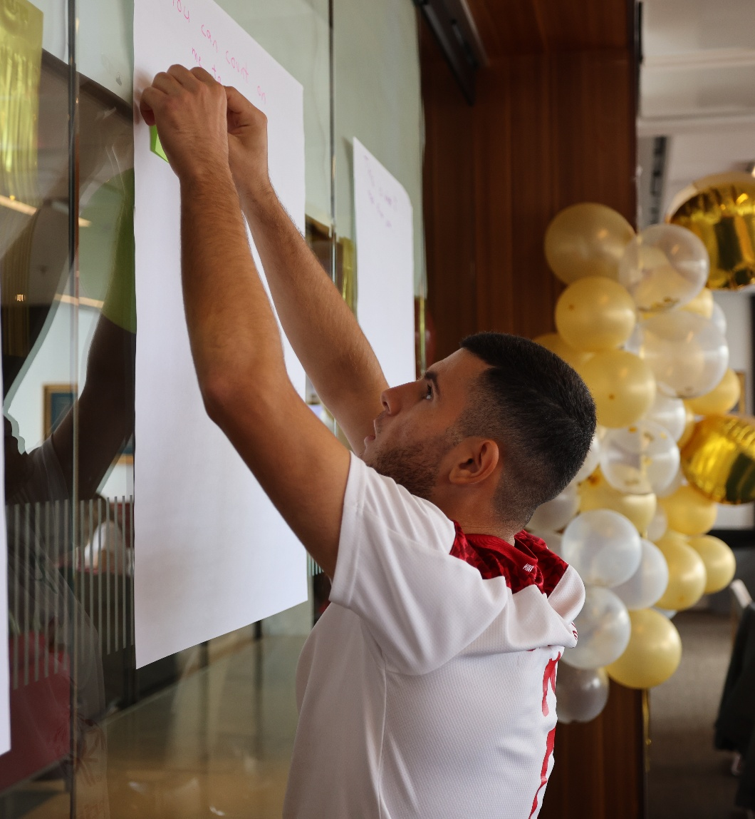
Project Management Phases
Executing
Three things that will help you execute your tasks better:
Setting and sticking to a consistent routine
Good communication between you and others
Documenting everything that happens
EXECUTING

Slide 79

Project Management Phases
Executing
Setting and sticking to a consistent routine
Good communication between you and others
Documenting everything that happens
v
Set up a routine of checking your project plan on a regular basis.
A good routine:
Helps you stay on track and ensures progress
Breaks tasks into smaller steps and set deadlines
Ensures you and your team are not forgetting anything.
EXECUTING

Slide 80

Project Management Phases
Executing
Good communication between you and others
Documenting everything that happens
v
Keep everyone informed about progress, changes, and challenges.
Use regular check-ins, emails, or meetings to ensure alignment.
Be clear, concise, and proactive in asking for help or offering updates.
EXECUTING

Slide 81

Project Management Phases
Executing
Documenting everything that happens
v
Keep records of decisions, changes, and completed tasks to track progress.
Documentation helps solve problems, maintain accountability, and improve future projects.
Use tools like notebooks, digital trackers, or project management software to stay organized. (Smartsheet, excel, google sheets, Teams, etc. )
EXECUTING

Slide 82

As a Project Manager,
What are three ways you will document your project work?
What are some ideas for document?
Reflection

Slide 83



Project Management Phases
Monitoring, Controlling & Evaluation
Throughout the project, we keep an eye on progress, checking for any issues or changes needed to stay on track.
INITIATING
PLANNING
EXECUTING
MONITORING, CONTROLLING & EVALUATION
CLOSING

Slide 84
Project Management Phases
Monitoring, Controlling & Evaluation
Throughout the project, we keep an eye on progress, checking for any issues or changes needed to stay on track.
MONITORING, CONTROLLING & EVALUATION

Slide 85
Project Management Phases
Monitoring, Controlling & Evaluation
During the Monitoring, Controlling & Evaluation Phase of project management, you will:
Review and track the progress of the project
Manage project issues
Assess risks
MONITORING, CONTROLLING & EVALUATION

Slide 86


Project Management Phases
Monitoring, Controlling & Evaluation
Define Risks and Issues
Risks are problems that could happen in the future.
Issues are problems that are already happening
Example: A key team member might leave before the project is done.
Example: The venue you booked for an event just canceled on you.
MONITORING, CONTROLLING & EVALUATION

Slide 87
Project Management Phases
Monitoring, Controlling & Evaluation
How to plan for risks?
Think Ahead – What could go wrong?
Sort Them – Is it a risk or an issue?
Risk = might happen | Issue = already happening
Find Solutions – How can we prevent or fix them?
By thinking ahead, you’ll be ready to handle challenges and keep your project on track!
MONITORING, CONTROLLING & EVALUATION

Slide 88

Risk Analysis
Question: “How big is the risk?”
Risk Rating System
Low | Medium | High | Extreme
Snooze. No big deal, continue as planned. | Thinking? Consider taking some action to reduce risk. | Yikes. Get help and adjust your plan. | Full uh-oh. May need to pause or rethink the project.
MONITORING, CONTROLLING & EVALUATION

Slide 89
Project Management Phases
Closing
FIVE PHASES OF PROJECT MANAGEMENT
INITIATING
PLANNING
EXECUTING
MONITORING, CONTROLLING & EVALUATION
CLOSING
Notes:
Finally, let’s explore Closing….

Slide 90
Project Management Phases
Closing
Review the project to make sure all goals were met and officially close it.
CLOSING

Slide 91
Project Management Phases
Closing
During the Closing of project management, you will:
Document what you learned
Complete any remaining requirements
Create a report to share what you accomplished
Celebrate with your team
CLOSING

Slide 92
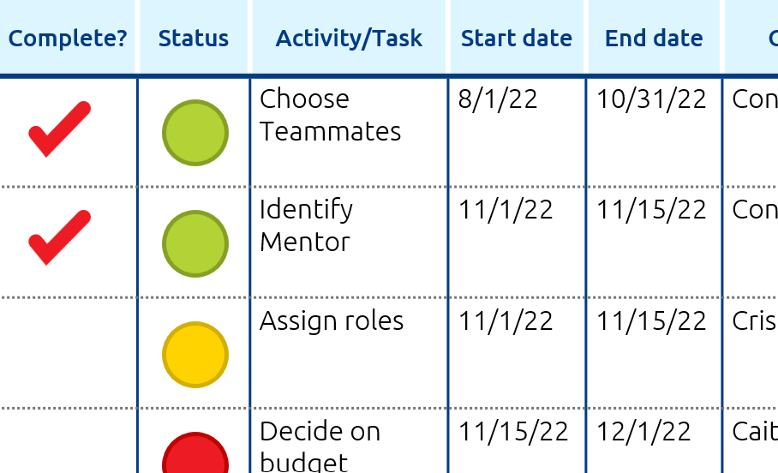
Project Management Phases
Closing
Finalize Your Project Plan and Schedule
Look at your project schedule.
Have you checked off all your tasks?
Review to see what is still missing.
What needs to be completed?
CLOSING

Slide 93
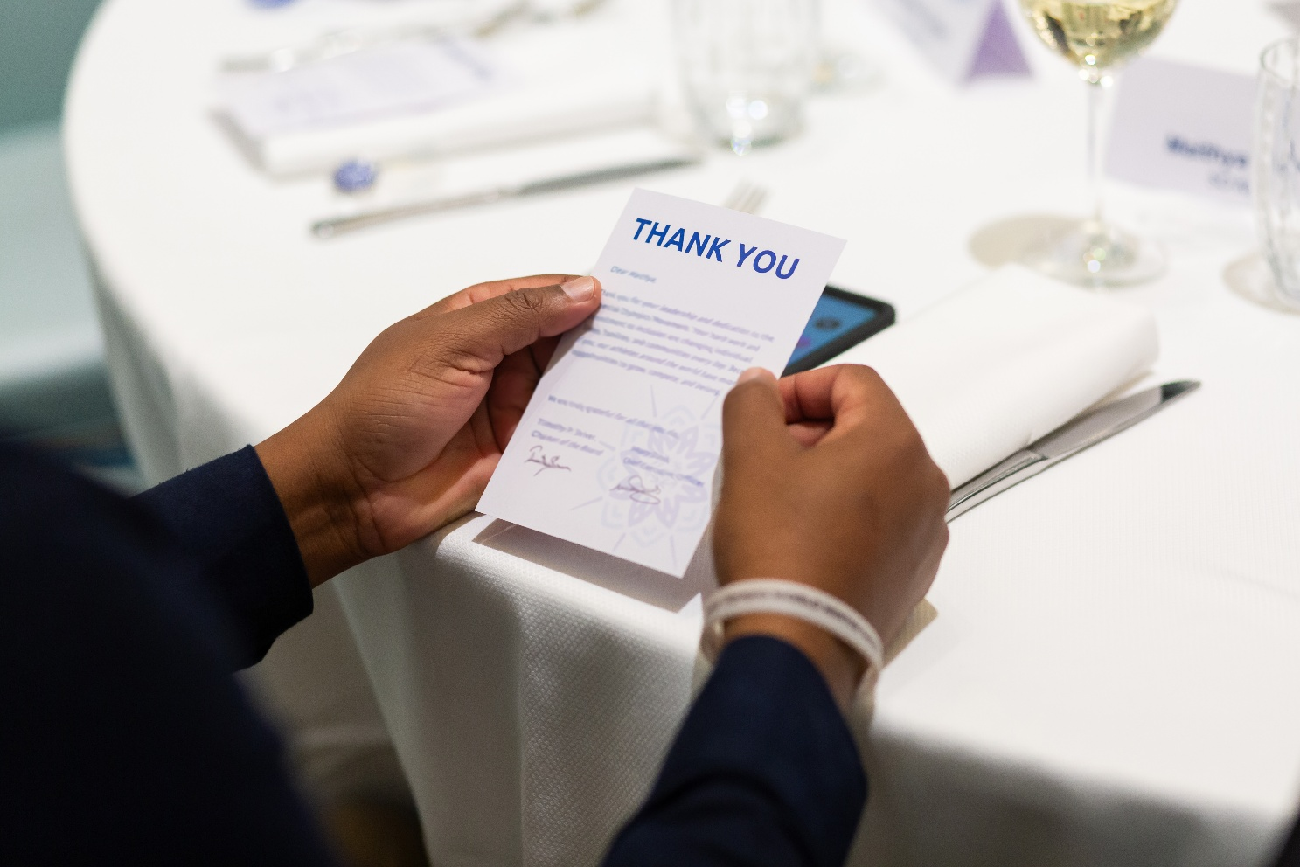
Project Management Phases
Closing
Show Appreciation
Send thank-you notes, give shout-outs, or celebrate together.
CLOSING

Slide 94

Project Management Phases
Closing
Your project stories are powerful, meaningful and worth sharing.
Your project stories show the big moments and the teamwork.
Your project stories also show the strength in facing challenges and problem solving.
Your project stories help others understand and support you and your project.
Your project stories inspire others to keep the project going and either build upon it or do something similar in their own area.
Telling
the story of your project is important
CLOSING

Slide 95
Project Management Phases
Closing
Creates connection
Inspires other to take action
Shows Impact
Why share your Project?
Invites others to listen
Builds Empathy
Helps Others Understand “Why”
CLOSING

Slide 96
Project Management Phases
Closing
It explains…
What the problem was
What you did
What changed because of it
Telling a Powerful Story…
It communicates real people and real experiences…
CLOSING

Slide 97
Reflection
Activity: Build Your Story
› What was the challenge or need? Example: “There aren’t enough coaches for young athletes in my community.”
Write your own
› What did you (or someone else) do to help? Example: “I started a plan to recruit new coaches by visiting schools and talking to teachers.”
Write your own
› What changed because of that action? Example: “Three new coaches signed up, and now we can start a new soccer team for younger athletes.”
Write your own
› What real-life experience or emotion could you include to help people care? (Don’t share names or private info—just focus on how it felt or what happened.) Example: “One student with disabilities said it was the first time they felt included on a team.”
Write your own
CLOSING

Slide 98




Sharing your Project
Project Management Phases - Closing
Public Speaking
Things to remember:
Be confident
Emphasize Words
Watch your body language
Keep Calm

Slide 99
Sharing your Project
Project Management Phases - Closing
Public Speaking Group Activity
Be confident – Did the speaker believe in their message? Did they look comfortable?
We need 2 – 3 volunteers to share your project story, from the previous activity, with the group.
The challenge or need
Why you did to help
what changed because of that action
A real-life feeling or experience you can share
Emphasize words – Did they use their voice to highlight the most important parts of their story?
Watch your body language – Did they make eye contact, use hand gestures, or tell the story instead of reading the story?
Instructions for the Group:
As you listen, use the 4 public speaking tips to give helpful and kind feedback.
Keep calm – Did they keep going even if they forgot something or make a mistake?

Slide 100

After You Share: Practice and Improve
After sharing your project, take time to reflect.
Listen to feedback from the audience and other speakers.
Ask yourself:
What went well?
What could I do better next time?
Make notes to help you grow as a presenter and improve your project.
Practice sharing your project again
Feedback is a gift

Slide 101
Project Management Phases
Closing
What are the most common places for athlete leaders to share their story?
Think about your project, who are the people who could help your project make a larger impact?
Where do you think you could share your project?
Where to share your Project Story?
CLOSING

Slide 102
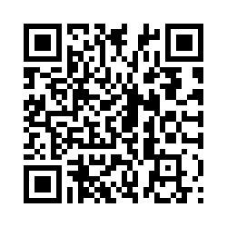
PROJECT MANAGEMENT
TRAINING FOR ATHLETE LEADERS
Please take the evaluation: http://bit.ly/3NtXZ0C
THANK YOU!

