Slide 1
ATHLETES AS SPORT ASSISTANTS
SO LEADERSHIP AND SKILLS CURRICULUM

Slide 2

Welcome
Introduce yourself
Tell us your name and your SO Program
Please introduce your mentor
Let’s get to know each other!

Slide 3
The purpose of this course
This course is designed to introduce you to the role of a sport assistant.
What does a sport assistant do?
How does a sport assistant do their job?
Why a sport assistant is important to a team?
Is being a sport assistant a good leadership role for me?

Slide 4

Have you completed Module 1: Intro to Athlete Leadership and Module 2: Understanding Leadership of the Leadership & Skills Curriculum?
If not, stop here and go back and complete those two courses first.
STOP

Slide 5


Athletes as Sport Leaders
SO Leadership and Skills Curriculum
The role of mentors in your Sport Leader journey
The mentor's job
DO assist athletes if they ask for it
DO be positive and encouraging
DON'T speak for athletes or do their work for them
DON'T step in unless the athlete asks for help

Slide 6
Athletes as Sport Leaders
SO Leadership and Skills Curriculum
Overview of the course
1
2
3
4
5
From Athlete to Sport Assistant
Working with Athletes with IDD
Special Olympics Sports Training
Being a Sport Assistant
Putting training into practice

Slide 7
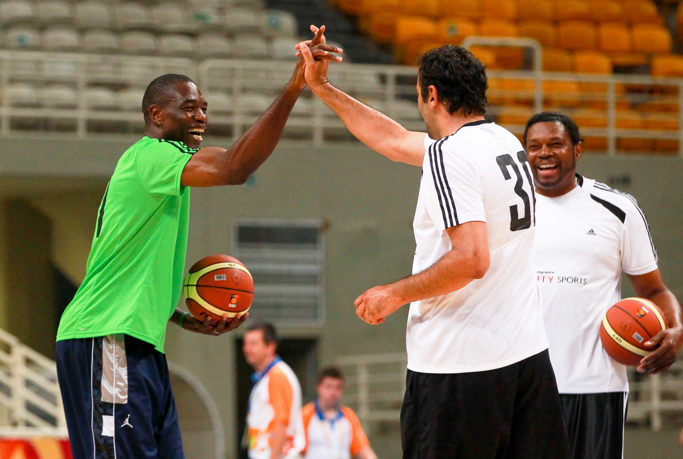
1
FROM ATHLETE
TO SPORT ASSISTANT

Slide 8



Athletes as Sport Leaders
From Athlete to Sport Assistant
LEVEL 4
Head Coach –
Advanced / Senior Coach
Special Olympics Coaching Pathway
LEVEL 2
Introductory – Coach Assistant
LEVEL 3
Coach
LEVEL 1
Sport Assistant
1

Slide 9
LEVEL 4
Head Coach –
Advanced / Senior Coach
Athletes as Sport Leaders
From Athlete to Sport Assistant
LEVEL 2
Introductory – Coach Assistant
The path to becoming a Sport Assistant
LEVEL 3
Coach
Explore
Learn
Practice
LEVEL 1
Sport Assistant
Reflect
1

Slide 10


Athletes as Sport Leaders
From Athlete to Sport Assistant
Explore: Athlete to Sport Assistant
PLAYING
HELPING
Playing a sport
Being a student of the sport
Being a teammate
Actively participating on the court/field
Working on your performance goals
Helping a Sport Assistant
Assisting the Coaching staff
Being on the sideline to assist where needed
Helping other athletes improve their performance
1

Slide 11

Qualities of a Good Leader
Level 2
Facilitation
Course
1
Notes:
Create scenarios that demonstate these qualities.

Slide 12
Athletes as Sport Leaders
From Athlete to Sport Assistant
What are my interests? | What sports do you play? How long have you been an SO athlete?
Why I want to help? | Do you enjoy assisting athletes? Do you enjoy helping the coaches and assistant coaches?
What qualities do I have that will make me a good sport assistant? | Are you reliable? Are you friendly? Do you practice good sportsmanship?
What makes me a good leader?
Complete a self-assessment related to sport leadership
1

Slide 13
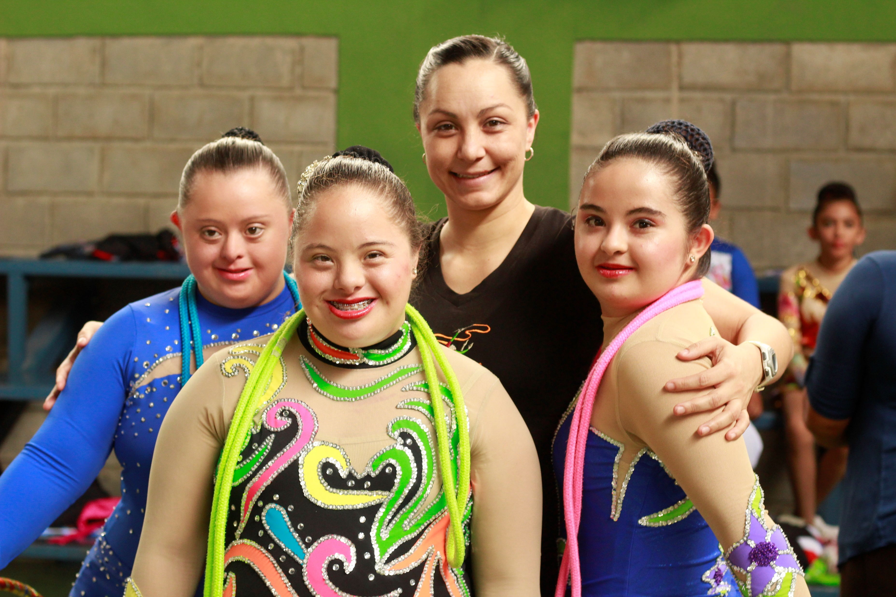
2
WORKING WITH
ATHLETES WITH IDD

Slide 14

Athletes as Sport Leaders
Working with Athletes with IDD
What does IDD mean?
https://youtu.be/g0wZ-D_7qLo
2

Slide 15

Athletes as Sport Leaders
Working with Athletes with IDD
Special Olympics Athletes
Are like athletes without IDD
Want to be good in their sport
Work hard to achieve individual performance goals
Are good teammates
Do their best and help others to do their best
2

Slide 16

Athletes as Sport Leaders
Working with Athletes with IDD
Persons with intellectual disabilities:
How does IDD impact learning?
Use many different learning tools to grasp new skills
Often need individual attention to understand new information
Rely on assistance to complete complex tasks
2

Slide 17

Athletes as Sport Leaders
Working with Athletes with IDD
Strengths and Weaknesses
Everyone has strengths and weaknesses when it comes to learning.
People with IDD may use different words, may need extra time in understanding and may learn at a different speed or in a different way.
It’s important to understand the different ways we learn and how communication plays a role in that process.
2

Slide 18








Athletes as Sport Leaders
Working with Athletes with IDD
Ways to communicate
Use easy words
Use only a few words
Use pictures
Demonstrate
Give step-by-step instructions
Reward effort and positive attitudes
Check for understanding
2

Slide 19
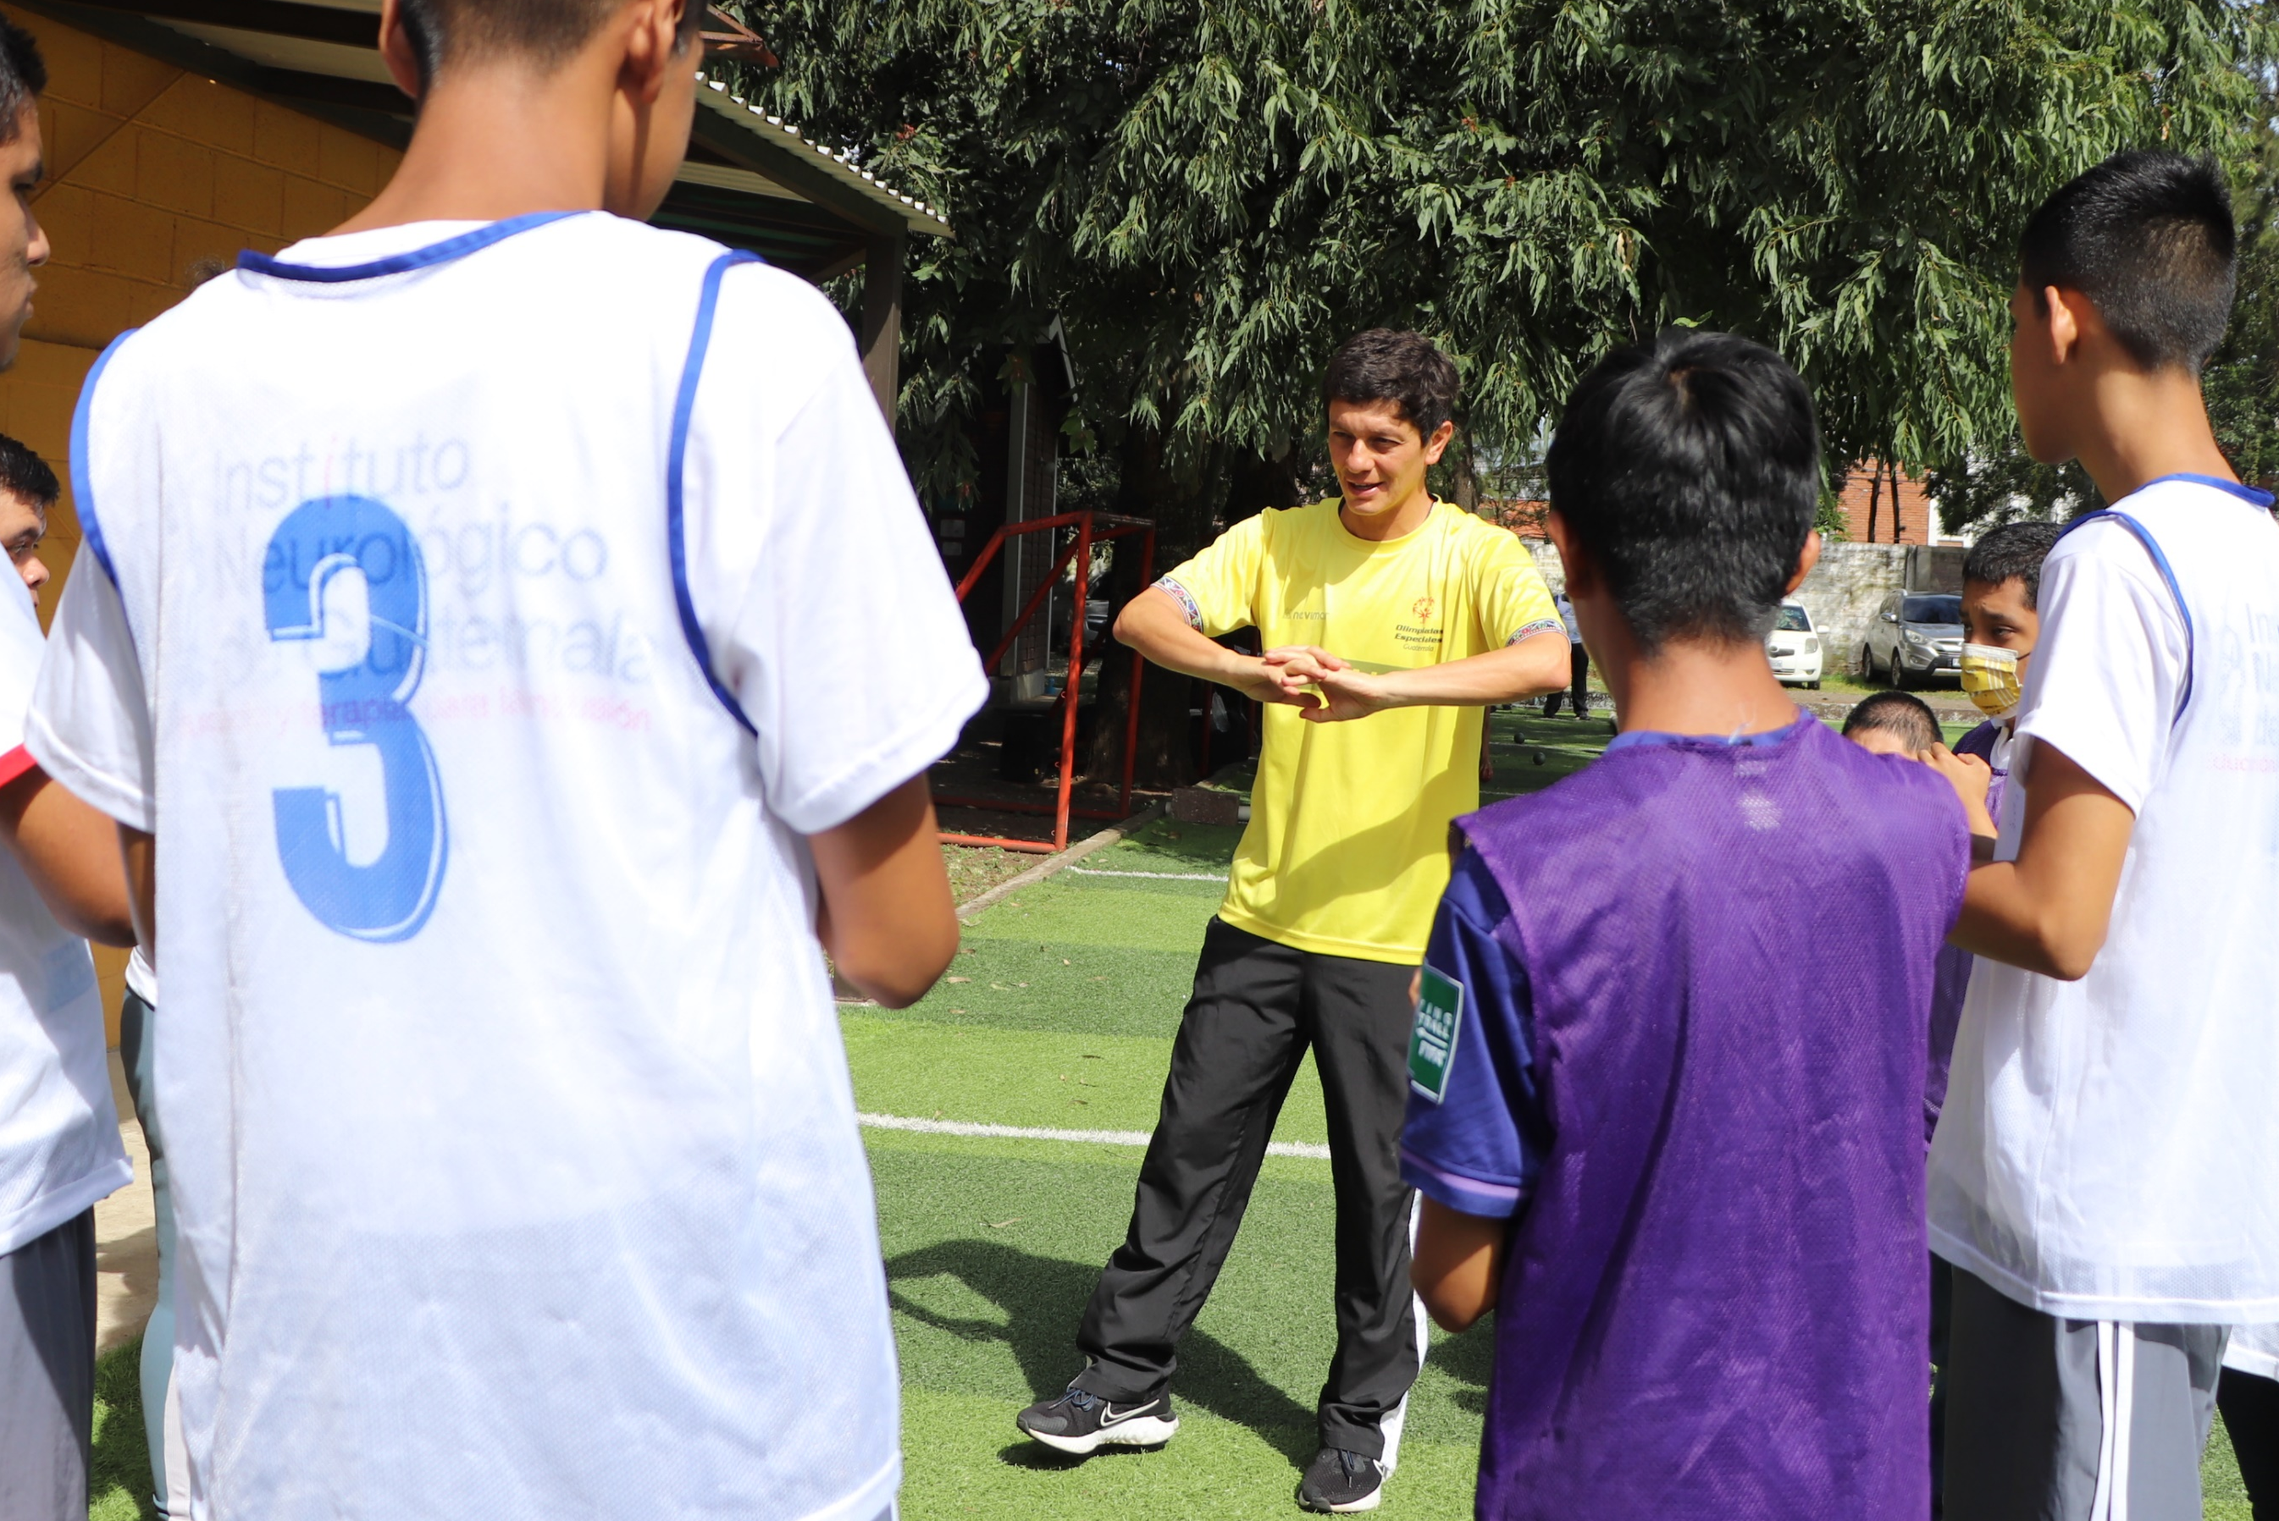
3
SPECIAL OLYMPICS
SPORTS TRAINING

Slide 20





Athletes as Sport Leaders
Special Olympics Sports Training
Warm-up
Sports
Training Session
Review of previously learned skills
Introduce new skills & drills
Competition style practice / scrimmage
Cool down & review
3

Slide 21
Athletes as Sport Leaders
Special Olympics Sports Training
Letter | Description of Activity
 | Break into groups and scrimmage or play a short game.
 | Stand in a circle and run in place for 30 seconds. Follow this with stretching activities while marching in place. These are called dynamic stretches.
 | Ask an athlete in the group to demonstrate a skill from last week's practice. Have the whole team perform the skill several times.
 | At the end of practice, before everyone leaves, do some light stretching. This is a good time to review what we learned at this practice and hear announcements for upcoming practices.
 | Watch a coach demonstrate a skill. Then all athletes repeat what the coach just showed you. Break into groups and practice the skill.
Sports
Training Session
ACTIVITY: Match the letter from the session elements listed below, the correct practice element in the table.
Work alone or with your mentor only to complete this activity.
A- Warm-up
B- Review of Previously Learned skills
C- Introduce New Skills & Drills
D- Competition preparedness
E- Cool Down
3

Slide 22
Special Olympics defines fitness as a state of optimal health and functional ability.
3

Slide 23
Athletes as Sport Leaders
Special Olympics Sports Training
Fitness as part of sport performance
Endurance & Stamina
Speed & Agility
Strength & Power
Flexibility
The body's ability to do continual activity over a long period of time
The body's ability to move quickly both in a straight line and when changing directions frequently
The body's ability to move against resistance quickly & forcefully
Allows the body to move efficiently and helps prevent injuries
3

Slide 24



Athletes as Sport Leaders
Special Olympics Sports Training
Special Olympics Fitness
Optimal health and performance through adequate physical activity, nutrition, and hydration.
3
Notes:
Before we proceed further, let’s clarify what fitness means to SOI.
A brief history may help to put this into context. Although it has been a topic of discussion for a long time, we didn’t have a formal focus on fitness within SOI until about 4 years ago. If you’ve been around a while, you have likely seen programs come and go - like TRAIN and Strive and SHIP, but nothing really caught on or made meaningful changes for athletes. We realized that fitness needed to be more of a priority, and in 2015 SOI dedicated a staff member to focus on fitness. Several of our Programs had already been making efforts to improve the fitness levels of their athletes, so SOI reached out to learn from those Programs in developing our definition, vision, and direction for fitness. The SOI fitness team spoke with regional leaders within SOI, Program staff, and some external experts and compiled what we heard to create a simple definition.
SOI defines fitness as: Optimal health and performance through adequate physical activity, nutrition, and hydration. The definition highlights both the benefits of fitness and the behaviors to get there.
There are some components of the definition that are intentionally vague. “Optimal” – this term is relative to a person and refers to a state that is most favorable for a given individual at any given time. “Performance” - notice it does not specify sports performance. Of course it could be sports, but it could also be activities of daily living or work-related performance. “Adequate” – SOI recognizes that what is considered adequate, or enough, will change depending on what “optimal” means to the individual.

Slide 25
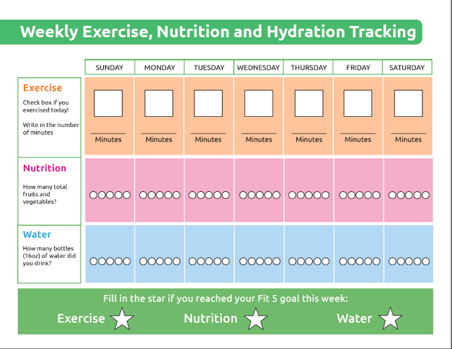

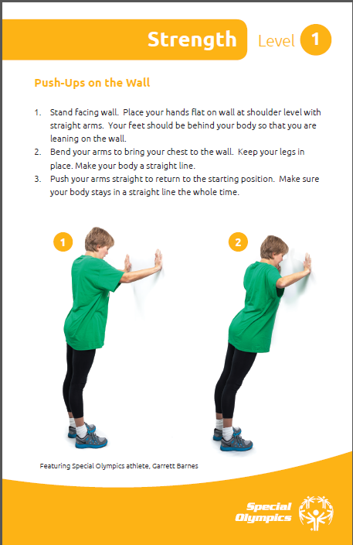
Athletes as Sport Leaders
Special Olympics Sports Training
Resources to promote fitness
3
Notes:
One great resource that SOI has created is the Fit 5 Guide. There are lots of ideas for achieving fitness, including adequate physical activity, nutrition, and hydration, and it includes tracking sheets and great visuals.
This is only one example of a resource that is available, we also have Fitness Cards, sample practices and workouts, nutrition tip sheets, a fitness assessment guide for those coaches who would like to examine any improvements in fitness of their athletes – this can be a great motivator. There are also warm-up and cool-down suggestions, FAQ sheet, and a guide for organizing active practice sessions.
You are encouraged to review and use these very user friendly resources to inspire you to integrate fitness into the great work that you already to.

Slide 26
As a Sport Assistant, what are some ways you can encourage athletes on your team to incorporate fitness into their day?
3

Slide 27
Athletes as Sport Leaders
Special Olympics Sports Training
Athletes are grouped for competition based on:
Their gender, age and sport ability level as determined by an assessment or preliminary competition.
Team groupings are determined by a team rating score.
Divisioning for fair and equitable competition
3

Slide 28
Athletes as Sport Leaders
Special Olympics Sports Training
For individual sports, coaches submit an athlete’s qualifying or assessment score. For team sports, coaches submit a team rating form or a combination of individual assessment scores.
At competition, preliminary rounds will be held and those scores will be submitted for divisioning for final medalling rounds.
Divisioning is a two-step process
3

Slide 29
Athletes as Sport Leaders
Special Olympics Sports Training
Divisioning is a two-step process
For individual sports, coaches submit an athlete’s qualifying or assessment score.
For team sports, coaches submit a team rating form or a combination of individual assessment scores.
At competition, preliminary rounds will be held and those scores will be submitted for divisioning for final medaling rounds.
3

Slide 30
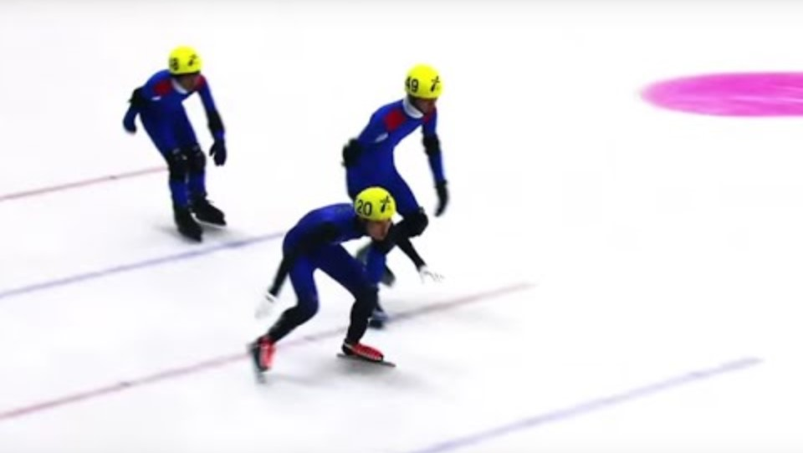
Athletes as Sport Leaders
Special Olympics Sports Training
Game On:
A Quick Guide to Special Olympics Divisioning
https://youtu.be/oOFkQssMM8U
3

Slide 31
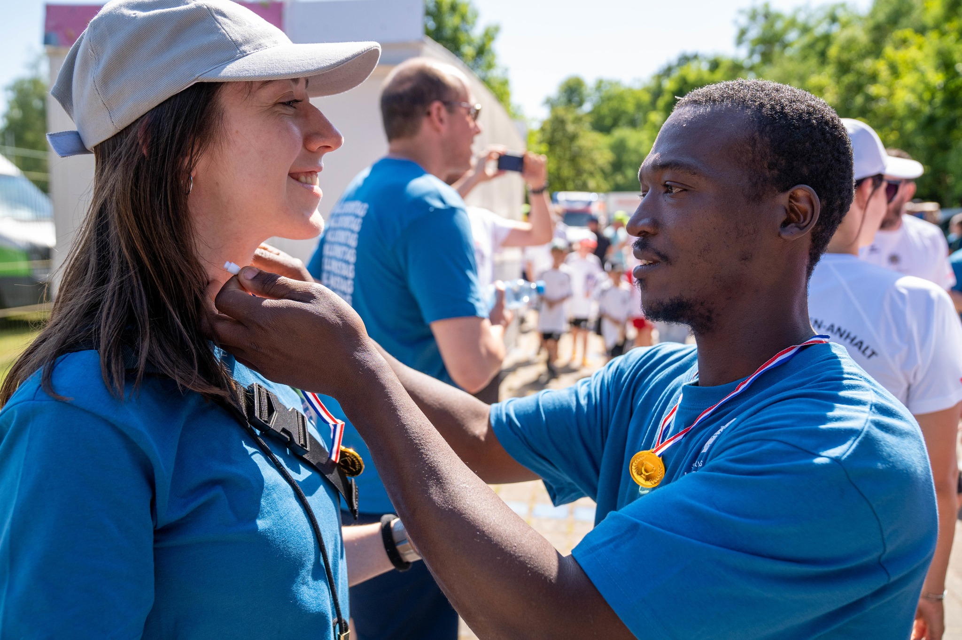
4
BEING A SPORT
ASSISTANT

Slide 32



Athletes as Sport Leaders
Being a Sport Assistant
What is a Sport Assistant
A Level 1 - Sport Assistant is a Special Olympics volunteer role and the first step in the SO Coaching pathway
Sport Assistants help Coaches with the running of sports programs & competition
No experience is required, however, as an SO athlete you have knowledge and experience of how SO works.
4

Slide 33

Athletes as Sport Leaders
Being a Sport Assistant
What does the Sport Assistant do?
Athlete & Team Support |  | Uniforms, equipment & facilities support |  | Support Coaches
Escorts Take attendance Manage water stations Maintain athlete and team paperwork |  | Distribute & collect uniforms Distribute & collect equipment Field/court set-up Survey playing area for hazards |  | Distribute schedules and rosters to assist Coaches and Families Perform other duties as assigned by the Coach
4

Slide 34
Athletes as Sport Leaders
Being a Sport Assistant
Be a good Role Model
Qualities of a Sport Assistant
Dress appropriately for the sport.
Be on time and stay for the whole practice.
Show up every practice.
Demonstrate behaviours you expect from your athletes.
4
Notes:
Enthusiastic
Patience
Caring
Encouraging

Slide 35
Athletes as Sport Leaders
Being a Sport Assistant
Be a Strong Leader
Qualities of a Sport Assistant
Safety and security is top priority.
Take responsibility.
Be an attentive listener to both athletes & coaches.
Ask for help when you need it.
4

Slide 36
Athletes as Sport Leaders
Being a Sport Assistant
Be a good Teammate
Qualities of a Sport Assistant
You are part of a coaching team now.
Work in partnership with your coaching teammates.
Support your teammates.
Prioritize team goals.
4

Slide 37
Athletes as Sport Leaders
Being a Sport Assistant
Have a positive attitude
Qualities of a Sport Assistant
Be polite and courteous to everyone.
Practice good sportsmanship.
Always be watching, listening, and learning.
4

Slide 38

Athletes as Sport Leaders
Working with Athletes with IDD
Safety is everyone's responsibility
Report field/court hazards to the Coach immediately before an emergency happens
Know where to go in an emergency
Know what your job is if someone is injured or there is any emergency
Know where the first aid kit is and how to find the medical person
4

Slide 39
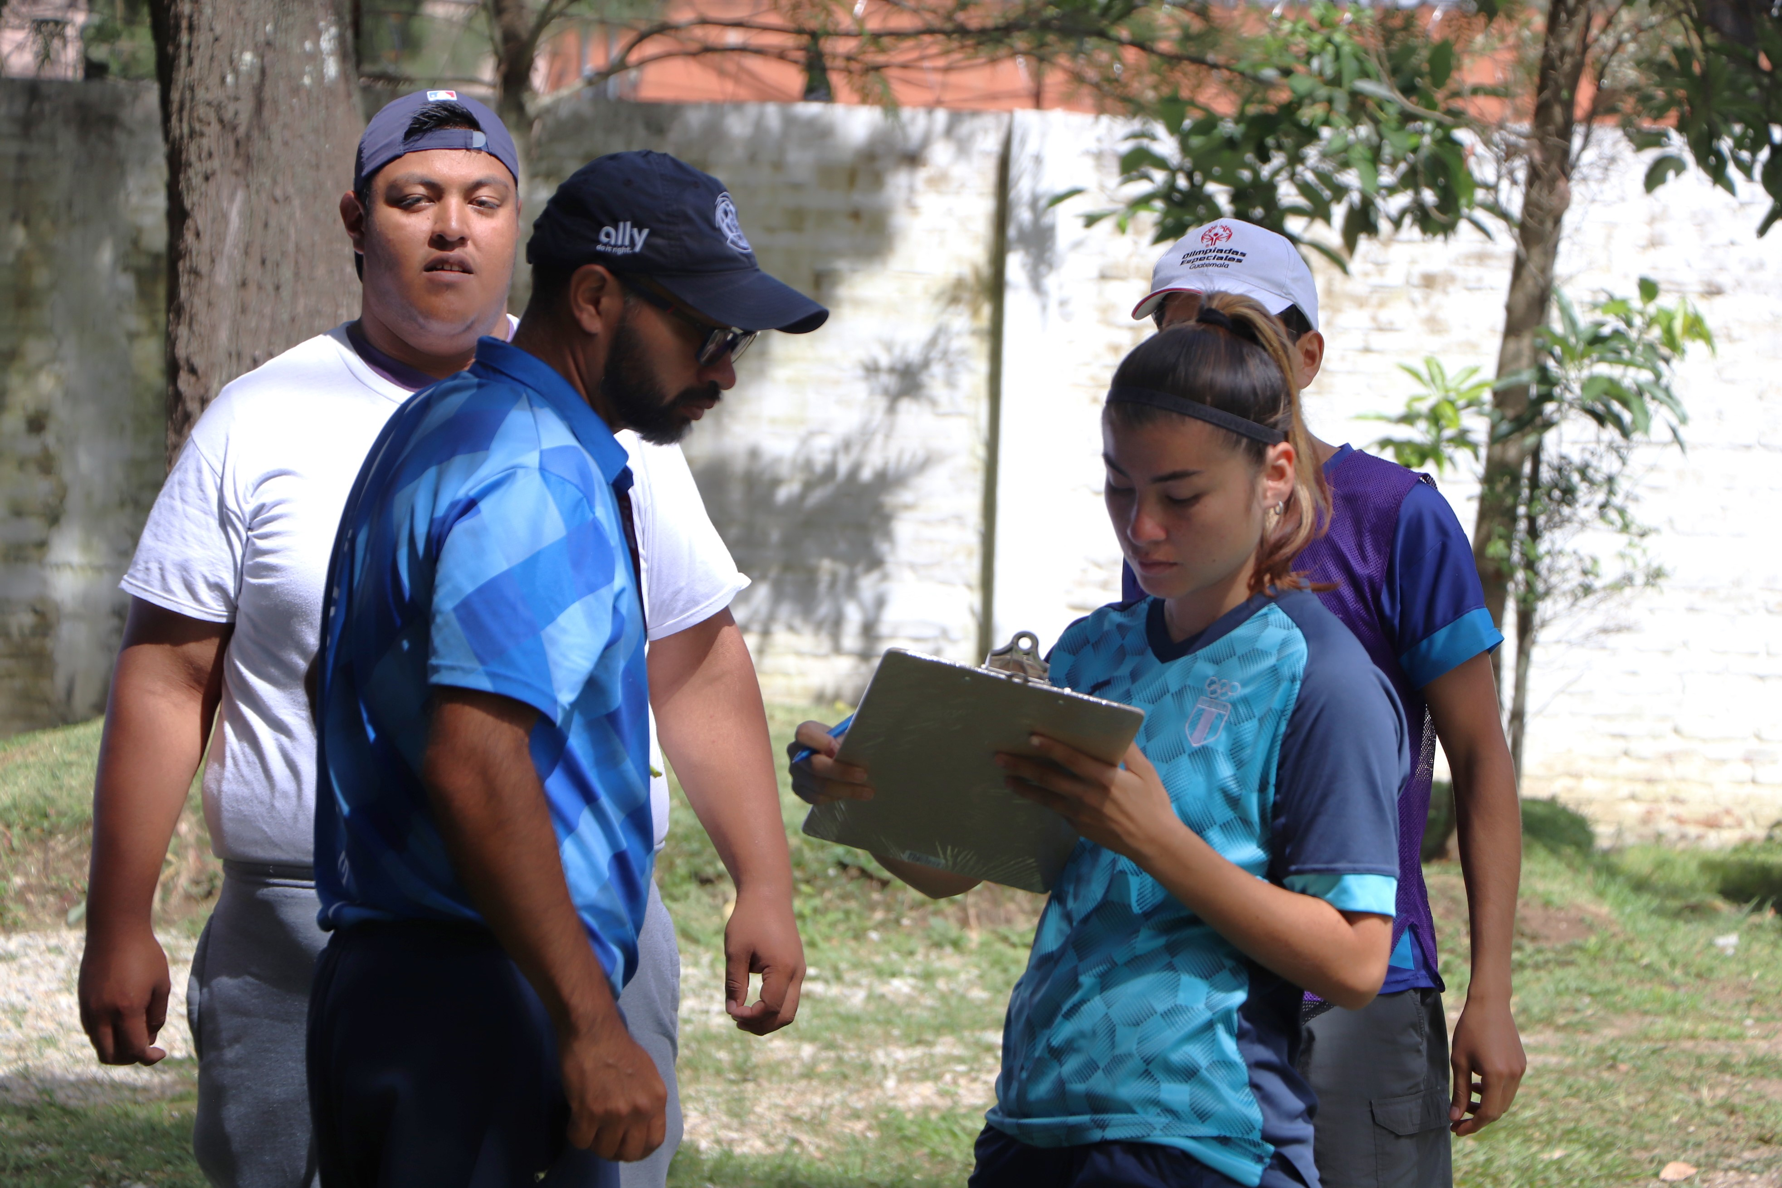
5
PUTTING TRAINING
INTO PRACTICE

Slide 40
Athletes as Sport Leaders
Putting Training into Practice
A practicum is an on-the-job opportunity to put into practice what you have learned in this course.
A practicum helps you gain experience working with a team as a Sport Assistant.
A practicum also helps you build a library of successful skills.
What is a practicum?
5

Slide 41
Athletes as Sport Leaders
Putting Training into Practice
List three sports you have played and enjoy.
Do you have any time conflicts? For instance, what is your work schedule? Are there any other times when you would not be available?
What is your transportation plan?
Who is your Special Olympics program representative that will assist you with finding a Head Coach and team to work with? Schedule a time to talk with this person to find a placement.
How to select your practicum?
5

Slide 42

Athletes as Sport Leaders
Putting Training into Practice
Developing your role as a Sport Assistant
Working
Working in a sport/team setting for a full season.
5

Slide 43


Athletes as Sport Leaders
Putting Training into Practice
Developing your role as a Sport Assistant
Working
Working in a sport/team setting for a full season.
Performing
Performing the duties of the Sport Assistant as previously defined.
5

Slide 44


Athletes as Sport Leaders
Putting Training into Practice
Developing your role as a Sport Assistant
Working
Working in a sport/team setting for a full season.
Performing
Performing the duties of the Sport Assistant as previously defined.
Gaining experience
Getting a chance to try out your new role.
5

Slide 45


Athletes as Sport Leaders
Putting Training into Practice
Developing your role as a Sport Assistant
Working
Working in a sport/team setting for a full season.
Performing
Performing the duties of the Sport Assistant as previously defined.
Gaining experience
Getting a chance to try out your new role.
Demonstrating your leadership abilities
Showing the Coach and team athletes that you are prepared for this leadership role.
5

Slide 46
Athletes as Sport Leaders
Putting Training into Practice
Be professional!
When attending your first practice as a Sport Assistant:
Be on time – dress appropriately.
Introduce yourself to the team.
Observe and listen.
Ask the coach for specific instructions.
5

Slide 47


Athletes as Sport Leaders
Putting Training into Practice
Reflect & Review to improve
WHAT?
SO WHAT?
WHAT NOW?
Describe what happened
Why is it important to reflect upon?
What would you do differently?
5

Slide 48
Athletes as Sport Leaders
Putting Training into Practice
How did practice go?
Did you enjoy it?
Did you communicate well with the athletes and coaches?
What new things did you learn?
What was really good that you want to continue doing at the next practice?
What will you do differently at the next practice? And how?
?
?
Questions to ask yourself
Meet with your Coach/Mentor on a frequent basis and ask for feedback.
5

Slide 49

Athletes as Sport Leaders
Putting Training into Practice
What is critical reflection?
https://youtu.be/vGyjF9Ngd8Y
5

Slide 50

Athletes as Sport Leaders
Putting Training into Practice
Make your reflection plan now
Ask your mentor to help you develop a reflection schedule.
Stick to the schedule.
Develop a list of topics to cover in your reflection.
Determine the best method to record your observations and feelings, ie. Journal/diary, voice recording, zoom recording with your mentor.
5

Slide 51
Recap
Brief overview of core content and key messages.
Quiz questions/Knowledge application (as in Understanding Leadership course).

Slide 52
CONGRATULATIONS!
You have completed the coursework required to be a Special Olympics Sport Assistant. Good luck on continuing your journey.

