Slide 1


YEAR 2
Fitness Captains
Facilitator Guide
January 2026

Slide 2
Fitness Captain
Facilitator Guide
This facilitator guide provides an outline on how to host and lead the Year 2 Fitness Captain training course using the PowerPoint presentation and the participant workbook.
If you are looking for resources to help prepare for and lead a training virtually, you can find them here.
Alternatively, the worksheets, PowerPoint and this resource can be adapted for delivery via platforms like Zoom, WhatsApp, Facebook or for in person delivery.
Be sure to complete the following actions to prepare for each session:
Review this facilitator guide and accompanying PowerPoint presentation.
Review the worksheets and complete each activity yourself to be familiar with the activity and have examples to share. Additionally, think about what information you can add from your Program perspective.
Host a practice session with all facilitators and cover every slide.
Give feedback to each other.
Host a second practice of entire presentation.
Send out the worksheets and session instructions to the participant one or two weeks before the training. Invite athlete leaders to look through all the resources so they are familiar with the content.

Slide 3
Training Overview
Topic | Description | Est. time
Lesson 1: Year 1 Review Fitness Captain Responsibilities Warm-Up and Cool-Down Practice Communication | Review how to do proper warm-ups and cool-downs Discuss different ways to share Health Tips Review communication tips Share successes and challenges as a Fitness Captain | 1 hour
Lesson 2: Game Day Minds Self-Care for Leaders Strong Messaging Breathing and Stretching | Discuss how to take care of yourself as a leader Learn about strong messaging to help you and your teammates “get your head in the game” Practice breathing while stretching | 1 hour

Slide 4
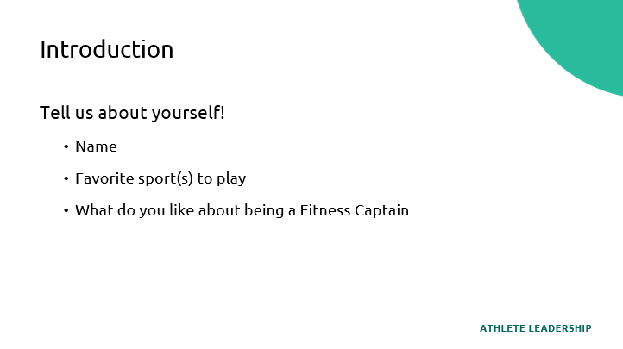
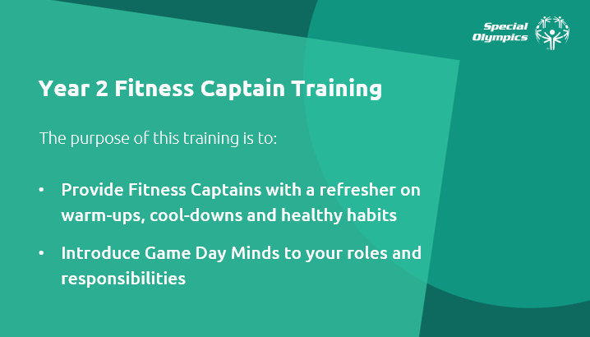
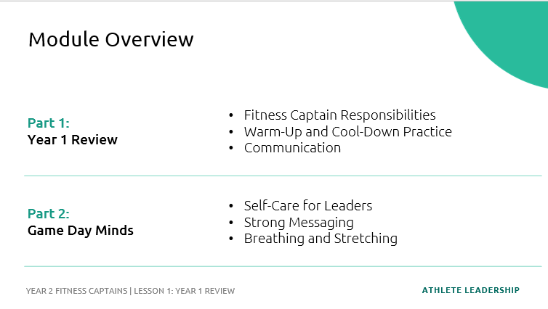
Prep | Description | Slide
Topic Welcome and Introductions Time: 8 minutes Lead: | Welcome participants Introduce the facilitators Hello everyone! Welcome to the Year 2 Fitness Captains training! Introduce yourself. To begin, I would like each of you to introduce yourself and tell us your favorite sport to play and what you like most about being a Fitness Captain. Each person introduces themselves.
Topic Purpose of the Year 2 Fitness Captain Training Time: 1 minute Lead: | To be a great athlete, you must be a healthy athlete. Living a healthy lifestyle takes knowledge, skills, support, and a dedication to healthy behaviors year-long and lifelong. The purpose of the Year 2 Fitness Captain training course is to review what you previously learned in your training, celebrate your successes, address any challenges you might be facing, and introduce Game Day Minds to your roles and responsibilities as a Fitness Captain!
Topic Module Overview Time: 1 minute Lead: | The Year 2 Fitness Captain training course is divided in two lessons: Year 1 Review Game Day Minds This course will take about 2 hours to complete. We will have a break in between Part 1 and Part 2. Let’s begin!

Slide 5
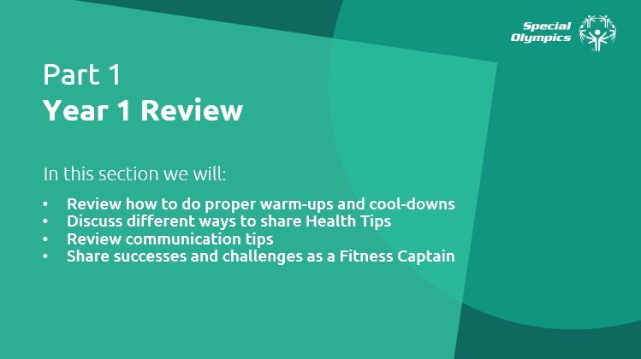
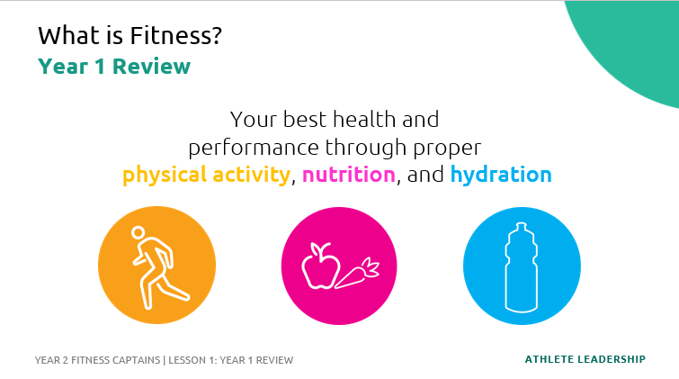
Prep | Description | Slide
Topic Part 1: Year 1 Review Time: 1 minute Lead: | Now, let’s start Part 1: Year 1 Review In this section we will: Review how to do proper warm-ups and cool-downs Discuss different ways to share Health Tips Review communication tips Share successes and challenges as a Fitness Captain
Topic Part 1: Year 1 Review What is Fitness? Time: 4 minutes Lead: | Fitness is your best health and performance through proper physical activity, nutrition, and hydration. QUESTION: Think of a person you consider fit. What kind of things do they do, or you think they do to stay fit? Write your answer down in your workbook. Ask a few participants to share their answers. Great answers! Being fit is all about making daily healthy choices in the three areas from the definition—physical activity, nutrition, and hydration. A person who is fit has good health and well-being. And the healthy choices you make in those three areas each day can help you to be healthier and perform better in your sport, your job, your hobbies, and other aspects of your life. When you are fit, you feel good and have lots of energy because your body is strong and healthy.

Slide 6
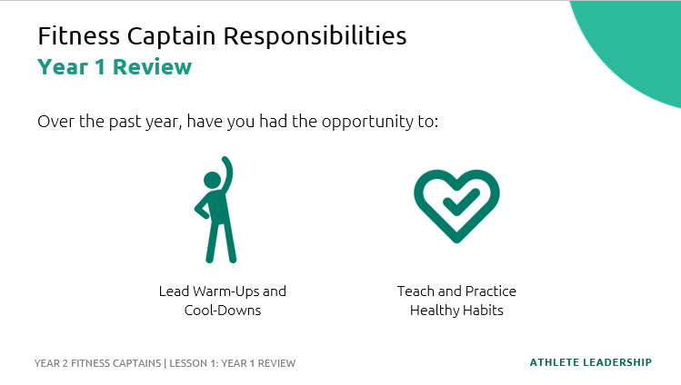
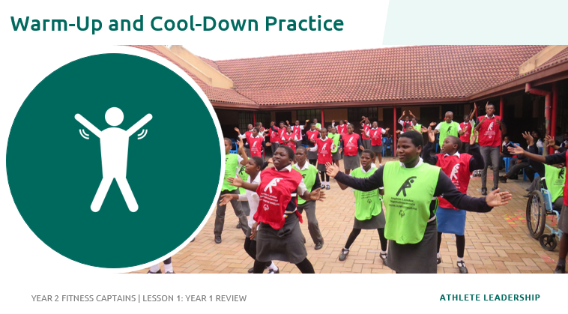
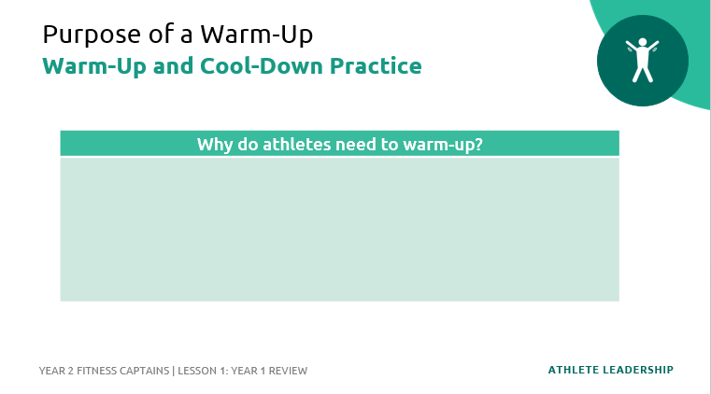
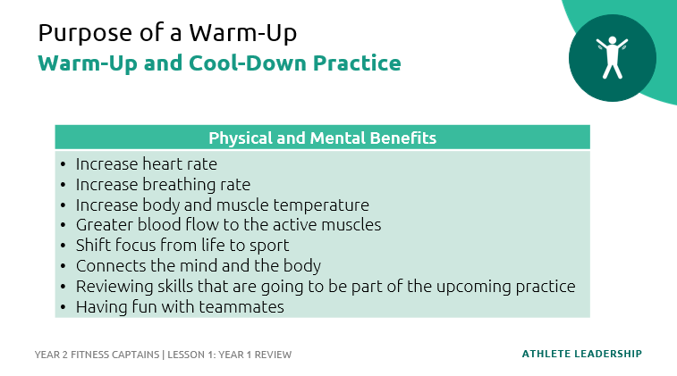
Prep | Description | Slide
Topic Part 1: Year 1 Review Fitness Captain Responsibilities Time: 2 minutes Lead: | As a Fitness Captain, you have been working closely with your coaches to make sure health and fitness is a key component of the sports experience by: Leading your team in proper warm-up and cool-down routines Sharing health education tips with your teammates Supporting your team to practice healthy behaviors and encourage them to participate in other health/fitness programming. You should always take care of your teammates in a positive and supporting manner.
Topic Part 1: Year 1 Review, Warm-Up and Cool-Down Practice Purpose of a Warm-Up Time: 5 minutes Lead: | Let’s review warm-ups and cool-downs! A warm-up should be the first physical activity in every training session or competition. It helps you get your body and mind ready for your sport. QUESTION: Why do athletes need to warm-up? Ask the participants to write down their answers or raise their hand up to respond. Warm-ups have many physical and mental benefits. Read some of the benefits listed on the slide and compare to what the athletes said. When you prepare both the body and the mind, you are less likely to suffer an injury and will perform better at each practice, training and competition.

Slide 7
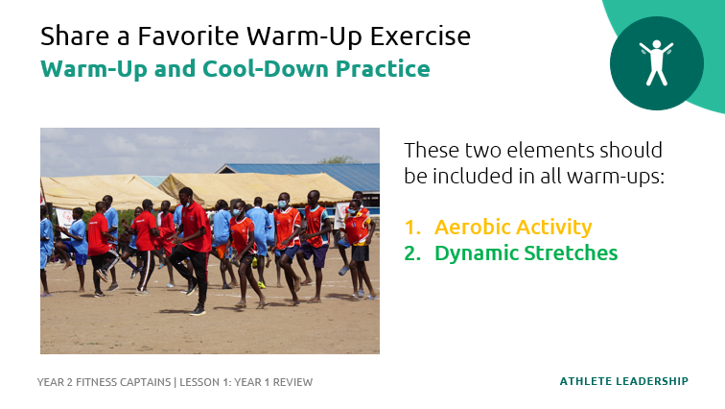
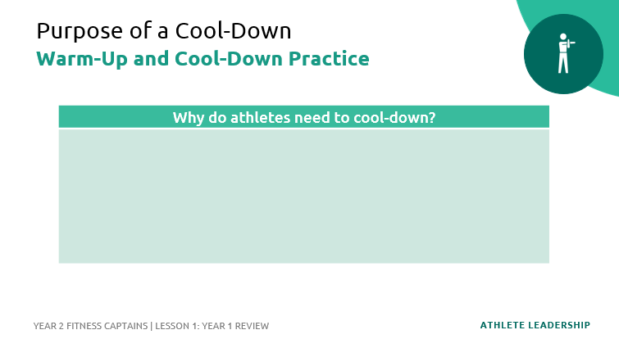
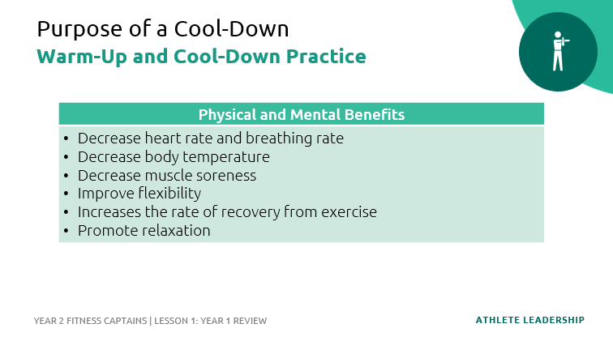
Prep | Description | Slide
Topic Part 1: Year 1 Review, Warm-Up and Cool-Down Practice Share a Favorite Warm-Up Exercise Time: 5 minutes Lead: | Every sport is different, and each sport has specific skills and movements. Your warm-up routine should be personalized to the sport you are participating in that that moment. All warm-ups, no matter the sport, should have these elements: Aerobic Activity Dynamic Stretches Warm-ups should begin at a slow pace and gradually become a little faster and more difficult. Remember, you may need to give your teammates modifications, or options, for the exercises! Ask each Fitness Captain to share a favorite warm-up exercise: they can choose EITHER an aerobic activity or a dynamic stretch.
Topic Part 1: Year 1 Review, Warm-Up and Cool-Down Practice Purpose of a Cool-Down Time: 4 minutes Lead: | Now let’s talk about cool-downs! When your training, practice or sport session is complete, you should always cool-down. It is just as important to have a good cool-down as it is to have a good warm-up. QUESTION: Why do athletes need to cool-down? Ask the participants to write down their answers or raise their hand up to respond. Like warm-ups, cool-downs have many physical and mental benefits. Read some of the benefits listed on the slide and compare to what the athletes said. QUESTION: What do you notice about this list? How does it differ from warm-ups? You might have noticed that cool-downs have some opposite benefits as warm-ups. For example, a warm-up increases heart rate, but a cool-down decreases heart rate. The cool-down is a time to relax and rest.

Slide 8
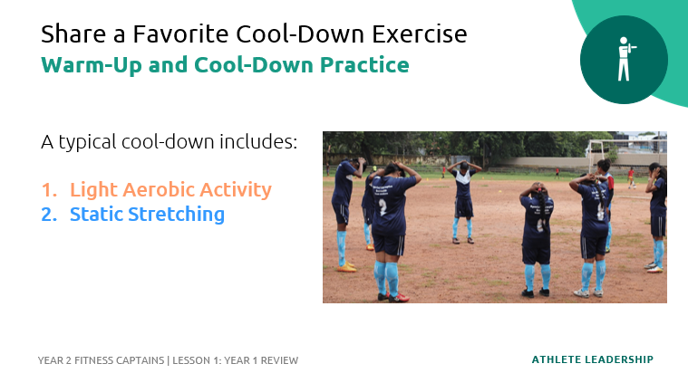
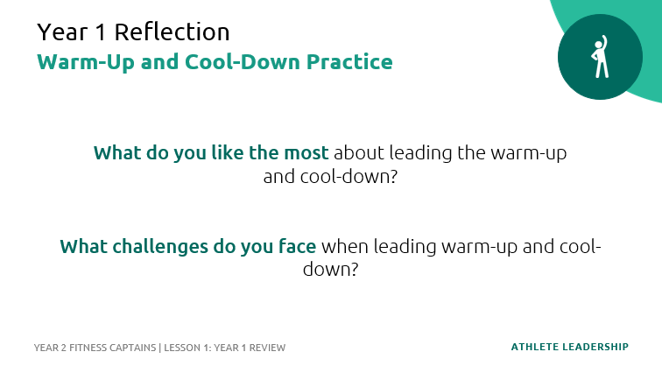
Prep | Description | Slide
Topic Part 1: Year 1 Review, Warm-Up and Cool-Down Practice Share a Favorite Cool-Down Exercise Time: 2 minutes Lead: | Similar to warm-ups, a cool-down routine includes: Aerobic Activity Static Stretches Cool-downs should be done at a slow, relaxing pace, and stretches should be “static” or stationary. Remember, your cool-down should be specific to your sport! Ask each Fitness Captain to share a favorite stretch that they like to include in their cool-down routines.
Topic Part 1: Year 1 Review, Warm-Up and Cool-Down Practice Year 1 Reflection Time: 10 minutes Lead: | QUESTION: What do you like most about leading your team’s warm-up and cool-down? QUESTION: What challenges do you face when leading the warm-up or cool-down? Ask the participants if anyone has a question or scenario that they would like to discuss with the group. Scenarios to discuss: Your coach interrupts your warm-up to start practice Your teammates leave practice before you can share your Health Tip A teammate is doing the exercise wrong Teammates aren’t participating in warm-ups or cool-downs A teammate needs a modification

Slide 9
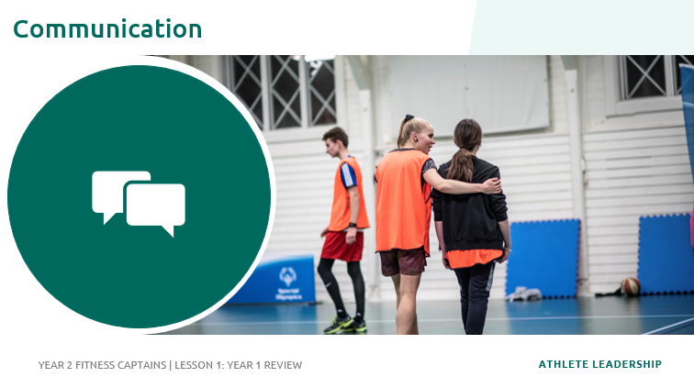
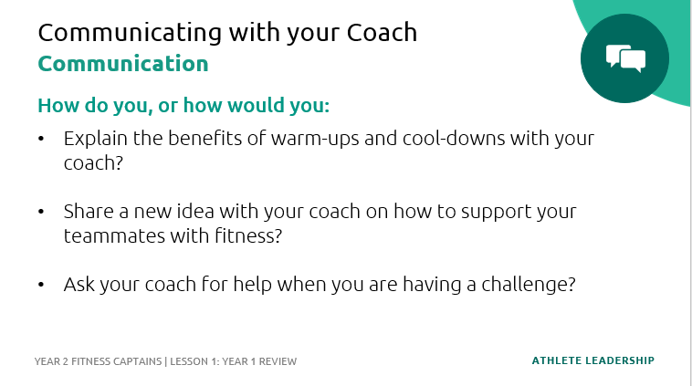
Prep | Description | Slide
Topic Part 1: Year 1 Review Communication Time: 2 minutes Lead: | As discussed in our scenarios, it’s important for you to talk to your coach about being a Fitness Captain. This should happen at the start of every season, and throughout the season before and after practices or at a time that you discussed. Let your coach know the benefits of doing the warm-ups and cool-downs when talking with them before your first practice Share the importance of being a healthy and fit athlete Tell your coach why being a Fitness Captain is important to you! You have all the knowledge and skills to be a great Fitness Captain – show your coach this!
Topic Part 1: Year 1 Review, Communication Communicating with your Coach Time: 5 minutes Lead: | Have the participants share a tip that works for them when communicating with their coach. Use the questions on-screen to guide the conversation. Remember that your coach and Special Olympics Program staff are here to help you! Ask them questions and tell them how they can support you!

Slide 10
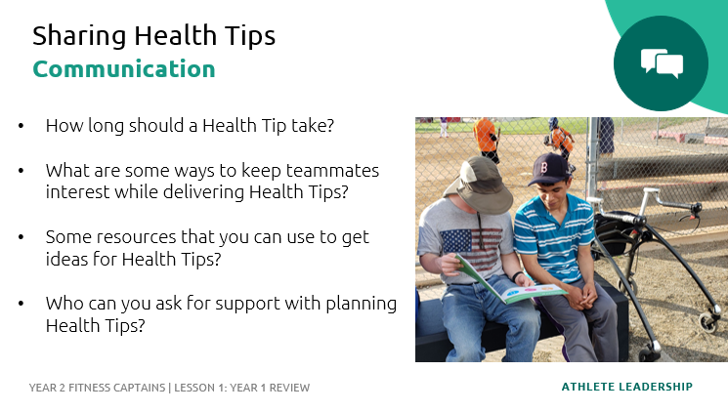
Prep | Description | Slide
Topic Part 1: Year 1 Review, Communication Sharing Health Tips Time: 4 minutes Lead: | These questions are a review of content in the first training so feel free to modify based on the skill and experience of your Fitness Captains! QUESTION: How long should a Health Tip take? They should be brief, only 2-5 minutes QUESTION: What are some ways to keep teammates interest when you share Health Tips? You can engage your teammates by: Asking them questions Allowing different members of your team to answer Providing examples Giving them a goal and check-in with their progress at the next training session QUESTION: What are some resources that you can use to get ideas for Health Tips? You can get ideas from the Health Tip Library or your Year 1 Fitness Captains Training workbook. As Fitness Captains, you can also work together and share ideas with each other! QUESTION: Who can you ask for support with planning Health Tips? You can ask your coach, a family member, or a fellow Fitness Captain!

Slide 11
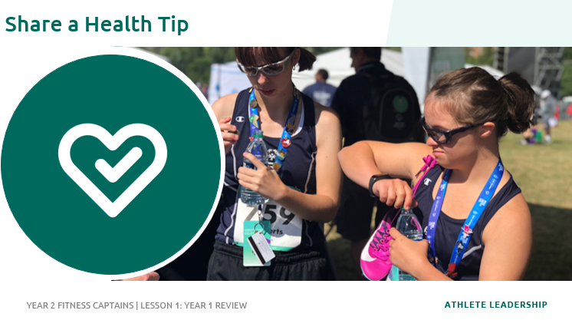
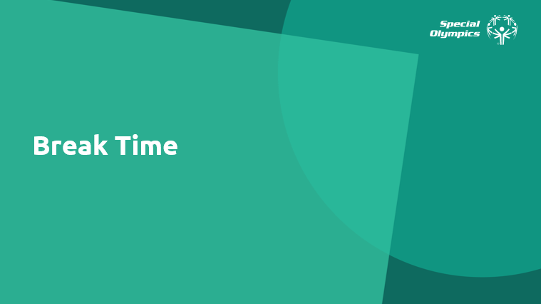
Prep | Description | Slide
Topic Part 1: Year 1 Review Share a Health Tip Time: 5 minutes Lead: | To end the Part 1 of our Year 2 Fitness Captains training, please turn to the person next to you and share a Health Tip. Time permitting you could do this as a large group.
Topic Part 1: Year 1 Review Break Time Time: 5 minutes Lead: | We’ve now completed Part 1 of the Year 2 Fitness Captains Training! We are going to take a short break before beginning Part 2. Share any instructions or details needed for the break.
 | Part 1 Complete

Slide 12
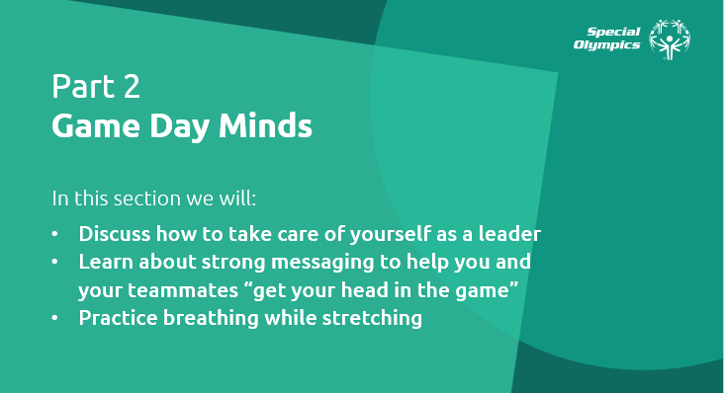
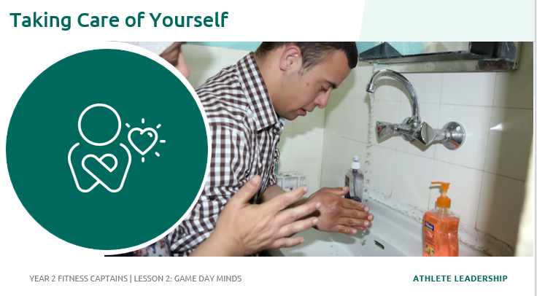
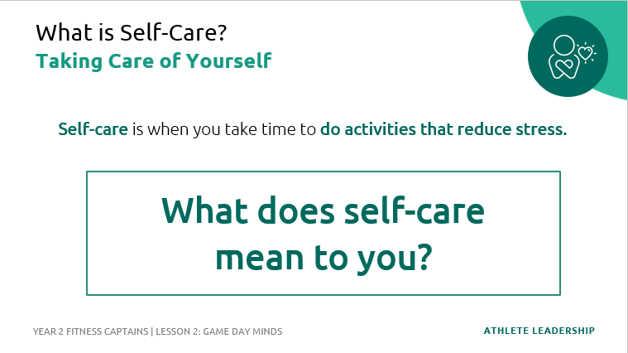
Prep | Description | Slide
Topic Part 2: Game Day Minds Time: 1 minute Lead: | Welcome back to the Year 2 Fitness Captains training! We will now complete Part 2: Game Day Minds. In this section we will: Discuss how to take care of yourself as a leader Learn about strong messaging to help you and your teammates “get your head in the game” Practice breathing while stretching
Topic Part 2: Game Day Minds, Taking Care of Yourself Time: 1 minute Lead: | As a leader, it’s important that you take care of yourself! Taking care of yourself helps you to be the best version of you – making you better prepared to support others! By taking care of yourself, you lead by example. You show your teammates that you value and practice the healthy behaviors that you share with them in your Health Tips!
Topic Part 2: Game Day Minds, Taking Care of Yourself What is Self Care? Time: 3 minutes Lead: | Self-care, or taking care of yourself, is important for your overall health. Self-care is when you take time to do activities that reduce stress. QUESTION: What does self-care mean to you? What is the first thing that comes to mind when you think of the words “self-care.” If participants are quiet, you can prompt them with these questions: Having fun and relaxing? Taking care of basic needs? Practicing healthy habits? Ask a few participants to share their answers.

Slide 13
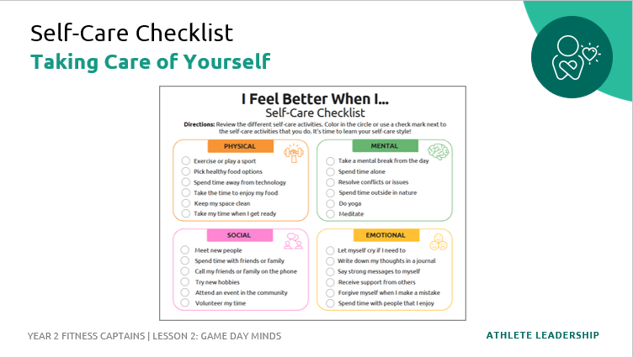
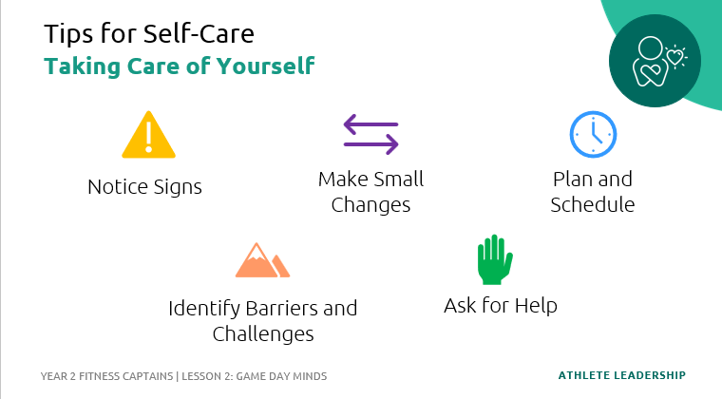
Prep | Description | Slide
Topic Part 2: Game Day Minds, Taking Care of Yourself Self-Care Checklist Time: 6 minutes Lead: | There are many ways to practice self-care! We are now going to complete the Self-Care Checklist. Directions: Review the different self-care activities on the checklist. Color in the circle or use a check mark next to the self-care activities that you do. It’s time to learn your self-care style! Allow the Fitness Captains to take a few minutes to complete the checklist. Time permitting, you can facilitate a discussion about their responses. QUESTION: What category did you have the most check marks in? Were there any activities you don’t do but you would like to try?
Topic Part 2: Game Day Minds, Taking Care of Yourself Tip for Self-Care Time: 8 minutes Lead: | Discuss the following questions. Use the Athlete Workbook and have athletes complete on their own. Leave a few minutes for reflection and debriefing. QUESTION: What are some signs you need to take care of yourself? For example, if you don’t drink enough water, do you get a headache? If you don’t get enough sleep, do you get angry easily? What is one thing from the Self-Care Checklist that you would like to try? How and when you will add this to your routine? What may get in the way of you practicing self-care? Who can help you?

Slide 14
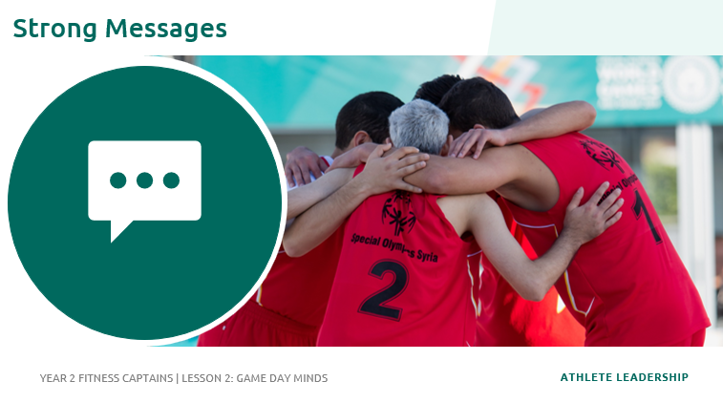
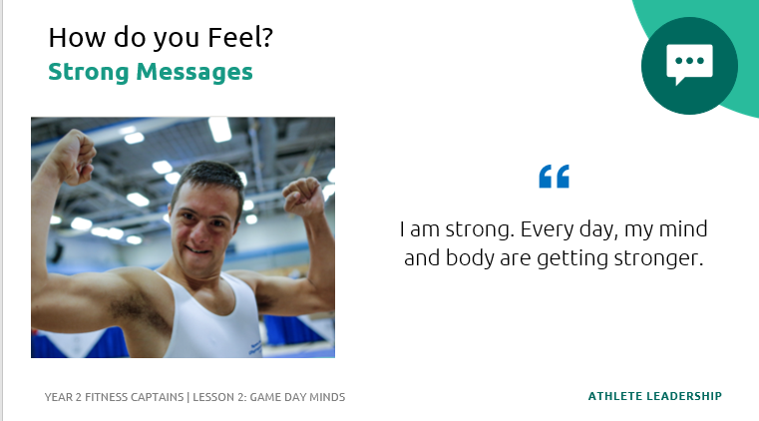
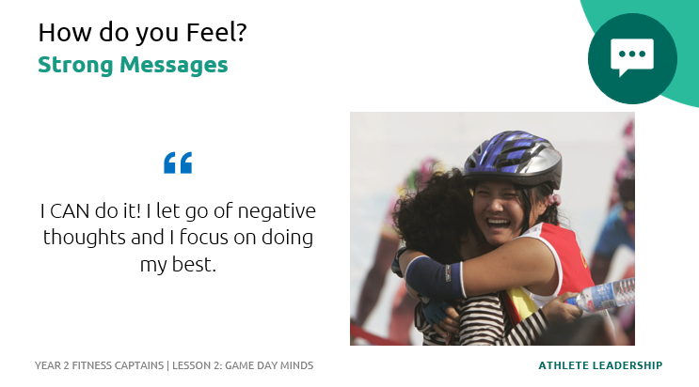
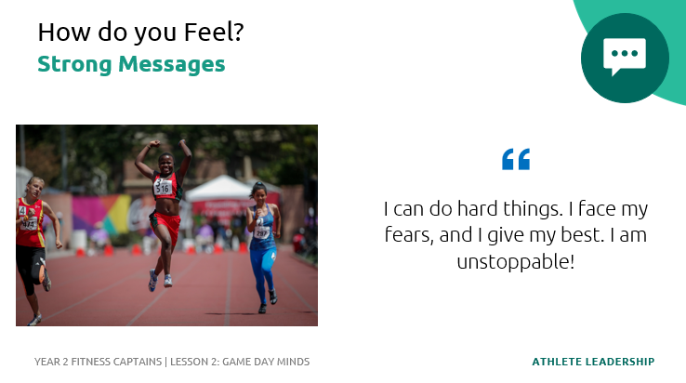
Prep | Description | Slide
Topic Part 2: Game Day Minds, Strong Messages Time: 1 minute Lead: | Now let’s talk about Strong Messages! On the next few slides, you will see examples of strong messages.
Topic Part 2: Game Day Minds, Strong Messages How do you feel? Time: 3 minutes Lead: | Read each strong message out loud – this can be done individually as a facilitator or participant OR read them out loud together as a group. After read each strong messages, ask the Fitness Captains how saying those messages make them feel. QUESTION: How does this strong message make you feel?

Slide 15
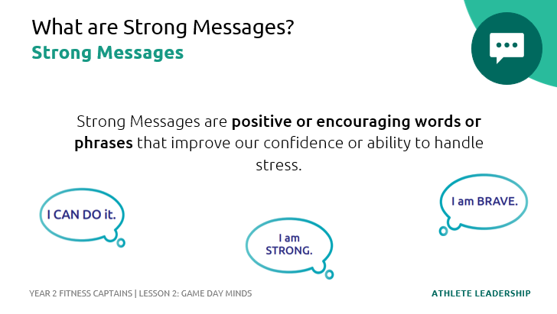
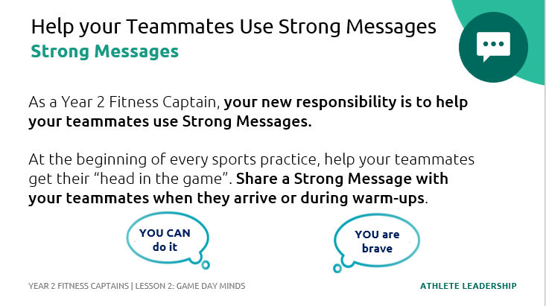
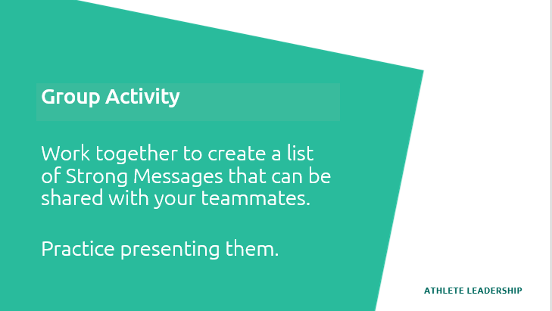
Prep | Description | Slide
Topic Part 2: Game Day Minds, Strong Messages What are Strong Messages? Time: 2 minutes Lead: | Strong Messages are positive or encouraging words or phrases that improve our confidence or ability to handle stress. These messages can help motivate you to work hard and try your best. QUESTION: Can anyone think of a time when they have used a Strong Message? Remind athletes that they can use Strong Messages anytime during training sessions and competitions, as well as in their daily activities. These messages can be helpful in stressful situations such as taking a foul shot in basketball, competing in a big event, etc.
Topic Part 2: Game Day Minds, Strong Messages Help your Teammates Use Strong Messages Time: 1 minute Lead: | As a Year 2 Fitness Captain, your new responsibility is to help your teammates use Strong Messages. At the beginning of every sports practice, help your teammates get their “head in the game”. Share a Strong Message with your teammates when they arrive or during warm-ups. Notice how these two Strong Messages use “YOU” rather than “I”. When you share Strong Messages with your teammates, it usually makes them feel good AND you feel good!
Topic Part 2: Game Day Minds, Strong Messages Group Activity Time: 7 minutes Lead: | Now that you know what Strong Messages are, let’s work together to create a list of Strong Messages that can be shared with your teammates. As time permits, allow the Fitness Captains to practice sharing them with each other. Encourage the Fitness Captains to make eye contact and smile when they say their message. They can also include gestures like a high five or fist bump.

Slide 16
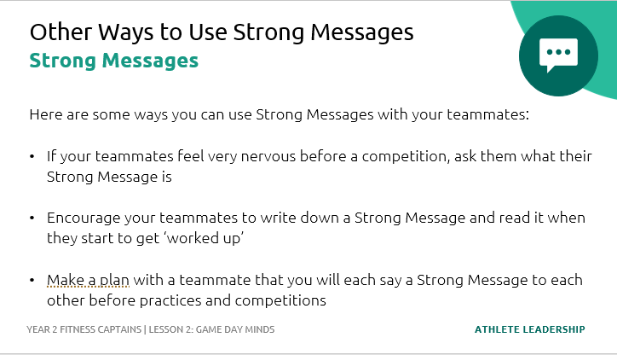
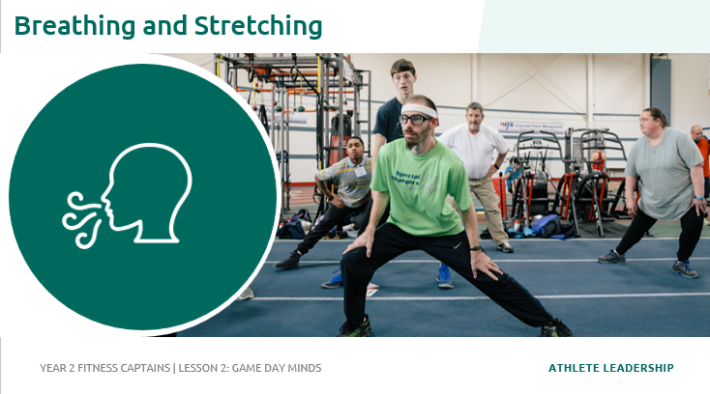
Prep | Description | Slide
Topic Part 2: Game Day Minds, Strong Messages Other Ways to Use Strong Messages Time: 4 minutes Lead: | As a Year 2 Fitness Captain, you will share a Strong Message with your teammates at the beginning of every sports practice but there are other times that your teammates may need your support! Hare some ways you can use Strong Messages with your teammates: If your teammates feel very nervous before a competition, ask them what their Strong Message is Encourage your teammates to write down a Strong Message and read it when they start to get ‘worked up’ Make a plan with a teammate that you will each say a Strong Message to each other before practices and competitions QUESTION: What other ideas do you have to remind you to use Strong Messages when your teammates need them most?
Topic Part 2: Game Day Minds, Breathing and Stretching Time: 1 minute Lead: | We are now going to complete our last section of the Year 2 Fitness Captains Training: Breathing and Stretching!

Slide 17
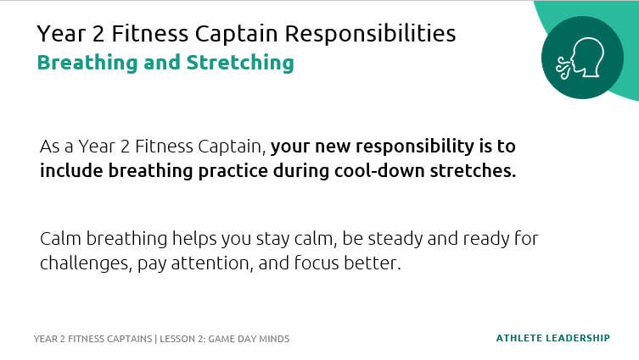
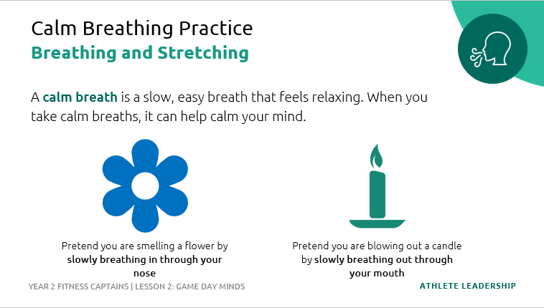
Prep | Description | Slide
Topic Part 2: Game Day Minds, Breathing and Stretching Year 2 Fitness Captain Responsibilities Time: 2 minutes Lead: | As a Year 2 Fitness Captain, your new responsibility is to include breathing practice during cool-down stretches. Calm breathing helps you stay calmer when things go wrong, be steady and ready for challenges, pay attention and focus better.
Topic Part 2: Game Day Minds, Breathing and Stretching Calm Breathing Practice Time: 5 minutes Lead: | A calm breath is a slow, easy breath that feels relaxing. When you take calm breaths, it can help calm your mind. QUESTION: How many of you have practiced breathing before? Perhaps maybe you did this at a Strong Minds screening or when you were doing an activity like meditation. Ask Fitness Captains to raise their hand if they have practiced breathing. Now, we are going to practice breathing together. You can close your eyes or keep them open. Let your breaths be slow, easy, and relaxed. We are going to try Flower and Candle breathing: Breathe in: Pretend you are smelling a flower by slowly breathing in through your nose. Fill your lungs. Breathe out: Pretend you are blowing out a candle by slowly breathing out through your mouth. Keep your shoulders and chest relaxed. Continue for around 8 cycles of breath. QUESTION: After practicing your breathing, how do you feel? Do you feel: Relaxed? Calm? Positive? Happy? Looser in your muscles? Taller in your spine? Sleepy?

Slide 18
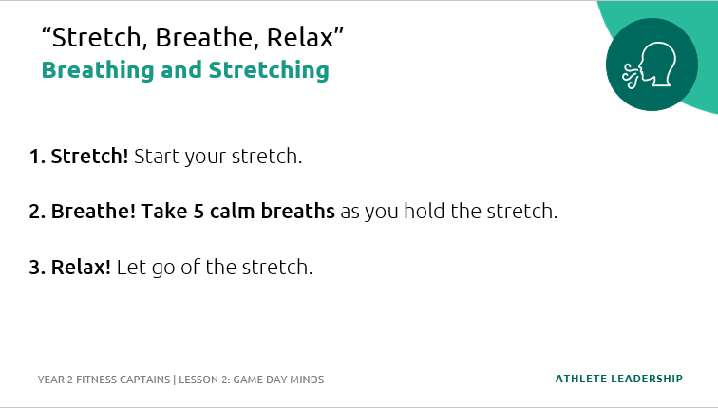
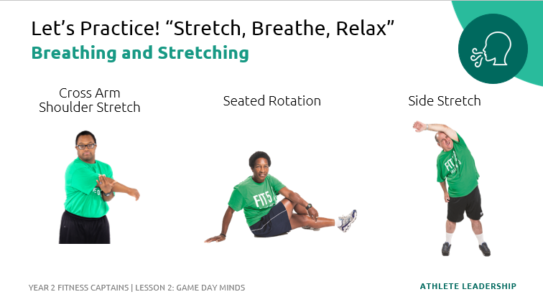
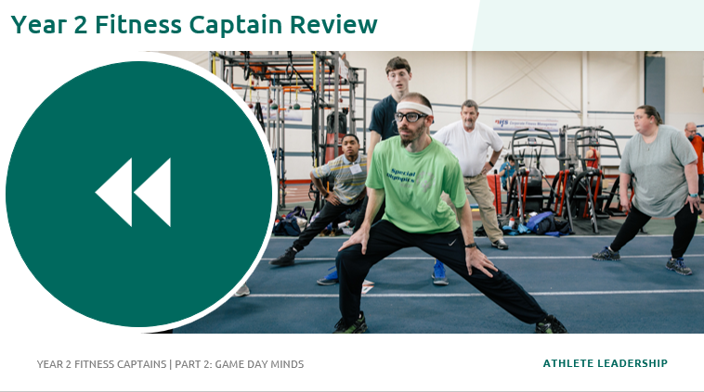
Prep | Description | Slide
Topic Part 2: Game Day Minds, Breathing and Stretching “Stretch, Breathe, Relax” Let’s Practice! “Stretch, Breathe, Relax” Time: 6 minutes Lead: | Now are going to combine breathing and stretching with an exercise called “Stretch, Breathe, Relax”. Guide them through the exercise by following the on-screen prompts. 1. Stretch! Start your stretch. 2. Breathe! Take 5 calm breaths as you hold the stretch. Notice your muscles relaxing as you inhale and exhale. 5 deep breaths should take around 30 seconds. 3. Relax! Let go of the stretch. Repeat the exercise a few times, doing the different stretches on the side and/or changing sides of the body. The Fitness Captains could also share their favorite cool-down stretches for this activity. 5 deep breaths should take around 30 seconds. Holding stretches longer, up to a minute, or 10 breaths will allow the muscles to relax even more!
Topic Part 2: Game Day Minds, Year 2 Fitness Captain Review Time: 1 minute Lead: | To finish our training, let’s review your roles & responsibilities as a Year 2 Fitness Captain!

Slide 19
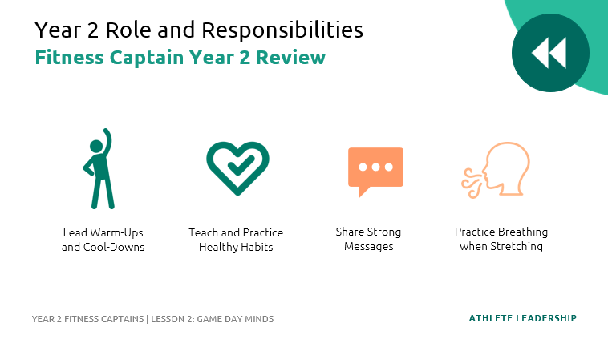
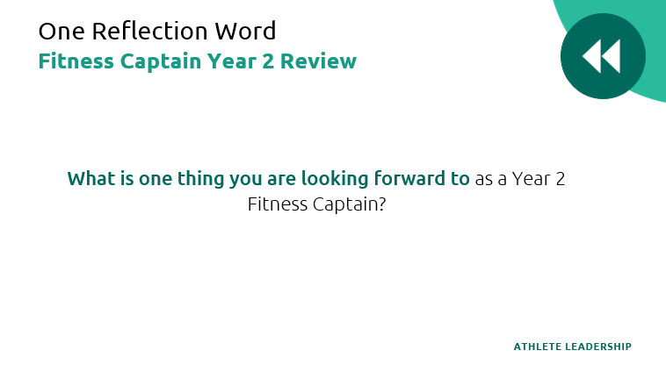
Prep | Description | Slide
Topic Part 2: Game Day Minds, Year 2 Fitness Captain Review Year 2 Roles and Responsibilities Time: 2 minutes Lead: | To review, you have four key responsibilities as a Year 2 Fitness Captain. Your first two responsibilities were included in your role as a Year 1 Fitness Captain. You will continue to do these activities! Lead your teammates in a warm-up and cool-down at every training session Share Health Tips with your teammates. Remember, it is important that you lead by example and practice the healthy behaviors that you are encouraging your teammates to do! Your two new responsibilities are: Share a Strong Message with your teammates when they arrive or during warm-ups. Smile and make eye contact. If you want, you can also give your teammates a fist bump or high five when you say your message. Remember: you can also share Strong Messages in other moments when your teammates might need support or encouragement. During your cool-down stretches, help your teammates with their breathing. You can use the “Stretch, Breathe, Relax” technique. Optional: add in an action plan and any next steps you would like the Year 2 Fitness Captains to take.
Topic: One Reflection Word Time: 1 minute Lead: | Invite the Fitness Captains to stand in a circle. QUESTION: What is one thing you are looking forward to as a Year 2 Fitness Captain?

Slide 20
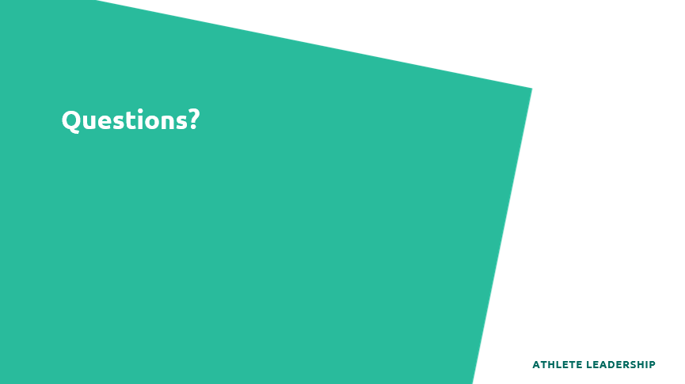
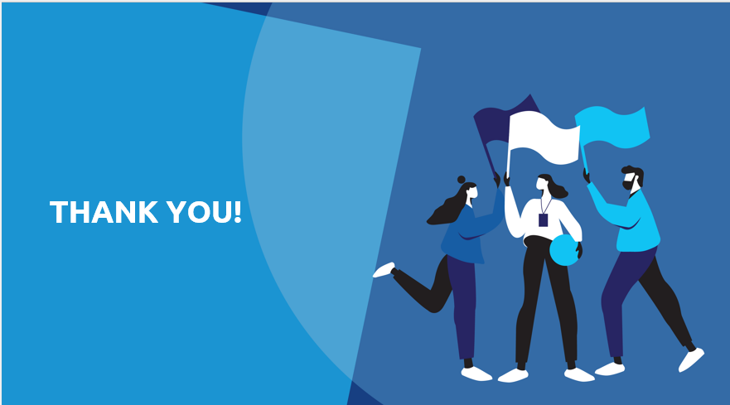
Prep | Description | Slide
Topic: Questions and Close Time: 5 minutes Lead: | QUESTION: Does anyone have any questions about anything we learned today? Congratulations! Thanks for participating, you have now concluded the Year 2 Fitness Captain training course. Remember, to be a great athlete, you must be a healthy athlete. Your coach and Program staff are here to help you!
 | Module Complete

Slide 21

Special Olympics Health activities are supported by many sources, including in the United States by Grant Number NU27DD000021 from the Centers for Disease Control and Prevention of the U.S. Department of Health and Human Services, with $18.1 M (64%) financed with U.S. Federal funds and $10.2 M (36%) supported by non-federal sources.
These contents are solely the responsibility of the authors and do not necessarily represent the official views of the Centers for Disease Control and Prevention or the Department of Health and Human Services.

