Slide 1
YEAR 2 FITNESS CAPTAIN
Notes:
Welcome to the Year 2 Fitness Captain training!

Slide 2
Introduction
Tell us about yourself!
  Name
  Favorite sport(s) to play
  What do you like about being a Fitness Captain
Notes:
[8 minutes/8-minutes total time]

Slide 3
Year 2 Fitness Captain Training
The purpose of this training is to:
Provide Fitness Captains with a refresher on warm-ups, cool-downs and healthy habits
Introduce Game Day Minds to your roles and responsibilities
Notes:
[1 minute/9-minutes total time]

Slide 4
Module Overview
Part 1: Year 1 Review | Fitness Captain Responsibilities Warm-Up and Cool-Down Practice Communication
Part 2: Game Day Minds | Self-Care for Leaders Strong Messaging Breathing and Stretching
YEAR 2 FITNESS CAPTAINS
Notes:
[1 minute/10-minute total time]
The Year 2 Fitness Captain training course is divided in two parts:
Year 1 Review
Game Day Minds
This course will take about 2 hours to complete. We will have a break in between Part 1 and Part 2.
Let’s begin!

Slide 5
Part 1
Year 1 Review
In this section we will:
Review how to do proper warm-ups and cool-downs
Discuss different ways to share Health Tips
Review communication tips
Share successes and challenges as a Fitness Captain
Notes:
[1 minute/11-minutes total time]

Slide 6
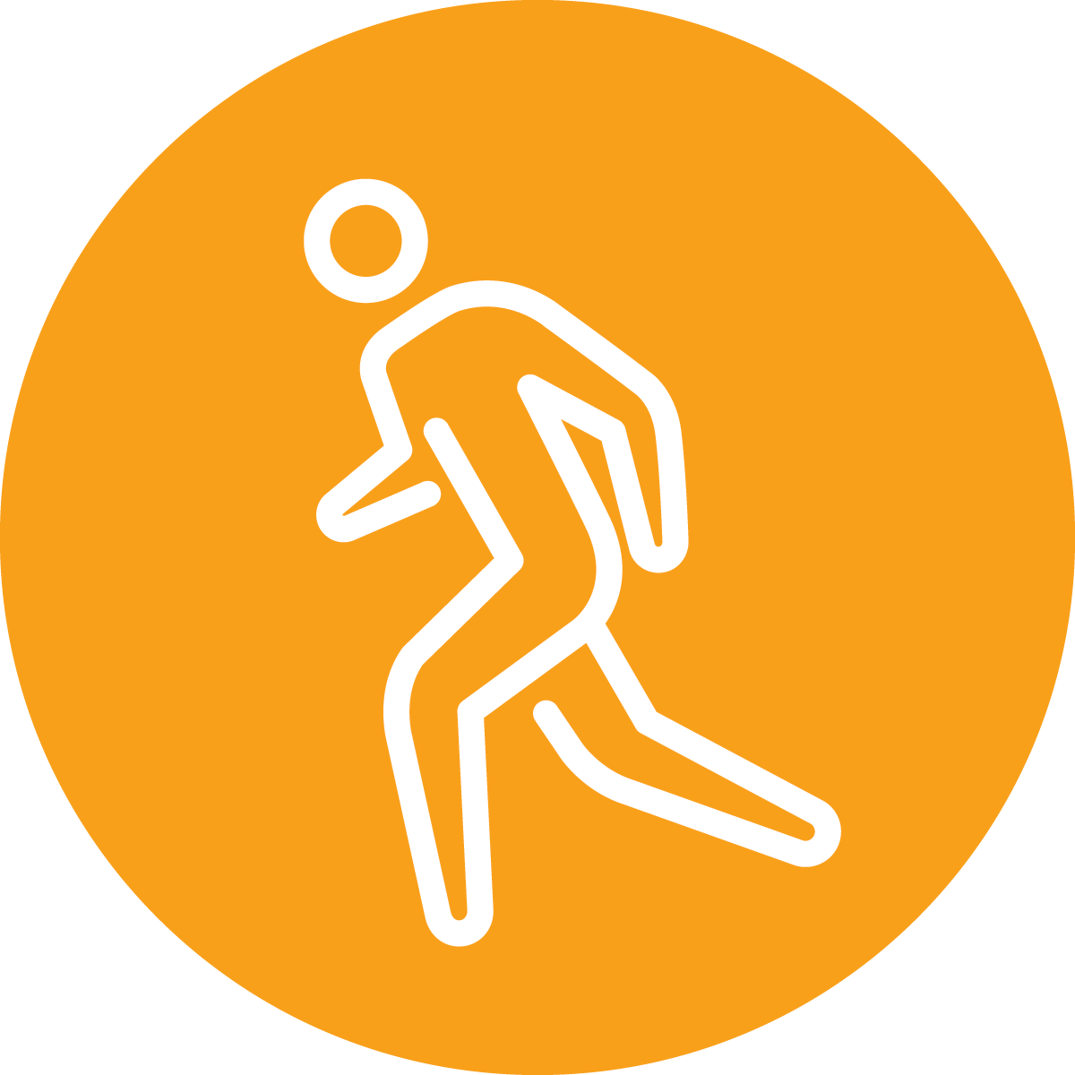


What is Fitness?
Year 1 Review
Your best health and
performance through proper
physical activity, nutrition, and hydration
YEAR 2 FITNESS CAPTAINS | PART 1: YEAR 1 REVIEW
Notes:
[4 minutes/15-minutes total time]
Fitness is Your best health and performance through proper physical activity, nutrition, and hydration.
QUESTION:
Think of a person you consider fit. What kind of things do they do, or you think they do to stay fit? Write your answer down in your workbook.
Ask a few participants to share their answers.
Great answers! Being fit is all about making daily healthy choices in the three areas from the definition—physical activity, nutrition, and hydration. A person who is fit has good health and well-being
And the healthy choices you make in those three areas each day can help you to be healthier and perform better in your sport, your job, your hobbies, and other aspects of your life.
When you are fit, you feel good and have lots of energy because your body is strong and healthy

Slide 7


Fitness Captain Responsibilities
Year 1 Review
Over the past year, have you had the opportunity to:
Lead Warm-Ups and Cool-Downs
Teach and Practice Healthy Habits
YEAR 2 FITNESS CAPTAINS | PART 1: YEAR 1 REVIEW
Notes:
[2 minutes/17-minutes total time]
As a Fitness Captain, you have been working closely with your coaches to make sure health and fitness is a key component of the sports experience by:
Leading your team in proper warm-up and cool-down routines
Sharing health education tips with your teammates
Supporting your team to practice healthy behaviors and encourage them to participate in other health/fitness programming.
You should always take care of your teammates in a positive manner and help your teammates succeed with praise and motivation.

Slide 8
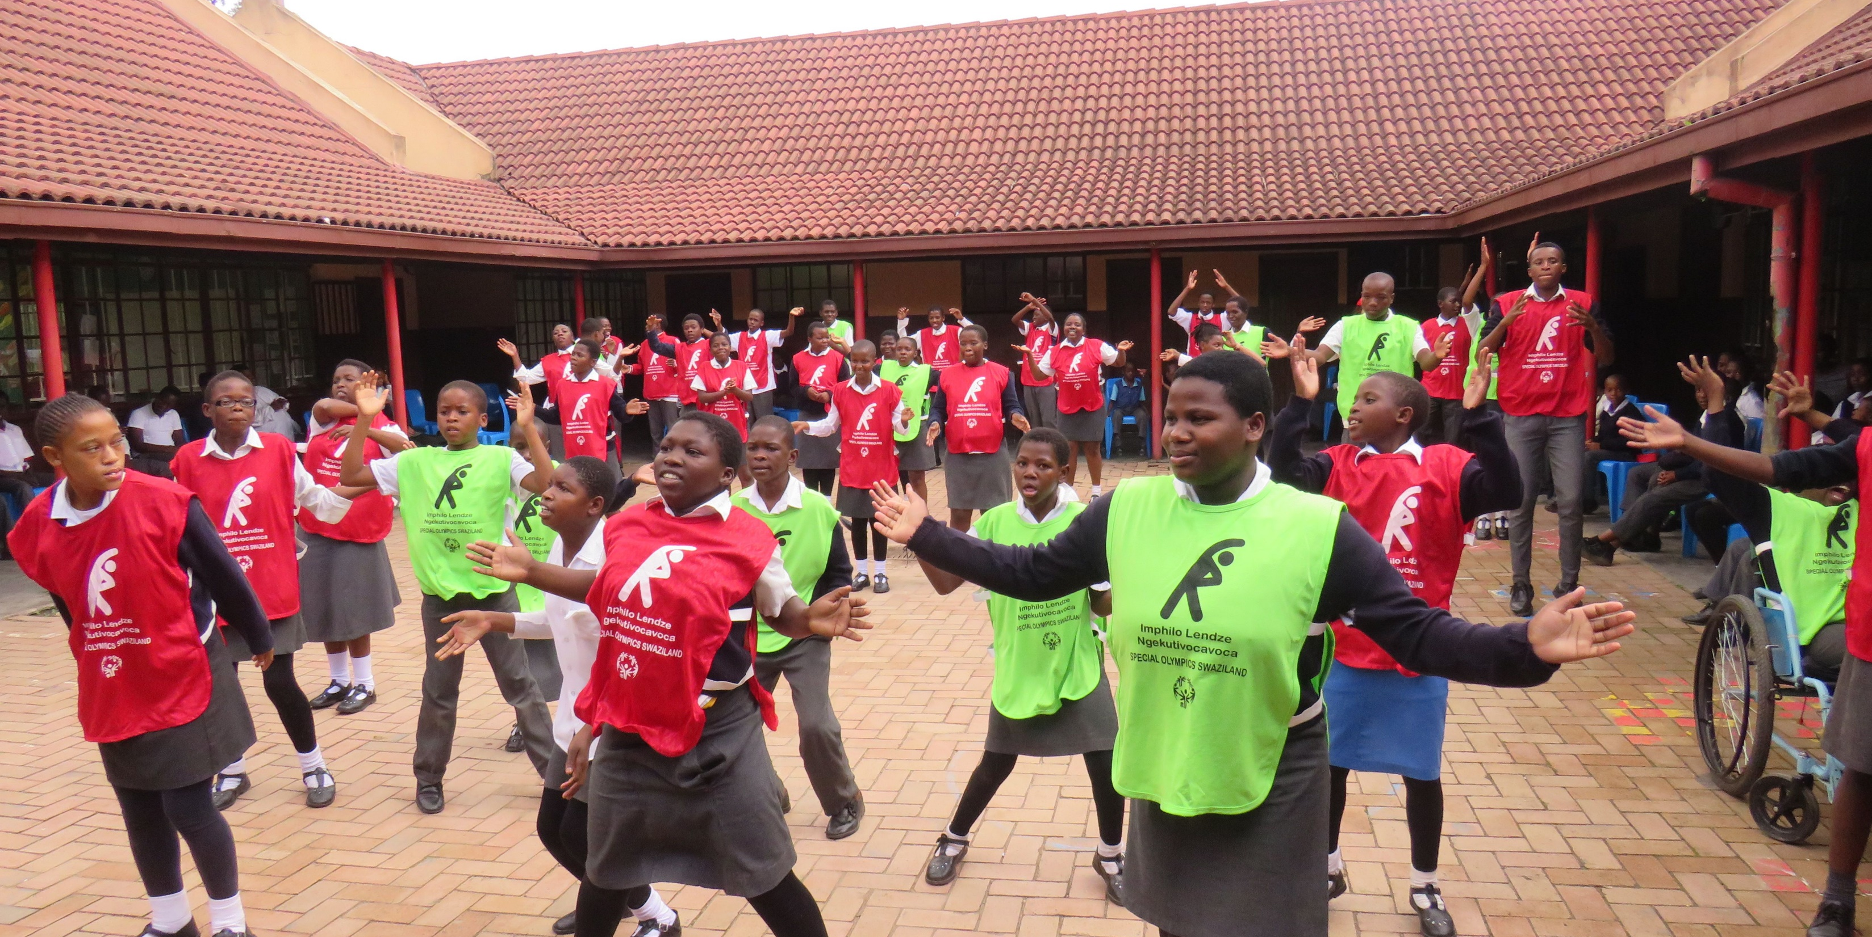

Warm-Up and Cool-Down Practice
Event Planning
Leadership Events
YEAR 2 FITNESS CAPTAINS | PART 1: YEAR 1 REVIEW
Notes:
Let’s review warm-ups and cool-downs!

Slide 9
Purpose of a Warm-Up
Warm-Up and Cool-Down Practice
Why do athletes need to warm-up?
YEAR 2 FITNESS CAPTAINS | PART 1: YEAR 1 REVIEW
Notes:
[3 minutes/20-minutes total time]
A warm-up should be the first physical activity in every training session or competition. It helps you get your body and mind ready for your sport.
QUESTION:
Why do athletes need to warm-up?
Ask the participants to write down their answers or raise their hand up to respond.

Slide 10
Purpose of a Warm-Up
Warm-Up and Cool-Down Practice
Physical and Mental Benefits
Increase heart rate Increase breathing rate Increase body and muscle temperature Greater blood flow to the active muscles Shift focus from life to sport Connects the mind and the body Reviewing skills that are going to be part of the upcoming practice Having fun with teammates
YEAR 2 FITNESS CAPTAINS | PART 1: YEAR 1 REVIEW
Notes:
[2 minutes/22-minutes total time]
Review the list and compare to what the athletes said:
Warm-ups have many physical and mental benefits. Read some of the benefits listed on the slide and compare to what the athletes said.
When you prepare both the body and the mind, you are less likely to suffer an injury and will perform better at each practice, training and competition.

Slide 11
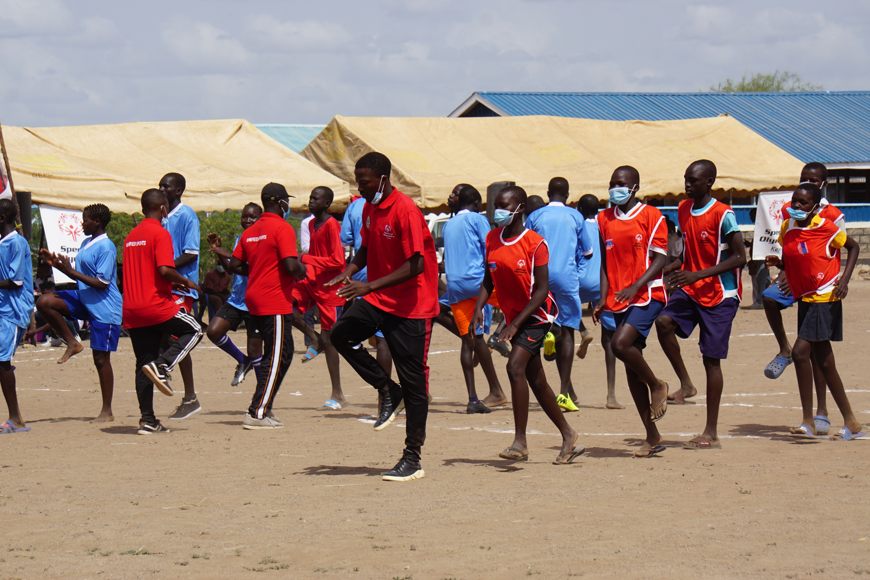
Share a Favorite Warm-Up Exercise
Warm-Up and Cool-Down Practice
These two elements should be included in all warm-ups:
Aerobic Activity
Dynamic Stretches
YEAR 2 FITNESS CAPTAINS | PART 1: YEAR 1 REVIEW
Notes:
[5 minutes/27-minutes total time]
Every sport is different, and each sport has specific skills and movements. Your warm-up routine should be personalized to the sport you are participating in that that moment.
All warm-ups, no matter the sport, should have these elements:
Aerobic Activity
Dynamic Stretches
Warm-ups should begin at a slow pace and gradually become a little faster and more difficult. Remember, you may need to give your teammates modifications, or options, for the exercises!
Ask each Fitness Captain to share a favorite warm-up exercise: they can choose EITHER an aerobic activity or a dynamic stretch.

Slide 12

Purpose of a Cool-Down
Warm-Up and Cool-Down Practice
Why do athletes need to cool down?
YEAR 2 FITNESS CAPTAINS | PART 1: YEAR 1 REVIEW
Notes:
[2 minutes/29-minutes total time]
When your training, practice or sport session is complete, you should always cool-down. It is just as important to have a good cool-down as it is to have a good warm-up.
QUESTION:
Why do athletes need to cool-down?
Ask the participants to write down their answers or raise their hand up to respond.

Slide 13
Purpose of a Cool-Down
Warm-Up and Cool-Down Practice
Physical and Mental Benefits
Decrease heart rate and breathing rate Decrease body temperature Decrease muscle soreness Improve flexibility Increases the rate of recovery from exercise Promote relaxation
YEAR 2 FITNESS CAPTAINS | PART 1: YEAR 1 REVIEW
Notes:
[2 minutes/31-minutes total time]
Like warm-ups, cool-downs have many physical and mental benefits. Read some of the benefits listed on the slide and compare to what the athletes said.
QUESTION:
What do you notice about this list? How does it differ from warm-ups?
You might have noticed that cool-downs have some opposite benefits as warm-ups. For example, a warm-up increases heart rate, but a cool-down decreases heart rate.
The cool-down is a time to relax and rest.

Slide 14
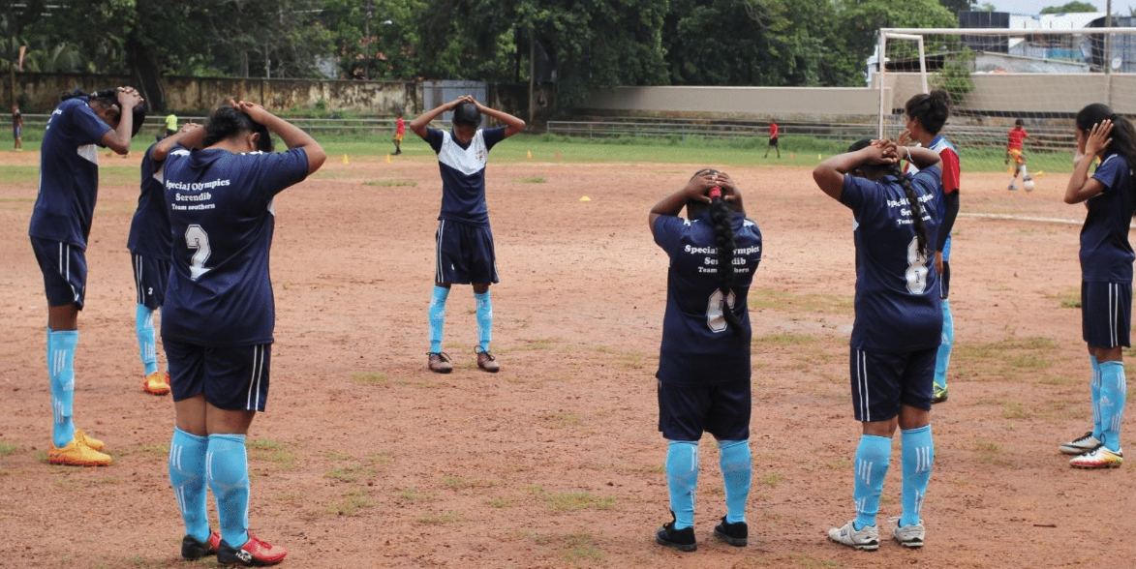
Share a Favorite Cool-Down Exercise
Warm-Up and Cool-Down Practice
A typical cool-down includes:
Light Aerobic Activity
Static Stretching
YEAR 2 FITNESS CAPTAINS | PART 1: YEAR 1 REVIEW
Notes:
[2 minutes/33-minutes total time]
Similar to warm-ups, a cool-down routine includes:
Aerobic Activity
Static Stretches
Cool-downs should be done at a slow, relaxing pace, and stretches should be “static” or stationary.
Remember, your cool-down should be specific to your sport!
Ask each Fitness Captain to share a favorite stretch that they like to include in their cool-down routines.

Slide 15

Year 1 Reflection
Warm-Up and Cool-Down Practice
What do you like the most about leading your team’s warm-up
and cool-down?
What challenges do you face when leading the warm-up or cool-down?
YEAR 2 FITNESS CAPTAINS | PART 1: YEAR 1 REVIEW
Notes:
[10 minutes/43-minutes total time]
QUESTION:
What do you like most about leading your team’s warm-up and cool-down?
QUESTION:
What challenges do you face when leading the warm-up or cool-down?
Ask the participants if anyone has a question or scenario that they would like to discuss with the group.
Scenarios to discuss:
Your coach interrupts your warm-up to start practice
Your teammates leave practice before you can share your Health Tip
A teammate is doing the exercise wrong
Teammates aren’t participating in warm-ups or cool-downs
A teammate needs a modification

Slide 16
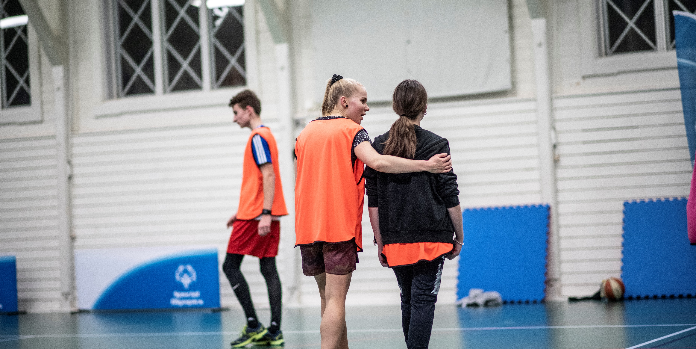

Communication
Event Planning
Leadership Events
YEAR 2 FITNESS CAPTAINS | PART 1: YEAR 1 REVIEW
Notes:
[2 minute/45-minutes total time]
As discussed in our scenarios, it’s important for you to talk to your coach about being a Fitness Captain. This should happen at the start of every season, and throughout the season before and after practices or at a time that you discussed.
Let your coach know the benefits of doing the warm-ups and cool-downs when talking with them before your first practice
Share the importance of being a healthy and fit athlete
Tell your coach why being a Fitness Captain is important to you!
You have all the knowledge and skills to be a great Fitness Captain – show your coach this!

Slide 17
Communicating with your Coach
Communication
How do you, or how would you:
Explain the benefits of warm-ups and cool-downs with your coach?
Share a new idea with your coach on how to support your teammates with fitness?
Ask your coach for help when you are having a challenge?
YEAR 2 FITNESS CAPTAINS | PART 1: YEAR 1 REVIEW
Notes:
[5 minutes/50-minutes total time]
Have the participants share a tip that works for them when communicating with their coach. Use the questions on-screen to guide the conversation.
Remember that your coach and Special Olympics Program staff are here to help you! Ask them questions and tell them how they can support you!

Slide 18
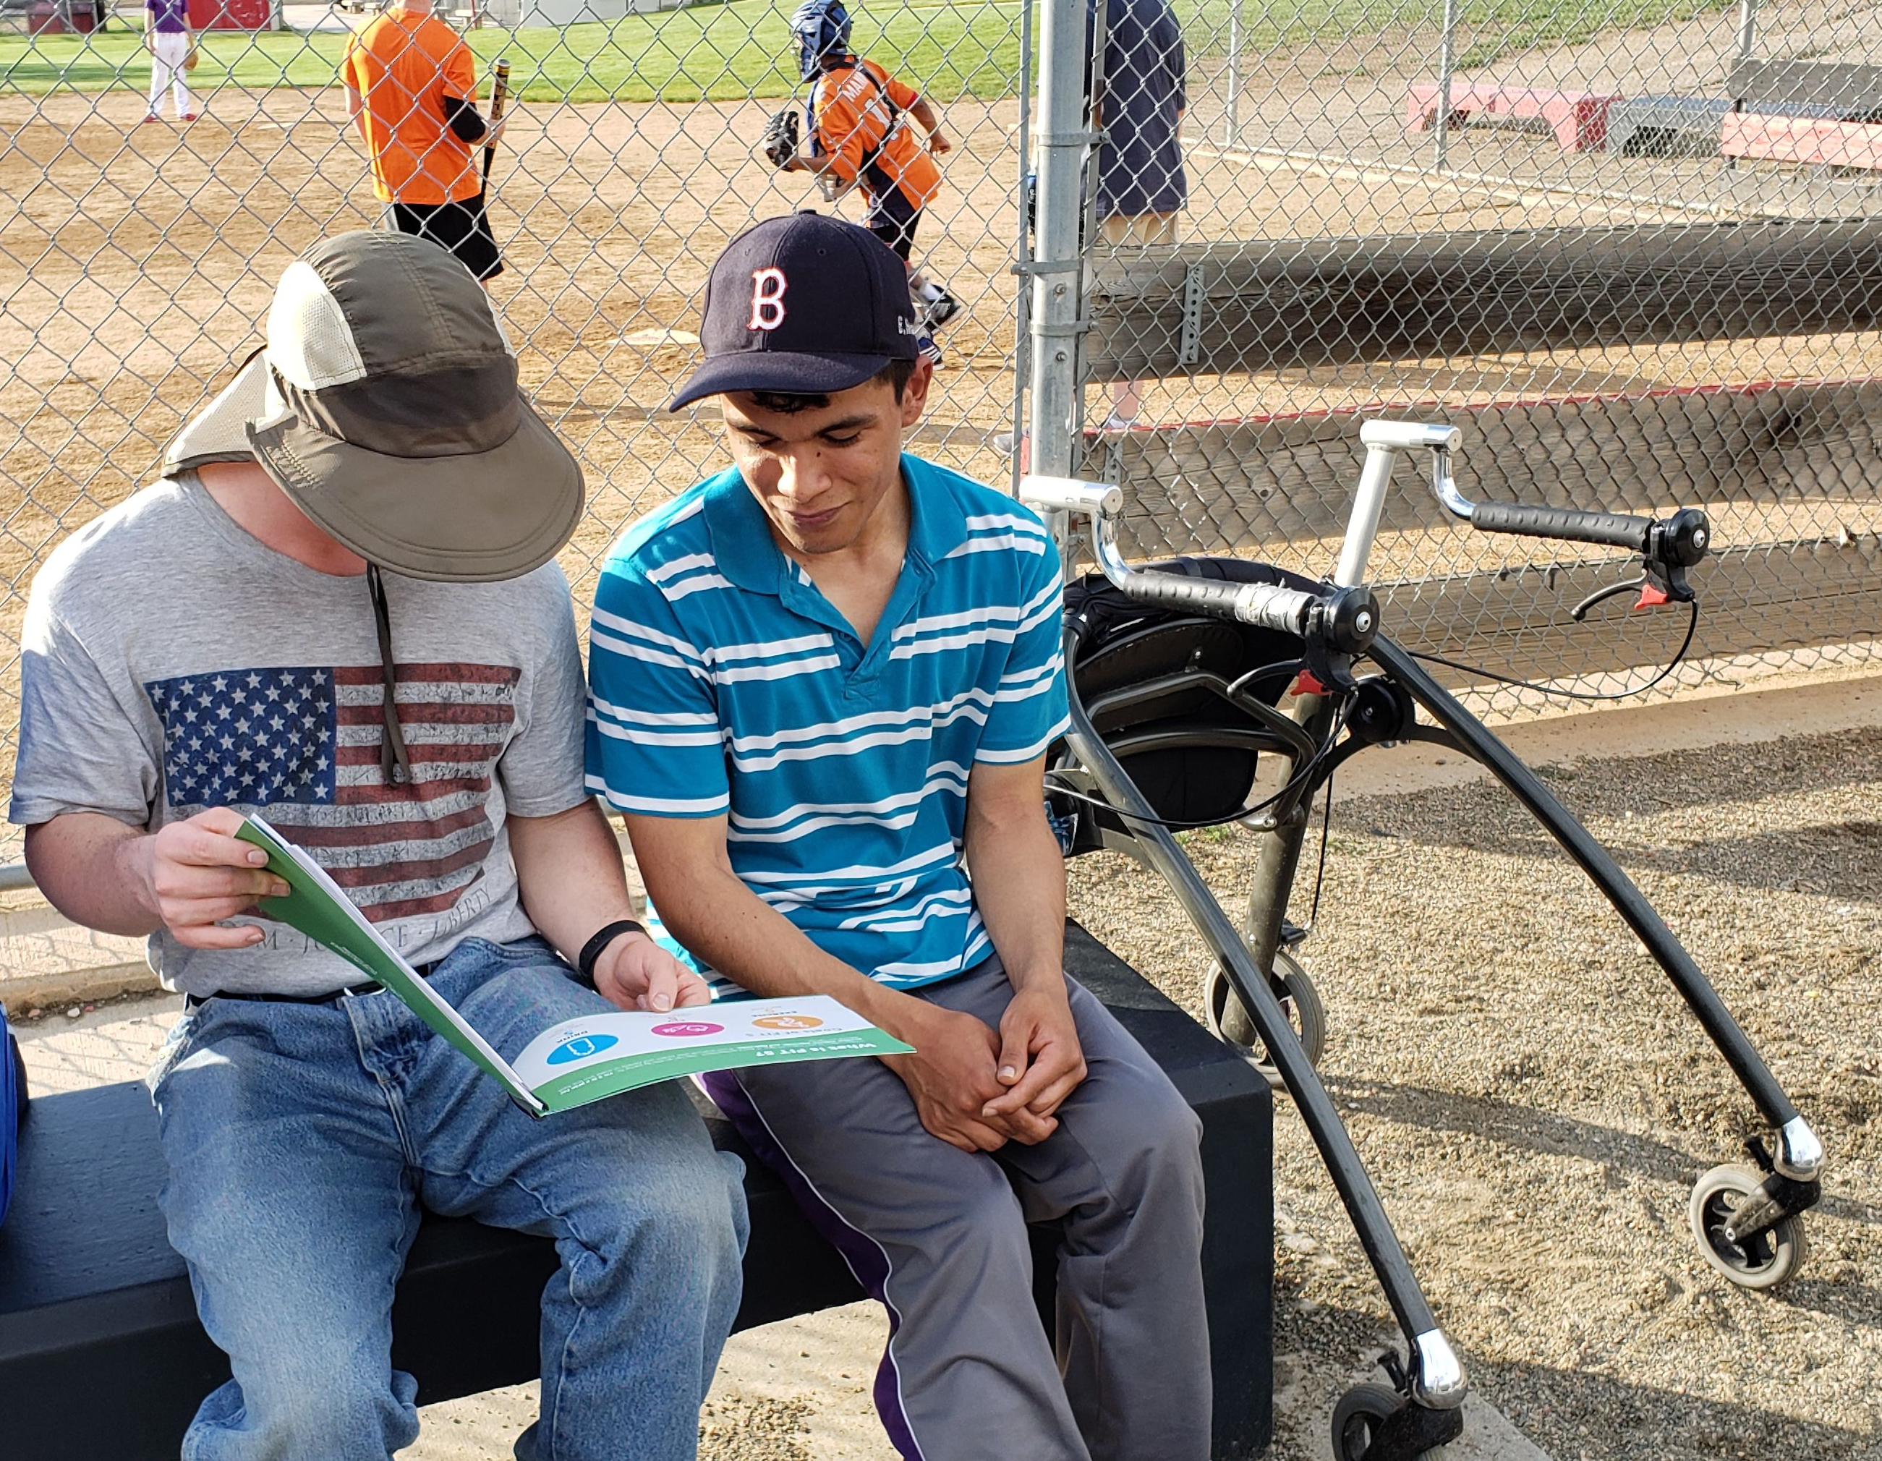
Sharing Health Tips
Communication
How long should a Health Tip take?
What are some ways to keep teammates interested when you share Health Tips?
What are some resources that you can use to get ideas for Health Tips?
Who can you ask for support with planning Health Tips?
YEAR 2 FITNESS CAPTAINS | PART 1: YEAR 1 REVIEW
Notes:
[4 minutes/54-minutes total time]
These questions are a review of content in the first training so feel free to modify based on the skill and experience of your Fitness Captains!
QUESTION:
How long should a Health Tip take?
They should be brief, only 2-5 minutes
QUESTION:
What are some ways to keep teammates interested when you share Health Tips?
You can engage your teammates by:
Asking them questions
Allowing different members of your team to answer
Providing examples
Giving them a goal and check-in with their progress at the next training session
QUESTION:
What are some resources that you can use to get ideas for Health Tips?
You can get ideas from the Health Tip Library or your Year 1 Fitness Captains Training workbook.
As Fitness Captains, you can also work together and share ideas with each other!
QUESTION:
Who can you ask for support with planning Health Tips?
You can ask your coach, a family member, or a fellow Fitness Captain!

Slide 19
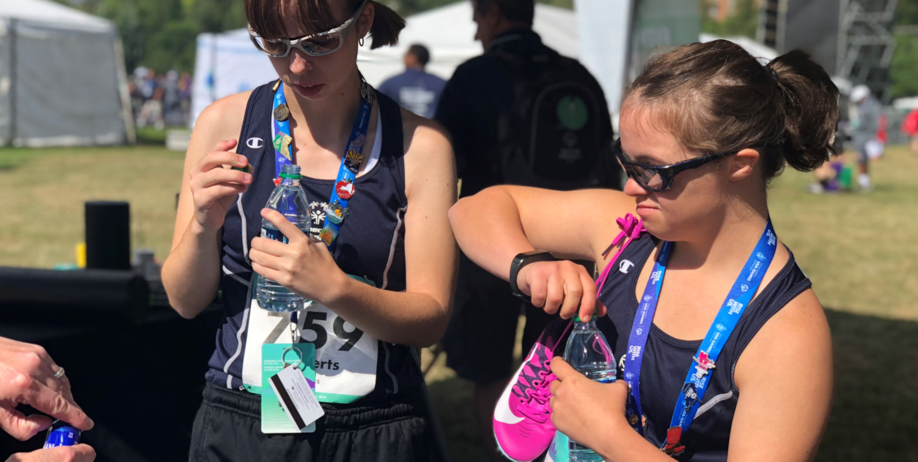

Share a Health Tip
YEAR 2 FITNESS CAPTAINS | PART 1: YEAR 1 REVIEW
Notes:
[5 minutes/59-minutes total time]
To end the Part 1 of our Year 2 Fitness Captains training, please turn to the person next to you and share a Health Tip.
Time permitting you could do this as a large group.

Slide 20
Break Time
Notes:
[5 minutes/64-minutes total time]
We’ve now completed Part 1 of the Year 2 Fitness Captains Training!
We are going to take a short break before beginning Part 2.
Share any instructions or details needed for the break.

Slide 21
Part 2
Game Day Minds
In this section we will:
Discuss how to take care of yourself as a leader
Learn about strong messaging to help you and your teammates “get your head in the game”
Practice breathing while stretching
Notes:
[1 minute/65-minutes total time]
Welcome back to the Year 2 Fitness Captains Training! We will now complete Part 2: Game Day Minds.
In this section we will:
Discuss how to take care of yourself as a leader
Learn about strong messaging to help you and your teammates “get your head in the game”
Practice breathing while stretching

Slide 22
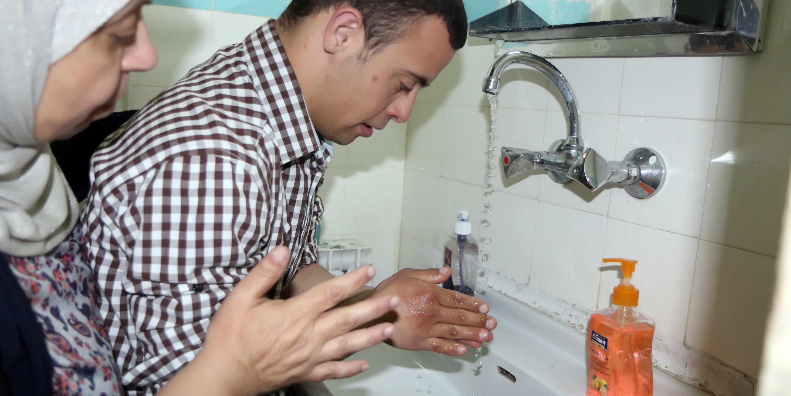

Taking Care of Yourself
YEAR 2 FITNESS CAPTAINS | PART 2: GAME DAY MINDS
Notes:
[1 minute/66-minutes total time]
As a leader, it’s important that you take care of yourself! Taking care of yourself helps you to be the best version of you – making you better prepared to support others!
By taking care of yourself, you lead by example. You show your teammates that you value and practice the healthy behaviors that you share with them in your Health Tips!

Slide 23
What is Self-Care?
Taking Care of Yourself
Self-care is when you take time to do activities that reduce stress.
What does self-care
mean to you?
YEAR 2 FITNESS CAPTAINS | PART 2: GAME DAY MINDS
Notes:
[3 minutes/69-minutes total time]
Self-care, or taking care of yourself, is important for your overall health. Self-care is when you take time to do activities that reduce stress.
QUESTION:
What does self-care mean to you? What is the first thing that comes to mind when you think of the words “self-care.”
If participants are quiet, you can prompt them with these questions:
Having fun and relaxing?
Taking care of basic needs?
Practicing healthy habits?
Ask a few participants to share their answers.

Slide 24
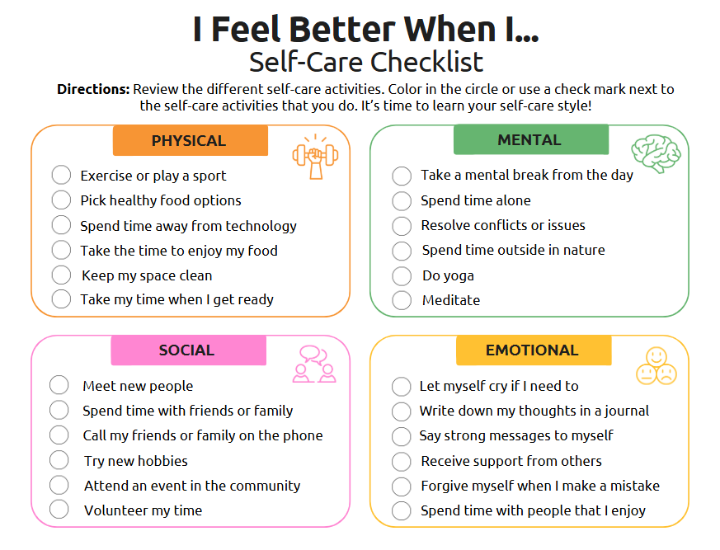
Self-Care Checklist
Taking Care of Yourself
YEAR 2 FITNESS CAPTAINS | PART 2: GAME DAY MINDS
Notes:
[6 minutes/75-minutes total time]
There are many ways to practice self-care! We are now going to complete the Self-Care Checklist.
Directions: Review the different self-care activities on the checklist. Color in the circle or use a check mark next to the self-care activities that you do. It’s time to learn your self-care style!
Allow the Fitness Captains to take a few minutes to complete the checklist.
Time permitting, you can facilitate a discussion about their responses:
What category did you have the most check marks in?
Were there any activities you don’t do but you would like to try?

Slide 25





Tips for Self-Care
Taking Care of Yourself
Notice Signs
Make Small Changes
Plan and Schedule
Identify Barriers and Challenges
Ask for Help
YEAR 2 FITNESS CAPTAINS | PART 2: GAME DAY MINDS
Notes:
[8 minutes/83-minutes total time]
Discuss the following questions. Use the Athlete Workbook and have athletes complete on their own. Leave a few minutes for reflection and debriefing.
What are some signs you need to take care of yourself? For example, if you don’t drink enough water, do you get a headache? If you don’t get enough sleep, do you get angry easily?
What is one thing from the Self-Care Checklist that you would like to try?
How and when will you add this to your routine?
What may get in the way of you practicing self-care?
Who can help you?

Slide 26
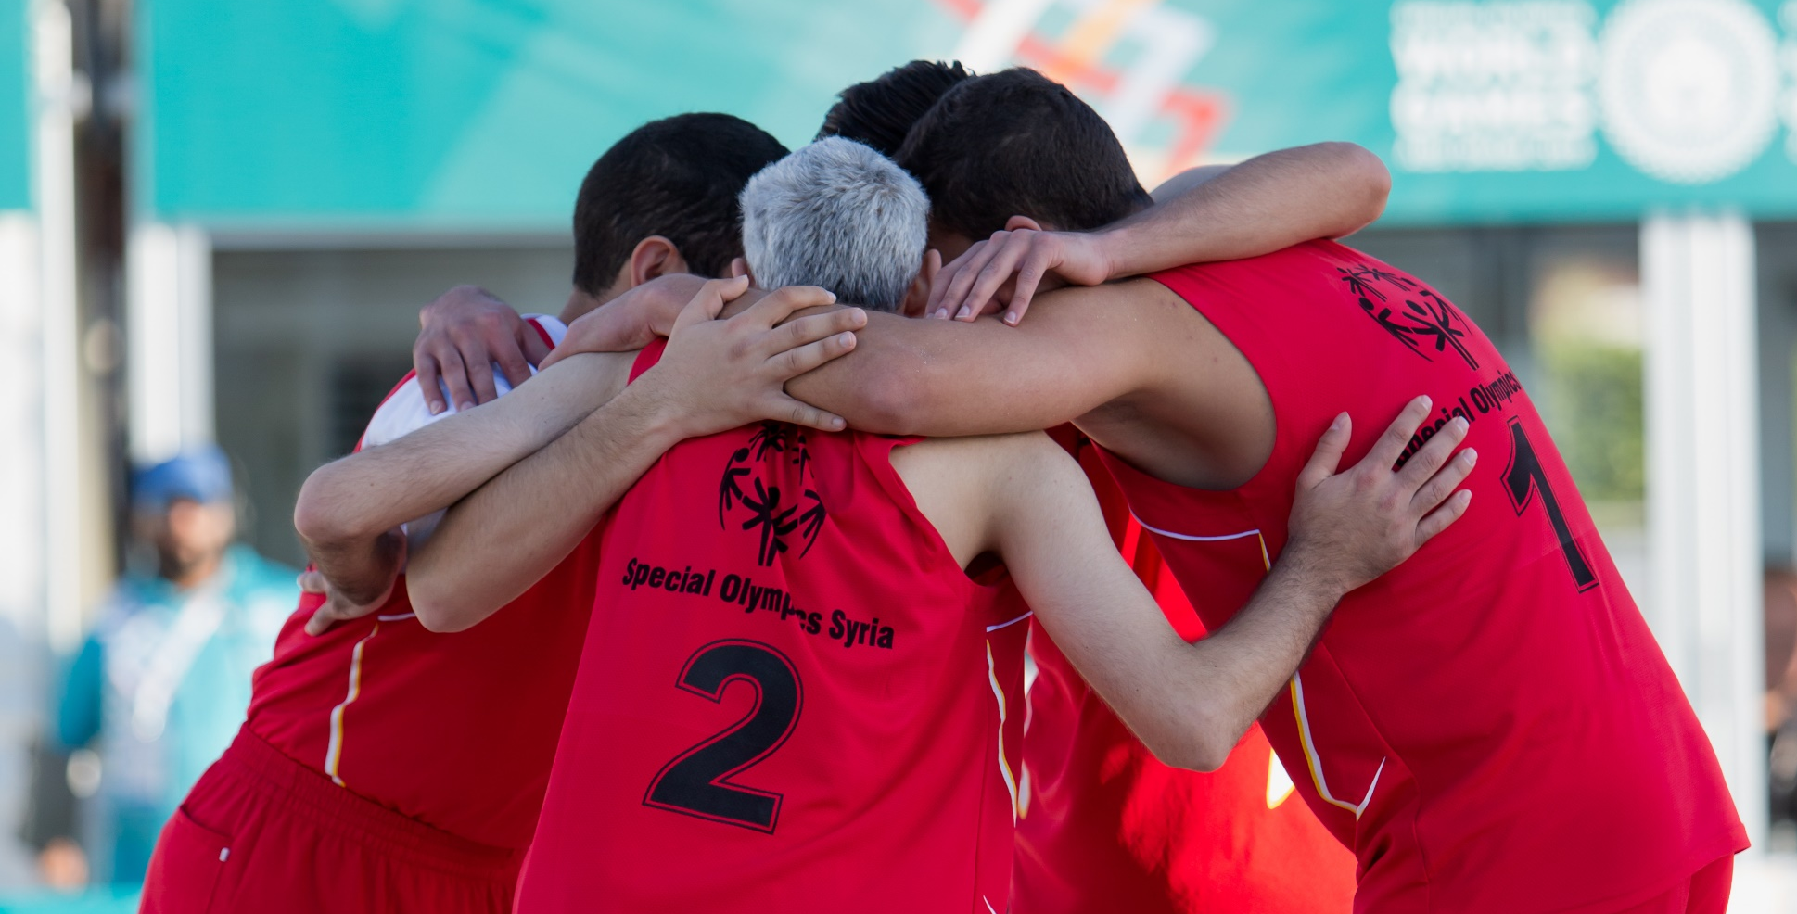

Strong Messages
Event Planning
Leadership Events
YEAR 2 FITNESS CAPTAINS | PART 2: GAME DAY MINDS
Notes:
Now let’s talk about Strong Messages!
On the next few slides, you will see examples of strong messages.

Slide 27
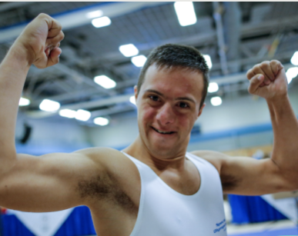

How do you Feel?
Strong Messages
I am strong. Every day, my mind and body are getting stronger.
YEAR 2 FITNESS CAPTAINS | PART 2: GAME DAY MINDS
Notes:
[1 minute/84-minutes total time]
Read each strong message out loud – this can be done individually as a facilitator or participant OR read them out loud together as a group.
After read each strong messages, ask the Fitness Captains how saying those messages make them feel.
QUESTION:
How does this strong message make you feel?

Slide 28
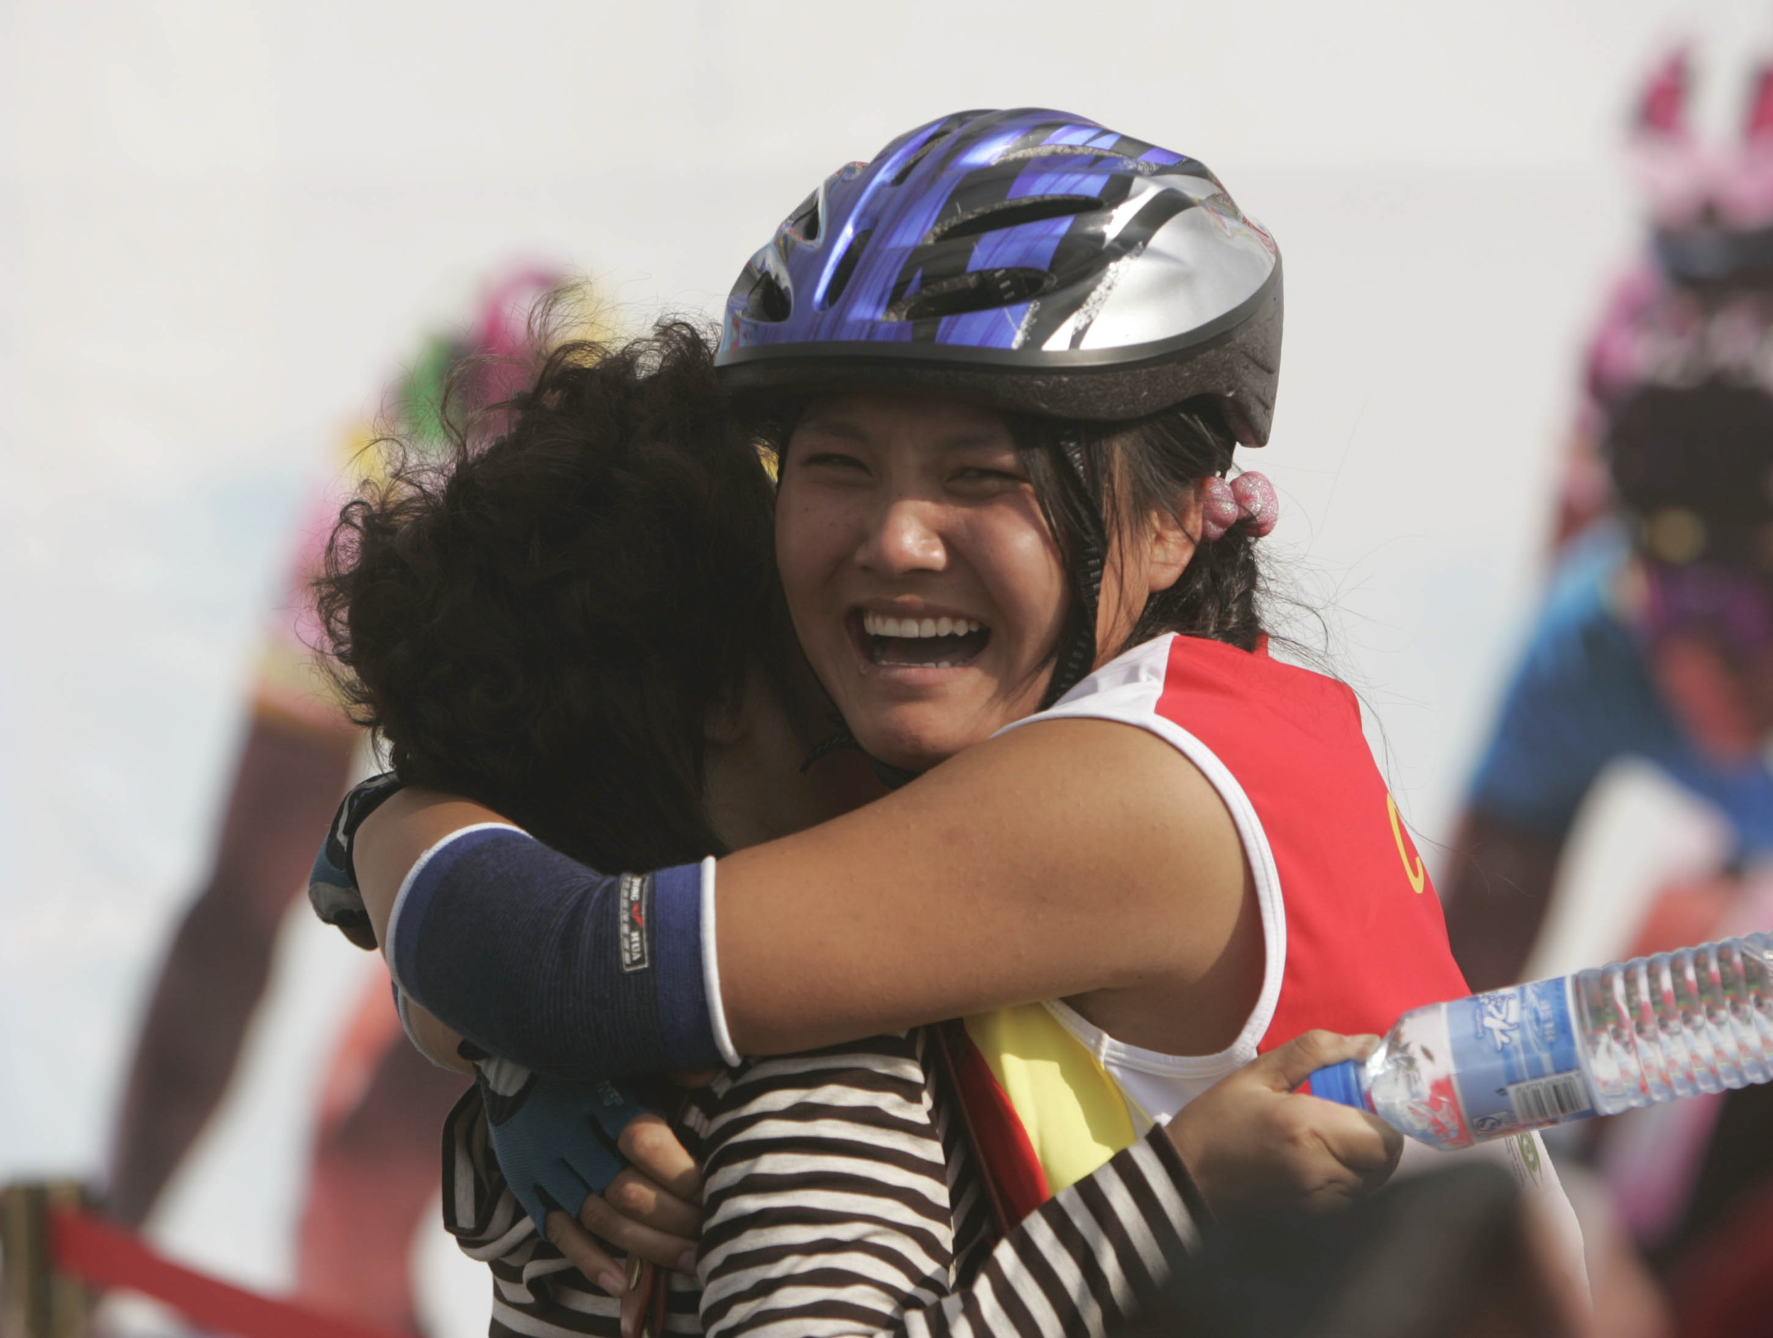
How do you Feel?
Strong Messages
I CAN do it! I let go of negative thoughts and I focus on doing my best.
YEAR 2 FITNESS CAPTAINS | PART 2: GAME DAY MINDS
Notes:
[1 minute/85-minutes total time]
Read each strong message out loud – this can be done individually as a facilitator or participant OR read them out loud together as a group.
After read each strong messages, ask the Fitness Captains how saying those messages make them feel.
QUESTION:
How does this strong message make you feel?

Slide 29
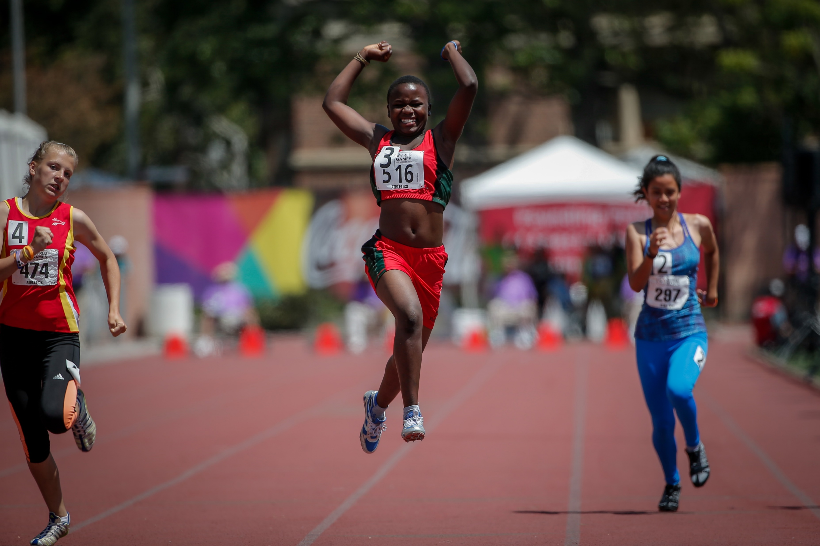
How do you Feel?
Strong Messages
I can do hard things. I face my fears, and I give my best. I am unstoppable!
YEAR 2 FITNESS CAPTAINS | PART 2: GAME DAY MINDS
Notes:
[1 minute/86-minutes total time]
Read each strong message out loud – this can be done individually as a facilitator or participant OR read them out loud together as a group.
After read each strong messages, ask the Fitness Captains how saying those messages make them feel.
QUESTION:
How does this strong message make you feel?

Slide 30
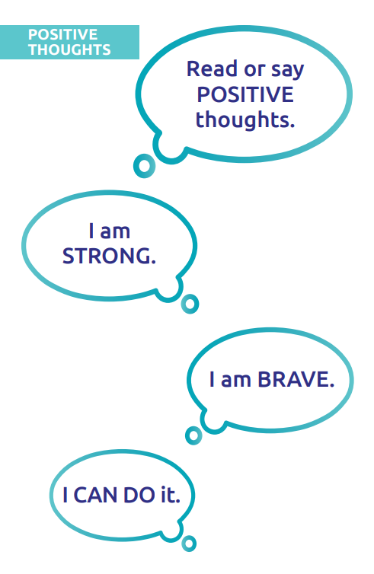
What are Strong Messages?
Strong Messages
Strong Messages are positive or encouraging words or phrases that improve our confidence or ability to handle stress.
YEAR 2 FITNESS CAPTAINS | PART 2: GAME DAY MINDS
Notes:
[2 minutes/88-minutes total time]
Strong Messages are positive or encouraging words or phrases that improve our confidence or ability to handle stress. These messages can help motivate you to work hard and try your best.
QUESTION:
Can anyone think of a time when they have used a Strong Message?
Remind athletes that they can use Strong Messages anytime during training sessions and competitions, as well as in their daily activities. These messages can be helpful in stressful situations such as taking a foul shot in basketball, competing in a big event, etc.

Slide 31
Help your Teammates Use Strong Messages
Strong Messages
As a Year 2 Fitness Captain, your new responsibility is to help your teammates use Strong Messages.
At the beginning of every sports practice, help your teammates get their “head in the game.” Share a Strong Message with your teammates when they arrive or during warm-ups.
YOU CAN do it
YOU are brave
YEAR 2 FITNESS CAPTAINS | PART 2: GAME DAY MINDS
Notes:
[1 minute/89-minutes total time]
As a Year 2 Fitness Captain, your new responsibility is to help your teammates use Strong Messages.
At the beginning of every sports practice, help your teammates get their “head in the game”. Share a Strong Message with your teammates when they arrive or during warm-ups. Notice how these two Strong Messages use “YOU” rather than “I”.
When you share Strong Messages with your teammates, it usually makes them feel good AND you feel good!

Slide 32
Group Activity
Work together to create a list of Strong Messages that can be shared with your teammates.
Practice presenting them.
Notes:
[7 minutes/96-minutes total time]
Now that you know what Strong Messages are, let’s work together to create a list of Strong Messages that can be shared with your teammates.
As time permits, allow the Fitness Captains to practice sharing them with each other. Encourage the Fitness Captains to make eye contact and smile when they say their message. They can also include gestures like a high five or fist bump.

Slide 33
Other Ways to Use Strong Messages
Strong Messages
Here are some ways you can use Strong Messages with your teammates:
If your teammates feel very nervous before a competition, ask them what their Strong Message is
Encourage your teammates to write down a Strong Message and read it when they start to get ‘worked up’
Make a plan with a teammate that you will each say a Strong Message to each other before practices and competitions
YEAR 2 FITNESS CAPTAINS | PART 2: GAME DAY MINDS
Notes:
[4 minutes/100-minutes total time]
As a Year 2 Fitness Captain, you will share a Strong Message with your teammates at the beginning of every sports practice but there are other times that your teammates may need your support!
Hare some ways you can use Strong Messages with your teammates:
If your teammates feel very nervous before a competition, ask them what their Strong Message is
Encourage your teammates to write down a Strong Message and read it when they start to get ‘worked up’
Make a plan with a teammate that you will each say a Strong Message to each other before practices and competitions
QUESTION:
What other ideas do you have to remind you to use Strong Messages when your teammates need them most?

Slide 34
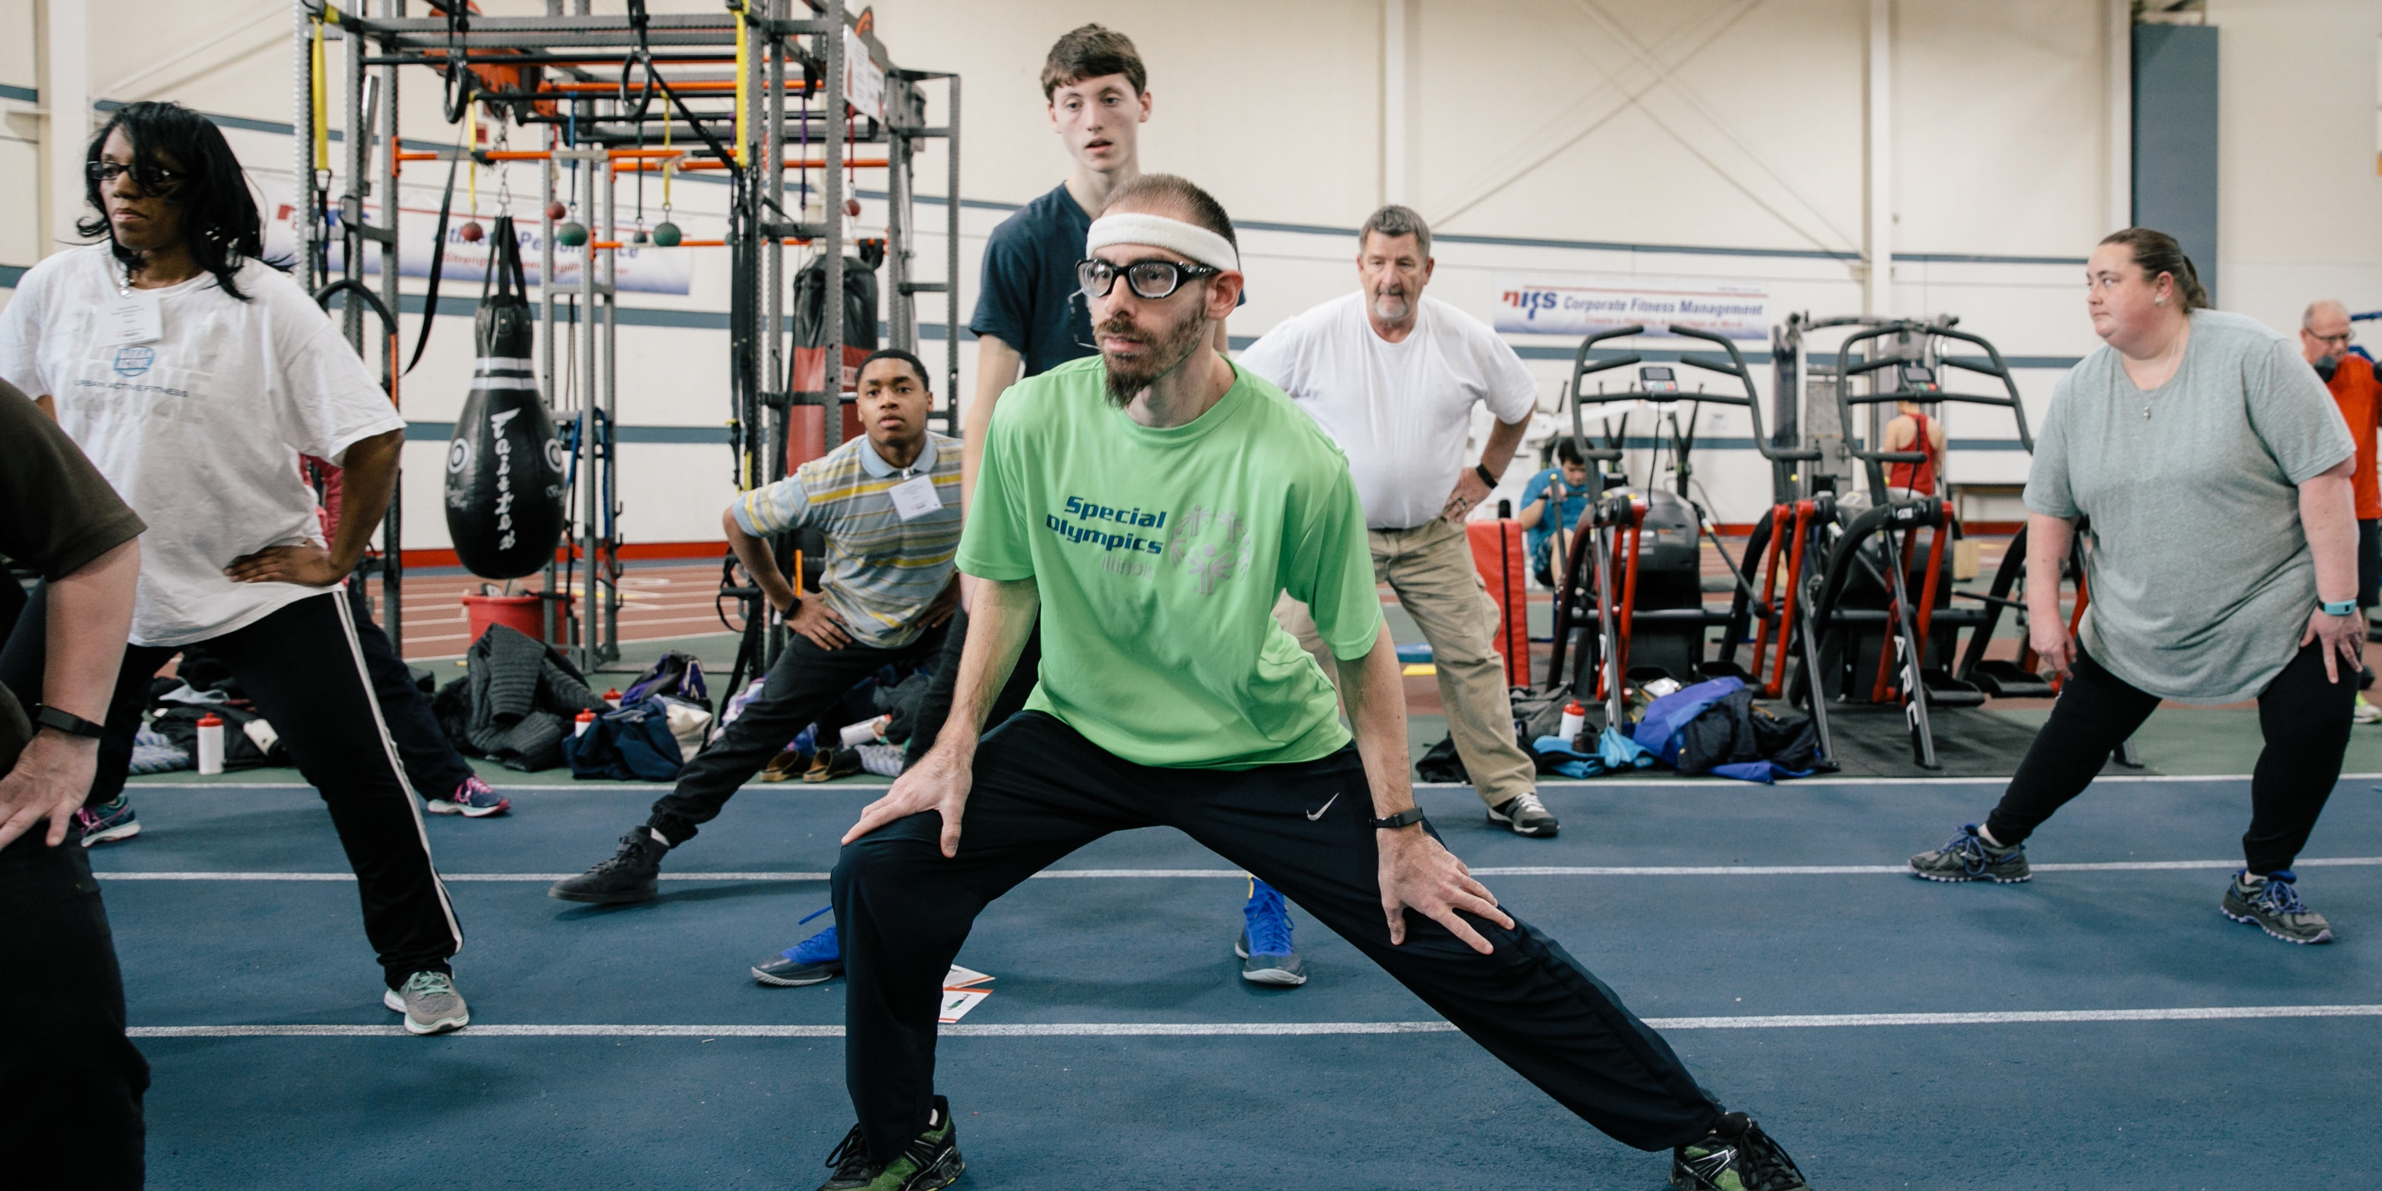

Breathing and Stretching
Event Planning
Leadership Events
YEAR 2 FITNESS CAPTAINS | PART 2: GAME DAY MINDS
Notes:
We are now going to complete our last section of the Year 2 Fitness Captains Training: Breathing and Stretching!

Slide 35
Year 2 Fitness Captain Responsibilities
Breathing and Stretching
As a Year 2 Fitness Captain, your new responsibility is to include breathing practice during cool-down stretches.
Calm breathing helps you stay calm, be steady and ready for challenges, pay attention, and focus better.
YEAR 2 FITNESS CAPTAINS | PART 2: GAME DAY MINDS
Notes:
[1 minute/101-minutes total time]
As a Year 2 Fitness Captain, your new responsibility is to include breathing practice during cool-down stretches.
Calm breathing helps you stay calmer when things go wrong, be steady and ready for challenges, pay attention and focus better.

Slide 36


Calm Breathing Practice
Breathing and Stretching
A calm breath is a slow, easy breath that feels relaxing. When you take calm breaths, it can help calm your mind.
Pretend you are smelling a flower by slowly breathing in through your nose
Pretend you are blowing out a candle by slowly breathing out through your mouth
YEAR 2 FITNESS CAPTAINS | PART 2: GAME DAY MINDS
Notes:
[5 minutes/106-minutes total time]
A calm breath is a slow, easy breath that feels relaxing. When you take calm breaths, it can help calm your mind.
QUESTION:
How many of you have practiced breathing before? Perhaps maybe you did this at a Strong Minds screening or when you were doing an activity like meditation. Ask Fitness Captains to raise their hand if they have practiced breathing.
Now, we are going to practice breathing together. You can close your eyes or keep them open. Let your breaths be slow, easy, and relaxed. We are going to try Flower and Candle breathing:
Breathe in: Pretend you are smelling a flower by slowly breathing in through your nose. Fill your lungs.
Breathe out: Pretend you are blowing out a candle by slowly breathing out through your mouth. Keep your shoulders and chest relaxed.
Continue for around 8 cycles of breath.
QUESTION:
After practicing your breathing, how do you feel? Do you feel:
Relaxed? Calm?
Positive? Happy?
Looser in your muscles?
Taller in your spine?
Sleepy?

Slide 37
“Stretch, Breathe, Relax”
Breathing and Stretching
1. Stretch! Start your stretch.
2. Breathe! Take 5 calm breaths as you hold the stretch.
3. Relax! Let go of the stretch.
YEAR 2 FITNESS CAPTAINS | PART 2: GAME DAY MINDS
Notes:
[2 minutes/108-minutes total time]
Now are going to combine breathing and stretching with an exercise called “Stretch, Breathe, Relax”.
Guide them through the exercise by following the on-screen prompts.
1. Stretch! Start your stretch.
2. Breathe! Take 5 calm breaths as you hold the stretch. Notice your muscles relaxing as you inhale and exhale. 5 deep breaths should take around 30 seconds.
3. Relax! Let go of the stretch.
Go to the next slide with more stretch examples.

Slide 38
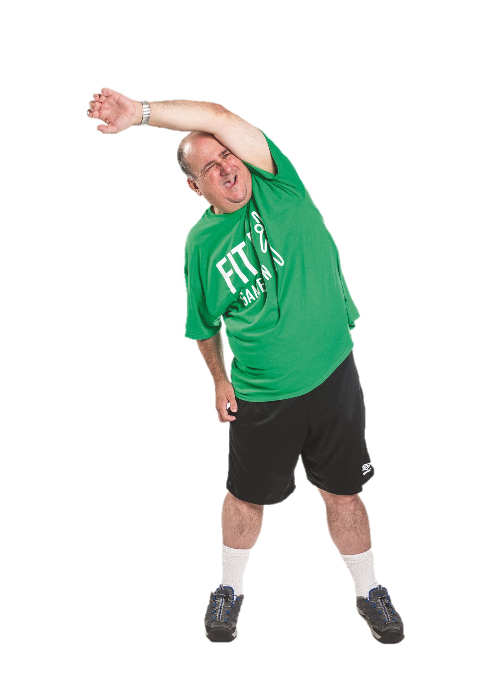
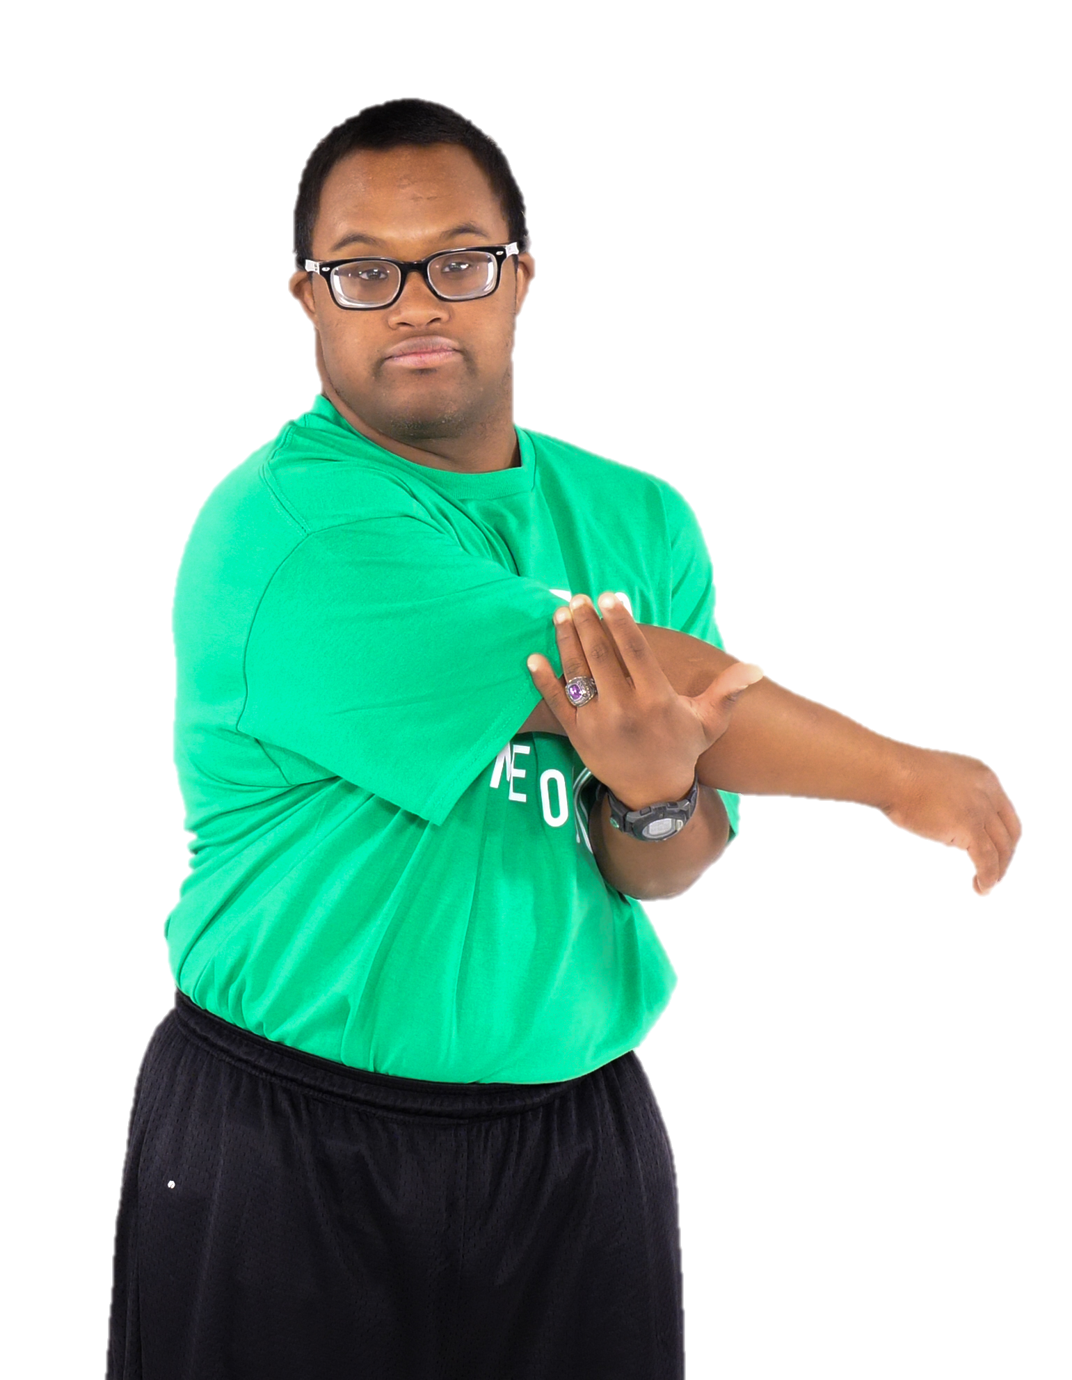
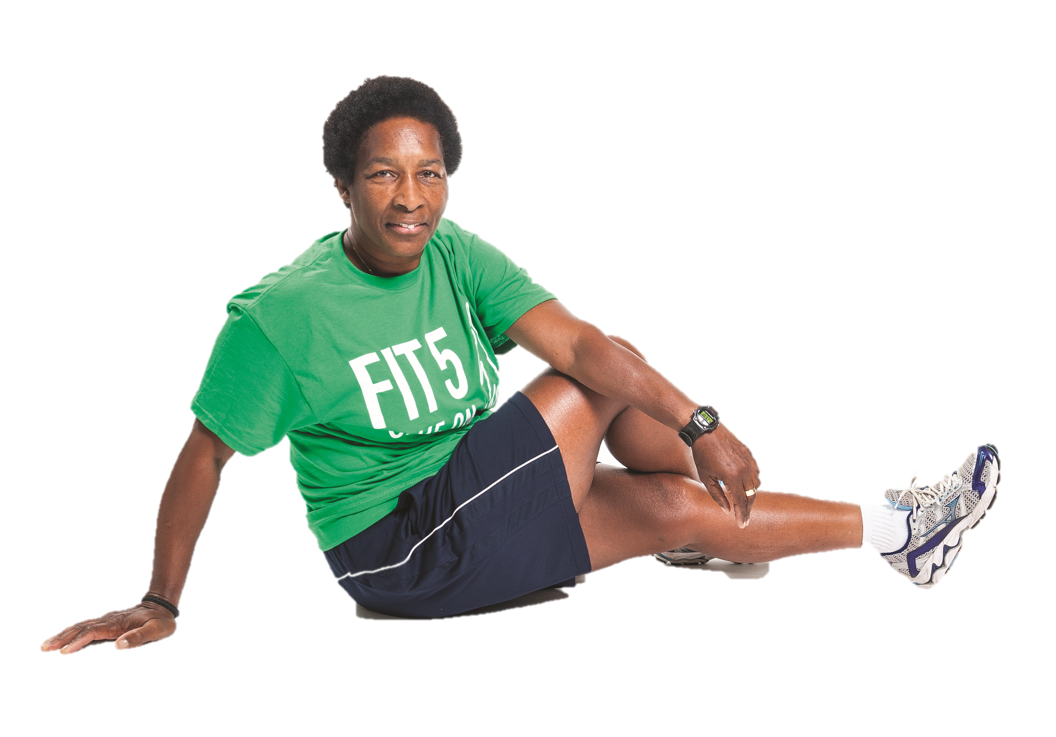
Let’s Practice! “Stretch, Breathe, Relax”
Breathing and Stretching
Cross Arm Shoulder Stretch
Seated Rotation
Side Stretch
YEAR 2 FITNESS CAPTAINS | PART 2: GAME DAY MINDS
Notes:
[4 minutes/112-minutes total time]
Repeat the exercise a few times, doing the different stretches on the side and/or changing sides of the body. The Fitness Captains could also share their favorite cool-down stretches for this activity.
5 deep breaths should take around 30 seconds. Holding stretches longer, up to a minute, or 10 breaths will allow the muscles to relax even more!

Slide 39

Year 2 Fitness Captain Review
Event Planning
Leadership Events
YEAR 2 FITNESS CAPTAINS
Notes:
To finish our training, let’s review your roles & responsibilities as a Year 2 Fitness Captain!

Slide 40


Year 2 Role and Responsibilities
Fitness Captain Year 2 Review
Lead Warm-Ups and Cool-Downs
Share Health Tips
Share Strong Messages
Practice Breathing when Stretching
YEAR 2 FITNESS CAPTAINS
Notes:
[4 minutes/116-minutes total time]
To review, you have four key responsibilities as a Year 2 Fitness Captain.
Your first two responsibilities were included in your role as a Year 1 Fitness Captain. You will continue to do these activities!
Lead your teammates in a warm-up and cool-down at every training session
Share Health Tips with your teammates. Remember, it is important that you lead by example and practice the healthy behaviors that you are encouraging your teammates to do!
Your two new responsibilities are:
Share a Strong Message with your teammates when they arrive or during warm-ups. Smile and make eye contact. If you want, you can also give your teammates a fist bump or high five when you say your message.
Remember: you can also share Strong Messages in other moments when your teammates might need support or encouragement.
During your cool-down stretches, help your teammates with their breathing. You can use the “Stretch, Breathe, Relax” technique.
Optional: add in an action plan and any next steps you would like the Year 2 Fitness Captains to take.

Slide 41
One Reflection Word
Fitness Captain Year 2 Review
What is one thing you are looking forward to as a Year 2 Fitness Captain?
YEAR 2 FITNESS CAPTAINS
Notes:
[3 minutes/119-minutes total time]
Invite the Fitness Captains to stand in a circle.
QUESTION:
What is one thing you are looking forward to as a Year 2 Fitness Captain?

Slide 42
Questions?
Notes:
[1 minutes/120-minutes total time]

Slide 43
THANK YOU &
CONGRATULATIONS!
Notes:
[120-minutes total time]
Congratulations! Thanks for participating, you have now concluded the Year 2 Fitness Captain training course.
Remember, to be a great athlete, you must be a healthy athlete. Your coach and Program staff are here to help you!

Slide 44

Special Olympics Health activities are supported by many sources, including in the United States by Grant Number NU27DD000021 from the Centers for Disease Control and Prevention of the U.S. Department of Health and Human Services, with $18.1 M (64%) financed with U.S. Federal funds and $10.2 M (36%) supported by non-federal sources.
These contents are solely the responsibility of the authors and do not necessarily represent the official views of the Centers for Disease Control and Prevention or the Department of Health and Human Services.

