Slide 1
FITNESS CAPTAIN

Slide 2
Introduction
Tell us about yourself!
Name
Favorite sport(s) to play
Why do you want to be a Fitness Captain

Slide 3
Fitness Captain Training
Purpose of Fitness Captain training:
Provide athletes the knowledge and skills to promote fitness through sport and competition.
Notes:
To be a great athlete, you must be a healthy athlete. Living a healthy lifestyle takes knowledge, skills, support, and a dedication to healthy behaviors year-long and lifelong.
The purpose of the Fitness Captain training course is to:
Provide athletes the required knowledge skills and knowledge to promote fitness through sport and competition.

Slide 4
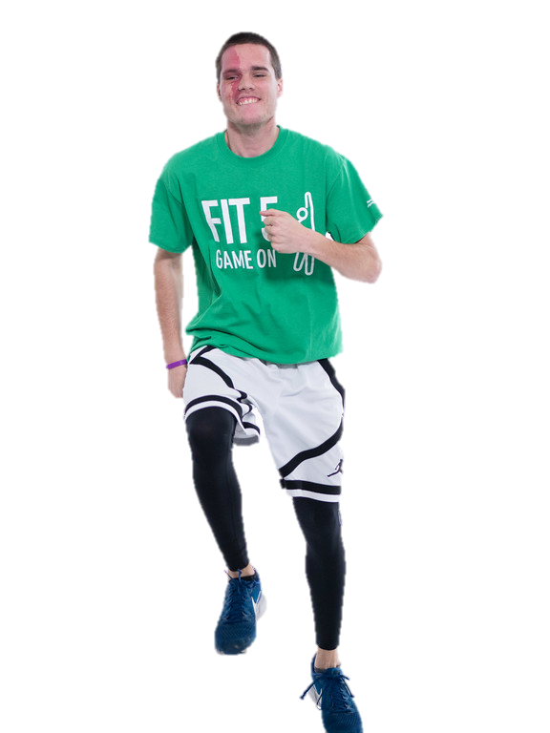
What is a Fitness Captain?
Fitness Captains are athletes on a sports team who lead their team in activities related to fitness and a healthy lifestyle
Fitness Captains have a passion for fitness and healthy habits
FITNESS CAPTAIN
Notes:
Fitness Captains can use their leadership and communication skills to encourage and empower fellow athletes to be healthy and fit on all Special Olympics teams
Fitness Captains must:
Have a positive influence with their teammates
Be reliable, dependable, and respectful at all times
Show great sportsmanship in all circumstances and have a great attitude
Be great team members and genuinely care about those around them

Slide 5
Role and Responsibilities
Fitness Captains
Fitness Captains will work closely with their coaches to make sure health and fitness is a key component of the sports experience by participating in these leadership roles:
Teaching Healthy Habits
Leading Warm-Ups and Cool-Downs
FITNESS CAPTAIN
Notes:
Teams that have Fitness Captains will:
Complete safe and effective warm-up and cool-down routines
Learn health education tips or lessons
Be supported to practice healthy behaviors and encouraged to participate in other health/fitness programming
Fitness Captains should take care of their teammates in a positive manner and help their teammates succeed with positive praise and motivation.

Slide 6
Role of Fitness Captain vs. Role of a Health Messenger
Health Messengers are Special Olympics athletes who have been trained to serve as a health leader, educator and advocate
Health Messengers are not Fitness Captains, but they are invited to complete this module
FITNESS CAPTAIN
Notes:
Health Messengers are Special Olympics athletes who have been trained to serve as a health leader, educator and advocate
Health Messengers are not Fitness Captains, but they are invited to complete this core module.
Fitness Captain program may be a step to becoming a Health Messenger. Fitness Captains may feel inspired and ready to take on other roles in Health

Slide 7
Role of Fitness Captain vs. Role of a Health Messenger
Fitness Captain | Both | Health Messenger
Sport Leader Shares a health tip at each sports practice Helps lead their team in warm-ups and cool-downs Comprehensive training in fitness | Teach healthy habits Role model | Health Leader Receives training in all areas of SO Health programming Learns about communication, social media, Strong Minds and advocacy May lead large health education like a presentation or lesson with activities
FITNESS CAPTAIN

Slide 8
Role of a Coach vs. Role of Fitness Captain
Coach | Fitness Captain
Leader of every practice Determines the order of practice Teaches sport skills and drills Addresses issues and challenges | Helps lead the warm-up and cool-downs Role model for their teammates Shares a health tip at each practice
FITNESS CAPTAIN
Notes:
Coach:
Leader of every practice
Determines the order of practice
Teaches sport skills and drills
Determines when practice begins and ends
Motivates athletes
Communicates with individual athletes when situations come up
Fitness Captains:
Helps lead the warm-up before practice begins
Is a positive example for their teammates
Shares a health education tip or lesson at each training session
Helps the cool-down stretches after practice

Slide 9
Module Overview
Lesson 1: Overview of Fitness | Definition of Fitness Physical Activity Nutrition Hydration Health Tips at Practice
Lesson 2: Leading Warm-Ups and Cool-Downs | Warm-Ups Cool-Downs Leading Warm-Ups and Cool-Downs at Practice Communicating with your Coach
FITNESS CAPTAIN
Notes:
The Fitness Captain training course is divided in two lessons:
Overview of Fitness
Leading Warm-Ups and Cool-Downs

Slide 10
Lesson 1
Overview of Fitness
In this lesson we will:
Learn about the basics of physical activity, nutrition, hydration and how to support your teammates

Slide 11
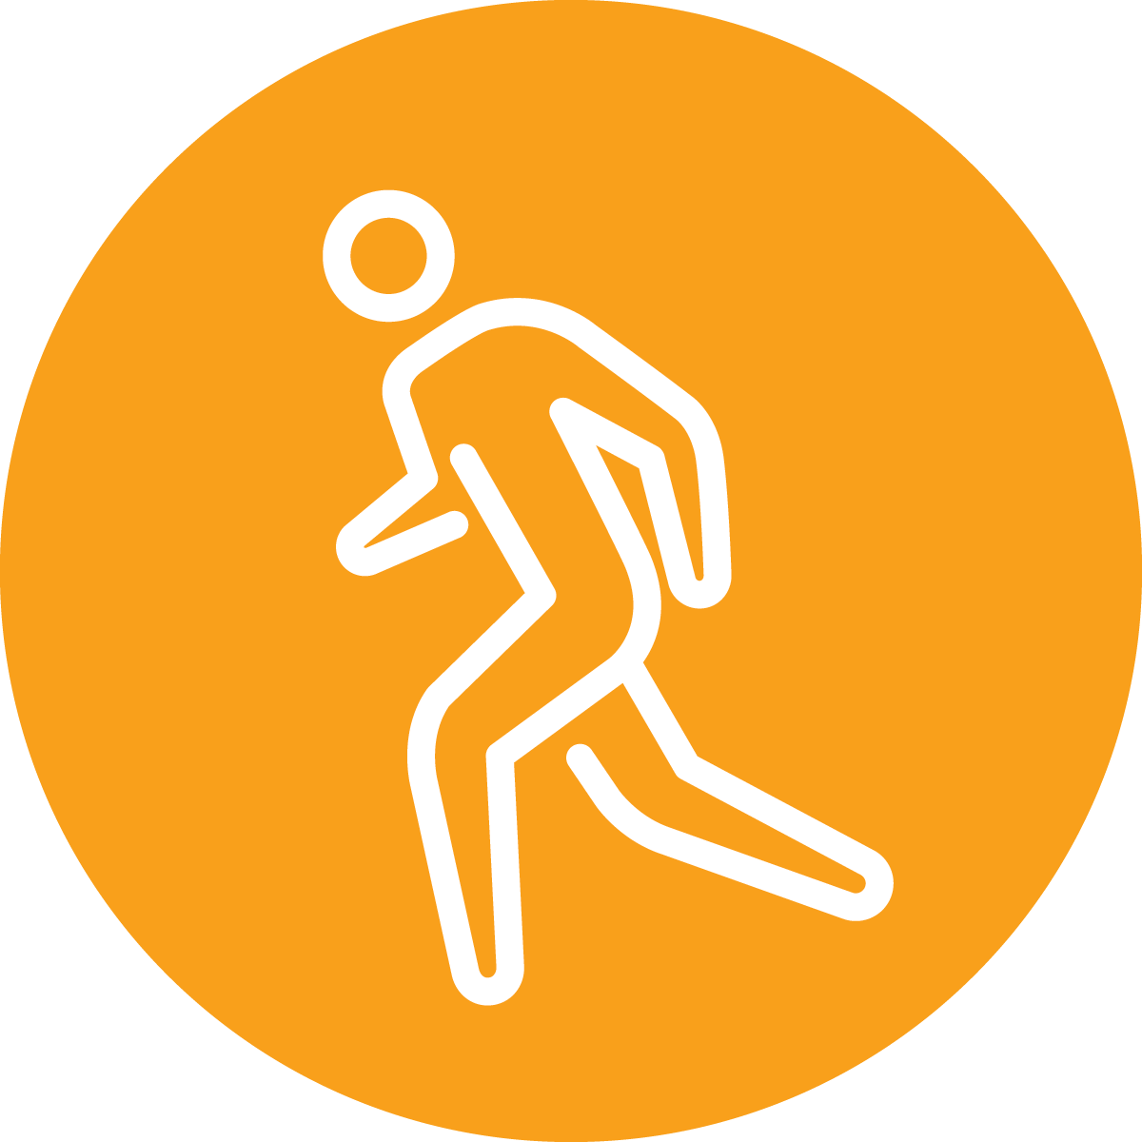
What is Fitness?
Your best health and
performance through proper
physical activity, nutrition, and hydration
FITNESS CAPTAINS | LESSON 1: OVERVIEW OF FITNESS
Notes:
Fitness is Your best health and performance through proper physical activity, nutrition, and hydration.
QUESTION:
Think of a person you consider fit. What kind of things do they do, or you think they do to stay fit? Write your answer down in your workbook.
Ask a few participants to share their answers.
Great answers! Being fit is all about making daily healthy choices in the three areas from the definition—physical activity, nutrition, and hydration. A person who is fit has good health and well-being
And the healthy choices you make in those three areas each day can help you to be healthier and perform better in your sport, your job, your hobbies, and other aspects of your life.
When you are fit, you feel good and have lots of energy because your body is strong and healthy

Slide 12
Why is Fitness Important?
Improve Sports Performance
Increase Energy
Feel Happier
Improve Sleep
Healthy Weight
Live Longer
Reduce Stress
FITNESS CAPTAINS | LESSON 1: OVERVIEW OF FITNESS
Notes:
There are many reasons why fitness is important! Fitness can help you:
Perform better in your sport
Increase your energy levels
Feel happier
Improve your quality of sleep
Achieve a healthy weight
Be healthy and live longer
Reduce your stress level

Slide 13
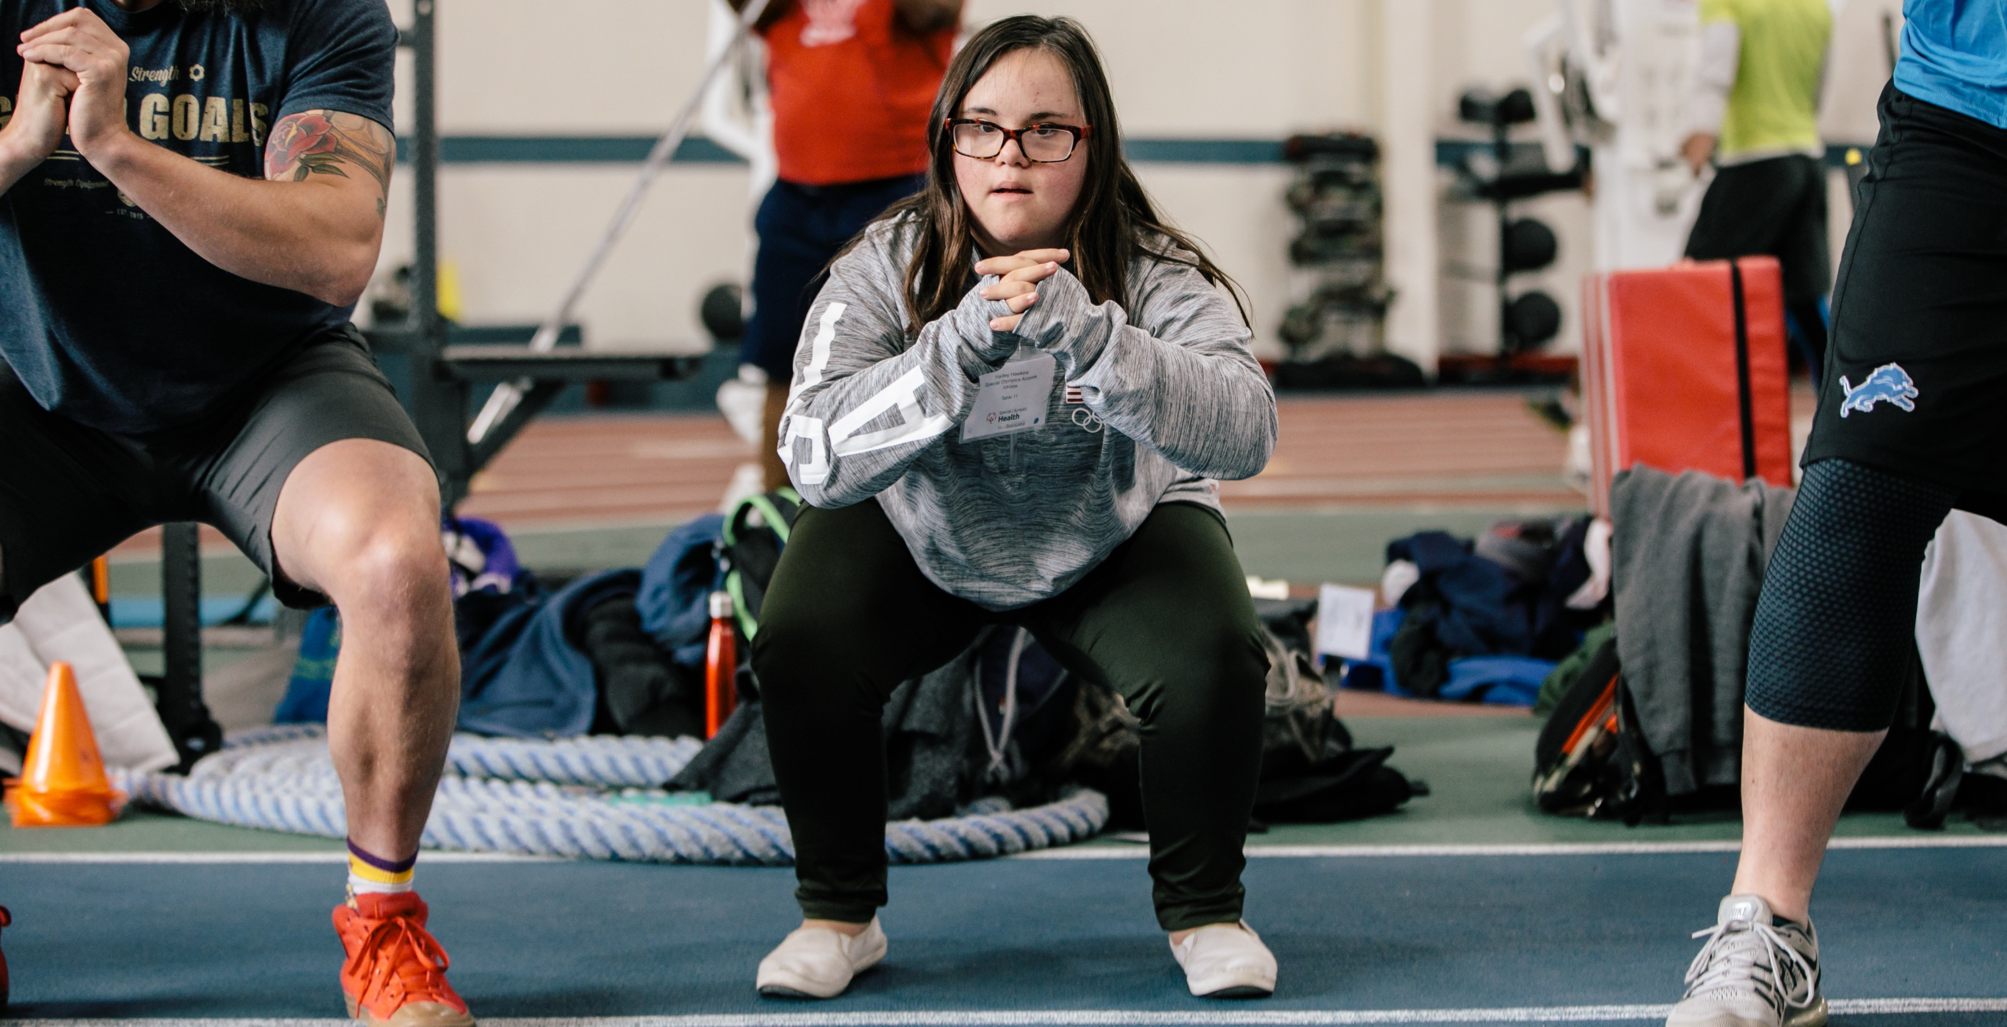
FITNESS CAPTAINS | LESSON 1: OVERVIEW OF FITNESS
Notes:
Let’s talk more about physical activity!

Slide 14
Physical Activity vs. Exercise
Physical Activity
Physical Activity
is any movement that our body makes. It is produced by our muscles and that uses energy.
FITNESS CAPTAINS | LESSON 1: OVERVIEW OF FITNESS
Notes:
Physical Activity is any movement that our body makes. It is produced by our muscles and that uses energy.
Physical Activity could include the ways you move your body throughout the day such as grocery shopping, walking at work, or gardening.

Slide 15
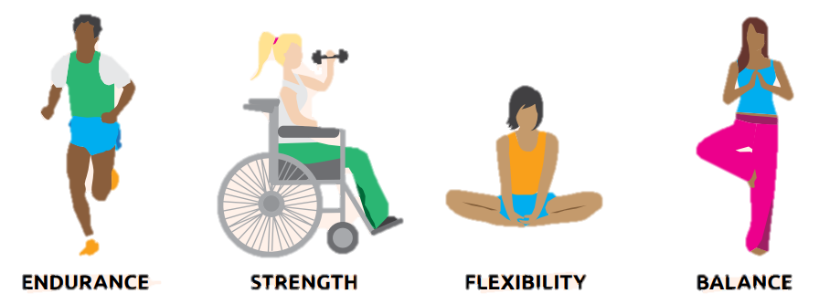
Physical Activity vs. Exercise
Physical Activity
Exercise
Is planned, structured, repetitive, and focuses on maintaining or improving one or more components of physical fitness.
FITNESS CAPTAINS | LESSON 1: OVERVIEW OF FITNESS
Notes:
Exercise is planned, structured, repetitive, and focuses on maintaining or improving one or more components of physical fitness.
You can become a better athlete by enjoying physical activity outside of your sports practice. There are many ways to be physically active. Certain exercises can help you improve the skills needed for your sport.
Exercise has four different components:
Endurance
Strength
Flexibility
Balance
All exercises work your body in different ways. In order to stay healthy, you need to incorporate different types of exercises.

Slide 16
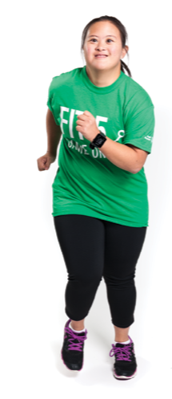
Endurance
Physical Activity
Endurance is the ability of your body to keep moving for long periods of time
Might also be called: aerobic fitness, cardiovascular fitness, cardio
The goal is to do an endurance activity for at least 30 minutes, 5 days per week
FITNESS CAPTAINS | LESSON 1: OVERVIEW OF FITNESS
Notes:
Endurance is the ability of your body to keep moving for long periods of time. Endurance can help you run farther distances without stopping and practice longer with fewer breaks.
The goal is do endurance activity for at least 150 minutes each week. That’s about 30 minutes each day, 5 days per week
QUESTION:
What are some examples of endurance exercises? Write your answers down in your workbook.
Ask a few participants to share their answers and go to the next slide.

Slide 17
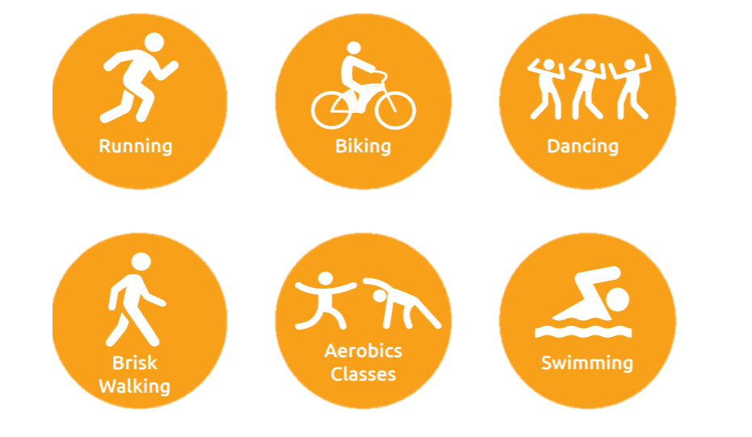
Endurance
Physical Activity
FITNESS CAPTAINS | LESSON 1: OVERVIEW OF FITNESS
Notes:
Here are some other examples of endurance exercises!
Endurance exercises are continuous, rhythmic movements like cycling, running, swimming.
Endurance exercises train the heart and lungs to pump blood better to get more oxygen to the muscles.
Endurance exercise also helps sleep and lowers blood pressure

Slide 18
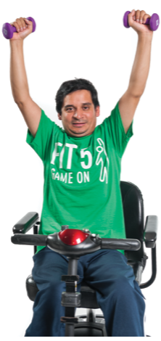
Strength
Physical Activity
Strength is the ability of your body to do work
Try to do strength exercises 2-3 days each week, for up to 30 minutes
FITNESS CAPTAINS | LESSON 1: OVERVIEW OF FITNESS
Notes:
Strength is the ability of your body to do work.
Try to do strength exercises 2-3 days each week, for up to 30 minutes
QUESTION:
What are some examples of strength exercises? Write your answers down in your workbook.
Ask a few participants to share their answers and go to the next slide.

Slide 19
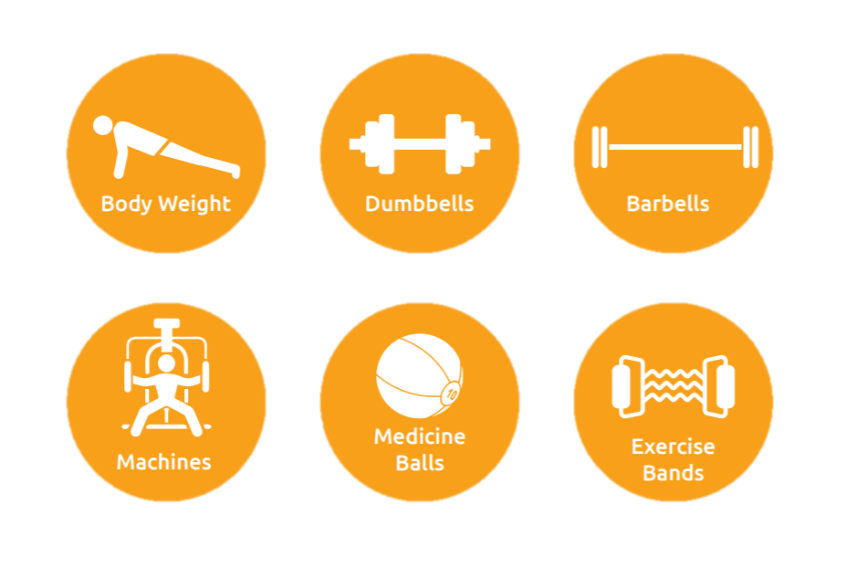
Strength
Physical Activity
*Athletes should use this equipment under supervision of a qualified professional.
FITNESS CAPTAINS | LESSON 1: OVERVIEW OF FITNESS
Notes:
Strength exercises increase the strength of not only your muscles, but also your bones.
Strength exercises can be done anywhere. The best way to get strong is to do strength exercises 2-3 days each week.
Remember – if you are using weights or equipment, make sure you are under the supervision of a qualified professional

Slide 20
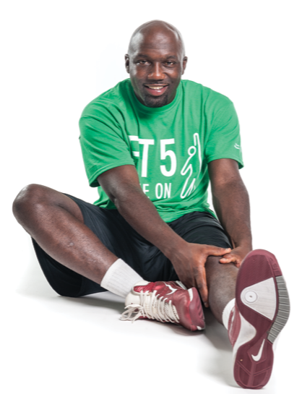
Flexibility
Physical Activity
Flexibility is the ability of your body to move easily in all directions
The best way to get flexible is to stretch!
Before and after practice session, workout or competiton
Every day
FITNESS CAPTAINS | LESSON 1: OVERVIEW OF FITNESS
Notes:
B bFlexibility is the ability of your body to move easily in all directions
The best way to get flexible is to stretch!
Before and after practice session, workout or competition
Every day
Being flexible makes it easier to do sports skills and helps prevent injuries to your muscles and joints!
QUESTION:
What are some examples of flexibility exercises? Think about what parts of your body you use in your sport. Write your answers down in your workbook.
Ask a few participants to share their answers and go to the next slide.

Slide 21
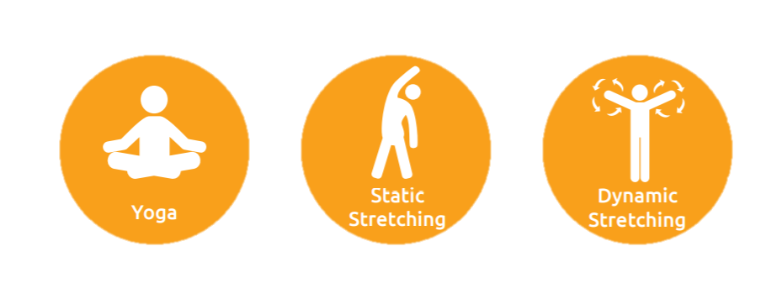
Flexibility
Physical Activity
FITNESS CAPTAINS | LESSON 1: OVERVIEW OF FITNESS
Notes:
You should do DYNAMIC STRETCHES before practice/activity and Static Stretches afterwards.
Dynamic stretching involves active, controlled movements that bring the body-parts through a full range of motion.
Static stretches are those in which you stand, sit or lie still and hold a single position. for a period of time

Slide 22
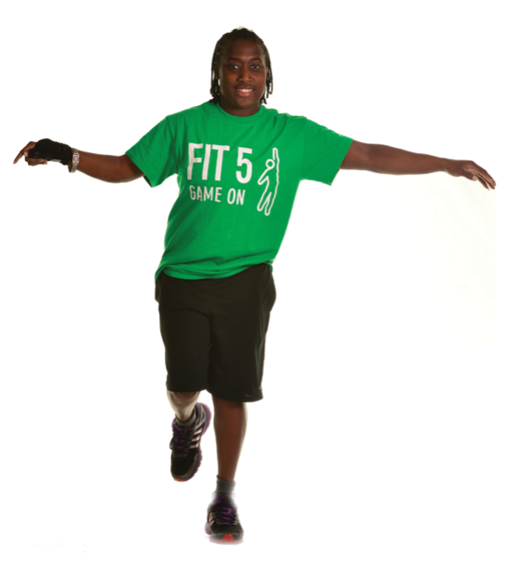
Balance
Physical Activity
Balance is the ability of your body to stay upright or stay in control of your movements
Try to do balance training 2 -3 days each week for up to 15 minutes
FITNESS CAPTAINS | LESSON 1: OVERVIEW OF FITNESS
Notes:
Balance helps you to stay in control when you are playing sports and helps you to avoid falls.
Try to do balance training 2 -3 days each week for up to 15 minutes

Slide 23
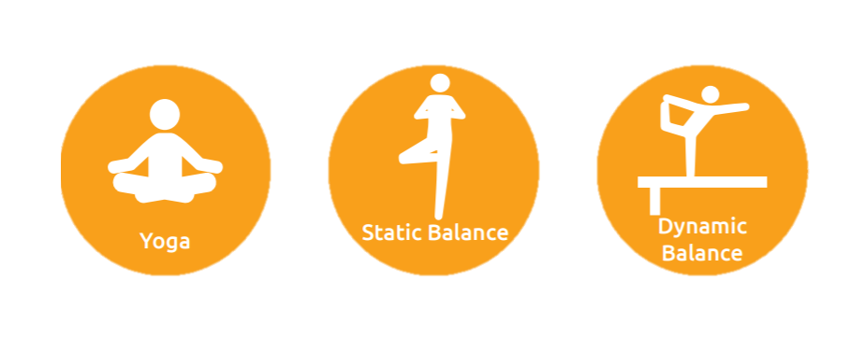
Balance
Physical Activity
FITNESS CAPTAINS | LESSON 1: OVERVIEW OF FITNESS
Notes:
Balance can be done anywhere. Do you remember the difference between dynamic and static exercises? Sports like gymnastics, figure skating and snow sports require a lot of dynamic balance!

Slide 24
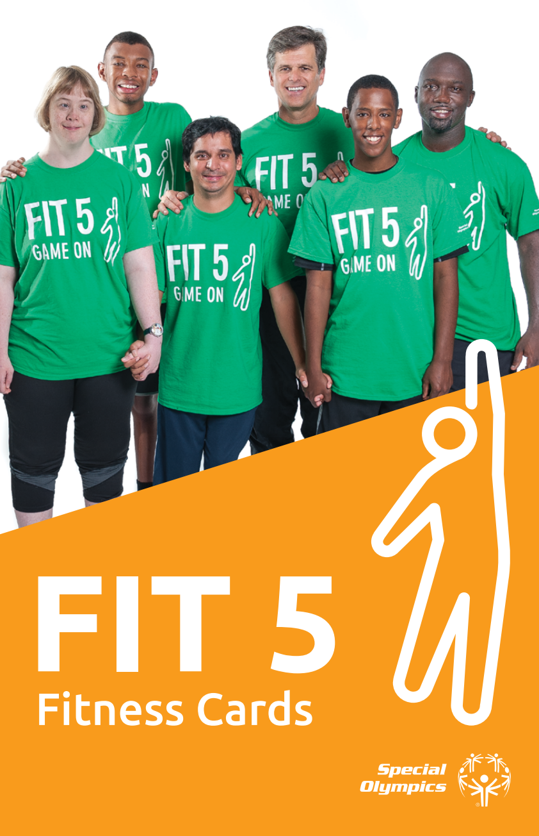
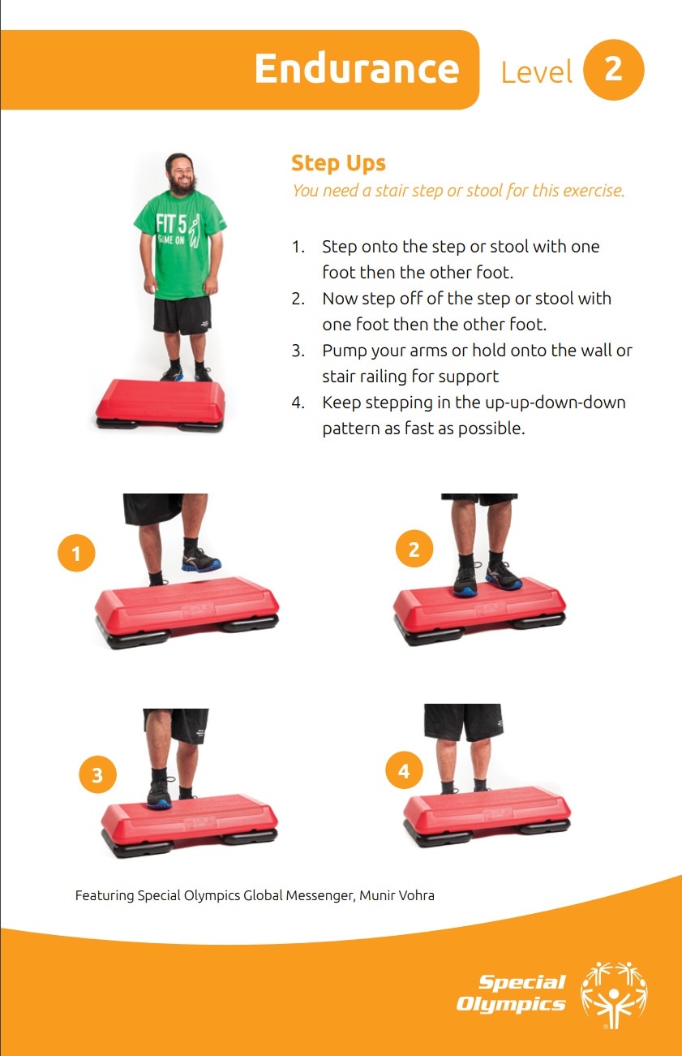
Fit 5 Fitness Cards
Physical Activity
FITNESS CAPTAINS | LESSON 1: OVERVIEW OF FITNESS
Notes:
You can use the Fit 5 Fitness Cards and Videos to help you do exercises in all 4 parts of physical activity.

Slide 25
FITNESS CAPTAINS | LESSON 1: OVERVIEW OF FITNESS
Notes:
Fitness is your best health and performance through proper physical activity, nutrition, and hydration. Now let’s talk about nutrition!

Slide 26
What is Healthy Eating?
Nutrition
Eating a variety of foods that give you the nutrients you need to properly fuel your body
FITNESS CAPTAINS | LESSON 1: OVERVIEW OF FITNESS
Notes:
Healthy eating is eating a variety of foods that give you the nutrients you need to properly fuel your body

Slide 27
Healthy Eating
Nutrition
Healthy eating is important to both your health and your fitness
Making the right choices can be easy because there are many delicious healthy foods!
FITNESS CAPTAINS | LESSON 1: OVERVIEW OF FITNESS
Notes:
Eating well helps you both on and off the field. It keeps your body and mind healthy, and increases your sport performance and recovery.
It keeps the body and mind healthy by:
Giving your body the energy to be active and function well
Helping your body to grow and repair itself
Helping the body to fight infections and illness
Healthy eating can increase your sports performance and recovery by:
Giving you more energy
Strengthening your muscles and bones
Improving your focus
Question:
What kind of foods do you eat? Write your answers down in your workbook.
Ask a few people to share their answers.

Slide 28
Healthy Foods
Nutrition
FITNESS CAPTAINS | LESSON 1: OVERVIEW OF FITNESS
Notes:
A healthy diet Includes foods from all the different food groups.
If, for example, you just eat only fruits and vegetables, your muscles will be weak.
If you never eat vegetables, may get sick a lot.
Save junk food like desserts, chips and sodas for special occasions. If you eat too much sugar, if may give you a boost of energy initially but then you’ll crash and feel tired and sluggish soon after.
Keep snacks healthy and small.
Make half of your plate fruits or vegetables. Fill the other half with foods like whole grains, dairy and protein.

Slide 29
Fruits & Vegetables
Nutrition
Fruits and vegetables give your body important vitamins, minerals and energy needed for good health and sports performance
FITNESS CAPTAINS | LESSON 1: OVERVIEW OF FITNESS
Notes:
Fruits and vegetables give your body important vitamins, minerals and energy needed for good health and sports performance
Your goal is to eat at least 5 fruits and vegetables per day
QUESTION:
What are some of your favorite fruits and vegetables? Write down at least 3 fruits and 3 vegetables in your workbook.
Ask a few participants to share their answers and go to the next slide

Slide 30
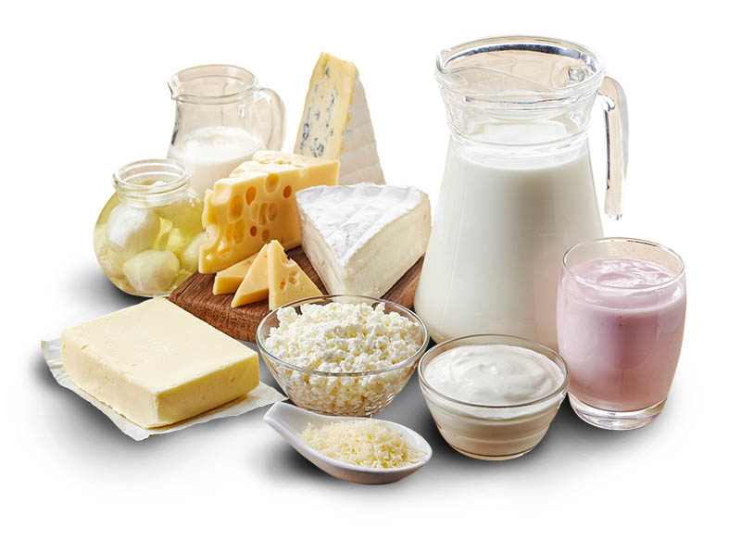
Dairy
Nutrition
Dairy foods help keep your bones strong. This can prevent fractures, and prevent muscle pain and weakness
FITNESS CAPTAINS | LESSON 1: OVERVIEW OF FITNESS
Notes:
Dairy foods help keep your bones strong. This can prevent fractures, and prevent muscle pain and weakness
Dairy foods contain Vitamin D and calcium
Your goal is to have at least 3 cups of dairy per day
QUESTION:
What are some of your favorite dairy foods? Write down at least 3 examples in your workbook.
Ask a few participants to share their answers and go to the next slide

Slide 31
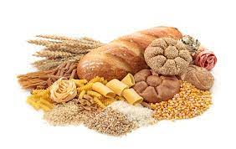
Grains
Nutrition
Grains are naturally high in fiber, helping you feel full and satisfied — which makes it easier to maintain a healthy body weight!
FITNESS CAPTAINS | LESSON 1: OVERVIEW OF FITNESS
Notes:
Grains are naturally high in fiber, helping you feel full and satisfied — which makes it easier to maintain a healthy body weight!
Try to make half your grains whole grains
QUESTION:
What are some of your favorite grain foods? Write down at least 2 examples in your workbook.
Ask a few participants to share their answers and go to the next slide

Slide 32
Protein
Nutrition
Protein helps with recovery and repair of tissues in the muscles, skin, organs, blood, hair and nails
Protein gives you energy
FITNESS CAPTAINS | LESSON 1: OVERVIEW OF FITNESS
Notes:
Long term energy source

Slide 33
Portion Control
Nutrition
Eat what your body needs:
Use smaller plates and bowls
Limit distractions during meals
Keep extra food off the table
Eat slowly and chew your food
Stop eating when you are full
FITNESS CAPTAINS | LESSON 1: OVERVIEW OF FITNESS
Notes:
Portion control means choosing a healthy amount of a certain food.
Portion control helps you get the benefits of the nutrients in the food without overeating. Eat what your body needs.
Here are some tips to help you with portion control:
Use smaller plates and bowls
Limit distractions during meals
Keep food off the table
Eat slow
QUESTION:
Are there other things you try to do to control how much you eat? Write down your answer in your workbook
Ask a few participants to share their answers and go to the next slide

Slide 34
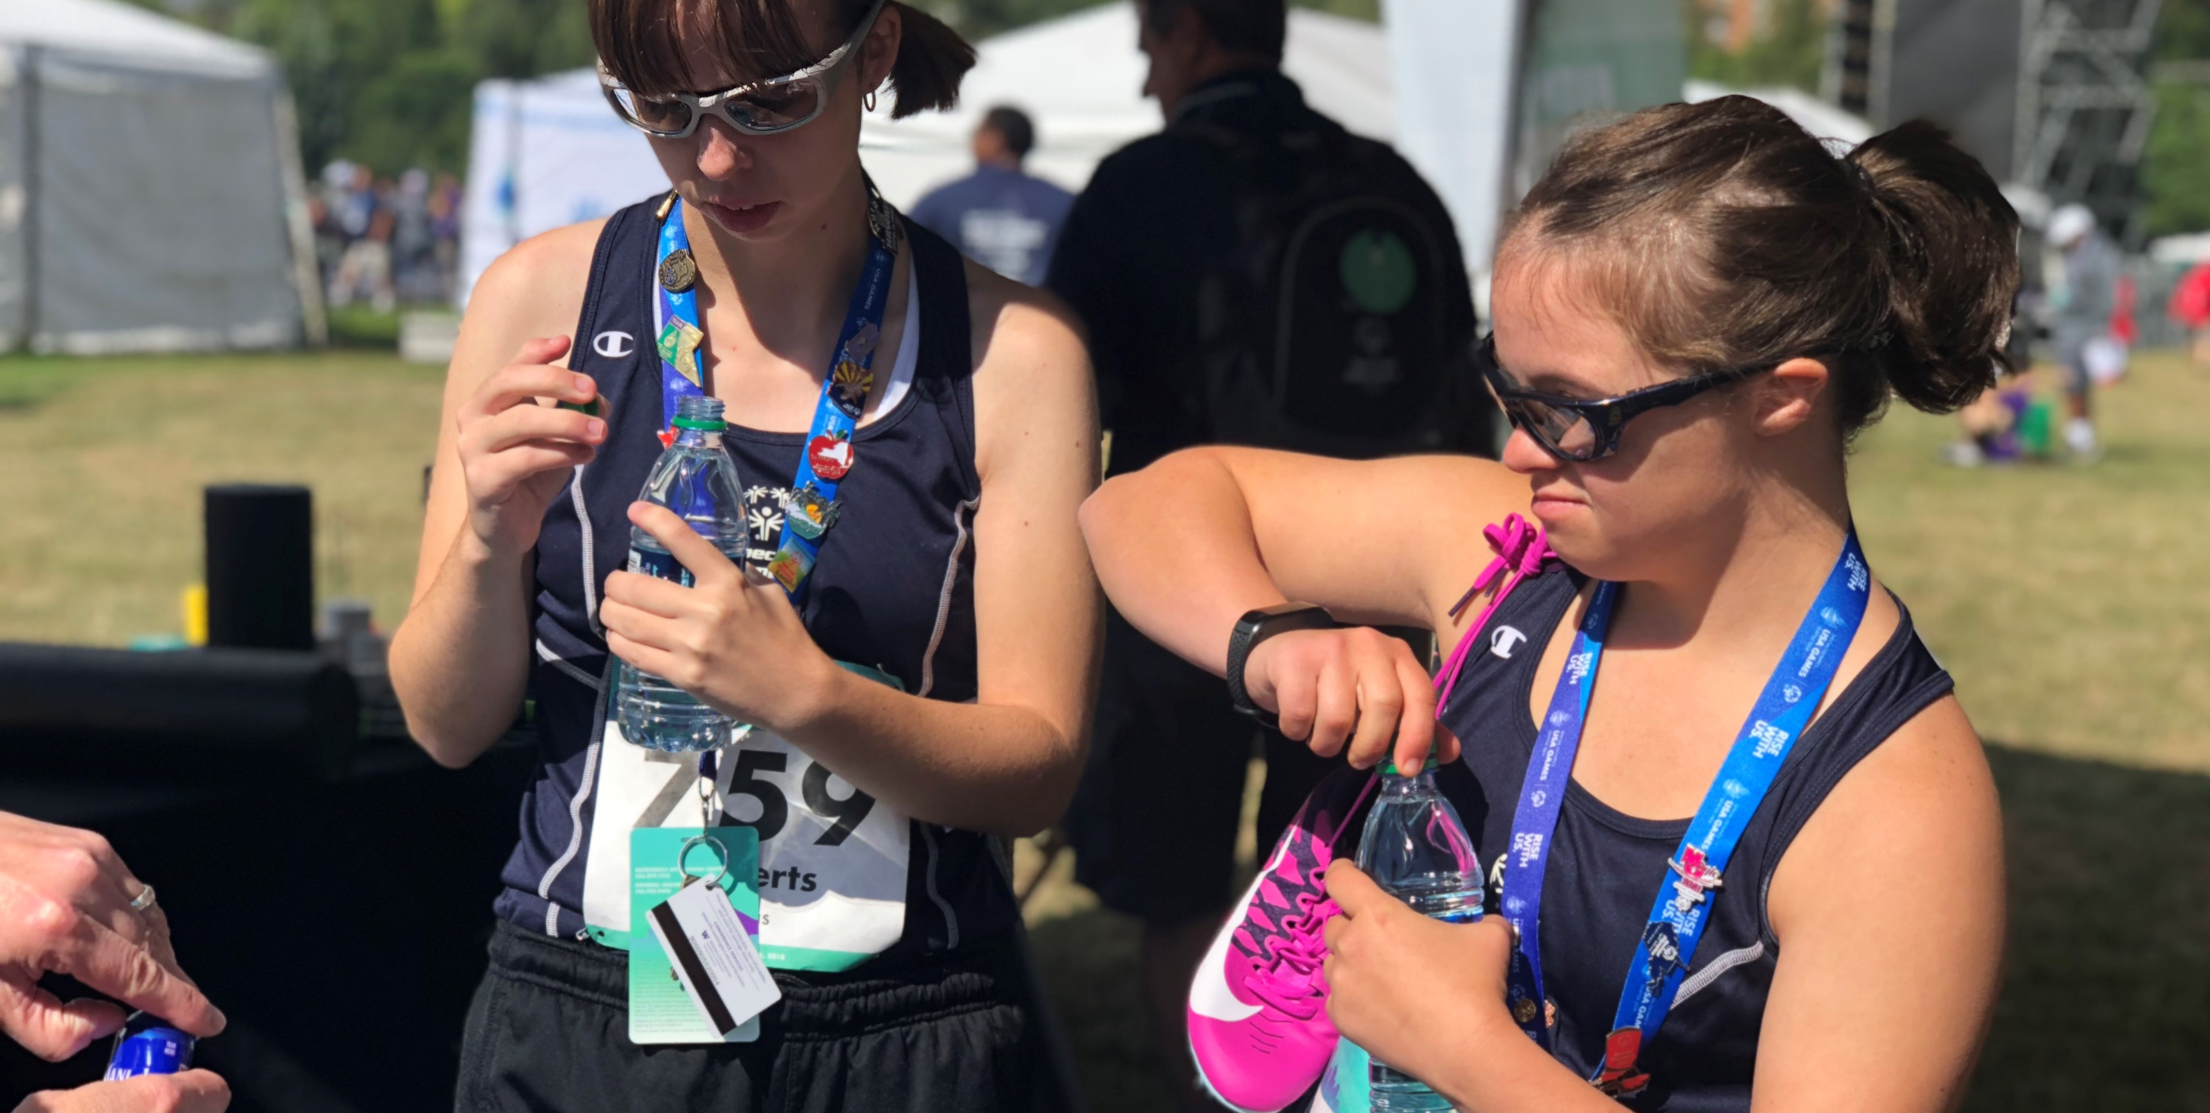
Event Planning
Leadership Events
FITNESS CAPTAINS | LESSON 1: OVERVIEW OF FITNESS
Notes:
Last but not least, let’s talk about hydration!

Slide 35
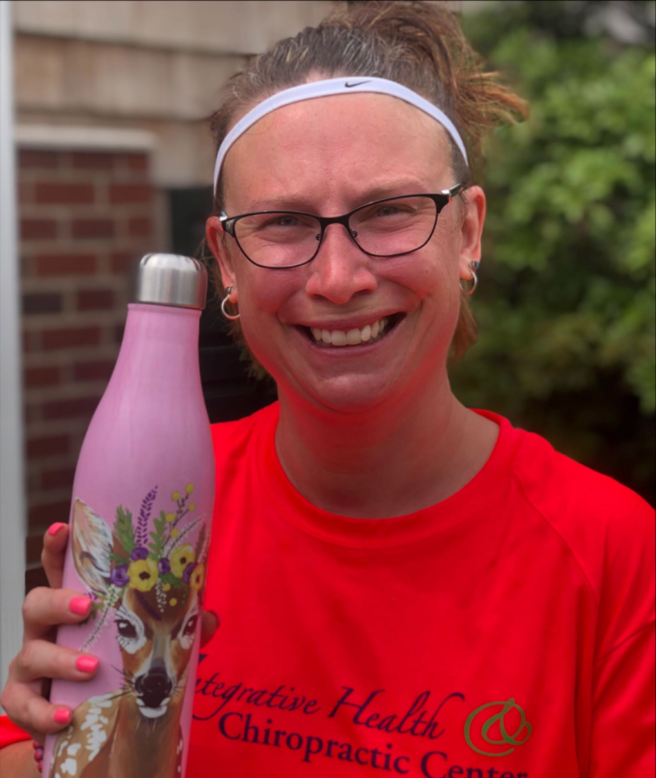
Drinking Water
Hydration
Hydration is keeping the amount of fluid you need in your body
Drinking the right amount of water is important for your health, especially when you exercise
FITNESS CAPTAINS | LESSON 1: OVERVIEW OF FITNESS
Notes:
Hydration is keeping the amount of fluid you need in your body
Drinking the right amount of water is important for your health, especially when you exercise

Slide 36
Benefits
Hydration
Balance Body
Temperature
Absorb Vitamins and Minerals
Helps with Digestion
Body and Mind Work Properly
FITNESS CAPTAINS | LESSON 1: OVERVIEW OF FITNESS
Notes:
Did you know that your body is made up of 60% water! So, it’s not surprising that water is the most important drink for your body. it’s needed for every function in our body!
Hydration:
Helps your body balance the temperature inside your body.
Aids in the breakdown of the foods you eat.
Helps your body absorb vitamins and minerals from foods eaten
Helps your body and mind work properly.

Slide 37
Healthy Beverage Choices
Hydration
Sodas, energy drinks, and sports drinks are NOT good beverage choices
Low-fat milk and 100% juice are also good choices in small amounts
Water is the best choice for a beverage!
FITNESS CAPTAINS | LESSON 1: OVERVIEW OF FITNESS
Notes:
There are many beverage options available, but some of them are healthier choices than others.
Sodas, energy drinks, and sports drinks are NOT good beverage choices
These drinks have extra sugar and can make you gain weight.
Energy drinks and many sodas also have caffeine. Caffeine does not help you stay hydrated.
Moderate amounts of low-fat milk and 100% juice are also good choices in small amounts
No more than 3 cups of milk and 1 cup of juice per day.
Water is the best choice for a beverage! Drink water every day! Water doesn’t have to be boring either. If you like flavored drinks, try sparkling water or try infusing your water.
ACTVITY:
You can do the activity in your workbook when the lesson is complete.

Slide 38
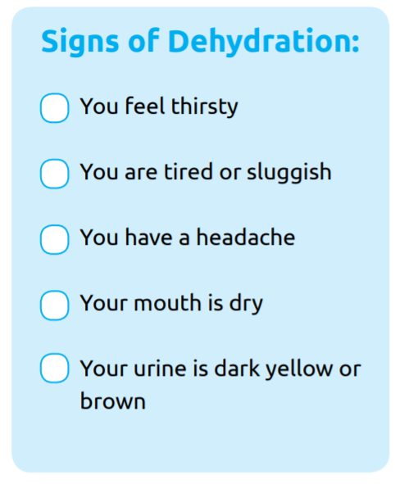
Signs of Dehydration
Hydration
If you lose too much water without drinking more, your body and mind won’t work as well. This is called dehydration
FITNESS CAPTAINS | LESSON 1: OVERVIEW OF FITNESS
Notes:
You lose water when you go to the bathroom, sweat, exercise or even breathe.
Did you know that dehydration of 1-2% of your body weight can decrease your sport performance? You lose water every day when you go to the bathroom, sweat, and even when you breathe.
If you lose too much water without drinking more, your body won’t work as well. This is called dehydration.
Here are some signs of dehydration:
You feel thirsty
You are tired or sluggish
You have a headache
Your mouth is dry
Your urine is dark yellow brown

Slide 39
Adapting your Water Needs
Hydration
Some people may need to increase their water consumption.
These factors can affect how much water you should be drinking in order to stay properly hydrated:
Frequent, vigorous exercise when you are sweating a lot or out of breath
Hot weather
High elevations
Illness
FITNESS CAPTAINS | LESSON 1: OVERVIEW OF FITNESS
Notes:
Your goal is to have 5 bottles of water per day but some people may need to increase their water consumption.
These factors can affect how much water you should be drinking in order to stay properly hydrated:
Frequent, vigorous exercise when you are sweating a lot or out of breath
Hot weather
High elevations
Illness
Don’t wait until you are thirsty for a drink – drink water before, during and after your workout or sport practice
QUESTION:
What are some tips to stay hydrated? Write your answers down in your workbook.
Ask a few participants to share their answers and go to the next slide

Slide 40
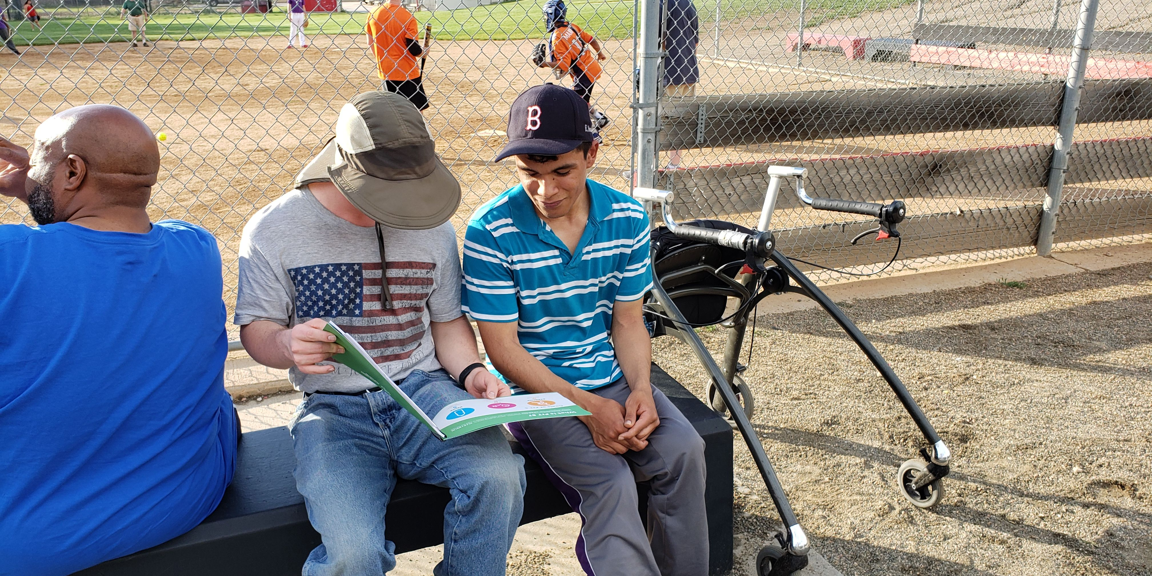
Event Planning
Leadership Events
FITNESS CAPTAINS | LESSON 1: OVERVIEW OF FITNESS
Notes:
To end our session, let’s talk about sharing health tips to your teammates!

Slide 41
Teaching your Teammates
Health Education
Fitness Captains are expected to share a health education tip at each training session
You will also lead by example during all practice and competitions
FITNESS CAPTAINS | LESSON 1: OVERVIEW OF FITNESS
Notes:
As a Fitness Captain, you are expected to share a health education tip at each training session. You should teach healthy habits that improve fitness and sports performance.
You will also lead by example during at practice and competitions

Slide 42
What is a Health Tip?
Health Education
Health Tips should be brief, only 2-5 minutes
When possible, make the health tips interactive:
Ask your teammates questions
Allow different members of your team to answer
Provide examples
Give them a goal and check-in with their progress at the next training session
FITNESS CAPTAINS | LESSON 1: OVERVIEW OF FITNESS
Notes:
Health Tips are small but useful pieces of advice that can help you and your teammates make healthy choices. They should be brief, only 2-5 minutes
When possible, make the health tips interactive! You can engage your teammates by:
Asking them questions
Allowing different members of your team to answer
Providing examples
Giving them a goal and check-in with their progress at the next training session

Slide 43
Example
Health Education
Here is a Health Tip about eating healthy and nutritious foods!
Fruits and vegetables give your body important vitamins, minerals and energy needed for good health. They provide energy for your practice and competition. Eat the rainbow of colors – mix the red, green, orange and yellow foods. Can you name a food for each color?
FITNESS CAPTAINS | LESSON 1: OVERVIEW OF FITNESS

Slide 44
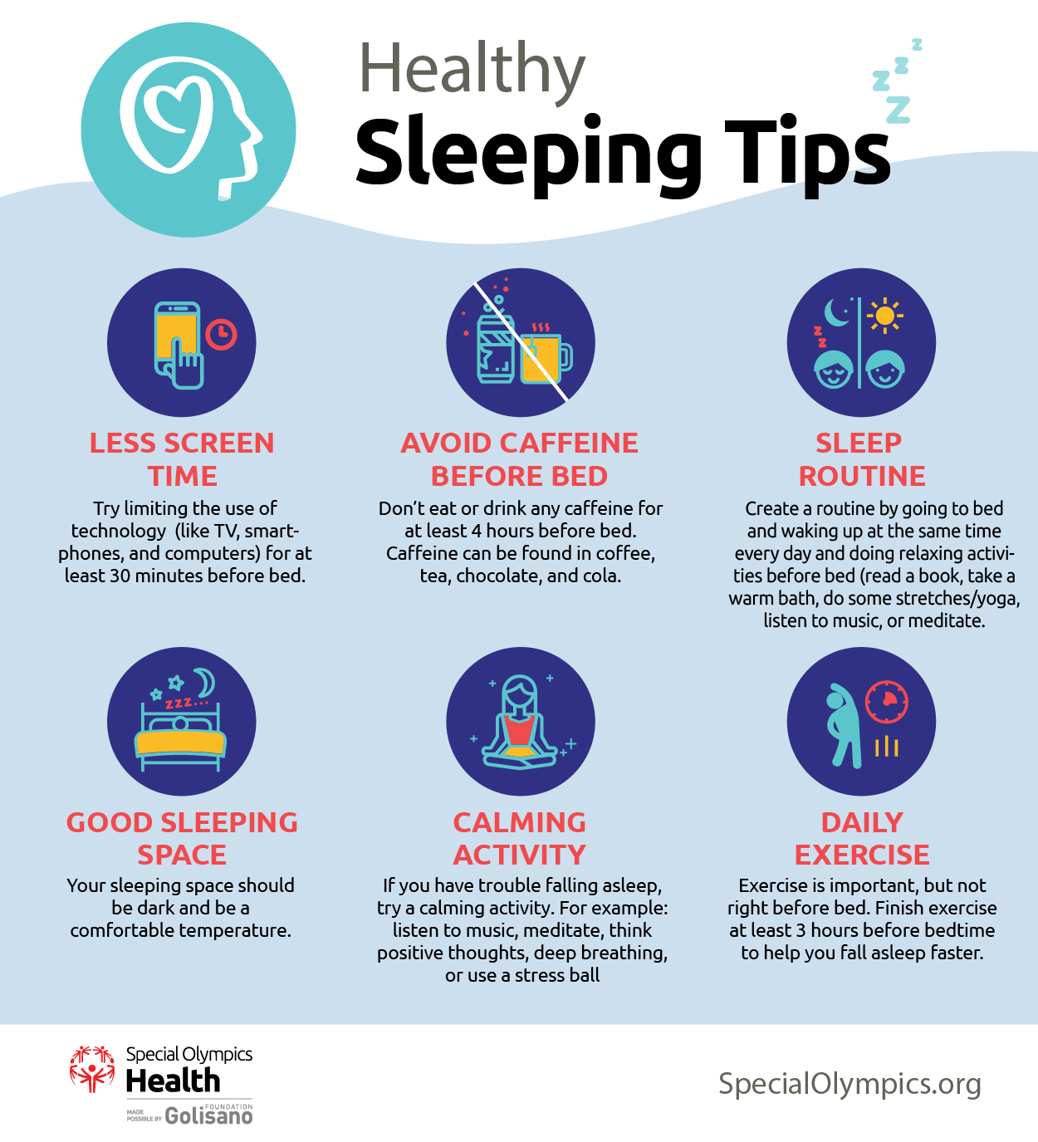
Example
Health Education
Here is a Health Tip about sleep, rest and recovery!
Doing 30 minutes of medium to hard physical activity 5 days a week is an important part of a healthy lifestyle. It is also important to give your body time off each week from exercise and get 7-9 hours of sleep every night. You can use the Healthy Sleeping Tips to improve your quality of sleep, rest and recovery.
FITNESS CAPTAINS | LESSON 1: OVERVIEW OF FITNESS

Slide 45
Group Activity
Work as a group to create Health Tips. One person from each group will present the Health Tips to the rest of the room!
Notes:
[Optional Group Activity]

Slide 46
Opportunities
Health Education
You can share health tips in many ways! Think about all the different ways you communicate with your fellow Special Olympics athletes
You might want to share a health tip during:
Water Breaks Cool-Down Stretches
FITNESS CAPTAINS | LESSON 1: OVERVIEW OF FITNESS
Notes:
You can share health tips in many ways! Think about all the different ways you communicate with your fellow Special Olympics athletes
You might want to share a health tip during:
Water breaks
Cool-down stretches
Make sure you talk to your coach about the best time to share a health tip at your sports practice!

Slide 47
Getting Started
Health Education
Using the Fit 5 Guide, you can share lessons on:
Staying active outside of sport
Eating healthy foods that fuel your body
Drinking hydrating beverages
FITNESS CAPTAINS | LESSON 1: OVERVIEW OF FITNESS
Notes:
You can give a health tip about any of the parts of fitness:
Physical Activity
Hydration Nutrition
ASK: How many of you have seen or used the Fit 5 Guide before? Raise your hand.
Great! Fit 5 is a guide to achieving fitness and your personal best with physical activity, nutrition and hydration. Using the information in the Fit 5 Guide, you can share lessons on:
Staying active outside of sport
Eating healthy foods that fuel your body
Drinking hydrating beverages

Slide 48
Getting Started
Health Education
In addition to the Fit 5 Guide and Fitness Cards, you can also find information for your Health Tips in these webpages and resources:
Special Olympics Health Education toolkit
High 5 for Fitness
Health Promotion – Educational Materials
Your Program’s fitness resources and guides
FITNESS CAPTAINS | LESSON 1: OVERVIEW OF FITNESS
Notes:
In addition to the Fit 5 Guide and Fitness Cards, you can also find information for your Health Tips in these webpages and resources:
Special Olympics Health Education toolkit
High 5 for Fitness
Health Promotion – Educational Materials
Your Program’s fitness resources and guides
You can also use your workbook to help come up with Health Tips!

Slide 49
Homework
Health Education
Select or create your own health tip and practice sharing it with others
At the beginning of our next lesson, you will be asked to present your health tip with the group!
FITNESS CAPTAINS | LESSON 1: OVERVIEW OF FITNESS

Slide 51
Lesson 2
Leading Warm-Ups and Cool-Downs
In this lesson we will
Practice leading dynamic warm-up and cool-down routines for different sports
Notes:
Welcome back to Fitness Captain Training! In Lesson 2 we will Practice leading warm-up and cool-down routines for different sports!

Slide 52
Check-In
Fitness Captains
Reflections and questions from Lesson 1
Practice presenting Health Tips
FITNESS CAPTAINS | LESSON 2: LEADING WARM-UPS AND COOL-DOWNS

Slide 53
Role and Responsibilities
Fitness Captains
Fitness Captains will work closely with their coaches to make sure health and fitness is a key component of the sports experience by participating in these leadership roles:
Teach Healthy Habits
Lead Warm-Ups and Cool-Downs
FITNESS CAPTAIN
Notes:
Let’s revisit the roles and responsibilities of a Fitness Captain.
Using your leadership skills, Fitness Captains will work closely with their coaches to make sure health and fitness is a key component of the sports experience by:
Teaching Healthy Habits to their teammates
Leading warm-up and cool-downs before and after practice
In Lesson 1, we learned about the different parts of fitness and how to teach Health Tips. Now, it’s time for you to learn about warm-up and cool-downs, and practice leading exercises!

Slide 54
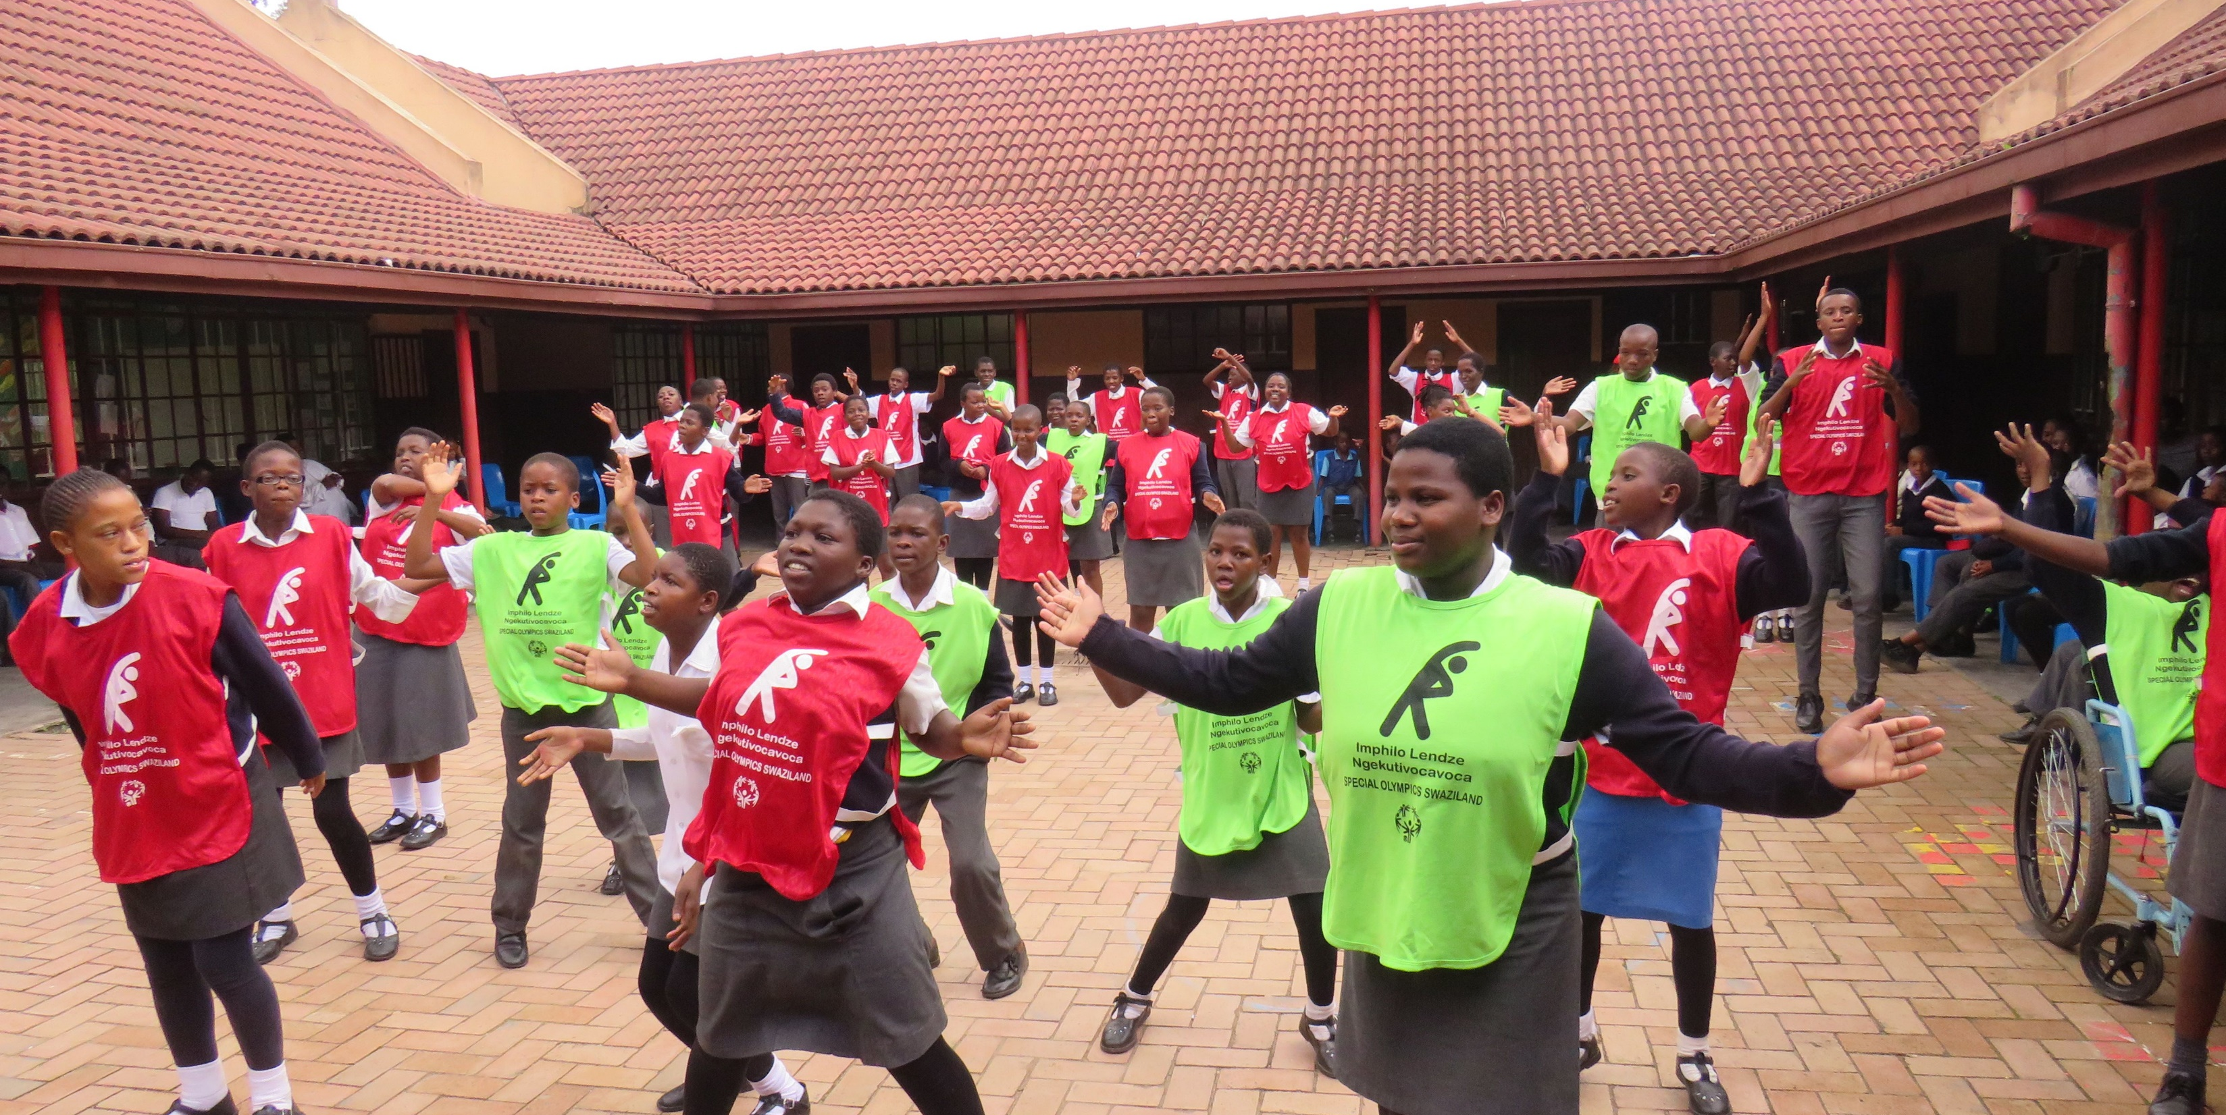
Event Planning
Leadership Events
FITNESS CAPTAINS | LESSON 2: LEADING WARM-UPS AND COOL-DOWNS

Slide 55
What is a Warm-Up?
Warm-Up
A warm-up should be the first physical activity at every practice and competition
A good warm-up helps athletes reach a state of physical and mental readiness
FITNESS CAPTAINS | LESSON 2: LEADING WARM-UPS AND COOL-DOWNS
Notes:
A warm-up should be the first physical activity in every training session or competition. It helps athletes to reach a state of physical and mental readiness. When athletes prepare both the body and the mind, they are less likely to suffer an injury and will perform better at each practice, training and competition.

Slide 56
Purpose of a Warm-Up
Warm-Up
Physical and Mental Benefits
Increase heart rate Increase breathing rate Increase body and muscle temperature Greater blood flow to the active muscles Shift focus from life to sport Connects the mind and the body
FITNESS CAPTAINS | LESSON 2: LEADING WARM-UPS AND COOL-DOWNS
Notes:
Warm-up prepares the body for sport or exercise and helps to prevent injury by increasing:
Heart rate
Breathing rate
Blood flow to the active muscles
Body and muscle temperature.
Warm-ups prepare the mind to focus on the sport or exercise by:
Helping athletes shift focus from life to sport
Mentally reviewing skills previously learned
Connecting the mind and the body (e.g. linking hand and eye coordination)

Slide 57
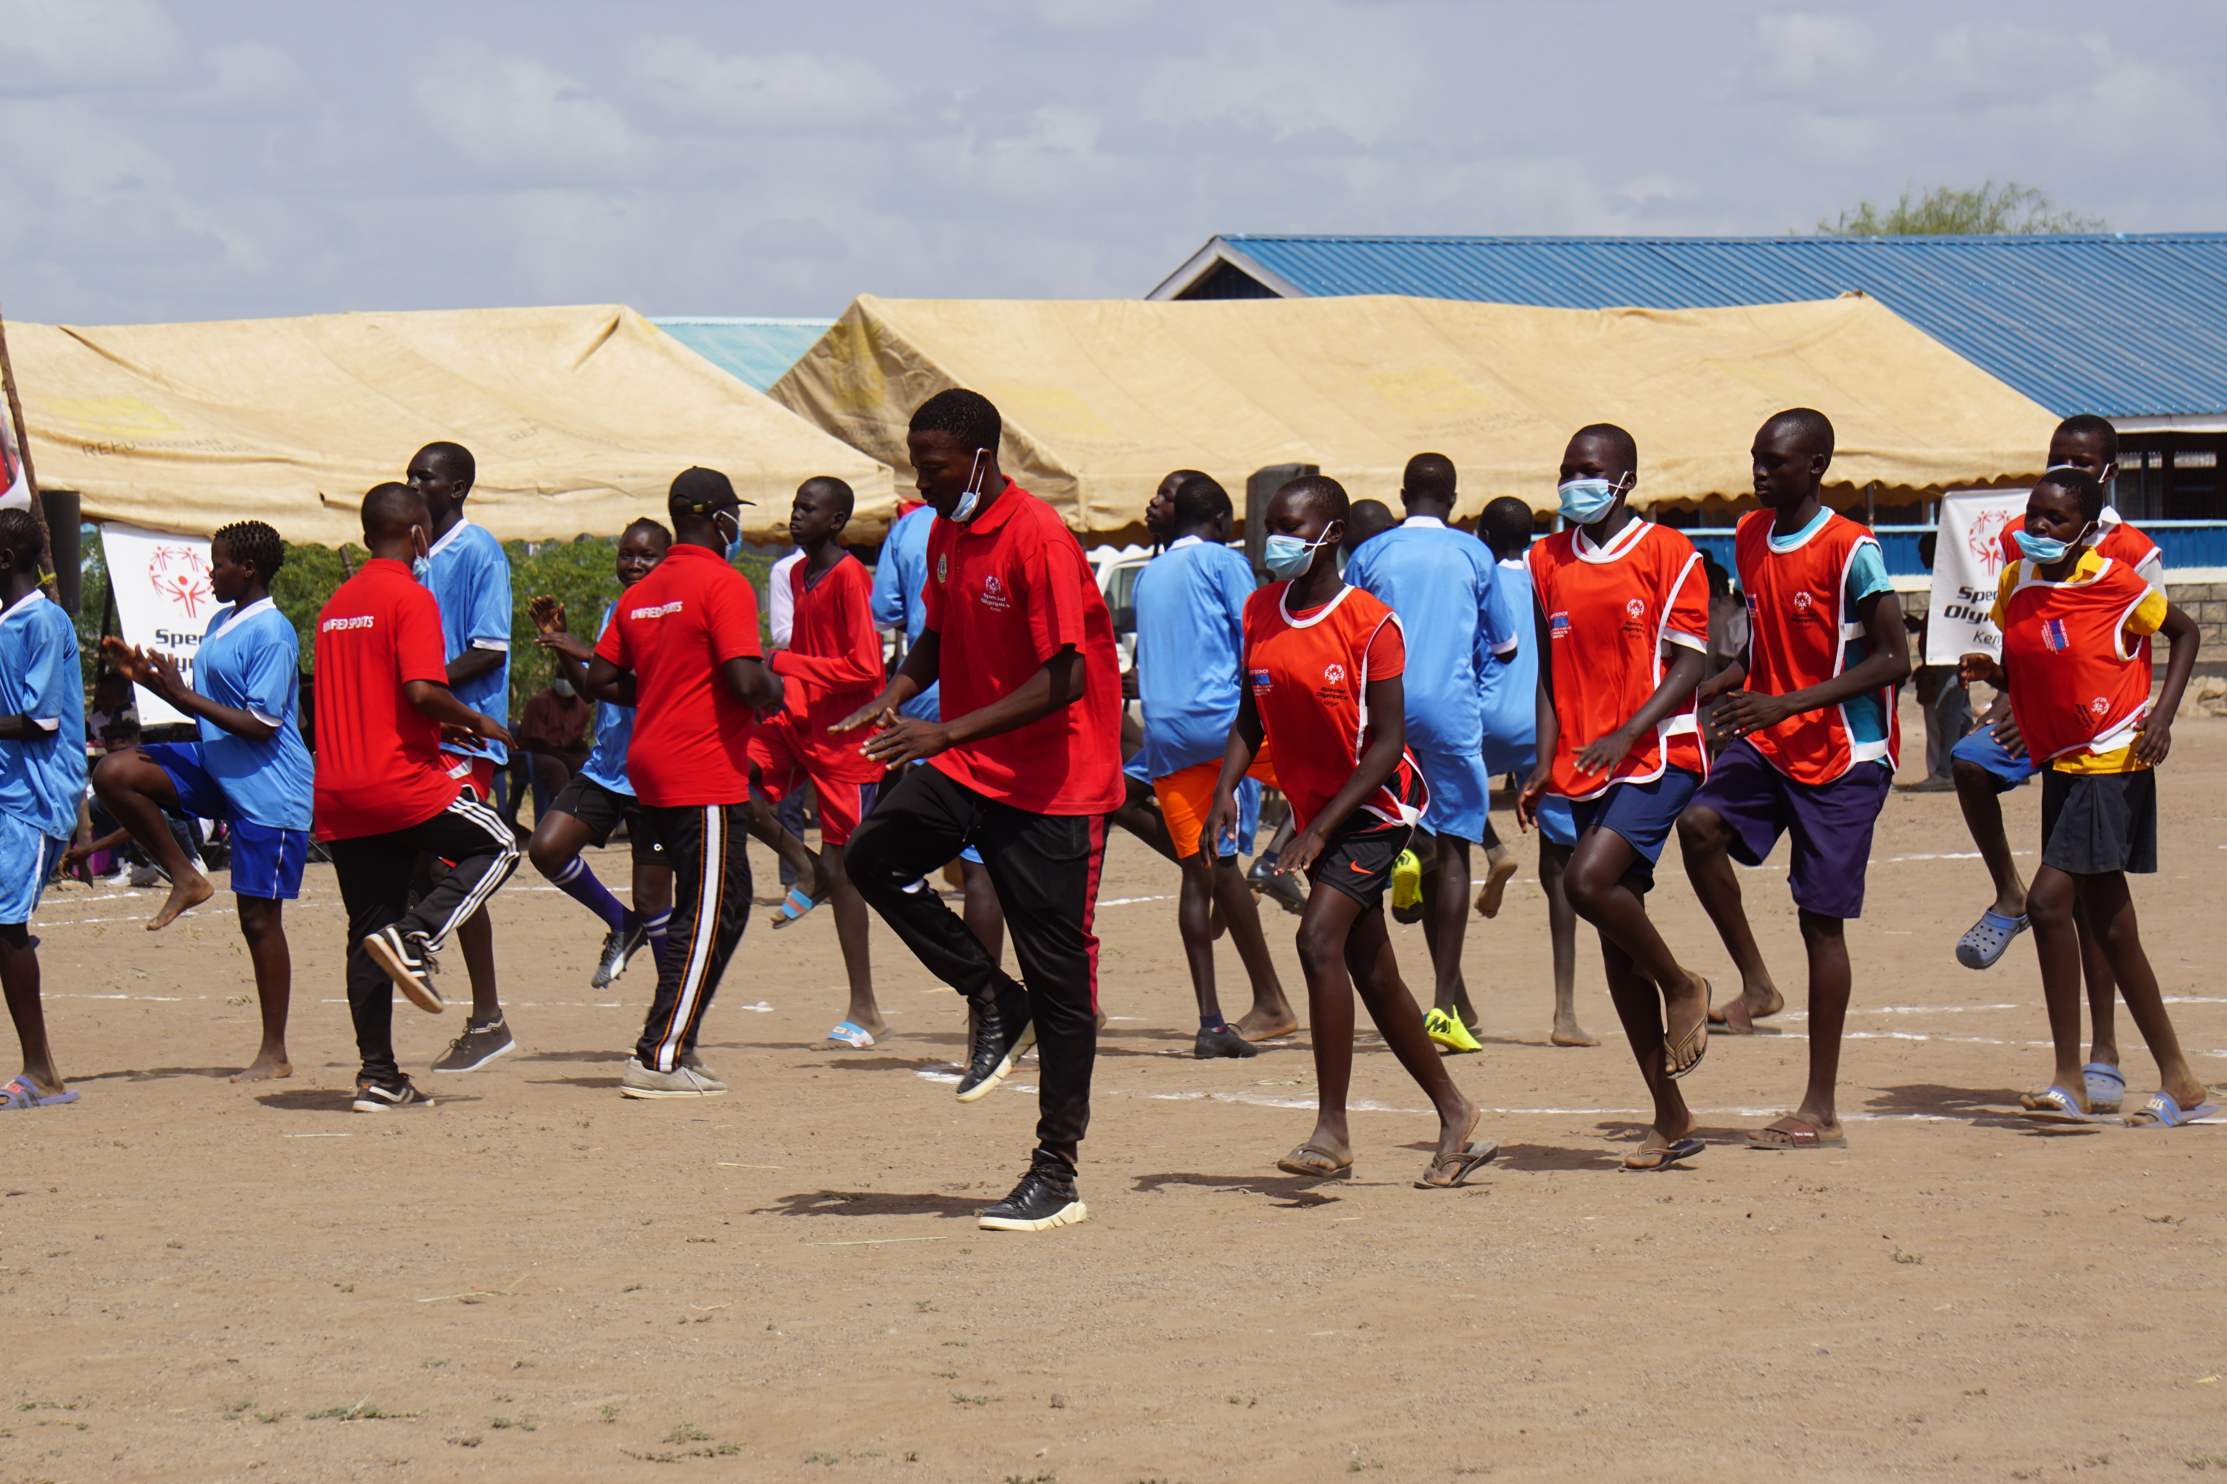
How do we Warm-Up?
Warm-Up
These two elements should be included in all warm-ups:
Aerobic Activity
Dynamic Stretches
FITNESS CAPTAINS | LESSON 2: LEADING WARM-UPS AND COOL-DOWNS
Notes:
Every sport is different and each sport has specific skills and movements. The warm-up should be personalized to the sport and the ability levels of the athletes. Warm-ups should begin at a slow pace and gradually become a little faster and more difficult.
Regardless of the sport, however, these three elements should be included in all warm-ups:
Aerobic Activity
Dynamic Stretches

Slide 58
Aerobic Activity
Warm-Up
Aerobic activities are whole body movements that will increase the heart rate.
Start at a slow pace and gradually increase in intensity/difficulty
Last at least 5 minutes
What are some aerobic activities that you can lead?
Think back to Lesson One… Aerobic = Endurance
FITNESS CAPTAINS | LESSON 2: LEADING WARM-UPS AND COOL-DOWNS
Notes:
Think back to Lesson 1…aerobic is a term used to describe endurance exercises.
Aerobic activities are whole body movements that increase heart rate. Activities should start at a slow pace and gradually increase in intensity/difficulty and last at least 5 minutes. Athletes should feel warm, a little out of breath and energized by the end. This can be a fun part of your training session!
QUESTION:
What are some aerobic activities that you can lead?
Ask a couple participants to share their answers.
Great answers! Here are some other ideas:
Walk or jog around the field or court for 5 minutes
Add direction changes or walking/running patterns such as sideways, backwards, skipping, galloping, etc.
Choose and lead a few Fit 5 Endurance Exercises
Develop a team dance or have the group dance independently

Slide 59
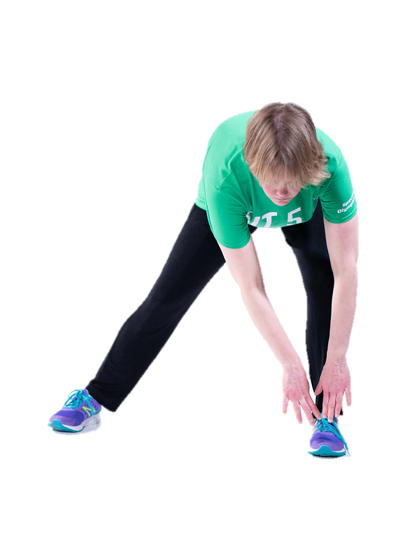
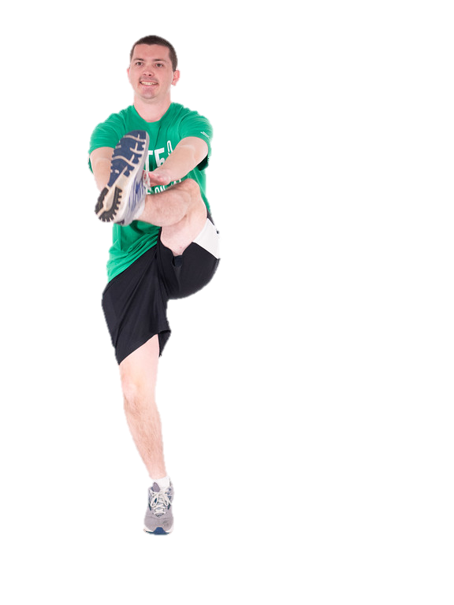
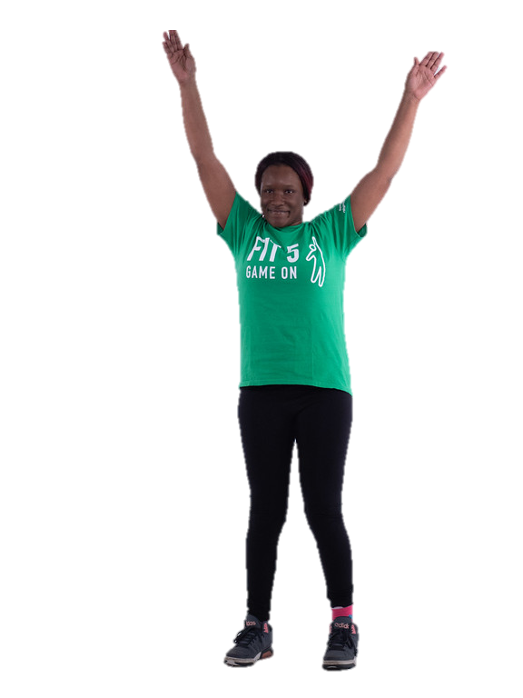
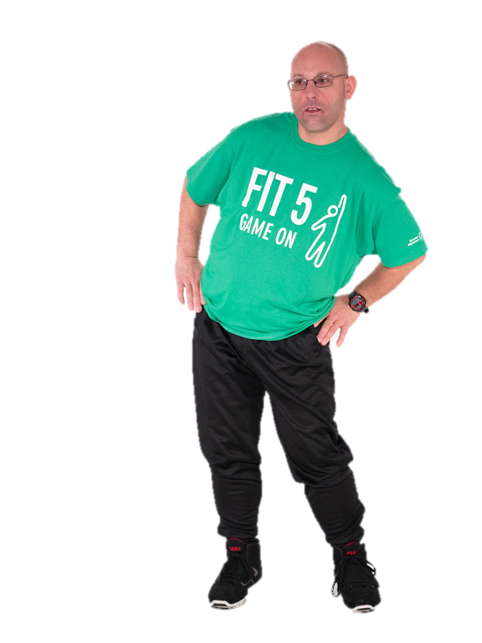
Dynamic Stretches
Warm-Up
Dynamic stretches consist of active, controlled movements that take body parts through a full range of motion
FITNESS CAPTAINS | LESSON 2: LEADING WARM-UPS AND COOL-DOWNS
Notes:
Once the body is warm from your aerobic activity, it is time to focus on stretching the muscles you will use during your sport.
Dynamic stretches consist of active, controlled movements that take body parts through a full range of motion. Some examples are arm circles and leg swings. These are better than traditional/static stretches in the warm-up because the body temperature and heart rate stay elevated. In addition, dynamic stretches have been shown to reduce injury better than traditional stretches.
Examples: arm swings, walking high kicks, hip circles

Slide 60
Warm-Up Guides
Warm-Up
Special Olympics created warm-up guides and videos for specific sports to help you lead these at practice!
FITNESS CAPTAINS | LESSON 2: LEADING WARM-UPS AND COOL-DOWNS
Notes:
Special Olympics created warm-up guides and videos for specific sports to help you lead these at practice!
This is a great resource to help you learn and lead warm-up routines.

Slide 61
How-To Lead a Warm-Up
Warm-Up
Warm-ups can be done in place or across the playing area
Start off slow, and gradually increase speed/pace
Follow a routine
When possible, provide modifications for your teammates if exercises are too easy or too difficult
Select exercises that are specific to your sport. They should use the parts of your body that you use when playing your sport.
FITNESS CAPTAINS | LESSON 2: LEADING WARM-UPS AND COOL-DOWNS
Notes:
When possible, provide modifications for your teammates if exercises are challenging (ex: march in place vs. high knees)
Select exercises that are specific to your sport. They should use the parts of your body that you use when playing your sport.

Slide 62
Example Modifications
Warm-Up
Exercise | Easier Modification | More Difficult Modification
High Knees | Go slower March in place | Increase your speed
Jumping Jacks | Step one leg out at a time Move only your legs and keep your arms down Go slower | Squat jump
Light Jog | Fast walk Jog in place | Add accelerations to your jog
FITNESS CAPTAINS | LESSON 2: LEADING WARM-UPS AND COOL-DOWNS
Notes:
Here are some examples of modifications
Now let’s look at the Modification Activity in your workbook

Slide 63
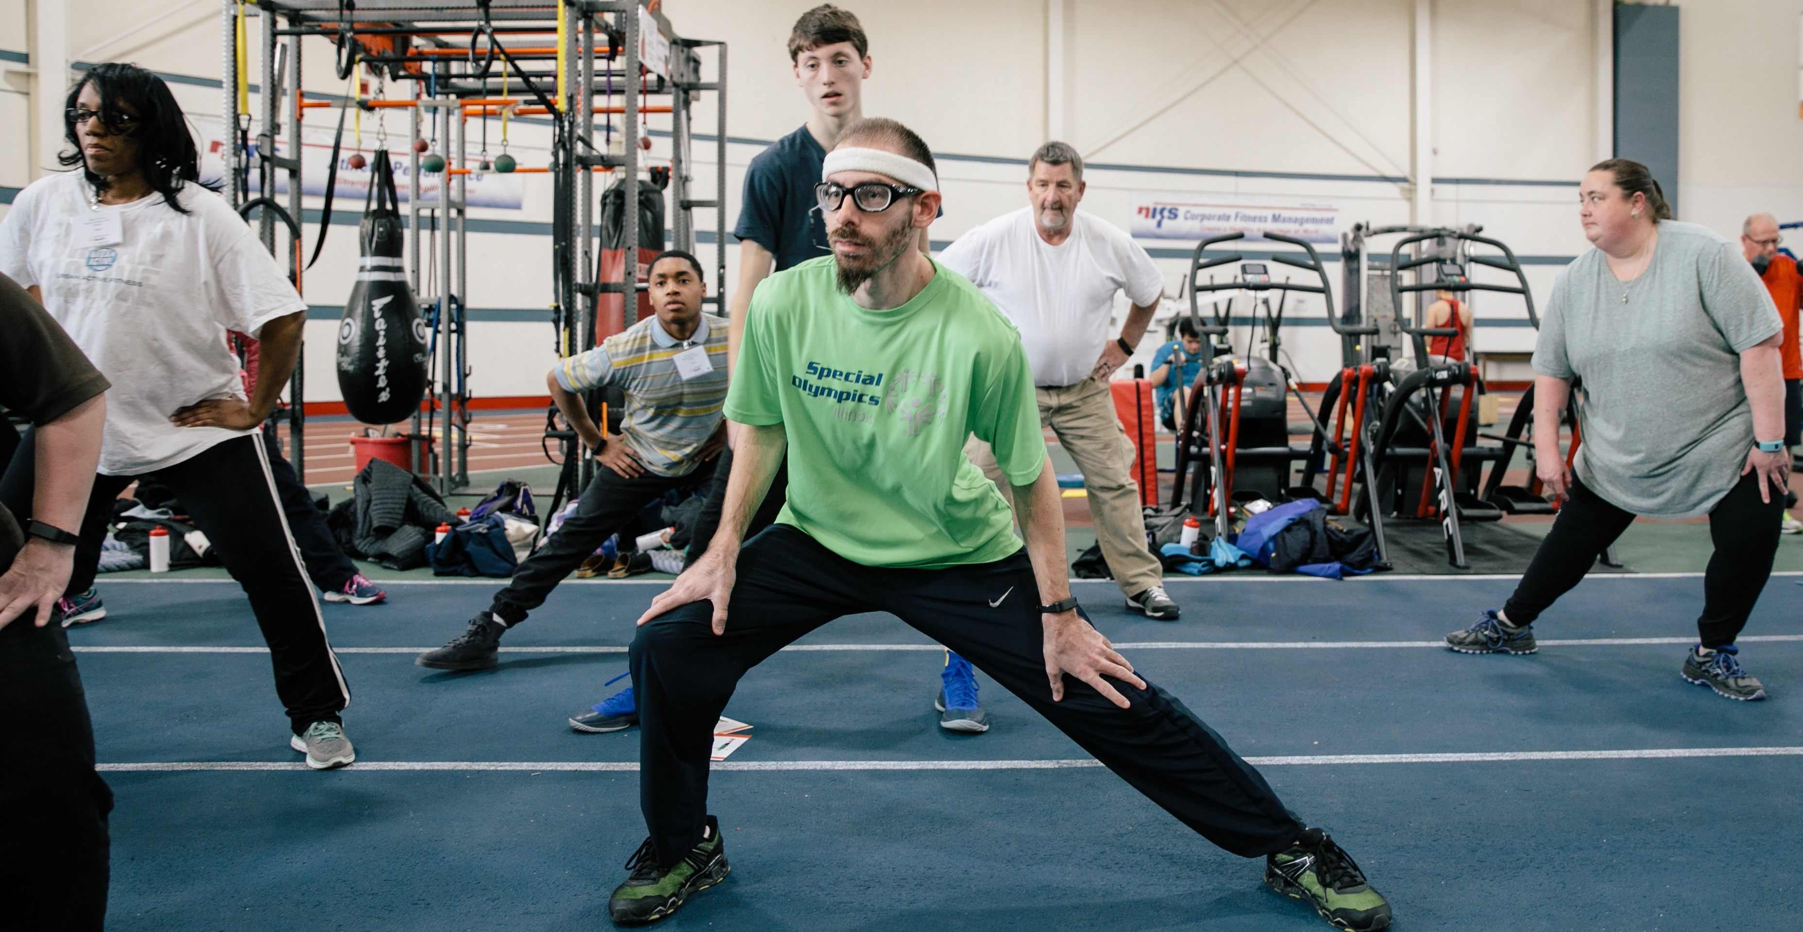
FITNESS CAPTAINS | LESSON 2: LEADING WARM-UPS AND COOL-DOWNS
Notes:
Now let’s talk about cool-downs!

Slide 64
What is a Cool-Down?
Cool-Down
When your training, practice or sport session is complete, you should always cool-down
A good cool-down allows the body to gradually return to a state of rest
FITNESS CAPTAINS | LESSON 2: LEADING WARM-UPS AND COOL-DOWNS
Notes:
When your training, practice or sport session is complete, you should always cool-down. A good cool-down allows the body to gradually return to a state of rest.
It is just as important to have a good cool-down as it is to have a good warm-up

Slide 65
Purpose of a Cool-Down
Cool-Down
Physical and Mental Benefits
Decrease heart rate Decrease breathing rate Decrease body and muscle temperature Returns rate of blood flow from the active muscles to resting level Decrease muscle soreness Improve flexibility Increases the rate of recovery from exercise Promote relaxation
FITNESS CAPTAINS | LESSON 2: LEADING WARM-UPS AND COOL-DOWNS
Notes:
It is just as important to have a good cool-down as it is to have a good warm-up. Like warm-ups, cool-downs have many physical and mental benefits, such as:
Decreasing heart rate, breathing rate and body temperature
Decreasing muscle soreness to increase the rate of recovery
Improving flexibility
Promoting relaxation
QUESTION:
What do you notice about this list? How does it differ from warm-ups?

Slide 66
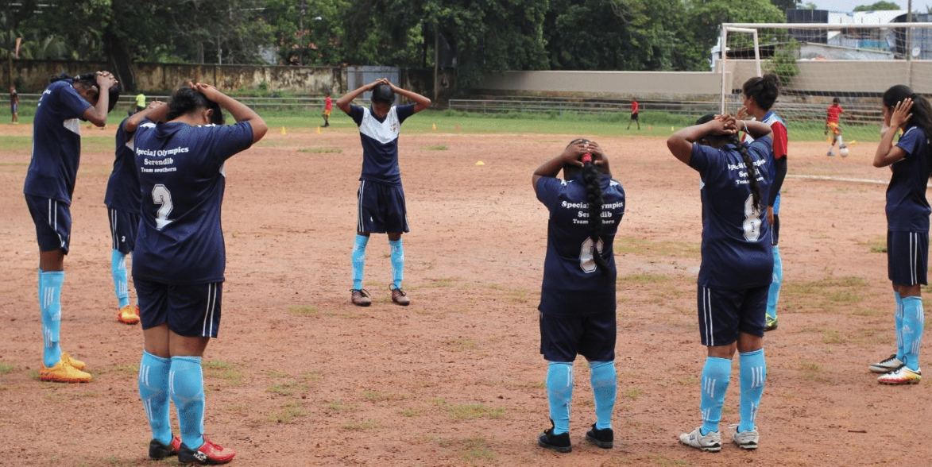
How do we Cool-Down?
Cool-Down
A typical cool-down includes:
Light Aerobic Activity
Static Stretching
FITNESS CAPTAINS | LESSON 2: LEADING WARM-UPS AND COOL-DOWNS
Notes:
Like warm-ups, a typical cool-down includes two key components:
Light aerobic activity
Stretching

Slide 67
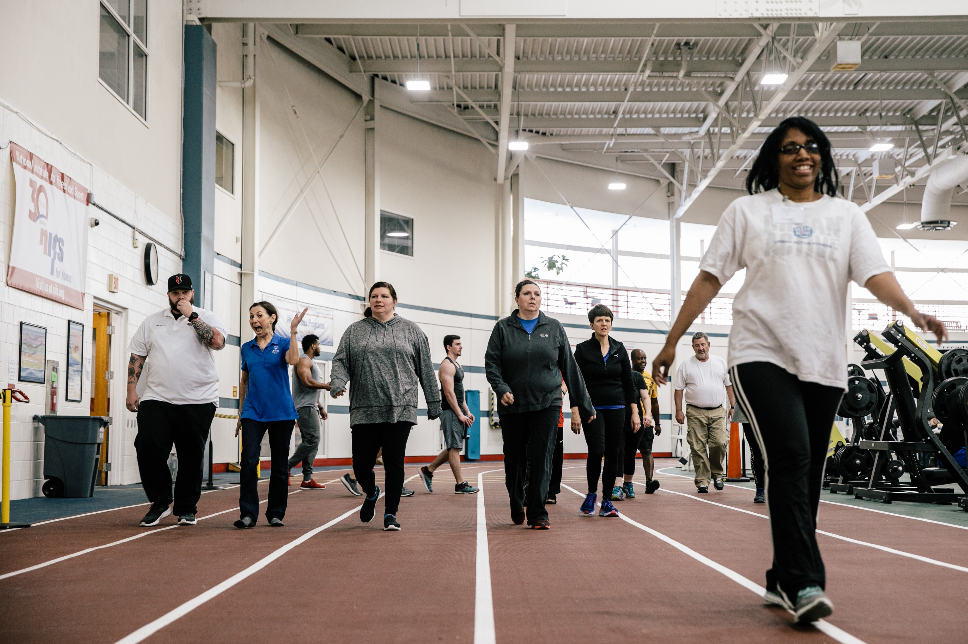
Light Aerobic Activity
Cool-Down
Aerobic activity should gradually decrease in intensity/difficulty
Your heart should be beating slowly, and you should not be out of breath
It could be a short jog/walk
FITNESS CAPTAINS | LESSON 2: LEADING WARM-UPS AND COOL-DOWNS
Notes:
Opposite to warm-ups, the aerobic activity in a cool-down should gradually decrease in intensity/difficulty. It could be a light jog, moving into a brisk walk and finally ending to a slow walk. You may also include some strength and conditioning exercises.
Your heart should be beating slowly, and you should not be out of breath. This activity could be a short jog/walk.

Slide 68
Static Stretches
Cool-Down
Each sport places stress on different muscles and joints, so it is important to make your stretches sport specific
Tips for stretching:
Hold each stretch for at least 30 seconds
Stretch both sides
Stretches should not be painful
You can also use this time to teach a health tip!
FITNESS CAPTAINS | LESSON 2: LEADING WARM-UPS AND COOL-DOWNS
Notes:
After you complete the light aerobic activity, you will want to stretch. Stretching for flexibility is very effective in the cool-down.
Static stretches should be held for 30 seconds or more and can help to improve flexibility. Each sport places stress on different muscles and joints, so it is important to make your stretches specific to your sport.
Here are some tips for stretching:
Hold each stretch for at least 30 seconds
Stretch both sides – if you stretch your right shoulder muscle, stretch the left!
Stretches should be performed to mild discomfort, but should not be painful.
You can also use this time to teach a health tip!
QUESTION:
What are some static stretches that are important for your sport? Think about the different body parts you use. Write your answers in your workbook.
Give the participants a couple of minutes to work on this, then ask a few participants to share their answers.

Slide 69
Cool-Down Guides
Cool-Down
Special Olympics created cool-down guides and videos for specific sports to help you lead these at practice!
FITNESS CAPTAINS | LESSON 2: LEADING WARM-UPS AND COOL-DOWNS
Notes:
Like warm-ups, Special Olympics created cool-down guides and videos for specific sports to help you lead these at practice!
This is a great resource to help you learn and lead cool-down routines.

Slide 70
How-To Lead a Cool-Down
Cool-Down
Follow a standard routine for your cool-downs
Have your team stand in a circle
Be mindful that some stretches may be challenging for balance
Your teammates can listen to your tips while they stretch!
FITNESS CAPTAINS | LESSON 2: LEADING WARM-UPS AND COOL-DOWNS
Notes:
It’s helpful to follow a standard routine for your cool-downs. Not only will this provide an opportunity for you to review the session or provide suggestions leading into the next practice, it will also create a routine you can suggest your teammates do at home
During stretches, have your team stand in a circle. You can stand in the middle so that everyone can see you and follow your stretches
Be mindful that some stretches may be challenging for balance. Encourage your teammates to hold onto a steady surface or each other’s shoulders
You can also the time at the end of practice to share a Health Tip. Your teammates can listen to your tips while they stretch!

Slide 71
Let’s Practice!
Warm-Ups and Cool-Downs
FITNESS CAPTAINS | LESSON 2: LEADING WARM-UPS AND COOL-DOWNS
Notes:
Now it’s time to practice! Everyone find some space, move your camera so that we can see you.

Slide 72
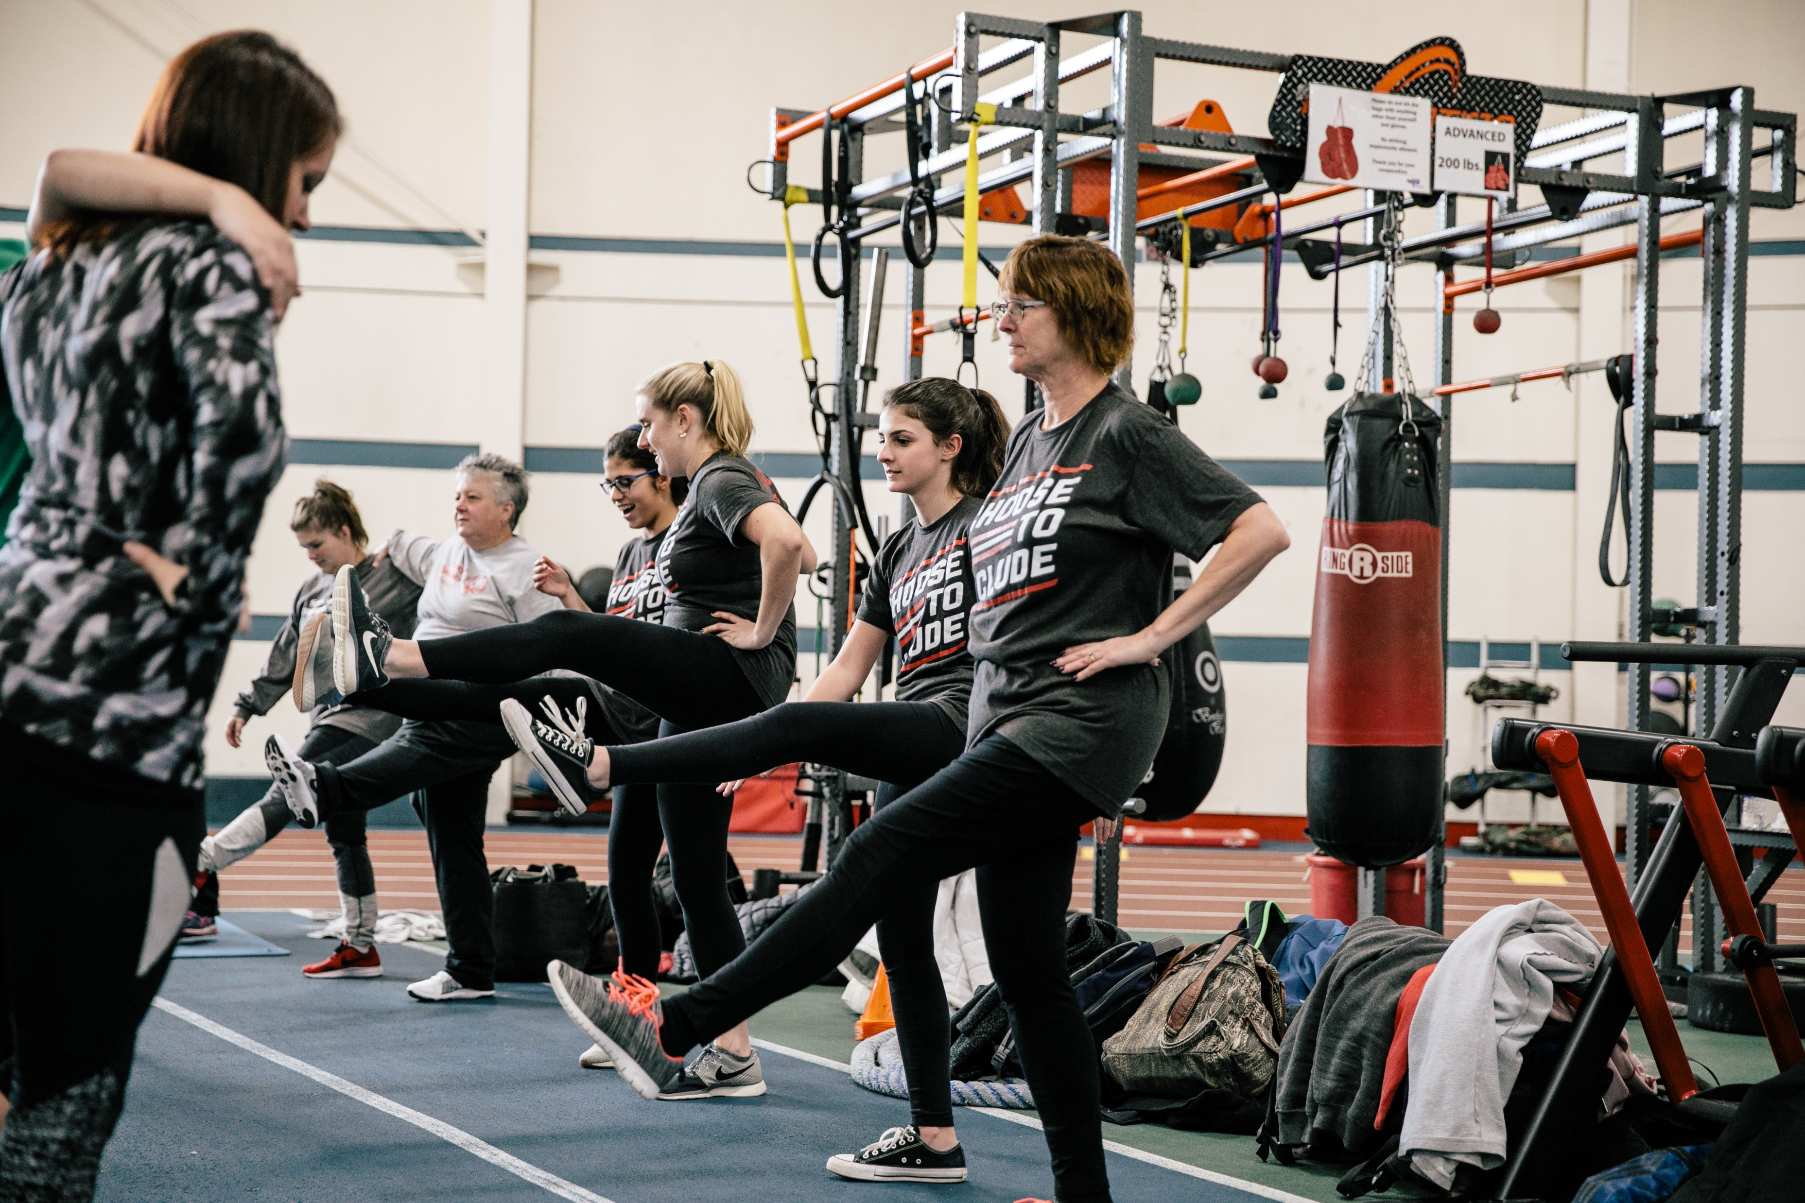
Your Turn!
Leading Warm-Ups
Let’s practice! Choose 4 dynamic stretches from this list:
High Knees
Butt Kicks
Arm Swings
Arm Circles
Side Shuffle
Open and Close the Gate
Forward Lunges
Heel and Toe Walks
Walking High Kicks
FITNESS CAPTAINS | LESSON 2: LEADING WARM-UPS AND COOL-DOWNS
Notes:
Let’s start with warm-ups. As a group, choose 4 dynamic stretches from this list.
Ask 4 volunteers to say one stretch they would like to try. Encourage them to pick an exercise that they may not already know. Example: a lot of people know how to do high knees, but side shuffle could be new to them.
Teach the participants how to do the exercise and practice. After a couple of minutes, ask someone to lead the stretch. Repeat for 4 stretches. Do each stretch for 30 seconds each.

Slide 73
Sample Warm-Up: Basketball
Leading Warm-Ups
Aerobic Activity | Dynamic Stretches
Jog or Fast Walk High Knees Butt Kicks Jumping Jacks | Forward Lunges – Walking or In Place Side Shuffle Arm Circles Arm Swings Rotational Jumps
FITNESS CAPTAINS | LESSON 2: LEADING WARM-UPS AND COOL-DOWNS
Notes:
NOTE: Change this slide based on the sport you’re teaching
Great job with those dynamic stretches! Remember, every sport is different so make sure you use the warm-up guides when leading warm-ups.
This is an example from basketball. You should do the aerobic activities for 30 seconds each. Dynamic Stretches should be done 10 times for each side/direction.
You can change this slide to a different sport. Make the slide applicable to the sport the Fitness Captains play. You can talk through and practice the different warm-ups for their specific sport.

Slide 74
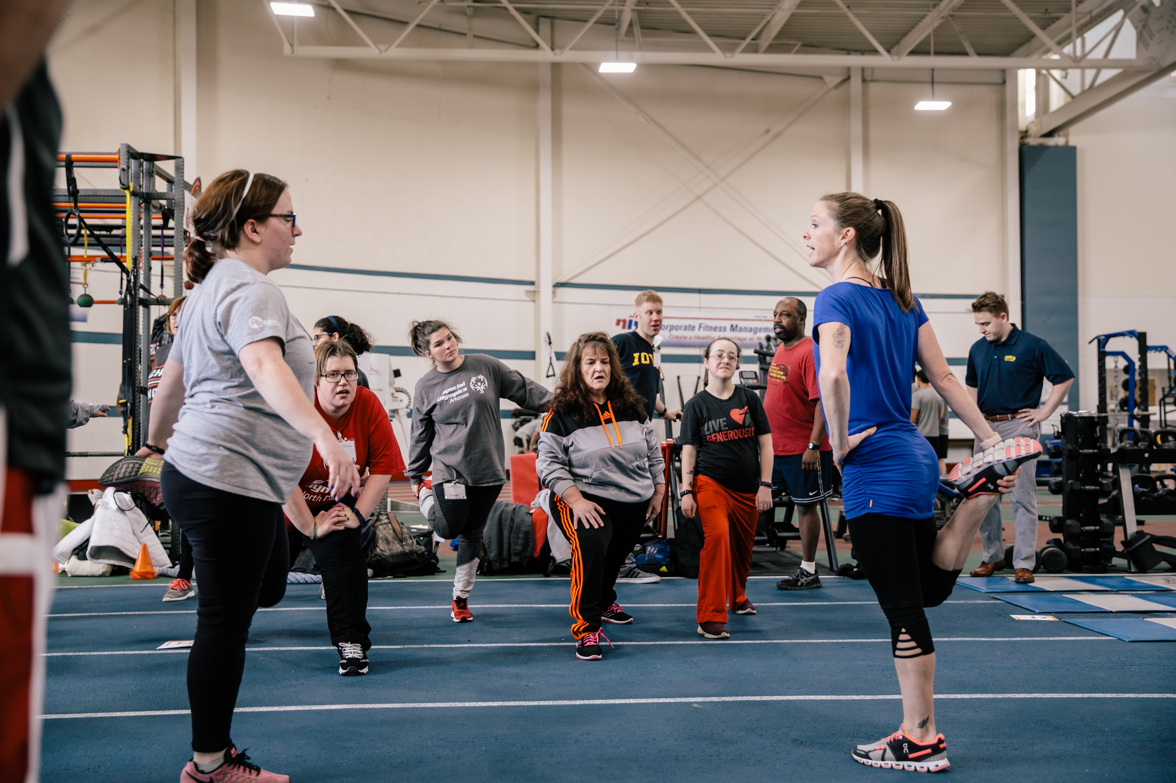
Your Turn!
Leading Cool-Downs
Let’s practice! Choose 4 static stretches from this list:
Rounded Upper Back Stretch
Standing Quadriceps Stretch
Hamstring Stretch
Calf Stretch
Kneeling Hip Stretch
Seated Rotation Stretch
Cross Body Shoulder Stretch
Wrist Flexion and Extension
Triceps Stretch
FITNESS CAPTAINS | LESSON 2: LEADING WARM-UPS AND COOL-DOWNS
Notes:
Now let’s practice cool-downs. As a group, choose 4 static stretches from this list.
Ask 4 volunteers to say one stretch they would like to try. Encourage them to pick a stretch that they may not already know, or to pick stretches for a couple of different body parts.
Teach the participants how to do the stretch and practice. After a couple of minutes, ask someone to lead the stretch. Repeat for 4 stretches. Hold each stretch for 30 seconds.

Slide 75
Sample Cool-Down: Basketball
Leading Cool-Downs
Light Aerobic Activity | Static Stretches
Slow jog or walk around the court | Standing Quadriceps Stretch Kneeling Hip Stretch Calf Stretch Butterfly Stretch Cross Body Shoulder Stretch
FITNESS CAPTAINS | LESSON 2: LEADING WARM-UPS AND COOL-DOWNS
Notes:
NOTE: Change this slide based on the sport you’re teaching
Great job with those static stretches! Remember, every sport is different so make sure you use the cool guides when leading stretches.
This is an example from basketball. You should do the aerobic activity for a couple of minutes, and hold each stretch for 30 seconds. Be sure to stretch both sides!
You can change this slide to a different sport. Make the slide applicable to the sport the Fitness Captains play. You can talk through and practice the different cool-downs for their specific sport.

Slide 76
Tips
Leading Warm-Ups and Cool-Downs
Follow a standard routine for your warm-ups and cool-downs
Be confident! Speak loudly and clearly
Encourage all your teammates to participate
Make sure you have enough space to safely and effectively do the exercises
Watch your teammates to make sure they are doing exercises correctly and offer help if they are not
FITNESS CAPTAINS | LESSON 2: LEADING WARM-UPS AND COOL-DOWNS
Notes:
Here are some more tips for leading warm-ups and cool-downs:
Follow a standard routine for your warm-ups and cool-downs
Be confident! Speak loudly and clearly
Encourage all your teammates to participate
Make sure you have enough space to safely and effectively do the exercises
Watch your teammates to make sure they are doing exercises correctly and offer help if they are not
SCENARIOS TO DISCUSS:
An athlete is always late
Unified partners aren’t participating
Your coach interrupts your warm up to start practice
A teammate is doing the exercise wrong
A teammate does not want to participate

Slide 77
Let’s Practice!
Communicating with your Coach
FITNESS CAPTAINS | LESSON 2: LEADING WARM-UPS AND COOL-DOWNS
Notes:
As mentioned during the scenarios, it’s important for you to talk to your coach about being a Fitness Captain. This should happen at the start of the season, and you can check-in before/after practices if you would like. Remember that your coach and Program staff are here to help you!

Slide 78
“I am a Fitness Captain”
Communicating with your Coach
“I am on your team, and I am a Fitness Captain. I have completed Fitness Captain training to lead warm-ups and cool-downs, and share health tips. Can we have some time at the beginning and end of practice to do this?”
FITNESS CAPTAINS | LESSON 2: LEADING WARM-UPS AND COOL-DOWNS
Notes:
Before your season starts, it’s important to communicate with your coach about being a Fitness Captain. It’s best to call them or meet in-person, but an email also works.
When you reach out, say:
“I am on your team, and I am a Fitness Captain. I have completed Fitness Captain training to lead warm-ups and cool-downs, and share health tips. Can we have some time at the beginning and end of practice to do this?”
Saying this lets your coach know that your role isn’t extra work for them, but it is a way to help them. It lets your coach know before the first practice that you are a Fitness Captain. This gives them a moment to understand your role and take into account the time needed for the warm-up and cool-down.
If you do an email, you can include an attachment with the warm-up and cool-down guide for your sport so you coach can look over it as well.
You can also let your coach know that you will come to practice with a printed copy of the guides.

Slide 79
Tips
Communicating with your Coach
Let your coach know the benefits of doing the warm-ups and cool-downs when talking with them before your first practice
Share the importance of being a healthy and fit athlete
Tell your coach why being a Fitness Captain is important to you!
FITNESS CAPTAINS | LESSON 2: LEADING WARM-UPS AND COOL-DOWNS
Notes:
I encourage you to share these additional items when you talk to your coach:
Let your coach know the benefits of doing the warm-ups and cool-downs when talking with them before your first practice
Share the importance of being a healthy and fit athlete
Tell your coach why being a Fitness Captain is important to you!
You have all the knowledge and skills to be a great Fitness Captain – show your coach this!

Slide 81
THANK YOU!
Notes:
Congratulations! Thanks for participating, you have now concluded the Fitness Captain training course.
Remember, to be a great athlete, you must be a healthy athlete. Your coach and Program staff are here to help you!

