Slide 1

Understanding Emotions
Notes:
Use the facilitator’s guide for notes on what to say and how long each section should take you! Overall, this training should take 2-2.5 hours.
Updated May 2021

Slide 2
Expectations – For Athletes
Be respectful of the person speaking
Engage in the class
Ask questions
Minimize distractions

Slide 3
Expectations – For Mentors
Be attentive
Be prepared to assist the athlete participants if they ask for it
Do not speak for the athletes; give help only if the athlete is asking for help
Don’t speak for athletes or assume they need help – ask them
Be energetic and positive
Minimize distractions

Slide 4
Expectations – For Facilitators
Be prepared to teach and try to meet the needs of all athletes
Challenge participants to learn something new about themselves and others
Provide opportunities for each athlete to be successful and grow
Support and engage in discussion and questioning that lead to learning
Treat athletes and mentors with respect and care
Create an atmosphere of mutual respect and joy of learning

Slide 5
Module Overview
Lesson 1: Self-Awareness. We will discuss identifying your emotions.
Lesson 2: Self-Management. We will discuss self-management techniques.
Lesson 3: Empathizing with Others. We will discuss the importance of empathy and responding to others with empathy.

Slide 6

Lesson 1: Self-Awareness
In this lesson we will:
Define self-awareness
Explore your emotions
Discuss how self-awareness strengthens your leadership
Identify how you can improve your self-awareness

Slide 7
Self-Awareness
The ability to identify and understand your emotions.

Slide 8
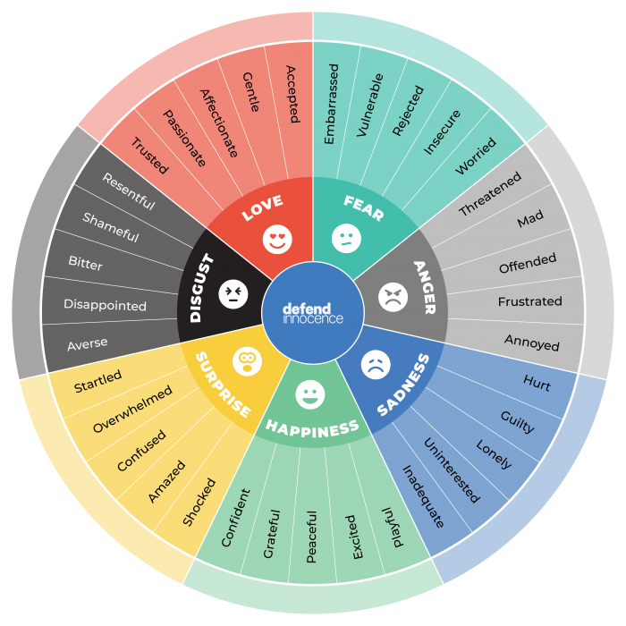
Emotion Wheel
Source: TeensHealth from Nemours
Notes:
Source: TeensHealth from Nemours

Slide 9
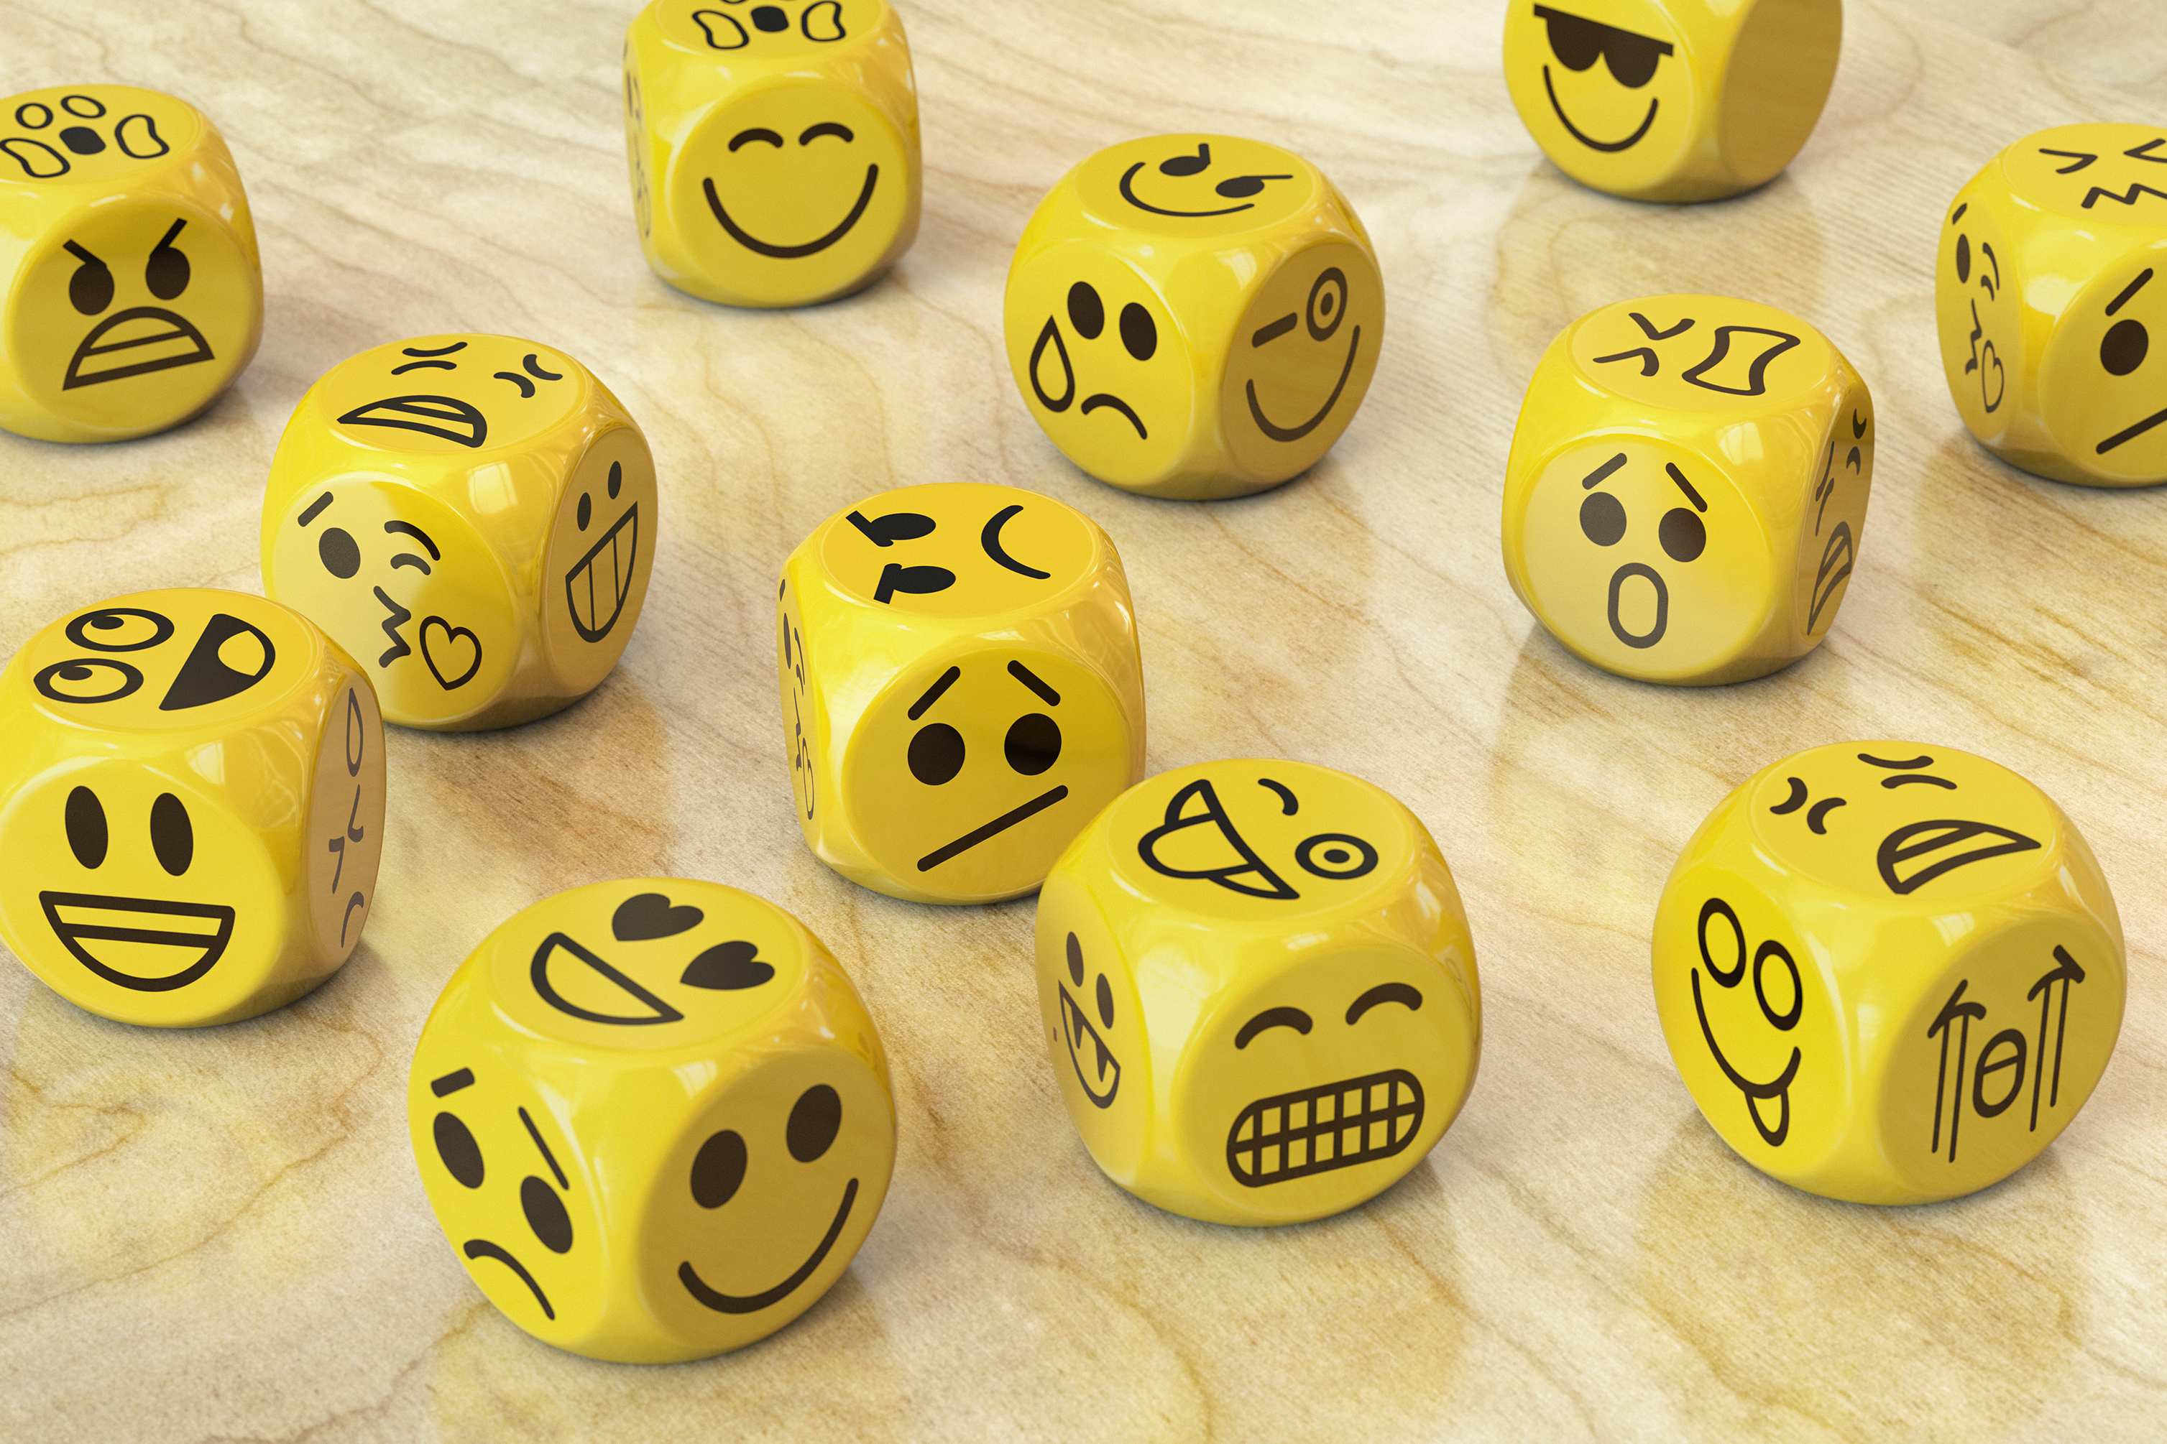
Emotions can be confusing
Depending on the situation you are in, the emotion you are feeling can mean different things.
Close your eyes and imagine the following situations thinking about the emotions you feel:
  Winning a gold medal
  Getting a hug from a family member
  How do you feel in these moments?
  How are the emotions the same or different?

Slide 10
Are emotions good or bad?
No such thing as good emotions or bad emotions
Everyone shows their emotions differently
They are the best way for people to communicate with one another especially if language is a barrier
You need to understand how your emotions affect others
Emotions can be mild or intense – or anything in between
Emotions change constantly – and that is okay!
Notes:
Source: TeensHealth from Nemours

Slide 11
Emotional awareness
You must control your emotions, so they do not control you!
How well do you control your own emotions?
Why is it important to control your emotions?
How can you control your emotions better?
  Pay attention to your emotions throughout the day and ask yourself what caused that emotion.
  Rate how strong the feeling is and why this version of this feeling you felt the other day is different.
  Share your feelings with other people.
  Fight the urge to judge your emotions in terms of bad vs. good emotions
Notes:
Source: TeensHealth from Nemours

Slide 12
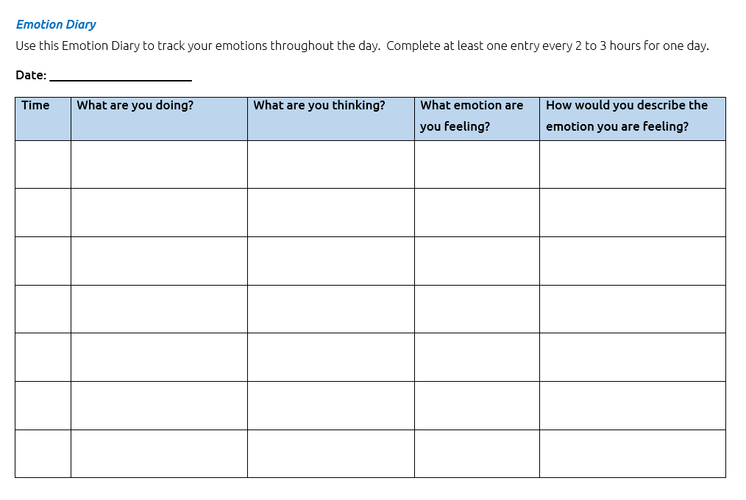
Emotion Diary

Slide 13
Discussion questions
What are the signs that tell you when you are happy? What about the signs that tell you when you are sad?
Why is it important to have self-awareness as a leader?
How can your emotions keep you from becoming a good leader?
How do you get better at knowing your emotions and changing how you act?

Slide 14

Lesson 2: Self-Management
In this lesson we will:
Define self-management
Review self-management techniques
Discuss how self-management strengthens your leadership
Identify how you can improve your self-management

Slide 15
Self-Management
Self-management is the ability to control your emotions, thoughts, and behaviors.

Slide 16
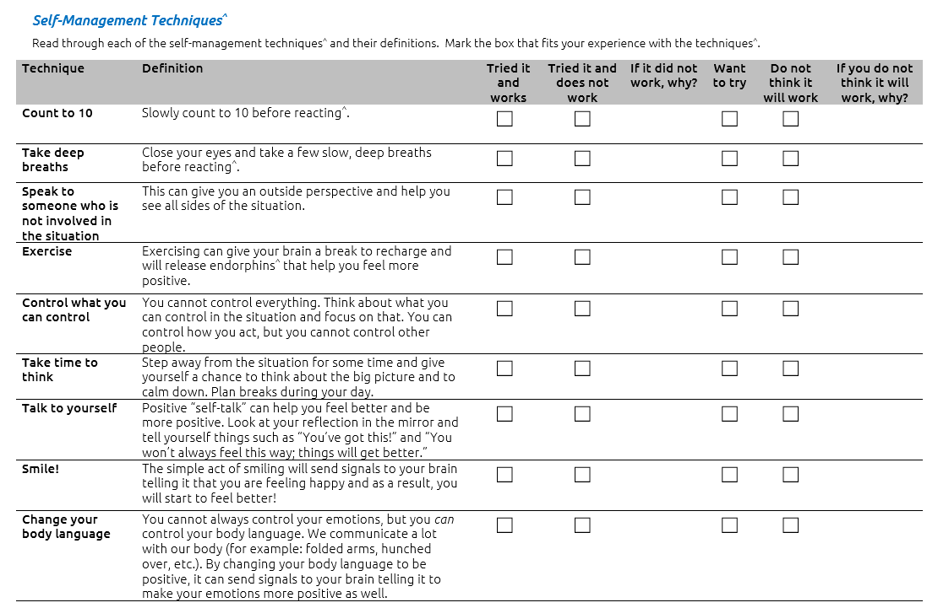
Self-Management Techniques

Slide 17

Strong Minds
Other resources available at: https://resources.specialolympics.org/
health/strong-minds

Slide 18
Discussion questions
How do you know if a self-management technique has worked to calm you or not?
Are there any techniques that are not on this list that you would recommend to others?
How can you get better at managing your emotions?
Is showing emotions good or bad?
Mentors: How do you deal with your emotions? Any advice for the athlete leaders?

Slide 19

Lesson 3: Empathizing with Others
In this lesson we will:
Define pity, sympathy, empathy, and compassion
Discuss what each of these looks like and how they are all different
Discuss how to respond to others with empathy
Discuss how empathy can strengthen your leadership
Identify how you can improve your empathy

Slide 20
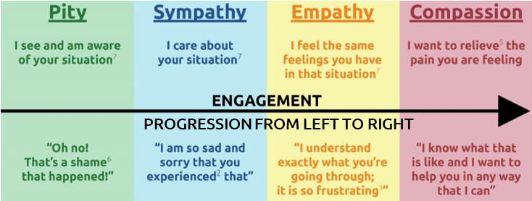
Pity
Pity is the feeling of sadness caused by the suffering and misfortune of others.
A person being pitied is typically being
looked down on for being in a bad situation.

Slide 21
Sympathy
Sympathy is the relationship between people
so when something affects someone,
the other person feels it as well.
It is better than pity because you think and care about their situation, but the feeling is not strong enough for you to try and help them.

Slide 22
Empathy
Empathy is the ability to understand and share the feelings of someone else.
Empathy is different from pity and sympathy because it involves an action of trying to understand and share someone else’s feelings.

Slide 23
Compassion
Compassion is the feeling when empathy is so strong that you must do something to help.
You understand their situation, maybe even feel the pain yourself, and will do anything to make them feel better.

Slide 24
Let’s review!

Slide 25
Which One is Empathy?
“I feel last week at practice and I do not think I can compete today.”
“Do not be a baby! You will be fine.”
“Oh man! I’m so sorry. That looks like it must hurt!”
“Ouch! You should see the bruise I got last week.”

Slide 26
Which One is Empathy?
“I’m anxious about my tennis match today.”
“It is going to be a tough match for you, but I think you can do it.”
“I understand and don’t blame you. Let’s find a replacement for you to take your place.”
“I understand being nervous, but I know you have been practicing a lot so I know you will do the best that you can!”

Slide 27
Which One is Empathy?
“The dentist told me I have to get a very painful root canal surgery.”
“Oh man, that’s horrible! Let me know if you need me to get you some soup or a milkshake afterwards.”
“My cousin had one and he said it did not hurt at all.”
“That is really going to hurt. Good luck!”

Slide 28
Reflection Questions
Tell us a time when someone showed you compassion. How did it make you feel (use the emotion wheel).
Tell us about a time when you showed someone else compassion.
How can having empathy help you as a leader?
How can you get better at showing empathy?

Slide 29
Guess the Emotion!
Group will be divided into groups of 2-4 individuals.
You will use the list of emotions from the emotion wheel from Lesson 1.
Each person in the group will take a turn selecting an emotion from the list and acting it out without using any words.
Group members must guess the emotion.
Notes:
Virtual Workshop

Slide 30
Guess the Emotion!
Group will be dividing into 2 teams.
One participant from Team A will select a flashcard that has an emotion written down on it. They will act that emotion out to their group without using any words.
Other Team A members must guess the emotion. You will have 15 seconds to guess the emotion.
If Team A guesses emotion correctly, they get 1 point.
Team B repeats the process by selecting a new emotion and acting it out.
Repeat until every team member has a turn to act out an emotion.
Team with highest score wins!
Notes:
In-person workshop

Slide 31
Guess the Emotion Debrief
What was difficult about guessing the emotions?
Were there certain emotions that were easier to guess?
What did you pay attention to in order to guess the correct emotion?
How can identifying emotions in people (and yourself) help you work with people and become a better leader?
Notes:
In-person workshop

Slide 32
Module Wrap Up
Self-Awareness is the ability to identify and understand your emotions. It helps you manage your emotions.
Self-management is the ability to control your emotions, thoughts, and behaviors. It helps you react calmly instead of emotionally.
Empathy is the ability to understand and share the feelings of others. It helps you understand why others react the way they do and allows you to respond appropriately.
Understanding your emotions, being able to control your emotions, and understanding the emotions of others will make you a stronger leader.

Slide 33
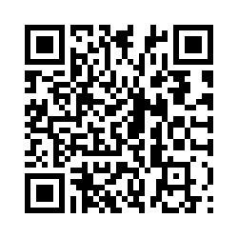
Please take the evaluation:
https://specialolympics.qualtrics.com
/jfe/form/SV_5cZHOzU0qemAkDP
Notes:
Please make sure all athlete leaders take the evaluation.

