Slide 1

SHOWING
THE WAY
Managing Time

Slide 2
Module Overview
Lesson 1: Thinking About My Time. We will discuss the first step of managing time- thinking about how you spend your time.
Lesson 2: Scheduling My Time. We will discuss the second step of managing time- scheduling your days.
Lesson 3: Managing and Adjusting My Time. We will discuss the third step of managing time- managing and adjusting your schedule and how you spend your time.

Slide 3
Introductions
Tell us about yourself:
  Name
  Share a favorite hobby

Slide 4
Expectations – For Athletes
Be respectful of the person speaking
Engage in the class
Ask questions
Minimize distractions

Slide 5
Expectations – For Mentors
Be attentive
Be prepared to assist the athlete participants if they ask for it
Do not speak for the athletes; give help only if the athlete is asking for help
Don’t speak for athletes or assume they need help – ask them
Be energetic and positive
Minimize distractions

Slide 6
Expectations – For Facilitators
Be prepared to teach and try to meet the needs of all athletes.
Challenge participants to learn something new about themselves and others.
Provide opportunities for each athlete to be successful and grow.
Support and engage in discussion and questioning that lead to learning.
Treat athletes and mentors with respect and care.
Create an atmosphere of mutual respect and joy of learning.

Slide 7

Lesson 1: Thinking About My Time
In this lesson we will:
Think about how we spend our time
Discuss how we would like to change how we spend our time

Slide 8
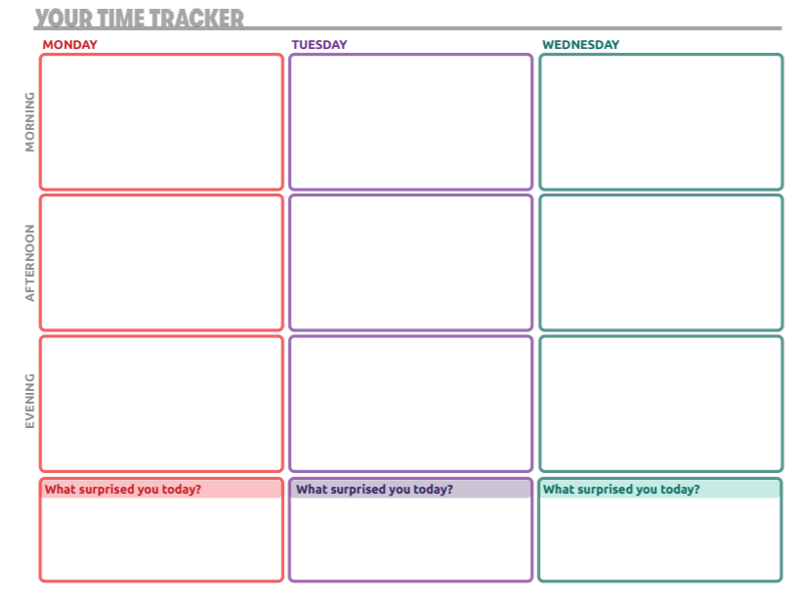
Time Diary
Brushed teeth
Got dressed
Ate breakfast
Went to work
Checked emails
Brushed teeth
Got dressed
Ate breakfast
Went to work
Checked emails
Brushed teeth
Got dressed
Ate breakfast
Went to work
Checked emails
Ate lunch
Meeting
Dentist appointment
Ate lunch
Worked on project
Went to grocery store
Lunch out with co-workers
Worked on project
Meetings
Made and ate dinner
Watched TV
Talked to friend on phone
Took shower
Swimming practice
Out to dinner with team
Took shower
Dinner with friends
Cleaned bedroom
Watched a movie
Took shower
I didn’t have time to clean my bedroom like I planned
I didn’t watch TV at all
I ate out two times today

Slide 9
Reflecting on your Time
Share one thing you learned or realized as you completed your time diary.
Share one thing you did not do during your week that you would like to add in the future.

Slide 10
Reflection Questions to Ask Yourself
What surprised you most about your time diary?
What could you spend less time doing during the week?
Is there anything you wrote down that you could cut out completely because it isn’t needed or you don’t enjoy doing it?
Is there anything you would like to add? Do you have a goal, hobby, or something else you enjoy that you would like to include in your week?

Slide 11

Lesson 2: Scheduling My Time
In this lesson we will:
Review tools and techniques for managing time
Apply those tools and techniques to our schedules

Slide 12
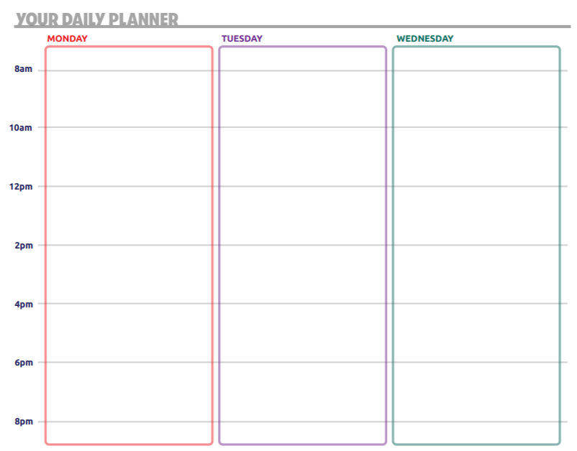
Calendar Activity
Morning Routine
Arrive at work
Check emails
Morning Routine
Arrive at work
Check emails
Morning Routine
Arrive at work
Check emails
Work on project
Lunch
Lunch
Lunch out with co-workers
Meeting
Work on project
Work on project
Meeting
Dentist appointment
Go to grocery store
Make & eat dinner
Clean kitchen
Talk on phone
Watch TV
Swim practice
Dinner with team
Shower
Dinner with friends
Clean bedroom
Watch movie
Shower

Slide 13


Share & Reflect
What big changes did you make to your calendar?
What did you add that you did not originally do when you made your time diary? Why did you add it?
Do you like using the calendar template to plan your week?

Slide 14
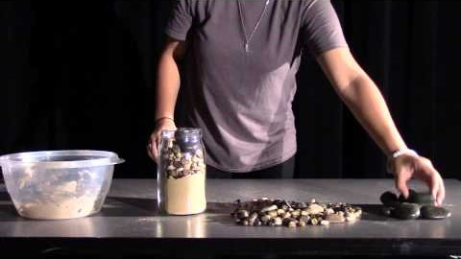
Rock, Pebbles & Sand
Notes:
0:26 to 1:50

Slide 15
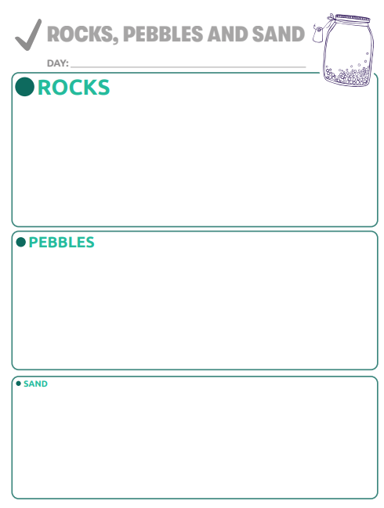
Rock, Pebbles & Sand

Slide 16
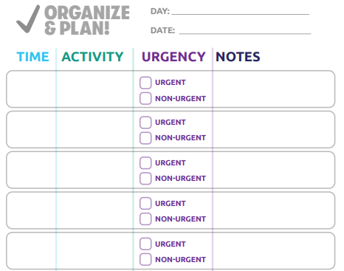
Enhancing Your Calendar

Slide 17
Enhancing Your Calendar

Slide 18
Enhancing Your Calendar

Slide 19
Enhancing Your Calendar

Slide 20
Discussion
Which of these techniques do you like best?
What other techniques have you used to manage your time?

Slide 21

Lesson 3: Managing and Adjusting My Time
In this lesson we will:
Practice flexibility and problem-solving

Slide 22
Debrief Questions
When you had to add in the Special Olympics meeting and doctor’s appointment, how did you do it?
What was your thought process for making the decision you did?
Would any of the tips we just went over have helped you?

Slide 23
Call to Action
Over the next month:
Work on managing your time using the techniques we used today
Follow up with your mentor and talk through successes and challenges
How can you schedule your calendar to give you time to work on your leadership journey?

Slide 24
Module Wrap Up
Everyone manages their time differently. You must find what tools and techniques work best for you.
Block out time for your most urgent and important tasks first before adding in other tasks and activities.
Always make sure you are scheduling time for your goals.
It is important to have a work-life balance.
Unexpected events will come up and that’s okay! Remember to be flexible and use your problem-solving skills when this happens.

