Slide 1

Introduction to Athlete Leadership
Notes:
Use the facilitator’s guide for notes on what to say and how long each section should take you! Overall, this training should take 2-2.5 hours.
Updated May 2021

Slide 2
Module Overview
In this module, you will:
  Discuss the Special Olympics mission and what makes it unique.
  Learn the basic concepts and guiding principles of Athlete Leadership.
  Identify Athlete Leadership roles that interest you
  Write your personal mission statement (goal or purpose).
  Create an action plan for your next steps toward Athlete Leadership

Slide 3
Introductions
Please tell us:
  Your name
  Something you’ve learned from being part of Special Olympics

Slide 4
Expectations – For Athletes
Be respectful of the person speaking
Engage in the class
Ask questions and ask your mentor for help if you need it
Minimize distractions

Slide 5
Expectations – For Mentors
Be attentive.
Be prepared to assist athletes if they ask for it.
Do not speak for athletes; give help only if the athlete is asking for help.
Don’t just step in and assume they need help.
Be energetic and positive.
Minimize distractions.

Slide 6
Expectations – For Facilitators
Be prepared to teach and try to meet the needs of all athletes
Challenge participants to learn something new about themselves and others
Provide opportunities for each athlete to be successful and grow
Support and engage in discussion and questioning that lead to learning
Treat athletes and mentors with respect and care

Slide 7
Introductions
Meet a fellow athlete leader!
  Insert pictures and description of athlete leader here
Notes:
OPTIONAL – remove slide if not using

Slide 8
Module Lessons
There are three lessons in this module:
Overview of Special Olympics
Principles of Athlete Leadership
Your Role in Athlete Leadership

Slide 9
Lesson 1: Overview of Special Olympics
In this lesson, you will:
Review and Discuss the Special Olympics Mission Statement
Review what makes Special Olympics unique
Learn important facts about Special Olympics

Slide 10
Special Olympics Mission Statement
To provide year-round sports training and athletic competition in a variety of Olympic-type sports for children and adults with intellectual disabilities, giving them continuing opportunities to develop physical fitness, demonstrate courage, experience joy and participate in the sharing of gifts, skills and friendship with their families, other Special Olympics athletes and the community.

Slide 11
What makes Special Olympics unique?
Special Olympics provides a variety of sports opportunities for all ability levels.
Athletes are grouped by ability through a process called divisioning.
Awards are provided to all participants who compete.
Special Olympics does not charge a fee to athletes (nor their families) to train nor compete.

Slide 12

Global 2019 Data
___ states and countries have SO programs
More than ___ million athletes
Over ___ young athletes
Over ___ competitions annually
Over ___ Athlete Leaders in meaningful roles
Almost ___ Youth Leaders

Slide 13
Global 2019 Data
216 states and countries have SO programs
More than 5.7 million athletes
Over 500,000 young athletes
Over 100,000 competitions annually
Over 50,000 Athlete Leaders in meaningful roles
Almost 100,000 Youth Leaders
Notes:
As of May 2021, we do not have updated Census numbers to share with everyone yet. Please update these numbers once updated information comes out.

Slide 14

Program Facts and Information
More than (#) athletes
(#) Young Athletes
(#) competitions
(#) Athlete Leaders
(#) Youth Leaders
Notes:
Feel free to add your own categories and make this whatever you want it to be.

Slide 15
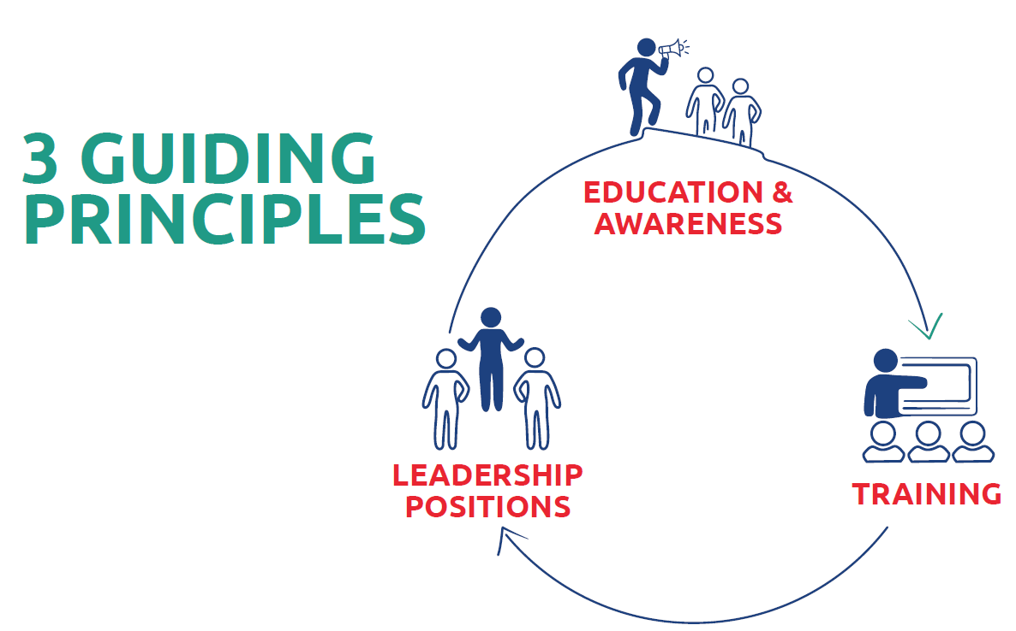
Lesson 2: Definition of Athlete Leadership
In this lesson, you will:
Learn the 3 guiding principles of Athlete Leadership

Slide 16
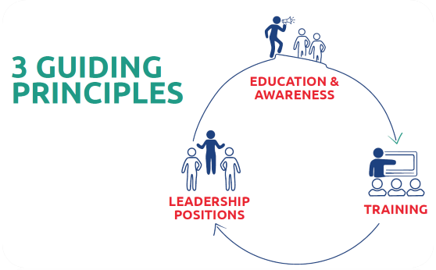
Guiding Principles

Slide 17
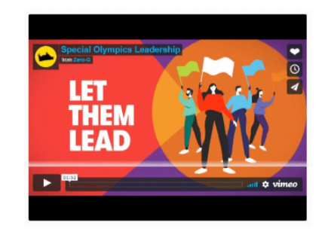
Education & Awareness:
Unified Leadership
Unified Leadership Video
Notes:
Video also available on YouTube: https://www.youtube.com/watch?v=nkgZ2lI0aDc

Slide 18
Guiding Principles of Athlete Leadership
Training:
Athletes have a choice in how and where you lead in Special Olympics. You need to be trained in the knowledge and skills to be successful in whatever you choose.

Slide 19
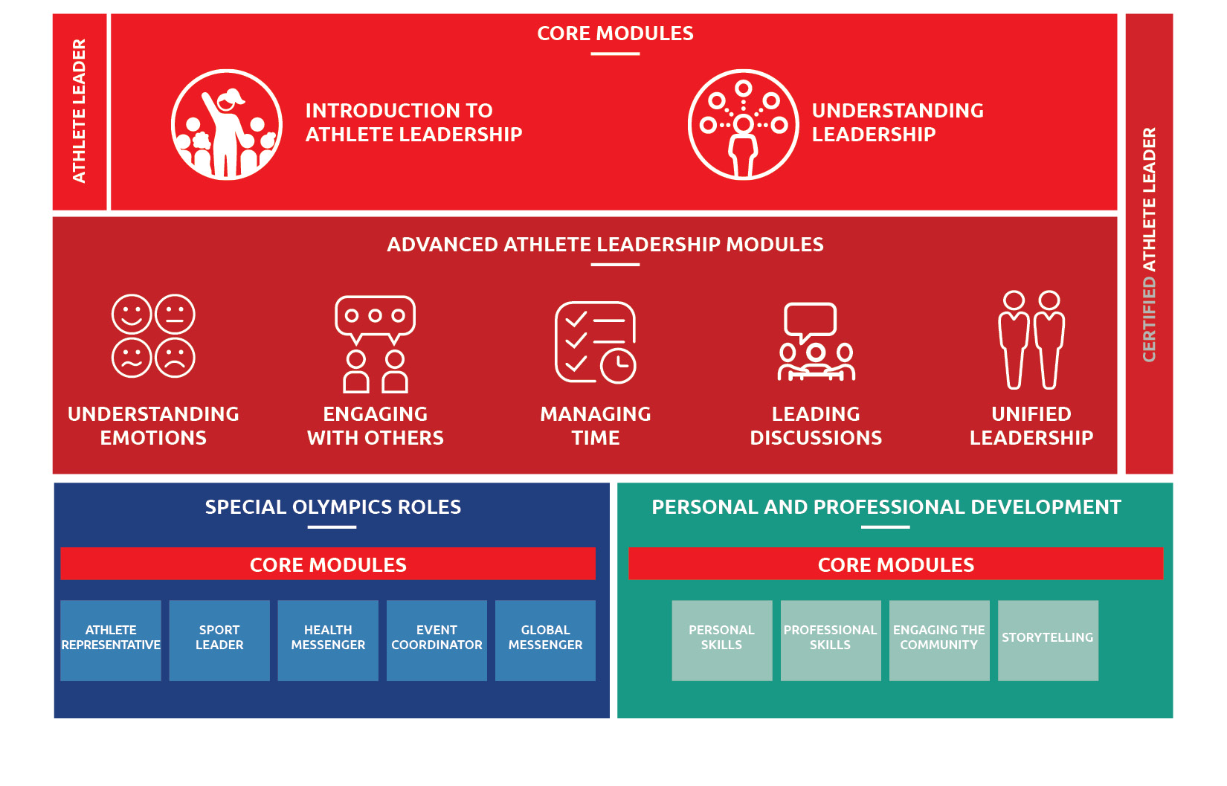
Guiding Principles of Athlete Leadership
CURRENTLY
IN DEVELOPMENT

Slide 20
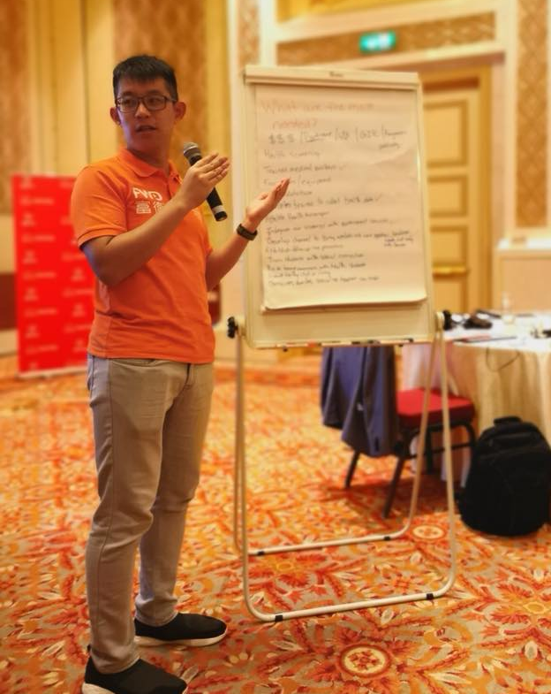

Slide 21
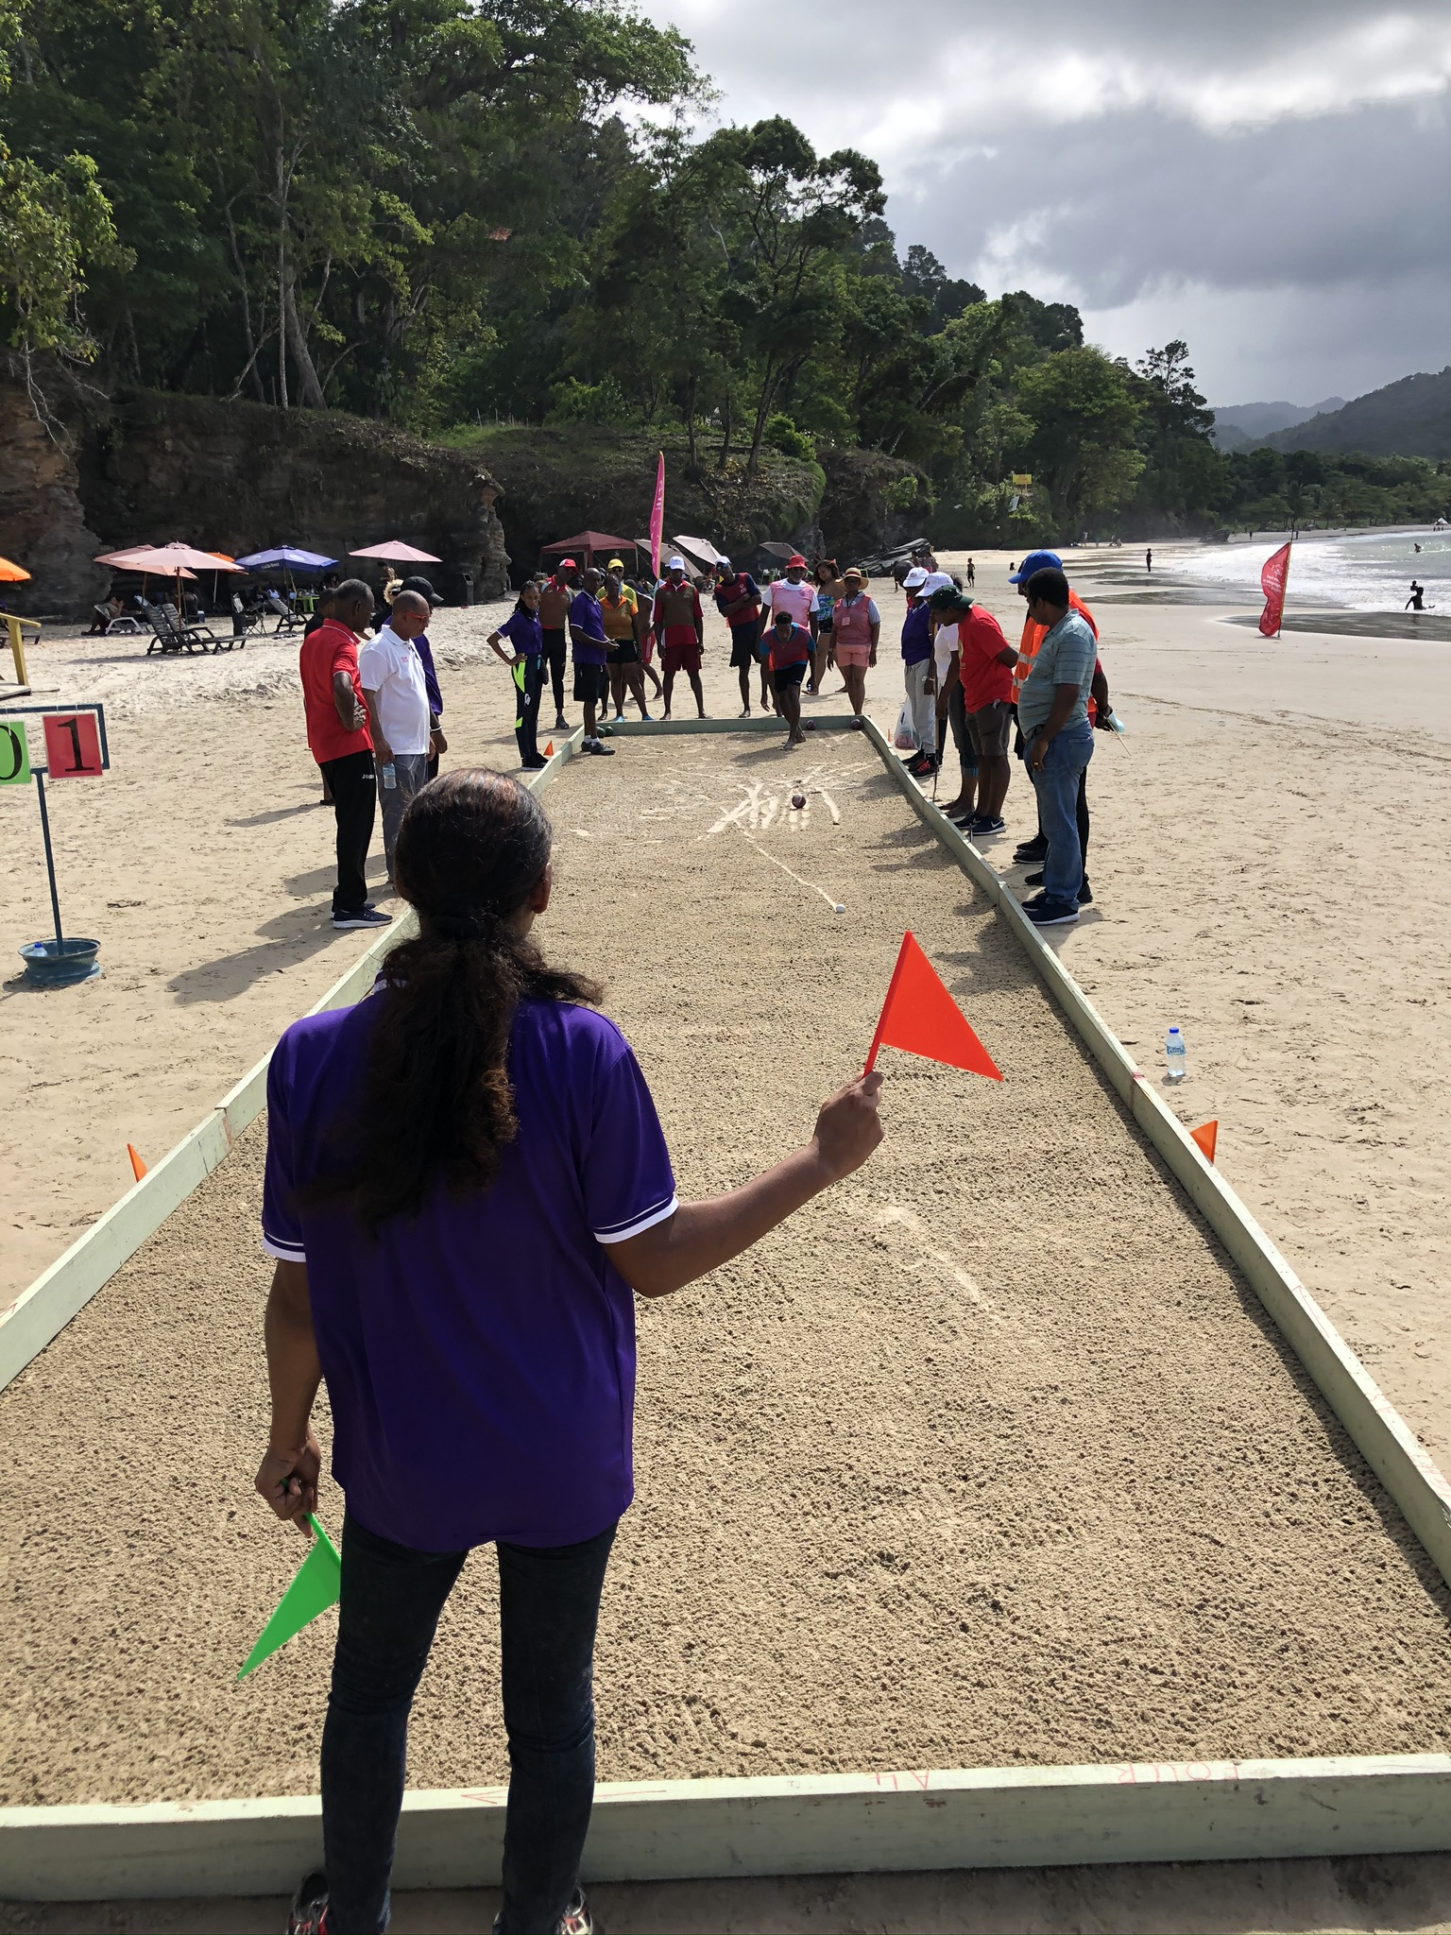

Slide 22
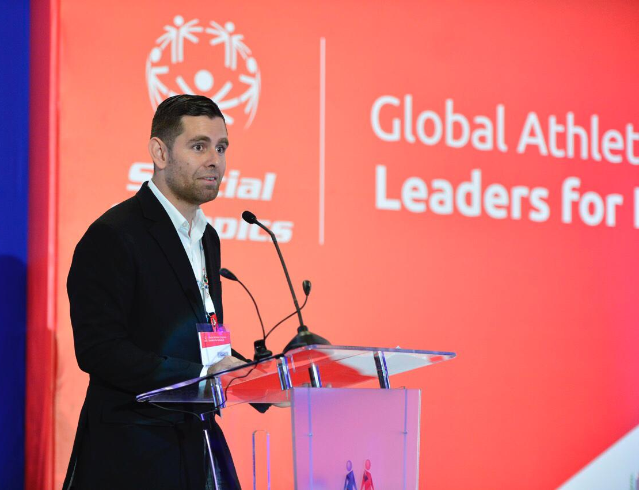

Slide 23
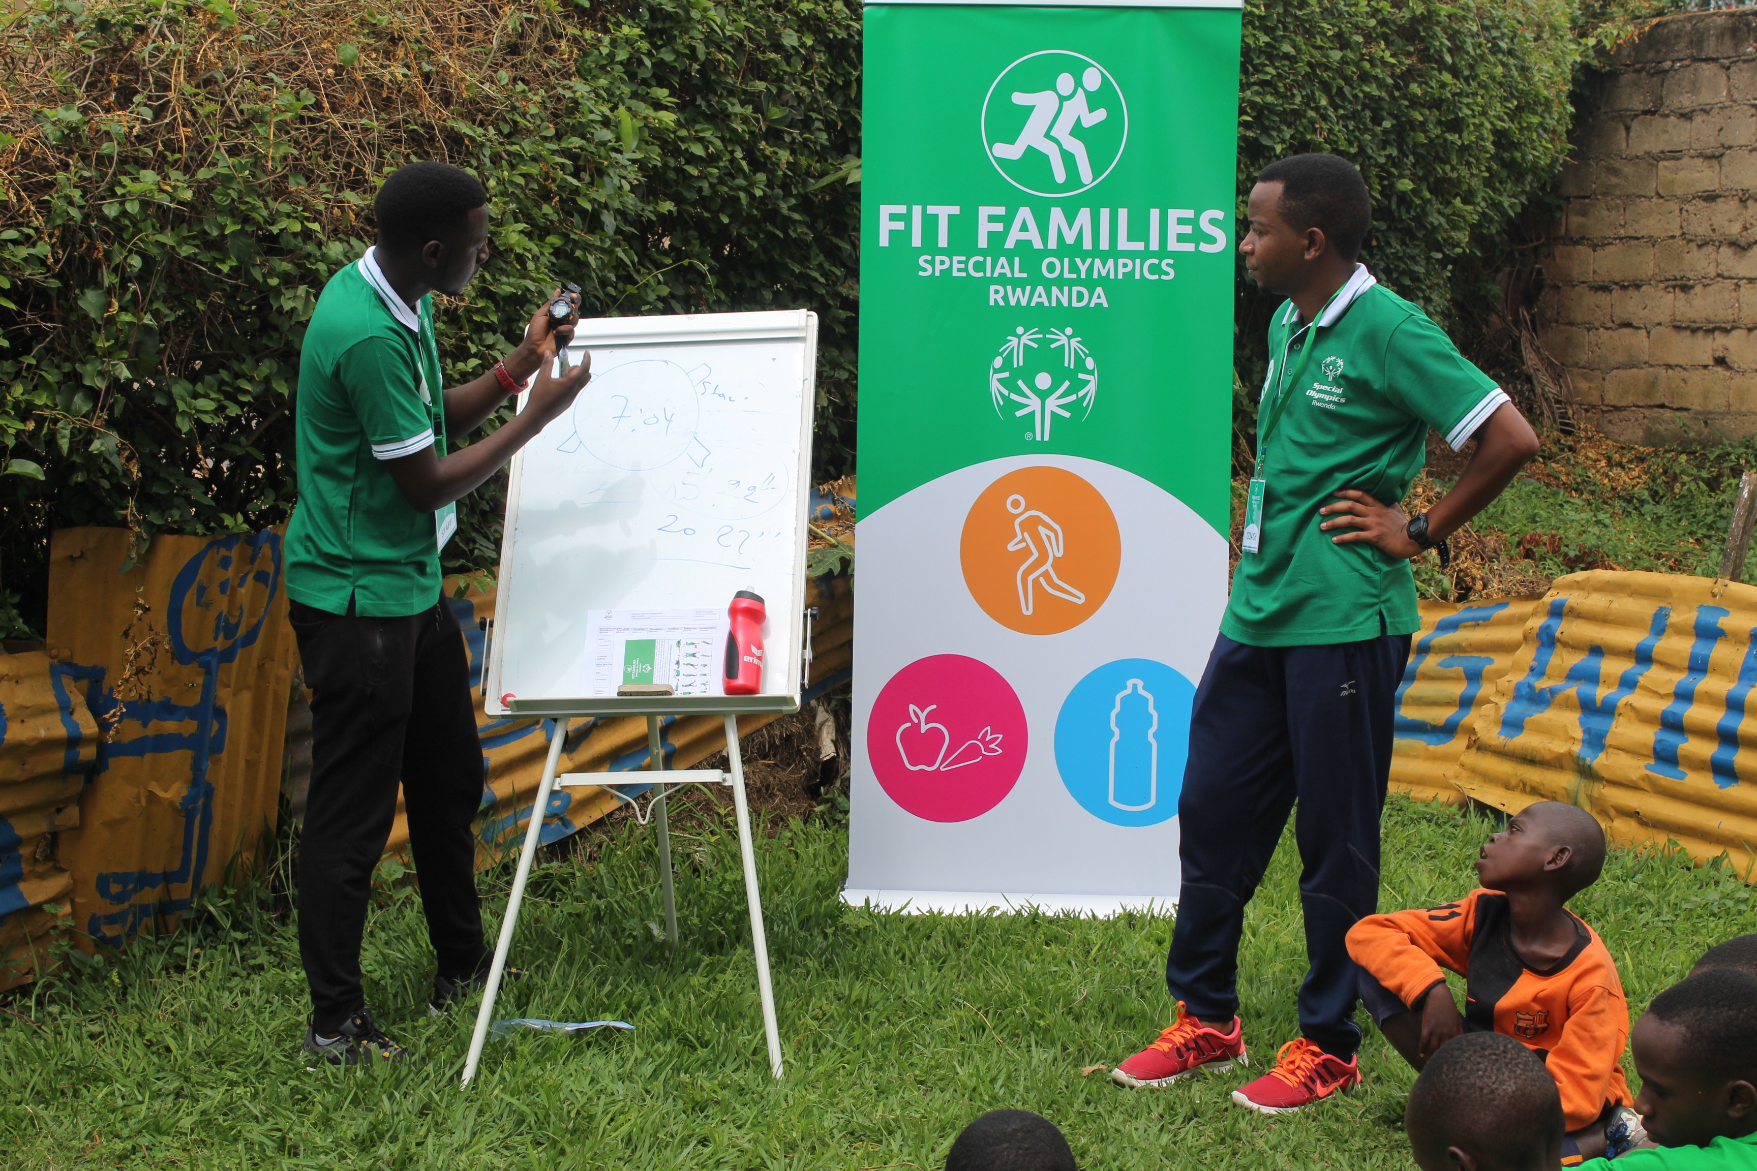

Slide 24
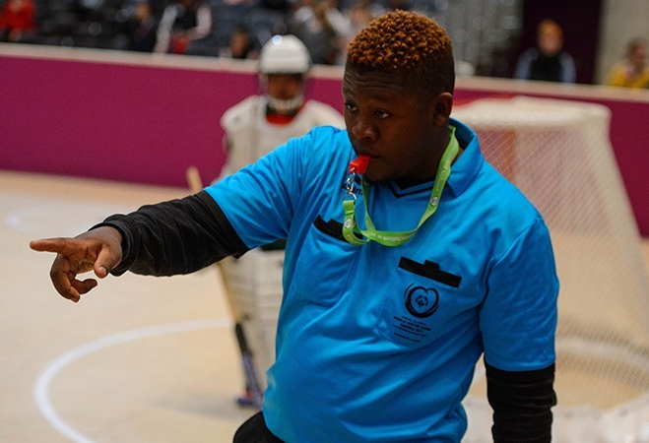

Slide 25
Guiding Principles of Athlete Leadership
CURRENTLY
IN DEVELOPMENT

Slide 26
Guiding Principles of Athlete Leadership
Leadership Positions:
Create meaningful positions of influence and leadership throughout the organization and community for people with intellectual disabilities. The organization will become athlete led where athletes help determine policy, set direction, and lead programming.

Slide 27
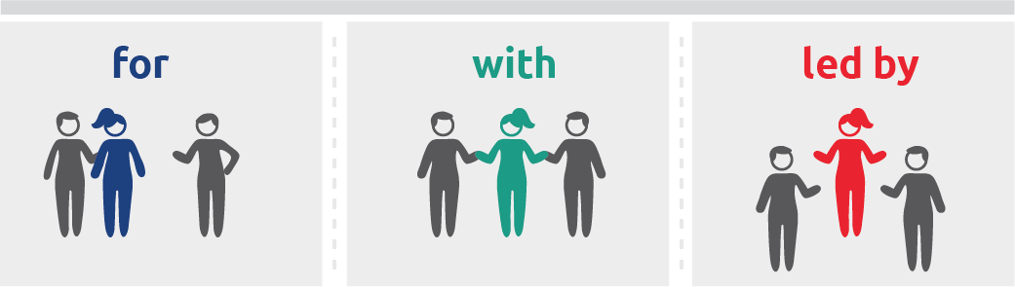
Organization Shift
Focus shifted from offering programs for people with ID to one of respect for people with ID, their experience, and their potential to develop their abilities even further.
Program leaders need to listen to ideas of athletes and make them part of the planning process.

Slide 28
Guiding Principles of Athlete Leadership
Principles in Practice:
1. You will be split into three equal groups.
2. The first group is assigned “Education and Awareness,” the second group has “Training,” and the third group has
“Leadership Positions.”
3. Your goal as a team is to show us what it will look like to you when that principle is done successfully. Be creative!
4. You have 10 minutes to think of a skit, make up a dance, create a song, draw something, create a story, tell a poem – whatever you want.

Slide 29
Lesson 3: Athlete Leaders
In this lesson, you will:
Explore specific roles available to Athlete Leaders.
Assess your strengths and opportunities for leadership development.
Write your personal mission (goal or purpose) statement
Start an action plan or identify the next steps to take on your leadership journey.

Slide 30
Local Program roles
List the roles that athlete leaders can take on within your Program

Slide 31
Strengths and Opportunities Reflection
What are my greatest strengths? What am I good at?
What things are most important to me? Why are those things important to me?
How can I best give back to Special Olympics? Why is that important to me?
What things do I want to get better at? How can I get better at them?

Slide 32
Personal Mission Statement
Mission Statement Outline:
  What leader do I want to be?
  How will I do it?
  Why do I want to do it?
I want to _____. I can do this through ______. My goal is to _________.
(be) (how) (why)

Slide 33
Action Plan
Personal Mission Statement:
Who are the people that can help me? | What training do I need? | What challenges might I face? | What are solutions to those challenges?

Slide 34
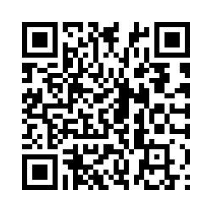
Please take the evaluation:
https://specialolympics.qualtrics.com
/jfe/form/SV_5cZHOzU0qemAkDP
Notes:
Please make sure all athlete leaders take the evaluation.

