Slide 1
Special Olympics Coaches' Guide to Sports Nutrition
This Special Olympics Coaches' Guide to Sports Nutrition is designed to assist Special Olympics Florida coaches of all sports activities and competitive levels in understanding the established principles of nutrition that can facilitate success for Special Olympics Florida Athletes.
Special Olympics Florida-Healthy Community in Conjunction
Florida International University Robert Stempel
College of Public Health-Dietetics Department Interns

Slide 2
Topics Covered
Hydration
Dehydration
MyPlate
Whole Grains
Carbohydrates (Good vs. Bad Carbs)
Protein
Fats
Portion Control
Vitamins and Minerals
Pre & Post Workout Snacks
Eating on the Road
Coaches Notes/Review

Slide 3
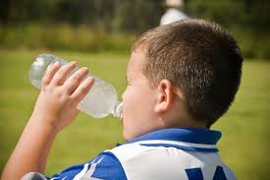
Hydration
The coach plays a vital roll in ensuring that their athletes are properly hydrated.
Hydrating is critical prior, during, and after practice and competition.
Athletes lose fluid through sweat (skin) and breathing (lungs).
If fluid is not replaced, dehydration could take effect.
Increase the number of water breaks in warm climates.
*The best replacement fluid is WATER!
Notes:
Water has various benefits besides quenching thirst. It tastes great and it is refreshing; it clears your skin, and it helps you lose weight.

Slide 4
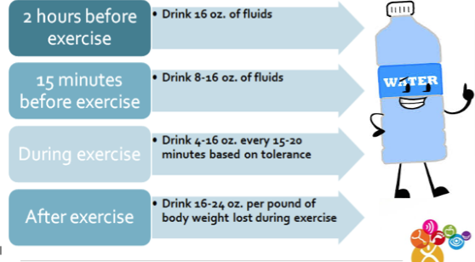
When should you hydrate?
Notes:
Try not to drink water right before practice or running. Drink water at least 15 minutes before activities.
Please go to folder 1 for ideas for teachable moments for Healthy Team Tips on Hydration.

Slide 5
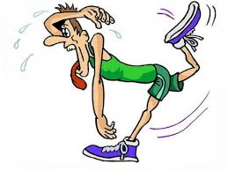
Dehydration
Signs and Symptoms of Dehydration
‣ Dry mouth
‣ Lack of tears/saliva
‣ Dizziness
‣ Inability to sweat or urinate
‣ Rapid Heart Rate
‣ Delirium
‣ Altered Mental Status
‣ Loss of Consciousness
*Drink before you feel thirsty!
Notes:
Encourage athletes to notify you, if they feel any of these symptoms. It may be due to dehydration or other more serious factors.

Slide 6
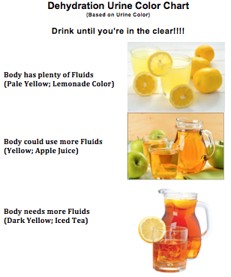
Drink Until You’re in the CLEAR!
Urine that is dark golden in color indicates dehydration.
Coaches should instruct their athletes to check their urine color and notify them if their color becomes too dark.
Notes:
Clear urine indicates that a person has had plenty of fluid. Dark or cloudy colored urine may indicate dehydration or other more serious conditions.
Please go to folder 2 for more tips on teachable moments for Healthy Team Tips on Dehydration.

Slide 7
MyPlate: Important Points
Notes:
On June 2, 2011, the US Department of Agriculture, with assistance from first lady Michelle Obama, launched a new visual guide designed to help Americans have balanced diets in an era of high concern about obesity among adults and children. The 'My Plate' is designed to help Americans visualize what they need to eat better than the former food pyramid did.

Slide 8
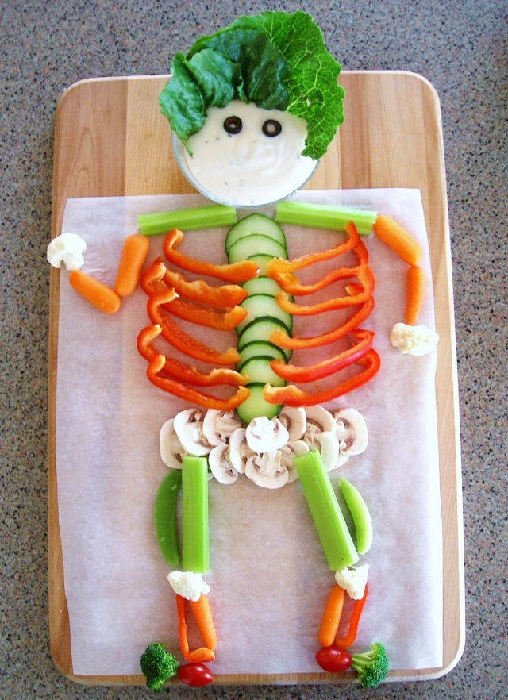
Build a Healthy Plate
Try some of these options:
Make half your plate fruits and vegetables.
‣ Switch to skim or 1% milk.
‣ Make at least half your grains whole.
‣ Vary your protein food choices.
‣ Keep your food safe to eat – learn
more at www.FoodSafety.gov
‣ Check out- www.choosemyplate.gov
Notes:
You can’t go wrong with using the guidelines of the My Plate—always make half of your plate fruits and vegetables.

Slide 9
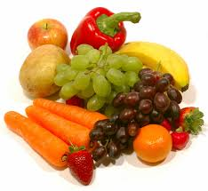
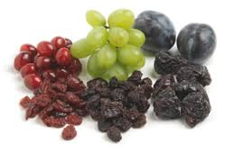
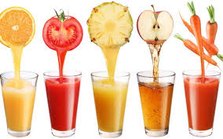
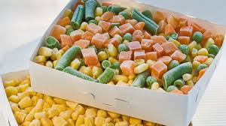
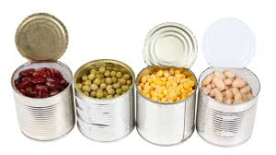
Make Half of your Plate Fruits & Vegetables
Any fruit or 100% fruit juice counts as part of the Fruit Group. Fruits and vegetables may be fresh, canned, frozen, or dried, and may be whole, cut-up, or pureed.
Notes:
Dried fruits and Juices are good, but they are often high in sugar; so don’t overdo it. When faced with both options (fruits or vegetables), choose more vegetables over fruits.

Slide 10
Healthy Plate
Notes:
Interactive tips:
Did you know that Avocado is the new super fruit? It helps lower cholesterol and reduce the risks of cancer, heart disease, and immune system disorders.
Avocadoes can be added to a smoothie to produce a creamy drink, sliced as an addition to a sandwich, or mashed and used as a substitute for mayonnaise.

Slide 11
Healthy Plate
Notes:
Interactive tips:
To lose or maintain weight, fill your plate with less food than when you are active or training.
Seek the assistance of a Registered Dietician for more advice on losing or maintaining weight.

Slide 12
Nutrition and Sports
Grains- Grains provide mainly carbohydrate, which is the body’s main source of fuel during exercise, particularly as intensity increases. Skimping on carbs leads to a break-down of muscle for energy.
Protein- Protein is important for muscle re-synthesis and re-building for athletes.
Fruits- Fruits provide carbohydrates, but also vitamins and minerals essential for proper recovery of trained muscles and prevention of illness.
Vegetables- Vegetables are a great source of fiber as well as vitamins and minerals. Fiber provides “staying power”, leading to sustained energy during activity.
Dairy- Choosing low-fat dairy products is a great way for athletes to take on more protein and carbs, as well bone-strengthening calcium and Vitamin D – two components important for protection from injury.
Notes:
You can never go wrong with using a combination of these food groups when making breakfast, lunch and dinner. Question: can you tell me where we just saw all of these food categories? On the My Plate!
Please go to folder 3 for ideas for teachable moments for Healthy Team Tips on My Plate.

Slide 13
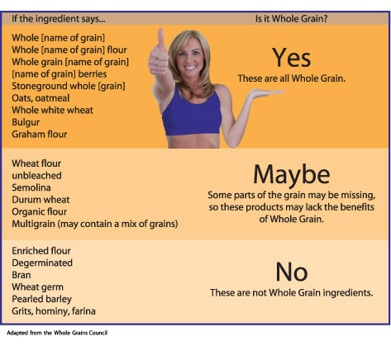
Opt for WHOLE GRAINS
Notes:
Did you know that you should look closely at the labels to see if grain products really are 100% whole grain?
Please go to folder 4 for ideas for teachable moments for Healthy Team Tips on Grains.

Slide 14
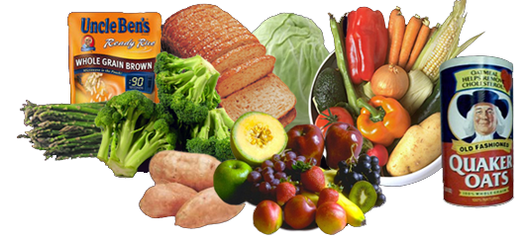
Carbohydrates
Carbohydrate is the primary fuel source for high-intensity, maximal-outburst activity, and significant early fuel source for endurance exercise.
Consuming adequate amounts of carbohydrate helps you maintain a high level of training intensity and promotes rapid recovery.
Carbohydrates should be eaten at all meals and before and after exercise
Foods containing carbohydrates: bread, rice, pasta, cereals, crackers, fruits, juices, vegetables, dried beans/peas

Slide 15
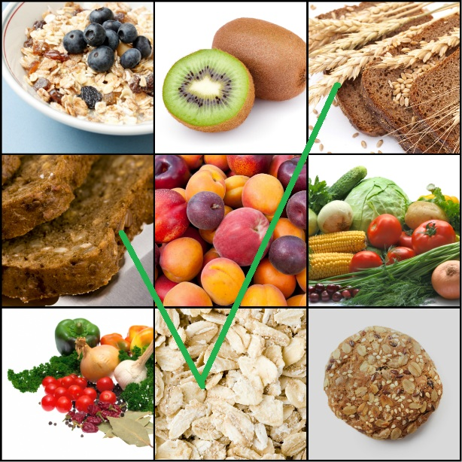
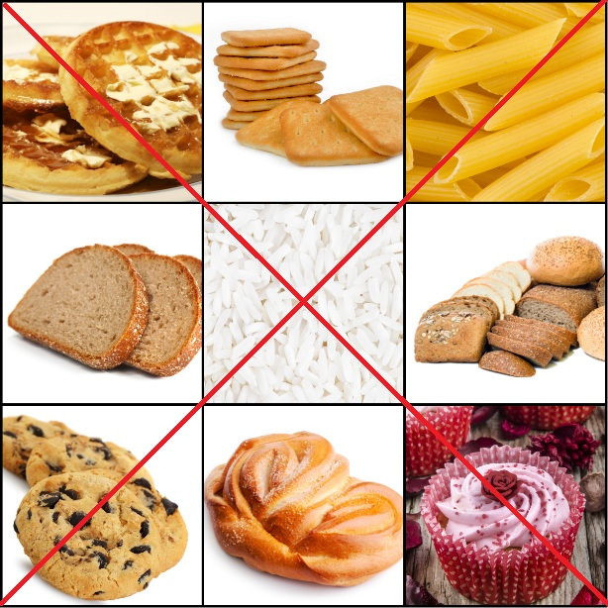
Good Carbs vs. Bad Carbs
Notes:
Good carbs fills you up quicker, keeps you full longer, and gives you energy. Please go to folder 5 for ideas for teachable moments for Healthy Team Tips on Carbohydrates Good and Bad

Slide 16
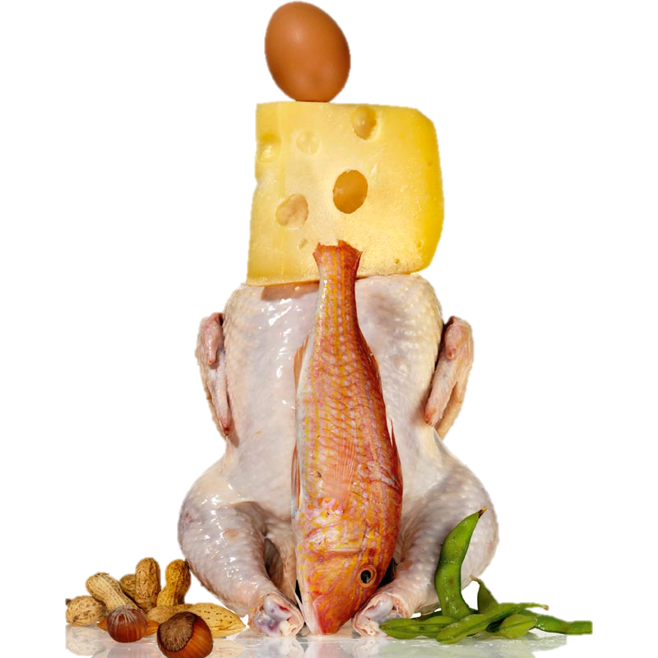
Proteins
Used for building and repairing muscles, red blood cells, hair, and other tissues.
Athletes get enough protein for muscle growth and repair in an average mixed diet.
Protein is found in meat, poultry, dairy products, eggs, nuts, tofu, and beans.
Notes:
Lean proteins help to build muscles. Emphasize building muscles to athletes.

Slide 17
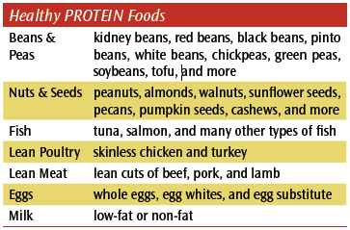
Proteins
Notes:
Please go to folder 6 for ideas for teachable moments for Healthy Team Tips on Protein.

Slide 18
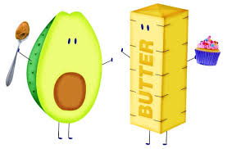
FATS
Helps sustain prolonged exercise
Source of stored energy, burned mostly during low-level activity and when other sources are not available
Fat should comprise no more than 20-25% of our total calories
Healthier fat choices: nuts, seeds, olive oil, canola oil, fish, avocados, and olives
Fat also regulates body temperature and hormones and provides fat- soluble vitamins and essential fatty acids.
Notes:
Nuts, salmon, olive oil and avocadoes are sources of good fats and Omega-3 fatty acids, which reduces the risks of some cancers. Please go to folder 7 for ideas for teachable moments for Healthy Team Tips on Fats.

Slide 19
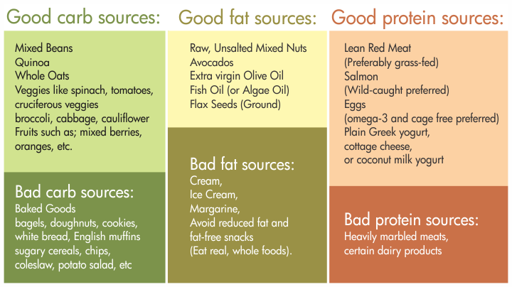
Carbs, Fat, Protein
Notes:
Please go to folder 5,6, and7 to review all of these topics.

Slide 20
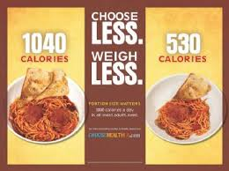
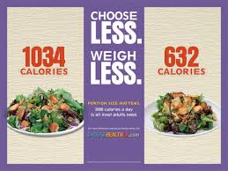
Portion Control
Too much of a Good thing can also be BAD
Remember to look for the serving size on the Nutrition Facts label.

Slide 21
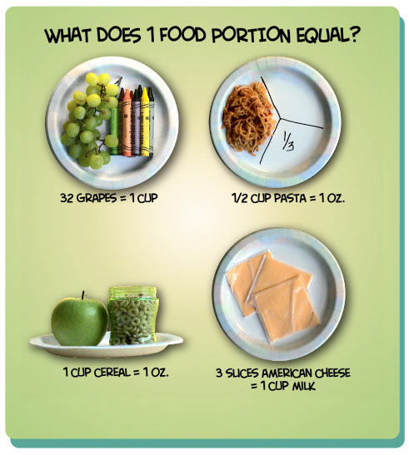
Portion Control
Notes:
Interactive tips:
Instead of having 3 meals, break them down to 5 smaller meals throughout the day. Please go to folder 8 for ideas for teachable moments for Healthy Team Tips on Portion Control

Slide 22
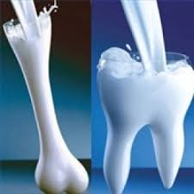
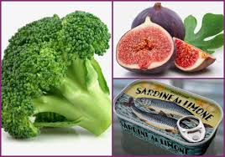
Vitamins and Minerals
Needed to regulate processes in the body- used to utilize energy from carbohydrates, protein, and fat.
Calcium
Builds bones, length, and strength.
Helps your muscles contract and nerves function
Found in dairy products, calcium-fortified orange juice, dark green vegetables, dried legumes
Not enough calcium can affect bone density and bone loss, increasing your risk of stress fractures. Lack of calcium can also contribute to muscle cramping.

Slide 23
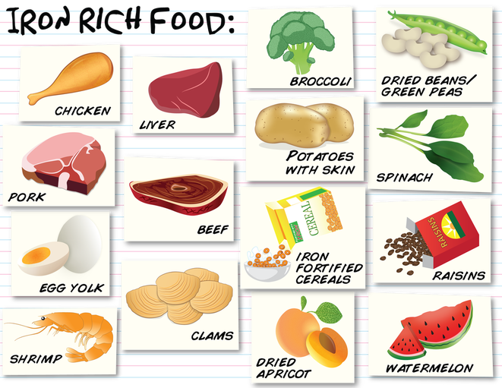
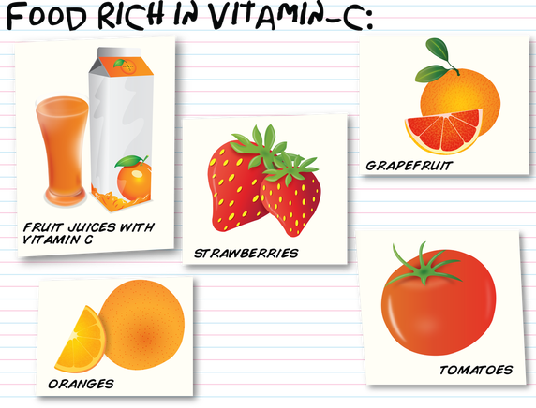
Vitamins and Minerals
Iron
Aids in energy metabolism.
Deficiency can lead to weakness and reduced resistance to infection.
Iron is found in lean meats, eggs, legumes, whole grains, green leafy vegetables
Vitamin C increases the body’s ability to absorb iron.
Notes:
Please go to folder 9 for ideas for teachable moments for Healthy Team Tips on Vitamins and Minerals

Slide 24
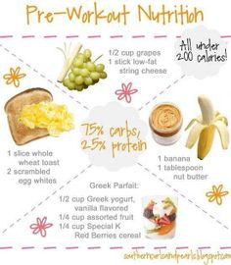
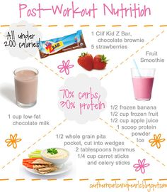
What should I eat?
Notes:
Please go to folder 10 for ideas for teachable moments for Healthy Team Tips on Pre and Post Workout Nutrition.

Slide 25
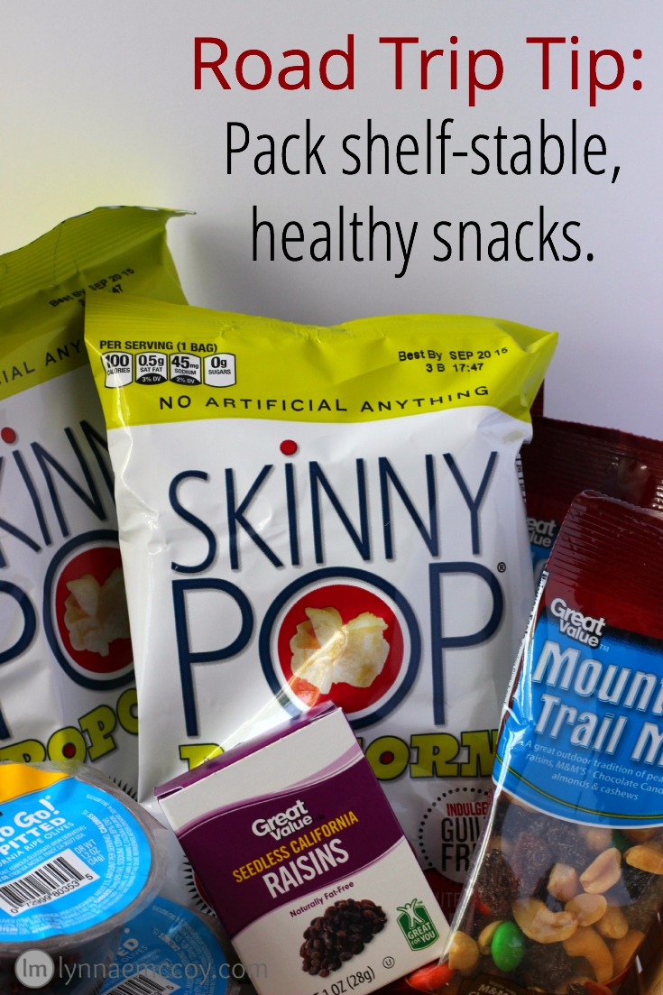
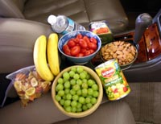
Planning ahead!
Decide in advance when and where the meals are going to be during the road trip.
Call ahead and order so the meals are ready when you arrive. Most chain restaurants have online menus.
Notes:
Please go to folder 11 for more information on this topic to share with families and how they can healthy travel tips for scrimmages and competition on the road.

Slide 26
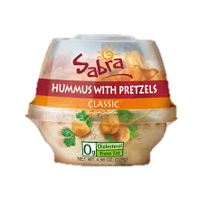
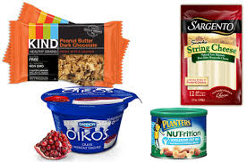
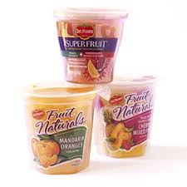
When Getting Snacks For the Team Cooler, Look for...
Notes:
Please go to folder 11 for more information on this topic to share with families

Slide 27
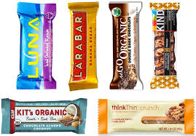
Healthy Snack Options
Notes:
Please go to folder 11 for information to share with families

Slide 28
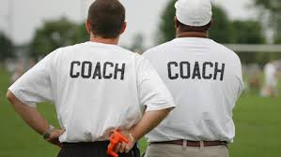
Notes for the Coach
Teach athletes about good nutrition
Foods that are high in carbohydrates provide athletes with the energy their muscles need
Healthy carbohydrates - whole grains, etc.
Encourage 4 servings per day of calcium-rich foods like milk, cheese, yogurt.
Encourage 4-5 servings per day of fruits and vegetables. Eat nutritious snacks provided at half-time.
Drink fluids throughout the training and events.
Notes:
This is a review of all the important concepts that you should be reinforcing in your practices as the occasions allow and in your daily life to serve a role model.

Slide 29
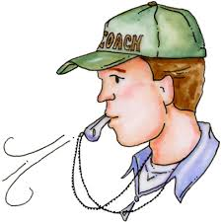
Notes for the Coach-Cont’d
Instruct athletes regarding the importance of pre-event meals and fluids.
Enforce healthy habits between-game eating.
Provide healthy snacks during tournaments.
Pre-select an appropriate restaurant that can healthfully handle the whole team.
Instruct players to pack their own healthy favorites.
Pre-game dietary goals should be, continuous hydration and maintaining low blood sugar levels.

Slide 30
Good examples of healthful restaurant choices:
Sandwich shops (Subway, Quiznos, Togos) - Encourage lean protein with lots of vegetables, baked chips
Bagel shops (Bruegger’s, Einstein Bros.) - Bagel with light cream cheese or egg for breakfast with fresh fruit or juice
Salad bar restaurants (Souplantation, Fresh Choice, Sweet Tomato, Crispers) - Encourage non-creamy soups, pasta, salads, breads, low-fat muffins
Italian eateries - Encourage pasta dishes with non- creamy sauces, non-fried items
Supermarkets - Salad bars, bagels, fruit, delis, yogurt, lunch meat, bread and peanut butter
Notes:
If you do have the opportunity to eat out with your team, think healthy meals!

Slide 31
For more information regarding Special Olympics Florida Healthy Community programs, please contact:
Karlyn G. Emile, MPH, CHES
Director, South Florida Healthy Community
Special Olympics Florida 6411 Taft Street Hollywood, FL 33024
(954) 901-9232 (954) 842-4573 - Fax karlynemile@sofl.org
http://www.specialolympicsflorida.org/healthy-community/healthy- community.html
https://www.facebook.com/specialolympicshealthycommunitys

