Slide 1
Health Transformations on Team Missouri 2018
Missouri
Notes:
Introduce yourself and let everyone introduce themselves. Thank Margaret, Catey, Jeanette and Brandon for this opportunity to partner up.
We’ll talk a little about Special Olympics Missouri, volunteering, the Training for Life Campus, funding/sponsors and our new Athlete Leadership Program and more, but we don’t want this to be a boring, stale presentation, so please pipe up if you have a question or comment during the presentation.

Slide 2
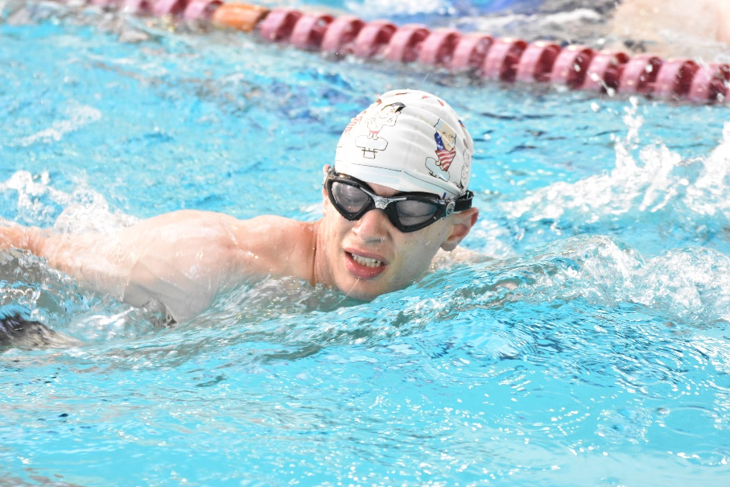
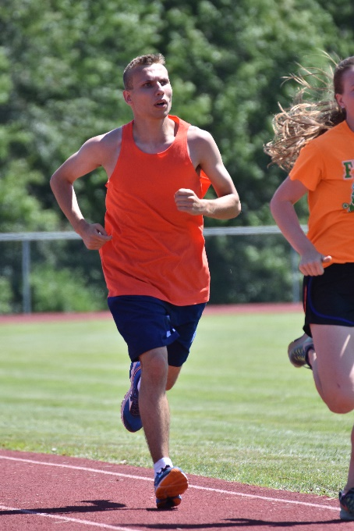
Team Missouri 2018
101 delegates
58 athletes
20 coaches
16 Unified Partners
7 staff
Train them in their sport, but also in leadership and health
Notes:
In Missouri, we start our selection process for national games nearly two years before the actual games begin by looking at athletes at our state competitions. We’re not always looking for the best athletes, but the best people to represent our state on the national stage. We look for those willing to listen, to work hard and to push themselves in every walk of life for the next 18+ months.
We took a total of 101 people with us to Seattle, 58 of which were athletes competing in 9 different sports. When we were first putting the team together, we were talking a lot about how we could incentivize them to want to go that extra mile. We wanted athletes who were willing to put in the work not just in their sport but at home as well, especially as it related to eating healthy and holding their teammates accountable.
We gave them a free pass to attend our Athlete Leadership University to take classes in a variety of subjects, some of which included healthy eating and living a healthy lifestyle. Every few months when we had a full team training, we made sure we utilized those newly trained athlete-leaders to address the team on why it was important to eat healthy and we’d have them set up food and drink stations where they could mix their own healthy chex-mix or granola and then we also had a station where we let them try adding various fruits to their water to show them a healthy alternative to sugary sodas or Gatorade.
It was important for us that it wasn’t just staff members talking to them about eating healthy, but coming from athletes (their own teammates) made all the difference. It helped those athlete-leaders gain confidence in talking to other people about those issues, but also the athletes in the crowd listen better when it’s one of their own talking to them about eating right and exercising.

Slide 3
Team Missouri 2018
Wanted a way to incentivize workouts
MO Magic Bucks
Spent their money on prizes
Top-10 and teams awarded special prizes
Notes:
Now you’d think that if you’re selected to a national or World Games team, you’d want to work out because you want to win a gold on the biggest stage possible, right? Wellllll, not so much. A lot of our athletes viewed it as they finally made it. All their training up TO that point paid off by making the team and they had 18 months to train, so why start right away? We knew we had to come up with a way to combat that.
We knew that SONA was working on getting all of our athletes wearable trackers to help with tracking their steps, but we didn’t want to rely on that in case it took too long for us to get them, so we had our coaches create individualized training plans for each of their teams. But to make sure our athletes were following through with that, we created an incentive program where we gave out “MO Magic dollars” or “Shaffer dollars” (named after our HOD Susan Shaffer) that athletes could put toward prizes if they tracked their progress.
Each dollar had a picture of Shaffer on it and was specific to that team because we also wanted to track how each team did and have the teams compete against one another for the prize of going out to a nice dinner in Seattle with Shaffer. I’m sure some would argue that should be the prize for whichever team loses, but you get the idea.
Depending on the activity (walking a mile per day, eating a healthy snack, posting about your exercise regimen on social media, etc.) they would earn points. If they worked out on the weekends they’d be double points. We’d also do random triple point days to keep them engaged. Depending on their dollar totals, they could use their money at our final team training to purchase items that we had donated including water bottles, stretch bands, exercise balls, towels, etc., but for the top 10, they had their choice of $50-$100 gift cards, a FitBit, (ie: the good stuff).

Slide 4
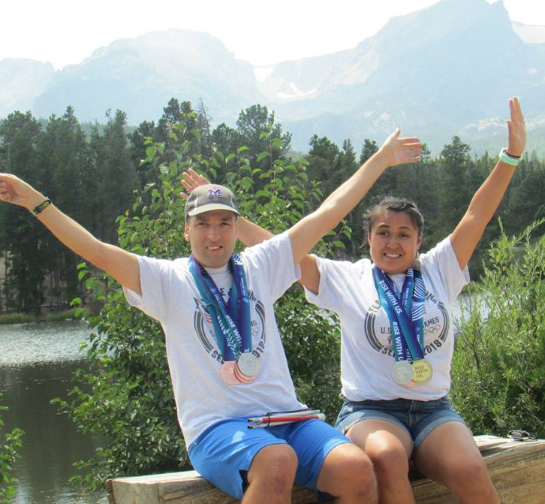
Team Missouri 2018
Success stories
Lynna and Jesse Hodgson
Paul and John Burnett
PAUL & JOHN BEFORE
PAUL & JOHN AFTER
LYNNA & JESSE
Notes:
Two of our biggest success stories are a family duo. First up is Lynna and Jesse Hodgson. They were both on the track team and each worked incredibly hard to be in the best shape of their lives for Seattle. Jesse lost probably 60-70 pounds and Lynna lost more than 40. They trained together at their home every. Single. Day. And we knew that they were training every day because Lynna is our social media queen. She would post in our Team Missouri Facebook group every day about their workout and what they ate that day. One would start on the bike while the other would be on the treadmill and then they would switch. Lynna was always encouraging other athletes to workout and eat healthy and personally challenging athletes to share their own success stories online. She was our first athlete to hit 1 million steps as well. Together, they were an unstoppable force. Lynna actually just traveled to D.C. as part of the Health Messenger training and in her role with Athlete Leadership is on a mission to change the way we do our meals at SOMO state competitions – wanting to make them as healthy as possible.
Paul and John Burnett played on the softball team. For years, they battled high A1C levels and issues with their diabetes because of it. Their parents fought with them for years on getting them to work our and eat healthier, but they never took it seriously enough. Once they made Team Missouri though, things changed for them. They started working out and eating right because thety wanted to earn their way onto Team Missouri and then perform at the highest level. Their parents didn’t have to force them to train for USA Games as they took it upon themselves to train as much as they could. They started losing weight (more than 40 pounds between the two of them), but most importantly their A1C levels were dropping as well. They came down so much that their doctor said they didn’t need their medication anymore because their livers were functioning properly for the first time in 10 years. They weren’t really interested in the bucks or gaining prizes, they just wanted to get in better shape for Seattle.
We had other success stories as well where athletes and coaches lost weight, but for me the most encouraging success we’re seeing from our program is when our athletes don’t quit being healthy after they return from Seattle. You have people like Lynna who is STILL posting on our Team Missouri facebook group about how she’s working out and how many steps she’s getting in, trying to encourage her fellow athletes and coaches to keep working out. It’s inspiring to know that these athletes have now completely bought into a healthy lifestyle and are going to do their best to share that message with the rest of the state.

