Slide 1
Special Olympics Kenya
Healthy Communities

Slide 2
Advocacy
The First Lady has now included Universal and affordable health services for persons with disabilities, including intellectual disabilities in her 2018-2022 Strategic plan.
The Kisumu County Government was provoked to activate their County Disability act for the Governor’s assent. They are also establishing a disability Board and one of our family leaders from that county will sit on that board.
Special Olympics Kenya is collaborating with National Council for Persons with Disabilities to ensure that all persons with intellectual disabilities are registered so that they can access subsidised government services including health care services.

Slide 3
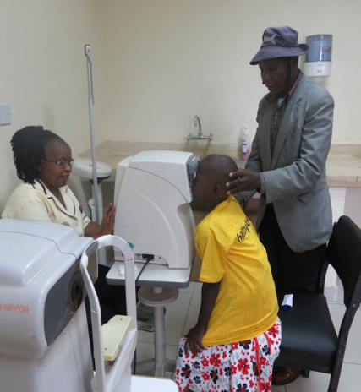
Follow Up care
Lions Sight First Screening provides post HAS follow up care for our athletes for free. The services include spectacles, drugs and surgeries. They also provide outside HAS health service opportunities for the athletes to access healthcare services from the hospital. Partnership with Lions is now expanding to Special Smiles and Healthy Hearing.
Special Olympics Kenya collaborates with the health departments of the counties where we conduct HAS events, who in turn facilitate the follow up care for athletes referred for other services other than Opening Eyes. We also appeal to them to provide waiver on the costs of health care service offered.

Slide 4
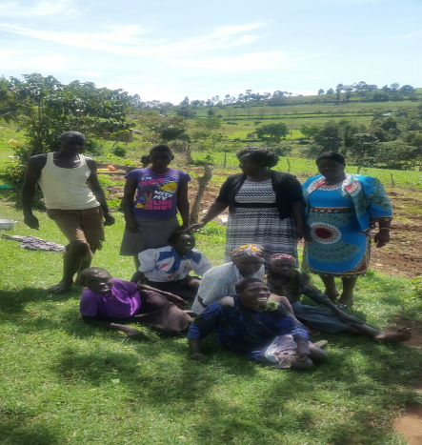
Example of SO Kenya-County Partnership
Nandi County( I will narrate the story.)

Slide 5
Questions

