Slide 1
Health Heroes

Slide 2
Health Heroes
Output: 30 Athlete Leaders trained and serving as Health Advocates amongst their peers, at SO events and on public platforms
Rationale:
Peer to peer education is often most effective
Integrates ALP’s programme in to Healthy Communities
Widens volunteer base at screenings
Ongoing health promotion impact for athlete leaders and their fellow athletes post screening
Athletes trained and ready to engage with stakeholders & sponsors when required

Slide 3
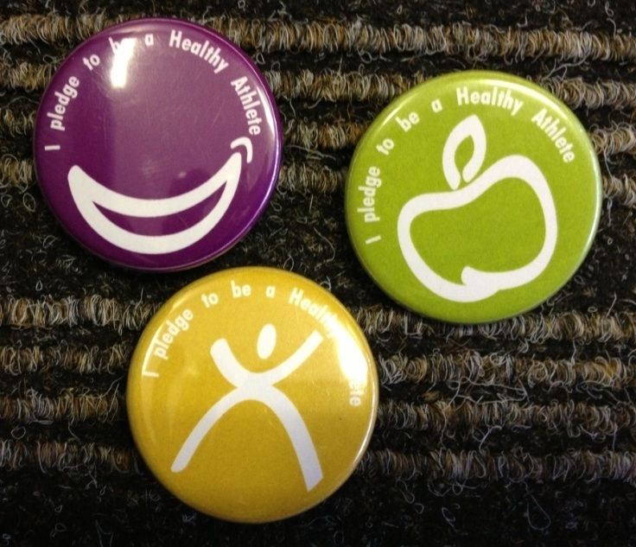
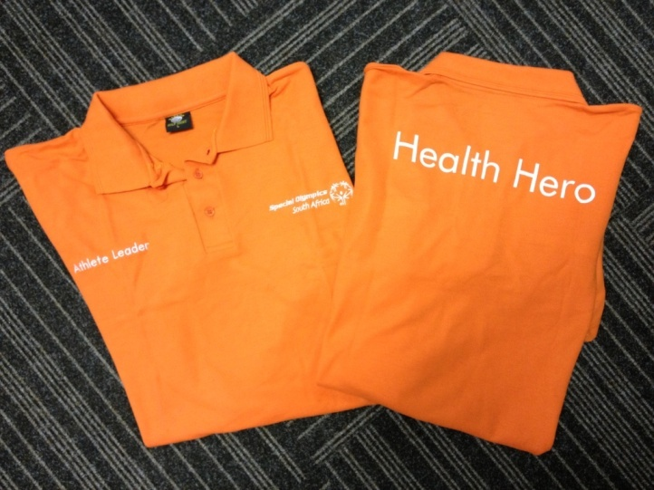
Process
Athlete Leaders are selected prior to a screening and trained the day before the screening
Health Heroes receive shirts and pledge badges and are assigned to a specific discipline at the screening (we have prioritised HP, SS, FunF & FF but it can be expanded to all disciplines)

Slide 4
Process
Health Heroes then provide interactive health education at the end of the discipline where they are assigned. The education involves giving info as well as asking questions to determine level of understanding.
Finally, the athlete is asked to make a pledge to improve their health e.g. “I pledge to brush my teeth twice a day”. On doing so, the athlete receives a pledge badge.

Slide 5
Notes
Program can be expanded within some disciplines eg Health Promotion may have a sun safety Health Hero, a hand washing Health Hero, a hydration Health Hero etc
Athlete selection is important – language, communication skills, reflect good health, positive attitude etc

