Slide 1
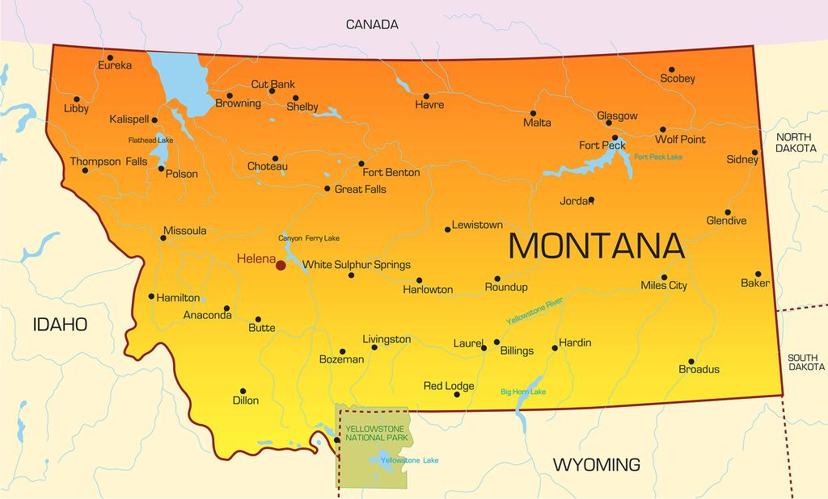

Worksite Wellness in Big Sky Country

Slide 2
Worksite Wellness in Big Sky Country
Globally
The World’s 3.2 billion workers are increasingly unwell
18% of labor force over 55 by 2030
52% of adults overweight or obese
76% are struggling or suffering in their physical wellbeing
Source: WELCOA
U.S.
100+ million Americans have been diagnosed with pre-or type 2 diabetes
A major consequence of type 2 diabetes is cardiovascular diseases
7 in 10 Americans take at least one prescription drug daily; one-half take two; 20% take five
Source: WELCOA
Why Worksite Wellness?
Increased Productivity
Improved Morale
Decreased Absenteeism and Presenteeism
Healthcare Cost Containment
Improved Employee Health Status
As employers, it makes sense to assist employees by creating a work environment that supports and encourages good health. Healthy employees make healthy companies.
Source: WELCOA

Slide 3
Worksite Wellness in Big Sky Country
Montana’s Worksite Wellness Programs – State-Wide Reach
Montana is home of Glacier National Park and Yellowstone National Park
“Big Sky Country”, “Treasure State”, and more recently “The Last Best Place”
630 miles long east to west
Grant through the Montana Department of Public Health, Chronic Disease and Health Promotion Bureau
Health Promotion Specialists at 13 public health departments provide technical assistance for up to three worksites in their region for up to 36 months
Reach is to 56 counties and seven tribal reservations
Penny Paul provides technical assistance for the state office to the 12 Health Promotion Specialists
Penny also has sites in her region she assists in worksite wellness, which includes Special Olympics of Montana in Great Falls, Montana

Slide 4
Worksite Wellness in Big Sky Country
The Process
Utilize Wellness Council of America’s (WELCOA) Seven Benchmarks for successful, sustainable program
WELCOA is one of the nation’s most respected resources for building high-performance, healthy workplaces
Founded by William Kizer, former CEO of Central States Indemnity in Omaha Nebraska along with founding Directors, Warren Buffett, Chairman/CEO of Berkshire Hathaway, and Dr. Lois Sullivan, former Secretary of Health
30 years old, over 5,000 members, impeccable reputation for helping businesses and health professionals improve employee well-being and create heathier organizational cultures
Seven Benchmarks serve as evidenced-based framework for building a results-oriented wellness program

Slide 5

Worksite Wellness in Big Sky Country
The Seven Benchmarks
Committed and Aligned Leadership – SOMT leadership had complete buy-in
Collaboration in Support of Wellness – diverse wellness team formed by those that wanted to serve
Collecting Meaningful data to Evolve a Wellness Strategy – survey done to access needs
Crafting an Operating Plan – developed an operating plan around needs that came forward from the employee survey
Choosing Initiatives that Support the Whole Employee – Bill Salonen will discuss
Cultivate Supportive Health Promotion Environments, Polices and Practices – working in this benchmark now - some policy changes in flex time – Bill will discuss
Conduct Evaluation, Communicate, Celebrate, and Iterate – will evaluate again in Spring 2020
(Seven Benchmarks pdf will be provided)
https://www.welcoa.org

Slide 6
Worksite Wellness in Big Sky Country
Special Olympics of Montana Worksite Health Perspectives from Bill Salonen
Monthly SOMT Wellness Committee Meetings with Penny – team currently on Benchmark #6
Weekly “Wednesday Wellness” health and wellness email; ergonomics, exercises, recipes, nutrition information/articles, inspirational quotes and some humor. Penny supplies information and resources.
Wednesday Walks – 9:00 a.m. – walk for 10-12 minutes in our residential neighborhood
Employee Flexible Schedules: Memorial Day to Labor Day – 4 10’s with Fridays off; options available now (ex: 4 9’s and working only half day on Friday)
Employee Flex Time: especially during the peak work periods (ex: time off the week of Thanksgiving after State Basketball Tournament)
Quiet Work Times
Engagement Activities (to reduce silos of Development, Sports, Health, etc.)

Slide 7

Worksite Wellness in Big Sky Country
Picnic, Bocce, Corn Hole in the Hall
Field trip to get Flu shots at the Health Department’s drive-through flu shot clinic
Chair Massage
Ergonomics Observation
Questions?
Bill Salonen
Senior Director of Innovation
Special Olympics Montana
bsalonen@somt.org
406-315-4230 (w)
406-788-4393 (c)
Fax: 406-315-5830
710 1st Avenue North
Great Falls, Montana 59401
PO Box 3507
Great Falls, Montana 59403

