Slide 1
Healthy Communities 2018 End of Year Report March 2018

Slide 2
Agenda
Drop Box
Event Calendar
Qualtrics
Important Dates and Deadlines

Slide 3
#CornyAppreciation
THANK YOU!

Slide 4
HC Criteria

Slide 5
Dropbox
If you still do not have access to your Dropbox folder, please let your RHM know!

Slide 6
Event Calendar

Slide 7
Qualtrics Links
Important
The Year-End Report link comes from your RHM, NOT the Resources page on the website!
They are specific to YOUR program individually!
Clicking the link on the website will bring you to a BLANK copy of the report.

Slide 8
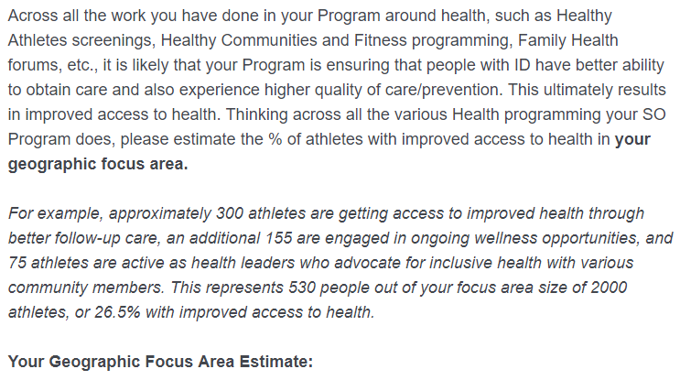
Qualtrics – Improved Access to Health

Slide 9
Qualtrics - Partners

Slide 10
Qualtrics – Go Slowly!

Slide 11
Qualtrics – PDF Copy

Slide 12
Important Dates and Deadlines
Report on Activities from 1 April 2018 – 31 March 2019
Deadline for ALL Submissions: 15 April 2019
Reminder: Link for your Program comes from RHMs
The Link will be provided no later than 25 March 2019

Slide 13
Questions?
If you have any questions about or issues with your Qualtrics report, please email: research@specialolympics.org sengel@specialolympics.org ldubois@specialolympics.org
Thank you!

