Slide 1
Single Health Evaluation
11 January 2022

Slide 2
Agenda
Goals
Metrics
Deadlines
High-level changes
Pillar reporting
Tracking tools
Questions/comments

Slide 3
Goals
To report the unique number of people participating in health activities.
Including, among others: athletes, family members/caregivers, and health professionals.
To understand reach of activities and outcomes.

Slide 4
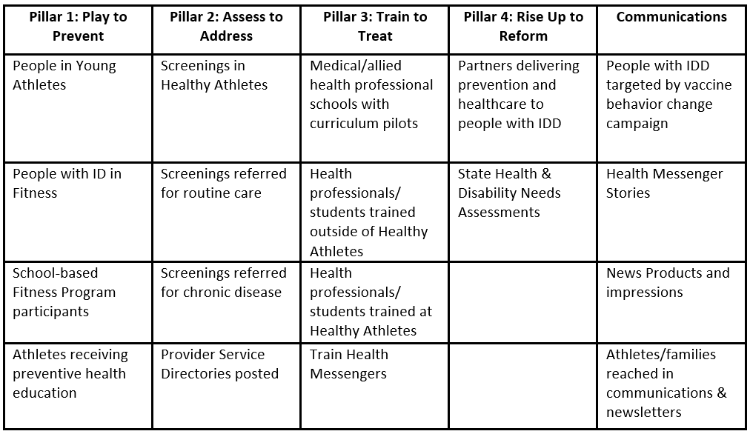
Metrics
Notes:
Special Olympics’ Global Strategic Plan's three broad strategies are to: (1) improve and expand local activities; (2) empower athlete and other leaders to create inclusive change; and (3) grow inclusive practices and activities. Needless to say, health, fitness and access to medical care are an essential part of each of these goals.

Slide 5
Deadlines
2 reports per year (every 6 months)!
CDC-Funded Programs:
Mid-year: 1 Aug 2021 – 31 Jan 2022 (due 15 February 2022)
End-of-year: 1 Feb 2022 – 31 Jul 2022 (due 15 August 2022)
Golisano-Funded Programs:
Mid-year: 1 Jan 2022 – 30 Jun 2022 (due 15 July 2022)
End-of-year: 1 Jul 2022 – 31 Dec 2022 (due 15 January 2022)

Slide 6
High-Level Changes
No more geographic-focus area! Report Program-wide participation.
Re-organization of questions by Pillar
All health activities will be reported through the SHE, except Family Health Forums and the Online Learning Portal
The majority of open-ended questions have been moved to the Monthly Report

Slide 7
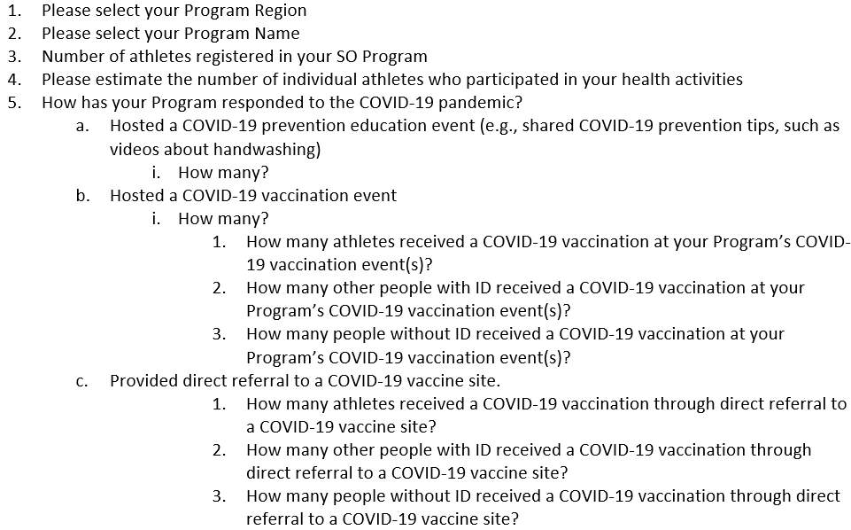
Pillar Reporting: General Information
Note: you should be reporting on the number of athletes vaccinated as a result of your COVID-19 activities, not, the number of vaccinated athletes in your Program.

Slide 8
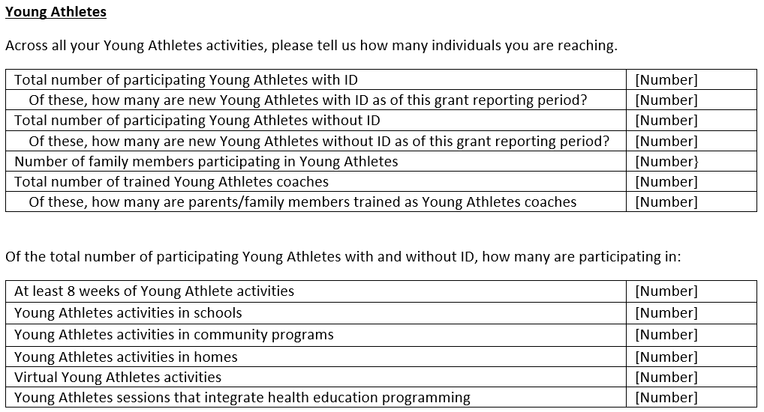
Pillar Reporting: 1 – Play to Prevent
Note: Young Athletes numbers should match how you report on the Census.

Slide 9
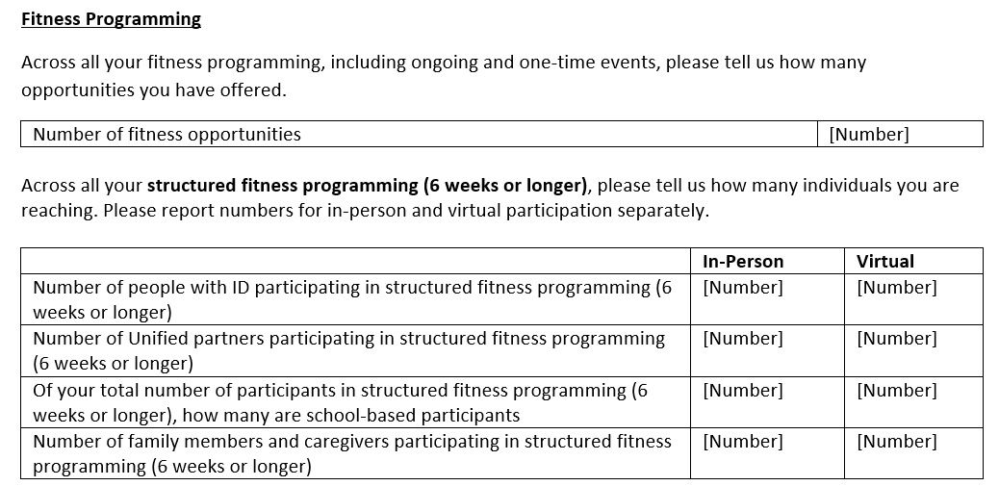
Pillar Reporting: 1 – Play to Prevent
Notes:
count the number of individuals participating in structured fitness.
include views of content on social media under Communications

Slide 10
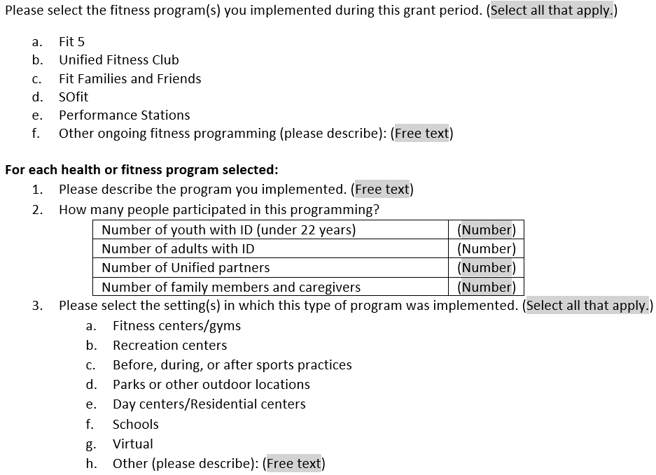
Pillar Reporting: 1 – Play to Prevent

Slide 11
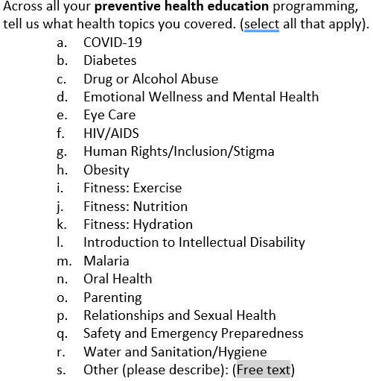
Pillar Reporting: 1 – Play to Prevent
Note: do not include Family Health Forum numbers here.

Slide 12
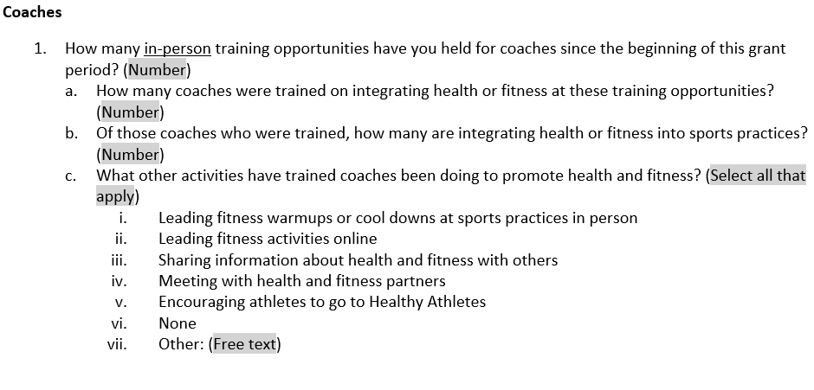
Pillar Reporting: 1 – Play to Prevent
Note: do not include those trained through the Online Learning Portal.

Slide 13
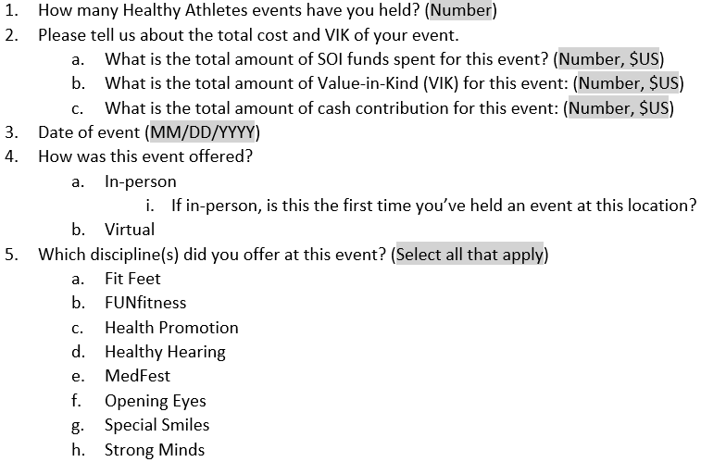
Pillar Reporting: 2 – Assess to Address

Slide 14
Pillar Reporting: 2 – Assess to Address
Notes:
must use HAS forms to complete this section
Highlighted section only for FUNfitness and Health Promotion
MedFest has unique follow-up care questions
No referrals for Strong Minds

Slide 15
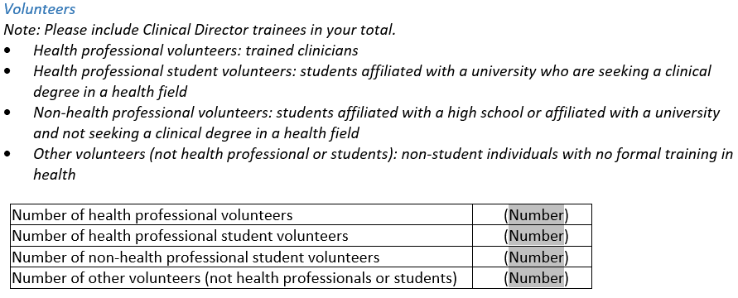
Pillar Reporting: 2 – Assess to Address

Slide 16
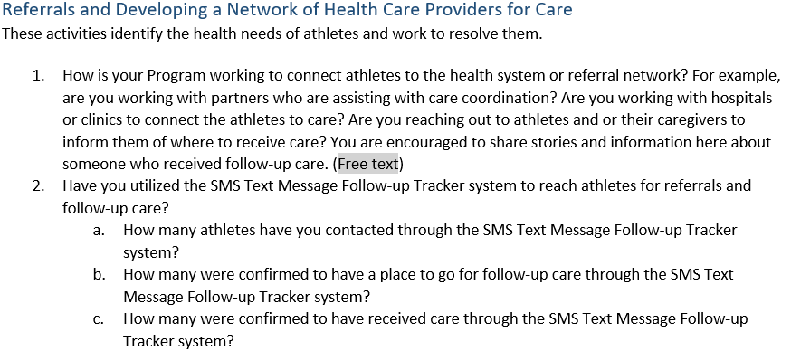
Pillar Reporting: 2 – Assess to Address

Slide 17
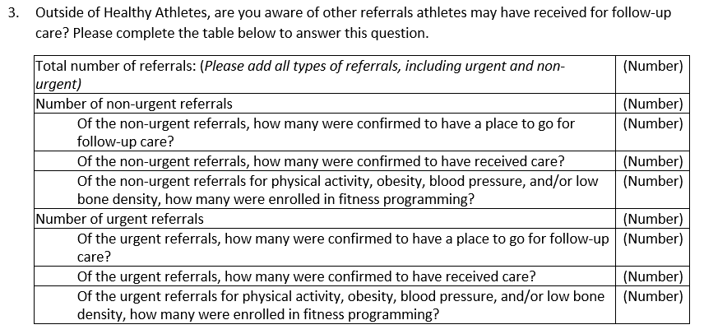
Pillar Reporting: 2 – Assess to Address
Note: track enrollment in fitness programming only for referrals in physical activity, obesity, blood pressure, and low bone density.

Slide 18
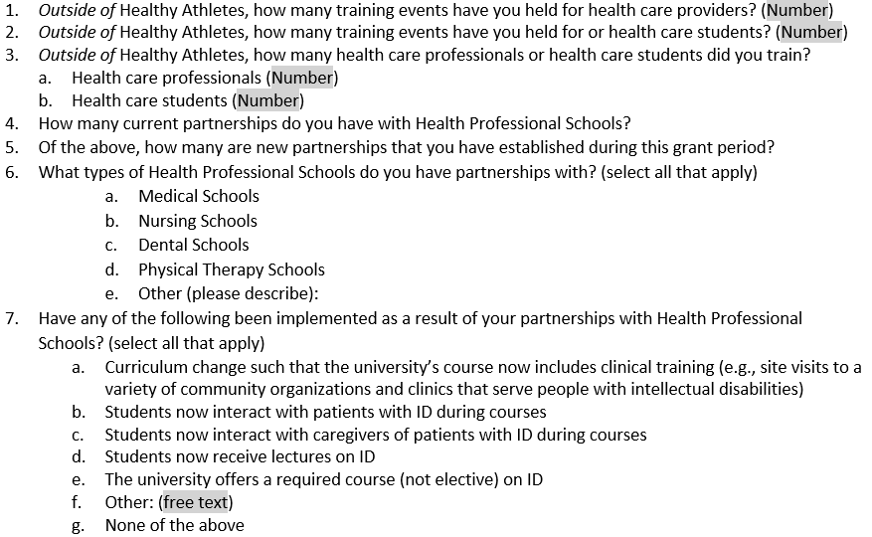
Pillar Reporting: 3 – Train to Treat
Notes:
do not include training through the Online Learning Portal
Only include active partnerships

Slide 19
Pillar Reporting: 3 – Train to Treat

Slide 20
Pillar Reporting: 3 – Train to Treat
Note: do not include Health Messengers trained by SOI or your region.

Slide 21
Pillar Reporting: 4 – Rise Up to Reform
Notes:
include only active partnerships
you will still submit a complete partners list

Slide 22
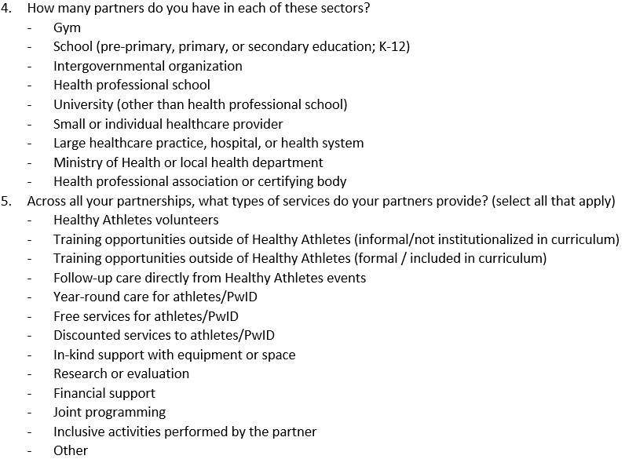
Pillar Reporting: 4 – Rise Up to Reform

Slide 23
Pillar Reporting: 4 – Rise Up to Reform

Slide 24
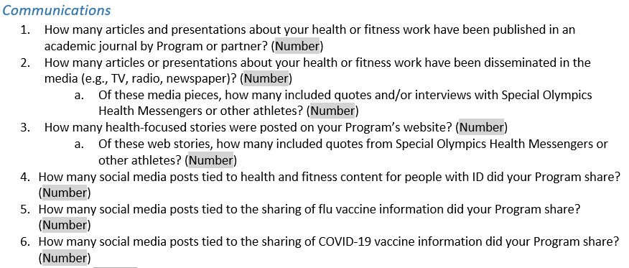
Pillar Reporting – Communications

Slide 25
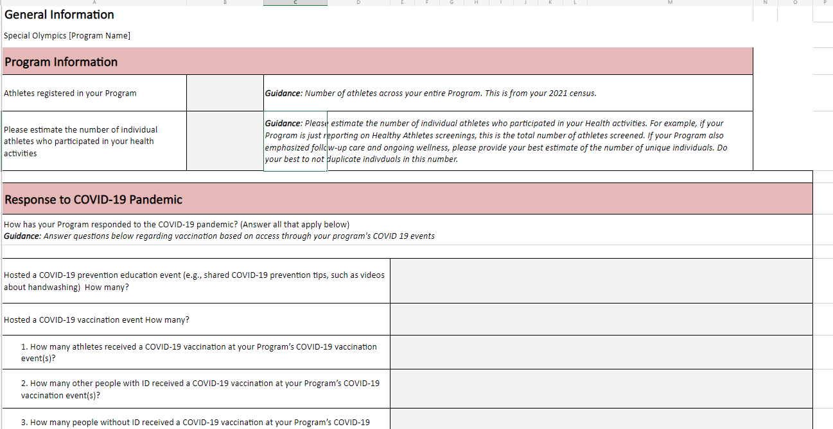
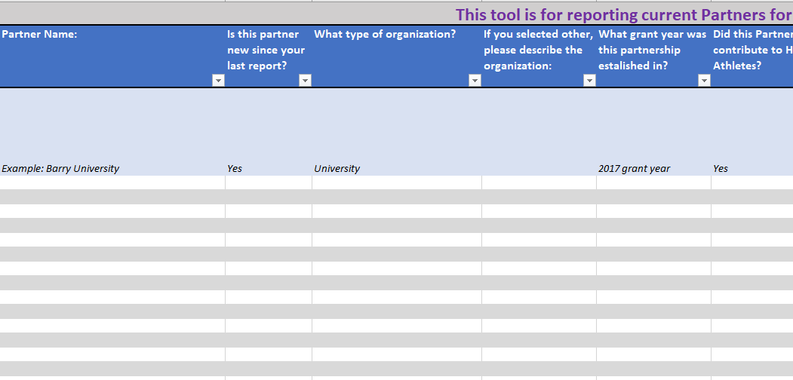
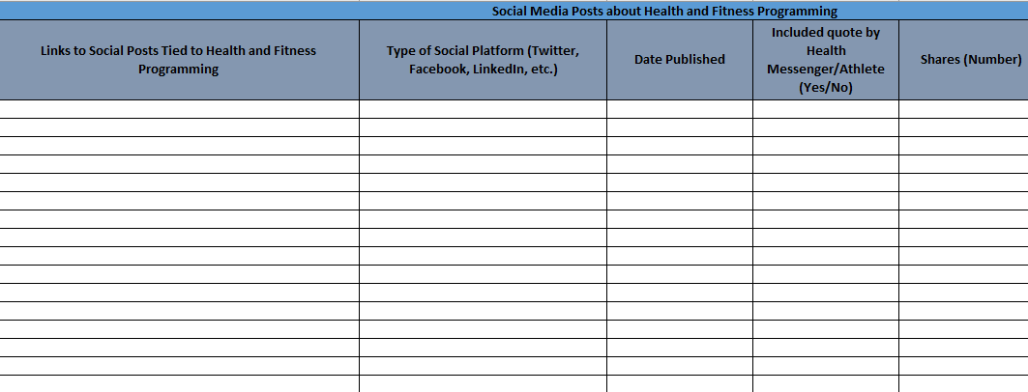
Tracking Tools
Single Health Evaluation
Partner’s List
Communications Metrics

Slide 26
Questions/Comments Following this meeting, please contact research@specialolympics.org with any other questions!

