Slide 1
SPECIAL Olympics Indiana

Slide 2
Indiana State Department of Health
Indiana
Biennial budget

Slide 3
Building the Relationship
Stakeholder Workshop in 2017
Indiana
Spring 2017 and Spring 2019
Division of Nutrition and Physical Activity 2-3 meetings
July 2019 applied for Youth and Adolescent Physical Activity (YAPA) Grant
Received YAPA Grant
October 2019- State Conference invited grant personnel to speak and attend

Slide 4
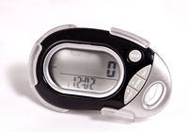
YAPA Grant
Physical Activity Implementation
Physical activity opportunities in classroom, school, and before or after school program setting
Unified Fitness Clubs as model to follow
Fitness Pedometers for schools
Recruitment of schools as been done with collaboration with Unified Champion Schools

Slide 5
Advice
Highly involving grant personnel in the whole process

Slide 6
Questions
Jeff Mohler, CEO
jmohler@soindiana.org
Itzel Graber, Manager of Health and Fitness
igraber@soindiana.org

