Slide 1
Kaiser Permanente of Washington Partnership Special Olympics Washington Della Norton , Director of Health Programs dnorton@sowa.org Mary Do, Senior Vice President of Development and Communications mdo@sowa.org

Slide 2
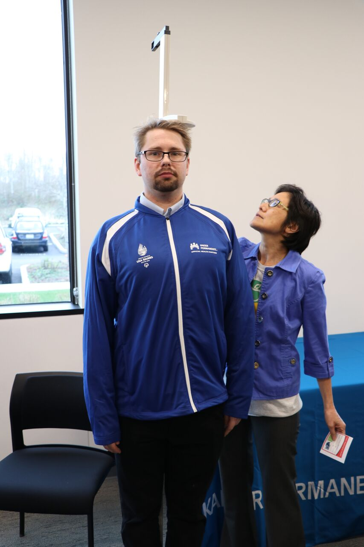
Who Kaiser is and why they were initially interested in our health work?
Kaiser is a national healthcare company (formerly: GroupHealth)
They sponsored the USA Games in 2018 and were drawn to the national stage and platform
Overlapping goals and commitment to improve health of athletes, data/technology on health metrics and follow up care
Opportunity to gain membership through working with our program
Storytelling opportunities with our athletes
Kaiser worked with our local program and athletes through “Team WA” leading up to games
Notes:
2 parts: Kaiser Medical Group & Insurance – they work in tandem
Medical group is the clinicians, Insurance is the benefits piece
Working with our athletes on a local level was more impactful and the possibility of more creativity outside of USA Games was intriguing to them – many became clinical directors and volunteered at the USA Games
Storytelling opportunities with our athletes – who we know are Kaiser members!

Slide 3
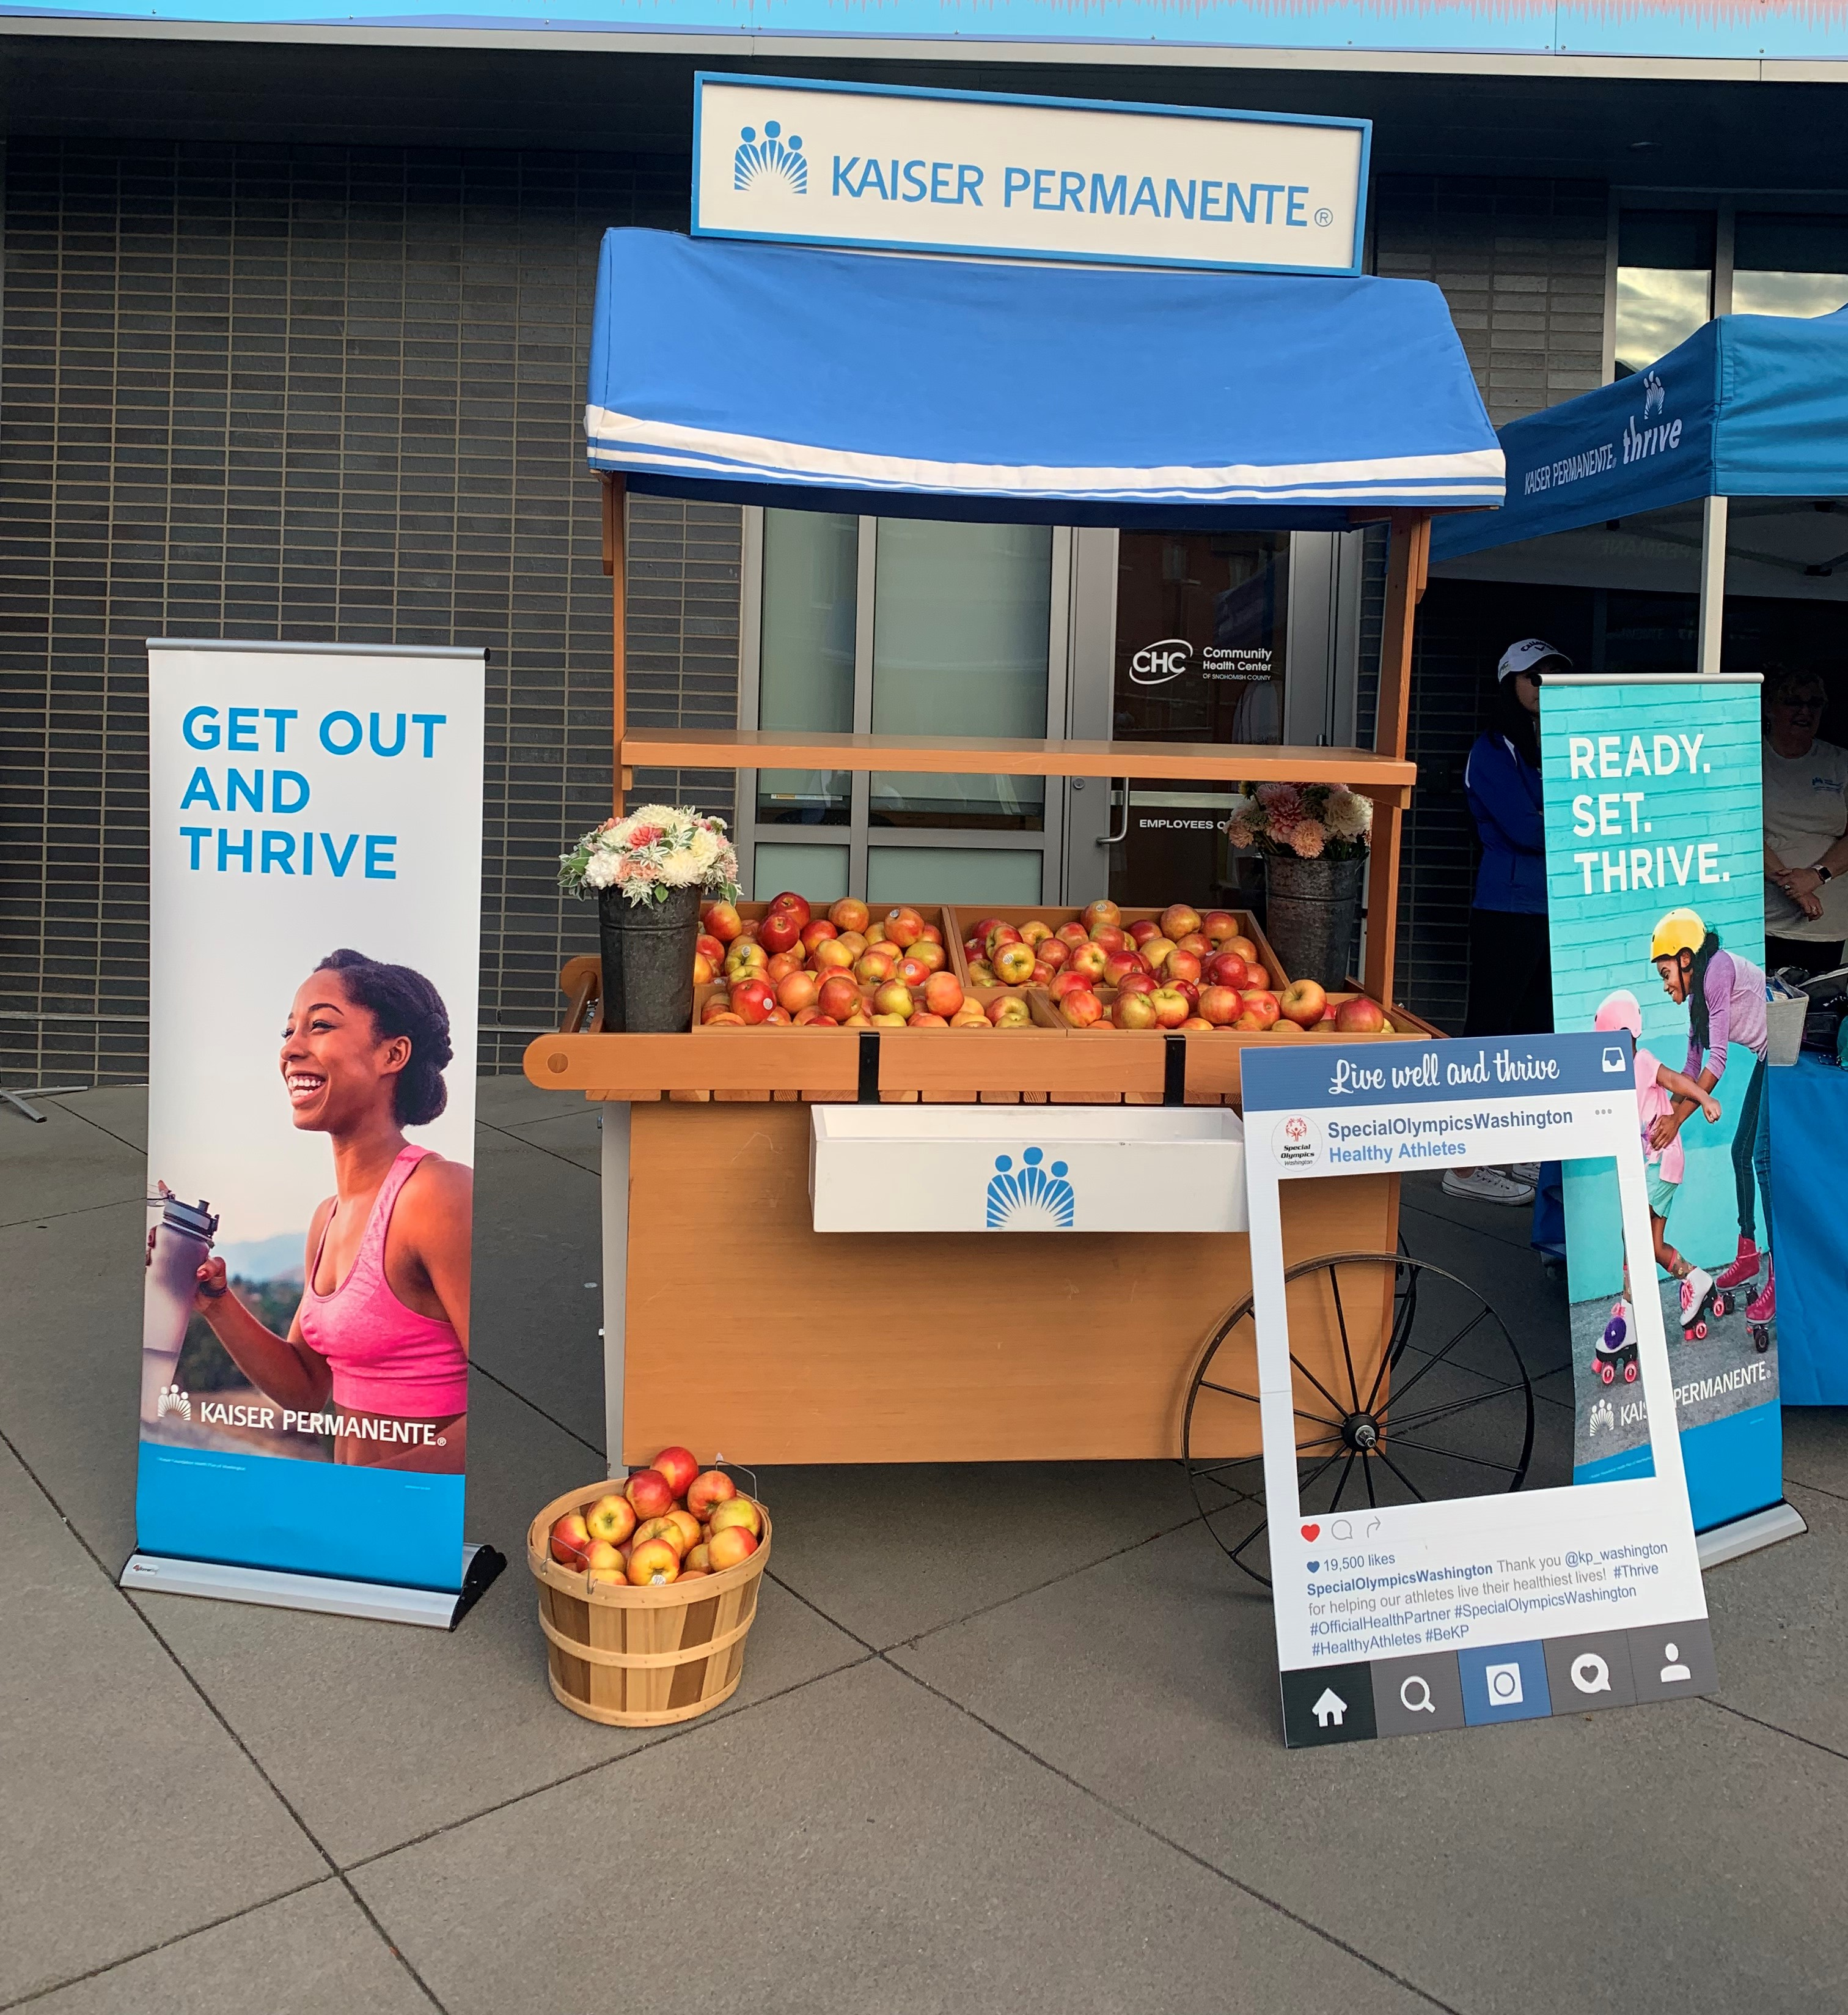
How did we approach them about funding and build a strong relationship?
Capitalized on the momentum after USA Games
Aligned our priorities
Emphasized flexibility in partnership and activation
Gave them opportunities to see their marketing dollars at work
Demonstrated potential impact on their target audience: teachers, parents, youth
Kaiser Fruit Stand at Summer Games 2019
Notes:
They really appreciate flexibility
Presented them with marketing opportunities through the Unified Champion Schools Program – (teachers, youth, parents)
Expand their reach through visibility at LETR & Polar Plunge Events

Slide 4
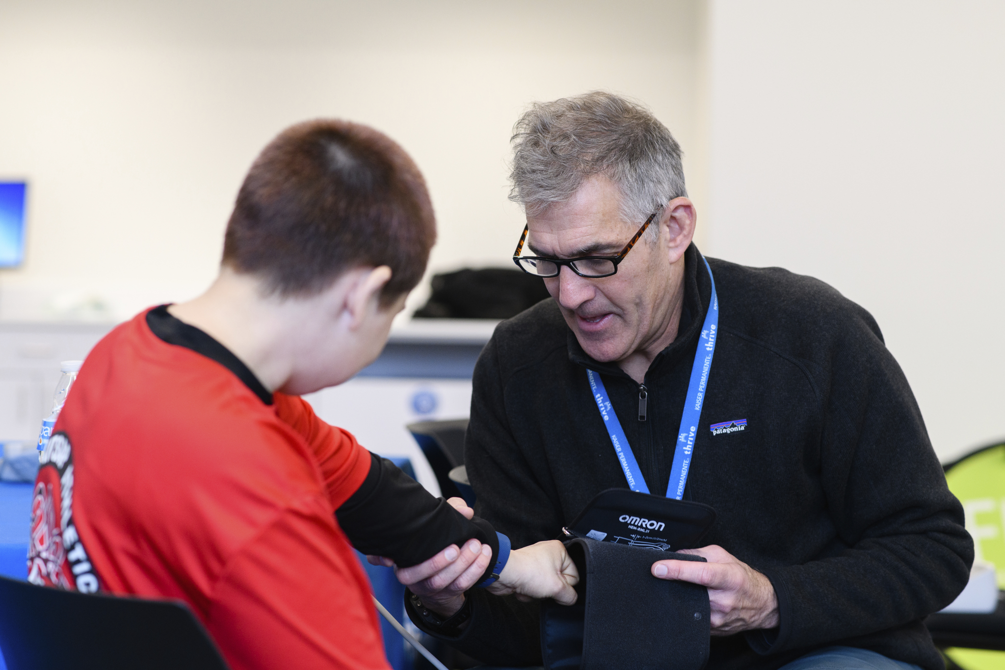
What are they funding us to do & do we think they will renew funding in the future?
Designation as Official Health Partner
Year-round gold level sponsorship & recognition
Onsite volunteer and leadership opportunities
Sideline Support & First Aid
Train new Clinical Directors
Storytelling Opportunities
Notes:
(Healthy Athletes and Healthy Communities) – recognition as official health partner
sponsorship (logo and marketing activation at LETR, Polar Plunge, RWTC’s, Day of Inclusion
Technology,
EVERYTHING HEALTHY ATHLETES and HEALTHY COMMUNITIE
Multiyear agreement
In Kind and Cash
Large portion designated for technology
We absolutely think they will renew in the future – we see this as a lifelong partnership

Slide 5
Challenges we had to overcome, key players and advice:
Challenges:
Not overselling on something we can’t deliver on
Respecting exclusivity while delivering on our needs
Aligning as a staff to deliver on partnership agreements
Advice:
Development and Health department working together = key
Aligning priorities with sponsor
Meet frequently & designate an account manager to execute benefits
Notes:
Advice:
Determine, what are their priorities (be prepared to solve both of your problems) - at the end of the day they are a business, in the end, how are we getting more members for them, elevating their brand and vice versa
Meet frequently- every 2 weeks and now we have an account manager (activation piece doesn’t just fall on one person)
Challenges:
Working in making sure that the development side is not overselling on something we can't deliver
They want "official health partnership" - but they can't deliver on all our needs (ex: dental)
Being honest with kaiser - "this puts us in a bind, are you ok with us approaching other like sponsors"
Athlete Involvement:
Many SOWA Athletes are KP members - storytelling opportunities & real opportunity to elevate this

Slide 6
Thank you! Della Norton , Director of Health Programs dnorton@sowa.org Mary Do, Senior Vice President of Development and Communications mdo@sowa.org

