Slide 1
Hawaii’s Daily Tooth Brushing Program (Pilot)
Jen Ernst
ha@sohawaii.org
1/16/2019

Slide 2
The “IDEA”
Poor Oral Hygiene!
Urgent Dental Needs
Additional Ongoing Wellness Program; Criteria 5
Simple, grass roots solution
Win for Individuals, Program (IEP) and Community
Easy to start
Not “that” expensive; 50% supported by in-kind
Easy to track
Engaging/fun
Easy to sustain…hopefully

Slide 3
Partnerships
Goodwill Adult Day Health Program
100 participants; SO and Non-SO
16 support staff
Henry Schein Dental
Brushes
Paste
Timers
Stickers
Dental Office/Dentist
Healthy Communities Grant
Printing of poster
Mouth models
Hand mirrors

Slide 4
Educate Staff
WHY is this important?

Slide 5
Staff Training: The FACTS
People with intellectual disabilities have an equal right to good oral health.
Good oral hygiene can improve social experiences, behaviors and eating.
Oral care is not only an important part of the participant’s personal grooming care, it is the prevention of secondary infections that can travel to other parts of the body and have SERIOUS consequences!
YOU can have a positive influence on the health of your participants by helping them learn how to independently and regularly brush their teeth.

Slide 6
Staff Training…program highlights
Weekly lesson plans; incrementally increase skills each week
Empower participant to brush independently as much as possible
Infection control techniques; storage/no sharing!
Inform parents; support program; brush before bed
Reinforce positive brushing behavior
Motivation for staff
Simple tracking form and requirements
Incentives ($5 gift card) for submitting roster at end of 6 week.

Slide 7
Individuals with Intellectual Disabilities (Disparities)
Are at a higher risk for gum disease and tooth decay compared to the general population:
Poor communication skills, lack of manual dexterity, fear, uncontrolled movements, and other physical, emotional or behavioral factors can make it difficult to maintain proper oral hygiene.
 | Special Olympics athletes (%) | General population (%)
Mouth pain in Special Olympics athletes and general population (pain in face and jaw) (18+) | 11.7 | 4.8¹
Untreated Tooth Decay in Special Olympics athletes and general population (18-64) | 25.6 | 23.7¹
Missing teeth in Special Olympics athletes (missing teeth) and general population (broken or missing teeth) (18+) | 32.7 | 16.9²

Slide 8
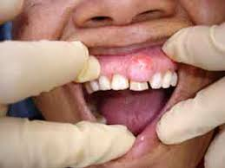
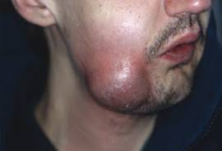
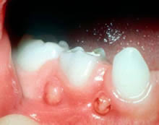
A Dental Abscess
The gum tissue can become inflamed, swollen, or infected. A small pimple on the gums may develop and is usually a sign of a dental infection.
If left untreated, infection can spread deeper into the tissue and affect surrounding teeth and bones. This could lead to increased pain and swelling and the infection could travel to other parts of the face and body.

Slide 9
Dental Abscess: Symptoms and Signs
Common symptoms of a dental abscess include
swelling,
pain when chewing,
a constant toothache or a dull,
constant throb associated with the tooth.
Other symptoms may include
swelling of the glands of the neck,
fever,
bad breath, and
odd or bitter taste in the mouth.
The abscess can be painful but occasionally the problem can go unnoticed unless detected by a dental professional.
If seen, recommend participant seek dental evaluations as soon as possible.

Slide 10
6 Weeks – 6 Lesson Plans

Slide 11
Adding incremental skills….

Slide 12
Options to keep it interesting!

Slide 13
Keep Tracking Simple
Need to know if SO Athlete or not for reporting

Slide 14
Supplies for Participants
Full sized toothpaste:
2 per participant
Soft bristled brush:
2 per participant
2- minute timers :
1 per participant
Weekly Stickers:
6 per participant

Slide 15
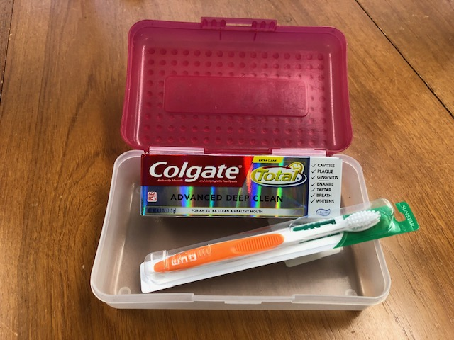
Individual Container for EACH PARTICIPANT
Name on Box
Dry brush

Slide 16
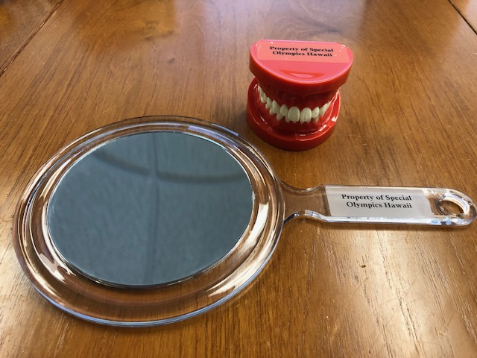
Additional Supplies for Program

Slide 17
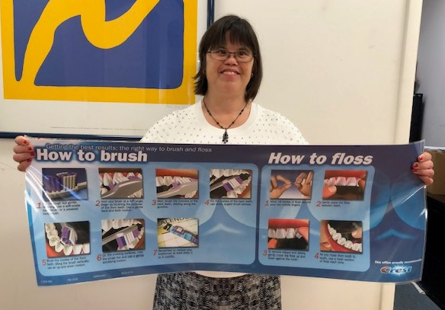
Poster Printed for Each Program

Slide 18
So far so good!
Some programs are on week three already!
Waited to provided take home supplies until roster submitted.
Created “parent letter” to accompany take home supplies.
Encouraging photos for Henry Schein Dental and to promote within program.
Hoping after six weeks program will continue.
Program to seek own donations or purchase.
Meet with staff for feedback.
Duplicate for other programs.

