Slide 1



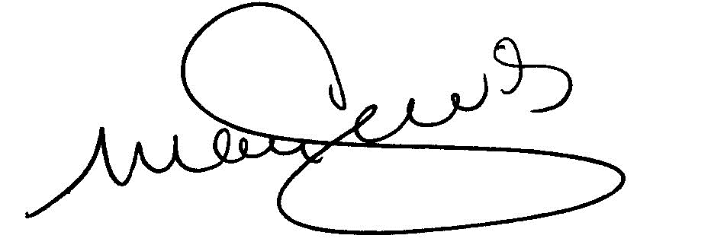
This certificate recognizes
Athlete Name
for successfully completing the
Special Olympics "Becoming A Health Messenger" training
and committing to promote, educate and encourage healthy lifestyle choices and advocate for the health of people with intellectual disabilities.
Tim Shriver, PhD
Chairman
Special Olympics International
Mary Davis
Chief Executive Officer
Special Olympics International
Alicia Bazzano, MD, PhD, MPH
Chief Health Officer
Special Olympics International

