Slide 1
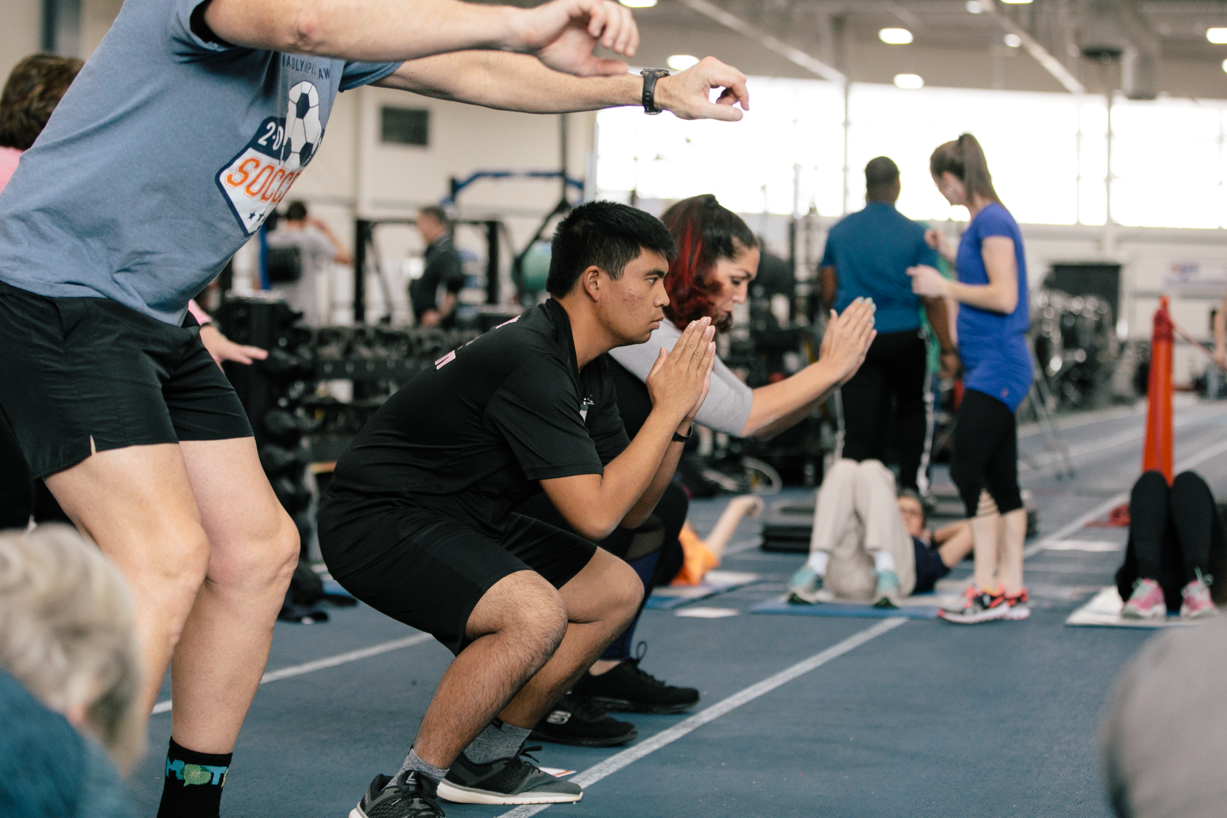
Fitness for Health Messengers

Slide 2
What is Fitness?

Slide 3
Fitness
Your best health and
performance through proper
physical activity, nutrition, and hydration
Notes:
When you are fit, you feel good and have lots of energy because your body is strong and healthy

Slide 4
Why is Fitness Important?
Helps you perform better in sport
Gives you energy
Makes you feel better
Improves your sleep
Helps you have a healthy weight
Helps you to be healthy and live longer
Reduces your stress

Slide 5
Fit 5
Notes:
Provide athletes with Fit 5 Guide for Health Messengers from the Workbook section of the Health Messenger Resources page. Give athletes 3-5 minutes to look through the guide.
ASK: a show of hands - who is familiar with FIT5?
SAY:
Special Olympics created a guide called “How to get your Fit 5” to make it easier to be fit.
The guide is based on 3 simple goals:
Exercise 5 days per week
Eat 5 total fruits and vegetables per day
Drink 5 water bottles of water per day
The guide has lots of information to help athletes reach their goal in each of those areas.
You can track your progress on the tracker in the back of the guide.
It was designed to be by athletes, for athletes, with athletes teaching other athletes each lesson. There are adaptive exercises included throughout. We encourage you to implement FIT5 with athletes in your communities.
We will focus on Nutrition and Hydration in another session. Now we will focus on Physical Activity and Exercise.

Slide 6
Physical Activity
Notes:
Let’s talk more about physical activity!

Slide 7
Physical Activity and Exercise
Exercise
Physical Activity
What’s the difference?
Notes:
SAY:
Sometimes the words physical activity and exercise are used as the same thing, but they are not.
Physical Activity is ANY movement of our bodies.
Exercise is intentional movement that is done to improve or maintain your fitness.
Exercise is a TYPE of physical activity, but not all physical activities are exercise.
ASK:
Can you give me 3 examples of each that are not already pictured?
Examples of PA would be anything active—gardening, walking, biking, cleaning, taking the stairs, etc.
Examples of exercises would be things like yoga, jogging or brisk walking, weight lifting, push ups, etc.

Slide 8
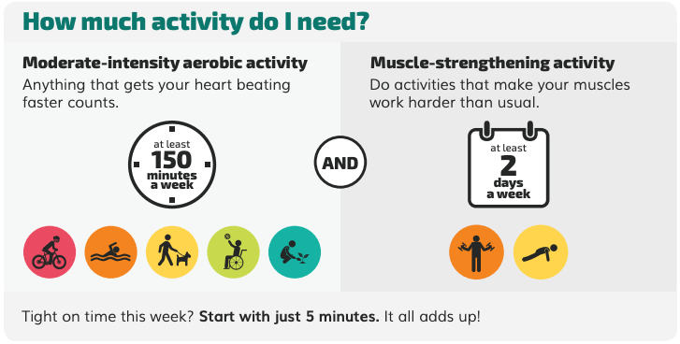
Notes:
SAY:
It is recommended to get at least 150 to 300 minutes (2.5-5 hours throughout the week) of medium to hard physical activity throughout the week to stay healthy. Following the Fit 5 goal of EXERCISING 5 days per week will make sure you get that recommendation. Need a mix of physical activity to stay fit and healthy. These are the guidelines for adults. Moderate intensity means activity that makes your heart beat faster, breathe harder, and makes you sweat.
For people who prefer a harder, more vigorous workout like running then you can aim for 75 minutes per week.
Try to be active throughout the day with both exercise and physical activities. Even light physical activity, like taking the stairs, standing instead of sitting, or doing chores in your house is better for you than sitting and doing nothing.

Slide 9
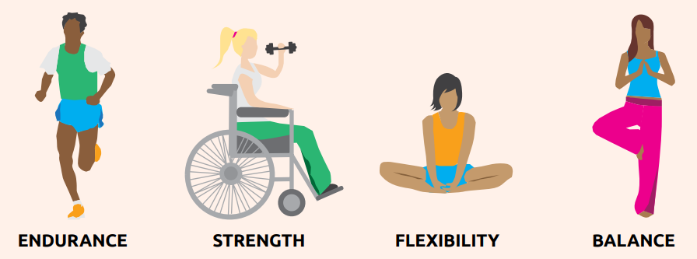
Four Parts of Fitness
Notes:
You can become a better athlete by enjoying physical activity outside of your sports practice. There are many ways to be physically active. Certain exercises can help you improve the skills needed for your sport.
Fitness has 4 parts related to exercise and physical activity:
Endurance
Strength
Flexibility
Balance
All exercises work your body in different ways. In order to stay healthy, you need to incorporate different types of exercises.
Endurance is the ability of your body to keep moving for long periods of time. Endurance can help you run farther distances without stopping and practice longer with fewer breaks. What are some examples of endurance exercises? (ask for 2 examples)
Strength is the ability of your body to do work. Strength gives you the ability to jump higher, throw farther, and sprint faster. What are some examples of strength exercises? (ask for at least 2 examples)
Flexibility is the ability of your body to move easily in all directions. Being flexible makes it easier to do sports skills and helps prevent injuries to your muscles and joints! What are some examples of flexibility exercises? (ask for 2 examples)
Balance is the ability of your body to stay upright or stay in control of your movements. Balance helps you to stay in control when you are playing sports and helps you to avoid falls. What are some examples of balance exercises? (ask for 2 examples)

Slide 10
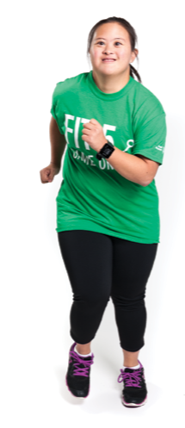
Endurance
Ability to keep your body moving for long periods of time
Helps you run far distances without stopping and practice longer without a break
Improve endurance by doing activities that increase your heart rate and make you breathe harder
Notes:
Endurance might also be called: aerobic fitness, cardiovascular fitness, cardio
Endurance exercises are continuous, rhythmic movements like cycling, running, swimming.
Endurance exercises train the heart and lungs to pump blood better to get more oxygen to the muscles.
Endurance exercise also helps sleep and lowers blood pressure

Slide 11
Endurance Activities
What exercises do you do to build endurance?
Notes:
What are some other endurance exercises? What is your favorite?
Endurance exercise can be done anywhere. Try your favorite endurance exercise for 30 minutes, 5 days each week.

Slide 12
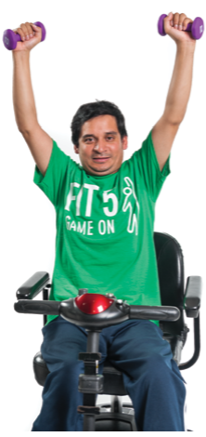
Strength
Ability of your body to do work
Strength helps you to jump high, throw far, and sprint fast
When you are strong, you can lift and carry heavy things
Improve strength by doing activities that load your muscles with weight
Notes:
Start light and get heavier

Slide 13
Strength Activities
What are your favorite exercises to build strength?
Notes:
What are some other strength exercises? What is your favorite?
Strength exercises increase the strength of not only your muscles, but also your bones.
Strength exercises can be done anywhere. The best way to get strong is to do strength exercises 2-3 days each week.

Slide 14
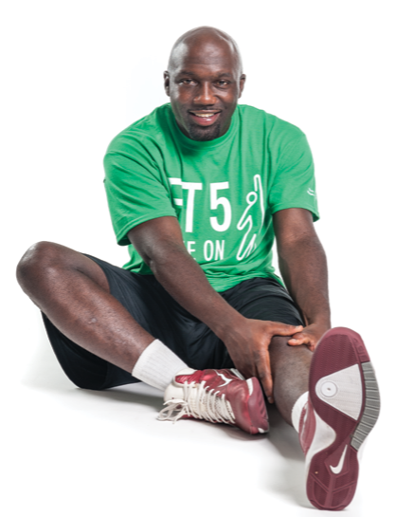
Flexibility
Ability of your body to move easily in all directions
Makes it easier to do sports skills
Prevents injuries to your muscles and joints!
Improve flexibility by doing dynamic and static stretches

Slide 15
Flexibility Activities
Dynamic stretches move the whole body to get muscles ready for activity
Best for warm-up
Static stretching is holding stretch position without moving
Best for cool-down
Notes:
Remind athletes that they should be doing DYNAMIC STRETCHES before practice/activity and Static Stretches afterwards.
Briefly explain the difference between the two.
Dynamic stretches are high knees, arms circles, leg kicks, etc.
What are some other stretches? What is your favorite?
Stretches can be done anywhere. Try to complete a stretch for all body parts, 2-3 days each week!

Slide 16
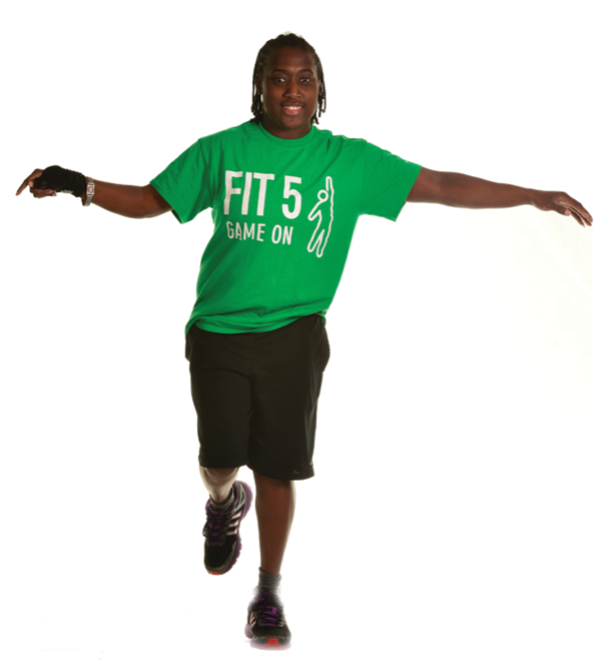
Balance
Ability of your body to stay upright and stable, and be in control of movements
Helps you to stay in control when playing sports and to avoid falls
Improve balance by doing activities that have you standing on one or both feet, moving, and shifting your weight
Notes:
Balance makes it easier to move.
Balance helps prevent injury.
Balance helps to decrease falls.

Slide 17
Balance Activities
Give an example of when you use balance?
Notes:
What are some other stretches? What is your favorite?
Balance can be done anywhere. Try to complete a full body balance workout, 2-3 days each week!

Slide 18
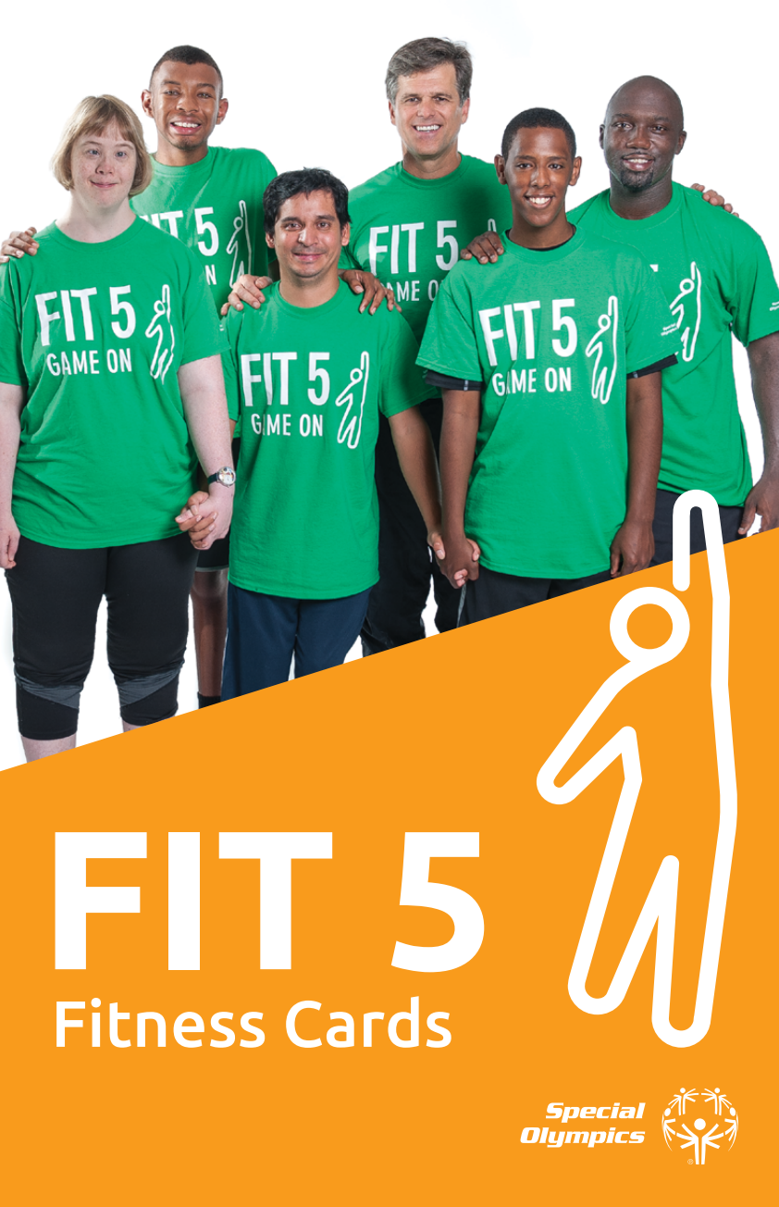
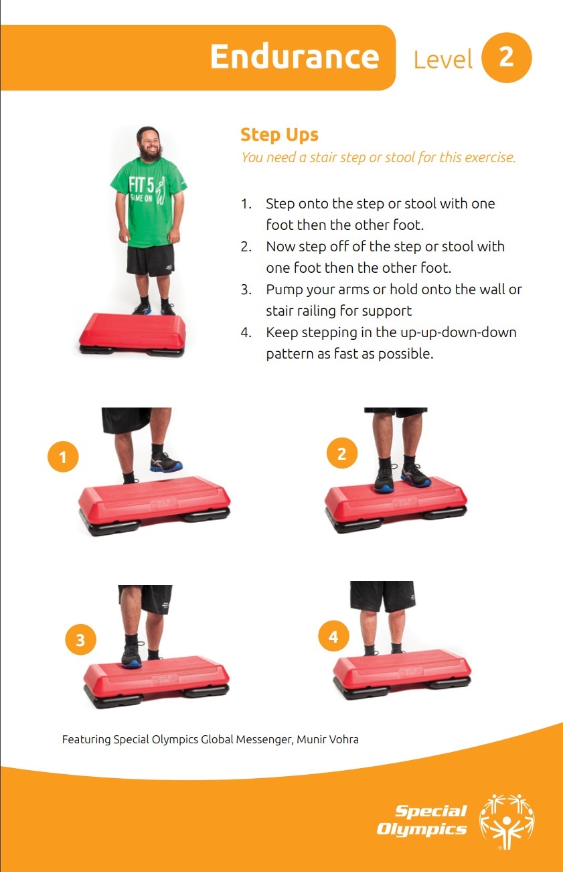
Fitness Cards
Notes:
You can use the Fitness Cards to build out exercise routines. These are cards with 5 levels in endurance, strength, flexibility and Balance!
As a Health Messenger, you might be asked to lead exercises as part of practice, a fitness program, or even as part of a presentation. Today, we are going to work together to design a workout. We will do a warm up as a large group first

Slide 19
Tips for Health Messengers

Slide 20
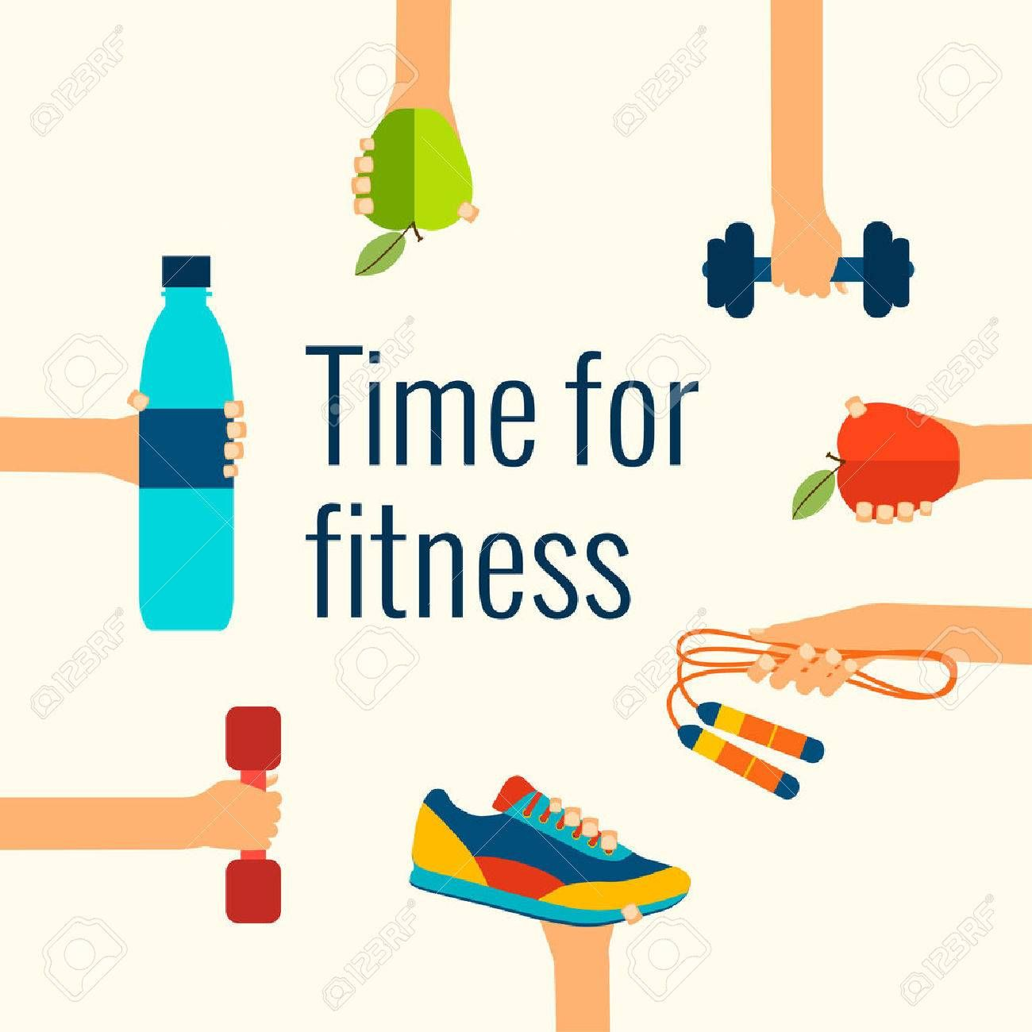
Keys to Fitness
Should be fun and challenging
Should be social
Should be personalized
Must be safe
Start slow and use good form
Is year-round
Is progressive – keeps getting better and better
Fitness makes you the best you!

Slide 21
What Can You Do?
Lead exercise classes and/or Fit 5 lessons
Support your coach and lead dynamic warm-ups and cool-downs at practice
Be a fitness role model
Start a walking or running group
Teach other athletes about fitness and help them to set goals
Lead a healthy eating class
Organize a hydration challenge

Slide 22
Your homework!
Teach your teammates to exercise!
Create a video of yourself teaching others how to do an exercise. Include at least one way to make the exercise harder or easier
OR
Create an exercise circuit – write it down and share it with your teammates
You can use the Fitness Cards or your favorite exercises!
Notes:
Now for your homework! As a Health Messenger, you might find that you like to lead your teammates in exercise. Your homework is to create a video of you teaching an exercise. Or you can create an exercise circuit with a few exercises and share it with a friend. Try to include at least one way to make the exercise harder or easier. You can use Fitness Cards or any other of your favorite exercises. If you love what you created, you can post it on social media for other athletes to do!
Bonus points if you can tell me the benefits of these exercises!
Thanks everyone for joining today and learning about fitness, physical activity and exercise! If you have any questions after today’s presentation you can email us at fitness@specialolympics.org! Wednesday you will learn about the other two components of fitness—nutrition and hydration. We can’t wait to review your homework!
Bye everyone!

Slide 23
Acknowledgement
This document was developed with funding from many sources, including in the United States by Grant Number NU27DD000021 from the Centers for Disease Control and Prevention (CDC) of the U.S. Department of Health and Human Services (HHS), with $18.1 M (64%) financed with U.S. Federal funds and $10.2 M (36%) supported by non-federal sources.
The contents of this document are solely the responsibility of the authors and do not necessarily represent the official views of the Centers for Disease Control and Prevention or the US Department of Health and Human Services.

