Slide 1
Outline
These are intended as ideas that HM’s can consider helping to teach fellow athletes. Their HPCD (or we) can help develop activities to teach concepts. Notes have more content than will be shared if using this ppt for training Health Messengers, but show how to teach other athletes about nutrition beyond F and V
MyPlate
Meat, chicken, fish, eggs and dairy
Fruits
Vegetables
Dairy
Grains
Nutrition and weight control
Nutrition and bone health
Nutrition and healthy blood pressure
Portion sizes
Hydration

Slide 2
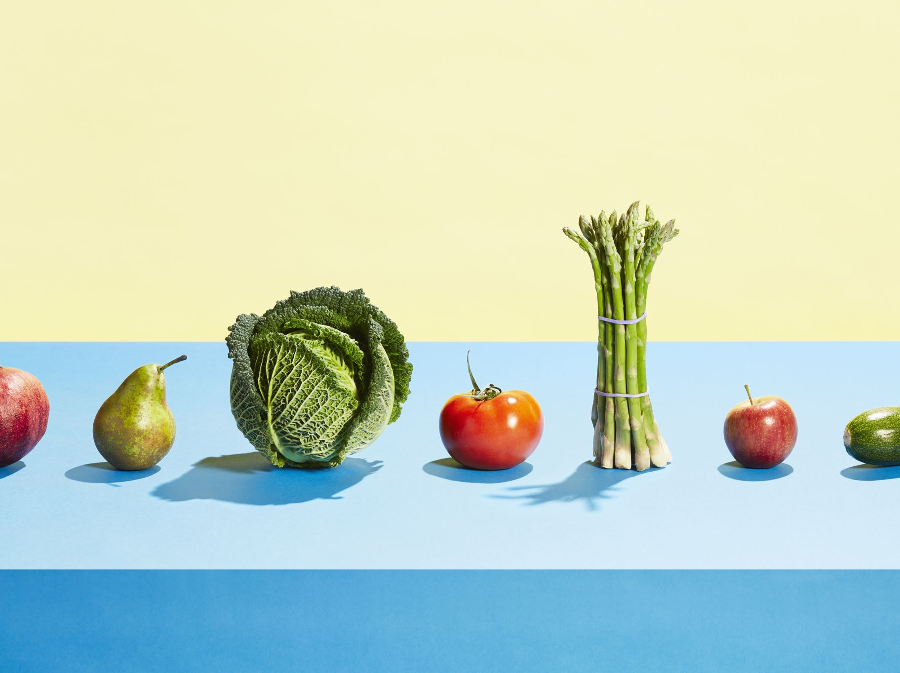
Food Nutrition and Hydration for Athletes
Eating right is important to your health and your sports performance. Eating right can be easy because there are many delicious healthy choices.

Slide 3
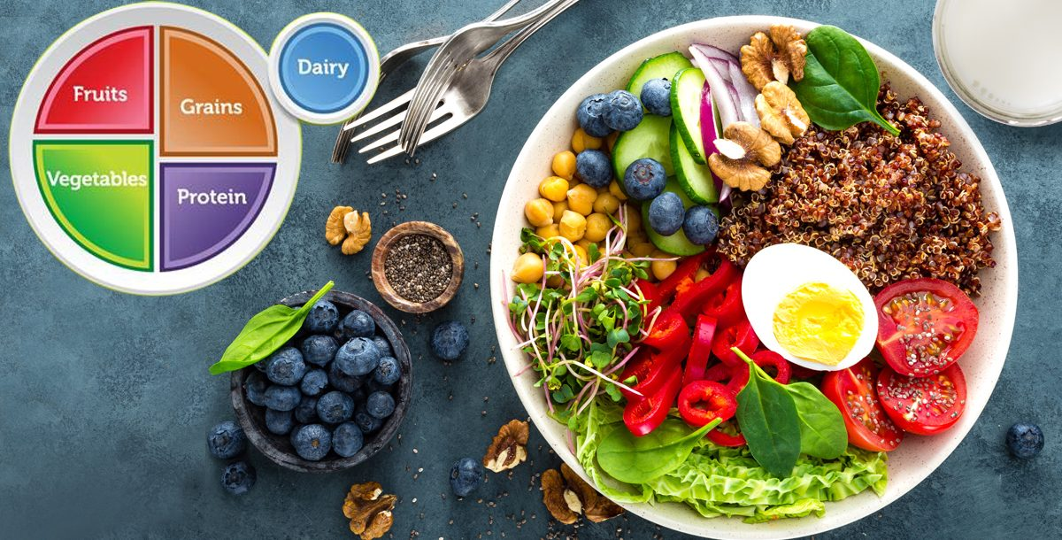
Following MyPlate makes it easy to plan healthy meals and snacks.
Notes:
MyPlate is a plate divided into four sections, with each section showing how much of each food group you should eat. Vegetables make up the largest section, followed by grains. Together, fruits and vegetables fill half the plate while proteins and grains fill the other half. Milk and dairy products are included.

Slide 4
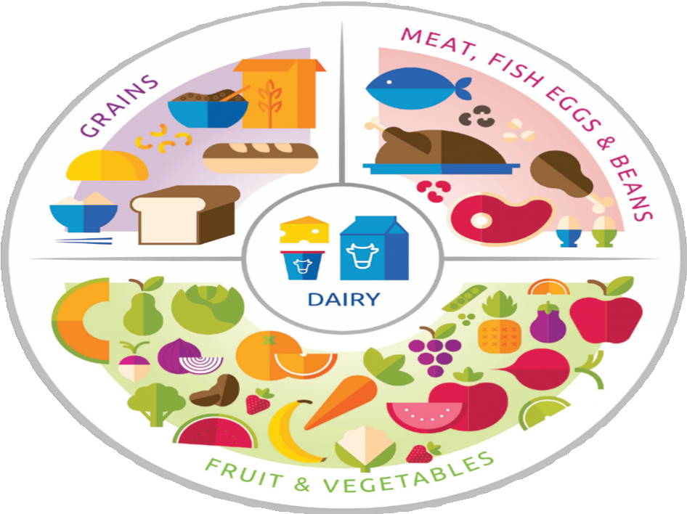
MyPlate works for all cultures. You just pick your healthy foods by groups shown in the circle.
Notes:
By eating less processed, nutrient-dense foods and limiting sugars, salt and saturated fats, at any age we can begin forming healthy eating patterns.
Why do you want to eat healthier? (ask group to share_

Slide 5
MyPlate with healthy foods. Make half the food you eat fruit and vegetables
Notes:
Watch the amounts of food you put on your plate. See the Perfect Portion slide.
Replace junk food like desserts, chips and sodas with delicious healthy choices.
Add more fruits and vegetables to your meals. Keep snacks healthy and small.
.

Slide 6
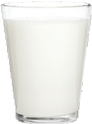
Healthy Beverage Choices
There are many beverage options available, but some of them are better for you than others. This guide can help you make the best choices to stay hydrated and perform your best.
Sodas, energy drinks, and sports drinks are NOT good beverage choices.
3 cups of of low-fat milk and 100% juice are also good choices.
.
Water is the best choice for a beverage to rehydrate yourself.
Notes:
Sodas, energy drinks, and sports drinks have extra sugar and can make you gain weight. Energy drinks and many sodas also have caffeine. Caffeine does not help you stay hydrated.
Low-fat or skim milk and 100% fruit juice are good choices with meals. Keep serving sizes small. Aim for 3 cups of milk and no more than1 cup of juice per day
Drink water throughout the day! If you like flavored drinks, try sparkling water or add a few pieces of fruit into your water bottle.

Slide 7
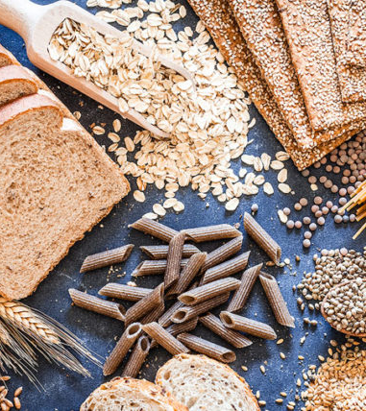
Notes:
Experts recommend eating six servings of grain per day, at least three of which are whole grain. A serving* of grain is any of the following: one slice of bread; a half cup of cooked oatmeal, pasta or rice; an ounce of crackers; or a cup of dry cold cereal.
Whole grains have the rich outer skin called bran. It’s full of fiber and nutrition. Try to chose or buy whole grain bread, cereal, rice (brown), tortillas (corn not flour) and pasta (whole wheat not white)
. Which whole grains do you like? Have fun trying new whole grain foods
Refined grains like white bread are important because folic acid is added to them. That’s why we say “at least half your grains should be whole grains.”

Slide 8
Why do we need healthy meat, fish, eggs and beans?
Notes:
These foods are needed for our whole body to function well. Athletes need protein to help keep their muscles strong. Your heart is a muscle too, and protein helps your heart and all your organs. Choose low fat protein foods. Most fat comes from added in cooking.
Chicken- most of the fat is in the skin, so remove it! Avoid deep fried chicken like you get at fast food places. Peel off the skin because lots of the cooking fat stays in the skin.
Beef- shop for the lowest fat hamburger.
Fish- it’s hard to find a fish that isn’t healthy. How you cook it matters, so eat fish that isn’t fried in lots of fat.
Eggs- eggs are an inexpensive healthy choice of protein. Some experts say to have no more than 2-3 eggs a day. How do you like eggs cooked?
Pork- caution to try to eat less processed meat like bacon, ham, and deli meats. They have added chemicals and lots of salt.
Beans and legumes: Excellent protein because it’s low in fat, has fiber and extra nutrition so they are great for your health.
Dairy- cows milk, oat and soy milks, cheese and yogurt all have healthy protein and many other nutrients for bones, teeth and your overall health.

Slide 9
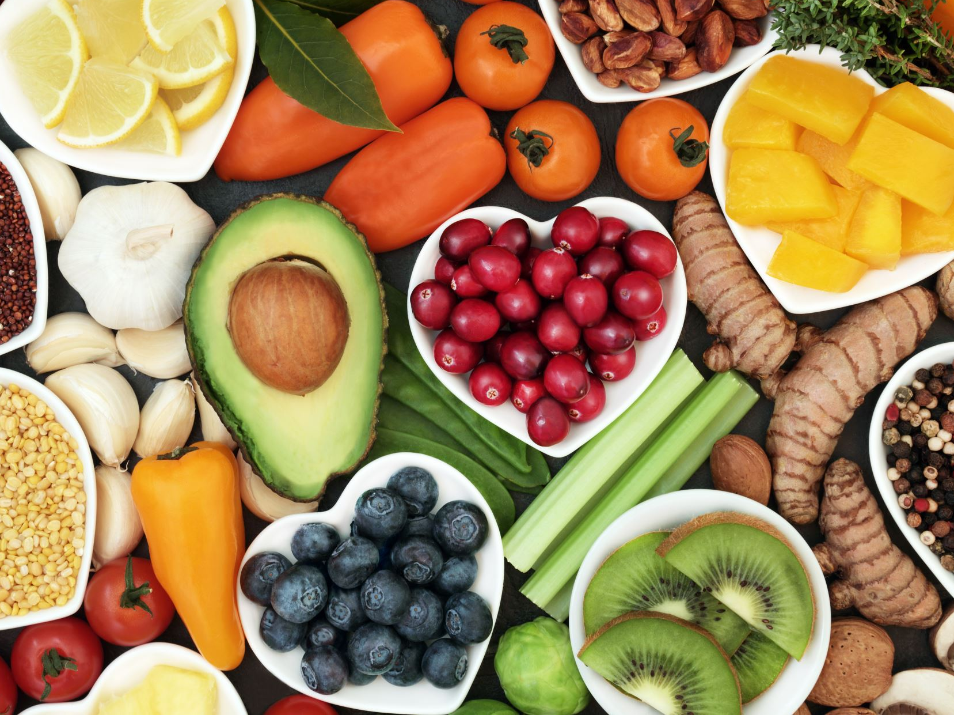
What are some of your favorite fruits?
Notes:
A diet rich in vegetables and fruits can lower blood pressure, reduce the risk of heart disease and stroke, prevent some types of cancer, lower risk of eye and digestive problems, and have a positive effect upon blood sugar, which can help keep appetite in check.
Fruit provides vitamins, minerals, fiber and nutrients that help to keep us healthy and protect against heart disease, diabetes, stroke and some types of cancer.
They taste wonderful and add color, taste and nutrition to our meals.
If you get canned fruit, rinse with water before eating to remove added sugar.
What are your favorite fruits? When do you eat fruit during the day?

Slide 10
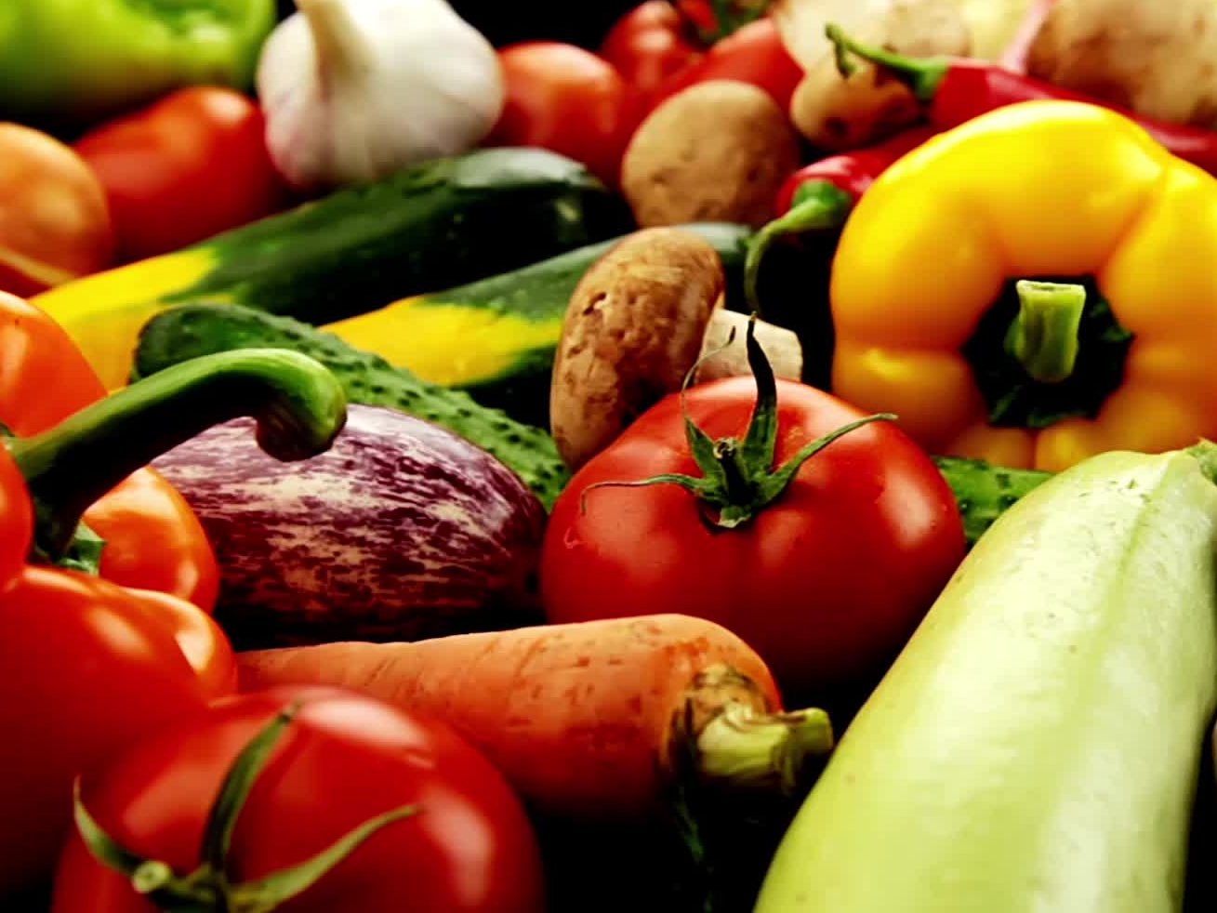
What are the healthiest vegetables?
Notes:
Vegetables are super healthy.
Eating lots of vegetables and fruits can
lower blood pressure,
reduce the risk of heart disease and stroke,
prevent some types of cancer,
lower risk of eye problems,
Help your blood sugar
help keep appetite in check.
Half of what you eat should be fruit and vegetables. Fresh, frozen and canned are all great.
If you get canned vegetables, get low salt ones

Slide 11
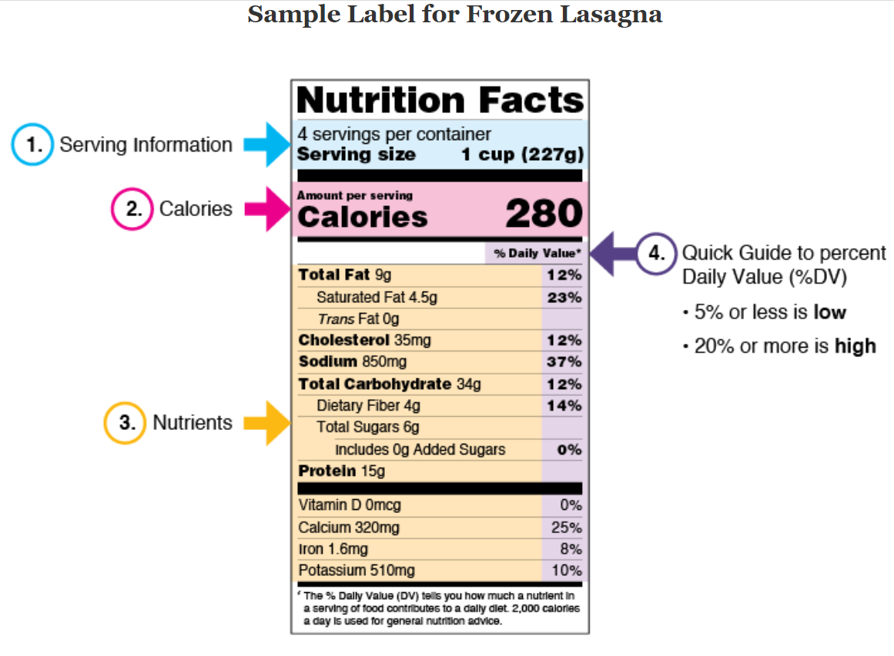
Ways to know if a packaged food is healthy.
Notes:
The number of servings you consume determines the number of calories you eat. Eating too many calories per day is linked to overweight and obesity
Nutrients to get less of: Saturated Fat, Sodium, and Added Sugars.
What are Added Sugars and How are they Different from Total Sugars?
Nutrients to get more of: Dietary Fiber, Vitamin D, Calcium, Iron, and Potassium.

Slide 12
Foods and drinks that strengthen your bones
Notes:
Foods that give us calcium, vitamin D and minerals are important for our bones.
milk, cheese and other dairy foods.
green leafy vegetables, such as broccoli, cabbage and okra, but not spinach.
soya beans and tofu
plant-based drinks (such as soy drink) with added calcium.
nuts
fish where you eat the bones, like sardines and pilchards.
Salmon and tuna
Eggs
Sun dried mushrooms
vegetables

Slide 13
Nutrition for healthy blood pressure
Notes:
The same food choices that are shown on MyPlate help us control blood pressure
Avoid processed foods with added salt (get low sodium versions of canned foods when possible)
Added sugars have an effect similar to salt, so avoid foods and drinks with added sugar, or ones labeled as “lite”, like yogurt and canned fruit.
Use a small amount of salt on your food, and don’t add it during cooking.
Choose foods that make you healthy
Get 5 fruits and veggies daily
Get 3 servings of low-fat dairy daily
Eat meat, chicken , fish and beans with no added salt
Take a vitamin D pill daily
Avoid foods that can increase blood pressure
Avoid junk and processed foods and fast foods
Avoid foods and drinks with added sugar
Avoid salty snacks, cured meats, and salty seasonings

Slide 14
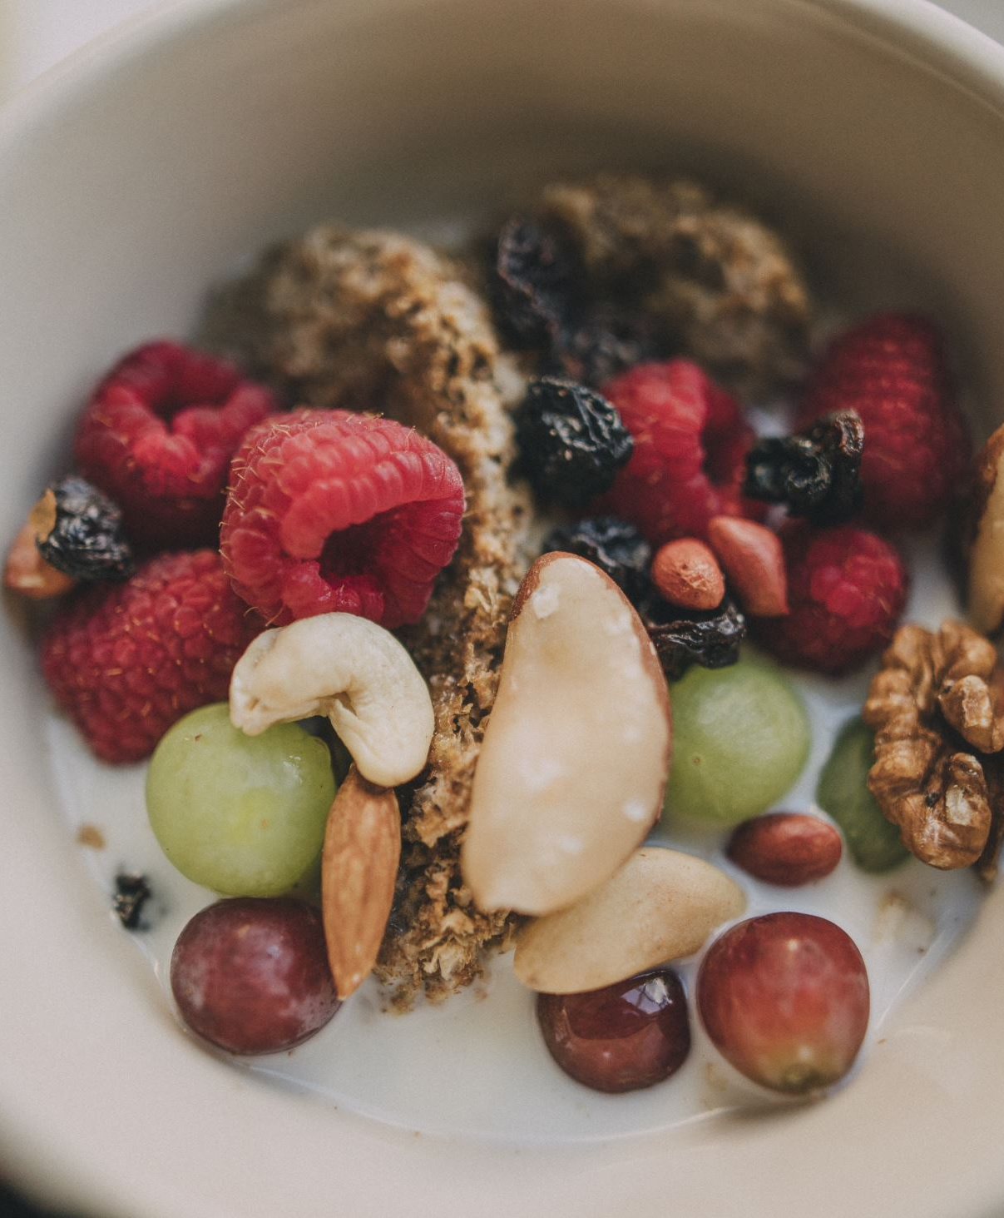
Nutrition for healthy weight and smaller waist size
Notes:
Following MyPlate is the best approach to maintaining healthy weight.
Eat more fruits without added sugar, vegetables, whole grains, and fat-free or low-fat milk and milk products.
Includes a variety of protein foods such as seafood, lean meats and skinless chicken and turkey, eggs, legumes (beans and peas), nuts, and seeds.
Is low in added sugars, sodium, saturated fats, trans fats, and cholesterol.
Adding exercise helps with weight loss!

Slide 15
Perfect Portions
Here is a fun way to remember how much to eat when you have a serving. The size of sports equipment on the left is about the same size as one serving of the foods on the right.
=
1 serving of fruit
1 serving of rice or pasta
1 serving of vegetables
baseball
=
1 serving of bread
1 serving of beans
1 serving of meat
hockey puck
=
1 serving of cheese
1 serving of nuts
1 serving of nut butter
golf ball
Notes:
Controlling your portions doesn’t mean you need to eat tiny amounts or measure out precisely the amount to eat.
But if we’re eating too much, then we may need to retrain our brains to see a smaller-than-normal portion as satisfying enough. Here are some tricks to try:
Be selective with your seconds
Drink water before you start eating
Check food labels or chart above for healthy serving sizes
Fill up on fruit and vegetables early on so you won’t feel so hungry
Instead of unsatisfying small portions of energy-dense foods, try these less energy-dense options by swapping:
Chips or crackers for plain popcorn
a berry muffin for fresh berries
cheese for low-fat sugar free yogurt
garlic bread for wholegrain pita bread or tortilla
Use smaller plates
Be selective with your seconds

Slide 16
Foods that strengthen your bones and teeth.
Notes:
milk, cheese and yogurt. Choose low fat or fat free dairy foods with no added sugar. 3 servings a day!
green leafy vegetables, such as broccoli, cabbage and okra, but not spinach.
Tofu and edamame .
plant-based drinks like soy, pea or oat milk with added calcium and vitamin D.
Nuts and seeds
Fish: salmon, tuna and fish where you eat the bones, such as sardines and other small fish.
Many athletes need calcium citrate supplements and vitamin D pills to get enough calcium and vitamin D. Ask your doctor!

Slide 17
Hydration and Your Health

Slide 18
Healthy beverages
Notes:
Hydrating beverages suggestions. Chose drinks that have
No added sugar
Contains simple ingredients
Free from chemicals and additives, artificial color
Plain fresh water is perfect for hydrating your body. Low fat or skim milk is ideal for hydration because it provides water, electrolytes, protein and other nutrients.
Avoid electrolyte supplement powders. They aren’t needed unless you work out intensely for an hour or more, if you sweat a lot. They can be harmful to take if you don’t need them. “ Electrolyte, minerals found in blood help regulate and control the balance of fluids in the body. These minerals play a role in regulating blood pressure, muscle contraction and keep your system functioning properly. Excess electrolyte supplements can cause the following side effects: Diarrhea. Cramps. Gas formation

Slide 19
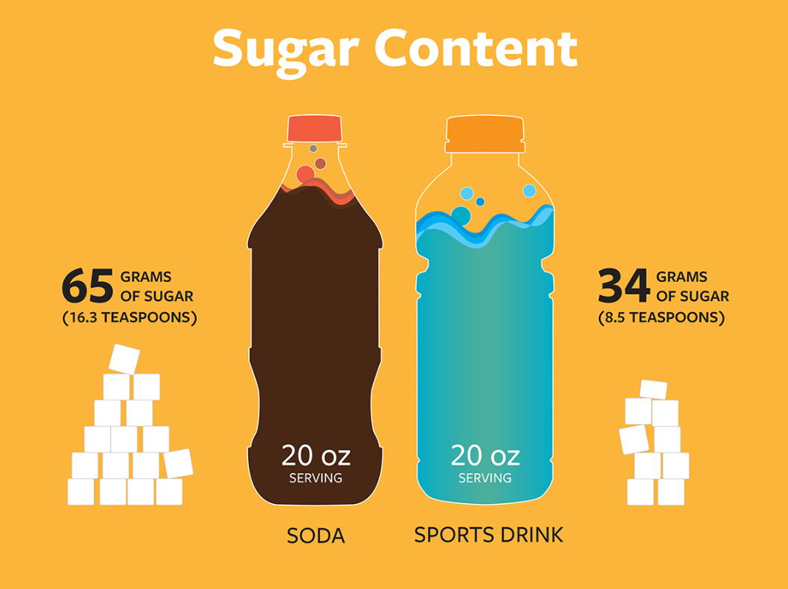
Notes:
People all over the world now consume too much added sugar. Added sugars are sugars that manufacturers add to food to sweeten them.
Most of the sugar we eat comes from processed food, fast food and sugar sweetened beverages, deserts, yogurt and candy.
Health experts recommend no more than 6 teaspoons of sugar a day.
Too much sugar causes
Low energy level, feeling tired and being less alert
Low mood: increased depression and mood swings.
Bloating: bloating and gas
Tooth decay
Elevated blood pressure
Large waist
Excess empty calories

Slide 20
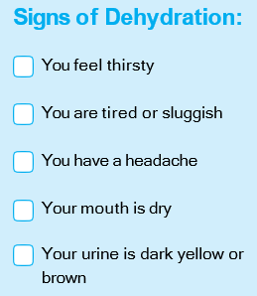
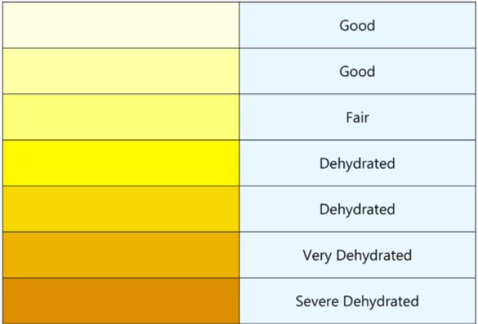
Signs of Dehydration
Did you know that dehydration of 1-2% of your body weight can decrease your sports performance?
Spotting dehydration
Notes:
Water helps to keep your body working properly. You lose water when you go to the bathroom, sweat, exercise or even breathe. If you lose too much water without drinking more, your body won’t work as well. This is called dehydration.
Signs of dehydration in athletes
Fatigue.
Decreased athletic performance.
Nausea.
Headache.
Apathy.
Irritability.
Thirst.

Slide 21
Following MyPlate recommendations is a safe and delicious way to eat healthy. Good luck on your journey to good nutrition.

Slide 22
Thanks for your interest in healthy nutrition and hydration.

Slide 23
Acknowledgement
This document was developed with funding from many sources, including in the United States by Grant Number NU27DD000021 from the Centers for Disease Control and Prevention (CDC) of the U.S. Department of Health and Human Services (HHS), with $18.1 M (64%) financed with U.S. Federal funds and $10.2 M (36%) supported by non-federal sources.
The contents of this document are solely the responsibility of the authors and do not necessarily represent the official views of the Centers for Disease Control and Prevention or the US Department of Health and Human Services.

