Slide 1
Emotional Health

Slide 2
What is emotional health?
Notes:
OVERVIEW:
What is emotional health?
Emotional health is the same as mental health. It focuses on the health of minds/thoughts and emotions.
It is important that we learn ways to stay emotionally healthy just like we learn ways to stay physically healthy!
We have to take care of ourselves inside and out!

Slide 3
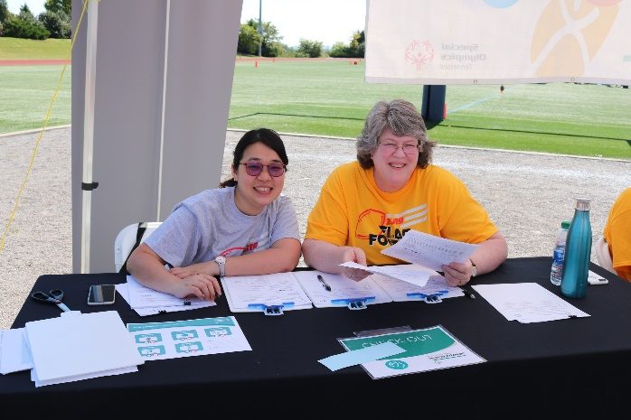
Your Role as a Health Messenger
Individual Level:
Use & share strategies with others!
Team Level:
Add strategies to practices or games!
Program Level:
Create messages with Program staff!
Notes:
There are several ways that you as a Health Messenger can help the Special Olympics community stay on track with emotional health.
Some examples include:
Individual Level: going through a breathing exercise with a friend if you notice they are felling stressed
Program Level: Work with SO program staff to create social media messages that can be shared to your SO program community
Team Level: Work with your coach to share Mental Health “Pro-Tips” with teammates before or after practice

Slide 4
Emotions
Notes:
General emotional health concepts – it’s not only about feeling happy or sad. Tell us other emotions you experience. How do your emotions show?
It is normal to feel a range of emotions – even sadness or anger! If you’ve seen the movie “Inside Out” you’ll know ALL our emotions work together to make us well rounded people who can respond to events or situations appropriately
The important thing is to find tools to try to get you back on track… it is not healthy to stay in the negative zone for too long.

Slide 5
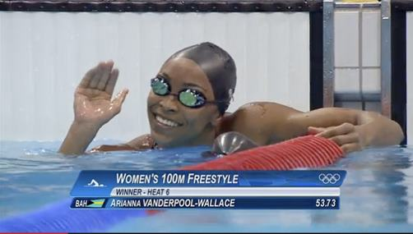
Threats to Emotional Health: Stress
Notes:
There can be many threats to our emotional health. Here is one that helps show the connection between our emotions, thoughts, and bodies: STRESS
Stress is a bodily reaction we have to stressful situations (like presenting in front of your class, looking out at the ocean on a beach visit, or when you about to start a race)
Stress can make us feel like our heart is racing. Your breathing can go much faster. Our palms might get sweaty and you might feel frightened. Feeling stressed is NORMAL. And in some situations its even good because it tells your body what you need to do to respond well to a stressful situation.
However, too much stress for extended periods of time is NOT good. It can contribute to health problems like high blood pressure and even impact our memory

Slide 6
Signs of Stress
EMOTIONAL SIGNS
Being Easily Upset or Mad
Feeling Overwhelmed
PHYSICAL SIGNS
Low Energy
Nervousness
Headaches
Upset Stomach
Tense Muscles
Trouble Sleeping
Aches and Pain
Having Difficulty Relaxing
Feeling Bad About Yourself
Avoiding Others
Can’t Focus
Always Worrying
Poor Judgement/Decision Making
Chest Pain and Rapid Heartbeat
Notes:
Review slide, ask participants if they have noticed any of these signs before.

Slide 7
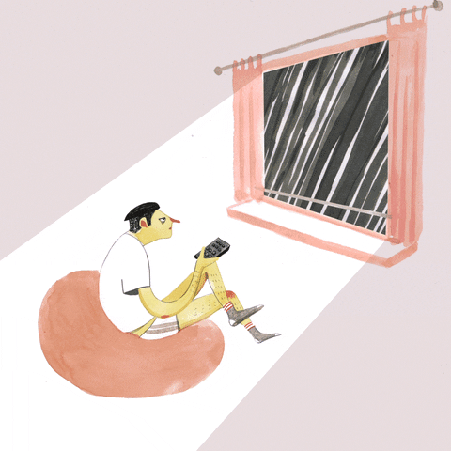
What Can We Control When We’re Stressed?
I CANNOT Control…
I CAN Control…
Respond vs. React
ME
OTHER
Notes:
In different situations the only thing you can control is yourself. Some examples of things we cannot control are: 1) weather, 2) other people
Respond to situations with intention! Don’t just react.
That means take time to think about what you are feeling and decide what you should to handle things best.
Activity: Give examples of situations with negative reactions vs positive responses. Help participants recognize thoughts, feelings, and behaviors.

Slide 8
Sources of Stress
What Stresses
You Out?
Let’s Brainstorm…
Notes:
Start a discussion… some examples include: not seeing friends and family because of COVID
Prompt the group to think about things that stressed them out before COVID

Slide 9
Focusing on Emotional Health
Many people may feel sad, stress, or confused especially now that we are dealing with a pandemic. It's important to think about things you can do for your emotional health.
Let’s learn 5 techniques you can do daily for emotional health!
Using a Stress Ball
Thinking Positive Thoughts
Deep Breathing
Stretching
Getting Support
Notes:
We are going to going through 5 techniques together that promote our emotional health.

Slide 10
Strategy 1: Using a Squeeze
If you are feeling stressed, angry or overwhelmed, try squeezing something like a stress ball. Squeeze the ball for 3 seconds, release the ball slowly, and then repeat 5 to 10 times for 1 minute.
Notes:
If you are feeling stressed, angry, or overwhelmed, try squeezing something like a stress ball for a few minutes. Squeeze the ball for 3 seconds, release the ball slowly, and then repeat 5 to 10 times for 1 minute.
Let’s do stress ball squeezes 5 times.

Slide 11
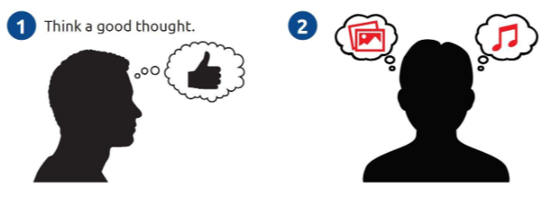
Strategy 2: Thinking Positive Thoughts
We all find our inspiration from different places and it’s important to find what works for you. Many people feel well when listening to their favorite music. Other people have a list of encouraging words to read or pictures to look at – kind like of a pep-talk to yourself.
Notes:
We all find our inspiration from different places and it’s important to find what works for you. Many people feel well when listening to their favorite music. Other people have a list of encouraging words to read or pictures to look at – kind like of a pep-talk to yourself.
I have something to share, my Positives Thoughts vision board! It has all the words and happy images that help me feel good.
Write in the chat box some things that you’d put on your Positive Thoughts vision board.

Slide 12
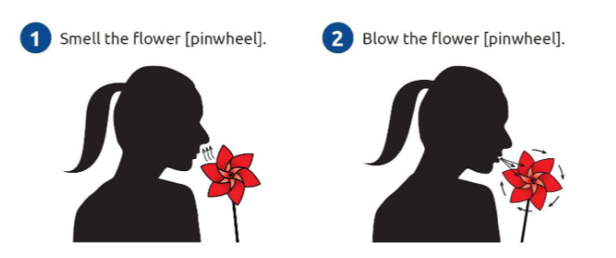
Strategy 3: Deep Breathing
Doing deep breathing can help you feel more relaxed and calm. Pretend you are smelling a flower, by breathing through your nose slowly. Then, pretend you are blowing out a candle slowly.
Notes:
Doing deep breathing can help you feel more relaxed and calm. Pretend you are smelling a flower, by breathing through your nose slowly. Then, pretend you are blowing out a candle slowly.
- Breath in for 5 counts and exhale for 5 counts. Repeat 3 times.

Slide 13
Strategy 4: Stretching
Stretching can help your body feel more relaxed and release emotions. Try a few different simple stretches or yoga positions, but remember to start slowly and gently!
Notes:
Stretching can help your body feel more relaxed and release emotions. Try a few different simple stretches or yoga positions, but remember to start slowly and gently!
Here are a couple of my favorite stretches…
- Show two of your favorite stretches and stretch for at least 20 seconds on each side

Slide 14
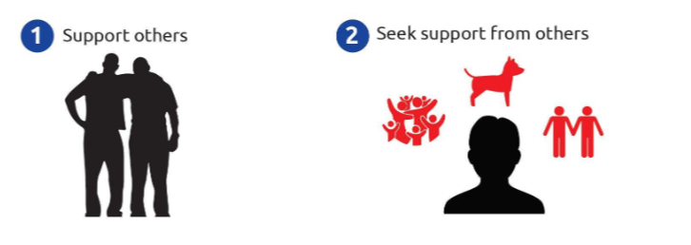
Strategy 5: Getting Support
Other people can be helpful to us when we are trying to deal with our thoughts and feelings. Talking to people you trust can help, like your family, friends and coaches.
Give others a smile, a fist bump, or words of encouragement (instead of a high five).
Notes:
Other people can be helpful to us when we are trying to deal with our thoughts and feelings. Talking to people you trust can help, like your family, friends and coaches. You may also talk to a mental health professional like a psychologist or counselor.
Give others a smile instead of a high five.

Slide 15
Homework
Vision board with positive thoughts
Use happy pictures, notes, words of affirmation
Assignment
Notes:
Let’s do an activity that helps us practice emotional health.
We’ll create an Emotional Health Vision Board!

Slide 16
Acknowledgment
This document was developed with funding from many sources, including in the United States by Grant Number NU27DD000021 from the Centers for Disease Control and Prevention (CDC) of the U.S. Department of Health and Human Services (HHS), with $18.1 M (64%) financed with U.S. Federal funds and $10.2 M (36%) supported by non-federal sources.
The contents of this document are solely the responsibility of the authors and do not necessarily represent the official views of the Centers for Disease Control and Prevention or the US Department of Health and Human Services.

