Slide 1
Using Social Media to Spread Health Messaging
Notes:
Total presentation time – 30 minutes
Slide Presentation – 20 minutes
Individual planning activity – 10 minutes

Slide 2
Social Media Session Goal
Learn how to create a community using social media to help other athletes improve health and fitness
Build a plan to guide you to using social media as a Health Messenger
Notes:
Say:
The goal of this session is for you to leave ready to use your social media to spread messaging to your teammates and Special Olympics community about health and wellness!
I want you to understand that this can be easily done.
This session is going to help you get a plan started, so you feel ready to get started on your own when you get home.

Slide 3
Why Choose Social Media to Deliver Your Message?
Easy way to reach a group of people
Ability to have a 2-way conversation
A place where people already are
Notes:
Say:
By far, social media the easiest, most accessible way to reach a group of people at a given time.

Slide 4
Your Goal as a Health Messenger
Social media offers another platform for you as a Health Messenger to take on a leadership role and helps you:
Build a community dedicated to reaching the same goal
Inspire action from other athletes
Work to help other athletes be their healthiest to the best of your ability
Empower fellow athletes members to be their healthiest
Do you have anything else you want to accomplish?
Notes:
Say:
What do you hope to accomplish in this role?
Facilitator notes:
It is very important to guide your athletes through their role as Health Messengers.
Ask them if there are other things that they want to do in this role.

Slide 5
5-Minute Brainstorm
Answer the following questions:
What is your favorite social media platform and why?
How can you use social media to talk about health?
Notes:
Facilitator note:
Have the groups discuss these questions at their tables. (4 minutes)
Ask one table to share with everyone their answers. (1 minutes)

Slide 6
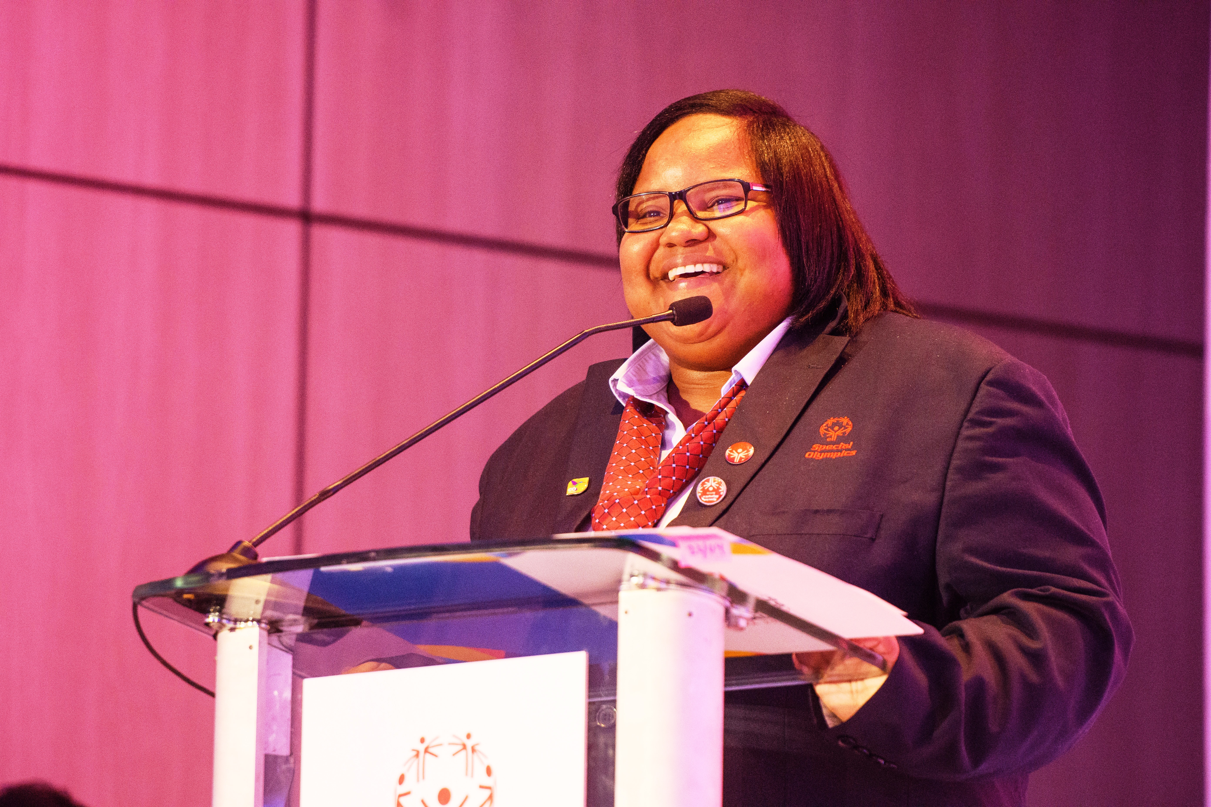
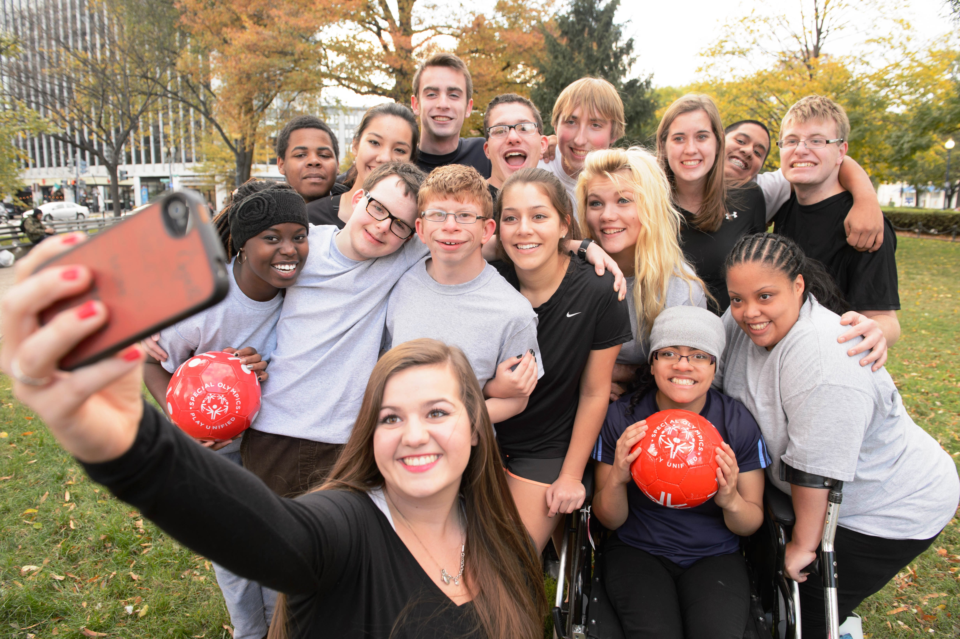
Finding Your Voice
When talking to your audience you should:
Be yourself—authentic & honest
Have a clear purpose
Remember you are talking to friends
Notes:
Facilitator note:
It is important for athletes to understand that they are leaders in this role. Here are some tips for them to help find their voice as leaders within the Special Olympics Health movement.

Slide 7
Different Ways to Use Social Media as a Health Messenger
Notes:
Say:
Everyone has their own style and will want to do things differently.
Here are the ways we recommend using social media, but does anyone else have another idea?
Facilitator notes:
These activation ideas are listed in order from least complicated to most.
The following slides will show what this looks like.

Slide 8
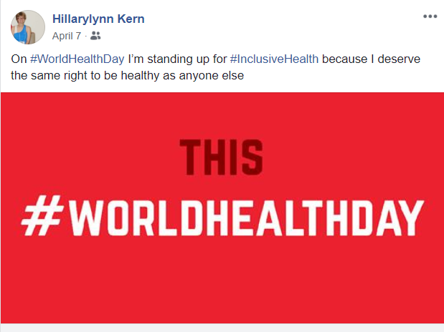
Post Messages to Your Own Page

Slide 9
Create a Dedicated Page
Notes:
Facilitator Note:
- This link will walk you through how to create a page: https://www.facebook.com/pages/creation/

Slide 10
Create a Private Group
Notes:
This link will show you how to create a private group: https://www.facebook.com/help/167970719931213/

Slide 11
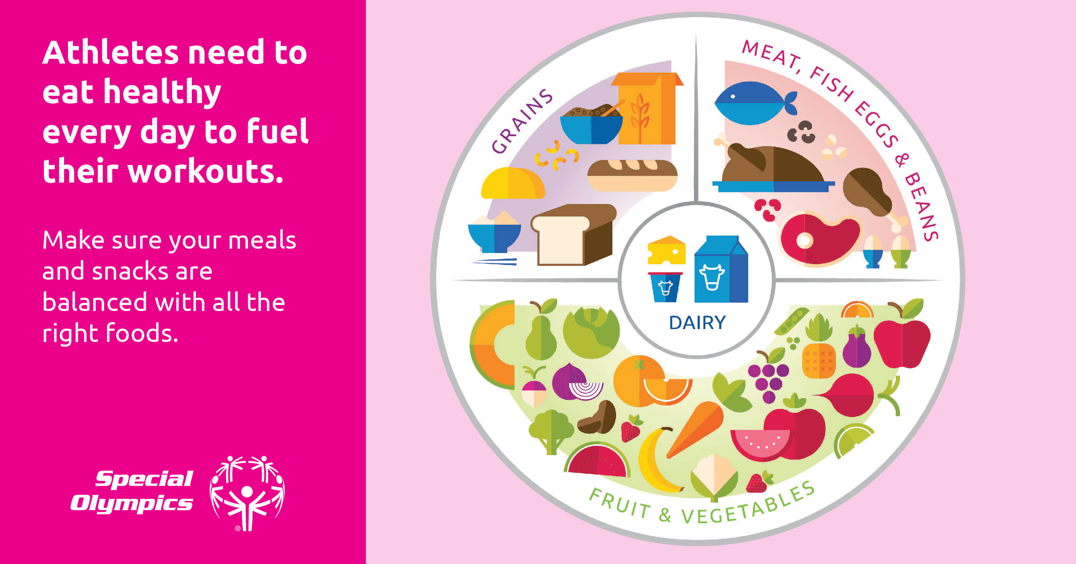
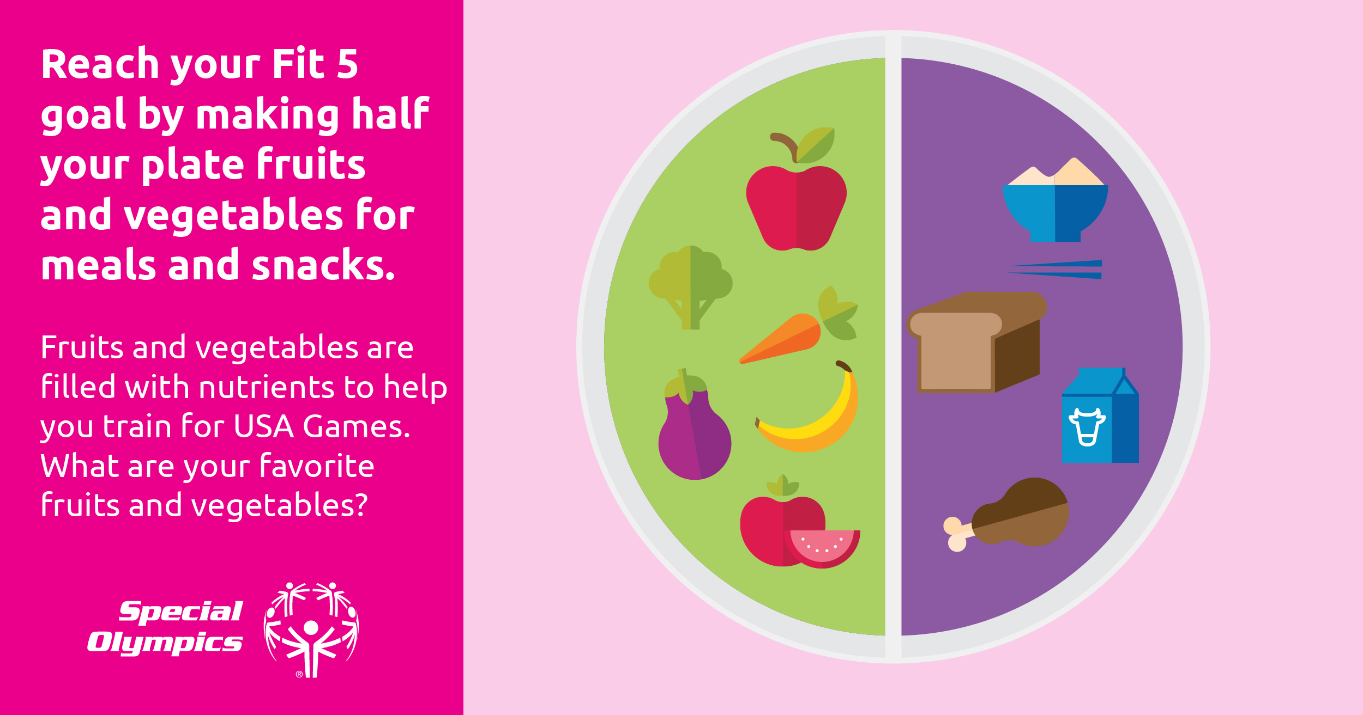
Materials and Resources
There are already a lot of materials which have been created to promote Special Olympics Health. Check these out!
www.SpecialOlympics.org/MyHealth
Notes:
Say:
There is no need to recreate the wheel! Special Olympics has created a lot of health graphics and information that you can use.
Facilitator note:
Instruct Health Messengers to browse already create resources!

Slide 12
Roadmap to Success – Planning Makes Perfect!
Month 1: Agenda-setting & planning
Use your planning documents to decide on what topics you will share, how many times a week you plan to post, on what days you plan to post
Month 2: Introductions to your group & getting everyone started
You have just become a Special Olympics Health Messenger, celebrate it! If posting in a group or page, add people and tell them why you are doing this. If posting to an existing profile, tell your friends about your new role & what they can expect
Month 3: Start posting tips
Notes:
Say:
You have an audience of other athletes waiting to hear from you!
Once you’ve figured out how you will activate on social media, it is important for you to create a plan for how you will keep your presence up!
This is a guideline for planning how you’ll to use social media in the first 6 months of being a Health Messenger.

Slide 13
Roadmap to Success - Planning Continued
Month 4: Keep posting tips!
Ask your audience what they are interested in hearing about
Get their feedback to see how you can do better in your role
Month 5: After asking your group members what interests them, try creating posts which cover those topics
Month 6: Introduce a challenge
See if you can come up with a challenge for your group members to participate in. Example: Drink 5 bottles of water everyday of two weeks or reach 10,000 everyday for a week
Notes:
Say:
Challenges are a great way to get a group of people activated on social media around health.
Can anyone share a health challenge they’ve seen or participated in?

Slide 14
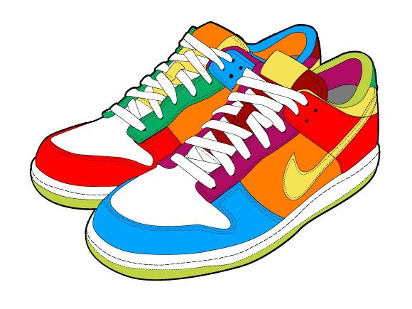
Challenge 1: Follow the Leader
All groups will choose a goal number of steps to reach for Day 1. After Day 1, the goal of all group members will be to take 100 more steps than the day before.
All group members will increase by 100 steps a day for 10 days! This will add a total of 1,000 extra steps in by the end of the challenge!
Notes:
Say:
Here are a few more challenge ideas.

Slide 15
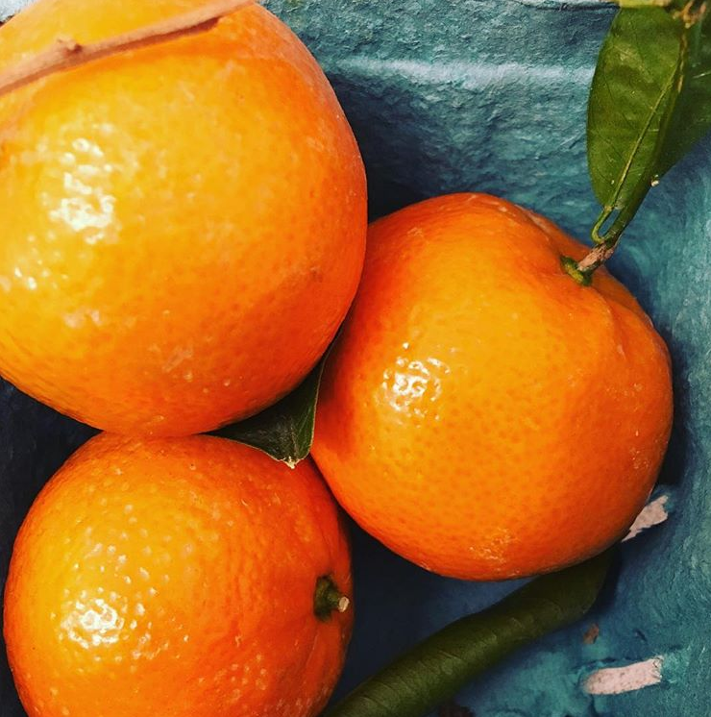
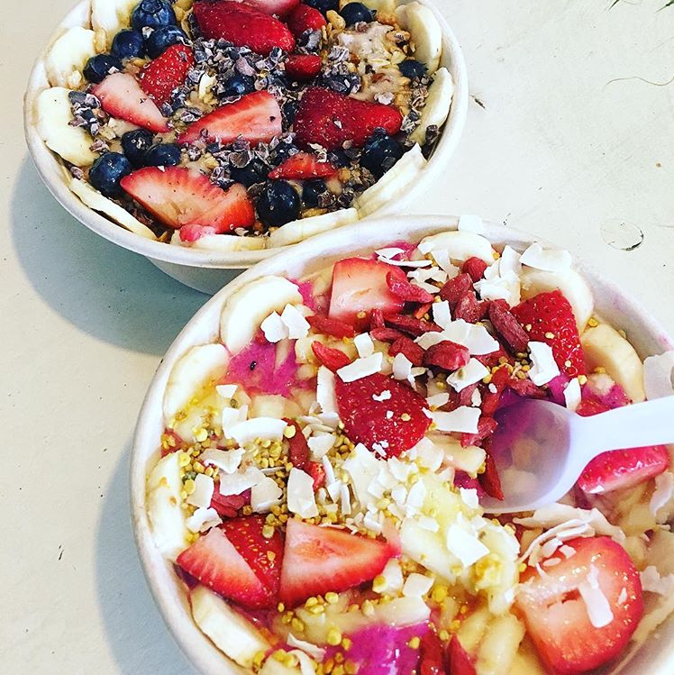
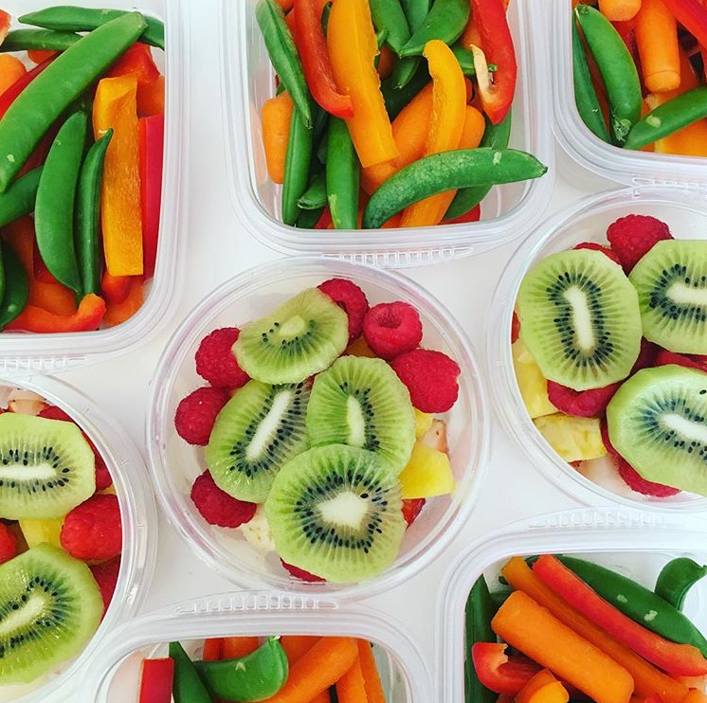
Challenge 2: Snacks on Snacks
Challenge your group to post a pic of their favorite healthy snack with the recipe--Encourage your teammates to try each other’s favorite things!
Notes:
Say:
- Who doesn’t love a good food picture?!

Slide 16
Getting Feedback
Feedback from your teammates is important because it gives you a chance to check in and hear from them
Samples of feedback questions:
How are you doing on your journey so far?
What tools are you finding helpful?
Are there any tips you think could be important for our group to know? Write your ideas here!
Is there something you think we should be doing differently? Comment here.
Notes:
Say:
It is important for Health Messengers to check in with their social network and see how they are doing.
It’s all a great opportunity to get recommendations from your friends and audience members on ways you can become better in your role as a Health Messenger.
*Also see planning document

Slide 17
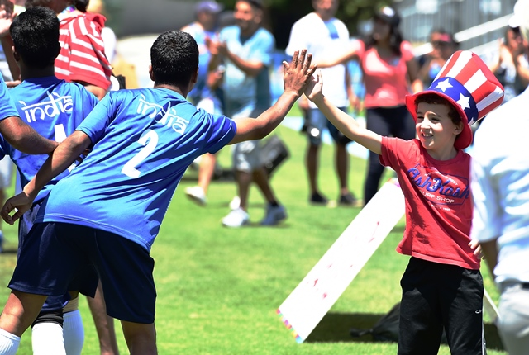
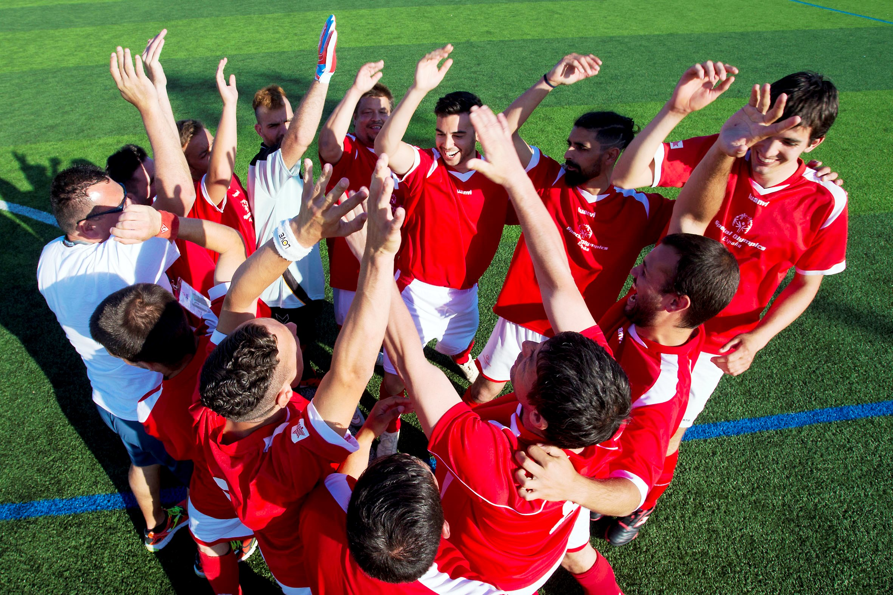
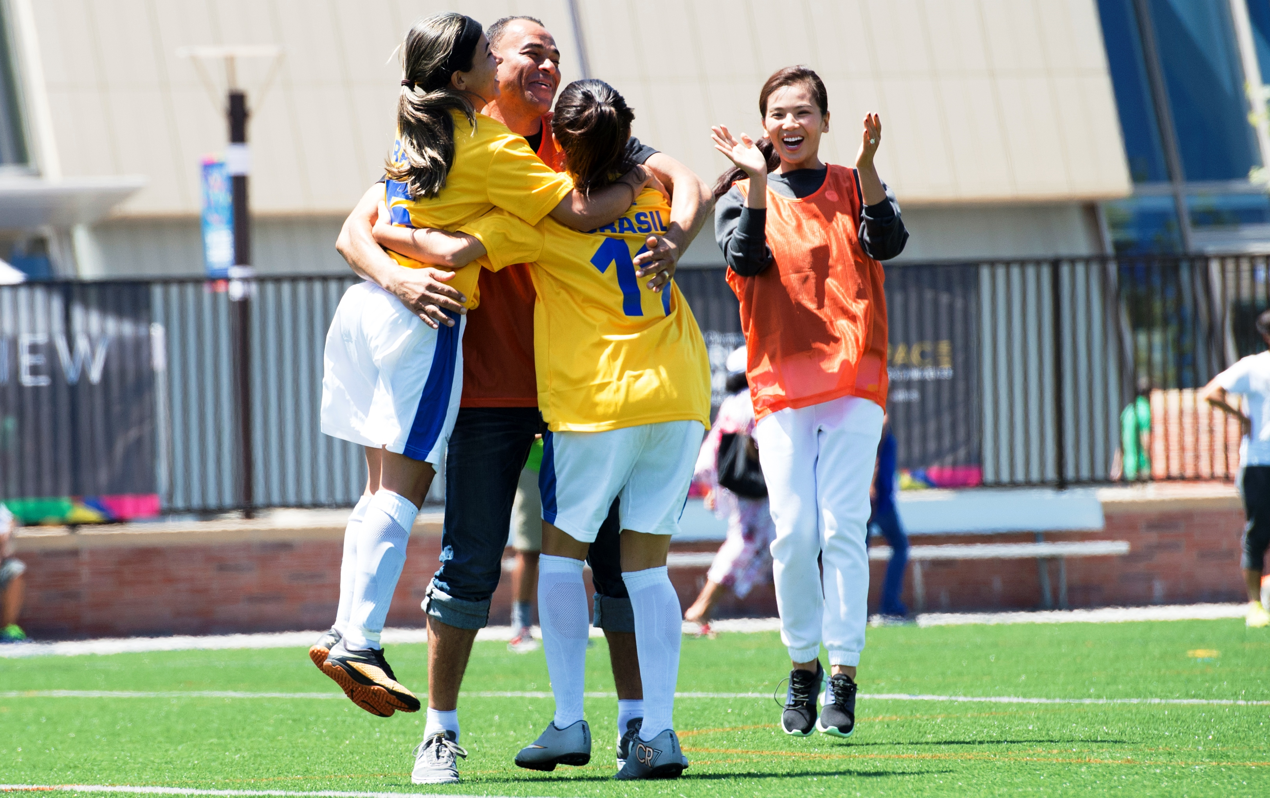
Sharing Successes
What are successes? Success will vary person to person, but no matter how big or small, they should all be celebrated!
Congratulate group members who post about their success
Notes:
Say:
Sharing successes is important to helping people stay motivated, especially in the health & fitness world.
Health Messengers should not only share their progress on social media but also reach out to their group members to see how they are doing, either by posting a question or by privately asking.

Slide 18
Creating a Plan That Works for YOU
How many times a week will you talk to your teammates?
Are there specific days you want to choose as post days? This way, they know what to expect! For example, if you commit to 2 days a week, you can choose to post every Monday and Wednesday.
Commitment: I will post ______ times a week. You can always add more or take away some. Find something that fits your schedule!
Notes:
Say:
For some of you, creating a physical plan will be a good way for you to keep up with you social media groups. However, this is not meant to be a one-size fits all. If someone doesn’t want to set a limit, they don’t have to.

Slide 19
Activity: Create Your Social Media Plan
Here is an example:
I will post 1 time per week.
2 fitness tips and 2 nutrition tips a month
1 feedback question a month
Share successes from group members per month starting in Month 3
Week-long challenges in Month 5 and Month 7
Notes:
Total time – 10 minutes
Health Messenger/mentor discuss and fill out social media planning document– 5 minutes
Group reporting – 3 minutes (1 minute per table)
Say:
We’ll now take a few minutes to create your plan which will guide your social media activity this year.
Here’s is an example of a plan. (read bullet points)
Facilitator notes:
The Health Messenger and their mentor should fill out the “Social Media Planning” worksheet together.
If there is an athlete who doesn’t want to use social media, that’s OK!

Slide 20
Acknowledgement
This document was developed with funding from many sources, including in the United States by Grant Number NU27DD000021 from the Centers for Disease Control and Prevention (CDC) of the U.S. Department of Health and Human Services (HHS), with $18.1 M (64%) financed with U.S. Federal funds and $10.2 M (36%) supported by non-federal sources.
The contents of this document are solely the responsibility of the authors and do not necessarily represent the official views of the Centers for Disease Control and Prevention or the US Department of Health and Human Services.

