Slide 1

Tips for Effective Communication

Slide 2
Your Opportunity
Reporters are covering more than one beat
Not only responsible for posting story, but tweeting all day, authoring a blog, taking video
We live in a 24-hour news environment
Competition is fierce for content
For our movement to speak in one voice
Show the world the meaning of inclusion and respect through your stories
Notes:
You are the ambassadors of our brand, of our health story, of our mission
Your stories will change people’s views on the abilities of people with ID.

Slide 3
Your Role
Reporters are covering more than one beat
Not only responsible for posting story, but tweeting all day, authoring a blog, taking video
We live in a 24-hour news environment
Competition is fierce for content
Help encourage more people to get involved with Special Olympics programming
Share your story of how Special Olympics health programming has changed your life or other people in your life
Find opportunities to tell your story to your fans, your community and members of the media
Notes:
Be an advocate for those who don’t have a voice.

Slide 4
Where We are Today
Over 6 million athletes and Unified partners in over 190 countries.
We are creating a world where people with intellectual disabilities have every opportunity to be healthy.
Inclusive health means people with ID are able to take full advantage of the same health programs and services available to people who do not have ID.
Notes:
Say
First you need to talk about who Special Olympics is. -- we want to end discrimination of people with ID.
Need to really explain what your definition of inclusive health is – access to doctors, fitness programs, etc.

Slide 5











Who are the Media?
Notes:
Television – National, local and cable news
Radio – National and local
Newspapers – National, local, international
Magazines – National and local
Wire services – Share stories with many news outlets
Internet – Blogs, social media (Facebook, Twitter), comment posts, video posts

Slide 6
The Media’s Job is Harder than Ever Before
Reporters are covering more than one beat
Not only responsible for posting story, but tweeting all day, authoring a blog, taking video
We live in a 24-hour news environment
Competition is fierce for content
News organizations are smaller, more fragmented
24-hour news environment
Want controversy and ‘scoops’
Want a powerful video
Social media has changed the way we get our news
Always on deadline
Reporters are covering more than one subject

Slide 7
How the Media Helps Build Special Olympics
Reporters are covering more than one beat
Not only responsible for posting story, but tweeting all day, authoring a blog, taking video
We live in a 24-hour news environment
Competition is fierce for content
Builds understanding of who we are and what we do
Communicates why our work is urgent
Changes opinions of what our athletes can achieve
Helps raise money
Brings people into the Special Olympics movement
Notes:
The media want to share the great work that we are doing. Mention School of Strength – TODAY Show

Slide 8







How We Consume Media
Notes:
How we get our news and content is so different today
How many of you stream your content?
How many of you watch cable TV?
How many of you get your news from social media apps like TikTok, Instagram, Facebook, How many of you get it from different apps on your phone?
From the newspaper?
At the beginning of 2021, it was estimated that there were more than six million Facebook users in the Dominican Republic – an increase of 124 percent compared to the 2.7 million users counted four years earlier. The figure was projected to surpass 7.5 million users by 2025.
Between 2017 and 2021, the estimated number of Instagram users in Jamaica increased by over 150 percent.

Slide 9
Types of News Stories
Breaking news – Big news stories covered everywhere
Feature story – Profile (ex: long piece in a newspaper or magazine)
Editorial or blog
Human interest story – Need to show impact, personal story
Being in the right place at the right time – Story that you help tell based on the current news
Reporters are covering more than one beat
Not only responsible for posting story, but tweeting all day, authoring a blog, taking video
We live in a 24-hour news environment
Competition is fierce for content
Notes:
Right now, in the area of COVID, our outreach to media has been around promoting that people with ID are dying from COVID at 6x the rate of those without ID and that they should be prioritized for vaccines.

Slide 10


Slide 11
A Good Spokesperson
Helps Make a Good Story
Why should they care?
News
Expertise
Simple
Examples

Slide 12
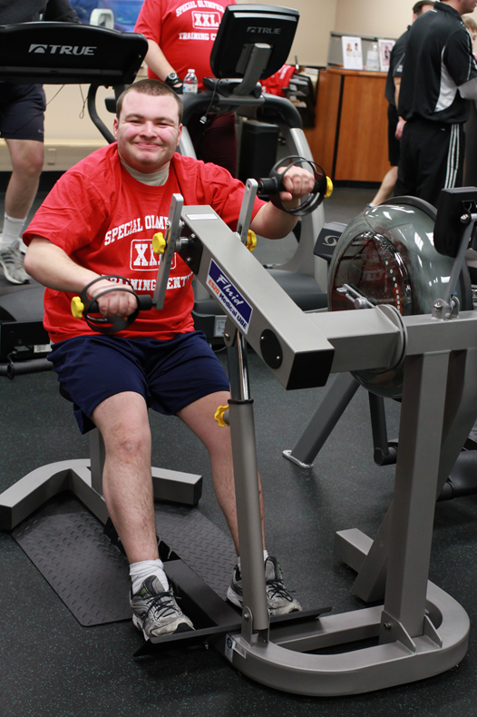
What Stories To Tell
Impact of Special Olympics
Follow-up care
Innovative practices
Partnership successes
Athlete leadership
Sponsorship highlights
Community change

Slide 13
How to Use Data to Make a Stronger Story
Special Olympics has trained 4,000 athletes like me to be self-advocates for health. We meet with public officials, advise healthcare students and speak to the media about our health needs.
Special Olympics is educating the next generation of health care professionals.
More than 300,000 health care providers and students have been trained in 60 countries and 130 health professional schools now have inclusive health curricula to train students on intellectual disabilities.
Since 1997, Special Olympics has delivered over 2 million free health screenings to athletes. Those who receive at least two screenings show health improvements.
Notes:
Using data can be a very powerful part of telling a story. Some people may think objective data can be dry but, used correctly, it can add context to the impact of a story and it can help paint the picture. That being said, it’s best to avoid using the data in the headline and utilize it more in the body of the story. For example: (the first example).
Example of how to turn second data point into headline?

Slide 14
Interview Expectations
Open- Ended Questions
  What’s the news here? Why are we talking today?
Don’t Be Shy
  Initiate conversation. Take control.
You Don’t Have to Answer a Question
  Resist simply responding to what’s asked.
Have Fun!
  Tell your story in your words.

Slide 15
4 Prep Questions
Who am I talking with?
Why am I doing this?
What’s my story?
What 3-5 points should I make?

Slide 16
Controlling the Interview
“Does anyone have questions for my answers?”
Henry Kissinger

Slide 17
Re-think the Q&A
Typically, it’s a back and forth…
  Q/A, Q/A, Q/A…
Instead
  Q Message

Slide 18
Bridging
A
ACKNOWLEDGE THE QUESTION
B
BRIDGE (PIVOT) FROM THE QUESTION
C
COMMUNICATE YOUR MESSAGE

Slide 19
Our Bridges:
Address the question…
  Thank you for that question. OR
  I’m glad you asked that.
Bridge Away, then…
  These events are important for our athletes because… OR
  Most people don’t realize…
Communicate your message!

Slide 20
Let’s Practice!
Any volunteers?
You may use the previous slide’s talking points in your answers.

Slide 21
Understanding Your Key Messages
Think before writing or sharing:
Who cares about this?
Why should they care?
How do I make more people care about this?
Notes:
You are speaking on behalf of the Movement and sharing your story.
You need to be able to say your key messages clearly and effectively throughout the interview.
You should focus on no more than 3 key messages.
Use words and phrases that your audience will understand. Explain things in a way that makes their meaning clear.

Slide 22
Flag What Matters
Focus on what is most important
Use your voice and your body to emphasize your important points

Slide 23

Plant Your Flag
“The most important point to be aware of…”
“There are three things to remember…”
“It’s important to stress…”
“What people don’t realize…”
“In a nutshell…”
“The real issue here is…”

Slide 24
Special Olympics Talk
Young Athletes
Strong Minds
Program
Healthy Athletes
Global Messenger
MATP
Healthy Communities
Eunice Kennedy Shriver
Special Smiles
Healthy Hearing
Notes:
-Outside of our Special Olympics family, the general public doesn’t understand what these explanations are.
- You must explain them when you are talking about them.

Slide 25
Special Olympics Talk
Young Athletes
Strong Minds
Program
Healthy Athletes
Global Messenger
Early childhood play program for children with and w/o intellectual disabilities, aged 2 to 7 years old.
A learning activity focused on developing adaptive coping skills; One of our 8 Healthy Athletes disciplines.
A Special Olympics local office/affiliate/chapter, etc.
Free health screenings and education to Special Olympics athletes.
Athlete spokespeople selected to lead the campaign for a more inclusive world for people with intellectual disabilities.
Notes:
Always reference our style guide if you need help! It’s on Resources.

Slide 26
Examples of Health Calls to Action
If speaking to fellow athletes:
  Participate in Healthy Athletes so you can improve your health and compete at your best.
  Share your health and fitness journeys so you can inspire others.
If speaking to media:
  Continue to cover and bring awareness to Special Olympics Health programs. You are helping Special Olympics make #inclusivehealth a reality.
Check out SpecialOlympics.org and follow @SpecialOlympics on social media to stay up-to-date on the latest health and fitness resources.
Notes:
Facilitator note:
- Ask the group to suggest other Calls to Action.

Slide 27
Interview Tips
Be yourself!
Prepare – make sure you know the facts and your messages!
Try to wear a Special Olympics logo (on shirt, pin, or medal)
Be positive and energetic
You are always on the record – if you are not sure of a fact, don’t say it
Remember that you play an important role in Special Olympics….no pressure!
Reporters are covering more than one beat
Not only responsible for posting story, but tweeting all day, authoring a blog, taking video
We live in a 24-hour news environment
Competition is fierce for content

Slide 28
How to Get in the News
Share photos with your local Program and write up a story about your health experience
If on social media, share your Special Olympics health story with photos
Alert your local Program when you are doing something so they can help you get coverage

Slide 29
Acknowledgement
This document was developed with funding from many sources, including in the United States by Grant Number NU27DD000021 from the Centers for Disease Control and Prevention (CDC) of the U.S. Department of Health and Human Services (HHS), with $18.1 M (64%) financed with U.S. Federal funds and $10.2 M (36%) supported by non-federal sources.
The contents of this document are solely the responsibility of the authors and do not necessarily represent the official views of the Centers for Disease Control and Prevention or the US Department of Health and Human Services.

