Slide 1
Inclusive Health Advocacy
Notes:
I’m excited to speak with you today about inclusive health advocacy. This is a new area of work for many Special Olympics Programs.
Like I will talk about, a lot of advocacy work is very specific and local. That is why this presentation has a lot of general information that is more like guidance.

Slide 2
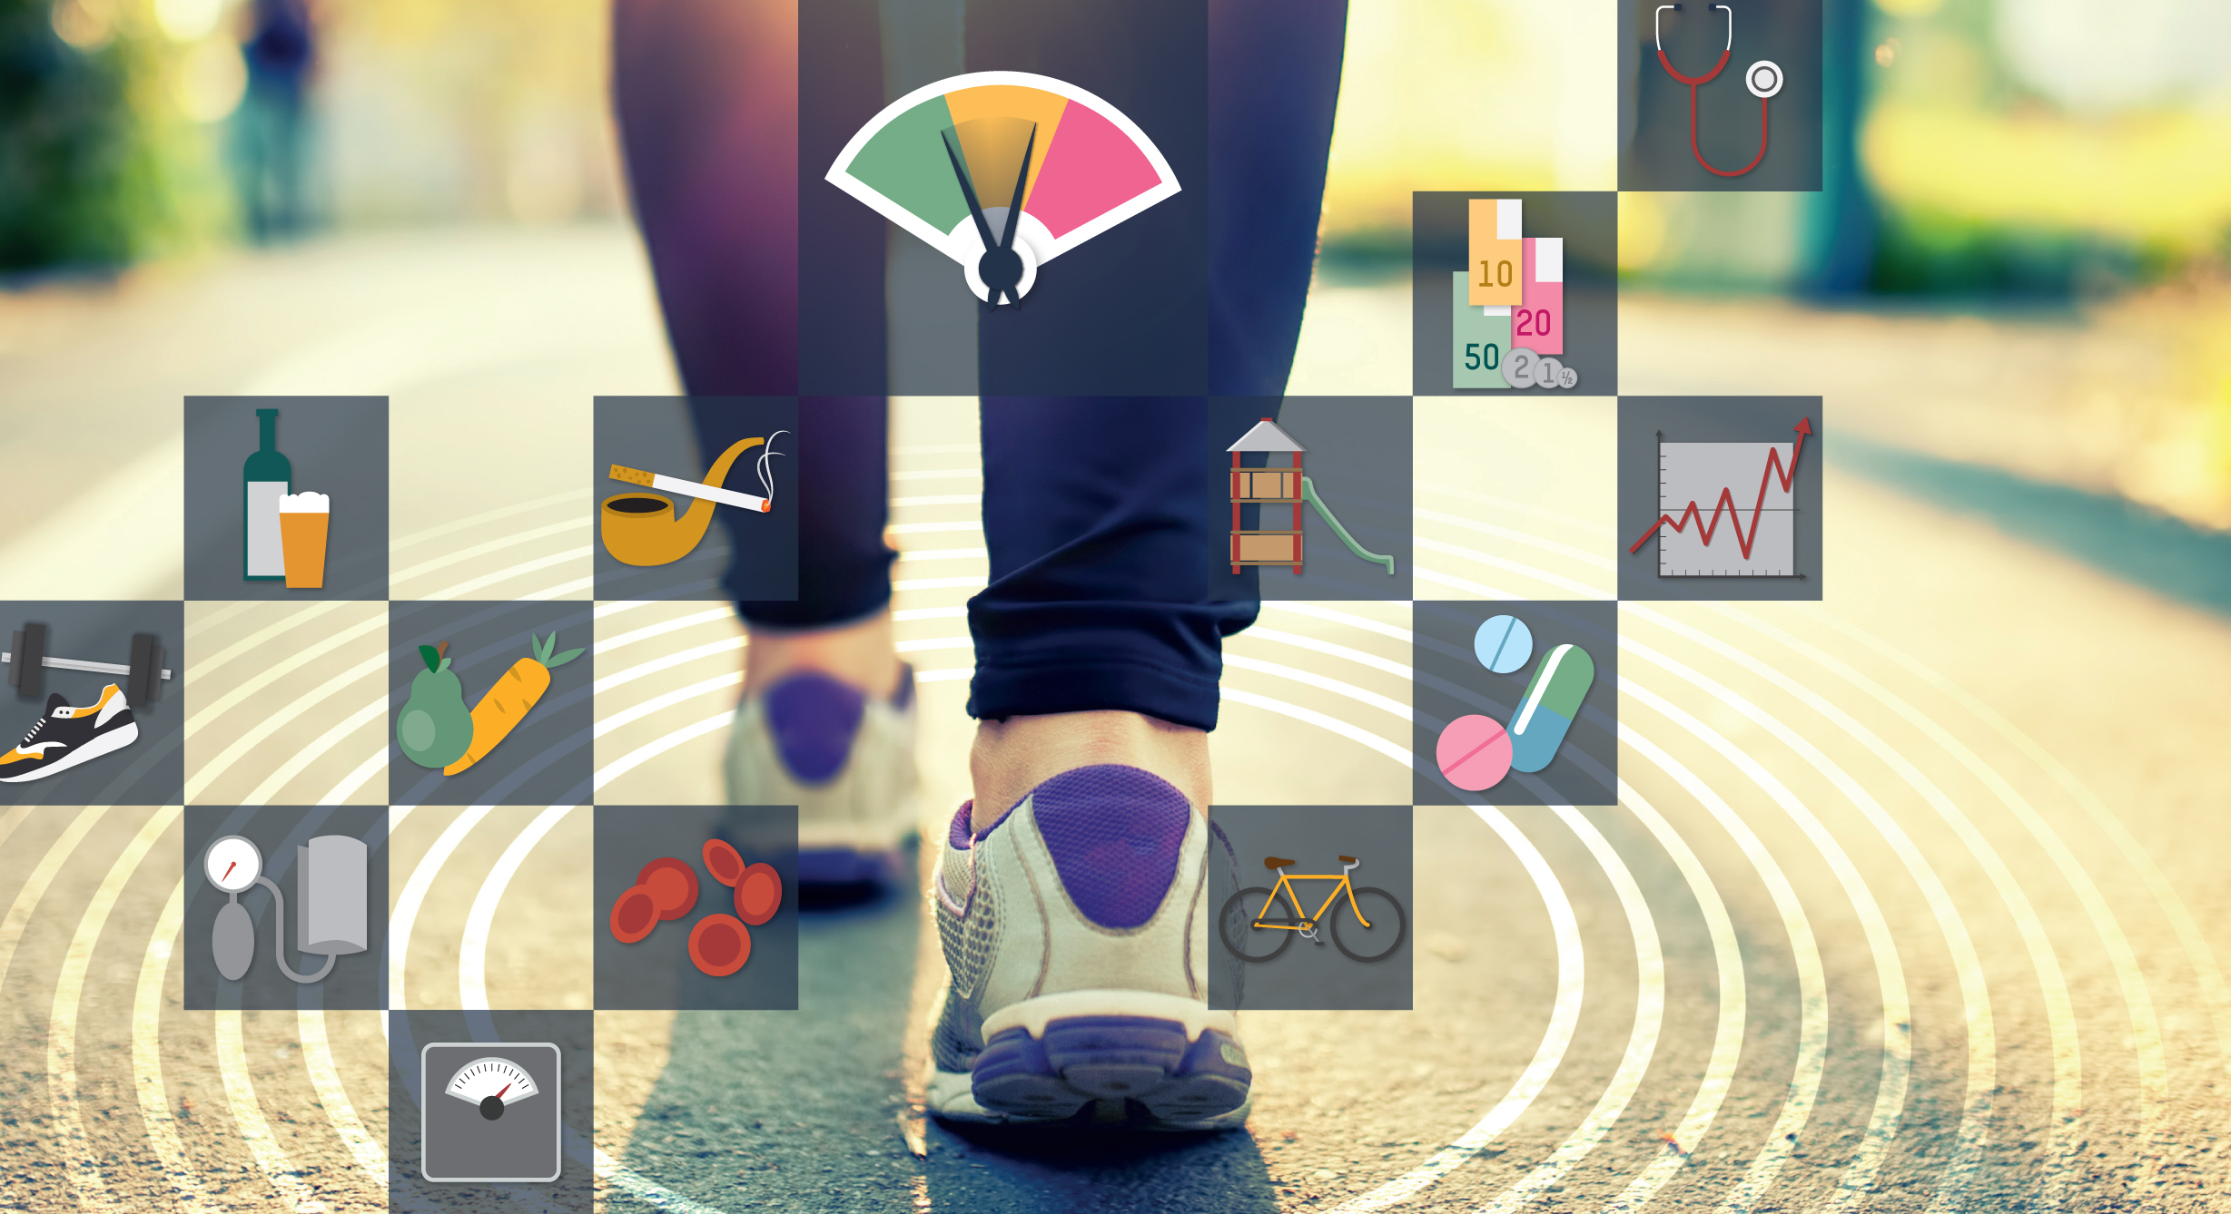
What is inclusive health?
Inclusive health means
people with intellectual disabilities (ID) have access to the quality health care that meets their needs.

Slide 3
What is inclusive health?
No access = poor health
Access to poor quality care = poor health
Access
+ good quality care
+ meets your needs =
Inclusive health

Slide 4
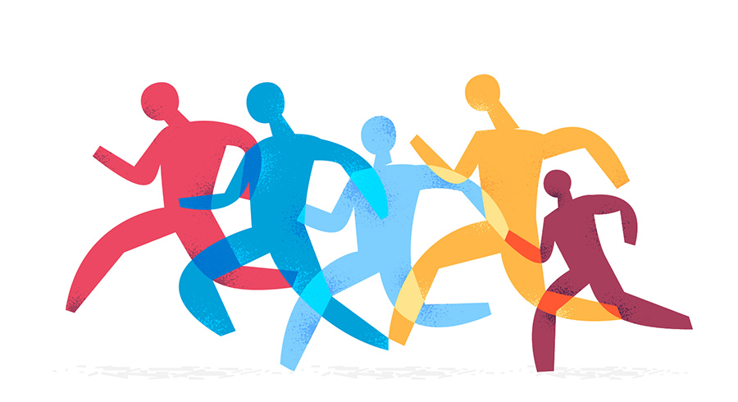
What is inclusive health?
Inclusive health means:
Health systems provide some services
There are low or no barriers to people with intellectual disabilities getting these services
Health professionals provide quality care for all

Slide 5
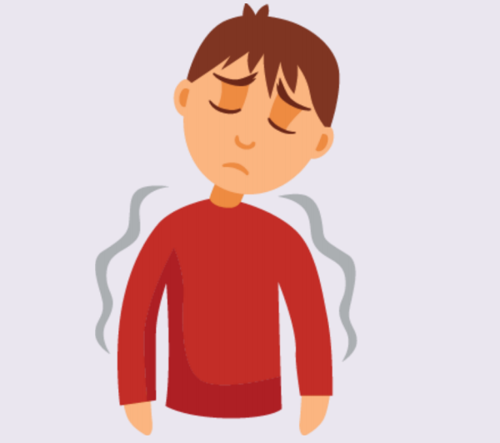
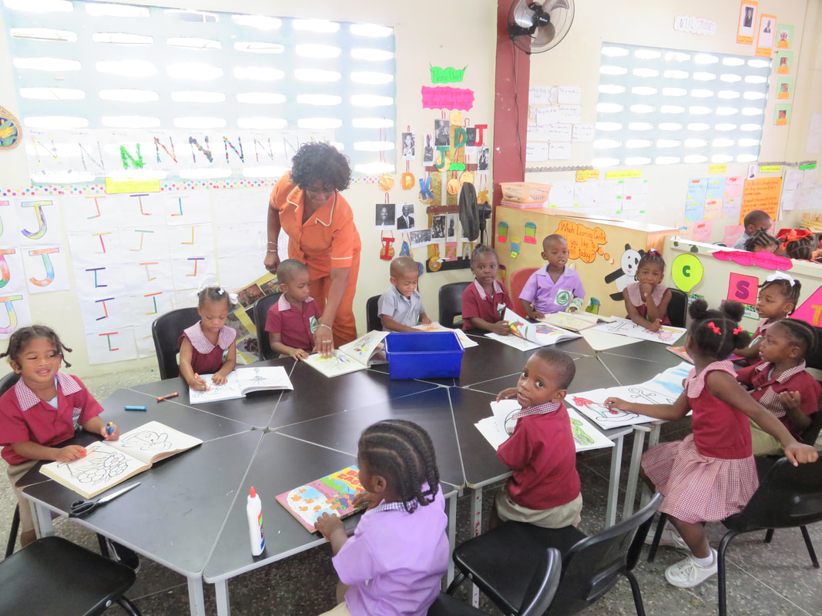
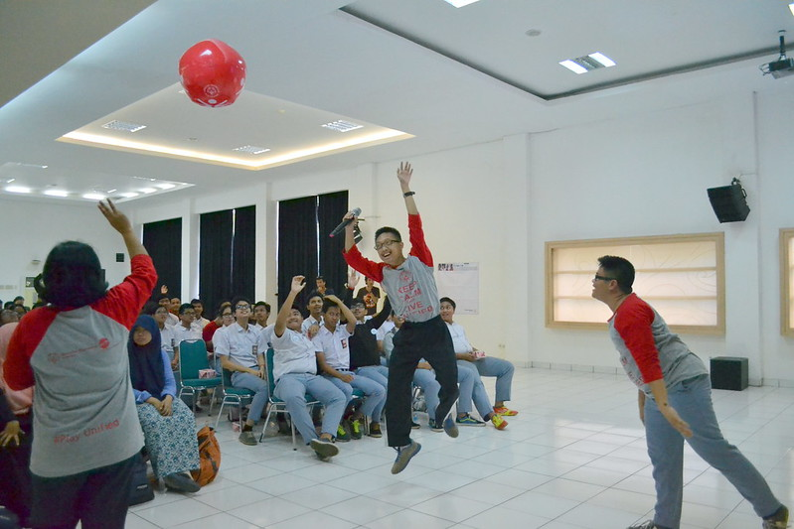
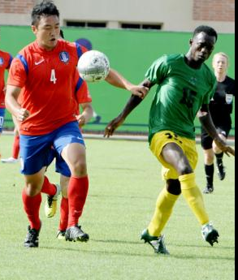
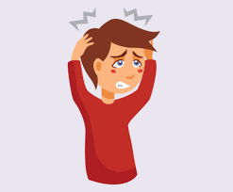
Why do we need inclusive health?
Health is important to being able to participate in society.
All people deserve to be in their best health. All people have a right to health.
But people with ID tend to be in poorer health than people without ID.

Slide 6
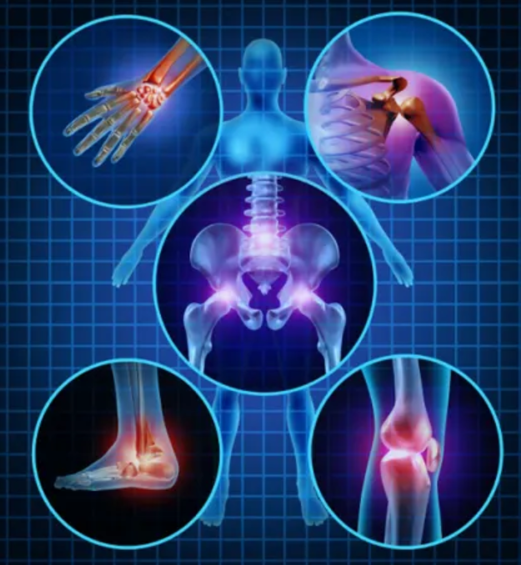
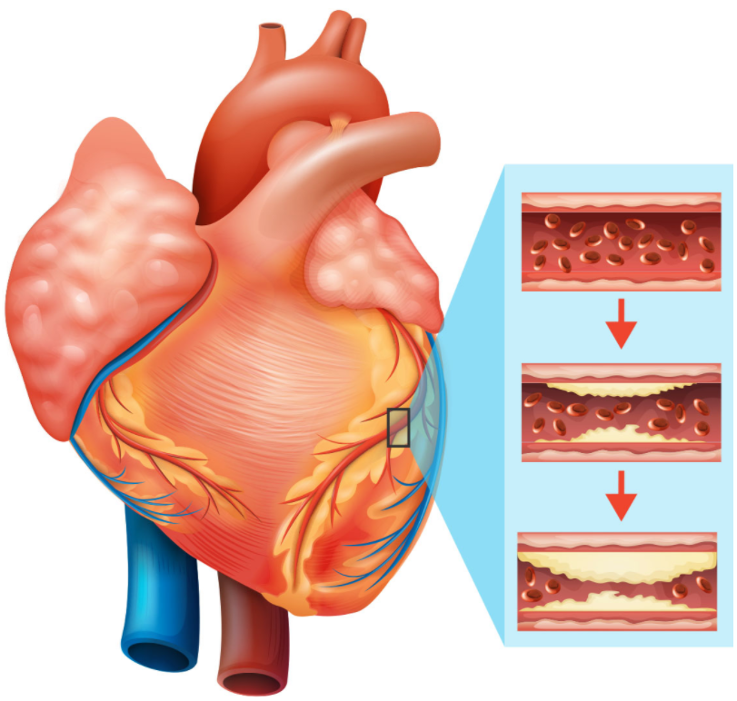
Why do we need inclusive health?
People with ID tend to be in poorer health than people without ID.
They are:
5 times more likely to have diabetes
3 times more likely to have arthritis
2 times more likely to have
heart disease and asthma
Have a 10% higher prevalence of obesity
Die on average 16 years sooner

Slide 7
Why do we need inclusive health?
Health systems can improve people’s health. They can do this by providing health services and education. The best is when these services and education are in the community!
Health systems often do not give people with ID the services and education that meet their needs. This is a big problem!

Slide 8
What is advocacy?
Notes:
Trying to influence decisions

Slide 9
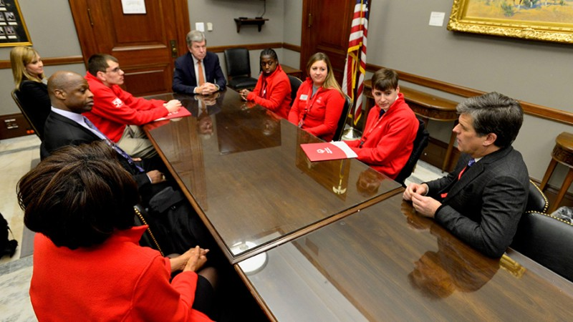
What is advocacy?
Speaking up for yourself
Speaking up for others
Speaking up for your community
Notes:
Trying to influence decisions

Slide 10
Important considerations for advocacy
Goals
Stakeholders
Advocacy environment

Slide 11
Important considerations for advocacy
Goals
Stakeholders
Who are the actors involved with my goals?
Who makes the decisions?
What are the rules around advocacy in my country?
Is it safe for me to advocate in my country?
Is it safe for me to advocate on the particular goal I chose?
What have stakeholders said or done related to my goal?
Advocacy environment
What do I want to achieve?

Slide 12
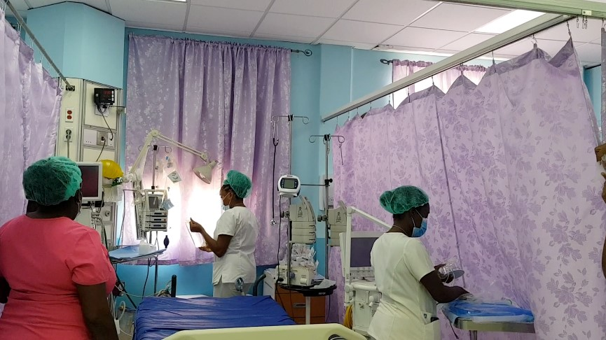
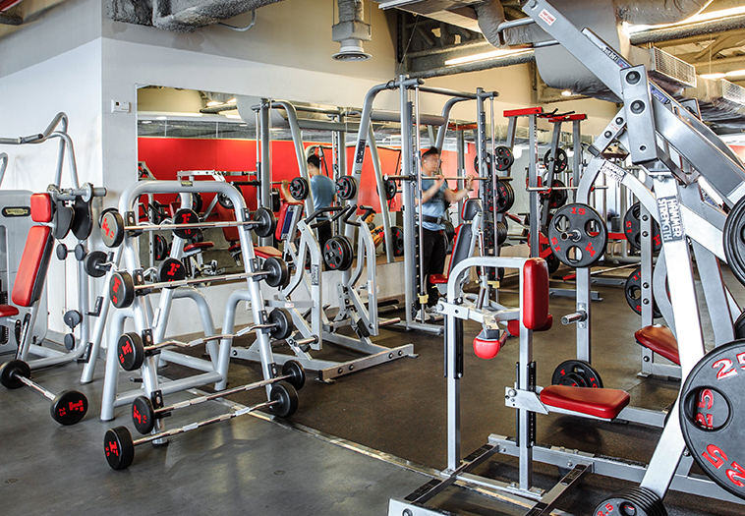
Important considerations for advocacy
Goals
National or local laws, policies, or plans
International commitments and treaties (Sustainable Development Goals, Convention on the Rights of Persons with Disabilities)
Expectations, rules, or customs about who can speak to whom
Stakeholders
Partnership with an organization to provide goods, services, or funds
Partnership with an organization to make their activities inclusive
Policy change – an extra-strong partnership or a new set of rules
Advocacy environment

Slide 13
Important considerations for advocacy
Goals
Stakeholders
Advocacy environment
Activities
Messages
Advocacy team

Slide 14
Important considerations for advocacy
Activities
Depend on goals and stakeholders
Messages
Often include data
Advocacy team
Can include many people
Think about goals and stakeholders when building the team
Should always include a Health Messenger!

Slide 15
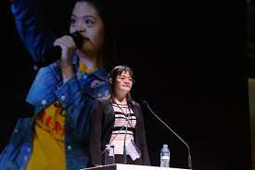
Important considerations for advocacy
Data are units of information. Examples of data:
6 out of every 10 Special Olympics athletes in the Caribbean who have been screened at Healthy Athletes have flexibility problems.
Almost half (48%) of Special Olympics Caribbean athletes screened at Healthy Athletes had untreated tooth decay!

Slide 16
Important considerations for advocacy
Who
What
Why
you are! your name, where you live, how long you been an athlete, the sports you do, where you study or work
information should your audience know about the health of people with ID – for example, data or experiences you or fellow athletes have had in the health system and/or with Special Olympics Health
do you want the decision maker help?
How
is it important to take action?

Slide 17
Activity
Pick a specific inclusive health problem you want to solve.
What goal do you want to achieve?
Who in your local community, state, province, region or country can help you achieve your goal?
What can that person can do?
What do you want them to know?

Slide 18
Acknowledgment
The original version of this document was developed with funding from many sources, including in the United States by Grant Number NU27DD000021 from the Centers for Disease Control and Prevention (CDC) of the U.S. Department of Health and Human Services (HHS), with $18.1 M (64%) financed with U.S. Federal funds and $10.2 M (36%) supported by non-federal sources.
The contents of this document are solely the responsibility of the authors and do not necessarily represent the official views of the Centers for Disease Control and Prevention or the US Department of Health and Human Services.

