Slide 1
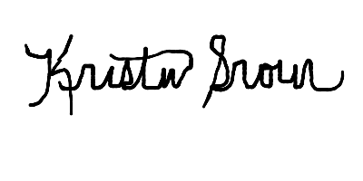
This certificate recognizes
Athlete Name
for successfully completing the Special Olympics Health Messenger Training
and committing to promote healthy lifestyles and advocate
for the health of people with intellectual disabilities.
Mary Davis
Chief Executive Officer
Special Olympics International
Kristin Hughes Srour
Senior Director
Global Community Health Programs
Special Olympics International

