Slide 1
Health Messenger Training
Notes:
Total presentation time – 90 minutes
Participant introductions – 20 mins
Slide presentation – 35 mins
Activities – 35 mins

Slide 2
Objectives
Learn how to build positive health behaviors and be a role model.
Learn skills and activities to help others become healthier.
Feel empowered to advocate for the health needs of people with ID.
Create individual Health Messenger activation plans.
Develop a network of Health Messengers.
Notes:
Read the learning objectives
Explain the agenda for the next 2 days:
Learning about the expectations of Health Messengers, the health of people with ID and the Special Olympics Health Program, and how to be healthy role models
Putting what we’re learning into action by sharing with each other and doing hands on activities
Working on our practicums throughout the training.
Play Tim Shriver’s welcome video.

Slide 3
Commitments for the day
Everyone has a unique experience to share.
Ask questions.
Work together.
Think globally, act locally.
Have fun!
This is a safe space. You are among friends.
Notes:
SAY:
This is your day. What rules do you have?
Activity (20 mins):
Ice breaker --- Let’s go around the room and have everyone say their Name, Program, Sport and one health issue athletes in their communities are facing.

Slide 4
Everyone has the same right to health
Notes:
Play the “Health Messenger Recap” video under “Health Messengers in Action” on the Resources page.
https://resources.specialolympics.org/Taxonomy/Health/Health_Messengers.aspx

Slide 5
Statistics
Compared to people without an Intellectual Disability (ID), people with ID:
Die 16 years earlier on average
Are at a more unhealthy weight
Have less control over their nutrition
Tend to have higher blood pressure
Notes:
SAY:
Before we get into the health messenger training it’s important to talk about the health of people with intellectual disability, and why we need your help.
People with intellectual disabilities are locked out of most aspects of health systems, creating significant health disparities for this population. As a result, they are:
5 times more likely to have diabetes
3 times more likely to have arthritis
2 times more likely to have cardiovascular disease and asthma
Have a 10% higher prevalence of obesity
Die on average 16 years sooner
This is attributed to limited or poor access to health care, sports, physical activities, etc. NOT because they have an ID!

Slide 6
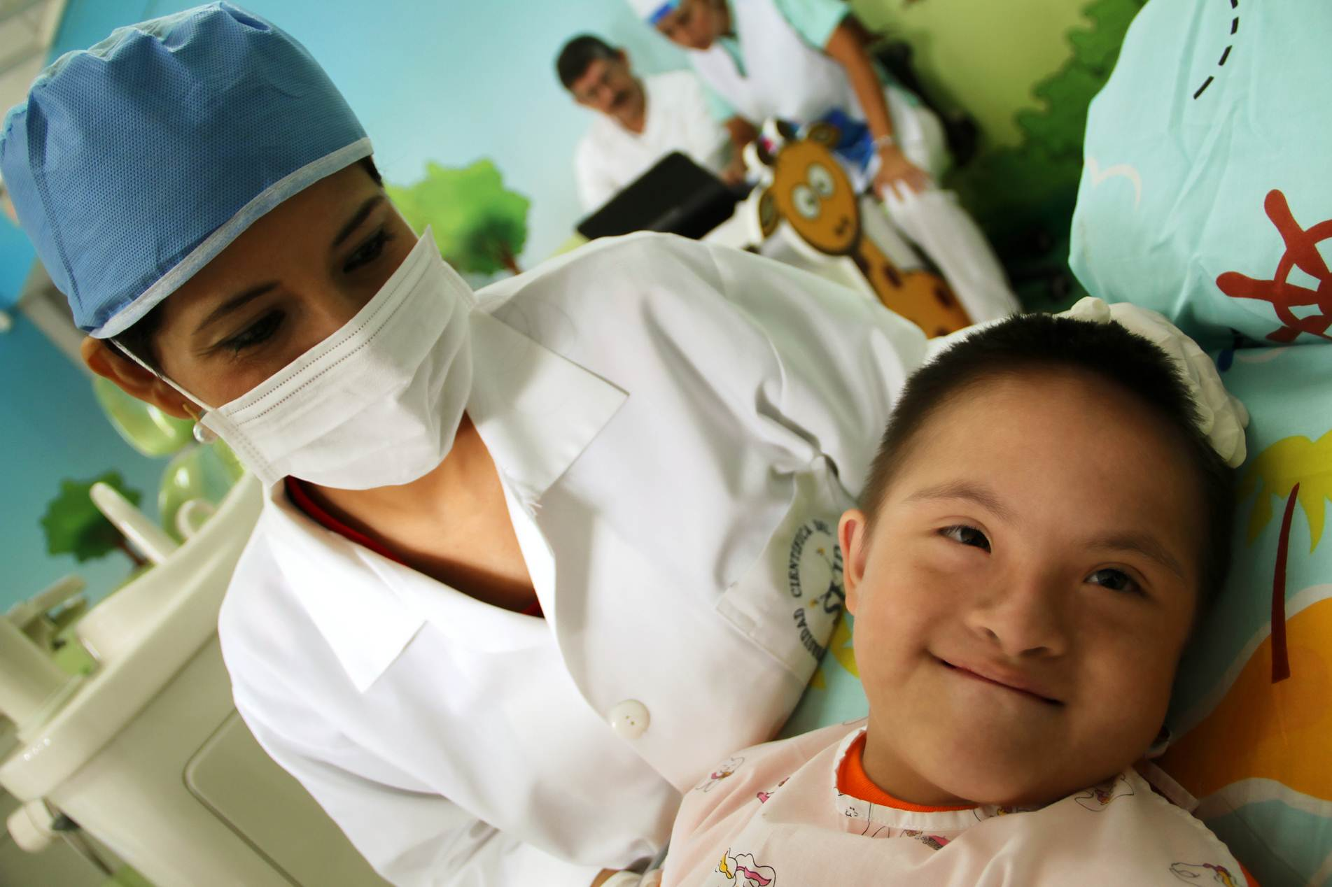
Why Do Disparities Exist?
Healthcare providers not properly trained
Prevention education is not adapted
Inaccessible facilities
Limited self-advocacy
Stigma
Cultural beliefs
Poor enforcement of laws

Slide 7
Activity
What challenges do you face in achieving good health?
What challenges do other athletes that you know face?
What are some solutions to meeting these challenges?
Notes:
Activity – total time 20 mins
Group discussion – 10 minutes
Report – 10 minutes
SAY:
You have 10 minutes to discuss each of these questions as a group at your table.
Pick 1 person from your table who will take notes and report back to the larger group about what you discussed.
{Have 3 flip chart sheets and markers taped up throughout the room.}
Title each page:
Challenges you face to achieving good health. (prompt some examples, if needed: cost, transportation, being surrounded by people making unhealthy choices, lack of control over my choices.)
Challenges other athlete face in achieving good health.
Solutions to achieving good health.
{Participants will use the “Importance of Being Healthy” worksheet for this activity.}

Slide 8
Special Olympics Health Goals
Improve health status of people with intellectual disabilities
Increase access to quality health care and health resources for people with intellectual disabilities
Notes:
SAY:
For the past 20 years Special Olympics has been working globally to change these statistics by focusing on two goals:
Improving the health status of people with ID and
Increasing access to health care and health resources for people with ID.

Slide 9
Special Olympics Health Programs
Healthy Athletes
Healthy Communities
Follow-up care
Health education and wellness programming
Fitness
Family Health Forums
Notes:
SAY:
Healthy Athletes - Provides screenings, education, and referral to athletes in eight categories of preventive health.
Fit Feet – checks to makes sure your feet are healthy.
Healthy Hearing – makes sure everyone can hear well and provides a hearing aide if they can’t.
Opening Eyes – makes sure everyone can see and provides glasses if they can’t.
Special Smiles – makes sure everyone’s teeth are healthy.
Fun Fitness –our physical therapy program.
Strong minds – our emotional wellness program.
Health Promotion – teaches athletes about eating well, drinking the right things, exercising, protecting their skin in the sun, not smoking, handwashing, and generally being healthy.
MedFest – provides the sports physicals athletes need to compete in Special Olympics.
Healthy Communities - Working to ensure year-round community-based access to quality health care, follow up care, and prevention programming.
Fitness- Activities beyond sport are improving our athletes sport performance, health and lives.
Fitness programs that were created by Special Olympics Programs have been replicated by other Special Olympics Programs around the world
Fit 5, which you’ll learn more about later, provides tips and information for athletes, parents, coaches, partners and other supporters to lead a healthy lifestyle through physical activity, nutrition, and hydration.
Fitness Cards and Videos have simple instructions and follow a leveled approach to make exercise possible for all abilities.
And finally Family Health Forums offer an environment where parents and caregivers can gain direct access to health information, resources, and support.
ASK:
Has anyone participated in any of these programs? If people raise their hands, ask them to share their experience. (2 minutes)

Slide 10
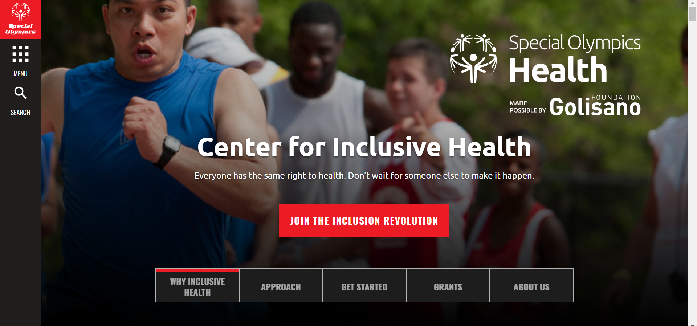
Inclusive Health
The inclusion of all people, including people with ID, in mainstream health policies and laws, programming, and services, training programs, research, and funding streams
Notes:
SAY:
All people – with or without intellectual disabilities – should have the same access to quality health care, education and services in their communities. Through the Center for Inclusive Health Special Olympics aims to strengthen the capacity of health organizations, providers, educators, and influencers to make policies, programming, services, research, trainings and funding streams inclusive and accommodating of people with intellectual disabilities.

Slide 11
People with ID must be given opportunities to speak for themselves and hold leadership roles in creating systems-wide, sustainable solutions
Notes:
(read slide)
SAY:
They are critical to ensuring Special Olympics achieves its goal of equitable health for all people with ID.

Slide 12
A Health Messenger is a Special Olympics athlete who has been trained to serve as a health and wellness leader, educator, advocate and role model within their Special Olympics communities and the community at large.
Notes:
SAY:
That’s why the health messenger program was created, and why you are here today! You are part of the solution to improving the health of people with intellectual disabilities. This work can’t be done without you!
(read definition)

Slide 13
Health Messenger Roles
Spokesperson
Healthy Athletes Coordinator
Healthy Habits Leader
Health & Fitness Leader
Health Advocate
Role Model
Notes:
SAY:
Leaders have different gifts, talents, experiences and passions. Within the Health Messenger program, athletes who are trained will assess how they want to serve as a leader. They may feel suited to serve in one leadership capacity or multiple. The typical leadership roles Health Messengers take on include:
1. Health Messengers serving as a spokesperson can speak to the media or health influencers, on behalf of people with ID, about the health and wellness needs and barriers faced.
2. Within Healthy Athletes events, Health Messengers can lead and be available throughout Healthy Athletes screenings to recruit and guide athletes through the screenings, serve as a peer educator at health education stations and assist with logistics of the screening.
3. Healthy Habits are health education stations at events that are led by Health Messengers. The Health Messengers can design and implement the event and/or stations. Setting up a sun screen or water station at an outdoor sporting event are good examples.
4. Health & Fitness Leaders are committed to promoting healthier lifestyles for athletes, unified partners, coaches and families through the creation of ongoing health and fitness education or activities either as part of a Special Olympics team or in parallel. Examples include: leading a fitness club, leading fitness activities as part of practices, using social media to provide health tips or encouraging messages, or teaching other athletes how to set personal health goals and helping them to achieve them.
5. Health advocates attend meetings with health and fitness partners and influencers to speak and advocate on behalf of people with ID.
6. Peer Role Models inspire other athletes on their teams and in their communities to be their healthiest through their own healthy behaviors. It’s how our health messengers “walk the walk.”
It’s OK if most people don’t know what they want their role to be just yet. That’s what the training is for!

Slide 14
Things to Think About
What kind of leader do you want to be after the training?
Are you good at motivating teammates?
Do you like talking to people in the community about why they should support Special Olympics?
Do you have a passion for fitness or nutrition?
Are you good at “selling” Special Olympics?
Notes:
SAY:
Here are some things you should be thinking about as you decide what you want your role as a Health Messenger to be.
ASK:
Does anyone want to share what role they think they would be good at, and why?
{Refer participants to the “Role of Health Messenger” worksheet which they will complete throughout the training.}

Slide 15
Health Messenger Practicum
Notes:
SAY:
A practicum is learning by doing. It is putting what you learn into action.
Each athlete who is certified as a Health Messenger is required to do one health and wellness focused practicum in their communities within one year of receiving training. It’s the health-focused project that you are committing to doing in your communities to demonstrate your leadership in health and wellness.
(share a few examples of what Health Messengers could do for their project)
ASK:
Show of hands: who met with their mentors before the training to choose a health activity practicum to focus on?

Slide 16
Notes:
SAY:
During the training, you’ll have time to work on developing a plan for your practicum. At the end of the training everyone will present their practicum to the group, for feedback.
{Refer participants to the “Practicum Planning” worksheet which they will complete throughout the training.}

Slide 17
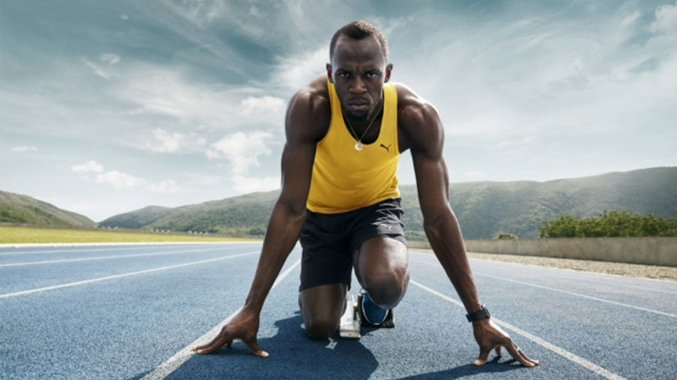
Notes:
ASK:
How would you describe this athlete?
Get the trainees to discuss all the healthy characteristics – Fit, nutrition, hydrated, healthy, strong, etc.

Slide 18
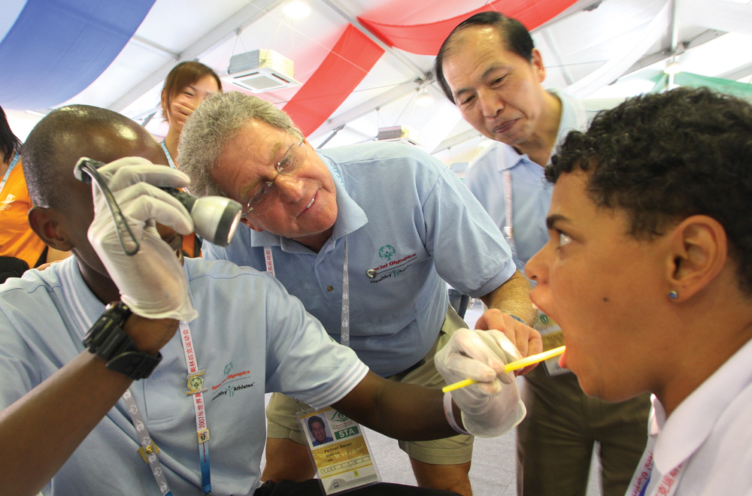
In order to be the best athlete you can be,
you need to be:
HEALTHY!
But being healthy is a CHOICE.
Notes:
(read slide)

Slide 19
Activity
What does being healthy mean to you?
Notes:
Activity – total time 7 mins
Discussion – 5 minutes
Report – 2 minutes
Discuss at your table.
Each group should report back to the group what healthy means
{Participants will use the “Importance of Being Healthy” worksheet for this activity.}

Slide 20
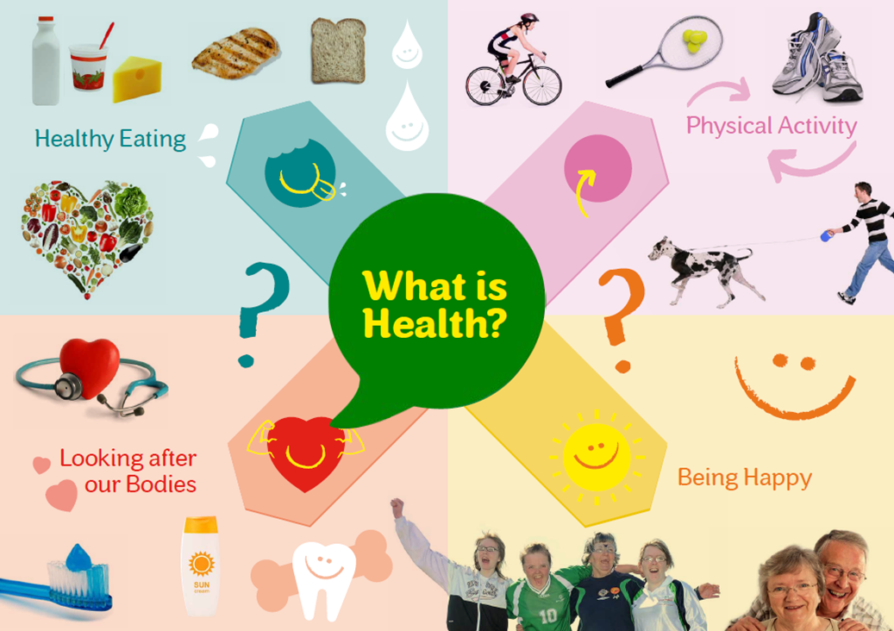
Health is a state of complete physical, mental and social well-being and not merely the absence of disease or infirmity.
Notes:
(read definition)
SAY:
As athletes, it is important to find the balance that allows us to train, work, and be valuable members of our families and community.
COMPLETE DEMONSTRATION:
Activity: – total time 5 mins
Rocks, pebbles, sand demonstration – 3 mins
Discussion – 2 mins
{Facilitator will use “Rocks, pebbles, sand activity guide” for this demonstration.}

Slide 21
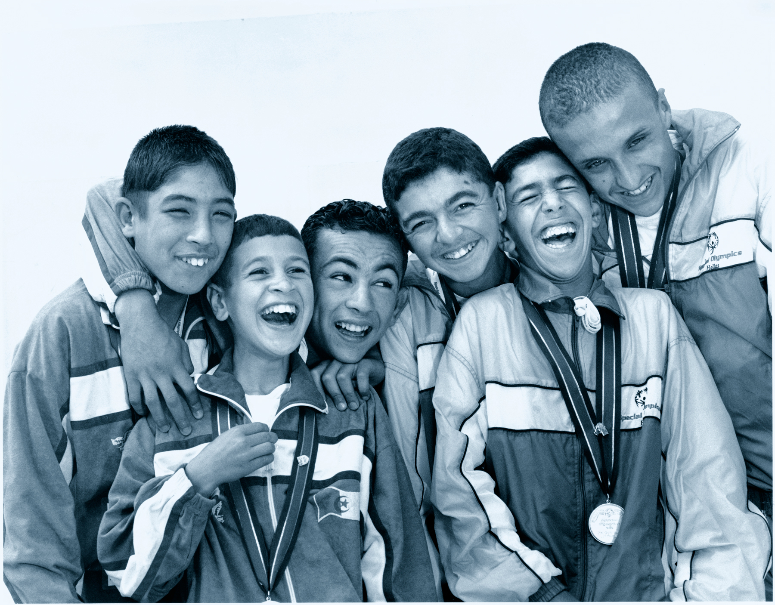
Notes:
SAY:
Can I have anyone who has received a gold, silver or bronze medal, please stand up? This is a room of champions! Give a high five to the person next to you!
Remain standing if you don’t smoke.
Remain standing if you ate a healthy dinner last night.
Remain standing if you slept for at least 7 hours last night.
Remain standing if exercise for at least 30 minutes 5 times a week.
Remain standing if you drink 5 water bottles of water a day.
Great job to those of you who are still standing! But for most people, it’s really hard to do all of these things all of the time. That’s where you come in!

Slide 22
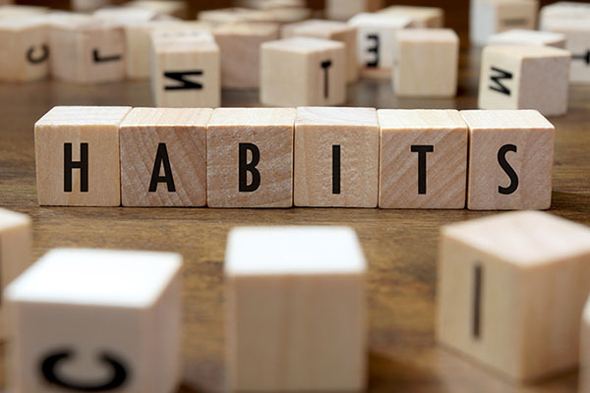
Health Messengers are Role Models
ENCOURAGE. MOTIVATE. SUPPORT.
Make Healthy Choices
Eat healthy meals
Exercise daily
Drink enough water
Maintain good hygiene
Get enough sleep
Maintain healthy relationships
Don’t smoke
See the doctor and dentist regularly
Notes:
SAY:
As health leaders, it is important to practice what you preach about being healthy, because people look up to you and copy your actions. So as Health Messengers you need to take really good care of yourselves and practice these healthy habits as much as you can!
Ask: Does anyone want to share what health activities they do every day?
{Have participants complete the “Importance of Being Healthy” worksheet to track what they do every day to be healthy.}

Slide 23
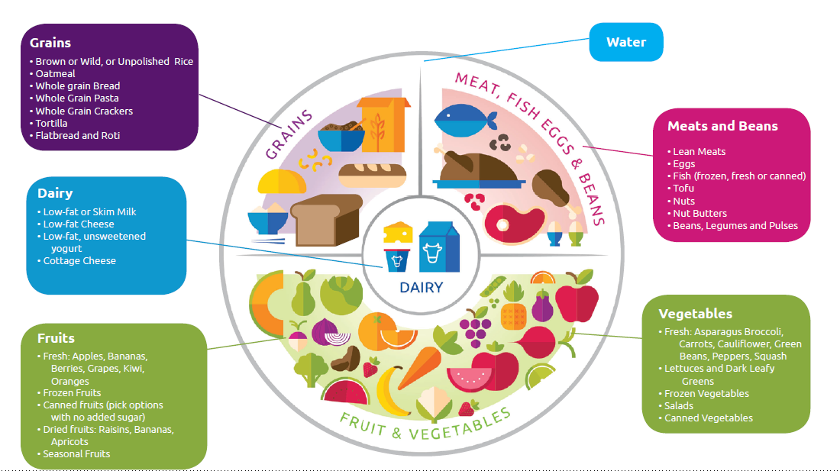
A Health Diet is important because it...
Keeps the body and mind healthy
Gives the body energy to be active and function well
Helps the body to grow and repair itself
Helps the body to fight infections and illness
Daily Serving Goal: 2 servings of fruit + 3 servings of vegetables =5 servings
Notes:
(read slide)
SAY:
The daily goal is to eat 5 servings of fruit and vegetables.
You will learn more about nutrition in a later session.

Slide 24
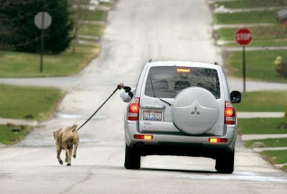
Notes:
Ask:
What’s wrong with this picture?
SAY: the goal is to exercise 5 days a week. There are lots of ways to do that.
Activity ( 1 minute):
Have everyone stand up and stretch to the ceiling as high as they can, while taking a deep breath in.
Then reach down and touch your toes for 10 seconds. Try to exhale your breath out as you bend down.
Repeat 3 times.
Don’t forget to breathe!

Slide 25
Why Exercise?
Be a better athlete
Have stronger muscles and bones
Stay at or get to a healthy weight
Increase your chances of living longer
Increase your energy level
Make yourself happier
Notes:
Ask:
Why is exercise so important?
SAY:
When you are not physically active, you are more likely to:
Be overweight
Get heart disease
Get type 2 diabetes
Have high blood pressure
Have high blood cholesterol
Have a stroke
Exercise is good for your mind, body and soul.
Exercise makes you happier! Physical activity releases chemicals in your brain called endorphins that are known to make you feel happier and more relaxed.
Exercise helps you maintain a healthy weight. Being active increases the amount of calories burned.
Exercise is good for your heart! It helps maintain a healthy blood pressure and improves circulation.
Exercise helps you concentrate better.
Regular physical activity helps you sleep better. When you are active during the day, you typically fall asleep easier and stay asleep longer.
So, exercise not only helps you to be a better athlete, it helps you live a longer, healthier life!

Slide 26
Activity
Excuses, excuses…
“I don’t have enough time.”
“Exercise is too hard.”
“I don’t have a gym membership.”
“I don’t know how to start.”
Notes:
Total activity time – 5 minutes
SAY:
You are trying to encourage a teammate to reach their goal of exercising 5 days per week. They came up with a bunch of excuses for not exercising. What would you say to your teammate to help them?
Have each athlete and mentor pick 1 excuse and come up with a response. (3 mins)
Ask for 3 volunteers who want to share what they would say. ( 2 mins)
You will learn more about fitness and FIT5 a little later.

Slide 27
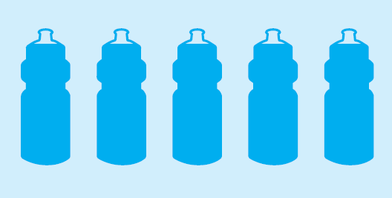
Hydration
Water is the best choice
Drink water throughout the day
Focus on staying hydrated while you’re being active
Notes:
ASK:
Who can tell me why water is good for you?
Answers:
Water is good for your skin and muscles
It helps flush your body of toxins
Its essential for athletic performance. It is important to stay hydrated with water, especially when we are playing sports because your body is sweating.
SAY:
Your goal should be to drink 5 water bottles of water per day. You will learn more about the importance of hydration a little later.

Slide 28
Personal Hygiene
Notes:
SAY:
Personal hygiene is also an important piece to keeping us healthy. Practicing good hygiene can prevent diseases and illnesses.
It is especially important to keep up on hygiene when you’re traveling. Why? Because there will be a LOT of germs everywhere and staying clean will help us avoid getting sick. It’s also important to maintain hygiene when you’re exercising a lot like you will be in training camp and at World Games. Why? Because it will probably be hot, and we will all get sweaty and need to stay clean to make sure we don’t offend anyone.

Slide 29
Good Hygiene Practices
Wash hands with soap and clean water for 20 seconds:
After using the bathroom.
Before cooking and eating food.
After blowing your nose or coughing into your hand.
Take a shower or bath daily and wear deodorant.
Brush your teeth twice a day.
Wear clean clothes and socks.
Notes:
Facilitator note: add practices that are relevant to athletes in your community.

Slide 30
Other Healthy Habits
Avoid smoking and breathing other people’s smoke
Build safe, healthy, supportive relationships with family and friends
Get 7-9 hours of sleep each night
Stay positive
Take time to relax
Visit the doctor and dentist
You should see a primary care doctor once a year (or as often as they say you need to)
You should see a dentist every 6 months (or as often as they say you need to)
Notes:
Read slide.
Ask: Does anyone want to share what new healthy habit they are going to try?
{Have participants complete the “Importance of Being Healthy” worksheet to say what new healthy habit they are going to try.}

Slide 31
Activity
Healthy Habits Quiz
Notes:
Total time – 10 minutes
SAY:
Now that we’ve talked about the different healthy behaviors, it’s time to have a friendly competition to test what you learned. The team that wins gets bragging rights. Trash talking is encouraged!
Facilitator note: Substitute relevant examples for your communities.

Slide 32
Our Fun Plan
Divide into two groups
Each group must select a leader to say the answers
The questions will be presented to both groups
The group members must help their leader to answer the question in 60 seconds
The group who raises their hand first gets to answer the question
The group with the highest score wins

Slide 33
Q1. What should you eat
a lot of daily?
Option 1. Bread
Option 2. Fruits and Vegetables
Notes:
Say:
While we want to eat bread for the carbohydrates that give us energy, eating too much of it every day will make us gain weight.
There is no limit on the amount of fruit or vegetables you can eat every day. They are a guilt free food! At meals try to make half your plate fruits and vegetables. This will help you get the recommended 5 servings per days.
And when you do eat bread, make sure it’s whole grain instead of white.

Slide 34
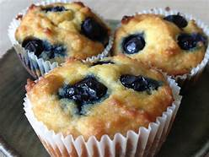
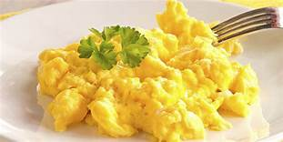
Q2. Which food is healthier
for breakfast?
Option 1. Blueberry Muffin
Option 2. Eggs
Notes:
Say:
Blueberries are a great source of nutrition; however, the muffins they are in are loaded with sugar, which will cause you to feel hungry again soon after eating them.
Eggs are the better choice. They are packed with protein, which helps to build your muscles and feel fuller longer. Plus you can eat them a lot of different ways.

Slide 35
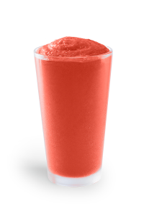
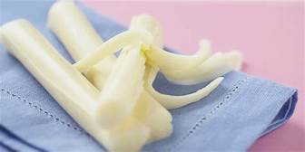
Q3. Which is the better snack?
Option 1. String Cheese
Option 2. Smoothie
Notes:
Say:
This one is a trick question.
Smoothies, like the one pictured here, are a great way to get your recommended fruits and veggies. But, they are often loaded with lots of extra sugar and calories that can turn it from a snack to a full meal. This smoothie, made with strawberries, kiwi and low fat yogurt…which are all healthy choices… is 450 calories and 94 grams of sugar. That’s much more sugar than a bottle of soda.
The winner here is string cheese. String cheese is actually low in fat and only has 60 calories and 0 grams of sugar. Plus it’s packed with protein, which is great for your muscles and will keep you feeling fuller longer, and calcium, which is great for your bones.
If you want to have a smoothie, try to make it at home with just water, fruit and veggies.

Slide 36
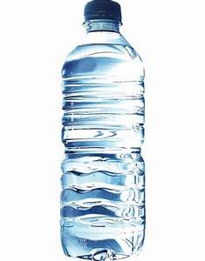
Q4. What is the best drink for hydration?
Option 2. Water
Option 1. Sports drinks
Notes:
Say:
While sports drinks are great for hydration after you’ve been doing 60 full minutes of intense exercise, it’s also loaded with a lot of sugar.
The best choice is always water.
Bonus question: how many bottles of water should you try to drink a day?
Answer: 5

Slide 37
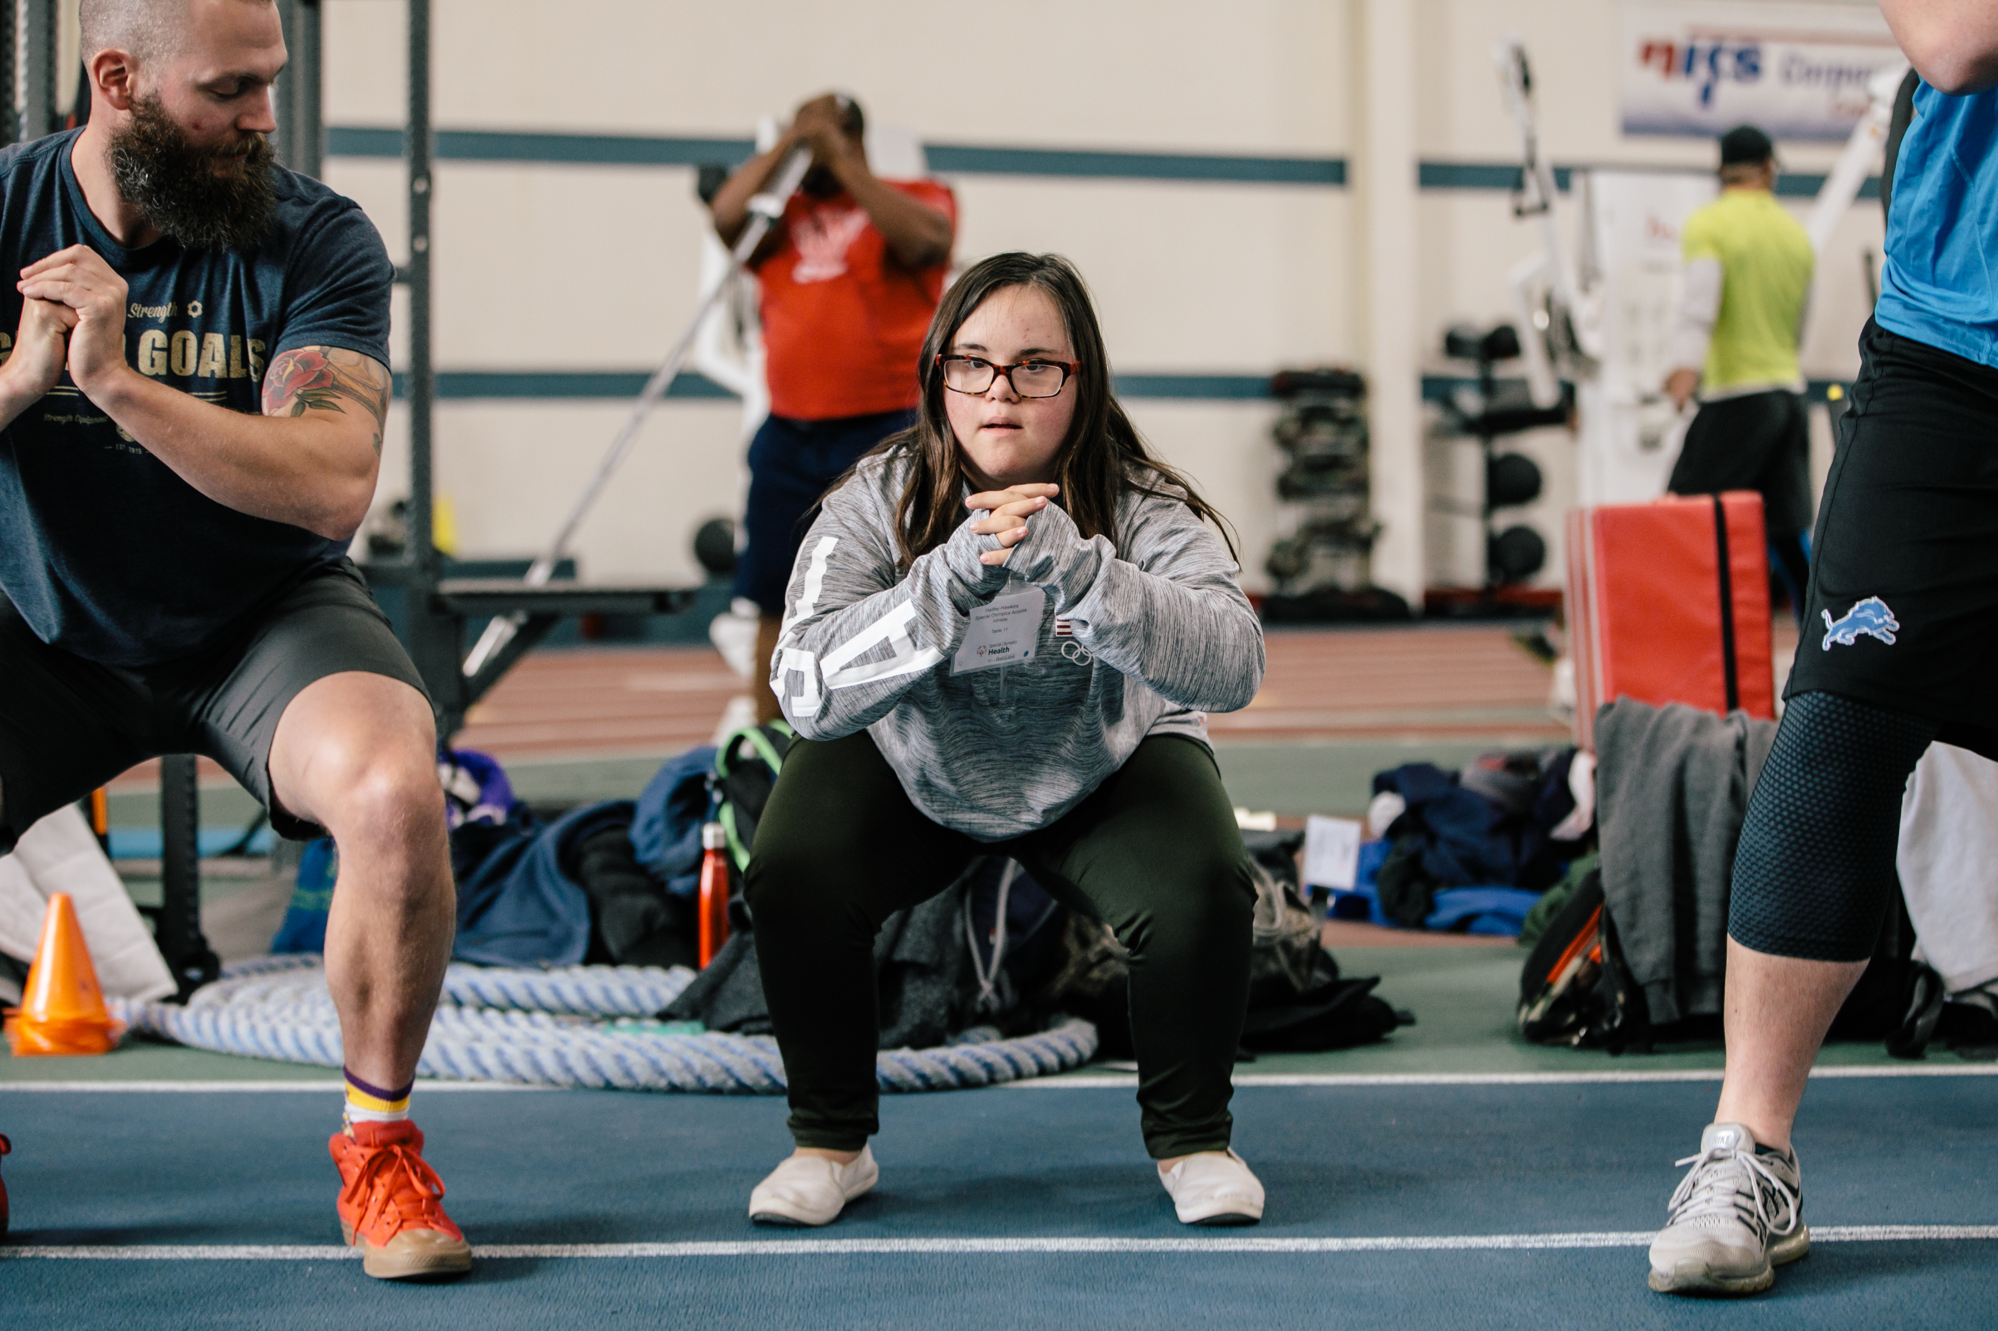
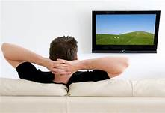
Q5. What will help you reduce stress the best?
Option 1. Exercise
Option 2. Watch TV
Notes:
Say:
While both options can be relaxing, sitting for too long is actually bad for your health. It’s always better to move whenever you can.

Slide 38
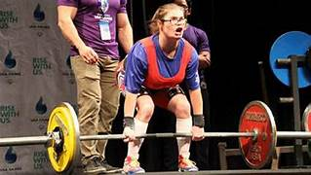
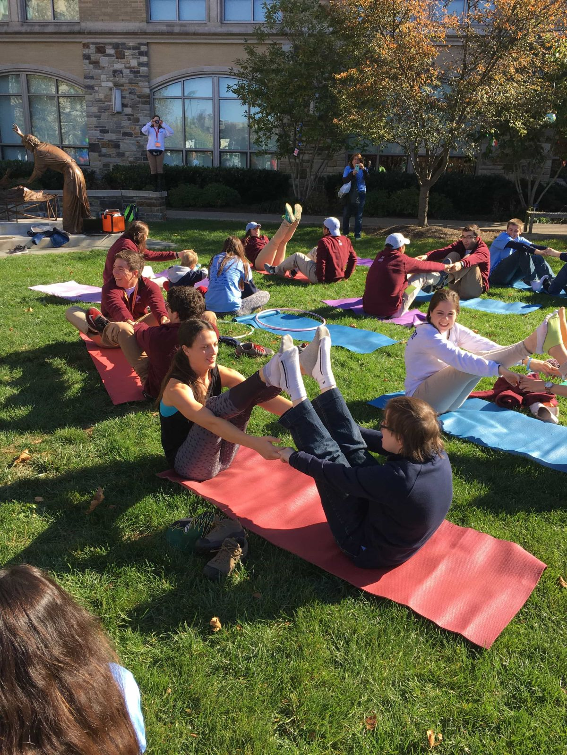
Q6. What is the best exercise for flexibility?
Option 1. Weight Lifting
Option 2. Yoga
Notes:
Say:
Weight training is great for building muscles and strength.
Yoga is the better option for improving flexibility.

Slide 39
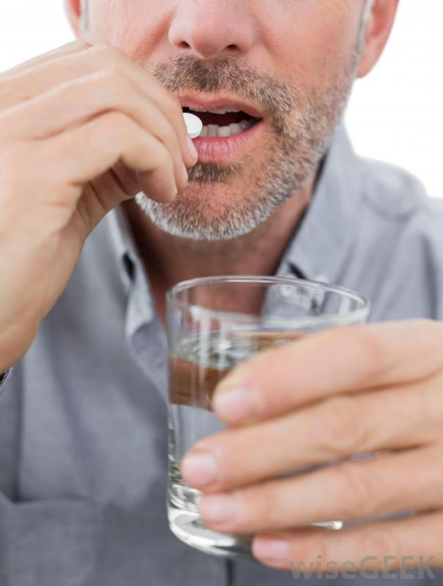
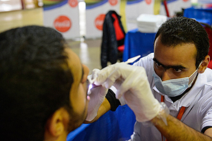
Q7. What advice would you give a friend with a toothache?
Option 1. Take a pain reliever
Option 2. Go to the dentist
Notes:
Say:
While pain reliever will cause temporary relief from a toothache, it’s not going to fix the problem long term.
When your teeth hurt, it usually means that there is something really wrong which will only get worse over time, and cause more pain. So it’s important to see a dentist as soon as you can so that they can determine what’s wrong and fix it quickly.

Slide 40
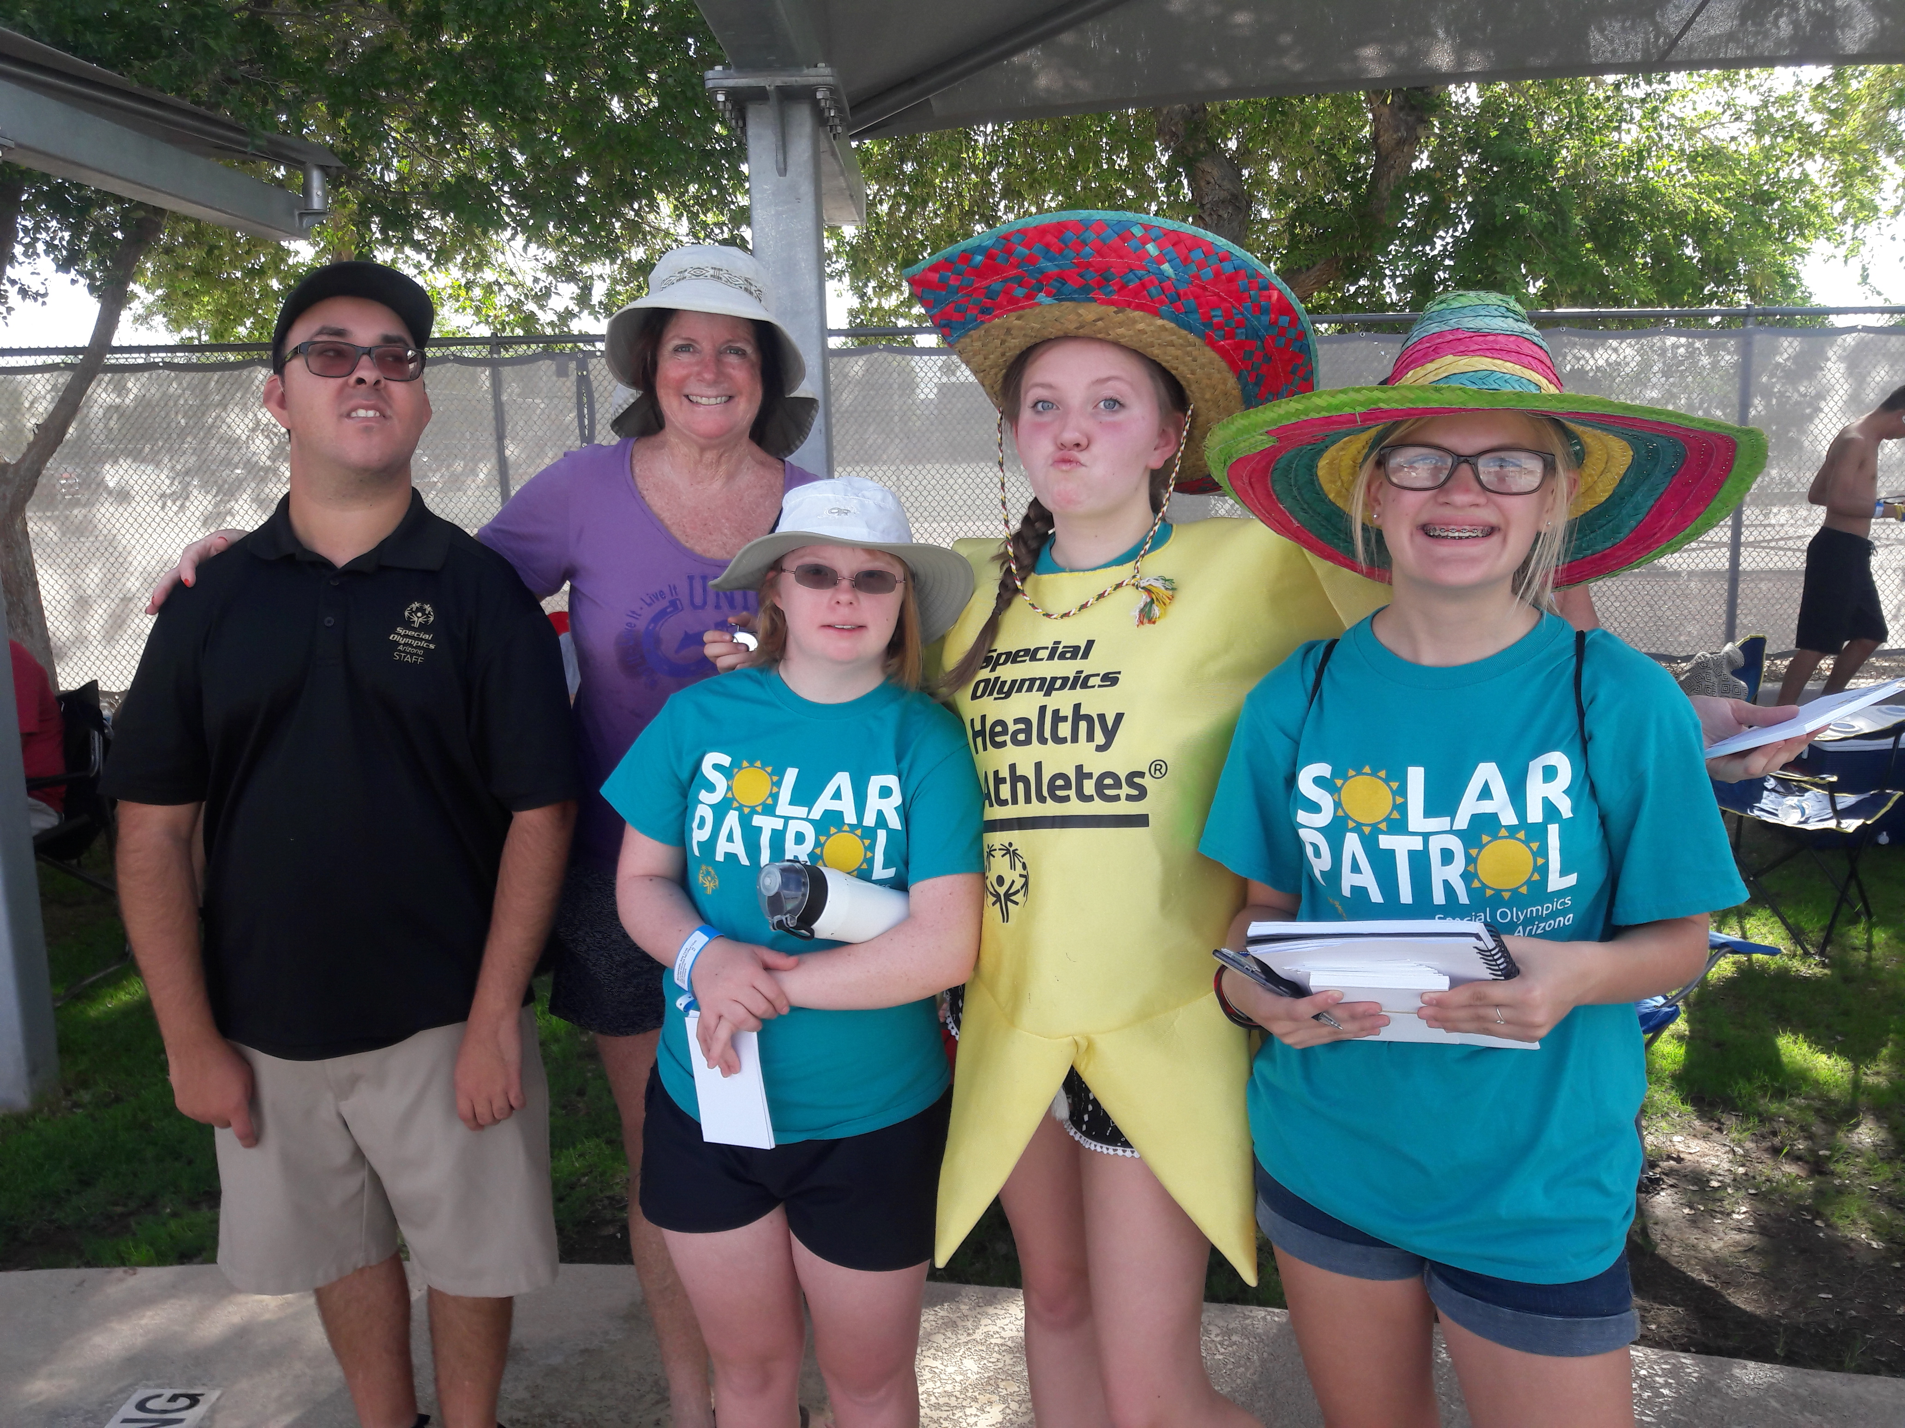
Q8. True or False?
The sun can provide important health benefits?
Notes:
Say: The answer is true.
The sun is an important source of Vitamin D, which is important for keeping our bones strong.
You only need about 10 minutes a day of direct sun exposure to get this benefit. After 10 minutes it’s best to spend most of your time in the shade, especially between the hours of 10am and 4pm, when the sun’s rays are the strongest.
If you have to be out in the sun for longer than 10 minutes, don’t forget to put sunscreen on any skin exposed to the sun, and wear protective clothing like a shirt and hat.

Slide 41
Q9. What should you do to relax before bed?
Option 1. Read a book
Option 2. Scroll through social media
Notes:
Say:
The blue light from TVs, tablets and cellphones send signals to your brain that makes it think it’s daytime instead of nighttime, which make it harder to fall asleep. Also, looking at social media or texting before bed can make us too excited or anxious to relax and fall asleep.
You should turn off all electronics at least 1 hour before bed and read a book to relax instead.
If you can, keep your phone out of your room, or silence it, so you aren’t tempted by your alerts.

Slide 42
Q10. True or False?
I should only go to the doctor when I feel sick or get hurt?
Notes:
False!
You should try to go to the doctor at least once a year for a check up, even if you are feeling great.

Slide 44
Vision, Goal and Healthy Habits
What is a Vision? A vision guides your life and provides the direction you need each day and for the choices you make.
What is a goal? A goal is a desired result or possible outcome that you envision, plan and commit to achieve.
What is a Healthy Habit? A behavior that helps your physical or mental health.
Notes:
SAY: As leaders, it is important you have a vision, goal or goals and healthy habits that you are committed to achieving. This helps you lead by example.
A vision guides your life and provides the direction you need each day.
A goal is a result that you envision, plan to accomplish and then commit to achieve.
A healthy habit is a behavior that helps your physical and mental health.

Slide 45
Example: Kristin
Vision
“Healthy, Happy, and Fit”
Goal(s)
Eat Healthfully, Reduce Stress, and Get Fit
Habit(s):
Half my plate is vegetables, meditate 5 mins a day, drink more water, exercise 5x/week, walk on the days I don’t go to the gym or exercise
Notes:
SAY: Here is an example of a vision, goal and healthy habit. (read slide)
Activity: (total time – 10 mins)
Have the Health Messengers write their own vision, goal and habit using the worksheet (8 mins)
Ask:
Does anyone want to share their vision, goal and habit? (2 mins)
Facilitator notes:
Use your own example to prompt the conversation.
If you want to go deeper, attendees can use the “My Personal Health Goal Worksheet” found on the Health Messengers Resources page, to plan how they will achieve their 1 health goal for the year.
This is a good activity to do during lunch. Attendees can discuss among themselves or share with the group.

Slide 46
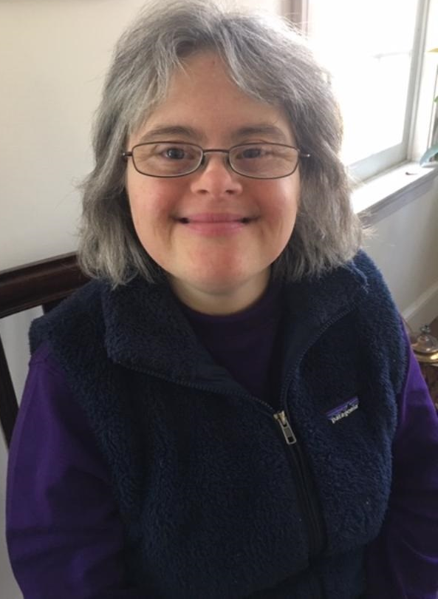
Dress for Success: Tips from Health Messenger Natasha
Look professional in your role of Health Messenger and as a representative of Special Olympics.
For Special Olympics events, always wear the Health Messenger shirt with formal pants or a skirt so people will think highly of you.
Always make sure your clothes are clean and tidy and your hair is neatly brushed or combed.
Always wear comfortable shoes for spending time on your feet at events. Uncomfortable shoes can make you feel very tired.
To be comfortable choose your outfits to suit the seasons: Lighter clothes in summer and spring, warmer clothes in fall and winter.
“Healthy living is very important to me. Choosing healthy foods and keeping fit helps me feel energized and good about myself, build stamina for my Special Olympics sports and always do my best.”
Natasha De Elye-Cole, Special Olympics Connecticut Athlete & Health Messenger
Notes:
SAY:
Another way that Health Messengers need to “walk the walk” is by looking professional any time that you are representing Special Olympics as a health leader. Here are some tips from Natasha from Connecticut.
(read slide)
Facilitator’s note: Add tips that are relevant to athlete’s in your region, or change the slide to include tips from one of your Athlete leaders.

Slide 47
Health Messenger Resources
https://resources.specialolympics.org/Taxonomy/Health/Health_Messengers.aspx
Notes:
SAY:
The Health Messenger Resources page has been created to support your health messenger work. On this site you will find all of the hands on activities that we’ll go through today, and many more. These activities include talking points and instructions you can use to teach athletes in your communities how to be healthier.
You will also find examples of health messengers in action, and an activation diary to capture the work that you’re doing throughout the year.
Facilitator note:
You may want to click on this site to show more. https://resources.specialolympics.org/Taxonomy/Health/Health_Messengers.aspx

Slide 48
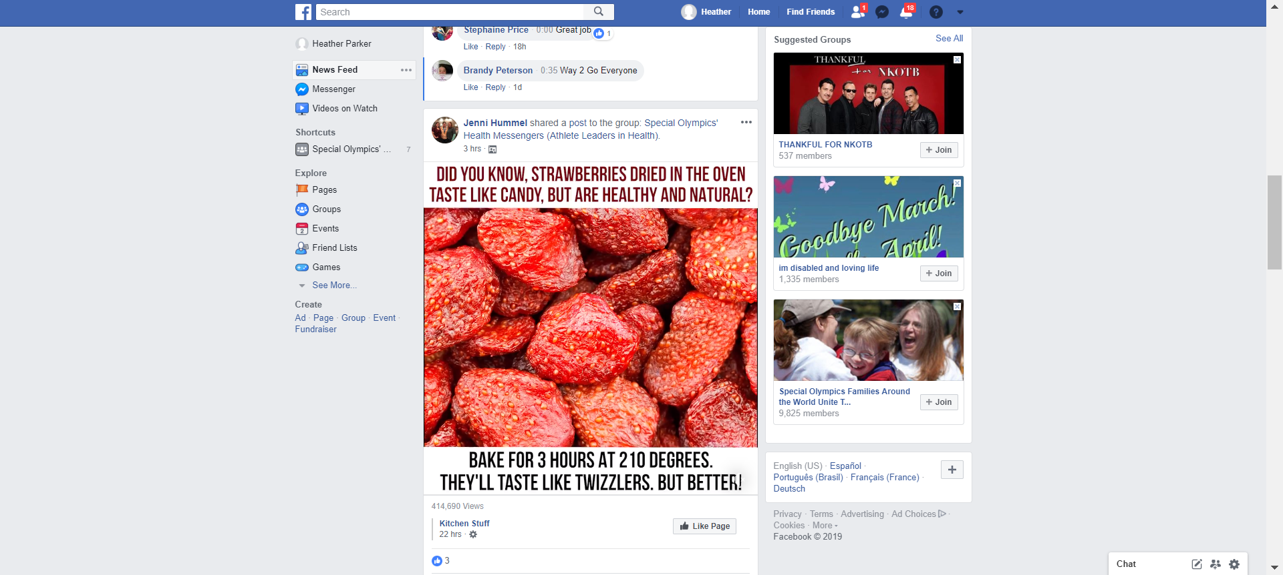
Join Our Facebook Group
https://www.facebook.com/groups/soathleteleadersinhealth
Notes:
SAY:
Stay connected with other Health Messengers by joining the Health Messengers Facebook group today.
https://www.facebook.com/groups/soathleteleadersinhealth

Slide 49
Congratulations!
Notes:
Health Messenger certificates presentation!

Slide 50
Training Survey
Your Feedback Helps Make This Training Better for Everyone!
Notes:
Ask participants to complete the Health Messenger training survey.
{Have participants complete the “Health Messenger Training” survey.}

Slide 51
Thank You!

