Slide 1
Health and Hygiene Athlete Health Messenger Training

Slide 2
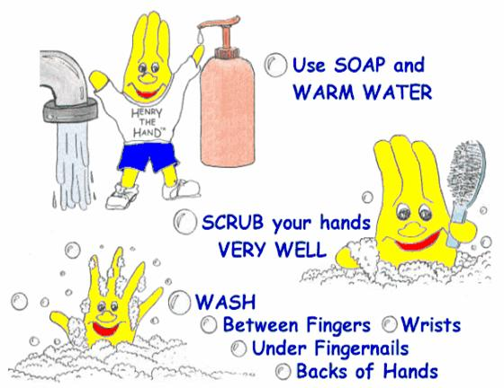
What is hygiene?
Hygiene is preventing disease through cleanliness.
We are all responsible for our personal hygiene
We must keep our environment clean

Slide 3
Personal hygiene
Keep your body clean

Slide 4
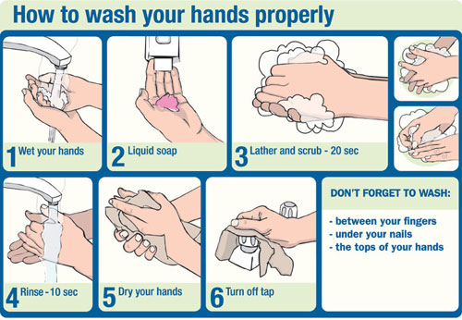
Wash hands properly

Slide 5
Bath or shower regularly

Slide 6
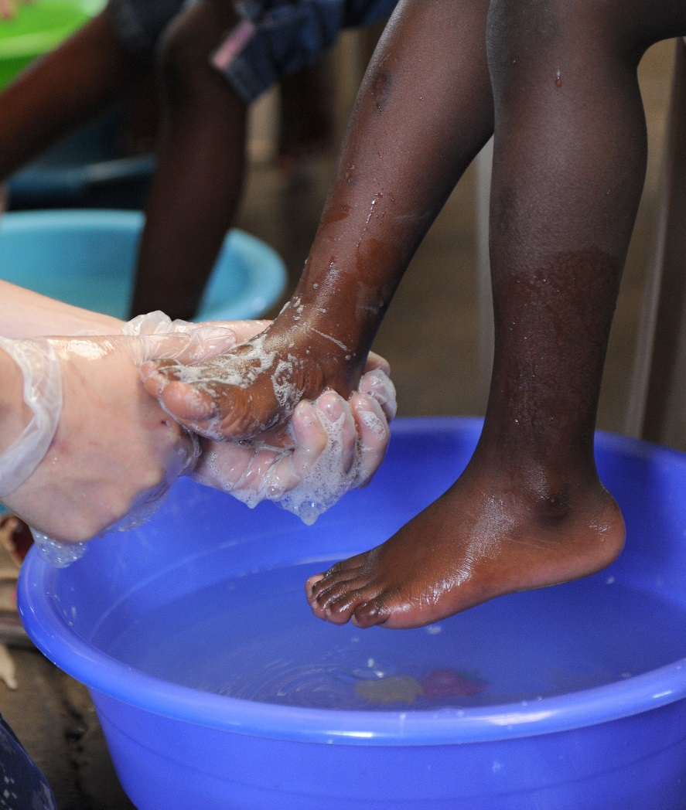
Keep feet clean

Slide 7
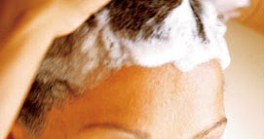
Keep hair clean

Slide 8
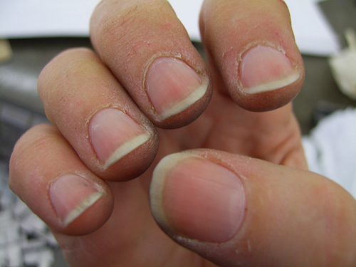
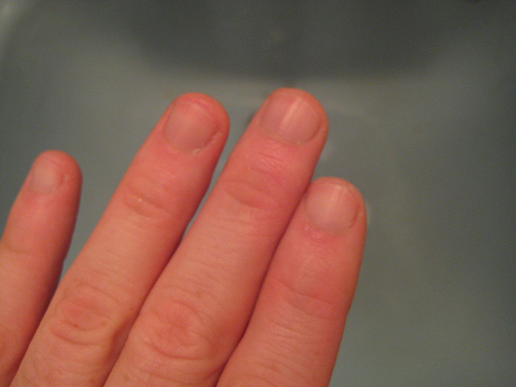
Keep nails Clean

Slide 9
Brush teeth everyday

Slide 10
Keeping the environment clean

Slide 11
Things to consider
Open windows for at least 1 hour a day
Clean up the room
Wear clean clothes( especially underwear) and use clean blankets
Keep the utensils clean
Keep food fresh and covered

Slide 12
Let us wash our hands!!

