Slide 1
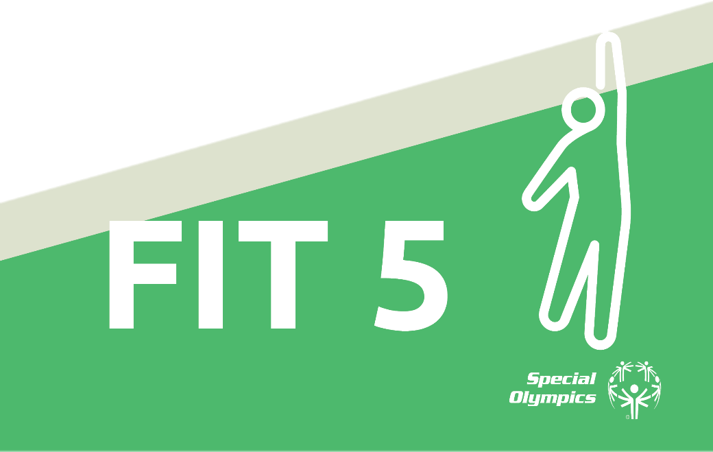
Asia Pacific Region Version
Fitness Cards

Slide 2
Thank you to our sponsors:
Logo
Logo
Special thanks to the athletes and leaders featured in this guide:

Slide 3
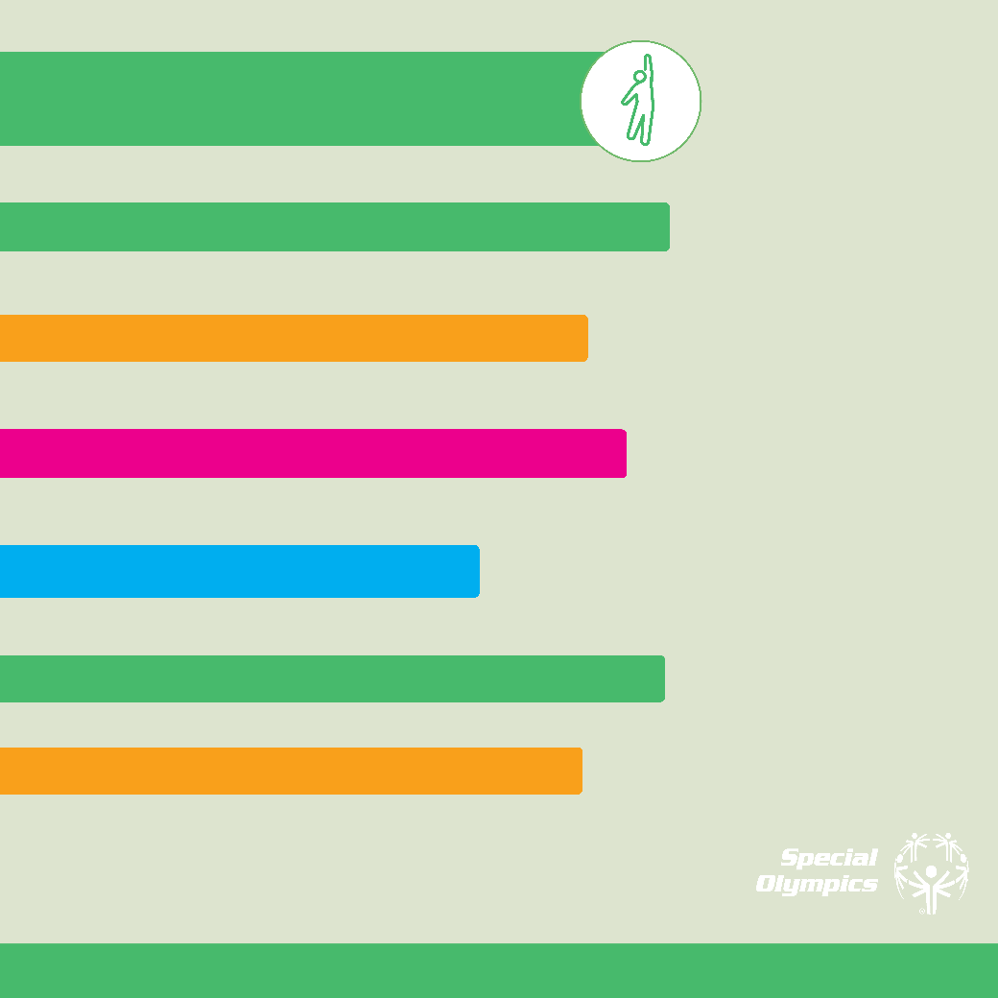
About this guide
Fit 5 Tracker
Exercise
Food and Nutrition
Hydration
Handwashing
COVID-19

Slide 4
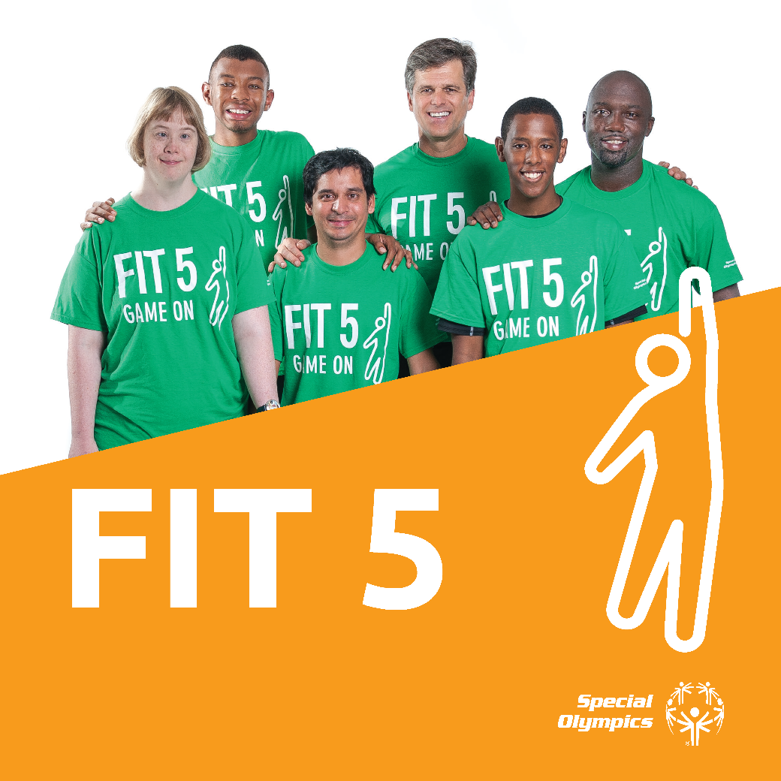
Fitness Cards

Slide 5
A guide to achieving fitness and your personal best with physical activity, nutrition, and hydration.

Slide 6
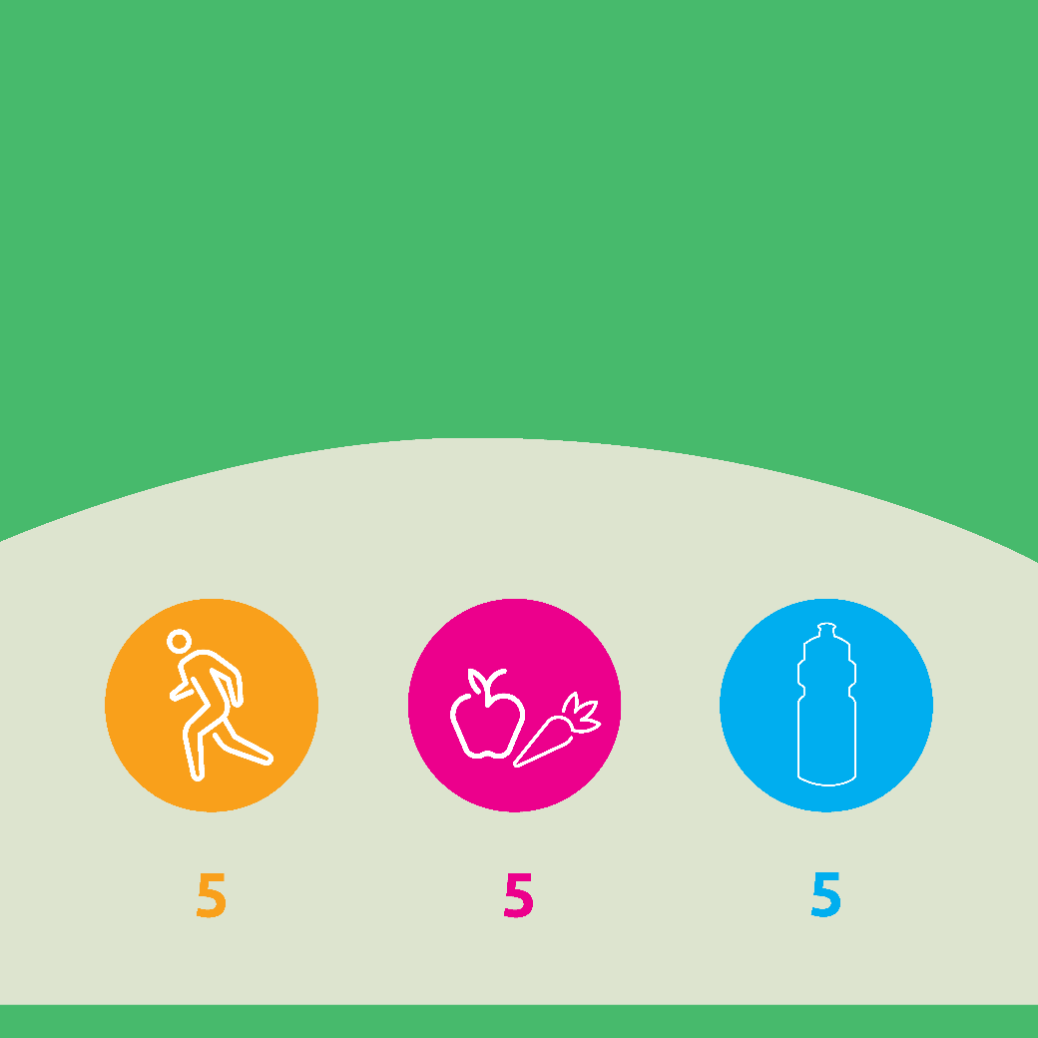
What is Fit 5?
Athletes want to perform their best at every competition.
You can do this by being fit.
Fit 5 is a plan for physical activity, nutrition, and hydration.
It can improve your health and fitness to make you the best
athlete you can be!
Goals of Fit 5
EXERCISE
days a week
total fruits and vegetables per day
water bottles per day
Notes:
https://media.specialolympics.org/resources/health/disciplines/health-promotion/choose-change-cards/Health-Promotion-Fruits-Vegetables-English-2018.pdf

Slide 7
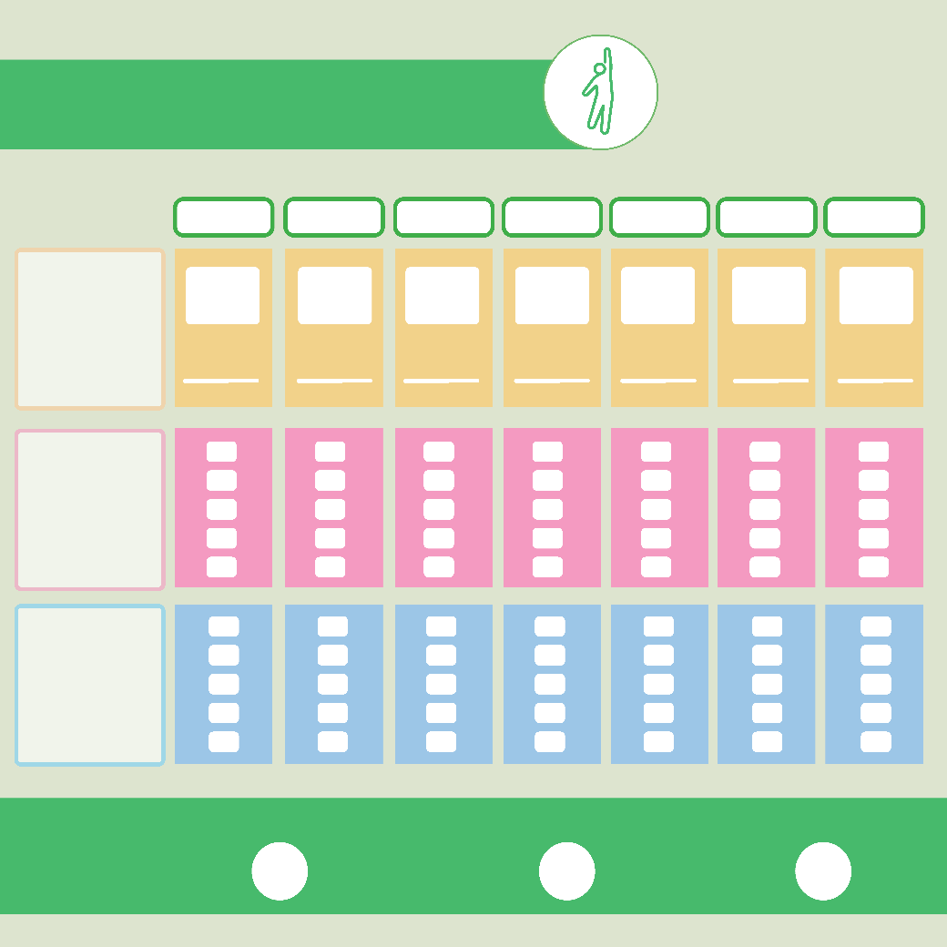
My Fit 5 Tracker
MONDAY
TUESDAY
WEDNESDAY
THURSDAY
FRIDAY
SATURDAY
SUNDAY
Exercise
Check the box if you exercised today!
Write in the number of minutes you spent active.
Minutes
Minutes
Minutes
Minutes
Minutes
Minutes
Minutes
Nutrition
How many fruits and vegetables did you eat?
Tick off the boxes.
Hydration
How many bottles (500 ml) of water did you drink?
Tick off the boxes.
Fill in the circle if you reached your Fit 5 goal this week!
Exercise
Nutrition
Water

Slide 8
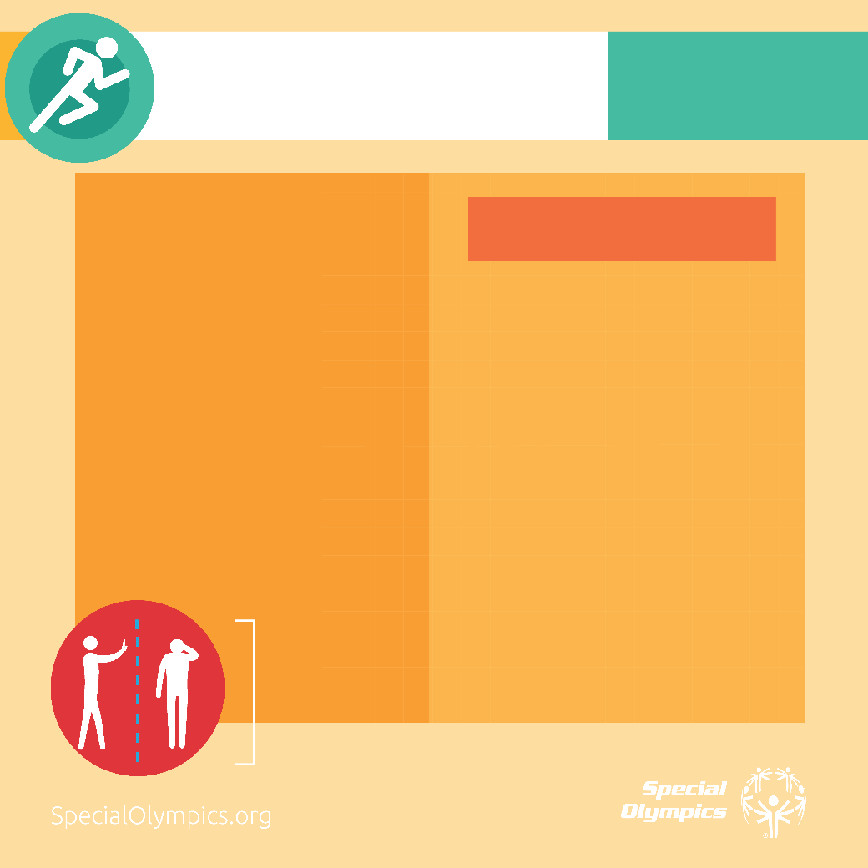
PHYSICAL ACTIVITY
MY GOAL:
Exercise or do physical activity 5 days a week
PHYSICAL ACTIVITY
EXERCISE IDEAS
While practising social distancing
Staying active can keep your body healthy and strong so you are ready when sports practise starts again. Do things that make your heat beat faster and make you breathe harder.
There are many ways to be active at or near the home, even while practising social distancing!
Practice sports drills by yourself or with family
Turn on some music and dance!
Clean your house or do yard work
Walk or jog around your home or neighbourhood
Practice some of your favorite exercises – the next few cards can give you a great workout!
Social distancing
means stay 6 feet or 1.5 meters away from others

Slide 9
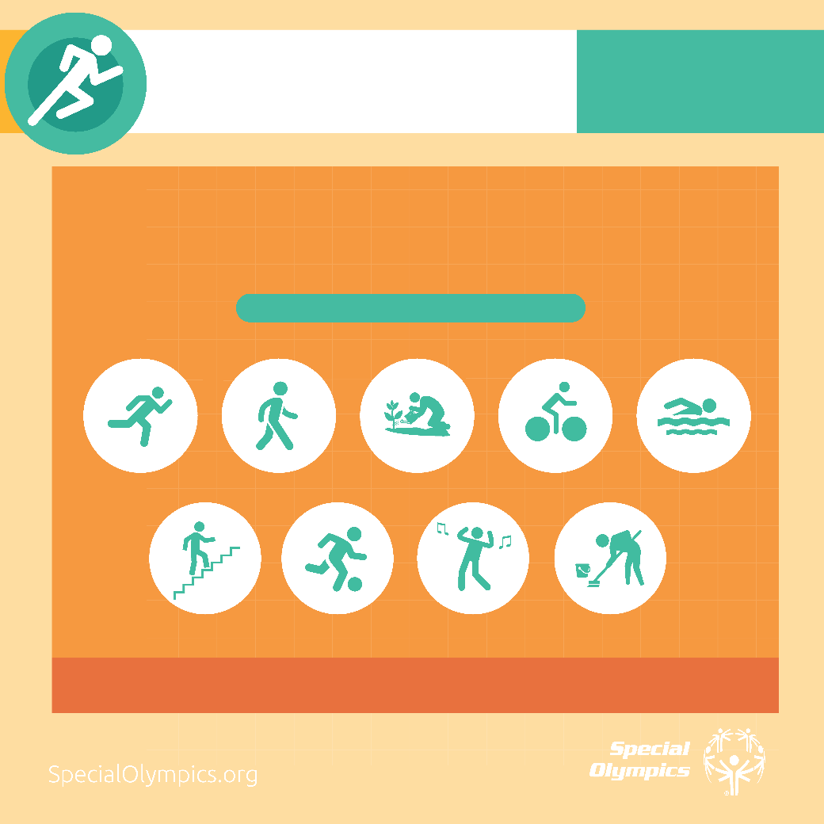
PHYSICAL ACTIVITY
MY GOAL:
Exercise or do physical activity 5 days a week
PHYSICAL ACTIVITY IS ANYTHING YOU DO THAT MAKES
YOU MOVE. IT’S EASY TO FIT PHYSICAL ACTIVITY INTO
YOUR EVERYDAY
What do you like to do to be more active?

Slide 10
PHYSICAL ACTIVITY
MY GOAL:
Exercise or do physical activity 5 days a week
BEING MORE ACTIVE MAKES US HEALTHIER
Improves sleep
Lowers blood pressures
Reduces appetite
Strengthens bones
Improves mood
Helps manage weight
Boosts brain power
Increases energy

Slide 11
Endurance
Do each exercise for 30 – 60 seconds
Repeat 3 times
March or Jog in Place
March or jog while standing in one
spot.
Switch your arms while you switch
your legs.
Go at a steady pace. You can change
your pace to make the exercise
easier or harder.
OR
High Knee Jog in Place
Try to get your knees as high as you
can while you jog in place.
Swing your arms the whole time.

Slide 12
Endurance
Do each exercise for 30 – 60 seconds
Repeat 3 times
Quick Punches
Stand with your feet a little
wider than your shoulders. Bend
your knees slightly.
Turn toward your left side. Punch
your right arm in that direction.
Return to the center with both
hands in fists by your chest and elbows
down by your side.
Now, turn toward your right side.
Punch your left arm in that direction.

Slide 13
Endurance
Do each exercise for 30 – 60 seconds
Repeat 3 times
Jumping Jacks
Jump up and spread your legs apart as you
swing your arms over your head.
Jump again and bring your arms back to
your sides and your legs together.
OR
Forwards Jacks
Stand with one foot in front of the other
and your arms down by your sides.
Jump up and switch your feet. Swing your
arms over your head.
Jump back to the starting position.

Slide 14
Strength
Do 10 – 20 of each exercise, then move to the next one
Repeat 3 times
Chair Squats
Stand in front of a chair with your arms straight out
in front and your feet apart.
Without using your hands, bend at the knees and
hips until you are seated in the chair.
Stand back up using your legs only.
OR
Squats
Stand with your arms straight out in front and your
feet apart.
Bend at the knees and hips, until it’s like you are
seated in a chair, and then stand back up.
Keep your chest up and your feet flat on the floor.

Slide 15
Strength
Do 10 – 20 of each exercise, then move to the next one
Repeat 3 times
Wall Push-Ups
Stand with hands placed flat on wall at shoulder
level and straight arms. Your feet should be behind
you so that you are leaning on the wall.
Keep your feet in place and body straight. Bend
your arms to bring your chest toward the wall.
Push your arms straight to return to the starting
position.
OR
Push-Up from Knees
See next page
OR
Plank Hold
See next page

Slide 16
Strength
Do 10 – 20 of each exercise, then move to the next one
Repeat 3 times
Push-Up from Knees
Start on your hands and knees. Walk
your hands forward and lower your hips
until your body is straight. Raise your
feet.
Bend your elbows and lower your body
toward the ground until your chest
touches.
Push your body back up to the
starting position while keeping your
body straight.
OR
Plank Hold
See next page

Slide 17
Strength
Do 10 – 20 of each exercise, then move to the next one
Repeat 3 times
Plank Hold
Start on your hands and knees.
Straighten your legs out behind and
put the balls of your feet on the floor.
Keep your elbows straight and your
body in a long line from heels to
head.
Keep your muscles tight and hold this
position for 20 seconds.

Slide 18
Strength
Do 10 – 20 of each exercise, then move to the next one
Repeat 3 times
Curl-ups
Lay on the floor. Bend your knees so
your feet are flat on the floor. Reach
your arms toward your knees.
Bring your head, neck, and upper
back off the ground as you reach
toward your knees. Pause and then
slowly lower back to the starting
position.
OR
Shin Touches
See next page

Slide 19
Strength
Do 10 – 20 of each exercise, then move to the next one
Repeat 3 times
Shin Touches
Lay on the floor. Put your legs
straight up over your hips and your
arms over your head.
Bring your head, neck, and upper
back off the ground as you reach toward your shins. Pause and the slowly
lower back to the starting position.

Slide 20
Balance
Do each exercise for the time or repetitions in the instructions
Repeat 3 times
Single Leg Stance
Stand on one leg with your arms out
to the side.
Try holding this position for
30 seconds.
Note: you can stand near a wall in
case you’re worried you might fall.

Slide 21
Balance
Do each exercise for the time or repetitions in the instructions
Repeat 3 times
Walk on a Line
Find or make a straight line on the
floor.
Put one foot in front of the other.
Walk on the line for 20 steps.
Tip: Change directions if your line is
not long enough for 20 steps.

Slide 22
Flexibility
Practice each stretch for 30 seconds
Repeat for each side
Knee to Chest
Lie on your back and bring your right
knee toward your chest.
Gently pull your leg closer to your
body until you feel a stretch in the
back of your thigh.

Slide 23
Flexibility
Practice each stretch for 30 seconds
Repeat for each side
Overhead Triceps Stretch
Raise one arm and bend your elbow
so that your hand touches your back.
Grasp your elbow with your other
hand and gently pull your arm closer
until you feel a stretch in your upper
arm.

Slide 24
Flexibility
Practice each stretch for 30 seconds
Repeat for each side
Modified Hurdler Stretch
Sit on the floor with your legs straight
out in front of you.
Bend your right knee, placing the bottom
of your foot on the inside of your
left knee.
Bend your hips and reach toward
your left foot until you feel a stretch
in the back of your left leg and the inside
of your right hip.

Slide 25
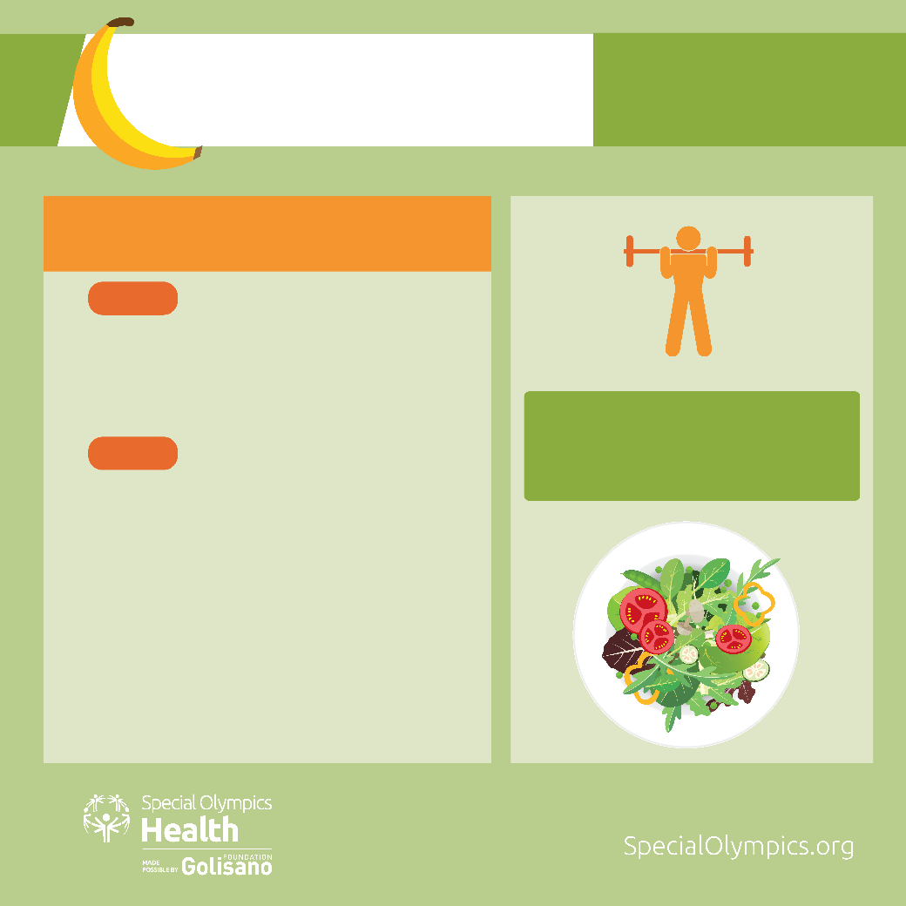
NUTRITION
MY GOAL:
Eat at least 5 fruits and vegetables every day.
I CHOOSE TO EAT MORE FRUITS AND VEGETABLE…
WHY?
They give your body important vitamins, minerals and energy needed for good health.
Provide energy for your sports performance.
TIP:
HOW?
Fresh, local and in season fruits and vegetables are the best
Eat a fruit a day with lunch.
Make half my plate fruits and vegetables every day. Have a salad for lunch.
When I want crunchy foods, I can eat apple slices,
little carrots, celery sticks and snap peas.
Make a fruit smoothie with low fat milk or low fat
plain yoghurt for dessert.

Slide 26
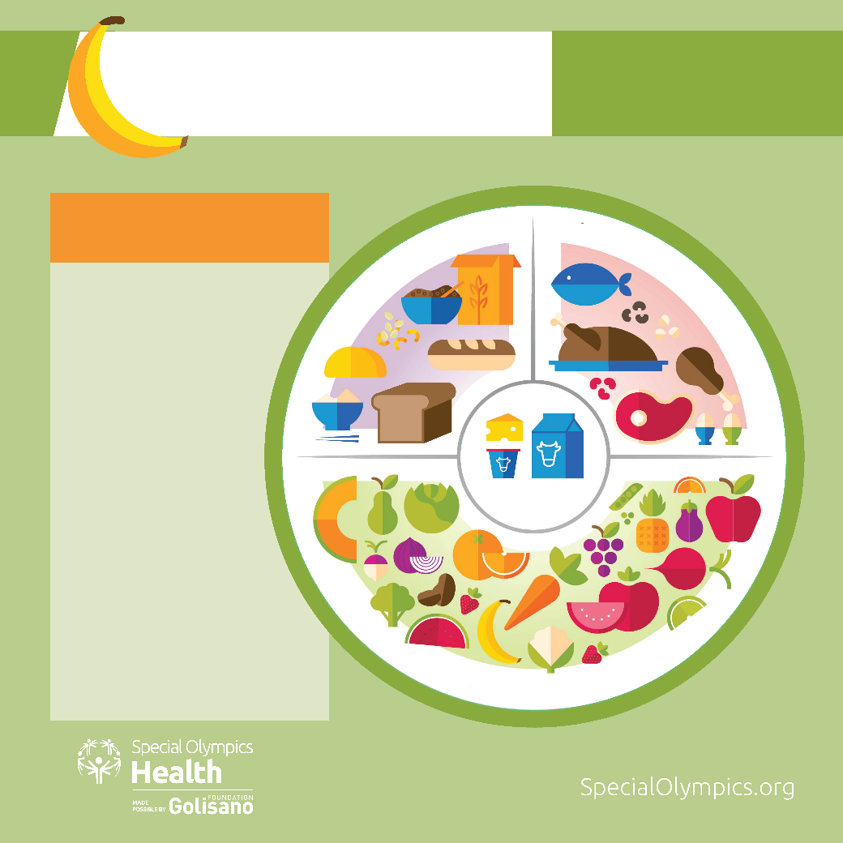
NUTRITION
MY GOAL:
Eat at least 5 fruits and vegetables every day.
CREATING A HEALTHY PLATE
GRAINS
MEAT, FISH, EGGS, AND BEANS
You know fruits
and vegetables
are important
for your health,
but sometimes it
can be difficult to
know what other
foods you should
be eating.
This plate has all
the food groups,
with some
great choices in
each group!
FRUIT & VEGETABLES
DAIRY

Slide 27
NUTRITION
MY GOAL:
Eat at least 5 fruits and vegetables every day.
IT’S EASY EVERY DAY
Make half my plate fruits and vegetables
Include fruit at breakfast
Include a salad for lunch and dinner
Eat a rainbow of colors
Add vegetable to
soups, broth and
sandwiches and other
foods
Plant a vegetable or
fruit garden at home
or in your community
TRACK YOUR DAILY 5 FRUITS AND VEGETABLES IN YOUR FIT 5 TRACKING TOOL

Slide 28
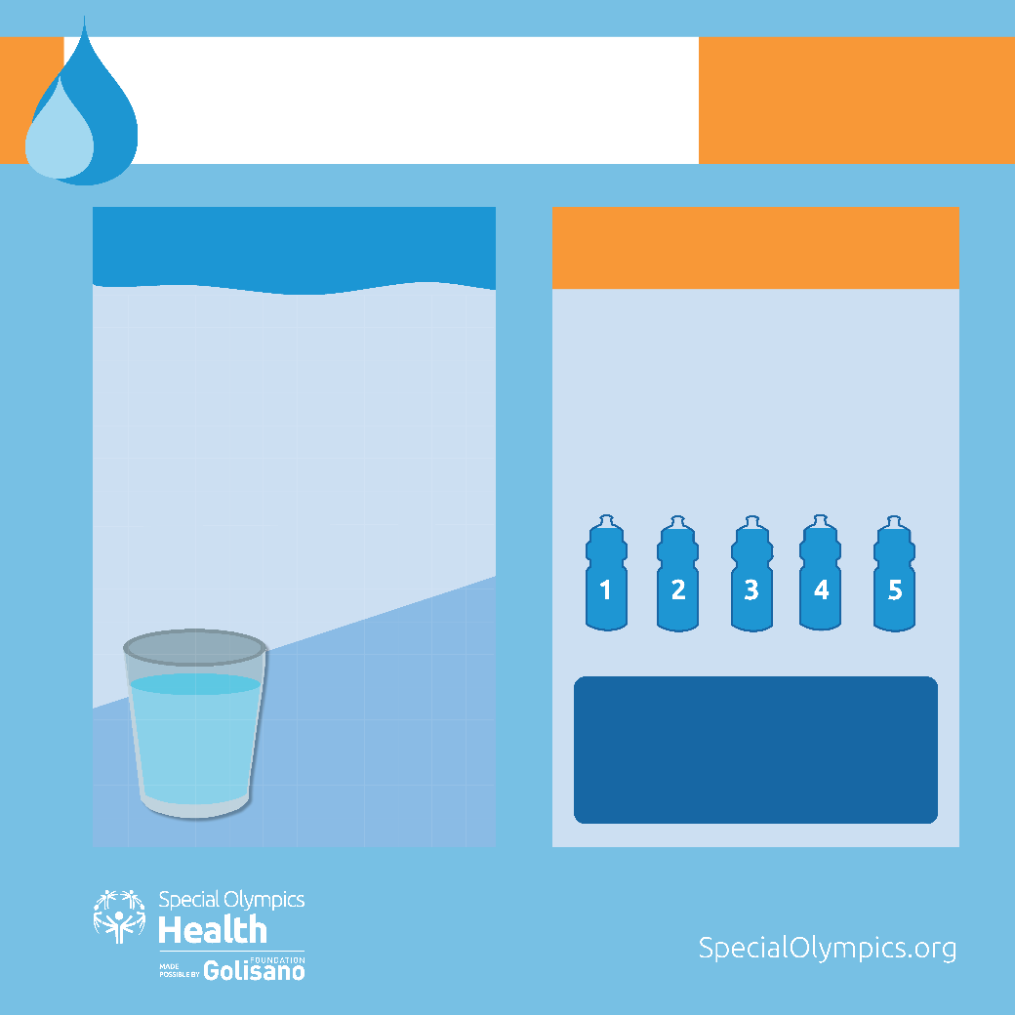
HYDRATION
MY GOAL:
Drink 5 bottles of water every day
WHY HYDRATION IS IMPORTANT
WATER FOR HEALTH AND SPORT PERFORMANCE
Your body needs water to keep it
working properly
You lose water every day when you go
to the bathroom, sweat and even when
you breathe
You need to replace the water you
lose so you stay healthy, hydrated and
perform at your best
Drink enough water throughout the
day to stay hydrated
Your bottle should be 16 - 20 ounces
or 500 - 600 ml
Water is
the best
choice for
hydration!
TIP:
Drink out of a sports water bottle -
they are refillable and can hold the
right amount of water

Slide 29
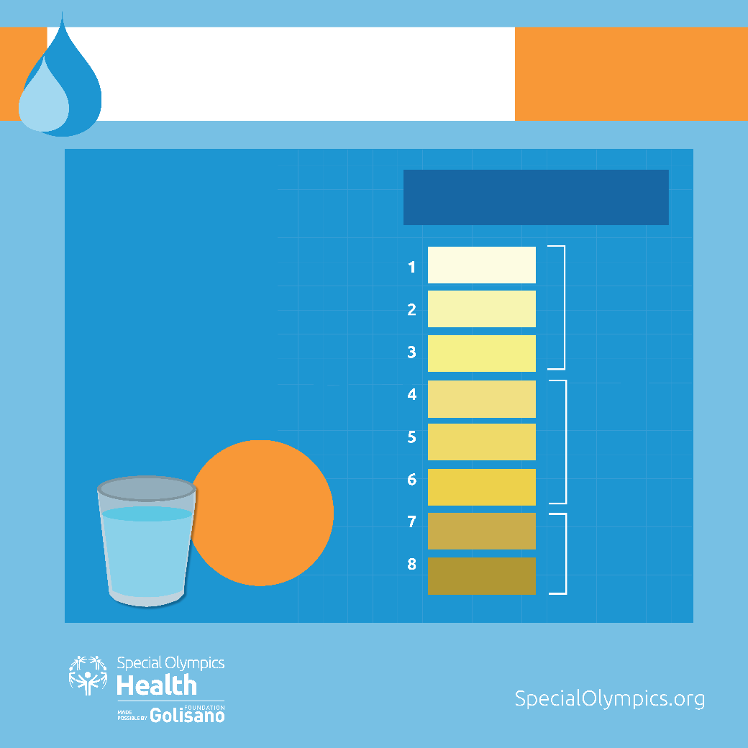
HYDRATION
MY GOAL:
Drink 5 bottles of water every day
SIGNS OF DEHYDRATION
URINE CHART
You feel thirsty
Hydrated
You are tired or sluggish
Keep up the good work!
You have a headache
You mouth is dry
Your urine is dark yellow or brown
Dehydrated
Drink water.
Drink water right away, slow down and cool off
Very Dehydrated
Drink water. See
a doctor, if your
urine continues
to stay this color.

Slide 30
Tips for keeping a
Strong Mind
CONNECT WITH OTHERS
GET 8 HOURS OF SLEEP
STAY ACTIVE
Text, call or video chat friends, team mates, coaches and family
Avoid caffeine and technology before bed
Exercise 30 minutes a day most days of the week
EAT HEALTHY FOODS
USE STRONG MINDS STRATEGIES
ASK FOR HELP
Text, call or video chat friends, team mates, coaches and family
Try deep breathing,
Stretching/yoga and thinking positive thoughts
Contact your medical provider if you feel overwhelmed

Slide 31
Healthy
Sleeping Tips
LESS SCREEN TIME
AVOID CAFFEINE BEFOREBED
SLEEP ROUTINE
Try limiting the use of technology (like TV, smart- phones, and computers) for at least 30 minutes before bed
Don’t eat or drink any caffeine for at least 4 hours before bed. Caffeine can be found in coffee, tea, chocolate, and cola
Create a routine by going to bed and waking up at the same time every day and doing relaxing activities before bed (read a book, take a warm bath, do some stretches/yoga, listen to music, or meditate
GOOD SLEEPING SPACE
CALMING ACTIVITY
DAILY EXERCISE
Your sleeping space should be dark and be a comfortable temperature
If you have trouble falling asleep try a calming activity. For example: listen to music, meditate, think positive thoughts, deep breathing, or use a stress ball.
Exercise is important, but not right before bed. Finish exercise at least 3 hours before bedtime to help you fall asleep faster.

Slide 32
What you need to know
SYMPTOMS
COUGH
SHORTNESS OF BREATH
OR AT LEAST TWO OF THE BELOW SYMPTOMS
REPEATED SHAKING WITH CHILLS
MUSCLE PAIN
HEADACHE
CHILLS
SORE THROAT
FEVER
NEW LOSS OF TASTE OR SMELL

Slide 33
What you need to know
CALL YOUR HEALTHCARE PROVIDER IF YOU
HAVE ANY OF
THESE SYMPTOMS

Slide 34
What you need to know
HOW DOES IT SPREAD?
The virus spreads from one person to others through
The air when someone with COVID-19 coughs or sneezes
Respiratory droplets.
These tiny wet drops
spray out when a person
who has COVID-19 coughs,
sneezes or talks
Touching or shaking hands
Touching your eyes,
mouth, or nose after
touching an object or
surface an infected
person also touched

Slide 35
What you need to know
HOW TO PROTECT YOURSELF?
Washing your hands often
with soap and water for
at least 20 seconds
Cover your mouth and nose
with a face covering
when around others
Practice social distancing.
This means stay 6 feet or
(about 2 meters)
away from others
Stay home as
much as possible,
and definitely
when you are sick
Clean surfaces
with disinfectant
Don’t touch your eyes,
nose and mouth with
unwashed hands
Cover your nose and
mouth when you
sneeze or cough

Slide 36
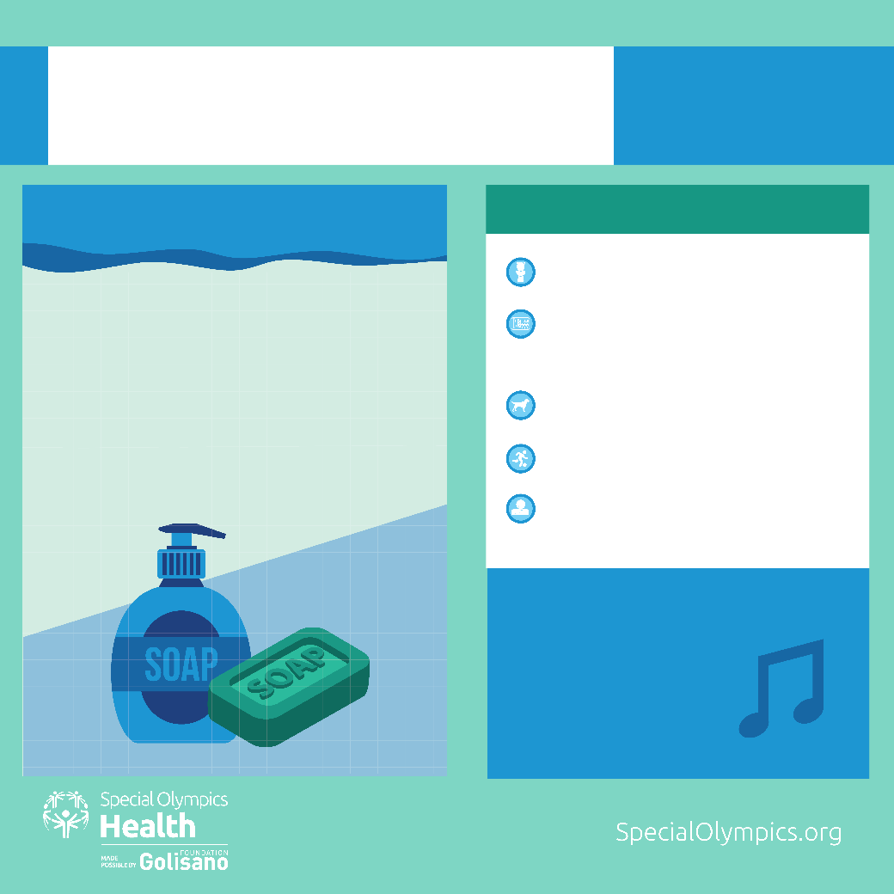
HANDWASHING
MY GOAL:
Have clean hands and
prevent spread of germs
HAND WASHING IS IMPORTANT BECAUSE…
WHEN TO WASH YOUR HANDS
After using the toilet
Before preparing, touching, or
eating food
After playing with animals
After your sports practice
After coughing, sneezing, or
blowing your nose or mouth
Regularly washing your hands with
soap and water can protect you
from illnesses caused by viruses and
Bacteria
It is the best way to stop germs from
spreading
HOW DO I KNOW IF I WASHED MY
HANDS FOR 20 SECONDS?
Sing happy birthday to yourself twice
OR
Sing the alphabet song
to yourself

Slide 37
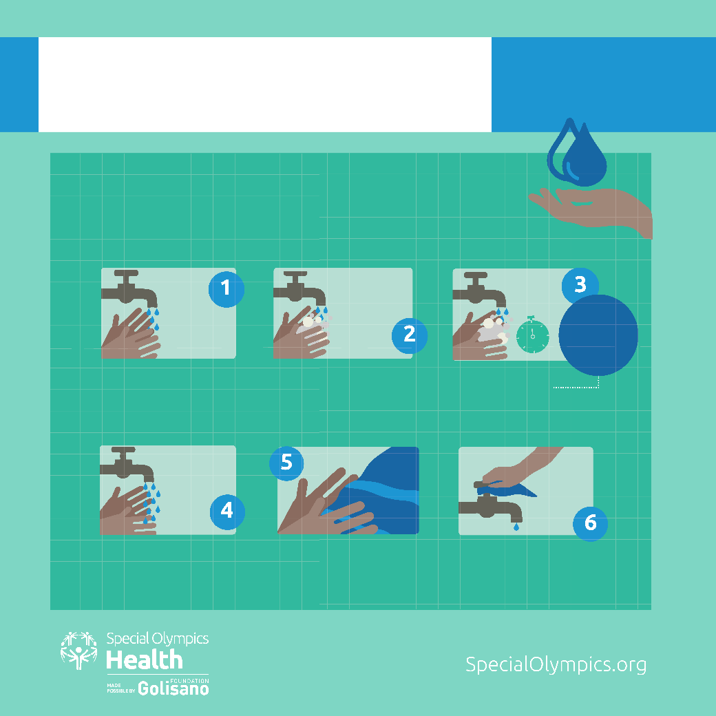
HANDWASHING
MY GOAL:
Have clean hands and
prevent spread of germs
6 EASY STEPS TO
CLEAN HANDS
Don’t forget to
scrub between
your fingers,
under your nails,
and the top of
your hands
WET YOUR HANDS
APPLY SOAP
WASH YOUR HANDS FOR 20 SECONDS
RINSE WELL
DRY YOUR HANDS
TURN OFF WATER WITH PAPER TOWEL

