Slide 1



Family Health Forum
Positive Parenting
This work was supported by Award Number NU27DD000021, funded by the Centers for Disease Control and Prevention.
Its contents are solely the responsibility of the authors and do not necessarily represent the official view of the Centers for Disease Control and Prevention or the Department of Health and Human Services.
Notes:
Note:
This slide deck is to guide the facilitator in the presentation and activities for the FHF on Parenting with Purpose.
Each slide includes a sample script.
Facilitator notes and commentary appear in this section on every slide
Adapt the slides, language, text, and images to suit your local context.
The Bold and italic sentences highlight key themes that should be presented, even when you adjust for your audience.
Remember to collaborate with local parenting and caregiving experts when adapting content, to ensure it reflects appropriate practices for your context.
About the Slides:
This deck includes content for children and youth (birth to 17 years). You may focus on one age range if preferred:
Young children (birth–7 years): slides 9–12
Middle childhood (7–12 years): slides 13–16
Adolescence (13+ years): slides 17–20
Say: (housekeeping and norms)
Before we get started, a few housekeeping needs:
In person Forum
Location of toilets/washrooms
Snacks or drinks
Other logistics
Virtual Forum:
Announce any scheduled breaks
Share how participants can respond/express themselves in the chat, raising hand, etc.
Remind participants to have their workbook ready (printed in advance or open on screen)
Materials:
Participant workbooks or a notebook to write in
Virtual forum: Ask participants to print the workbook in advance or show workbook questions on-screen so they can record responses in a separate notebook
In-person forum: Ensure space in the room for movement and small group activities

Slide 2

Introductions
2
Notes:
Say:
Welcome to our Family Health Forum! we are looking forward to talking about parenting today.
Before we begin, let’s get to know each other a bit.
Let’s go around and introduce ourselves.
In addition to your name, also tell us something unique that your child does that makes you smile.

Slide 3
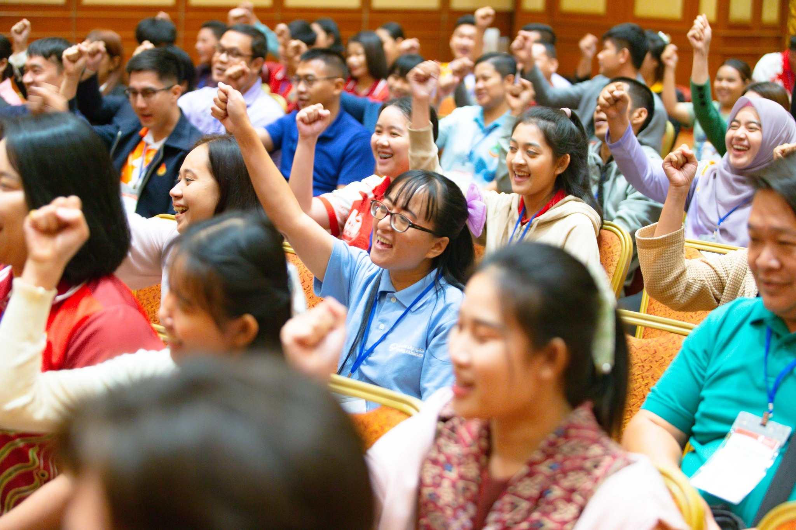
Family Health Forums:
Family Health and Wellbeing
FHFs focus on the whole family
Build connection with other families
Build connection with service providers
Our ways of working:
Respect
Active listening
Judgement free zone
Confidentiality
3
Notes:
Say:
Thank you for sharing, we will start with some background about Family Health Forums.
The goal is to reduce health disparities for people with intellectual disabilities (ID), and we know we can’t do this without supporting the whole family!
This space is for families to come together and support each other’s health and wellbeing.
Together, we will learn about health challenges and how families can work together to address them.
We also connect with other families and service providers to build support networks.
To make this a welcoming space, we will follow 4 principles during our time together:
We RESPECT each other’s opinions and recognize that we may all be at different stages of caring for ourselves.
We use ACTIVE LISTENING to stay fully present and give each other our undivided attention.
We are a JUDGEMENT-FREE zone – we recognize that we each bring unique experiences to this Forum.
We believe in CONFIDENTIALITY – we agree to keep private what is shared and discussed here
We are here to learn from and with each other – feel free to ask questions.
Before we begin our topic today let’s discuss why health is important for our athletes and their families.

Slide 4
Did you know?
Individuals with intellectual disability…
Have limited access to critical health services and resources to improve their health.
Are 2 times more likely to be obese
More likely to experience premature death from preventable health conditions.
Have higher rates of chronic health conditions like obesity, diabetes, asthma, and cardiovascular disease.
4
Notes:
Family Health Forums are one way that Special Olympics works to engage family members and provide tools and resources to support whole families’ health and wellbeing.
These Forums are important because we know that health has a substantial impact on the quality of life for people with ID and their families.
Recent data about Special Olympics athletes has informed us about the health and wellbeing of people with ID
We know that Special Olympics adult athletes are two times more likely to be obese compared to adults without ID
Also, individuals with ID have as many chronic health conditions at 20+ years old as individuals in the general population do at 50+ years old.
Lastly, people with ID often do not have access to critical health services and resources to improve their health and die 16 to 20 years sooner than people without ID due to preventable health conditions.
Health affects each Special Olympics athlete’s ability to train and compete in sports effectively.
Special Olympics recognizes the importance of supporting the health and wellbeing of athlete’s families.
As a reminder, Family Health Forums are one way that Special Olympics works to engage families by providing tools and resources to support health and wellbeing of the whole family.

Slide 5




Overview of the Forum
Building connection
Understanding child development
Self Care for Parents & Caregivers
Tips for managing challenging behavior
Notes:
Say:
Today we are going to discuss Parenting.
While the title of this presentation is Parenting with Purpose, when we use the word parenting, we mean anyone in a caregiving role where they are caring for a young person from birth to adulthood.
This could include siblings, grandparents, other family members, or community members.
This session will take about 90 minutes, and we are going to cover the following topics:
Building connection
Understanding child development
Self-care for parents and caregivers
Tips for managing challenging behavior
We will have a mix of activities, discussion and presentations
We all have something valuable to share and we are here to learn from each others’ experiences as well.
Feel free to share any questions or comments you may have as we go along.

Slide 6
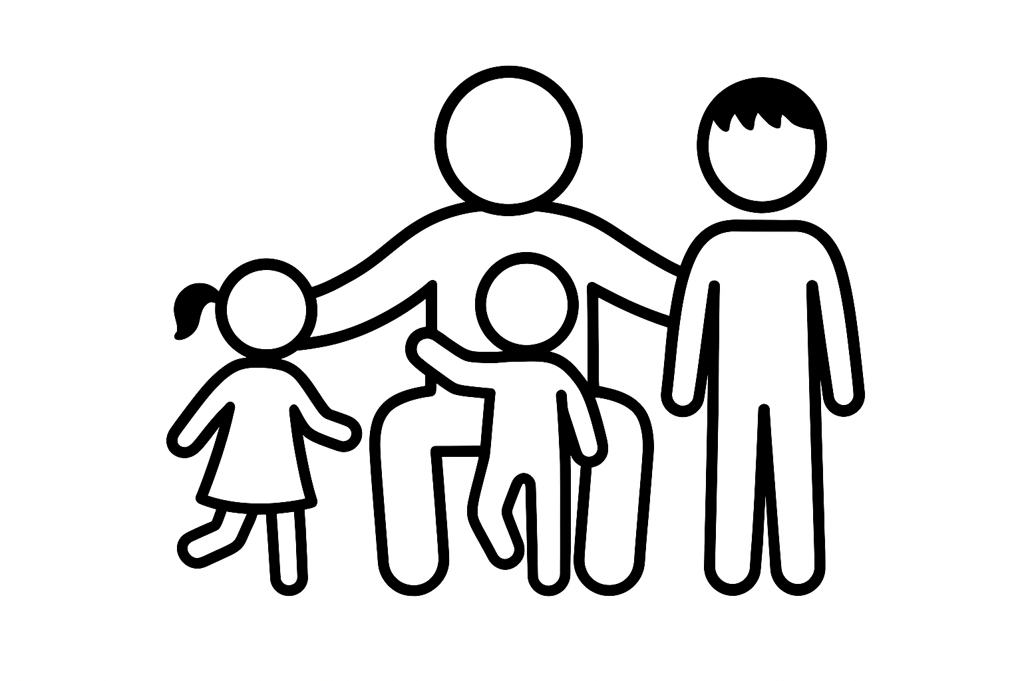
Reflection
What are your priorities in caring for your child?
Workbook page 2
Notes:
Say:
Before we begin let’s take a moment to think about our parenting journeys.
Ask:
What are your priorities in caring for your child?
Notes:
Give participants time to think about their response
Invite volunteers to share their response
Facilitator can also share their response
Say:
Thank you for sharing,
We know that parenting can be hard, there are no instructions and often we are learning from how we were cared for and adjusting along the way
As caregivers for children with ID we have all experienced wonderful moments with our children, and all of us here have also experienced very challenging times.
Also, important to remember is that as parents and caregivers we know our children best, we are the experts in our children and nobody else knows them like we do

Slide 7
How do you connect with your Child?
Strategies for Building Connection
What is 1 way that you connect with your child?
What is 1 thing you enjoy about these moments of connection?
Workbook page 2
Notes:
Say:
To start us off, let’s do an activity to start thinking about connection.
Whether we know it or not, we are already connecting with our children in different ways.
Together let’s discuss the following questions:
Ask:
What is 1 way that you connect with your child?
What is 1 thing you enjoy about these moments of connection?
Note virtual/in-person FHF:
In person FHF – split participants into groups or keep participants together
Virtual FHF – keep participants together

Slide 8
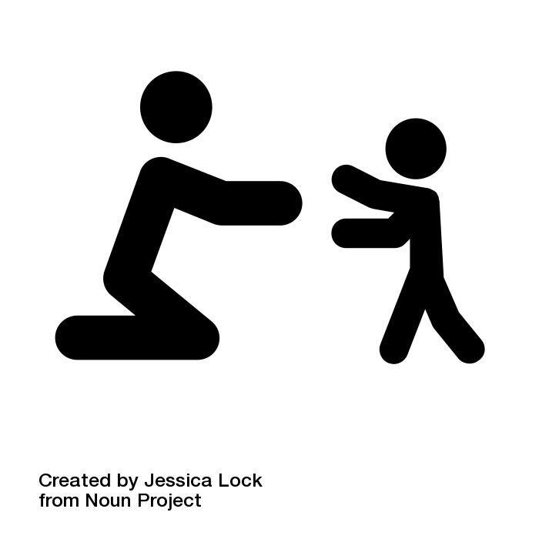

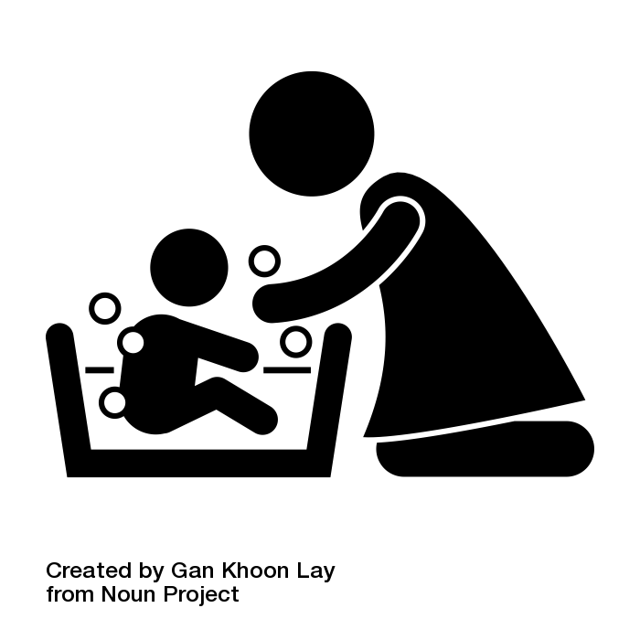
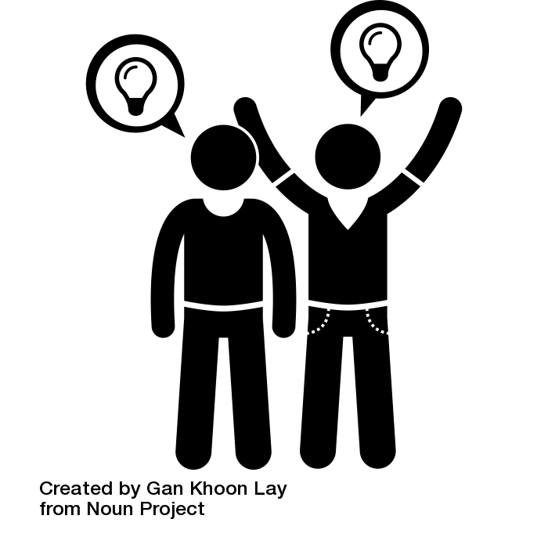

Strategies for Building Connection
Being present, understanding of our children’s needs, and responding their needs appropriately.
Creating special moments together
There is no one way to connect with our children
How we connect with our children can change at different stages of their development
Helps children feel safe, feel important, and feel understood
Helps us understand our child’s unique needs, behaviors and emotions
Notes:
Say:
Thank you for sharing your moments of connection and why they are important to you.
Connecting with our children is about being present and understanding their needs.
Regardless of a child’s age, moments of connection help them feel safe, valued, and understood.
Connection is also about creating special moments and spending quality time together.
These moments can be long or short, and can be with or without words.
There is no single way to connect with our children.
When we think about our children with IDD, it’s helpful to remember that how we connect with them may be different from how we connect with their siblings without IDD and even with other children with IDD.
Observing and trying out different interactions while noticing how our children respond can help us learn what works to connect them.
Remember, sharing small moments together counts just as much as the big moments.
What’s great is that these moments of connection are also good for us!
We feel good knowing that we are supporting our children in the ways that work best for them.
When we connect with our children, we can learn about their unique needs, likes, dislikes, behaviors and emotions.
This also helps us handle challenging situations more calmly.
How we connect with our children changes as they grow; we adjust based on where they are developmentally.
Let’s explore more about connection at different stages of development.

Slide 9
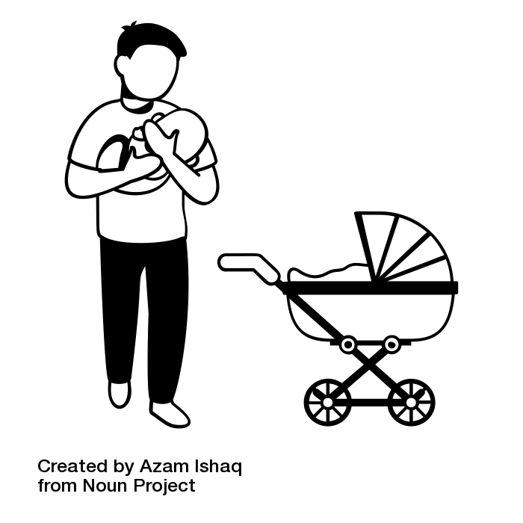

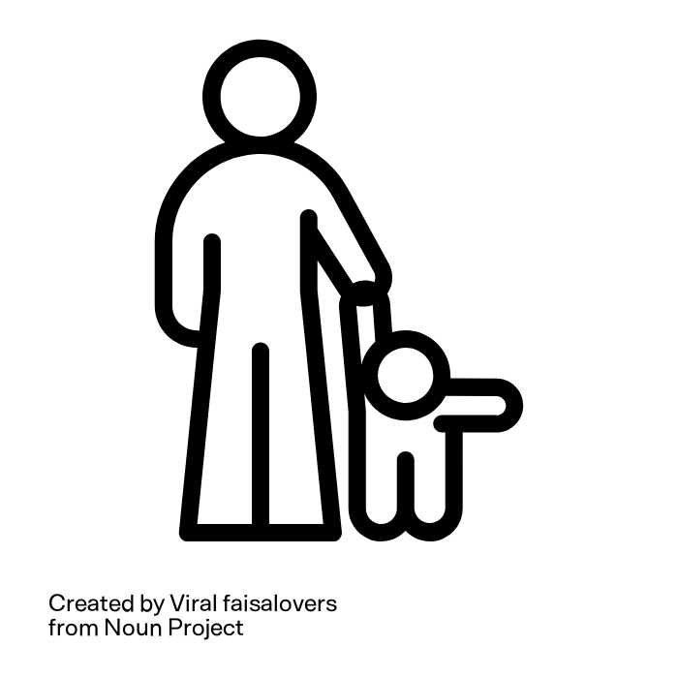

The Early Years: Building Connection
Showing care
Holding baby
Feeding baby
ATTACHMENT
BONDING
Playing
Talking/singing
Exploring items
Following our children’s lead
EXPLORATION
TRUST
Recognizing and responding to our children’s needs
Noticing gestures, words, actions
SAFETY
Notes:
Say:
Building connection with young children is especially important because it is also how we help them learn and grow.
We help our children learn and develop every day when we talk, play, feed, interact, and care for them.
This includes activities like showing care, following our children’s lead and recognizing and responding to their needs.
These simple interactions help our children’s brains develop.
They help building attachment and bonding with adults.
They provide a sense of trust and safety, which also helps encourage exploration and helps our children learn about the world.
Interacting with a child, showing care, recognizing and responding to their needs and interests is a way that we can provide responsive caregiving.
These practices help children feel safe, cared for, and secure.

Slide 10




The Primary School Years: Building Connection
Checking in
Eating together
Connection
Emotional Safety
Shared Joy
Support
Independence
Responsibility
Be present & consistent
Asking questions
What do you think?
How do you feel?
Listen & encourage self expression
Singing
Dancing
Playing sports
Play together
Getting dressed
Cleaning up
Encourage independence
Notes:
Say:
How we show care and build connection can change over time.
Just as each child is unique, every connection is unique.
Here are a few ways we can build connection with children in the primary school years.
Being present and consistent. Children are learning who they can trust: parents, teachers and other community members.
Being present includes things like eating together, checking in and listening to them share.
This regular connection helps build their self esteem and show them that they can rely on us to be there for them.
We can also build connection by listening to children’s feelings and ideas.
This can include asking questions like, What do you think about that? or How did that make you feel?
When we encourage children to express themselves, they feel heard, and this builds their trust and confidence.
It also helps to teach children that their voice/thoughts matters at home and in the world.
Playing together is another great way to connect with children in the primary school years.
Sharing in play and joy from singing, dancing, exploring nature, or other activities helps to build connection through shared experiences.
Encouraging their independence, supporting them to complete tasks with less assistance, helps to build their sense of responsibility and contribution to the larger family wellbeing.

Slide 11

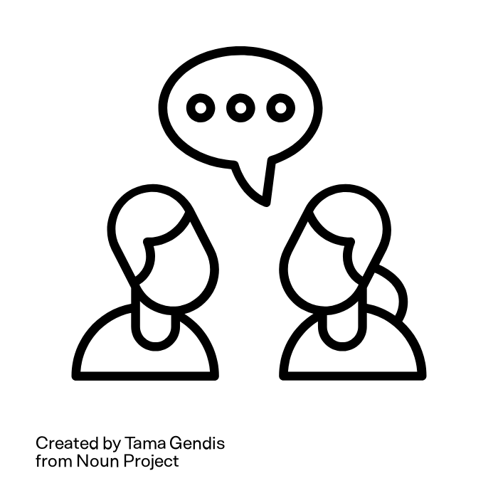
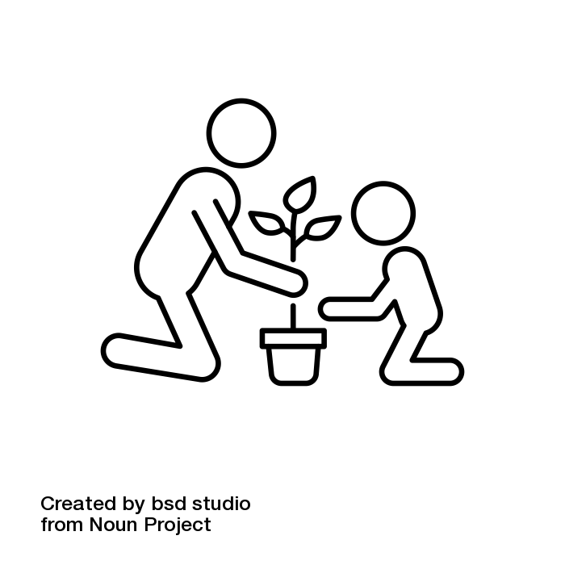
The Teenage Years: Building Connection
Planning activities for family/themselves
Respecting boundaries
Independence
Responsibility
Trust
Respect
Connection
Shared Joy
Responsibility & Autonomy
Listening &
Asking open questions
  What do you think?
  How do you feel?
Be curious
Projects
Gardening, cooking
Following teenagers’ lead
Shared activities
Notes:
Say:
We connect with teenagers by involving them in real-life decisions. Allowing them to take the lead supports their independence and strengthens trust and respect.
We can encourage greater independence by respecting their boundaries. Balancing our involvement helps teenagers grow in independence while still feeling emotionally supported.
Be curious and listen. Ask about their interests or friendships without judgement. Use questions like: “Tell me more about this?” “What do you think?” “How did that make you feel?” “What do you think could have been different?” Allow them to express themselves and listen
Build connection through shared activities. Work on projects together like gardening, cooking, and fixing things. Let them choose the activity and follow their lead. Doing things side by side can allow for more conversations and bonding
Support their evolving interests without judgement. This helps them feel accepted and valued for who they are rather than their achievements and builds emotional resilience and self esteem.

Slide 12
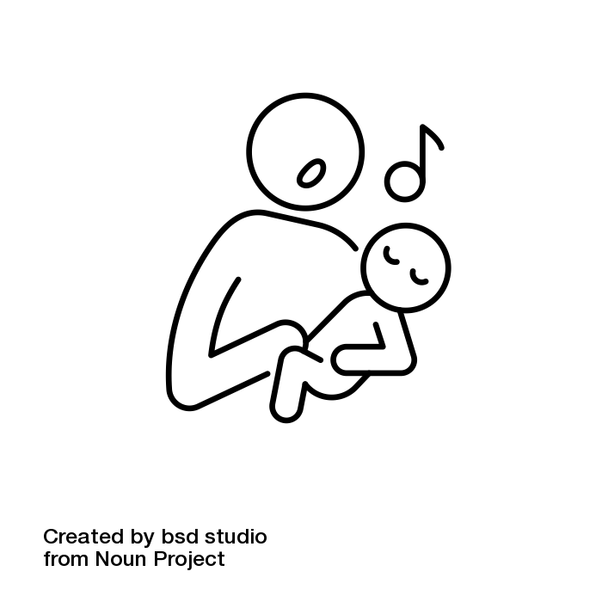
Things to Remember: Building Connection
We have many ways of building connection
Identifying and responding to our children’s signs and needs in the early years builds connection
Moments of connection happen everyday and everywhere
Playing together and sharing activities at all ages helps build connection
When we show and tell our children we value them for who they are it increases their self esteem and builds connection
Notes:
Say:
We have talked about building connection from birth through the teenage years.
Here are a few things to remember about connection:
There is more than one way of connecting with our children.
Moments of connection can vary with different children, families and communities - even between two people with the same intellectual disability .
The focus is meeting our children where they are and celebrating who they are.
Playing together and sharing activities at all ages, helps build connection
When we show and tell our children that we value them for who they are, not just their achievements or abilities, this helps to strengthen their self-esteem and connection during challenging and positive times.
Ask:
Are there other key points about building connection that we can add to this list?
Say:
Thank you for sharing.
Before we close this section on building connection with children and teenagers, let’s take a moment to explore how we can create time for daily moments of connection with our children.

Slide 13

Action Planning for Building Connection
Finding moments of connection:
When can I connect with my child/children?
What is something I can do with them?
Workbook page 3
Notes:
Ask:
Think about your daily or weekly routine.
Is there a time when you can connect with your child/children regularly?
What is one thing you can do? (For example, doing an activity together, asking them to share about their favorite activities during dinner or bathtime)
When and how would you arrange this time together?
Say:
Remember connecting with our children can happen in different ways.
It can also happen without words.
Say (after sharing):
Thank you for sharing
There are so many ways to connect with our children
Whether we use words or no words, they are all important ways of strengthening our relationship with our children
As we think about ways to build stronger connections, it’s also important to understand how children grow and develop, because their needs and behaviors change at every stage.
Let’s explore what that looks like across different stages

Slide 14


The Early Years: Child Development
The Early Years:
Attachment and bonding
Communication beginnings
Sensory exploration
Physical movement
May repeat actions or take longer to try new things
The Preschool Years
More communication
Enjoy playing more side by side or directly with others
Learning about feelings and beginning to understand social rules
Eager to understand themselves, rules the world
May seek to try things on their own, and still prefer being with familiar people
Notes:
Say:
Let’s think about what’s happening for young people from birth through the pre-school years.
We know that all children develop at their own pace and in their own time.
In the early years of life, babies are learning to bond, they rely fully on us for their survival and during this period we form strong attachments with them.
During this period, we also see how skills build upon other skills for example babies make sounds and gestures first and then these develop into words to communicate their needs.
This also works with physical development, before standing babies must have the skill of sitting and before sitting, they must first learn how to hold their head up.
These more advanced skills of sitting independently are built upon smaller skills such as holding the head up
This period in the early years lays the foundation of early skills, setting children up for more complex skills as they grow.
The early years is also a period of exploration.
Young children are exploring the world with all their senses, their eyes, ears, touch, their movements and their sounds.
They may repeat actions as they are trying to learn and master new skills.
After around 3 years, children continue to explore new ways of communication, more gestures, signs, pictures or speech
They may start to enjoy playing with others.
They also begin to learn about social rules such as waiting for their turn.
Exploration continues in more ways as they are excited to understand the world around them.
They may also be excited to try new things on their own.
It is helpful to monitor how our children are developing.
Monitoring development is about observing the skills a child has and is developing in areas such as movement, socializing, play, learning, and interacting with others.

Slide 15
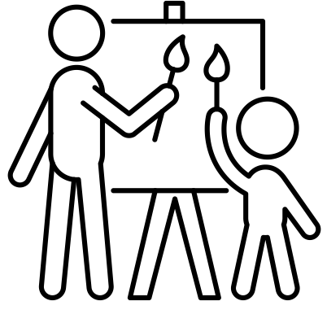
The Primary School Years: Child Development
Developing reading, writing, numeracy skills
Continuing to learn to express themselves in ways that work for them
Starting to solve problems and thinking in new ways
Friendships become more important
Develop their own specific interests
Ways of building connection change over time. Just as each child is unique, every connection is unique.
Notes:
Say:
Let’s review some general skills that may develop after our foundations in the primary years.
This could be different for your child, and that is ok.
Remember development is a journey not a race, skills build upon other skills, and this happens at each child’s own pace and time.
After the foundational skills in early years are laid, children may begin building skills in numeracy, and literacy through play and hands on activities.
Some children may need more time than others to learn these concepts.
During this phase children are continuing to learn to express themselves in ways that work for them like using gestures, actions, words.
Children may start to explore problem solving and thinking in new ways.
Their friends and peer groups may become more important
Children may also start to have specific interests for certain activities.

Slide 16
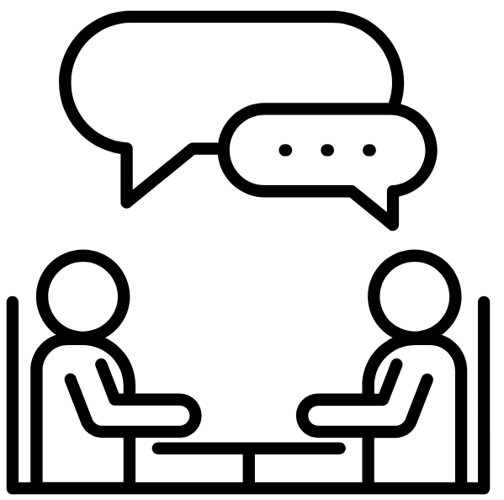
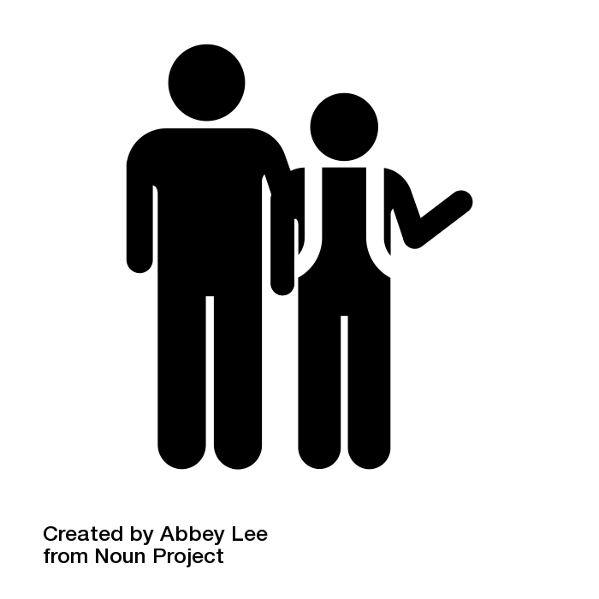
The TeenageYears: Child Development
Growing independence with everyday tasks and social interactions
Thinking about their feelings and their place in the world
Physical and emotional changes
Care about friends, relationships and being accepted
Ways of building connection change over time. Just as each child is unique, every connection is unique.
Notes:
Say:
Now let’s look at some skills we may find in the teenage years.
Remember, this could be different for your child, and that is ok,
Also remember, development is a journey not a race, skills build upon other skills, and this happens at each child’s own pace and time.
As children get older, they may seek more independence in their everyday tasks and or social interactions.
This could be in big or small ways, such as selecting what color t-shirt they will wear, to preparing their own meals.
We can meet our kids where they are and support them with gaining more independence.
Their friends and relationships may continue to be important, and they may care more about being accepted.
They may begin to go through puberty and have physical and emotional changes during this time.
They may also begin to think more about their future.

Slide 17

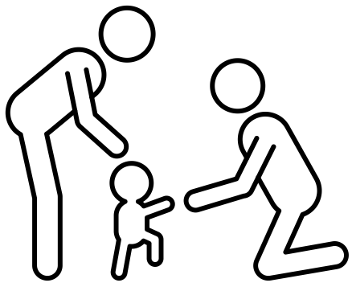

Things to Remember: Child Development
Children develop differently, at their own pace and time – there is no single right path
It’s not about catching up; it’s about understanding and supporting who they are
Skills build upon one another
All children can learn
Some children may need extra support
Notes:
Say:
Let’s review what we have explored about development from the early years to the teenage years
When we talk about child development, we mean the process by which children learn, communicate, relate to others, move their bodies, hands and fingers, and explore their environments with all their senses.
Skills build from simple skills to more complex ones. Early skills are important because they lay the foundation for more advanced skills.
Children learn at different paces. Some children learn quickly, some children need more time. There is a wide range, and this is normal
It is important to remember that all children can learn in their own way.

Slide 18
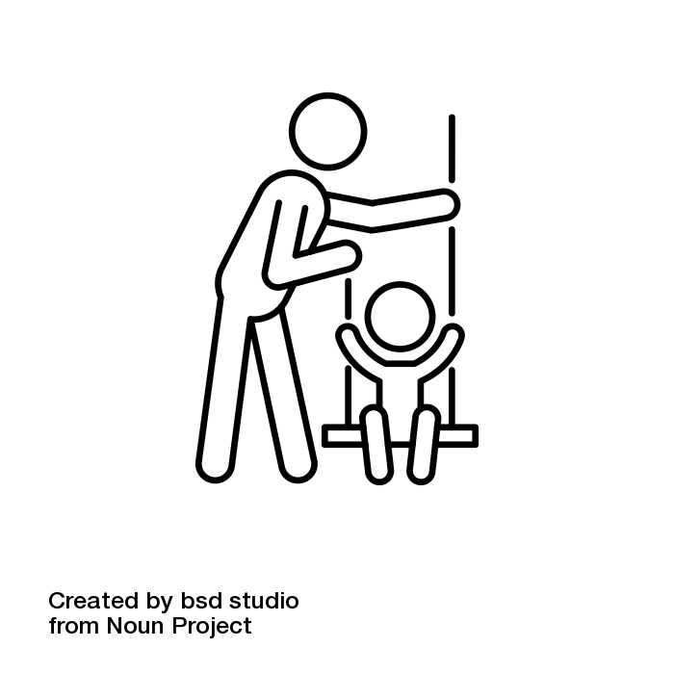
The Early Years: Showing Care
Daily routines provide comfort and security
Create a safe space to explore and try things repeatedly
Help child understand and express themselves
Playing together
Follow their interests
Pictures, stories, songs to understand daily activities and rules
Help them join group games/activities
Practice taking turns and making choices
Build connection by responding to their movements, sounds, and emotions
Notes:
Say:
We know that when we care for young children, we are supporting their development.
During the early years and preschool years, there are many ways that we show care and support development.
Showing that we care helps strengthen the connection with our children.
Remember, this can happen with or without words.
For example, daily routines help build comfort, this could be during feeding, bathing or bedtime.
We also show comfort through our physical touch, talking or singing with babies and toddlers.
We review their signs, sounds or gestures for communication and help them learn ways to express themselves.
We play and do activities together like reading, signing and other games.
We follow their lead, and we build connection.
Remember that connection can happen even with children or adults who are non-verbal.
We can respond to sounds, body movements, facial expressions, or even gestures.
Think about a child who really enjoys the sensation they receive when they are on a swing.
In this example, moments of connection could happen while pushing them on a swing or swinging them in your arms.
Let’s move now to building connection during this primary school years.

Slide 19
The Primary School Years: Showing Care
Help them learn in different ways
Praise their efforts rather than results
Build friendships through play or shared interests
Teach them to express themselves when they need something
Encourage them to complete activities of daily living on their own
Play and connect together through shared activities
Notes:
Say:
There are also many ways that we show care and support development for children in the primary school years.
You can Support their learning in different ways through reading, pictures, hands on activities, stories, movement.
Praise their efforts rather than their results, no matter how small.
For example, I noticed how hard you worked running today. You kept going even when you were tired, and you kept trying to pass the ball to your teammates. That kind of teamwork and persistence makes a great player.
Help them build friends through play or shared interests like sports, music or other activities
Continue to support their self expression so they can ask for what they need
Play and connect doing shared activities with them that they enjoy

Slide 20
The Teenage Years: Showing Care
Include them where possible in decisions and planning
Talk about growing up, feelings, body changes, safety and relationships
Help them learn life skills
Play and connect with them doing activities they enjoy
Notes:
Say:
We can show care and support the development of teenagers by:
Including them in decisions and planning for the family or household.
Encouraging them to make their own decisions.
Talking about body changes and growing up, seek support if needed for these conversations.
Helping them learn life skills like cooking, talking to new people, using transport services
We can also build connection with them by playing together and doing activities they enjoy

Slide 21

Activity: Showing Care
How do you/others around you show care for children and adolescents in your home or community?
What are some examples?
Can you think of 1 example of showing care that is non-verbal?
Workbook page 3
Notes:
Say:
Let’s explore what showing care is like in our homes and among other families in our community.
You will have a few minutes to discuss the following questions:
Ask:
How do you show care for your children in your home? If you do not have young children in your home, think about the families in the community, what have you observed about how others show care for young people?
What examples do you have and why do you think it is important?
Can you think of 1 example of showing care without using any words?

Slide 22

Self Care for Parent & Caregivers
Caregiving is filled with wonderful moments of shared play and connection
Caregiving also has challenging moments
Caring for a child with intellectual or developmental disability can be challenging
When we care for ourselves first,
we are better able to care for others
Notes:
Say:
While we can have moments of wonderful connection
We also have very challenging moments with our children.
Caring for children is not easy.
Caring for a child with ID also has its own challenges.
As parents we play an important role in our children’s lives
However, we can only care for others when we care for ourselves first.

Slide 23
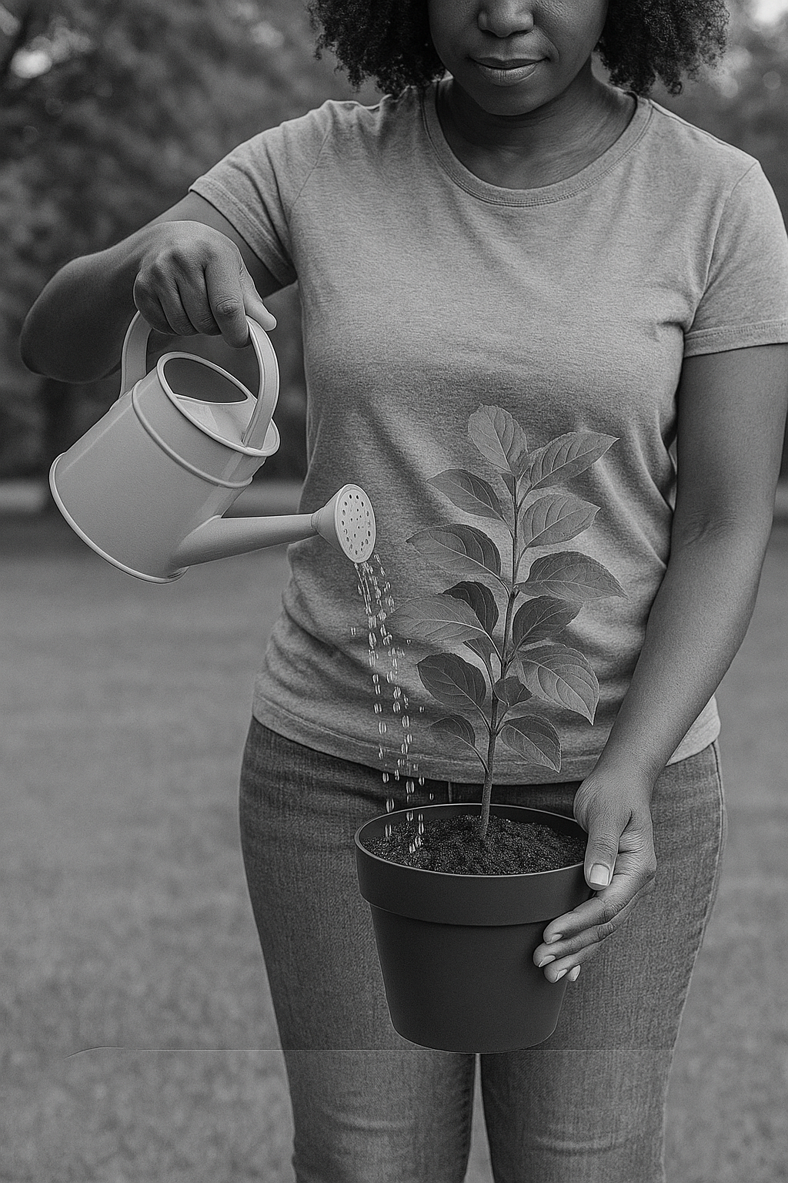
Check Your Self-Care Energy Level
Check your self-care energy
A healthy tree can support many birds, provide fruit and shelter.
A withered tree helps no one.
We cannot care for others if we have nothing to give
Notes:
Ask:
Have you heard the sayings ‘you can’t pour from an empty cup’ or ‘ put your own oxygen mask on first before helping others’?
What do these sayings mean to you?
Say:
As caregivers, we often give so much of ourselves to others or to other responsibilities.
These activities can deplete our energy.
When we have given too much or taken on too many draining tasks, our self-care energy can run low.
At that point, we are unable to give to others effectively.
Imagine yourself as a tree that provides shade, fruit, and shelter for others.
Without water, sunlight, and nutrients, even the strongest tree will wither.
Self-care is like giving the tree water, fertilizer, and sunlight.
A healthy tree can support many birds, provide fruit for years, and offer shelter.
But a withered tree cannot help anyone.
Without self-care, our energy runs low, and we can’t give to others.
Stress and draining activities are part of life and sometimes unexpected.
Balance depleting activities with joyful or nourishing ones.
Recharging daily helps us stay calm, energized, and supportive.

Slide 24

Reflection: Nourishing Your Tree
Identify 1 self care strategy to try the next month to “nourish your tree”.
  What will you do?
  When will you do it?
  How will you make yourself available for it?
  Who can you share this with to support and encourage you?
Workbook page 4
Notes:
Say:
Let’s explore how we take care of ourselves, just like a tree needs water, sunlight, and nutrients to stay strong.
Take a few minutes to think of 1 realistic way that you can “nourish your tree” when your energy feels low.
Select one strategy that you can try for the next month and commit to it
Think about what works best for you and your family.
It does not have to be something very big, what is important is that it is realistic and doable
Ask:
What are some things you currently do or things you would like to start doing to manage stress and challenges that come into your life? (time in nature, reading, walking, talking to friends)
Can you select 1 realistic strategy to try for the next month?
Notes:
Ask for any volunteers to share
Facilitator can also share
Say (after sharing):
When we take care of ourselves, we are better equipped to manage difficult moments such as challenging behavior.

Slide 25

Reflection: Challenging Behavior
What comes to mind when you think about challenging behavior?
Notes:
Say:
Sometimes our children have challenging behavior that is difficult to manage.
Ask:
What do you think of when you think about challenging behavior?

Slide 26
Reflection: Challenging Behavior
Think about a child who hits, cries, and kicks when it is time to stop doing their favorite activity.
What are some of the hidden strengths in this behavior?
Notes:
Say:
Underneath some challenging behaviors are also hidden strengths.
Challenging behaviors often serve a purpose
At times, the behaviors that frustrate us the most can be signs of emerging skills in need of guidance and direction.
When we pause to reflect, we may discover the hidden strength, need, or skill that is trying to emerge.
Think about a child who hits, cries and kicks when it is time to stop their favorite activity.
Ask:
What are some of the hidden strengths that this child is showing with this behavior?
Say:
Thank you for sharing
Some additional hidden strengths could be passion, deep focus, strong interests and persistence.

Slide 27
Introduction to Challenging Behavior
All behavior is a way of communicating
Every behavior has a reason behind it
Challenging Behavior:
Any behavior that makes it difficult for a child to learn, connect or participate in everyday activities
A way a child communities a need or feeling when they do not yet have the words or skills to express it differently
Notes:
Say:
Let’s look further at behavior.
We know that all behavior is a form of communication.
It is how we try to connect with others to share our wants and needs
Every behavior has a reason behind it. When we do something; there is always a ‘why’.
Challenging behavior can be defined as any behavior that makes it difficult for a child to learn, connect with others, or participate in everyday activities.
Challenging behavior can be a child’s way of communicating a need or feeling when they don’t yet have the words or skills to express it differently.
Let’s look at the main reasons or functions of the behavior or the why behind a behavior.

Slide 28
Functions of Behaviors
Main functions of behavior:
To get attention
  I want attention from someone
To get something
  I want that thing
To avoid something
  I want to leave
For sensory or internal reasons
  This behavior feels good inside me
All behavior is a way of communicating
Every behavior has a reason behind it
Notes:
Say:
There are 4 main reasons why we do things:
To get attention: sometimes people act a certain way to get others to notice them like a child screaming to get a caregiver to look at them.
To get something, like a book, or toy, something tangible
To avoid something or someone
For internal feels
Ask:
Can you think of a behavior your child does to get your attention?
Say:
Another reason we do things is to get access to something, like a book, a toy, something we can touch.
Ask:
Can you think of a behavior your child does to get access to something?
Say:
The third reason for behavior is to avoid something. For example, a student may get up from their desk, so they do not have to do their classwork
Ask:
Can you think of a behavior your child does to avoid something or someone?
Say:
The last reason we do things is for sensory or internal reasons. Some behaviors feel good to us inside; they help us stay calm. For example, tapping your foot, spinning, or fidgeting with a pen.
These behaviors are things we do for ourselves to help us feel a certain way.
Ask:
Can you think of a behavior your child does for their own sensory or internal reasons.
Say:
Let’s look at 3 examples to deepen our understanding about the different reasons behaviors occurs.

Slide 29

Activity: Functions of Behavior
Throws tantrums when asked to stop an activity
Peter loves playing with balls. When his grandmother says it’s time to stop, he screams, throws the balls and sometimes hits himself.
What could be the function, or reason, for this behavior?
Workbook page 5
Notes:
Ask:
What could be the function of this behavior?
Attention? Does Peter want attention from someone?
Access? Does Peter want to get something?
Avoidance? Does Peter want to avoid putting the balls away?
Internal distress? Does Peter have an internal feeling he is trying to meet?
Say:
Peter’s behavior is because he wants access to something, he want to keep playing with the balls.
The reason for this behavior is because Peter wants something.
His reaction isn’t just about ‘bad behavior’—it’s a sign he needs more support dealing with transitions from something he really enjoys.
His parents and caregivers can help him transition from an activity he enjoys by giving him visual cues, timers, and warnings to remind him about the transition and minimize his distress.

Slide 30

Activity: Functions of Behavior
2. Uses aggression to communicate
Sam has limited verbal language. When he is told it is time for homework, he screams, runs away and throws objects across the room.
What could be the function, or reason, for this behavior?
Workbook page 5
Notes:
Ask:
What could be the function of this behavior?
Attention? Does Sam want attention from someone?
Access? Does Sam want to get something?
Avoidance? Does Sam want to avoid putting the balls away?
Internal distress? Does Sam have an internal feeling he is trying to meet?
Say:
For Sam, aggression may be his way of saying: ‘I need something,’ or ‘I don’t feel safe or in control.
Exploring alternative ways for him to communicate — like visuals or sign language — could reduce the need to use aggression.
The reason for Sam’s behavior is because he wants to avoid doing homework.
His reaction to the homework, may be his way of saying “no” to his homework.
His parents and caregivers can explore different ways for him to communicate, like using visuals, or sign language to share when he doesn’t want to do something.

Slide 31
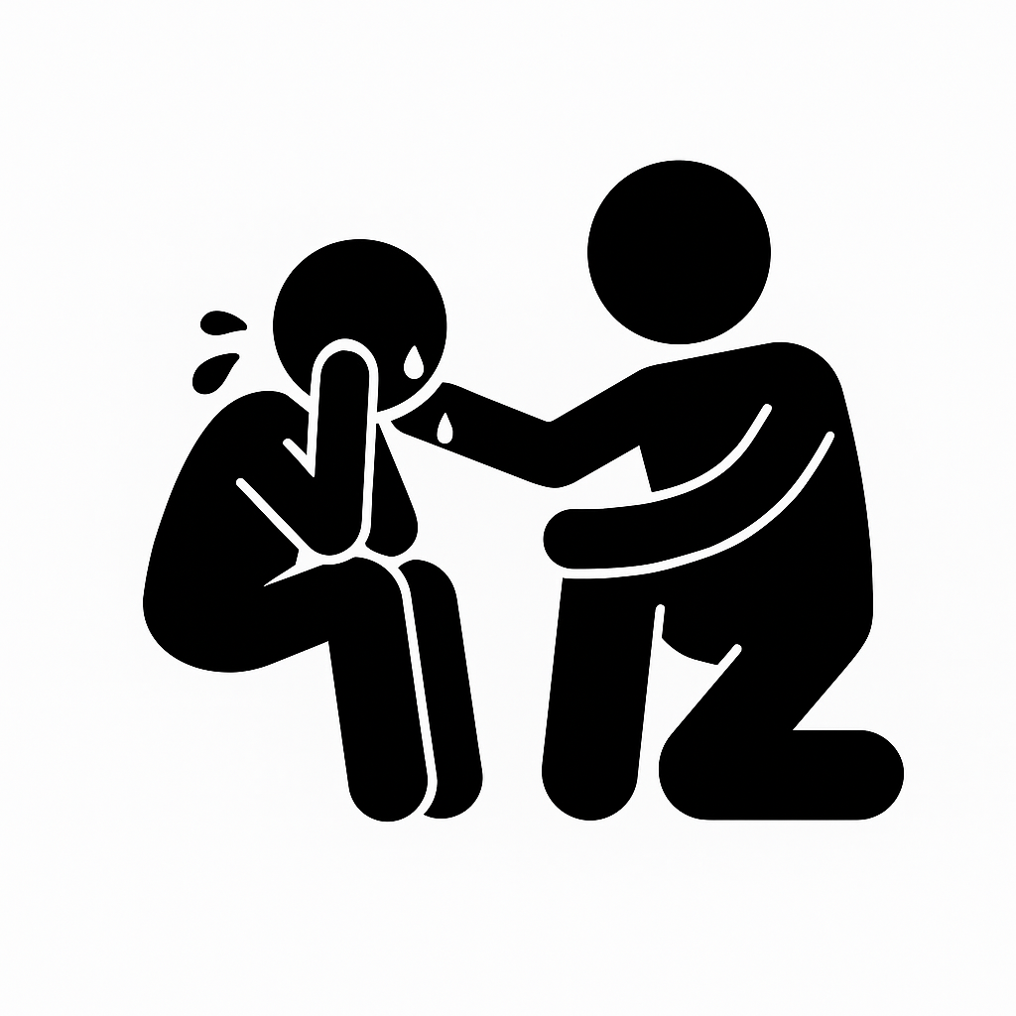
Activity: Functions of Behavior
3. Avoids new people or environments
Tetu becomes very distressed in unfamiliar environments. When visiting a new clinic, she clung to her mother refusing to enter the room and she began crying and covering her ears.
What could be the function, or reason, for this behavior?
Workbook page 5
Notes:
Ask:
What could be the function of this behavior?
Attention? Does Tetu want attention from someone?
Access? Does Tetu want to get something?
Avoidance? Does Tetu want to avoid putting the balls away?
Internal distress? Does Tetu have an internal feeling he is trying to meet?
Say:
The reason for Tetu’s behavior may be the loud or different sounds at the new clinic that she was not used to.
For some children, especially those with sensory sensitivities, unfamiliar places can feel scary and uncomfortable.
Tetu might also be trying to protect herself from the sounds by covering her ears.
Tetu’s parents and caregivers may explore using headphones or other devices to reduce the sounds in a room, giving Tetu gradual exposure to new place, reading social stories and having predictable routines.

Slide 32

Teaching new skills to replace challenging behavior
Identify another behavior/skill to replace the challenging behavior
Praise helpful behavior
Track and monitor the challenging behavior
Notes:
Say:
When we understand why a challenging behavior may be happening, we can also identify what skill our child might need to replace the challenging behavior.
We can do this by asking ourselves the following questions:
Is there another behavior to teach my child that can replace the challenging behavior?
Is there a new skill that would help my child communicate their wants in a more helpful way?
New skills could be:
teaching our children to use non-verbal communication such as gestures, pictures to communicate.
practicing waiting for something or someone.
finding other ways to sooth ourselves.
We can create games and practice the new skills when everyone is calm, rather than when the challenging behavior is occurring.
If we cannot teach the new skill, it is important to seek help from our support networks.
Additionally, to maintain the new skills it is helpful to praise the child when they show the new skill
It is also helpful to track and monitor the challenging behavior to see if there are any changes with the duration or number of times the challenging behavior occurs.
Let’s look at teaching a new skill with an example.

Slide 33
Activity: Replacing Challenging
Behaviors
Identify the missing skills & teach replacement behaviors
Review 1 example of challenging behavior
Identify some skills the child can learn that would help them express their wants in more helpful ways?
Workbook page 5
Notes:
Say:
Let’s explore teaching new skills to replace challenging behavior.
We will review 1 example of a challenging behavior to identify some skills the child can learn that would help them express their wants in more helpful ways.:
Note:
Facilitator can ask a volunteer to share a scenario in advance.
Facilitator can also create their own scenarios in advance that are contextually relevant. Include a child profile, objective, and description of behavior.

Slide 34
Activity: Replacing Challenging
Behaviors
Uses aggression to communicate
Jon has limited verbal language. When he wants a snack or when he’s told it’s not snack time, he hits, screams, or throws objects across the room.
What do you think is a hidden strength underneath this behavior?
What is one new skill or behavior that Jon can learn that can replace the throwing behavior?
Workbook page 5
Notes:
Say:
Let’s look at this example of Jon. When he wants a snack, he hits, throws and screams.
We can guess that Jon’s behavior is because he wants to get access to a snack.
Ask:
What do you think is a hidden strength underneath this behavior?
What do you think is a skill that would help Jon better communicate that he wants a snack instead of screaming, hitting or throwing?
Possible responses:
Hidden strengths: Jon knows what he wants, he’s persistent, and he’s motivated to communicate his needs.
Skills to build: Using words, pictures, or gestures to request; practicing “asking first”; or learning calm replacement strategies.
These responses are based on experiences and observations. This is not an exhaustive list—other strengths and skills may apply.

Slide 35

Quick tips: addressing challenging behavior in the moment
Stay calm
Remember you know how to connect with your child
Stop and think
Respond to their behavior
Notes:
Say:
Thank you for sharing!
When we think about why behaviors occur it can help us make changes and reduce the challenging behavior from occurring.
While this is helpful, we still need to address challenging behavior when it happens, in the moment.
Here are a few strategies for dealing with challenging behavior in the moment.
Stay calm, take some deep breaths
Remember you know how to connect with your child
Stop and think about the why
What is this behavior about? To get something or someone’s attention, to avoid something or to feel a certain way inside
If possible, to respond to the behavior
Can you move child to a safe space and wait for them to calm down?
Can you give attention or help them ask for the item they want?
Can you give them a break if they are trying to avoid something and help them to request a break?
Can you provide a safe or alternative activity that will offer an alternative sensation in the body?
Ask:
What other suggestions do you have about managing challenging behavior in the moment?
What has worked for you and your family?
Say:
Thank you for sharing your suggestions.

Slide 36
Key Points: Parenting with Purpose
Children develop differently, at their own pace and time – there is no single right path
Child development is not about catching up, it’s about understanding and supporting who a child is
All children can learn, skills build upon one another
Some children may need extra support to help them learn, communicate, move and interact with others
We can strengthen our connection with our children by recognizing and responding to their signs and interests in the early years
When we connect with our child’s interests we can identify when a challenging behavior may occur and prepare for it
Our wellbeing as caregivers is important; to support our children’s development, we also must be healthy and have ways of managing stress
Notes:
Say:
Before we close, let us summarize the key points from our session today.
Say:
Children develop differently, at their own pace and time – there is no single right path
Child development is not about catching up; it’s about understanding and supporting who a child is
All children can learn, skills build upon one another
Some children may need extra support to help them learn, communicate, move and interact with others
We can strengthen our connection with our children by recognizing and responding to their signs and interests in the early years
When we connect with our child’s interests we can identify when a challenging behavior may occur and prepare for it
Our wellbeing as caregivers is important; to support our children’s development, we also must be healthy and have ways of managing stress
Ask:
What are you taking away from this session?

Slide 37




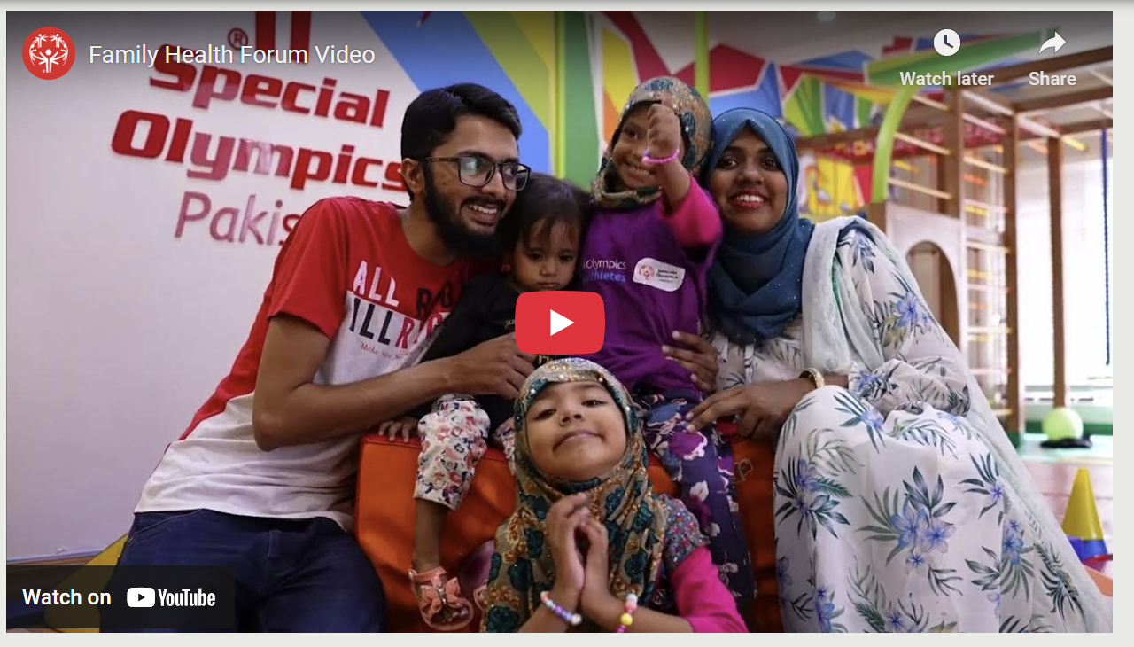
SO RESOURCES
Young Athletes App
Fitness Through Sport Playbook
Strong Minds (Mental Health) Resources
Healthy Start
Family Health Forum – Managing Stress & Building Resilience
Notes:
Say:
Thank you for your participation today.
Before we close, here are a few recourses that exist within Special Olympics that can support us on our parenting and caregiving journeys.
These include:
The Young Athletes App
Healthy Start Toolkit
The Homeplay activities from the Fitness Through Sport Playbook
Strong Minds Resources
The Parent and Caregiver Stress Management Family Health Forum (Managing Stress & Building Resilience)

Slide 38
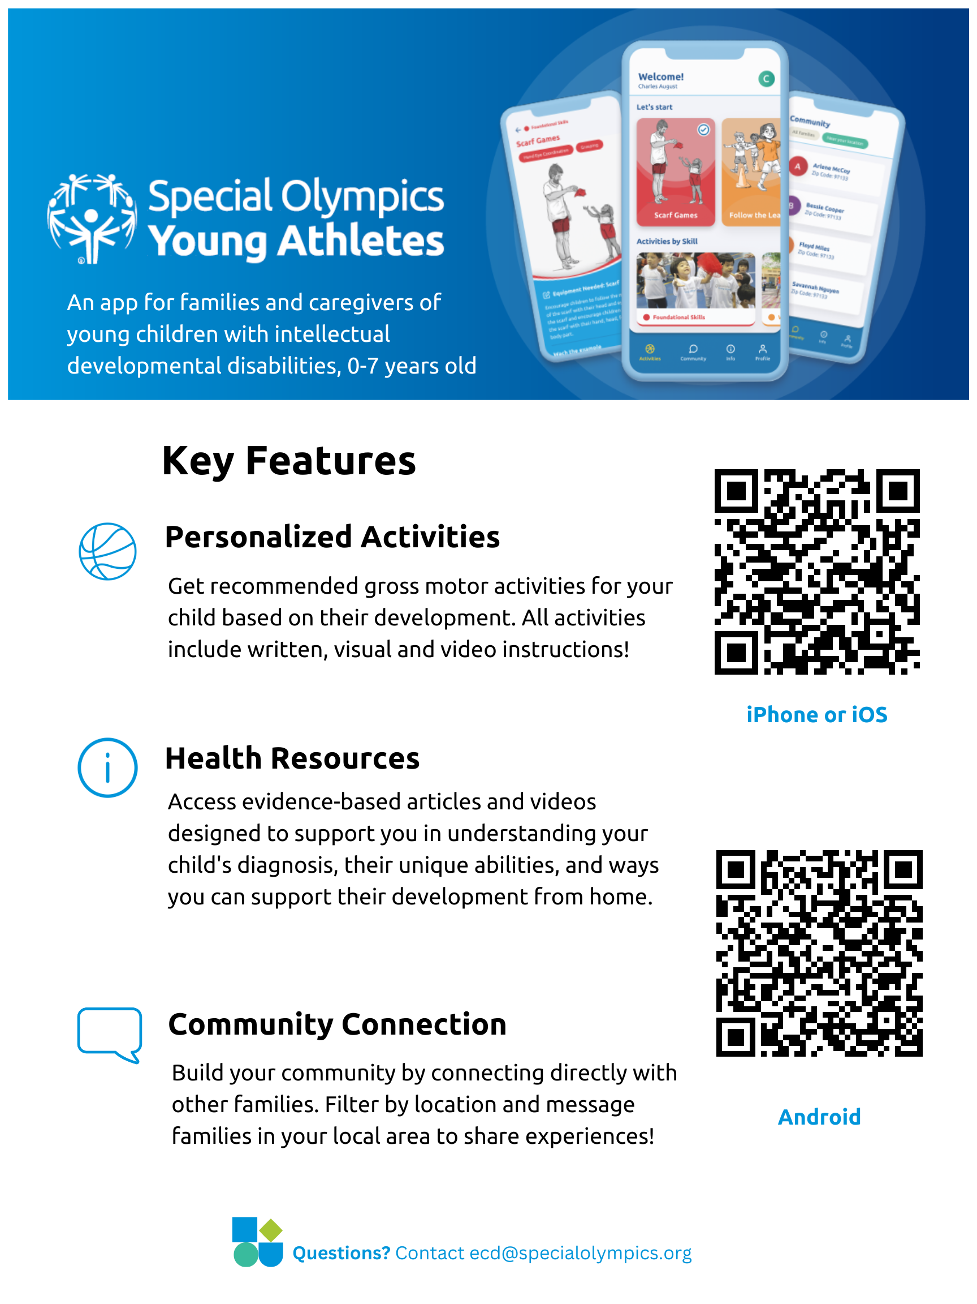
Notes:
Say:
The Young Athletes App provides activities, resources, and connections to support families of young children with and without intellectual disabilities.
After completing your child’s profile, you will receive suggested activities based on your child’s individual skills that you can complete at home and on your schedule.
In addition to activities for your child, the community section allows you to connect directly with other families to discuss shared experiences, exchange information and build a network.
The QR codes provided will take you to where you can download the app today.

Slide 39

Questions
Notes:
Say:
Before we close, let’s have some time for questions and discussions.
Ask:
Does anyone have any questions or outstanding challenges?
Notes:
This is the time to address any outstanding questions or concerns from participants
Start off by responding to the challenges and questions that participants shared at the beginning of the session.
Remember to answer as thoroughly as possible
If relevant you can also ask other participants if they have suggestions to share
Leverage your community partners, and /or topic experts to help you respond to questions.
If there are questions you are not able to respond to, be honest and if feasible do the following:
Refer individuals with that concern to community partners – have names and contacts for these referral partners
Take note of the question and tell the participants you will inquire about the answer and get back to them (be sure you have the capacity to do this follow up)

Slide 40
Thank You!
SO Program Team
Contact Us:
Name:
Tel:
Email:
Other
Contact Us:
Name:
Tel:
Email:
Other
Contact Us:
Name:
Tel:
Email:
Other
Contact Us:
Name:
Tel:
Email:
Notes:
Notes:
To close the meeting, thank participants for their participation and attendance
Share contact information for participants to ask further questions or to learn more
Include contacts for the Special Olympics program staff as well as for community partners
This may be a good time to invite community partners to share a bit about their services and how attendees can access them.
Ask participants to complete the FHF evaluation

Slide 41
Some helpful tips
Size 12 font is great for printed materials. Size 24 (at a minimum) is good for the body copy on PowerPoints.
Bold and colorful text is helpful to bring attention to a point or topic.
Titles can go in the bar above. To add interest and variety in slide, feel free to use the slide layout with the bars on the side and bottom. That layout is great if you have extra room on the slide and feel like you need to fill up space.
Utilize the icon library and high-quality photos to keep PowerPoints engaging!

Slide 42








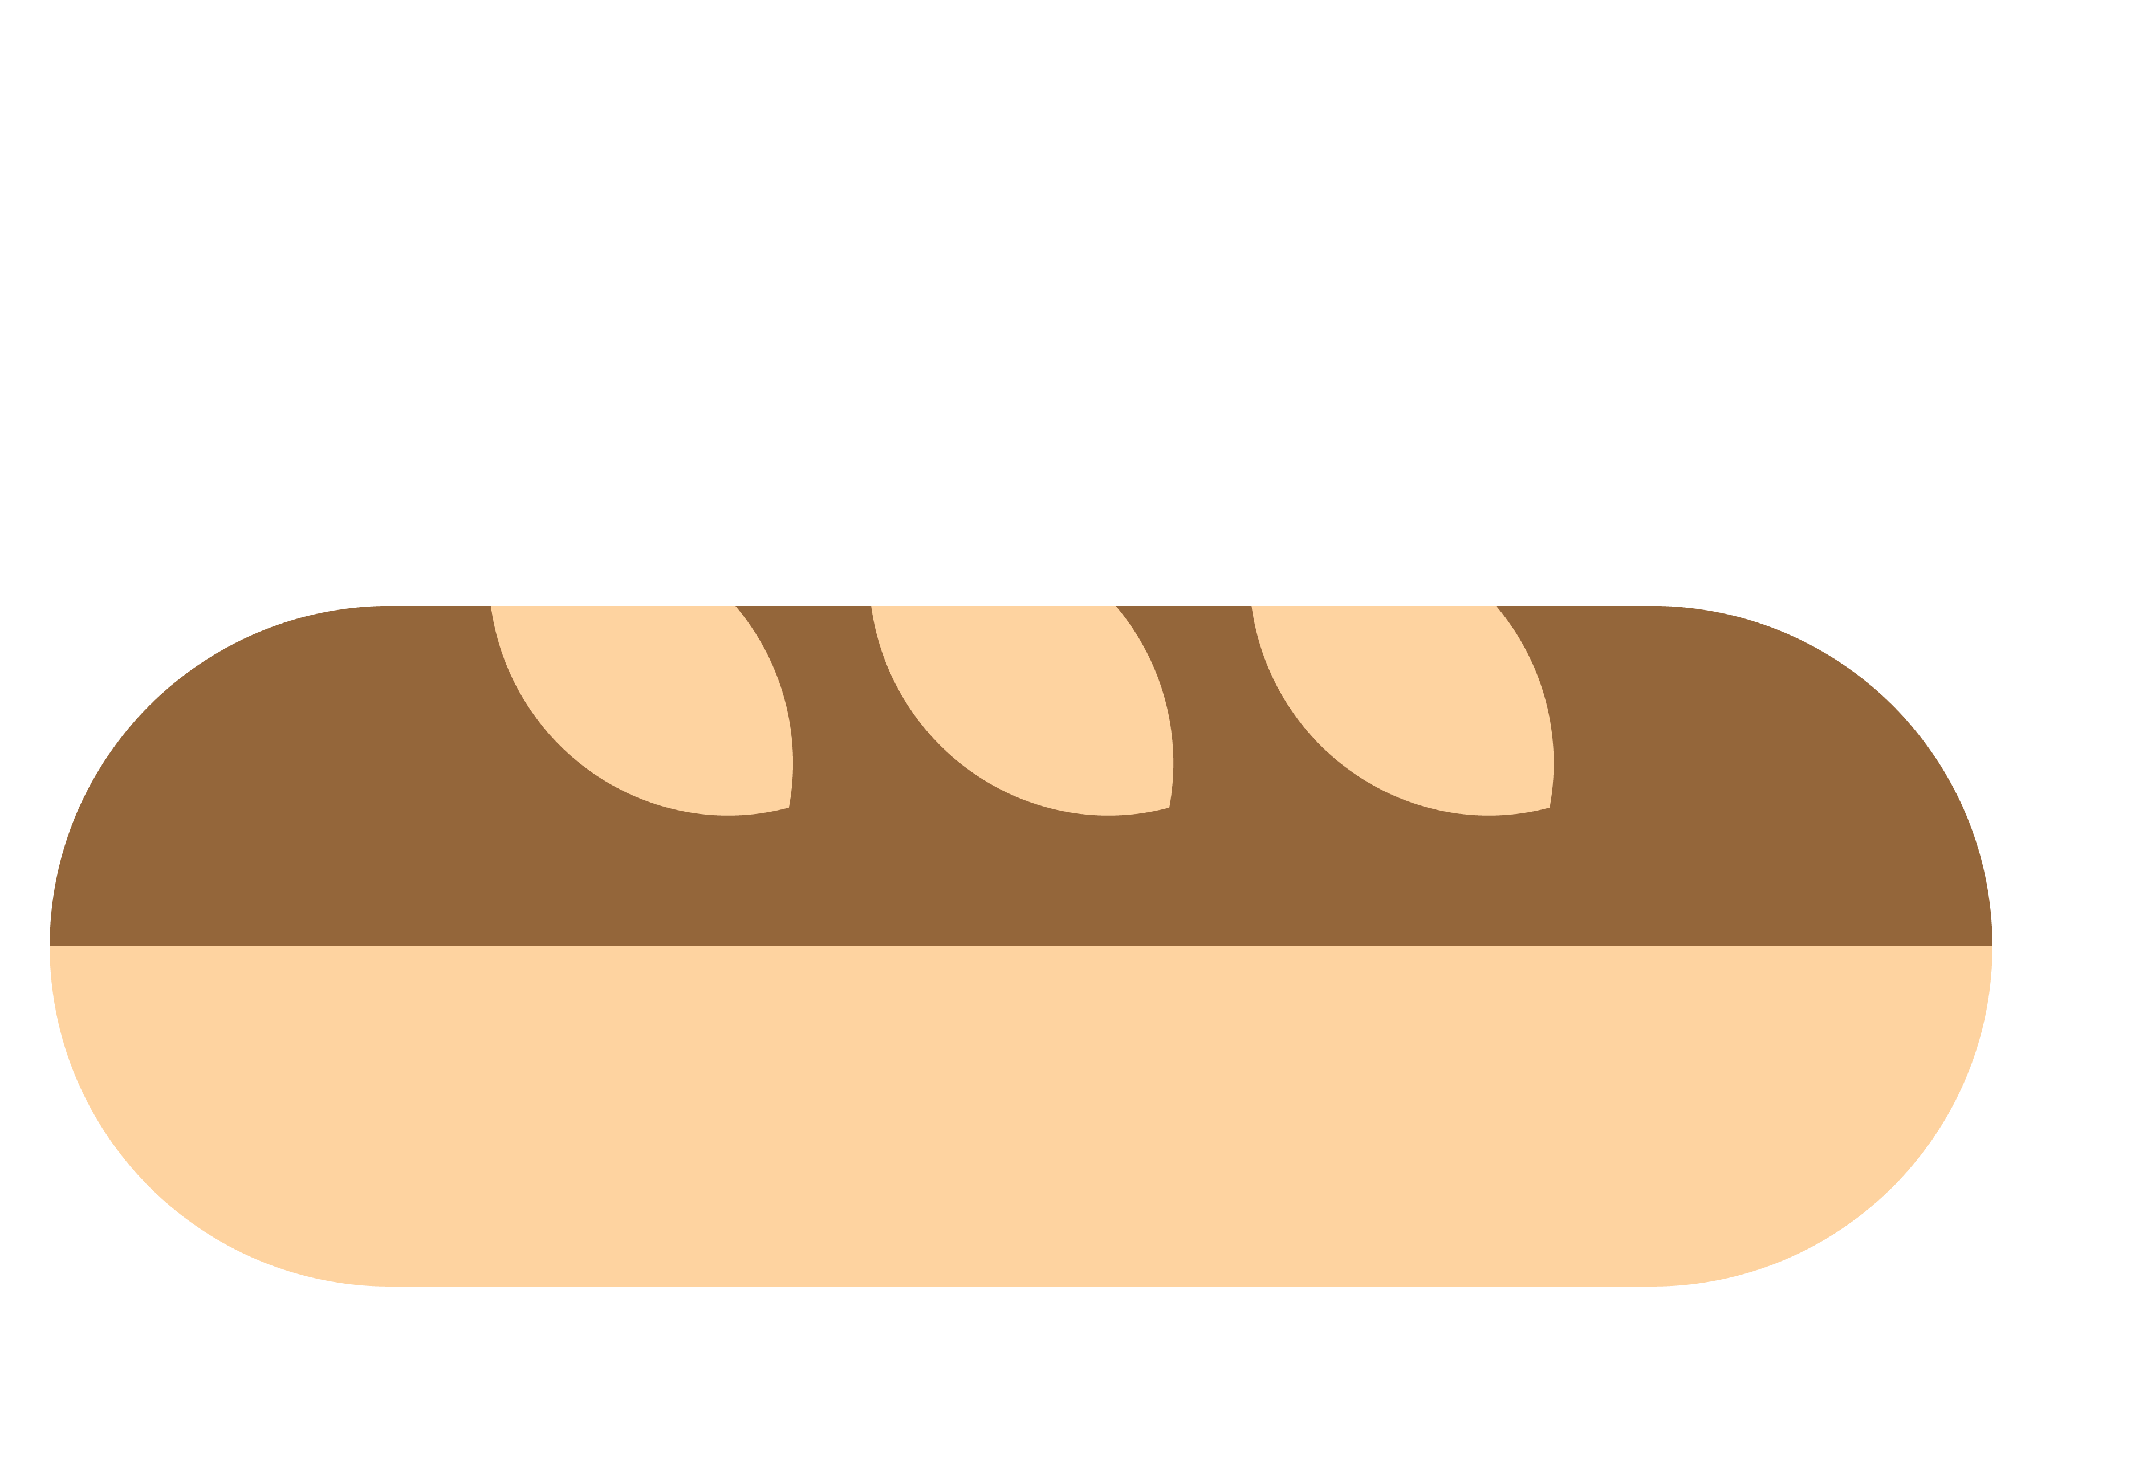







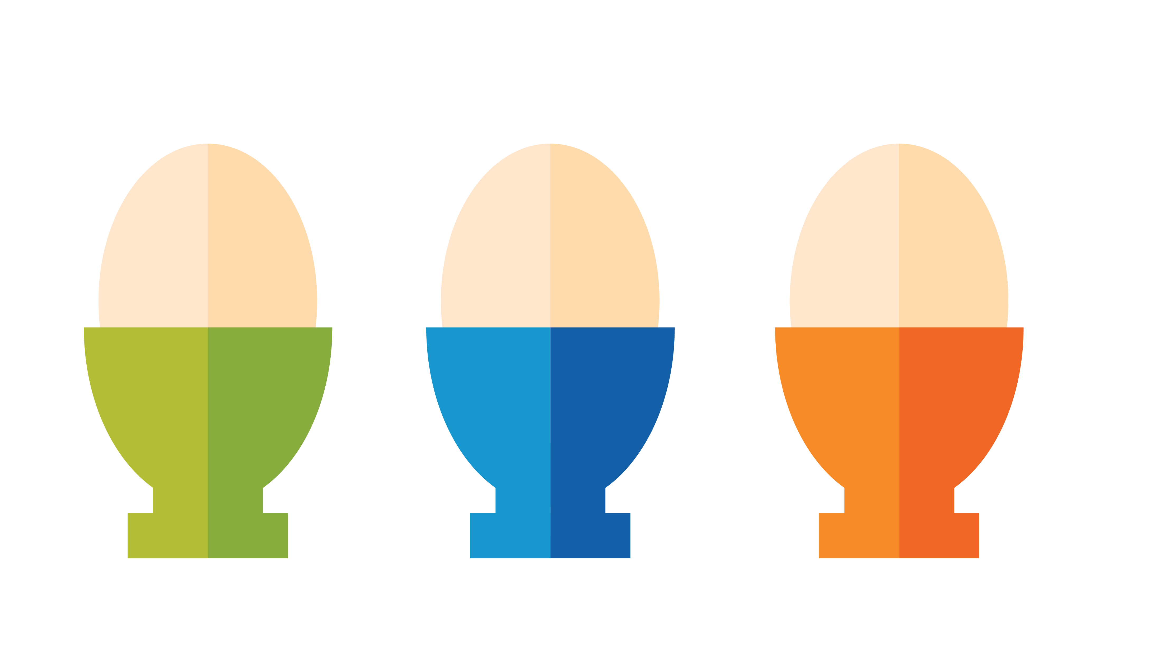



















































Icon Library

