Slide 1

Positive Parenting
Participant Guide

Slide 2
Welcome
Dear participant, we are very happy to welcome you to the Family Health Forum on Parenting with Purpose. Family Health Forums provide a space for parents, caregivers, and siblings of people with intellectual disabilities (ID) to engage with health professionals, community leaders, and social service providers.
Family Health Forums are for all family members! We know that relationships matter and the wellbeing of every member of the family is important. Thank you for joining us today on the topic of Parenting with Purpose.
During this Forum we will explore strategies for building connection at various stages of development. We will also review self-care strategies for parents and caregivers and share tips for managing challenging behavior. The content for this Forum focuses on children from birth through the teenage years. Children develop at their own pace and time, when we think about monitoring how a child is developing, we focus on understanding and supporting who they are and where they are at in their growth and development.
This is your personal workbook it contains worksheets, handouts, and other helpful resources related to the FHF on Parenting with a Purpose. During the event, your facilitator will guide you on when to use your workbook. This Forum and it’s supporting materials are works in progress. We invite you to share any feedback or ideas you may have. This will help us to improve these events for future participants.
Slide 8

Slide 3

Welcome Reflection
Slide 6
What are your priorities in caring for your child?
Activity Connecting with your child.
Slide 7
What is 1 way that you connect with your child?
What is 1 thing you enjoy about these moments of connection?

Slide 4
Action Planning for
Building Connections
Slide 13
Instructions: Use the chart below to plan moments of connection with your child/children.
When can I connect with my child or children?
 | Action 1 | Action 2 | Action 3
What is something I can do to connect with my child or children?
Activity Connecting with your child.
Slide 21
1. How do you/others show care for children in your community?
2. What are some examples of you/other showing care?
3. Can you think of 1 example of showing care that is non-verbal?

Slide 5
Slide 24
Reflection:
Nourishing Your Tree
Instructions:
Identify 1 self care strategy to try the next month to “nourish your tree”. Answer the following questions.
What will you do?
When will you do it?
How will you make yourself available for it?
Who can you share this plan with to support and encourage you?

Slide 6
Activity Functions of Behavior and Replacing Challenge Behaviors
Slides 29-34
Instructions:
Identify the function, or reason, for each behavior
PETER: Throws tantrums when asked to stop an activity. Peter loves playing with balls. When his grandmother says it’s time to stop, he screams, throws balls, and hits himself. What could be the function, or reason, for this behavior?
SAM: Uses aggression to communicate. Sam has limited verbal language. When he is told it is time for homework, he screams, runs away and throws objects across the room. What could be the function, or reason, for this behavior?
TETU: Avoids new people or environments Tetu becomes very distressed in unfamiliar environments. When visiting a new clinic, she clung to her mother refusing to enter the room and she began crying and covering her ears. What could be the function, or reason, for this behavior?
JON: Uses aggression to communicate Jon has limited verbal language. When he wants a snack or when he’s told it’s not snack time, he hits, screams, or throws objects across the room. What is a hidden strength? What new skill can replace the behavior?

Slide 7
My Notes
Slide 34
Slide 36

Slide 8

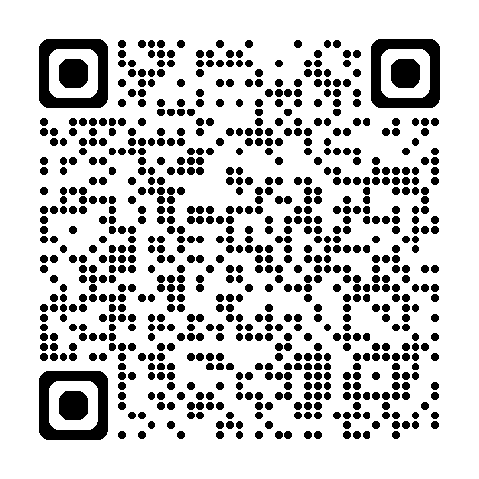
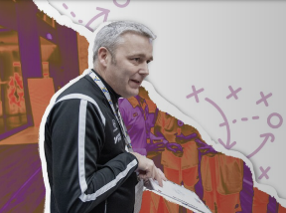
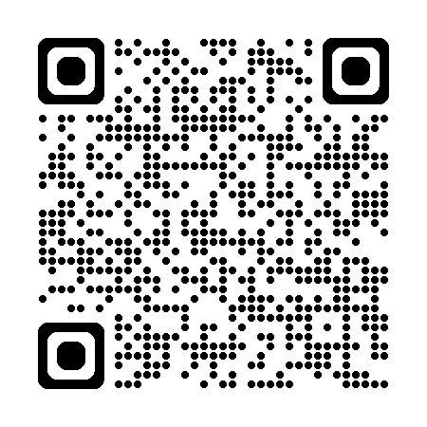

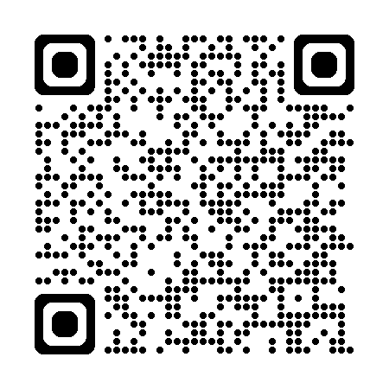

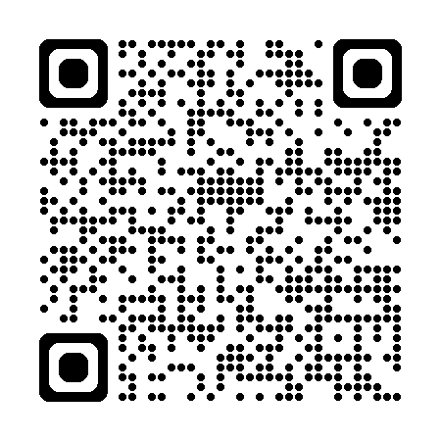
Helpful Resources
The following links have additional resources to support Parenting with Purpose beyond this Forum.
 | Special Olympics Young Athletes App Special Olympics App offering activities, resources and connections to support families of young children with and without intellectual disabilities.
 | Fitness Through Sport Playbook Provides strategies for fitness programming and tools for creating healthy habits
 | Strong Minds family tip sheet & calendar Strong Minds resources offer tips and ideas about ways to de-stress, have fun, and integrate healthy living choices into day-to-day lives.
 | Healthy Start A comprehensive guide for parents and caregivers to support the health and development of their children with intellectual disabilities and developmental delays.

Slide 9
Some helpful Tips
Size 12 font is great for printed materials. Size 24 (at a minimum) is good for the body copy on PowerPoints. Bold and colorful text is helpful to bring attention to a point or topic. Titles can go in the bar above. To add interest and variety in slide, feel free to use the slide layout with the bars on the side and bottom. That layout is great if you have extra room on the slide and feel like you need to fill up space. Utilize the icon library and high-quality photos to keep PowerPoints engaging! Don’t be afraid of white space, it helps the reader digest information easier.

