Slide 1

Managing Stress & Building Resilience
Topic Guide

Slide 2
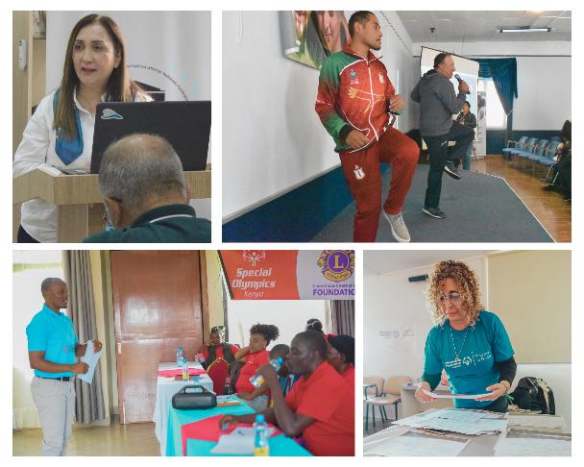
Forum at a Glance
This topic guide aligns with the Managing Stress & Building Resilience PowerPoint presentation. It highlights key materials, notes, and resources to support facilitation.
Learning Objectives
The aim of this Family Health Forum is to introduce the topic of stress management for parents and caregivers. At the end of this Forum participants will:
understand what stress is and how it impacts the body.
learn strategies for managing stress and regulating emotions.
develop an action plan for regular self-care practices
Facilitators
Potential facilitators might consist of community partners, coaches, and parents who have experience in fitness or working with families of individuals with intellectual disabilities (ID). Programs can also select other qualified persons to guide the Forum.

Slide 3
Agenda
The following is a general agenda for the Forum. It is estimated to take approximately 1 hour and 30 minutes to complete.
  Welcome and Introductions
  Overview of Family Health Forums
  Welcome Reflection
  Activity: What would you do? Stress Response Rame
  Discussion: What is stress? Understanding the Stress Response System
  Individual Reflection: Finding Joy
  Presentation: Self-Care activities from Strong Minds
  Individual Reflection: Selecting a self-care strategy to practice
  Presentation: Finding the Balance
  Closing: Key Takeaways
  Gratitude Sharing
  Q&A
  Sharing Community Resources
Materials
The following materials will be helpful for facilitation and planning of the Family Health Forum:
PowerPoint presentation on Caregiver Stress & Building Resilience
Printed copies of participant workbook or access to virtual copy
Writing/drawing materials
Clock/Timer/stopwatch to track time spent during activities
Ball or item to pass around during introductions
Box or basket to collect questions or comments from participants

Slide 4
Important Notes
Review the PowerPoint Presentation in advance:
  There is a suggested script in the notes section of the presentation. Reviewing it in advance will allow you to be comfortable with the presentation and reduce reading the script. Make wording changes to support the flow of the presentation.
Adapt Forum Materials:
  Include local photos, recommendations and community resources for Fitness available to your participants. Collaborate with local service providers. If possible, invite them to the Forum to be available to answer questions and provide further support
  Adjust the script and images to suit your participants.
  This forum includes physical activity that can be done as a group. Adapt them to for the accessibility of all participants. For example, push ups can be done on the wall, against a table, or on the floor.
Encourage engagement, sharing experiences, and asking questions:
  For an in-person Forum, you can have paper available for participants to write/draw their name. Participant Guides can be printed for better use.
  During discussions, allow time for participants to share their personal experiences. Facilitators can encourage discussions by sharing their experiences first.
  Make time or be available for participants to ask questions to further support families after the Forum.
4. Responding to Questions:
  Do your best to fully answer the questions. If someone in the group has a helpful experience, invite them to share.
  Leverage community partners or topic experts to help answer questions.
  If you’re unable to answer any questions, refer to a community partners or expert when feasible, or notate the question and follow up with an answer as soon as possible.

Slide 5
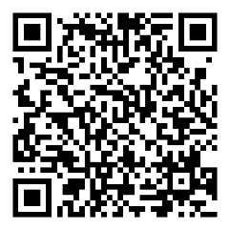

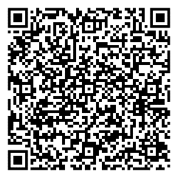


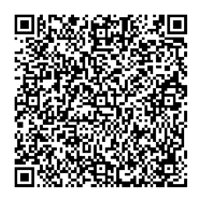
Helpful Resources
 | Special Olympics Strong Minds Website Strong Minds is an interactive learning activity focused on developing adaptive coping skills.
 | Tips for keeping a Strong Mind Strategies for emotional health and wellbeing.
 | Special Olympics Self-Care tips for families 10 strategies for self-care.

Slide 6

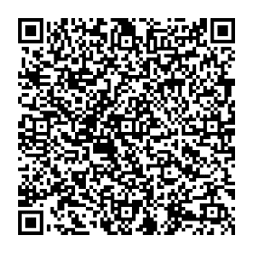



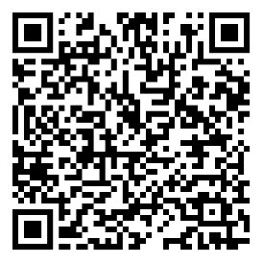
Helpful Resources
 | Strong Minds family tip sheet & calendar Tips and ideas about ways to de-stress, have fun, and integrate healthy living choices into day-to-day lives.
 | Special Olympics My Health Strategies to handle stress, understanding our sleep and where we feel stress in the body.
 | Special Olympics Strong Minds Mindfulness Recordings A series of 14, 5-minute Special Olympics Strong Minds meditations.

Slide 7
My Notes

Slide 8


Family Health Forums, part of Special Olympics Health, are made possible through the generous support of our funders.
This work was supported by Award Number NU27DD000021, funded by the Centers for Disease Control and Prevention. Its contents are solely the responsibility of the authors and do not necessarily represent the official view of the Centers for Disease Control and Prevention or the Department of Health and Human Services.

Slide 9








































































