Slide 1



Family Health Forum
Managing Stress & Building Resilience
Special Olympics Health activities are supported by many sources, including in the United States by Grant Number NU27DD000021 from the Centers for Disease Control and Prevention of the U.S. Department of Health and Human Services, with $18.1 M (64%) financed with U.S. Federal funds and $10.2 M (36%) supported by non-federal sources. These contents are solely the responsibility of the authors and do not necessarily represent the official views of the Centers for Disease Control and Prevention or the Department of Health and Human Services.
Notes:
Note:
This slide deck is to guide the facilitator in the presentation and activities for the FHF Caregiver Support: Managing Stress & Building Resilience
Notes and commentary for facilitators are indicated in this section on all the slides.
Be sure to adapt the slides, language, text and images to better suit your context.
Remember to collaborate with local topic experts in adaption of the content to ensure adherence to appropriate mental health guidelines/recommendations for your context.
Say: housekeeping and norms
Before we get started a few housekeeping needs:
Location of toilets/washrooms
Snacks or drinks
Other logistics

Slide 2

Introductions
2
Notes:
Say:
As you know, our topic today is managing stress and building resilience
We are going to spend the hour together, learning about stress and its impact on the body and exploring strategies on how we can manage stress.
Let’s take a moment to get to know each other and set some ground rules for our time together
Let’s get to know each other a little bit and introduce ourselves.
For this game we will pass around this ball and each person must say something that brings them joy.
The person speaking throws the ball to someone else and this person must say their name and something that brings them joy
Facilitator Note for Virtual Presentations:
Ask participants to say their name and something that brings them joy.

Slide 3
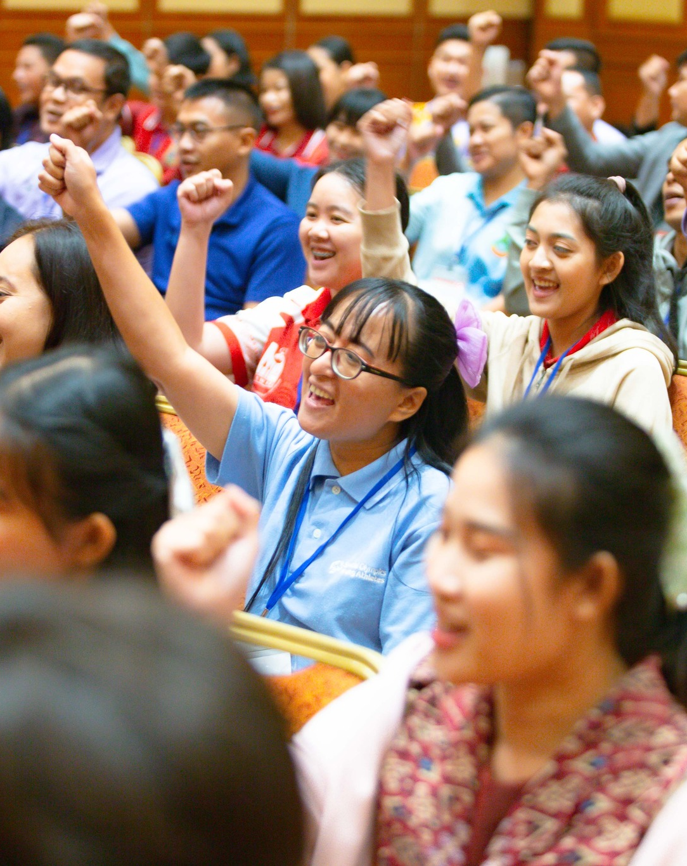
Family Health Forums:
Family Health and Well-Being
FHFs focus on the whole family
Build connection with other families
Build connection with service providers
Our ways of working:
Respect
Active listening
Judgement free zone
Confidentiality
3
Notes:
Say:
The goal of Family Health Forums is to reduce the health disparities for people with intellectual disabilities.
We know we cannot do this without supporting the whole family!
This space is for families to support each others health and wellbeing.
Here we focus on all the members of your family.
Together we will learn about different health challenges and how families can work together to address them together.
We also bring families together to establish support networks with other families and with service providers in our community
To make this a welcoming space, there are 4 principles to guide our time together:
We RESPECT each other’s opinions and recognize that we may all be at different stages of caring for ourselves
We use ACTIVE LISTENING to be fully present with each other and give each other our undivided attention.
We are a JUDGEMENT-FREE zone – we recognize that we each bring our own unique experiences to this event.
We believe in CONFIDENTIALITY – we agree to keep private what is shared and discussed here
We are here to learn from and with each other – feel free to ask questions at any time. You can, ask your question to the group, or you can write down your questions on the cards provided and place them in the question box.
Before we begin our topic today let’s discuss why health is important for our athletes and their families.

Slide 4
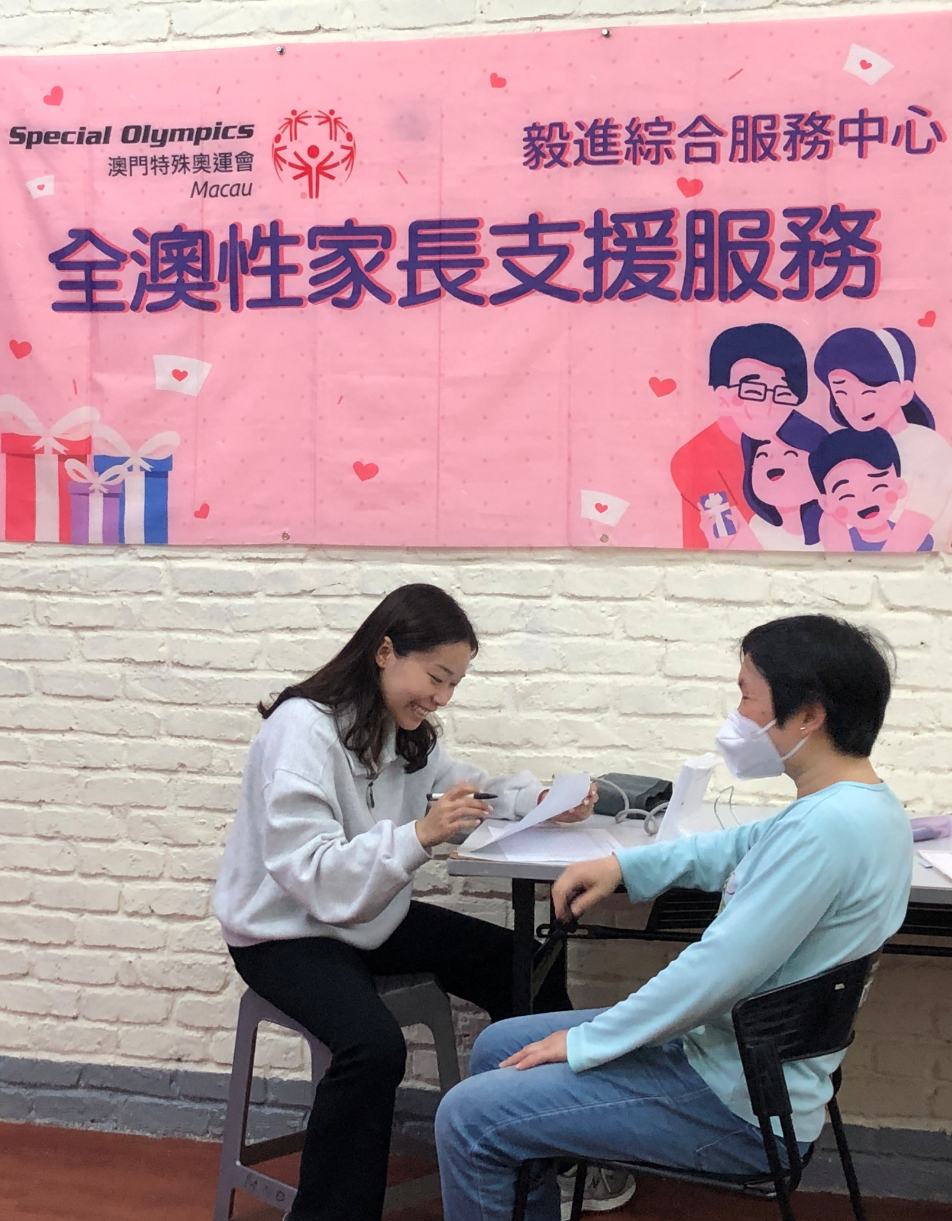
Did you know?
Individuals with intellectual disability…
Have limited access to critical health services and resources to improve their health.
Are 2 times more likely to be obese
More likely to experience premature death from preventable health conditions.
Have higher rates of chronic health conditions like obesity, diabetes, asthma, and cardiovascular disease.
4
Notes:
Say:
Family Health Forums are important because we know that health has a substantial impact on the quality of life for people with intellectual disability and their families.
Recent data from Special Olympics athletes has informed us about the health and wellbeing of people with intellectual disabilities.
We know that Special Olympics adult athletes are two times more likely to be obese compared to adults without intellectual disability.
Also, individuals with intellectual disability have as many chronic health conditions at 20+ years old as individuals in the general population do at 50+ years old.
Lastly, people with intellectual disability often do not have access to critical health services and resources to improve their health and die 16 to 20 years sooner than people without intellectual disabilities due to preventable health conditions.

Slide 5

Overview of the Forum
Understanding stress and wellbeing
Strategies for managing stress and regulating emotions
Action planning for a regular self-care routine
5
Notes:
Say:
During our time together, we will focus on the following 3 topics:
Understanding stress and wellbeing
Strategies for managing stress and regulating emotions
Action planning for a regular self-care routine
We will have a mix of activities, discussion, and presentations.
We all have something valuable to share and we are here to learn from each other experiences as well.
Feel free to share any questions or comments you may have as we go along.

Slide 6
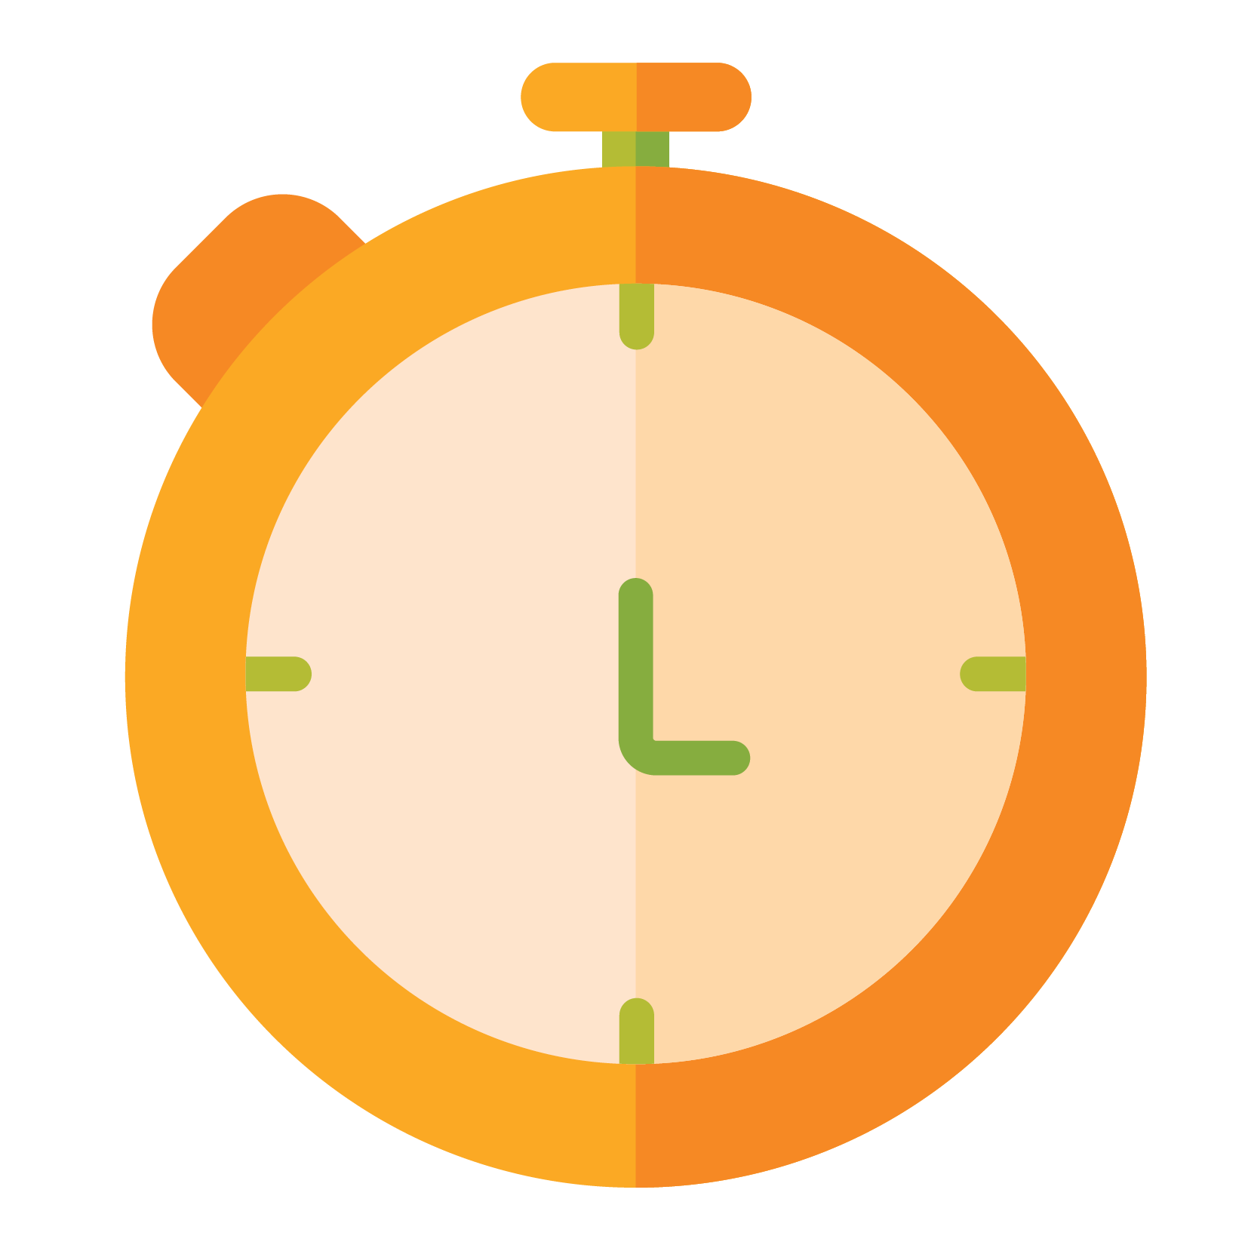
Moment of Silence
2 minutes
Calming activity
6
Notes:
Say:
Welcome to today’s Family Health Forum.
Before we begin, let’s take a moment to come together and calm our bodies and minds so that we can be fully present
We are going to have a moment of silence for 2 minutes.
During these 2 minutes please sit in a comfortable position, relax your arms, lower your eye gaze or close your eyes if you are comfortable. You are welcome to do any of the following:
Sit in silence
Say a prayer or sing a song to yourself
Focus on something in the room
Tensing and relaxing your muscles across your whole body
Practice deep breathing. To do this we breath in for a count of 3 (1,2,3) hold your breath for a count of 3 (1, 2, 3) and then exhale slowly for a count of 4 (1, 2, 3, 4)
I will start the timer now, and you can choose any activity for the next 2 minutes.

Slide 7

Welcome Reflection
What has worked for you when you are feeling stressed?
What has not worked or what has been some of your biggest challenges or areas of concern?
7
Workbook page 2
Notes:
Say:
We know that the journey of caring for a child with ID has its ups and downs and our care for ourselves, other family members can be impacted.
Before we begin, please take a moment to write down your successes and challenges, areas of concern, or questions you have regarding managing stress.
Turn to page 2 in your participant workbook and record your thoughts there.
Ask:
After a few minutes, ask participants if there any volunteers who would like to share their responses.

Slide 8
Activity: Stress Response Game
What would you do?
Group 1: You are alone in the wild and being chased by a lion
Group 2: You walk into your class and find out that there is a surprise test that you are not ready for
Group 3: You are a manager for a high-pressure company with no work-life balance
8
Workbook page 3
Notes:
Say:
We are going to play a game to learn about the stress response system
Let’s divide into 3 groups and each group will respond to the following scenarios.
The full description of each scenario is in your participant workbook starting on page__
In your groups you will respond to the following questions. These questions are also in your workbooks.
What would you do if you were in this situation? And why? Try and fight? Try and run away? Freeze in place?
What do you think would be happening with your body?
When completed each group will share their responses to the larger group
You will have 5 minutes for this activity
Facilitator Note for Virtual Presentations:
For virtual Forums, keep participants in the main room and guide the group through the Stress Response activity together.
Say:
We’re going to play a game to learn about the stress response system.
Instead of breaking into small groups, we’ll explore each scenario together as a whole group.
Please turn to your participant workbook to follow along with the three scenarios and questions.
For each scenario, I’ll read it aloud and then ask:
What would you do in this situation—and why?
Type your answers in the chat or raise your hand if you’d like to share out loud.
We’ll take about 2 minutes per scenario, so feel free to jot down your thoughts in your workbook as we go.

Slide 9
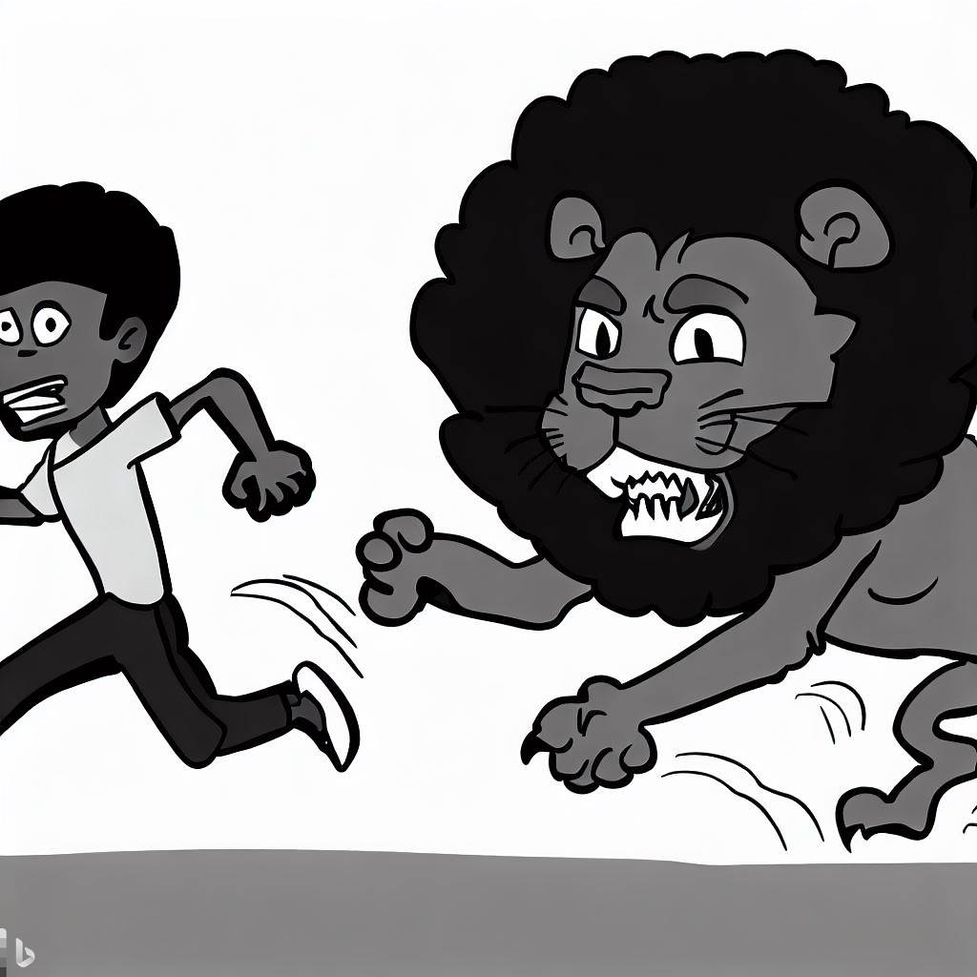
What is Stress?
Stress is normal
A natural human response to address perceived challenges and threats
Hormonal changes and physiological responses that help us:
  To fight a threat
  To flee to safety
  To freeze if we think danger is imminent
9
Notes:
Say:
Thank you for sharing your group responses.
Our bodies are incredible machines with many different parts that work together to keep us alive. Stress is part of this machinery.
Stress can be defined as our bodies response to things that happen that we perceive as stressful.
It is important to remember that stress is normal – it is a normal human response to a threat or challenge
When we think about why humans have developed a stress response system it was to keep us safe and alive
The hormonal changes that happen in our bodies happen immediately and often without our awareness.
They help to focus our attention, give us the energy and motivation to respond quickly and effectively to the threat to fight, to flee or to freeze all so that we can stay alive.

Slide 10



The Stress Response
System
Alarm
Stress Hormones
Body Wide Changes
10
Distress signal sent across the body
Rest and digest
Notes:
Say:
The stress response happens when we perceive situation as stressful
Our brain sends messages to other parts of the brain to alert an alarm and this releases the stress hormone called cortisol
Some of the body wide changes include breathing and heart rate increase, also blood pressure goes up, and our body releases more sugar into the blood. These increases in blood sugar level provide more energy for the body.
This increase in energy helps us to escape from or deal with a stressful situation – critical for fight or flight
This response happens so fast, sometimes before the brain’s visual centers have had a chance to fully process what is happening
This is why people are able to jump out of the path of an oncoming car even before they think about what they are doing.
After our brains recognize the threat has passed – our bodies calm down
The body-wide changes go back to their neutral state and balance is restored again in the body
Ask:
What are some, body-wide changes you experience when you feel stress?

Slide 11

Chronic Stress is
Harmful
Repeated and prolonged activation of stress response system
Stress response system does not restore to balanced
Results in a range of health problems
11
Notes:
Say:
The stress response is helpful in short periods to address a perceived threat and where the body returns to a balanced state
Repeated and prolonged activation of the stress response is unhelpful
In this situation the body does not return to a balanced state.
It means that the hormone levels in the body stay high
Over an extended period, high levels of these stress hormones can impact the brain and body systems and result in a range of health concerns such as:
High blood pressure
Heart disease
Depression and anxiety
Memory loss
Poor sleep
Remember some stress can be good for you, too much stress overtime, can be harmful.

Slide 12
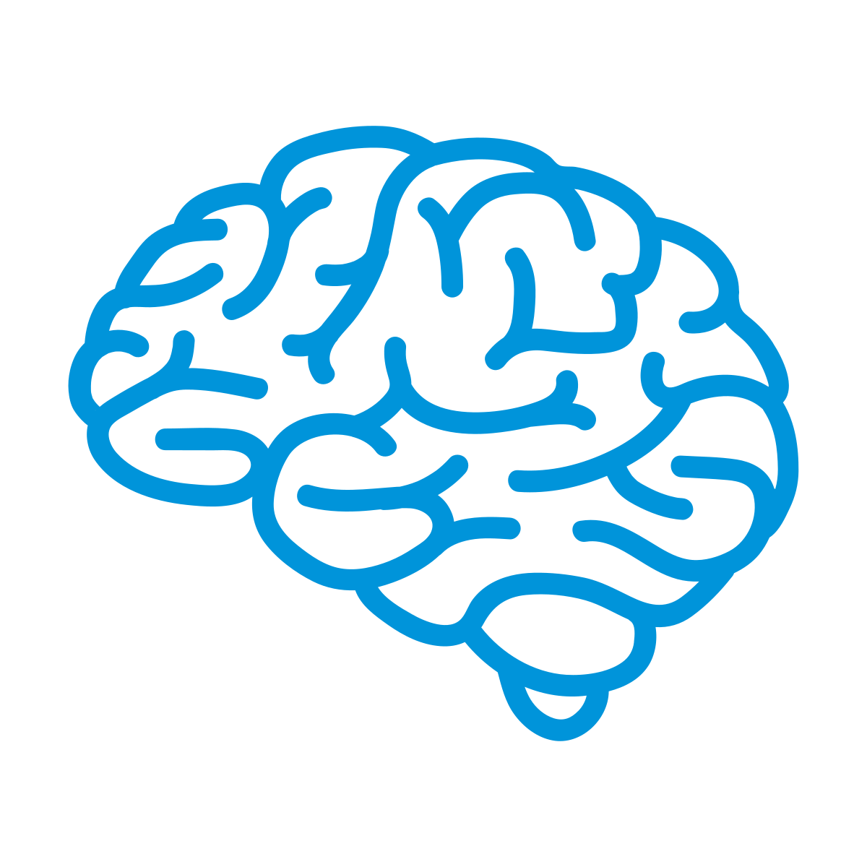


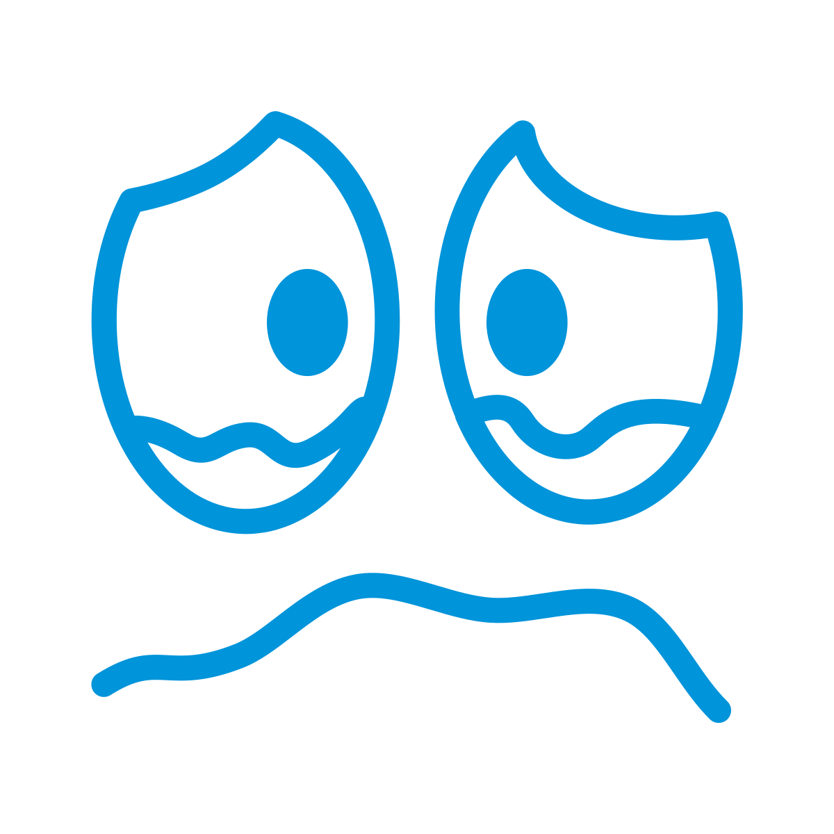




Chronic Stress can
Look Like…
Difficulty concentrating
Changes to your appetite
Trouble sleeping
Feeling tearful
12
Snapping at people
Drinking or smoking more
Feeling unwell
Shallow breathing
Notes:
Say:
While chronic stress can be harmful, it is never too late for us to learn how to manage stress and reduce its impact on our health
The first step is for us to recognize what stress feels like for us
It can be different for everybody.
Some examples include
Difficulty concentrating
Changes in our appetite
Increased alcohol consumption or smoking
Trouble sleeping
Feeling sad, angry, or unwell
Take a moment to think about what stress looks like for you in your body

Slide 13
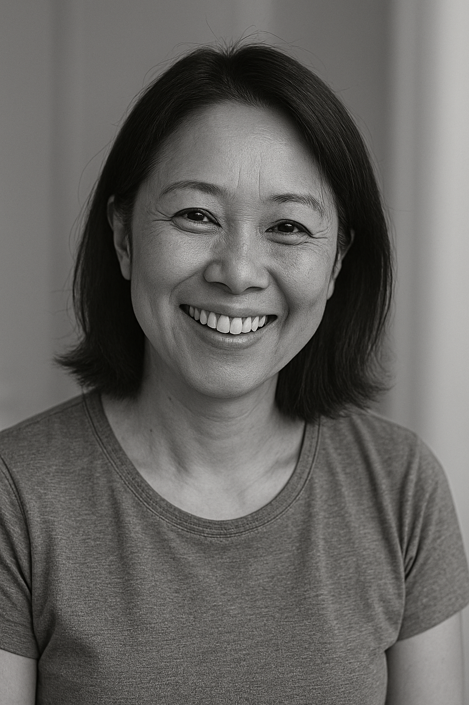
Individual Reflection
Finding Joy
What nourishes you?
What depletes you?
13
Workbook page 4
Notes:
Say:
When we think about managing our stress a first step is to think about the things that bring us joy or that nourish us
Sometimes it can be difficult for us to make time for the things that nourish us and bring us joy.
It can be difficult to balance everything as a parent, working or not, being a teacher, therapist, friend, confidante and so much more.
It is not possible to be all things and there needs to be a pause, stop sign, boundary, or limit even in our own family.
Let’s take a couple of minutes (no more than 5 minutes) to explore this on our own.
Please make a list of 10 things you do in a typical day.
Write an ‘N’ next to activities that nourish you or uplift you.
Write a ‘D’ next to activities that are depleting or take away your energy or enjoyment.
You might say ‘it depends’ for some activities and in that case, it is interesting to think about/break down what it depends on
Say:
Take a look at your list of N’s and D’s.
Are they balanced? Are there more D’s or more N’s.
Making time for activities that bring us joy is an important part of self care.

Slide 14
Managing Stress with
Self-Care
Managing stress with self-care
Physical
Social
Mental
Emotional
Spiritual
Self care helps to restore balance in our bodies
Self care is about being kind to ourselves
14
Notes:
Say:
When we think about creating time for joy or nourishing activities in our lives it is a form of self care
Self care is anything we do with the intention of being kind to ourselves.
Self care helps to restore balance in our bodies.
It is not a treat; it is an investment in our well being
We can have self care activities related to our physical, mindfulness, social, emotional and or mental well being.
Physical includes thins like exercise, nutrition, sleep and medical care.
Social includes things like relationships, community and connection with others
Mental includes learning, creativity and problem solving.
Emotional includes self-awareness and expressing feelings.
Spiritual includes reflection, a sense of inner peace, and connection to something greater than oneself.
We can try to enhance our activities in all these areas, or we can focus on 1 category, there is no one way for everyone
The goal is to bring awareness to at least one category and be kind to ourselves by intentionally identify an activity to practice.
Ask:
Can you take this time as an opportunity to deepen your love with yourself?

Slide 15
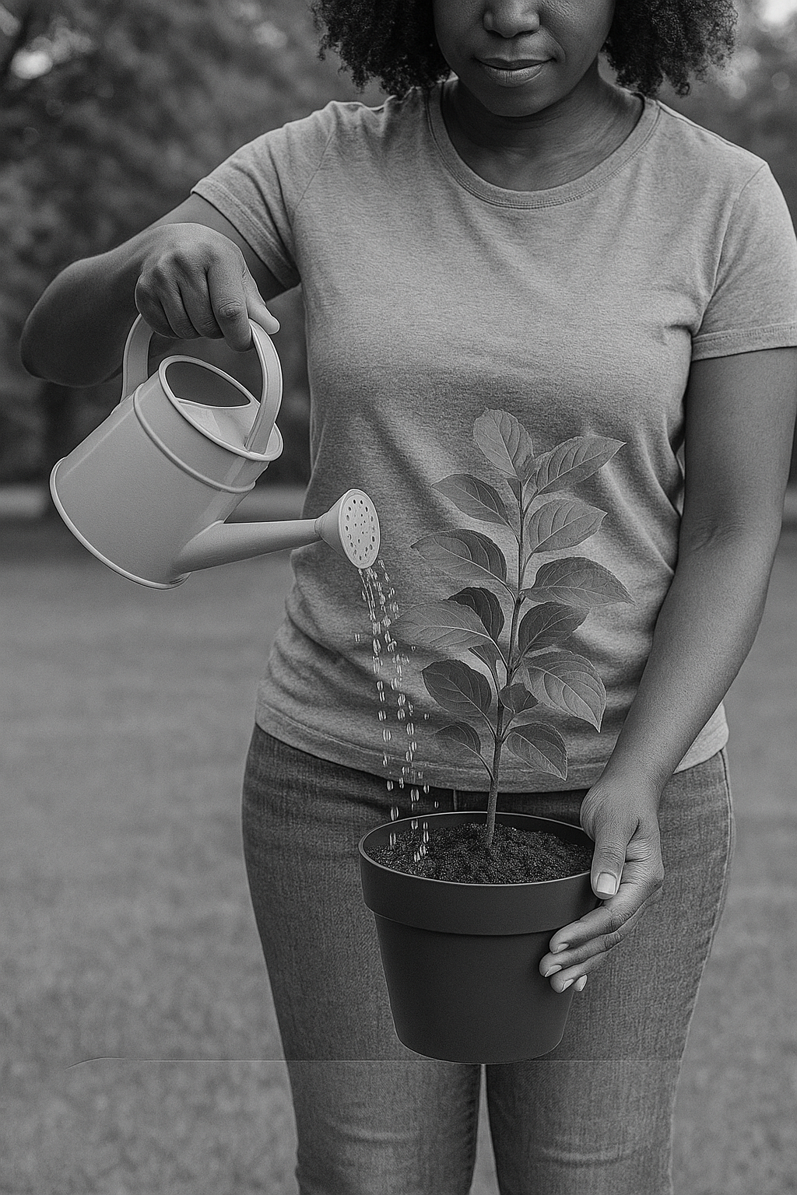
Reflection: Self-care
Check your self-care energy
A healthy tree can support many birds, provide fruit and shelter.
A withered tree helps no one.
15
Notes:
Ask:
Have you heard the sayings ‘you can’t pour from an empty cup’ or ‘ put your own oxygen mask on first before helping others’?
What do these sayings mean to you?
Say:
Often as caregivers, we give and give of ourselves to others or to other things
These activities can be depleting of our energy.
When we have given everything or had too many depleting activities our self care energy is empty and at this point, we are unable to give to others either.
Imagine yourself as a tree that provides shade, fruit, and shelter for others.
Without water, sunlight, and nutrients, even the strongest tree will wither.
Selfcare is like watering, fertilizing and ensuring the tree gets sunlight.
A healthy tree can support many birds, provide fruit for years, and offer shelter.
But a withered tree helps no one.
We are of no use to anyone else if we don’t care for ourselves and recharge our energy.
There will always be stressors or things that deplete our energy
We cannot always control these depleting activities, sometimes they are a surprise, such as a sick child
Too many depleting activities without counteracting these with joyful activities leaves little time for us to recharge
Only when we can recharge our energy can we then be at a healthy place to give to others
Fortunately, there are simple actions we can take to recharge.
Taking short bursts of time out of our day to recharge is not likely to have too much of a negative impact on the rest of our time
Rather it will make us happier, more energetic, more productive and more useful to others.

Slide 16
Small Group Activity
Physical
Social
Mental
Emotional
Spiritual
Recharging
our self-care batteries
16
Workbook page 4
Notes:
Say:
Let’s look again at the well-being categories- physical, spiritual, social, emotional, and mental.
These are all areas where we can practice self care and engaging in nourishing activities that bring us joy.
We will split into 5 groups; each group will focus on one of the well-being categories
Ask:
Thinking about your community, what are 5 nourishing activities people can do to recharge their self-care batteries in each of these categories?
Take into consideration your community, its environment, your religious practices.
Think of realistic and accessible actions that could be available to most individuals.
Say:
Please write down all your suggested activities so we can share them with each other
After your 5 minutes of discussion each group will share their list of 5 activities and then select 1 brief activity to demonstrate with the larger group
For example, if deep breathing is one of your activities, you can guide our larger group in a short deep breathing activity
Notes:
Split participants into 5 groups
Assign each group a category to focus on
Remind each group to select 1 activity from their list to demonstrate/facilitate with the larger group
When the groups are sharing their activities, record them on a flip chart/large paper and hang the paper on the wall for all participants to be able to see
If you are short on time, consider asking the groups to read out their list of 5 and skip the demonstration/facilitation
Facilitator Note for Virtual Presentations:
For virtual Forums, keep participants in one group and guide the activity together.
Explore each category one at a time
For each one, we’ll spend a minute or two sharing ideas in the chat or out loud.

Slide 17
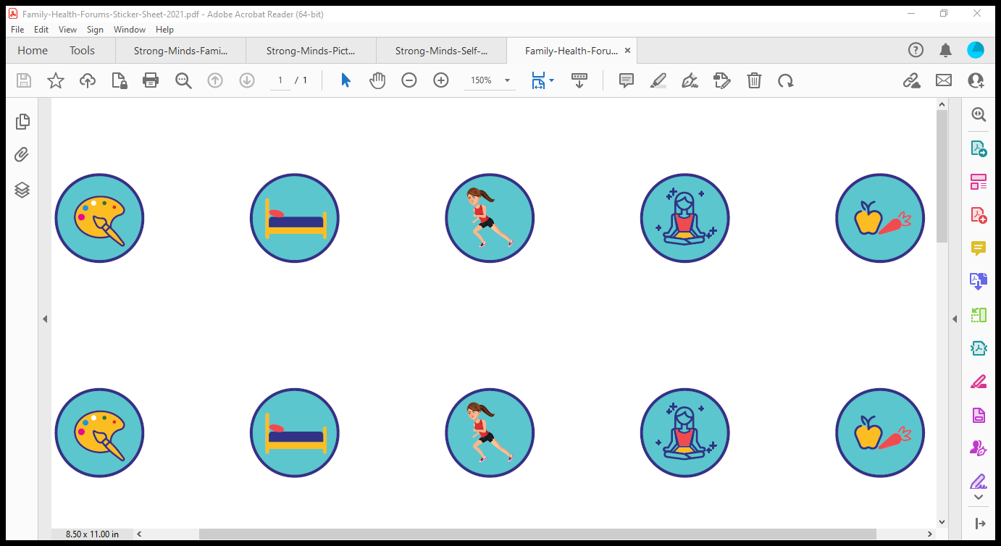
Self Care Activities
from Healthy Minds
Mindfulness
Creative
Self-expression
Physical fitness
17
Healthy Eating
Sleep
Notes:
Say:
Thank you for sharing your list of nourishing activities that can help us recharge.
Here are additional tips from Healthy Minds Family Tip Sheet – a copy of which is attached to your materials
Practice mindfulness: taking time to slow down and be present. This practice can help to improve our focus decrease stress and assist in managing emotion. Examples include doing a body scan, going for an exploration walk or a gratitude share
Healthy eating – our bodies are powered by what we eat. Certain foods have more nutrients and are better for our bodies. By eating healthy foods, we can make sure that our brain has the power to help us focus and learn and that our muscles have the fuel to help us move.
Sleep – giving our bodies to time rest and recharge is important. Routines for bedtime and relaxation can be helpful to build regular rest
Creative self expression: Art allows us to share and connect with others. We do not need to have special talents nor specific materials to produce great artwork. Exploring new materials and/or making something that is uniquely yours can be fun and relaxing
Physical fitness: When we take care of our bodies, we are also taking care of minds. Physical exercise helps keeps us healthy, decreases stress and can help to improve our mood. Explore different activities that can be done individually or as a whole family
In addition to these activities, connecting with other families going through similar experiences can be very helpful

Slide 18
Individual Reflection
What self-care strategies will you try at home?
What self care strategies are resonating with you? Is there something new you would like to try?
Select 1 strategy to try the next month that will be a specific self care strategy JUST FOR YOU
Make a Commitment
18
Workbook page 5
Notes:
Say:
Now that we have explored different strategies for recharging and managing our stress
Please take a couple of minutes (no more than 5 minutes) to think about 1 strategy that you can realistically do to recharge.
Select one strategy that you can try for the next month and commit to doing
Think about what works best for you and your family.
It does not have to be something very big, what is important is that it is realistic and doable
Once you have thought about a strategy to commit to for the first month.
Ask:
Would anyone like to share their self-care strategy they are going to try?

Slide 19

Title here
Questions?
19
Notes:
Say:
Before we close, let’s have some time for questions and discussion.
Ask:
Does anyone have any questions or outstanding challenges?
Notes:
This is the time to address any outstanding questions or concerns from participants
Start off by responding to the challenges and questions that participants shared at the beginning of the session.
Remember to answer as thoroughly as possible
If relevant you can also ask other participants if they have suggestions to share
Leverage your community partners, and /or topic experts to help you respond to questions.
If there are questions you are not able to respond to, be honest and if feasible do the following:
Refer individuals with that concern to community partners – have names and contacts for these referral partners
Take note of the question and tell the participants you will inquire about the answer and get back to them (be sure you have the capacity to do this follow up)

Slide 20

Title here
Closing:
Gratitude
Share
20
Notes:
Say:
Thank you all for your participation today.
Before we close, let’s take a moment to share one thing we are grateful for.
If you prefer not to share as a group, feel free to record your response in your workbook
Maybe you are thankful for something someone did for you.
Maybe you are thankful for the weather, or for a pet
Whatever it is you are grateful for, big or small, let’s take a moment to recognize it
Remember this is a practice that you can also build into your daily routine
Let us begin who would like to go first?
Notes:
Allow time for all the participants who chose so, to share.
Facilitators can go first and share what they are grateful for.

Slide 21
Thank You
SO Program Team
Contact Us:
Name:
Tel:
Email:
Community partner
Contact Us:
Name:
Tel:
Email:
Community partner
Contact Us:
Name:
Tel:
Email:
Community partner
Contact Us:
Name:
Tel:
Email:
21
Notes:
Notes:
To close the meeting, thank participants for their participation and attendance
Share contact information for participants to ask further questions or to learn more
Include contacts for the Special Olympics program staff as well as for nutrition partners in the community
This may be a good time to invite community partners to share a bit about their services and how attendees can access them.

Slide 22
Some helpful tips
Size 12 font is great for printed materials. Size 24 (at a minimum) is good for the body copy on PowerPoints.
Bold and colorful text is helpful to bring attention to a point or topic.
Titles can go in the bar above. To add interest and variety in slide, feel free to use the slide layout with the bars on the side and bottom. That layout is great if you have extra room on the slide and feel like you need to fill up space.
Utilize the icon library and high-quality photos to keep PowerPoints engaging!
Slide number
21
Workbook page #

Slide 23
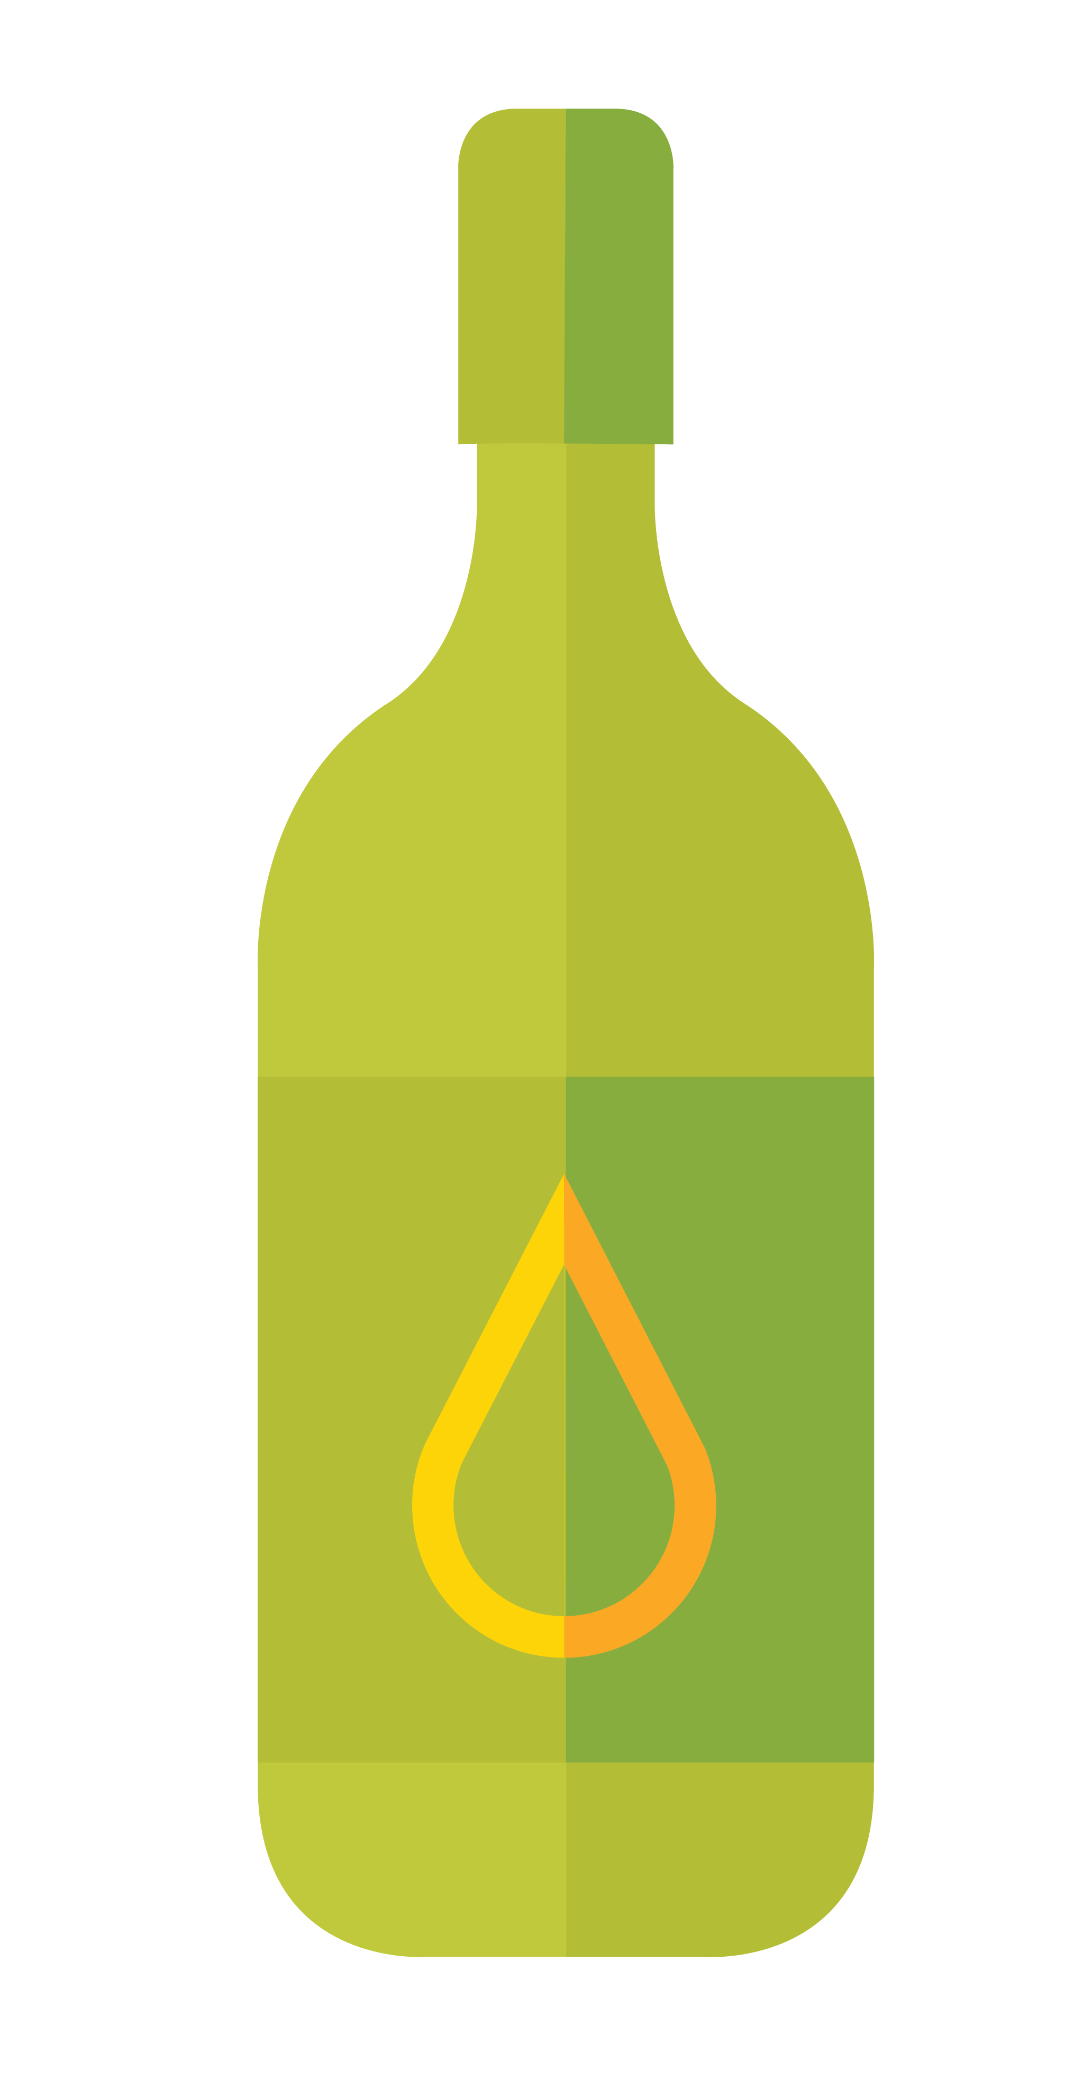


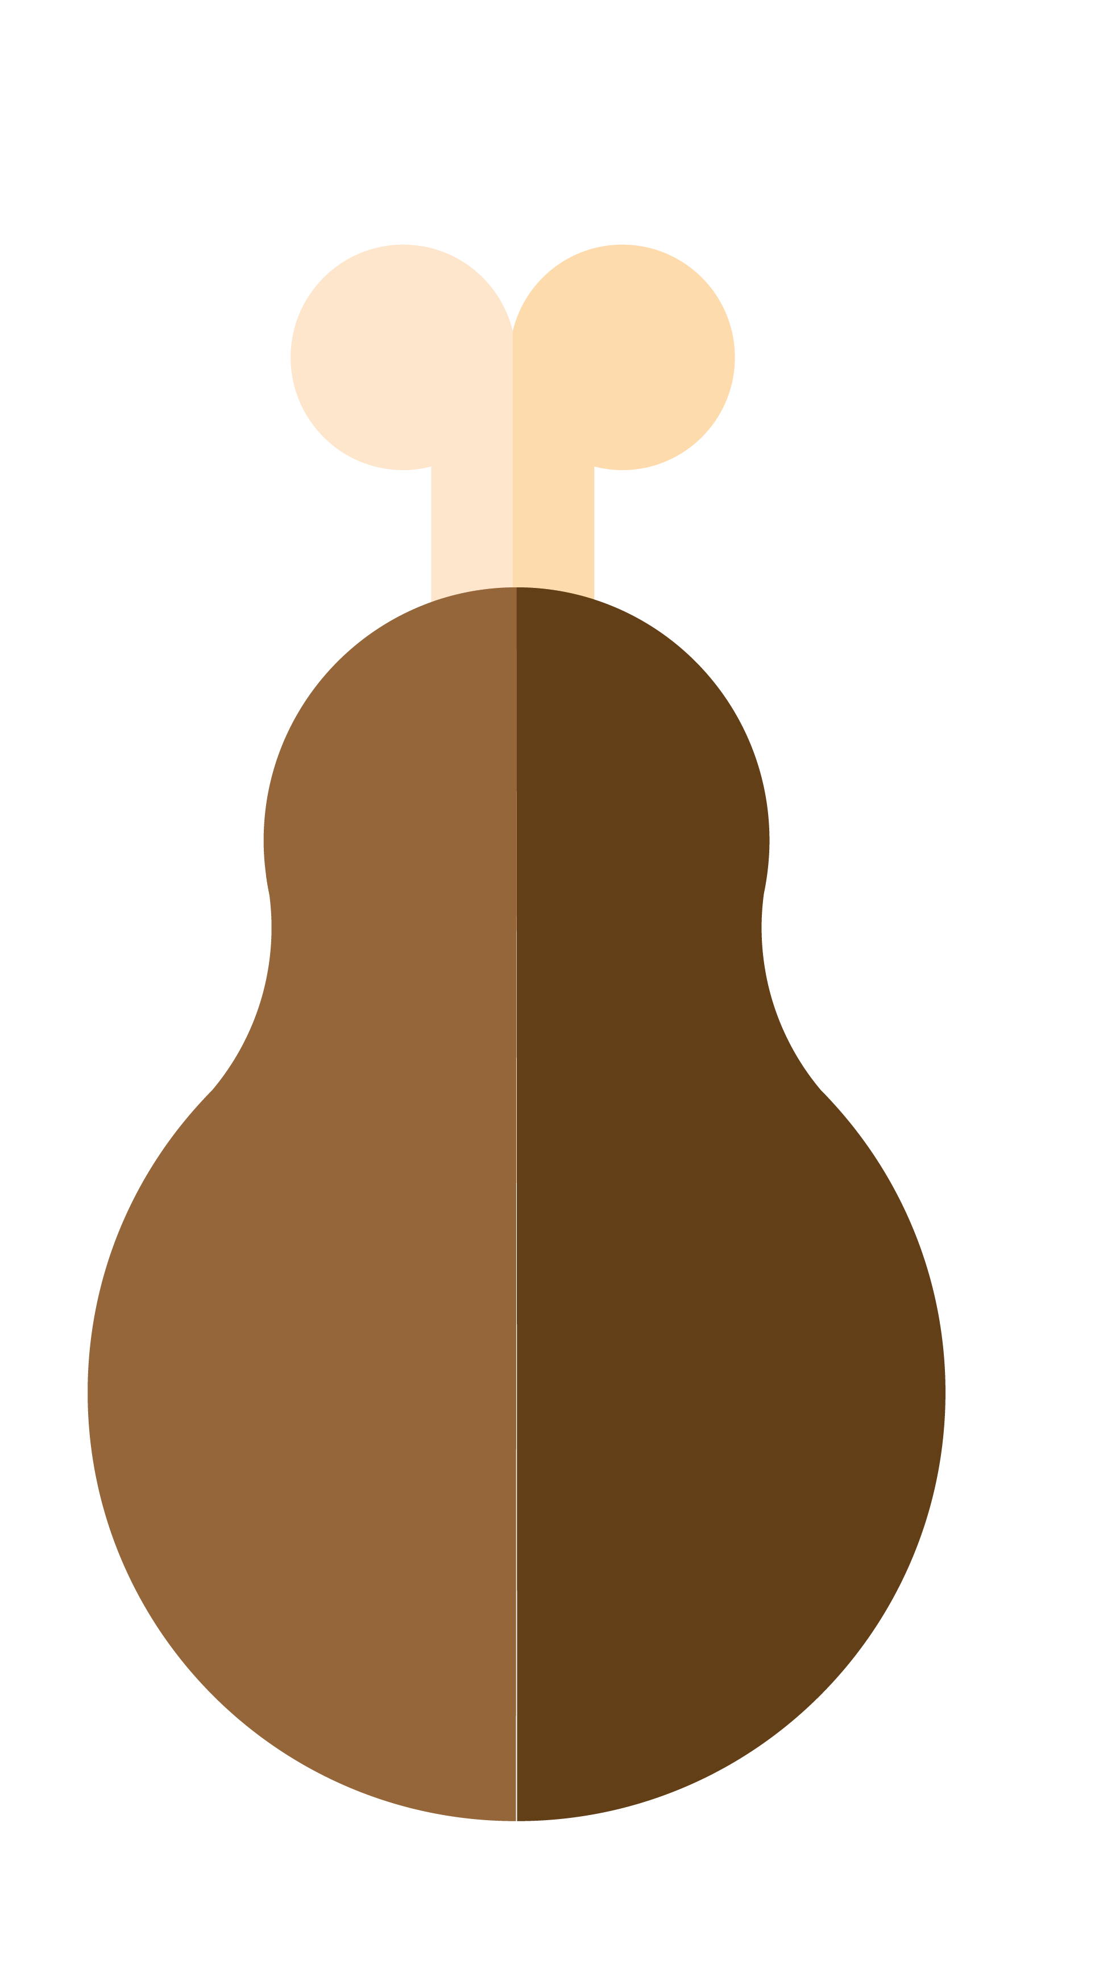

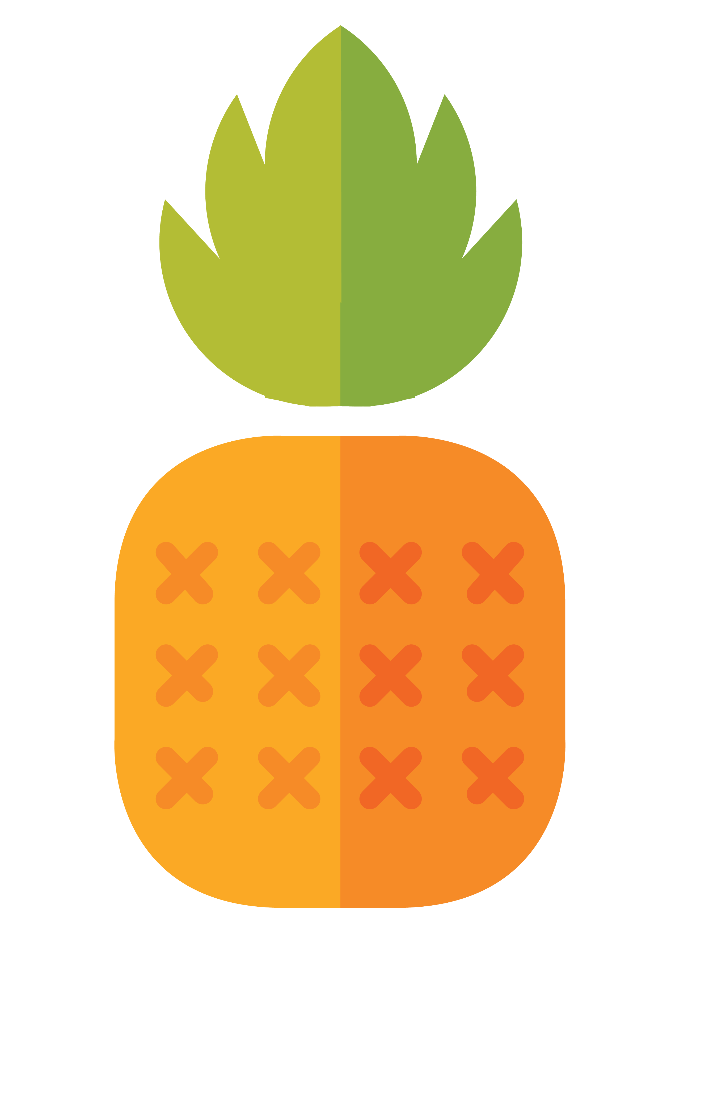


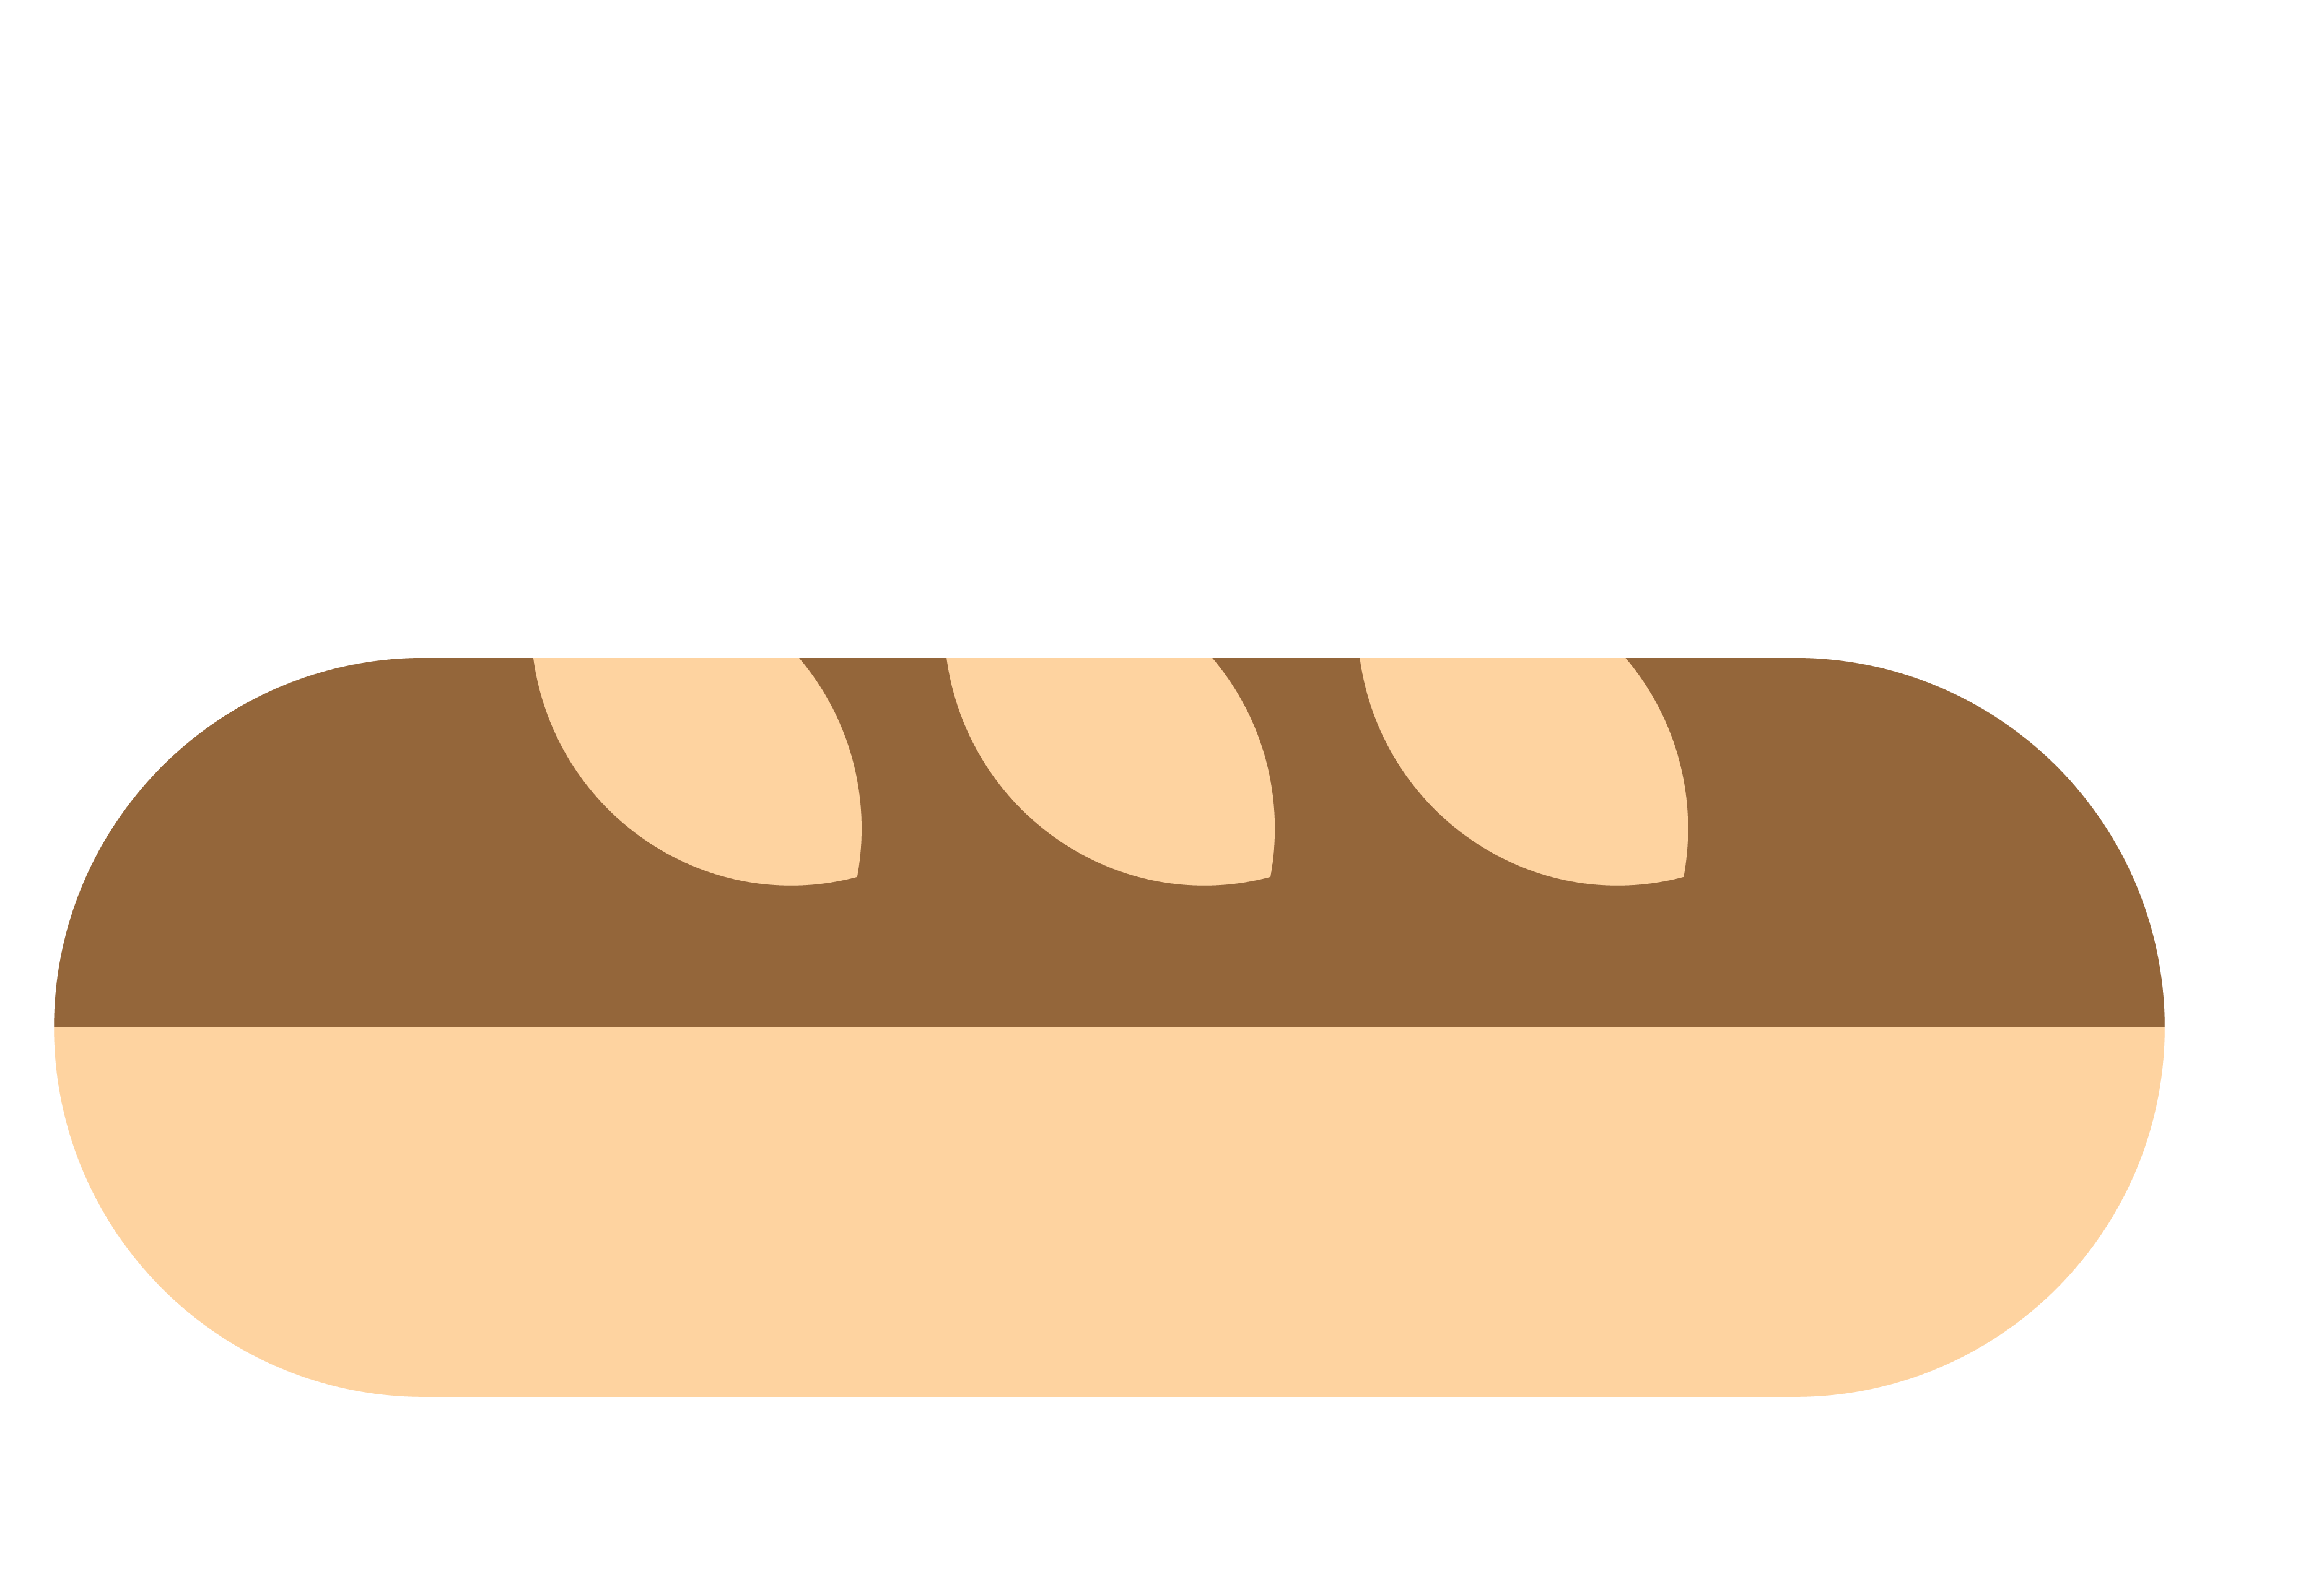







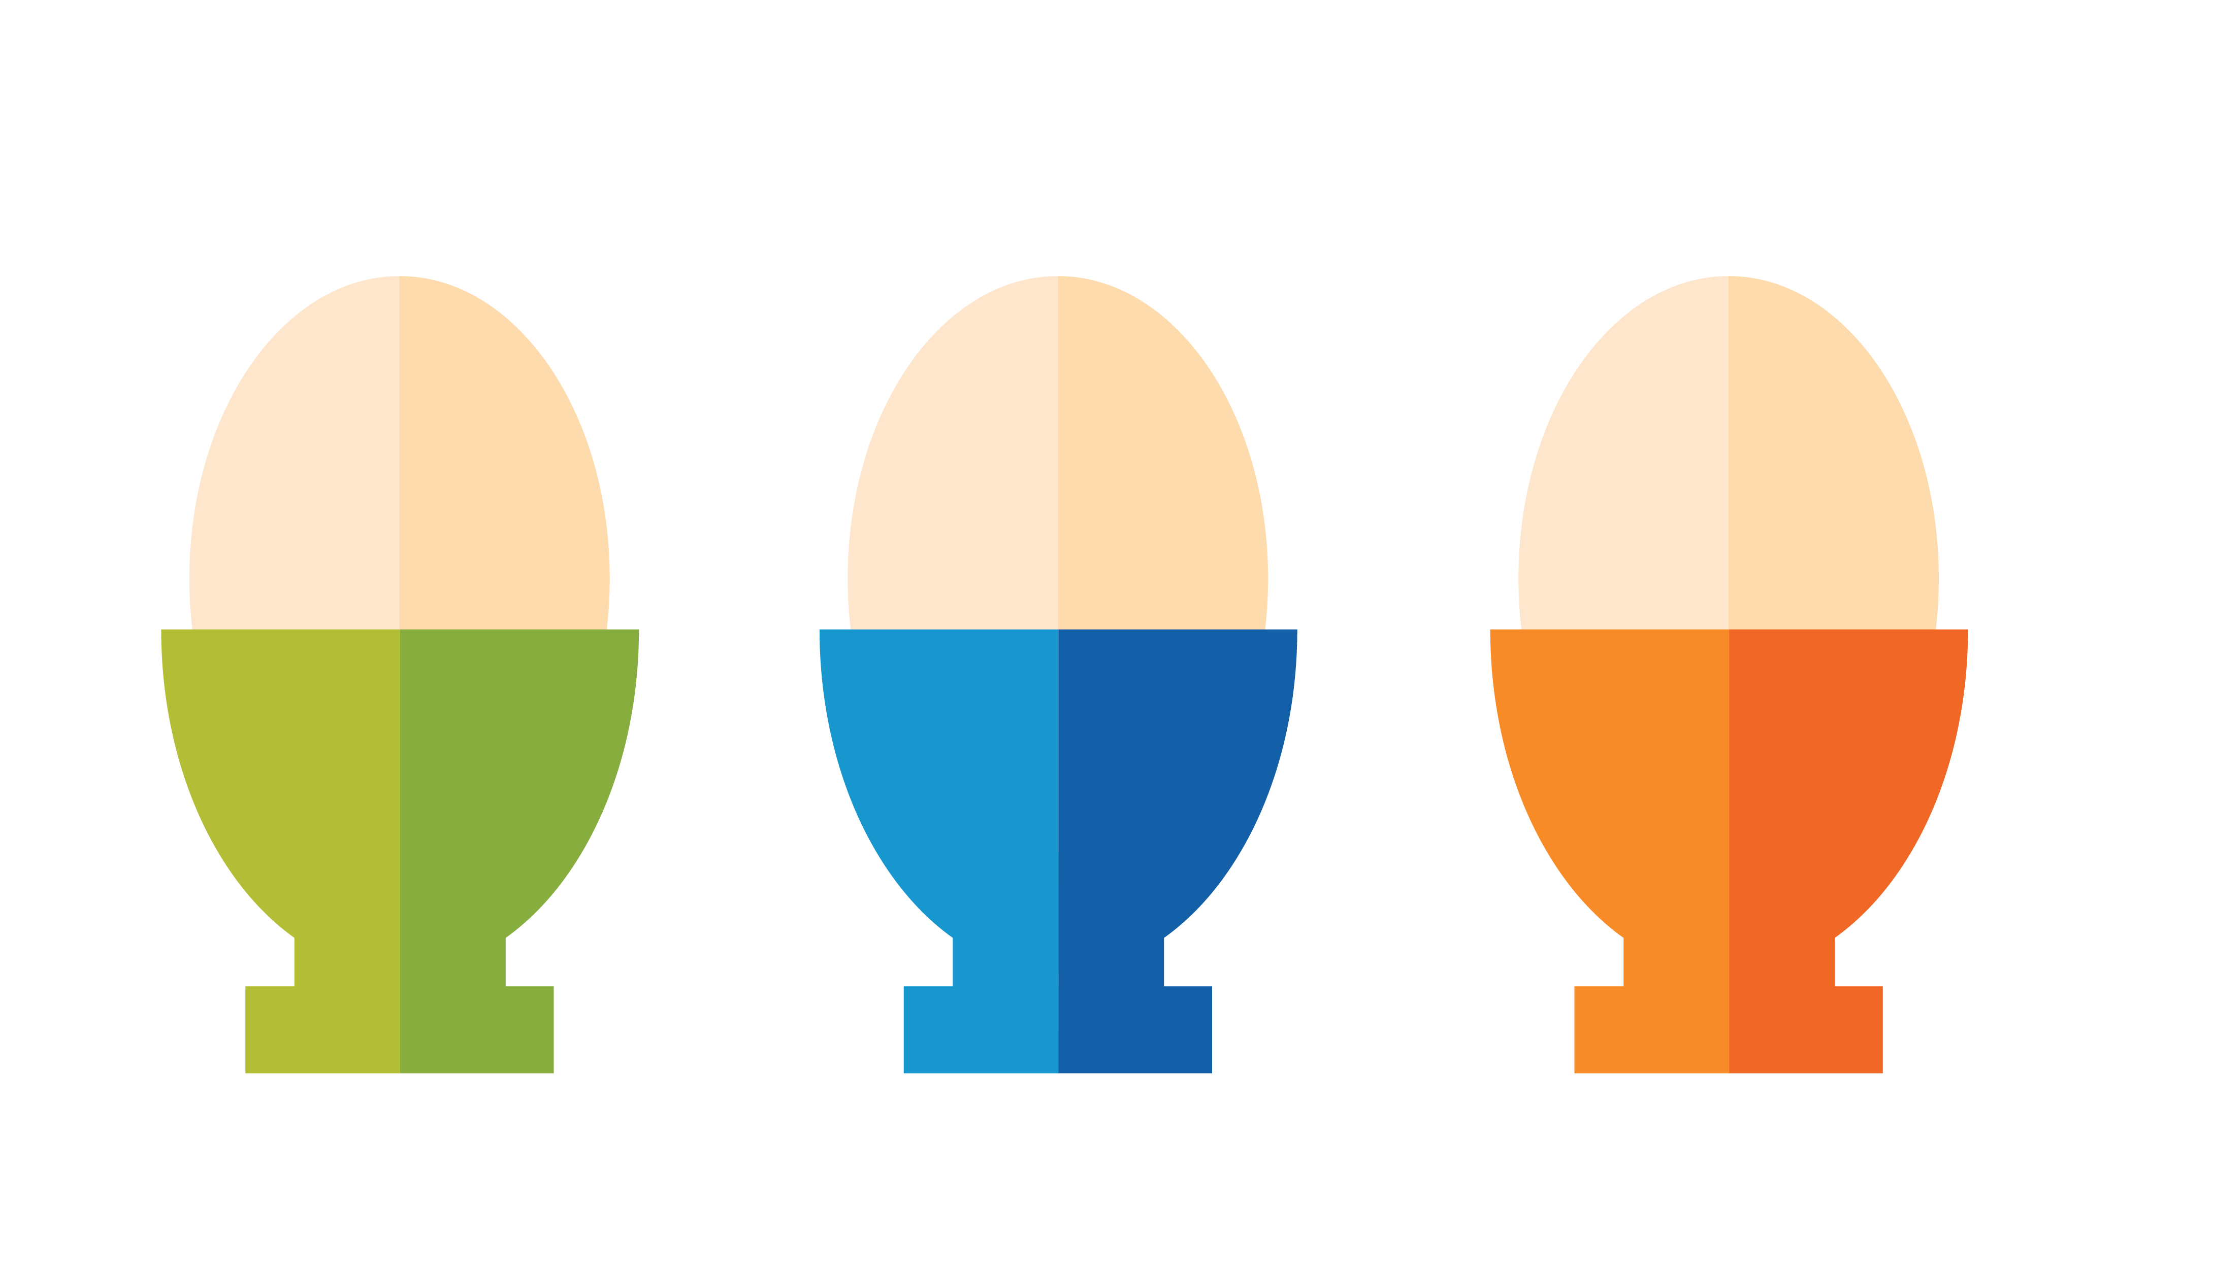



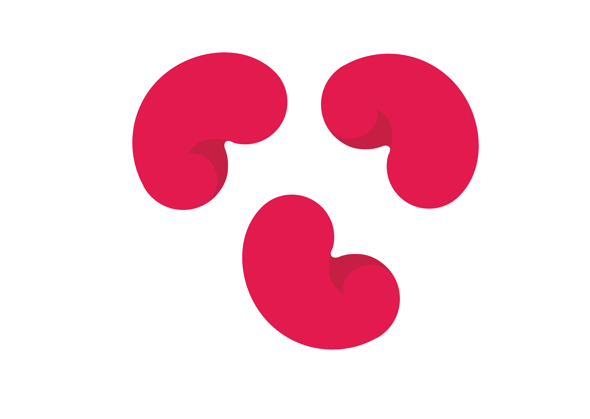



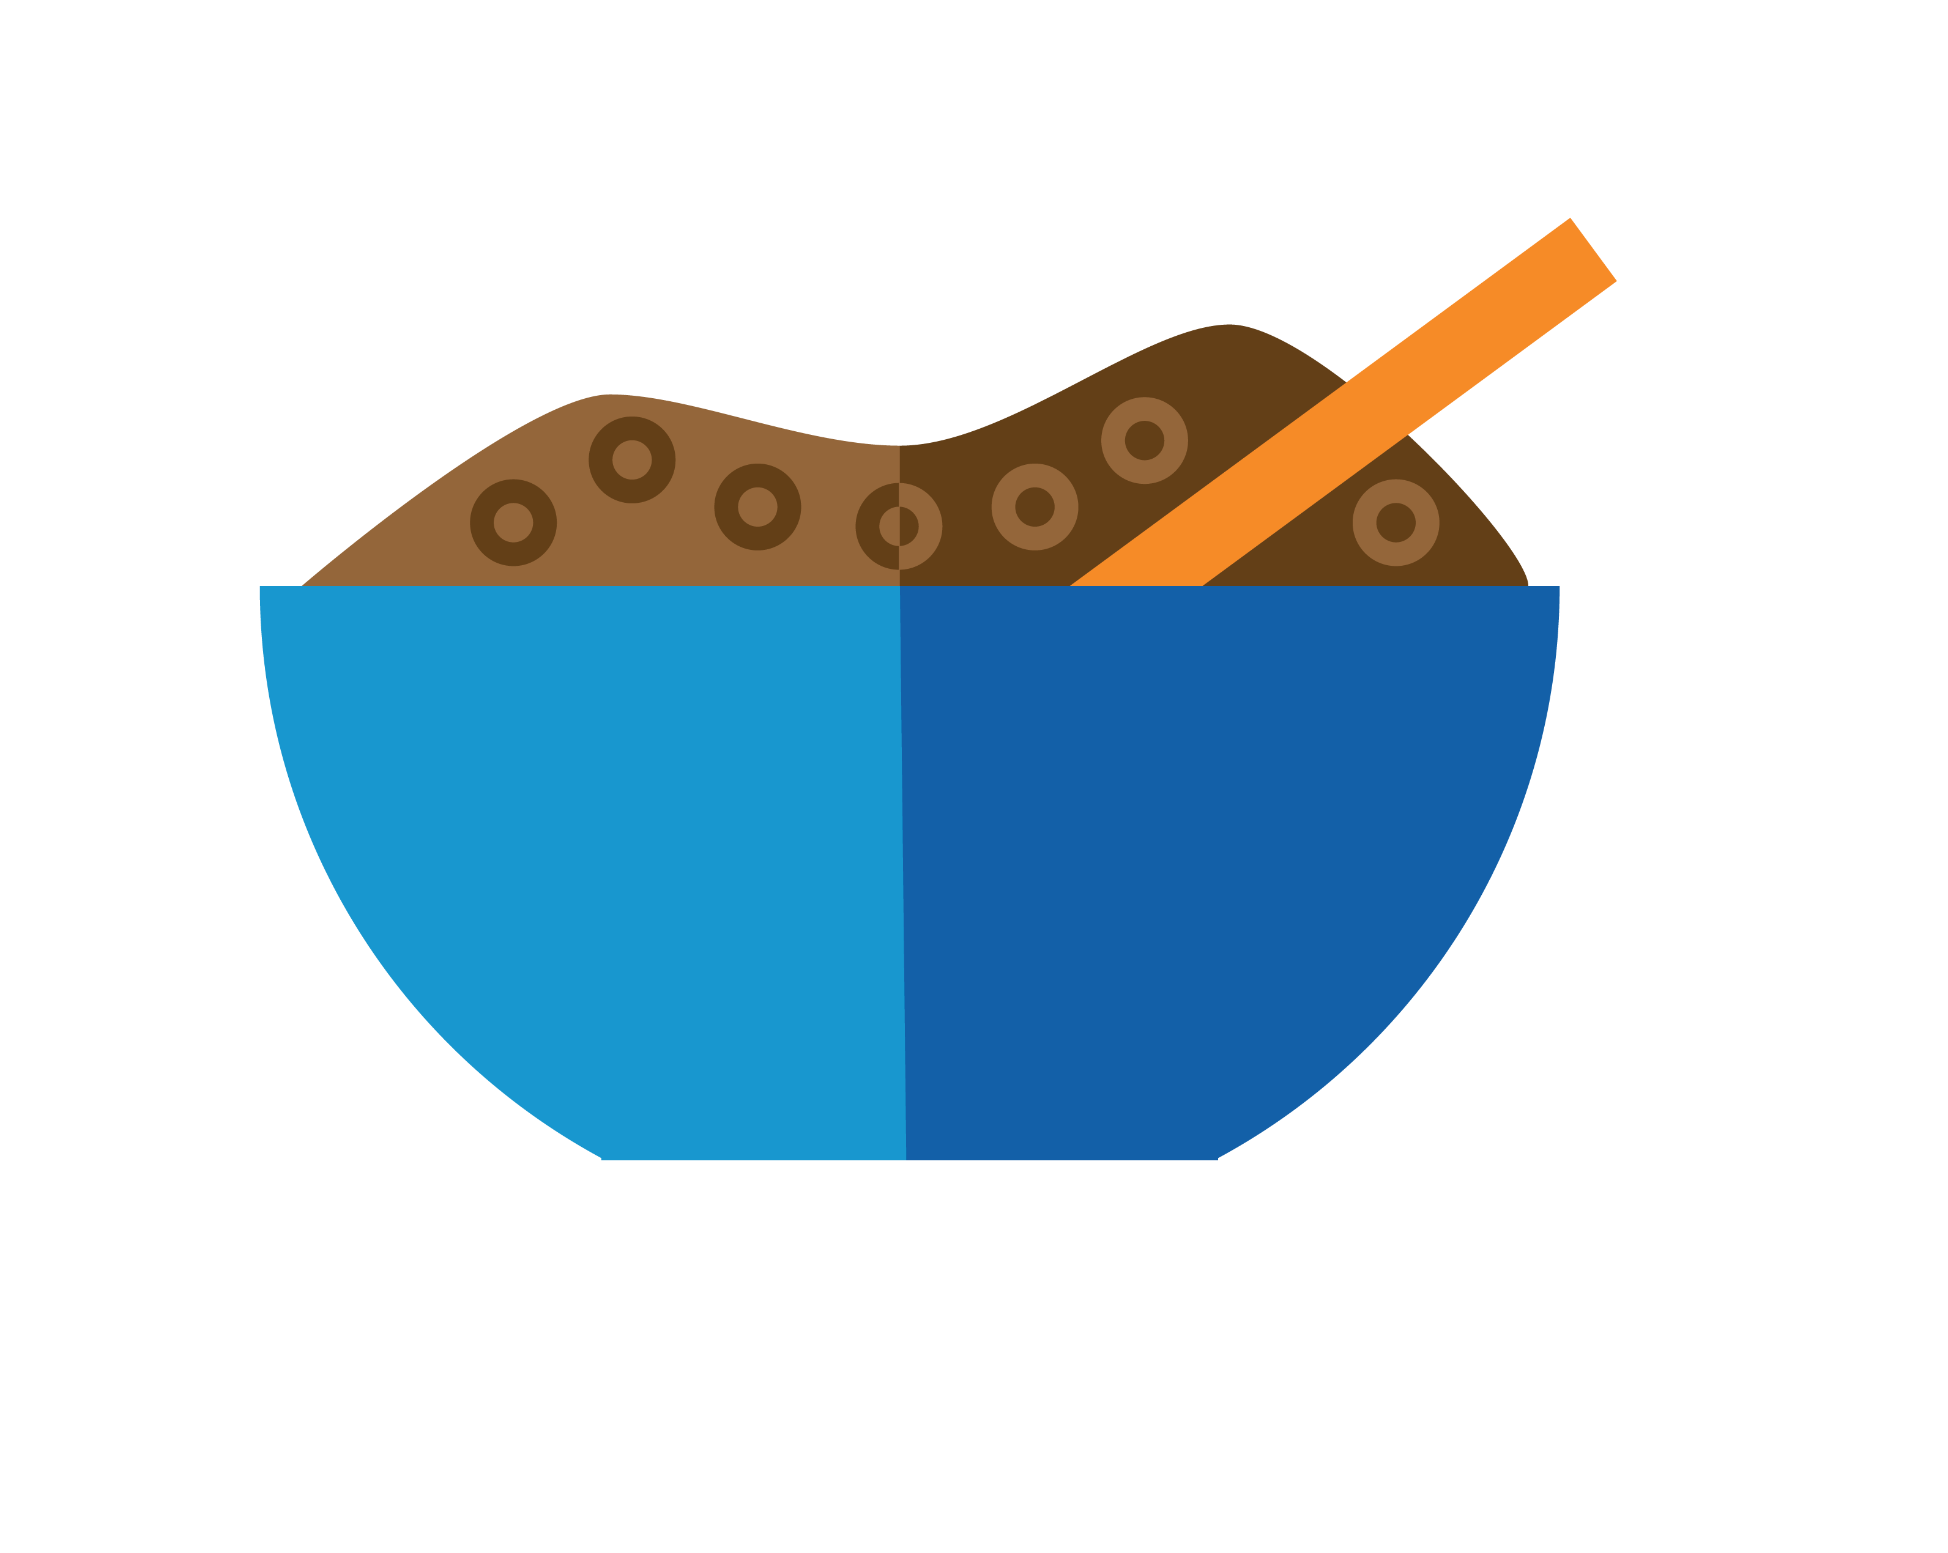
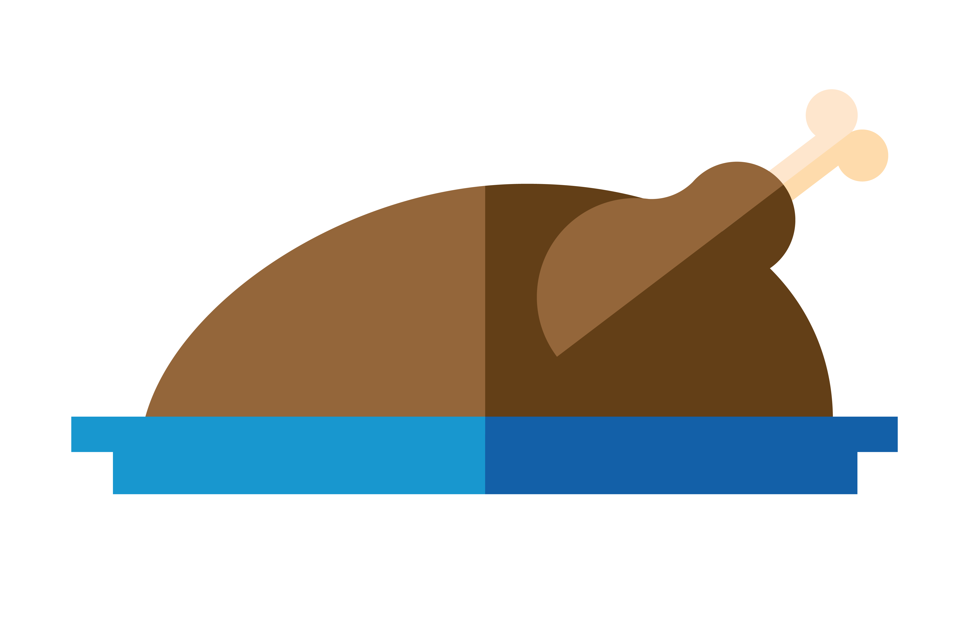

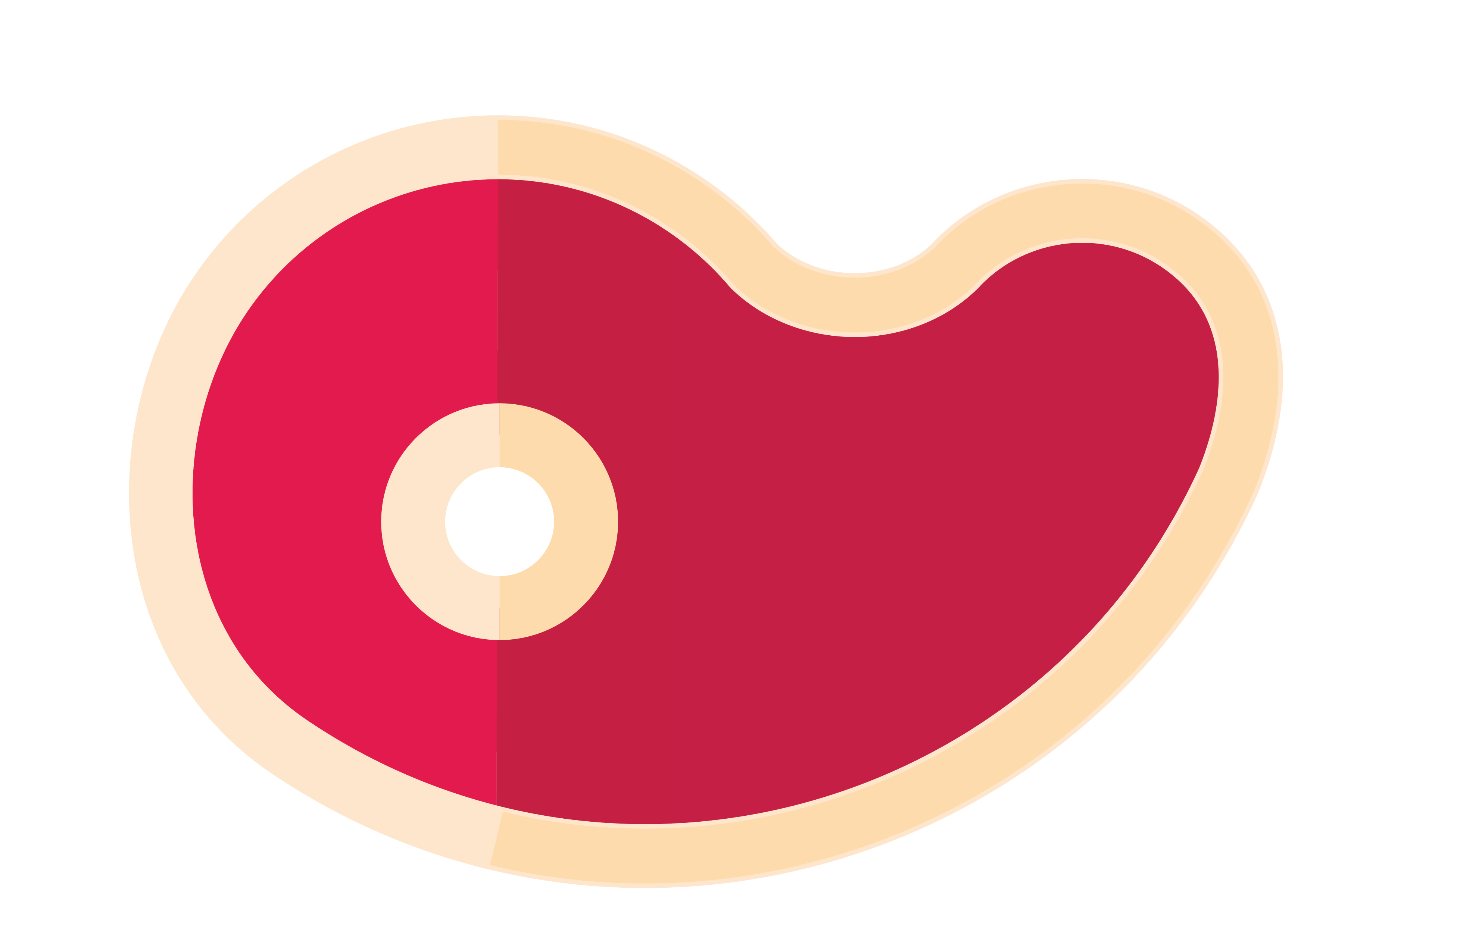


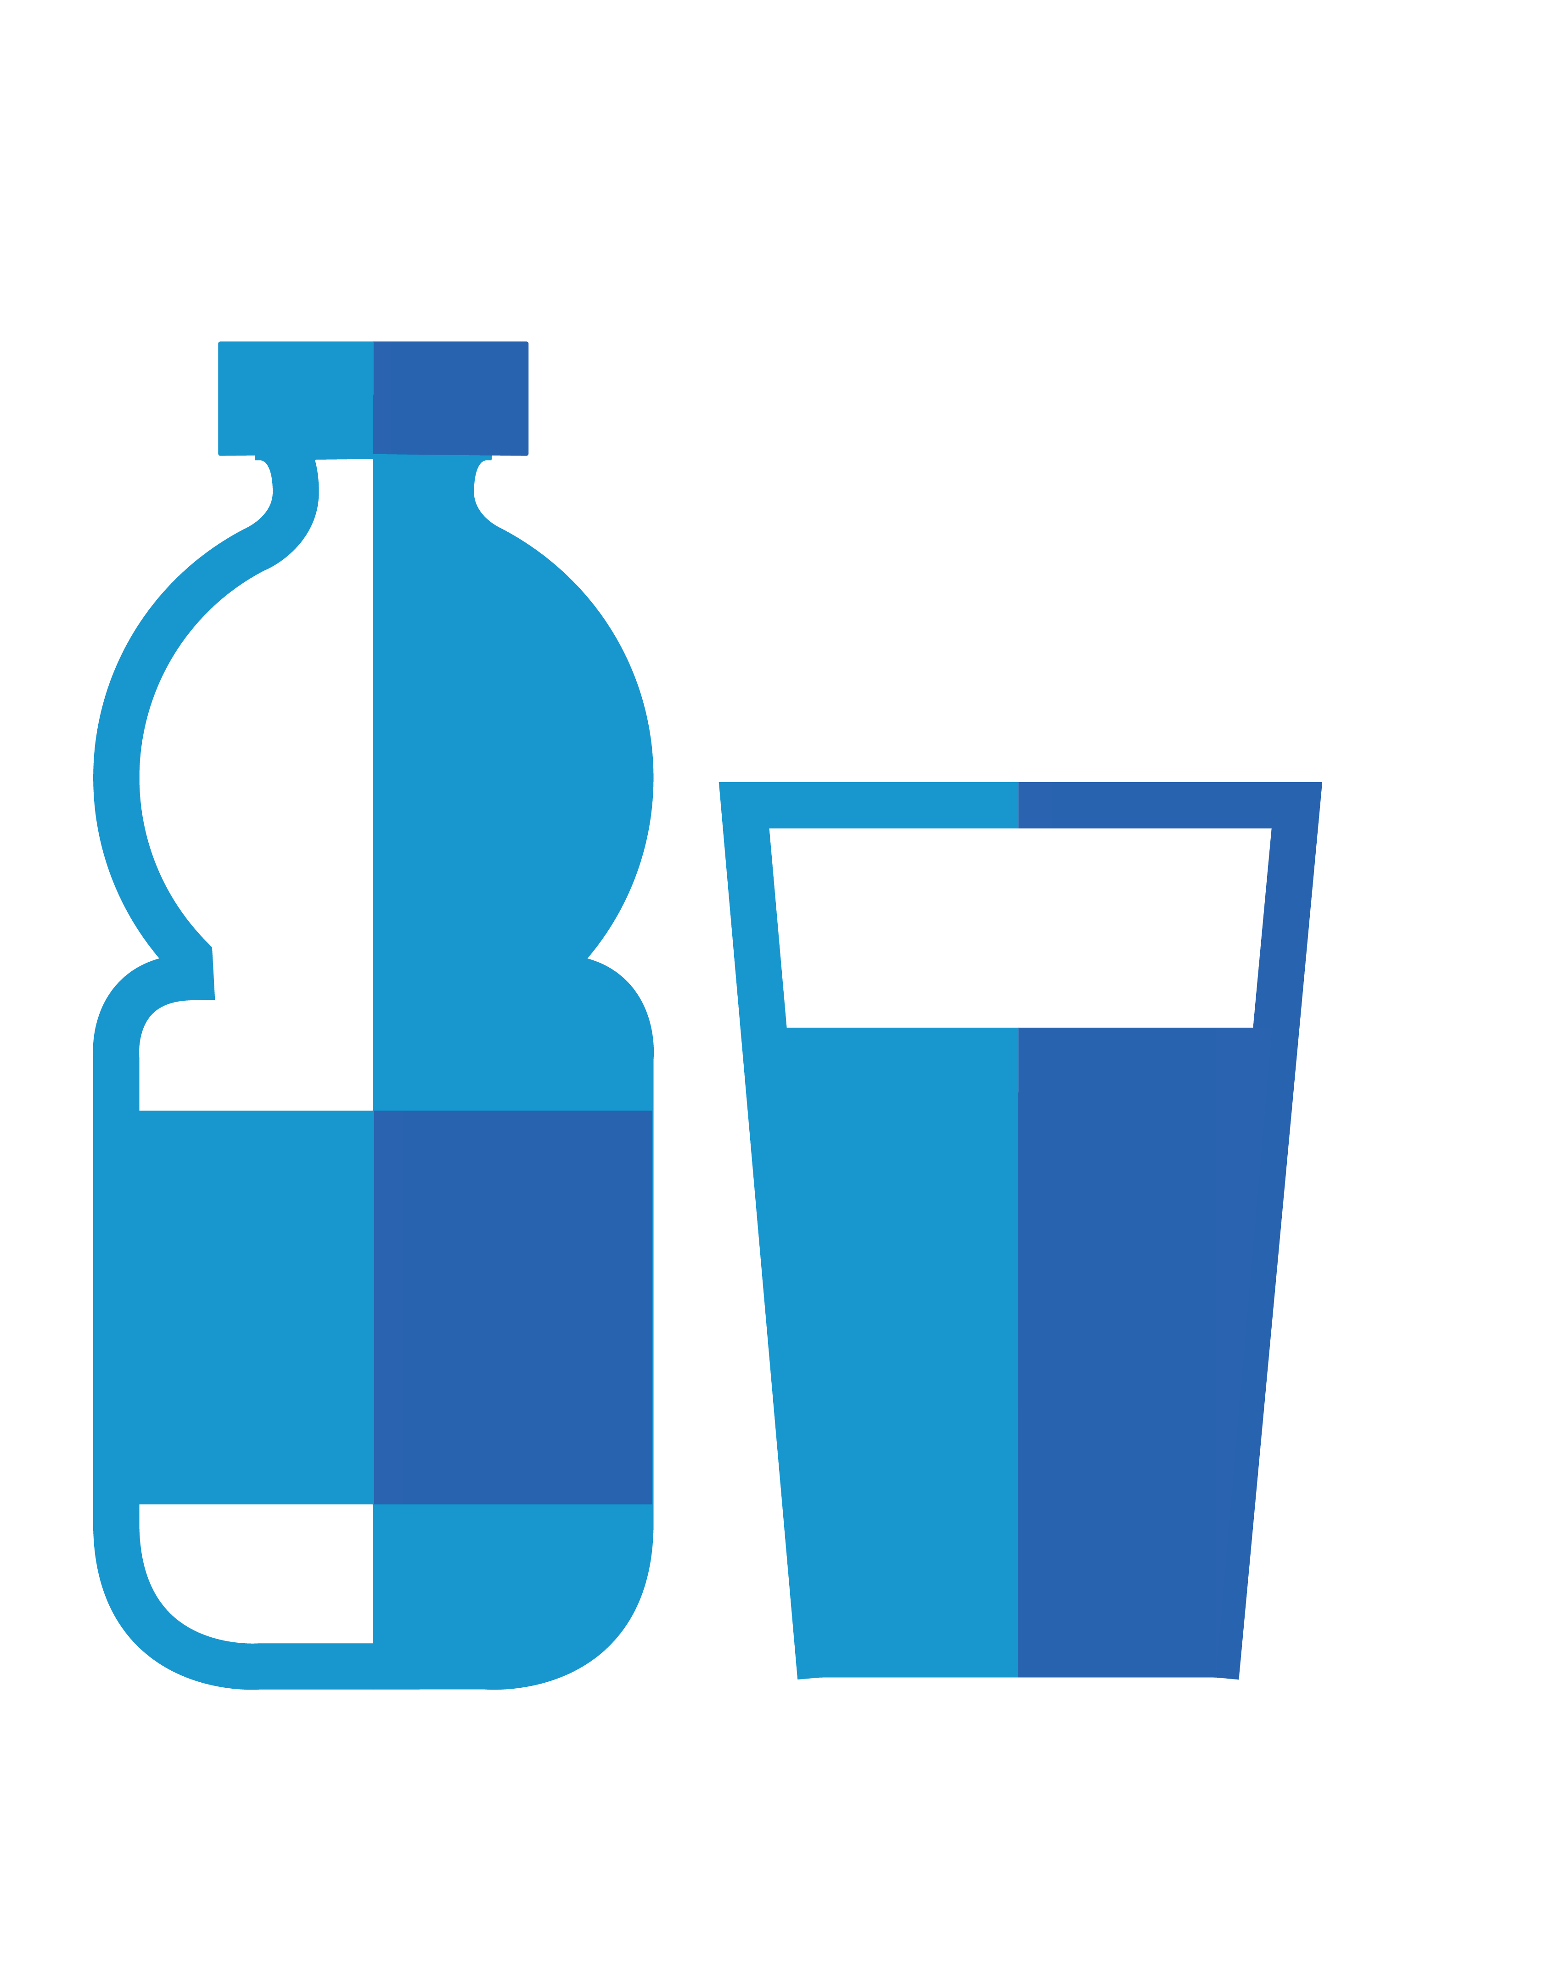


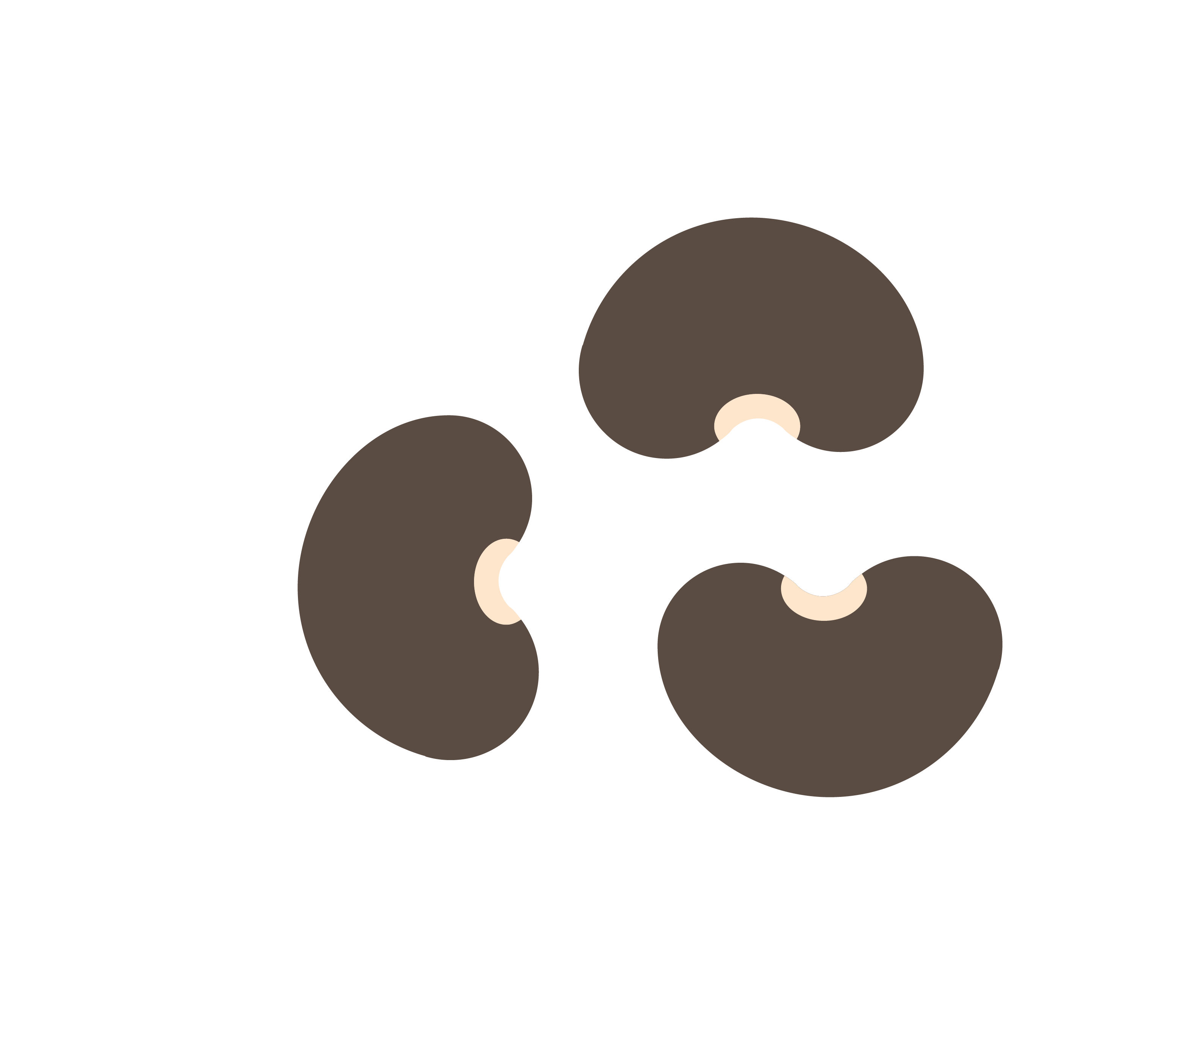

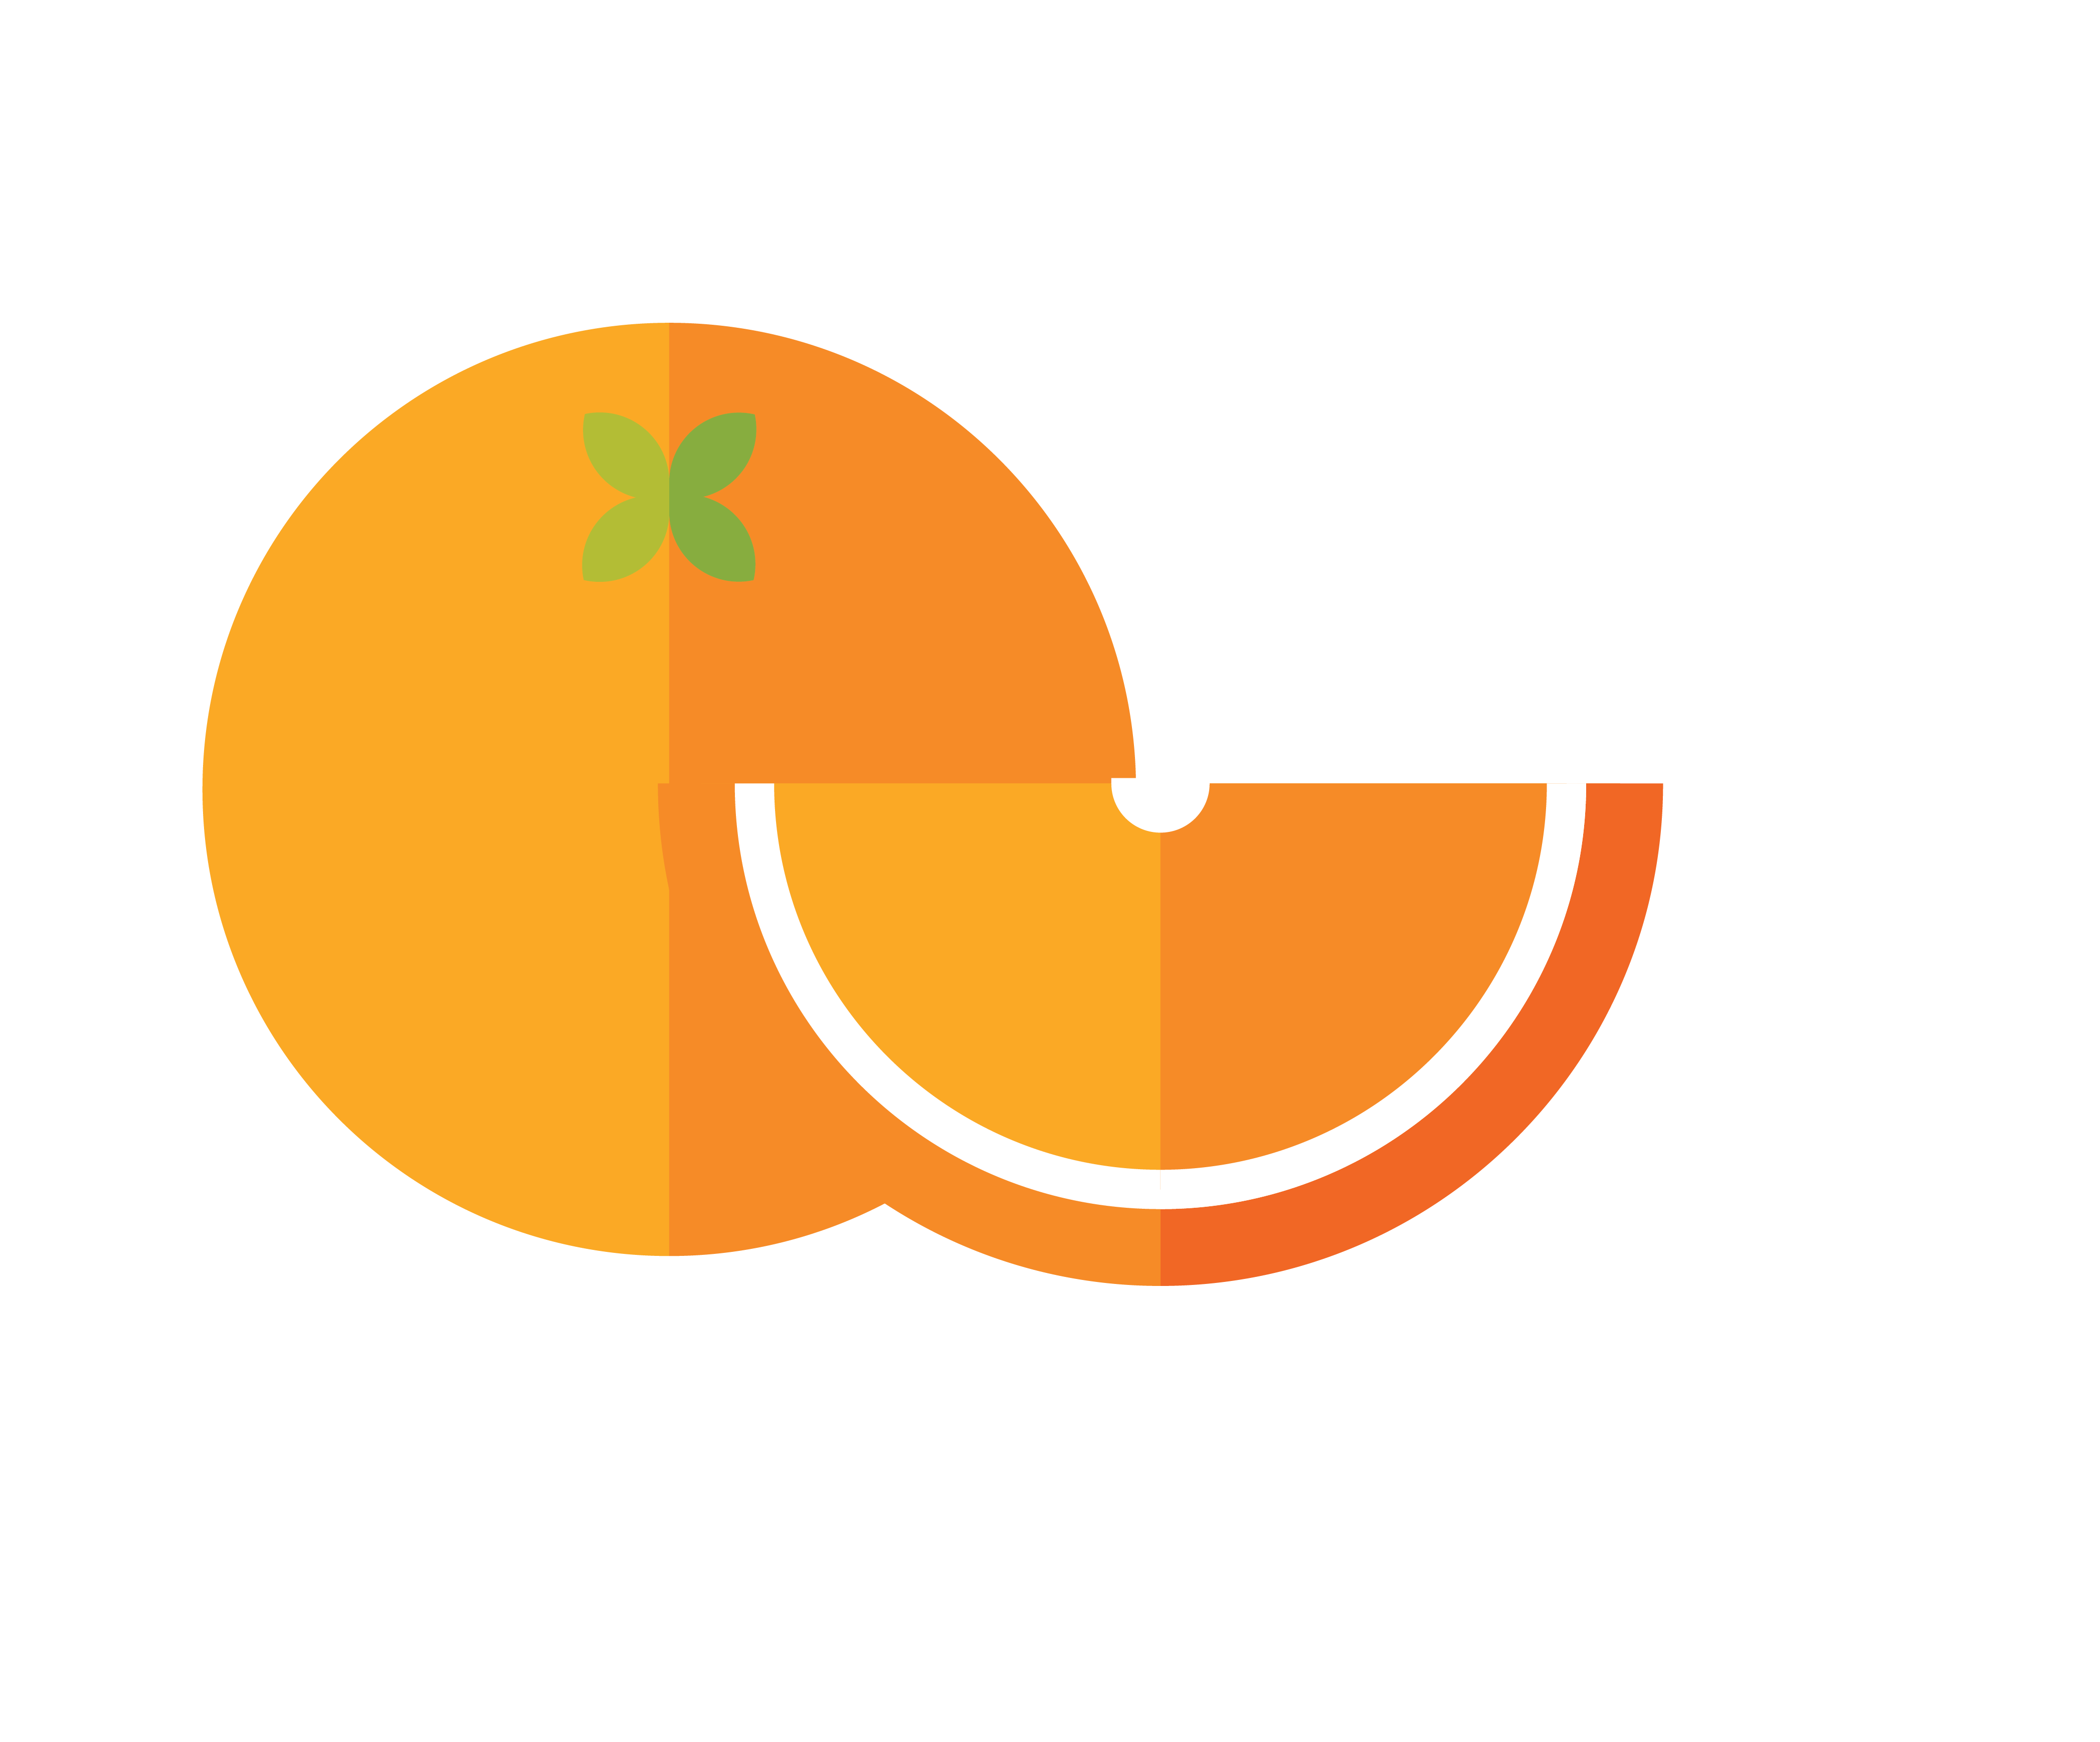

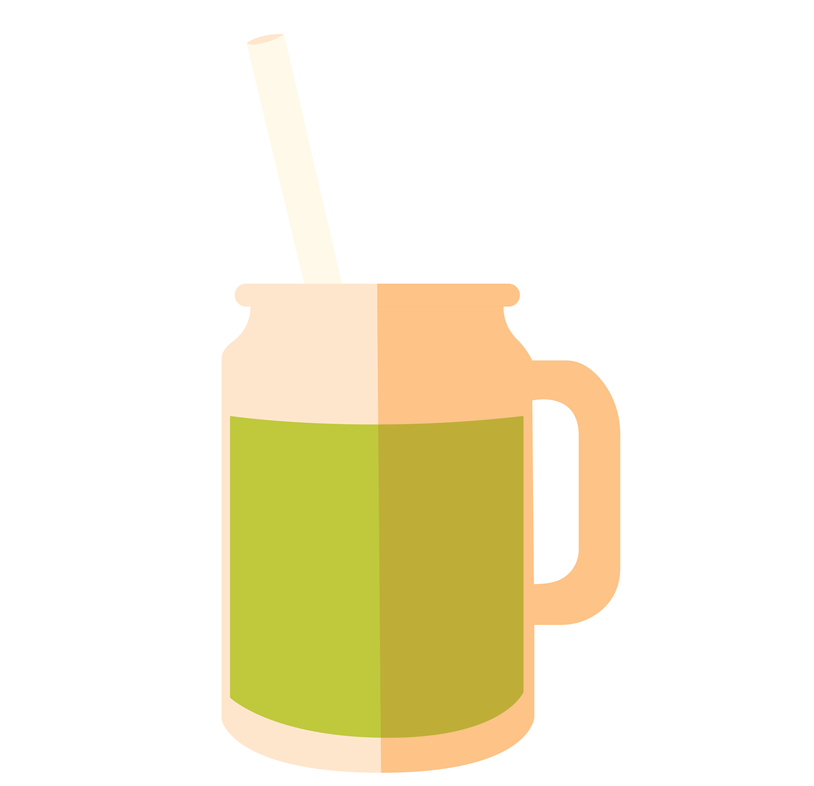
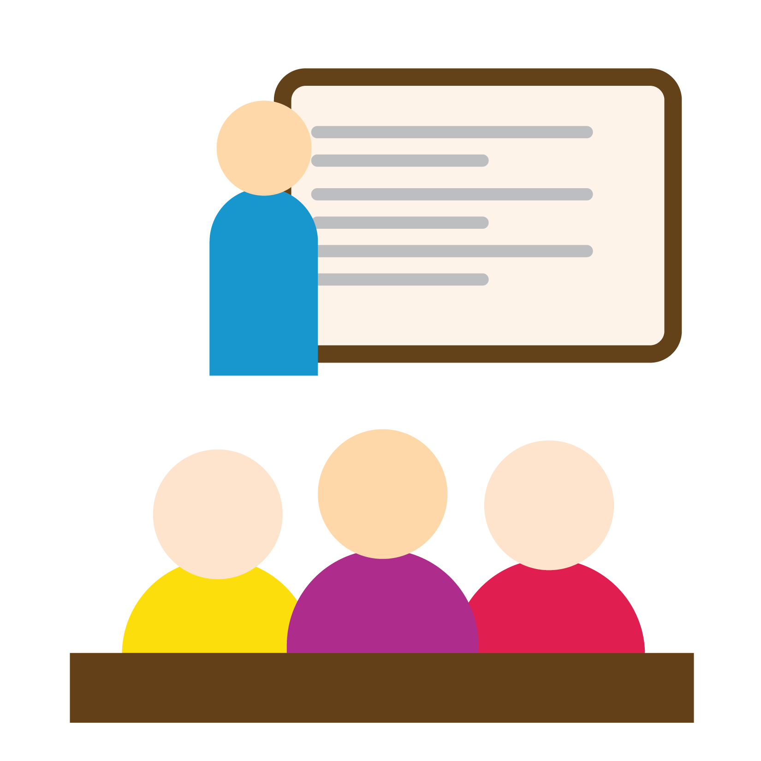

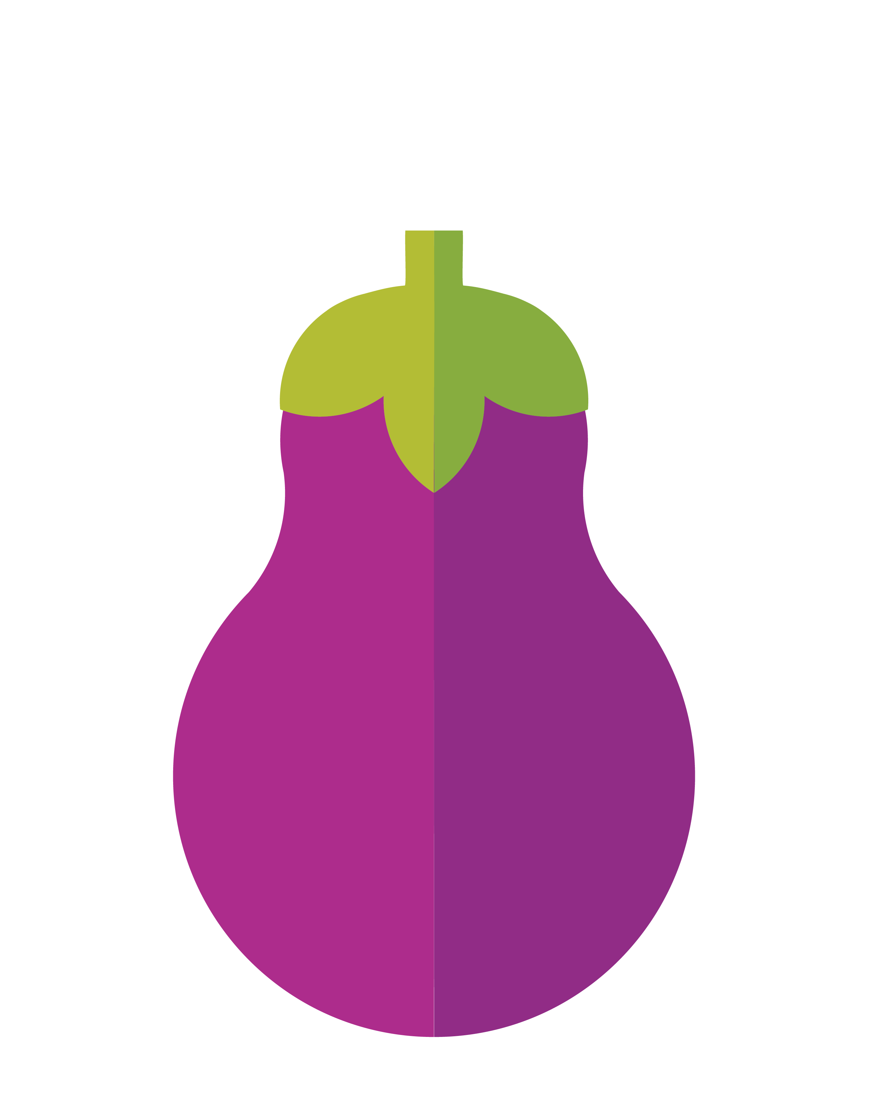




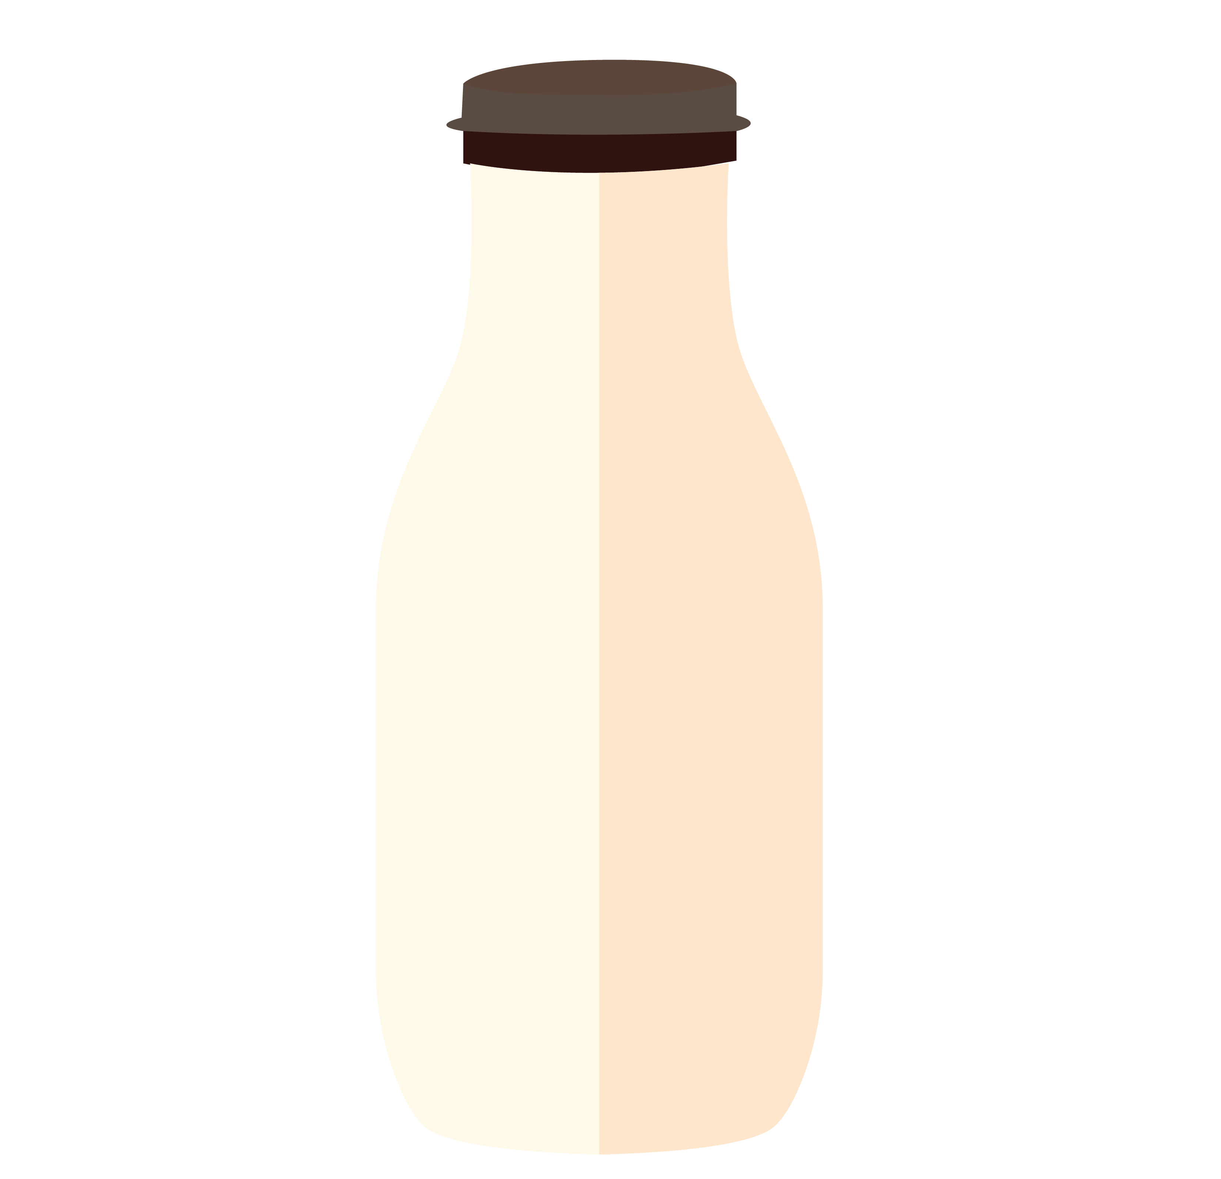

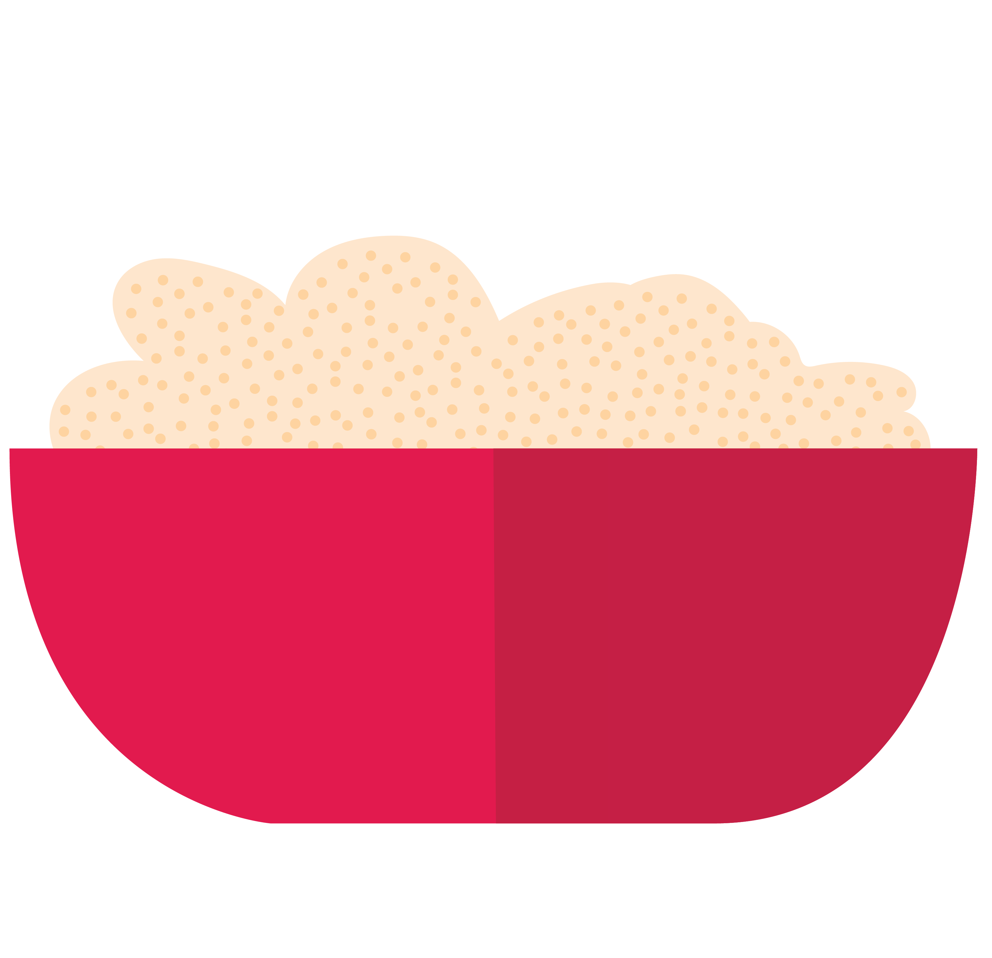








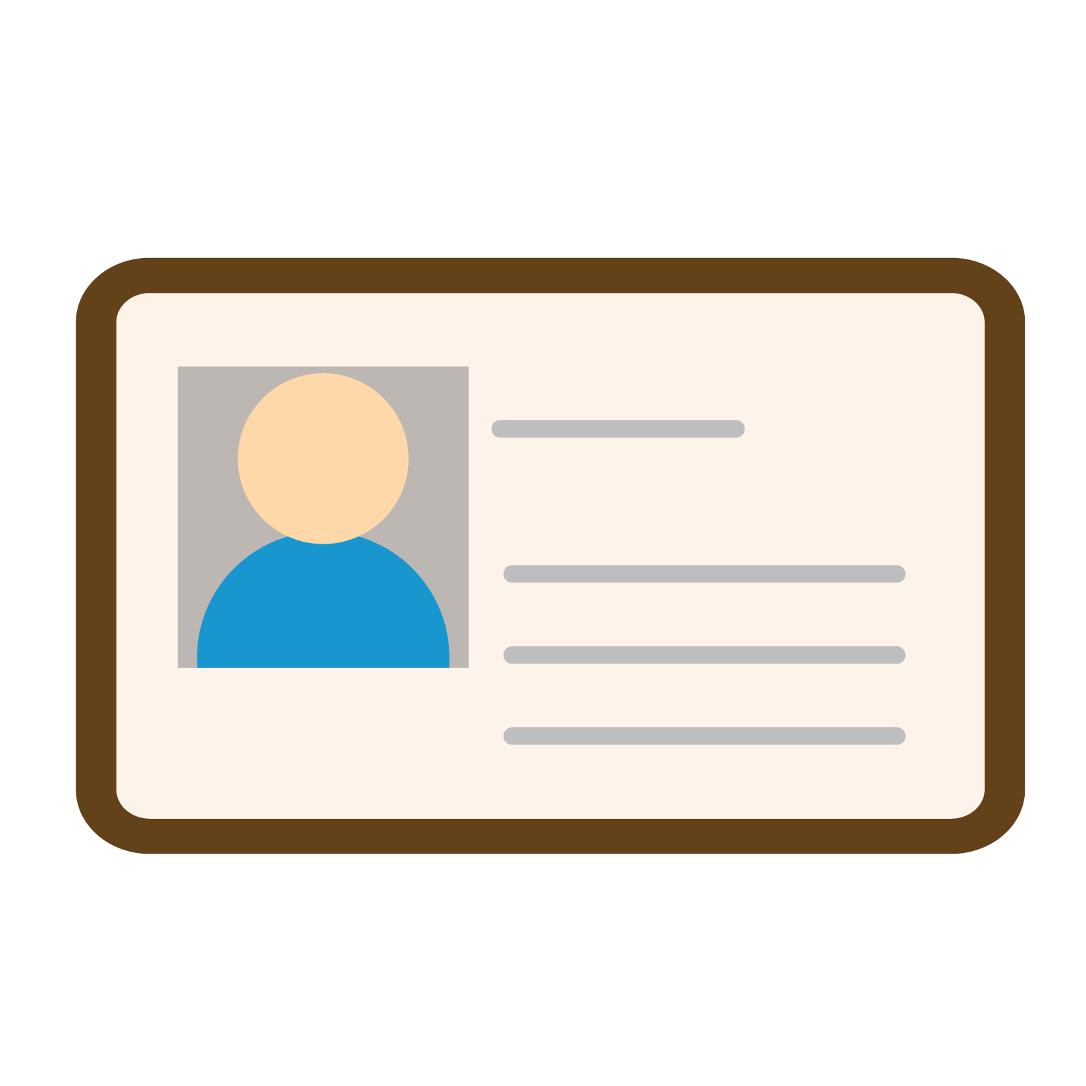












Icon Library

