Slide 1

Managing Stress & Building Resilience
Participant Guide

Slide 2
Welcome
Dear participant,
We are very happy to welcome you to the Family Health Forum on Managing Stress & Building Resilience. Family Health Forums provide a space for caregivers, parents, and siblings of people with intellectual disabilities to engage with health professionals, community leaders, and service providers. People with intellectual disability are more prone to chronic health conditions than people without intellectual disability. This includes conditions such as obesity, diabetes, asthma, and cardiovascular disease. Family Health Forums are places to learn more about different health conditions, understand the available services in our communities and to connect with other families.
This forum will focus on the following:
Understanding stress and wellbeing.
Strategies for managing stress and regulating emotions.
Action planning for a regular self-care routine
This is your personal workbook for The Forum. It contains the agenda, worksheets, handouts, and other helpful resources related to managing stress and building resilience. During the event, your facilitator will guide you on when to use your workbook.

Slide 3

Welcome Reflection
Let’s Think
What has worked for you when you are feeling stress?
What has not worked or what has been some of your biggest challenges or areas of concern related to managing stress?

Slide 4
Welcome Activity
The Stress Response Game
What would you do in this situation? Fight, Flee, Freeze?
What do you think is happening inside of your body during this situation?
Group 1:
While on safari you step out of the vehicle to take a picture. To your surprise you encounter a lioness and her cubs unexpectedly. Fear grips you as the lioness roars. With adrenaline coursing through your body will you run to safety? Freeze? Or try to fight the lioness?
Group 2:
During a routine school day, you settle into class expecting a typical lesson. However, the teacher starts handing out papers for a surprise test. You feel a wave a panic wash over you. Thoughts race through your mind as you try to recall the material for the test.
Group 3:
You work as a manager for a high-pressure company with tight deadlines. You constantly have new projects and dissatisfied clients. You struggle to find a work-life balance. Long hours and work-related worries have taken a toll on your physical and mental health. You feel trapped in a cycle, unable to seek help or make changes.

Slide 5

Individual Reflection
Finding Joy
Let’s think
What nourishes you?
What depletes you?
Individual Activity
Recharging my Self-Care Energy
Physical Wellbeing
Mindfulness
Emotional Wellbeing
Social Wellbeing
Mental Wellbeing

Slide 6
Individual Reflection
Let’s Think
What is one self-care strategy that you will try at home?
How will you carry out this strategy?
Who will you tell to help you achieve your goal?

Slide 7
My Notes

Slide 8
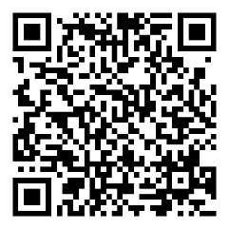

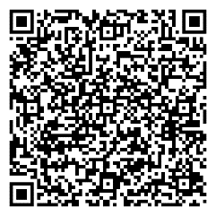


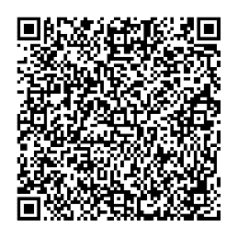
Helpful Resources
 | Special Olympics Strong Minds Website Strong Minds is an interactive learning activity focused on developing adaptive coping skills.
 | Tips for keeping a Strong Mind Strategies for emotional health and wellbeing.
 | Special Olympics Self-Care tips for families 10 strategies for self-care.

Slide 9

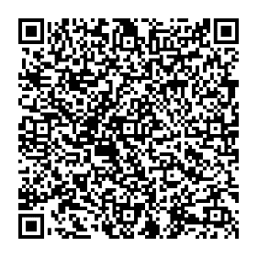



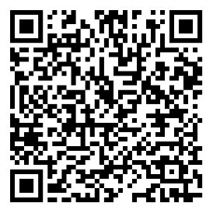
Helpful Resources
 | Strong Minds family tip sheet & calendar Tips and ideas about ways to de-stress, have fun, and integrate healthy living choices into day-to-day lives.
 | Special Olympics My Health Strategies to handle stress, understanding our sleep and where we feel stress in the body.
 | Special Olympics Strong Minds Mindfulness Recordings A series of 14, 5-minute Special Olympics Strong Minds meditations.

Slide 10


Family Health Forums, part of Special Olympics Health, are made possible through the generous support of our funders.
This work was supported by Award Number NU27DD000021, funded by the Centers for Disease Control and Prevention. Its contents are solely the responsibility of the authors and do not necessarily represent the official view of the Centers for Disease Control and Prevention or the Department of Health and Human Services.

Slide 11







































































