Slide 1


Family Health Forum
Healthy Eating for the Family
Notes:
Note:
This slide deck is to guide the facilitator in the presentation and activities for the FHF, Healthy Eating.
Notes and commentary for facilitators are indicated in this section on all of the slides
Be sure to adapt the slides, language, text and images to better suit your context
Remember to collaborate with local nutrition experts in adaption of the content to ensure adherence to appropriate nutrition guidelines/recommendations for your context
Say: housekeeping and norms
Before we get started a few housekeeping needs:
Location of toilets/washrooms
Snacks or drinks
Other logistics

Slide 2

Introductions
Notes:
Say: Welcome
Welcome to our Family Health Forum! we are looking forward to talking about healthy eating
Let’s get to know each other a little bit and play a memory game where we introduce ourselves.
For this game we will pass around this ball and each person must say their name and their favorite food item. The person speaking throws the ball to someone else and this person must say their name and their favorite food as well as the previous speakers’ names and favorite foods.
Materials:
Item to be passed around (i.e. ball) for introduction game
Name cards or paper for participants to write down their name/decorate

Slide 3
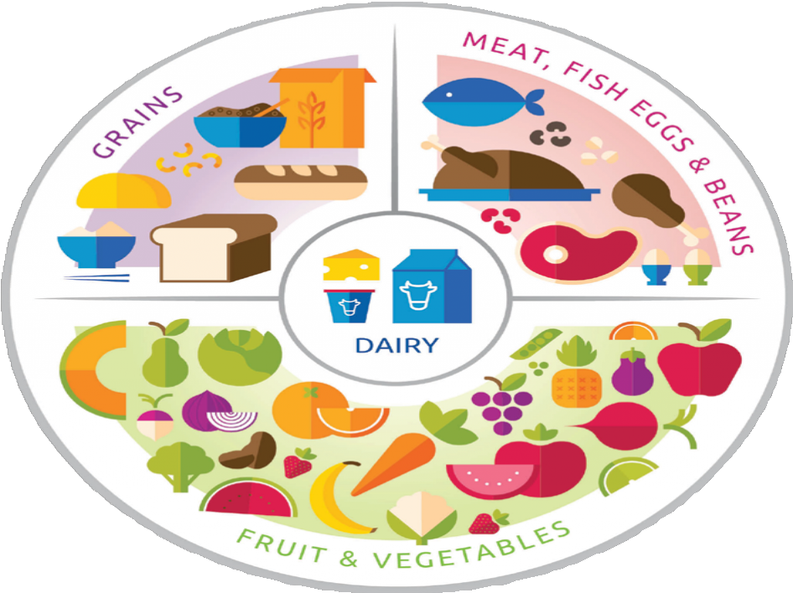
Overview of the Forum
Understanding what healthy eating means
Strategies for healthier meals at home
Action planning for greater access to healthy meals
Notes:
Say:
Today we are going to discuss healthy eating for the family
This session will take about 1 hour and we are going to cover the following topics
Discuss what healthy eating means and the benefits of different foods
Explore strategies for healthier meals at home
And finally, we will create realistic action plans for us to have greater access to healthy meals
We will have a mix of activities, discussion and presentations
We all have something valuable to share and we are here to learn from each other experiences as well.
Feel free to share any questions or comments you may have as we go along.

Slide 4
About
Family Health Forums
FHFs are spaces for:
Connection with other families
Connection with service providers
Our ways of working:
Respect
Active listening
Judgement- free zone
Confidentiality
Notes:
Say: Introduction to Family Health Forums
Family health Forums are occasions to bring families together to share their experiences with each other, and to connect with service providers in the community.
We strive to use these sessions to support your care and wellbeing for yourselves, your family members including athletes, siblings, athletes and others in the home.
As with all Family Health Forums – this is a welcoming space, and we have 4 principles to guide our time together:
We RESPECT each other’s opinions and recognize that we may all be at different stages of caring for ourselves and all members of the family
We use ACTIVE LISTENING to be fully present with each other and give each other our undivided attention. We also provide feedback that aims to enhance our mutual understanding of an issue.
We are a JUDGEMENT-FREE zone – we recognize that we each bring our own unique experiences to this event. We observe our own judgmental thoughts and replace them with non-judgmental ones.
We believe in CONFIDENTIALITY – we agree to keep what is shared and discussed here
We are here to learn from and with each other – feel free to ask questions at any time. You can, ask your question to the group, or you can write down your questions on the cards provided and place them in the question box.
Materials:
Writing/drawing utensils
Loose paper/cards
Basket or other container to collect questions

Slide 5
Welcome
Reflection
What are your successes relating to healthy eating?
What are your challenges or areas of concern relating to healthy eating?
Notes:
Say:
Before we begin, please take a moment to write down your biggest successes and challenges regarding healthy eating as a family.
Turn to page __ in your participant workbook and record your thoughts there.
Ask:
After a few minutes, ask participants if there any volunteers who would like to share their responses.
Other:
Remind participants it is not mandatory to share
To do:
Show participants where in their participant workbooks they can fill in their responses
Materials:
Writing/drawing materials

Slide 6





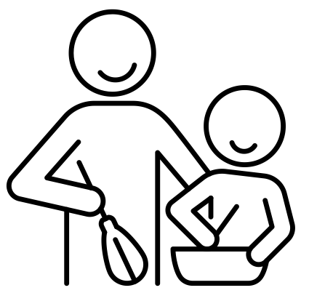

Healthy Eating Quick Tips
Variety is key
eat a variety of fruits, vegetables, and lean proteins
Balance is key
some foods have more benefits than other foods find the balance that works for you
Half & Half
eat half whole grains and half refined grains
Healthy can be affordable
More fruits & vegetables
eating healthy doesn’t have cost money
have more fruits and vegetables throughout the day
Cooking together
Show & tell
model health eating for others in the family
engage the whole family in meal preparation and cooking
Notes:
Say:
Throughout the session we will highlight the following key messages
Ask:
Is there a volunteer who would like to read out the first key messages?
Notes:
Continue asking until all the key messages are read. If no volunteers, facilitator reads out the key messages

Slide 7
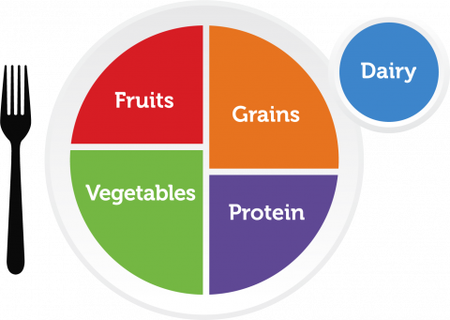
Healthy Eating Understanding MyPlate
MyPlate shows us how much of each food group we should eat
Notes:
Ask:
Is anyone familiar with this picture of a plate? What do you think it is about? You are welcome to also record your responses in your participant workbook.
Note:
Allow some time for participants to respond
Say:
This image of a plate is a helpful way for us to think about healthy eating
It shows us generally how much of each food group is recommended
You can see that vegetables are the largest section of the plate followed by grains
Together, fruits and vegetables fill half of the plate while proteins and grains fill up the other half.
And milk and dairy products are also included

Slide 8
Small Group Activity
What is in my food?
The food benefits game
Can you guess the benefits of your favorite foods?
Notes:
Say:
We are going to quickly refresh ourselves about the benefits of some of our common foods
In your groups you are going to play the Food Benefits Game
The aim of this game is to guess the benefits of the food group represented in the picture
I will show each picture on the screen for 1 minute.
In your groups you will have 1 minute to guess the benefits of that food group.
In your participant workbooks on page___you will also see the 3 pictures. Your group can record your list of benefits there.
We will see how many benefits you can record in 1 minute.
When you have completed all three food groups you can read the benefits in the back of your workbooks – you can see how may benefits were correct.
Notes:
Divide participants into 3 groups
Present on the screen the following pictures of different foods/or show participants where this appears in their workbooks
If virtual – assign a group leader for each group who will go through the pictures of food slides
Materials:
Participant workbook (page with pictures of the different foods for the food benefits game)
Food Benefit game PowerPoint slide pictures
Timer/stopwatch

Slide 9
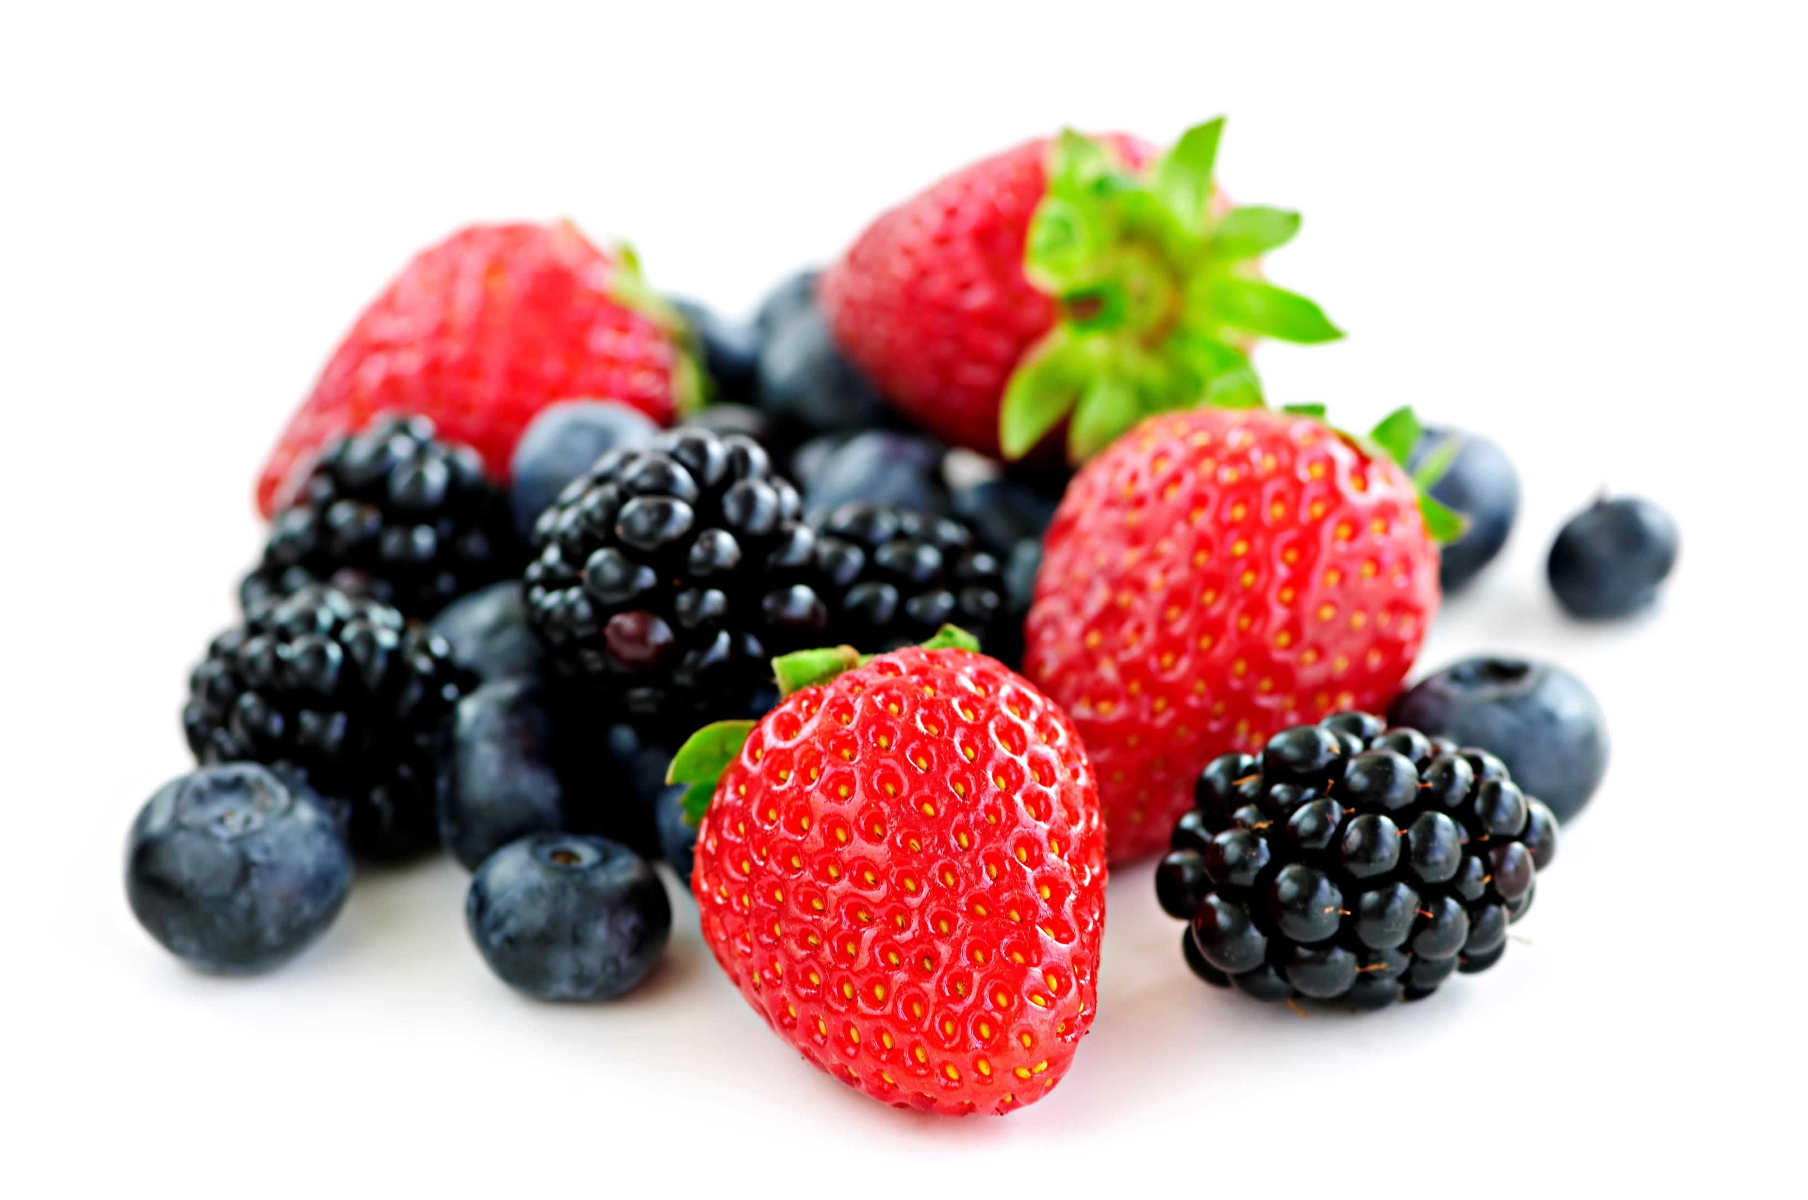
The Food Benefits Game: Picture 1
Notes:
Say:
The first picture is berries, representing the fruits category
Ask:
Are you ready?
Write down as many benefits as you can
Timer starts, now
To do:
Set timer for 1-minute
Say:
Time is up.
Save this and we will go on to the next picture

Slide 10
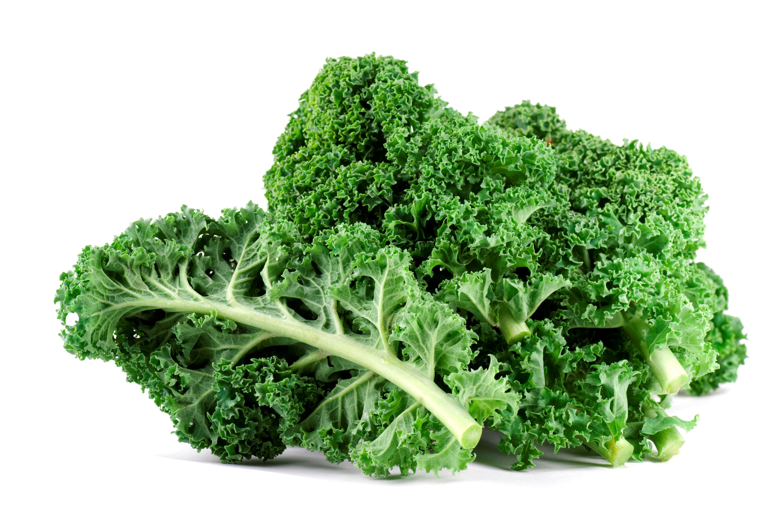
The Food Benefits Game: Picture 2
Notes:
Say:
The second picture is kale, a leafy green representing the vegetables category
Ask:
Are you ready?
Write down as many benefits as you can
Timer starts, now
To do:
Set timer for 1-minute
Say:
Time is up.
Save this and we will go on to the last picture

Slide 11
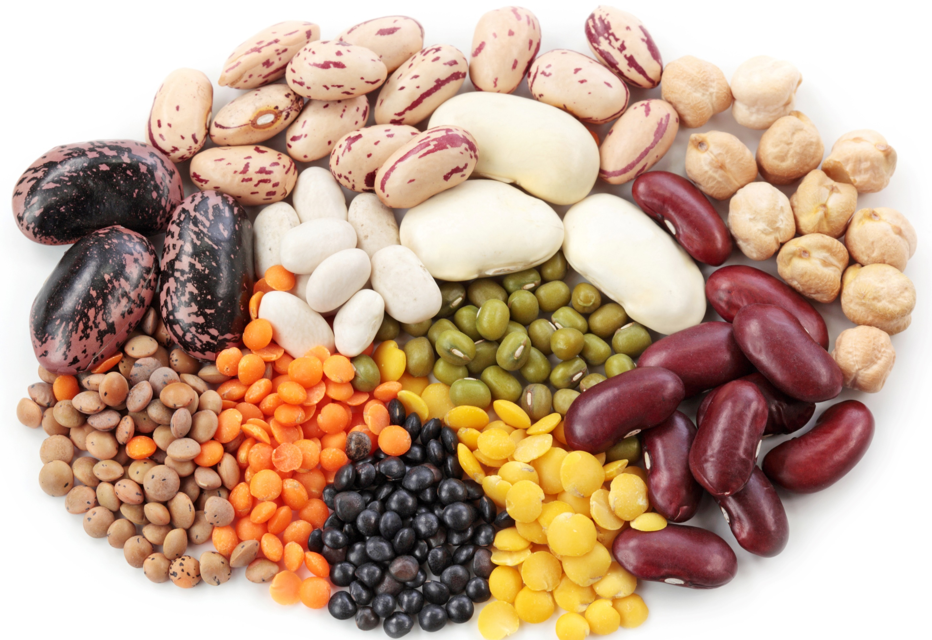
The Food Benefits Game: Picture 3
Notes:
Say:
Our last picture is a mix of beans and lentils, representing the proteins category
Ask:
Are you ready?
How many benefits of proteins can you recall?
Say:
Timer starts, now
To do:
Set timer for 1-minute
Say:
Time is up.
Now that you have finished, turn to page XX of your participant workbooks and read together the benefits of the food groups presented.
After 3 minutes:
Say:
We will move on, but you have in your workbooks a list of benefits for all of the food groups. Feel free to review them in your own time.

Slide 12
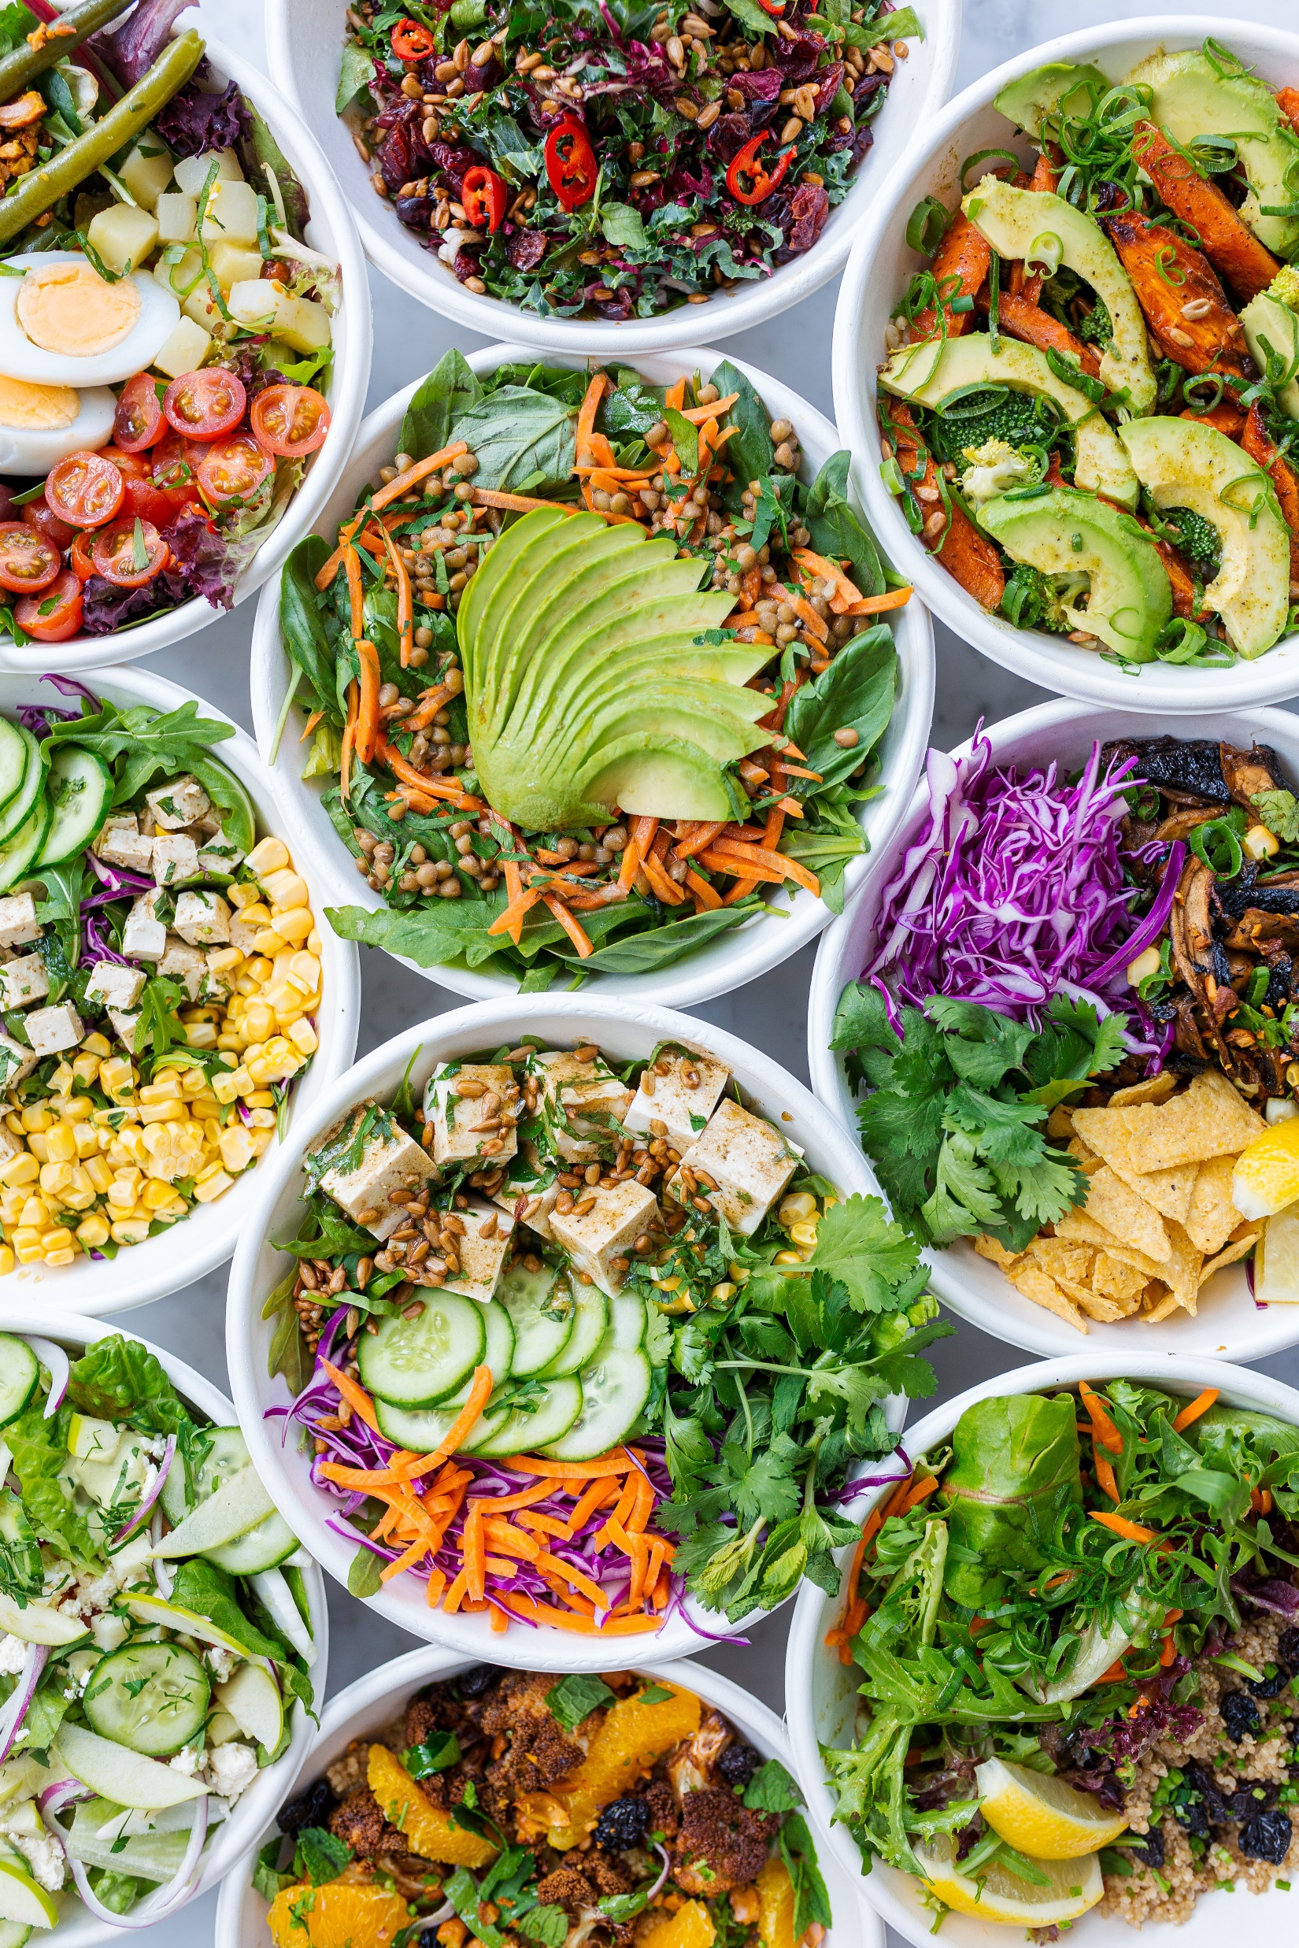
Recommendations for Healthy Eating
Eat a variety of fruits and vegetables
Consume a variety of proteins (including lean protein)
Eat half whole grains and half refined grains
Use unsaturated vegetable oils
Have more low fat or non-fat dairy options
Notes:
Facilitator note:
After The Food Benefits Game the following slides can be used to highlight recommendations of different foods
Say:
Thanks for playing the game, I hope we all have an idea now about the benefits of different foods.
Key things to remember is to eat a variety of foods across the food groups
Whole, sliced and pureed fruit is always a great choice – watch out for juice, unless it is 100% fruit it can have a lot of added sugar that reduces its health benefits
In your participant workbooks you will see a list of local foods across all these categories. Have a look at it when you have time and see which ones you already knew of and which ones are new.
To do:
Collaborate with your local nutrition partner to identify a list of locally available foods across all food groups for the participant workbooks

Slide 13
Small Group Activity: Build a Plate
Discuss in small groups which foods go into each category
As a small group create your own ‘Plate’ with materials provided
Notes:
Say:
Now that we are familiar with the benefits of different foods, we are going to work together in small groups to build a meal together across all the food groups.
In your small groups, build your plate, remember to ensure there are as many minerals and nutrients as possible. Remember to use common foods that are easily available
After you have made your plate, each group will share their plate with the larger group.
For this activity we are going to use the general guidelines of the MyPlate template, these are similar to the global guidelines for a healthy diet by the World Health Organization.
When you have time, you can review the global healthy diet guidelines which can be found in your participant workbooks.
Note:
Divide participants into their small groups
Guide participants to the MyPlate template in their workbooks.
Show participants the page in their workbooks for the global guidelines for a healthy diet by the World Health Organization.
Materials:
Drawing/writing materials – different colors
Participant workbook with blank template of MyPlate for participants to draw/write in their foods

Slide 14
Small Group Activity
Finding the Balance: Making meals healthier
Let’s see what happens to our Plate when we swap out certain foods and beverages!
Notes:
Facilitator note:
This activity takes place after participants have shared their ‘Plates’
Say:
Now that we have made our ‘Plates’ let’s explore how we can make some meals healthier
For this activity – turn to page in your workbooks. You have 3 meals pictured there. In your groups discuss how you can you make these meals healthier?
Can you replace the protein to one with more nutrients/benefits
Can you change how something was prepared to make it healthier?
Each group will have the opportunity to present their new ‘Plates’ and tell us how they are still keeping their overall meal healthy
To do:
Show participants the page in their workbooks with the 3 meals for this activity

Slide 15
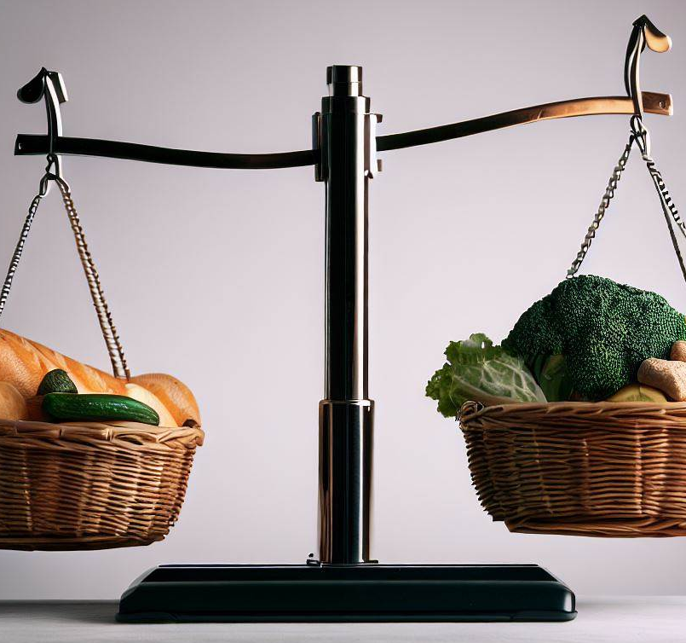
Finding the Balance
There are no ‘good’ or ‘bad’ foods
Some foods have more benefits than other foods
We can mix up the foods on our plate
Some foods we need to eat daily, some we eat occasionally
Notes:
Say:
Thank you for sharing your strategies to make meals healthier
As we can see, healthy eating is a balance.
Remember there are no good or bad foods, rather, some foods have more benefits that others
We don’t always have to eat meals that maximize minerals and nutrients. It is ok to mix it up.
Foods with a lot of vitamins and minerals are called nutrient dense.
We can mix foods on our plate and meals throughout the day so that we have an overall balance of nutrient dense foods and other foods.
Some foods we need to eat daily like fruits because they have a lot of vitamins and minerals, they are nutrient dense.
Some foods we eat occasionally like sweet and high fat foods because they have little vitamins and minerals.
What is important is to find the balance that works best for you and your family.
Ask:
What are some ways you mix foods with more and less minerals?

Slide 16
Small Group Activity
Having more healthy meals
Group 1:
What are 5 low-cost ways of eating healthy
Group 2:
What are 5 ways to support healthy eating among individuals with food preferences
Group 3:
What are 5 ways to create time for making healthy meals
Notes:
Say:
Next, we are going to explore how to have more healthy meals in our everyday lives
Each group will have 5 minutes to put together some responses to their prompts
After the 5 minutes each group will share what they have agreed on.
Notes:
Split participants into their 3 groups
Guide participants to the group questions in the participant workbook.
Materials:
Timer
Writing/drawing materials

Slide 17
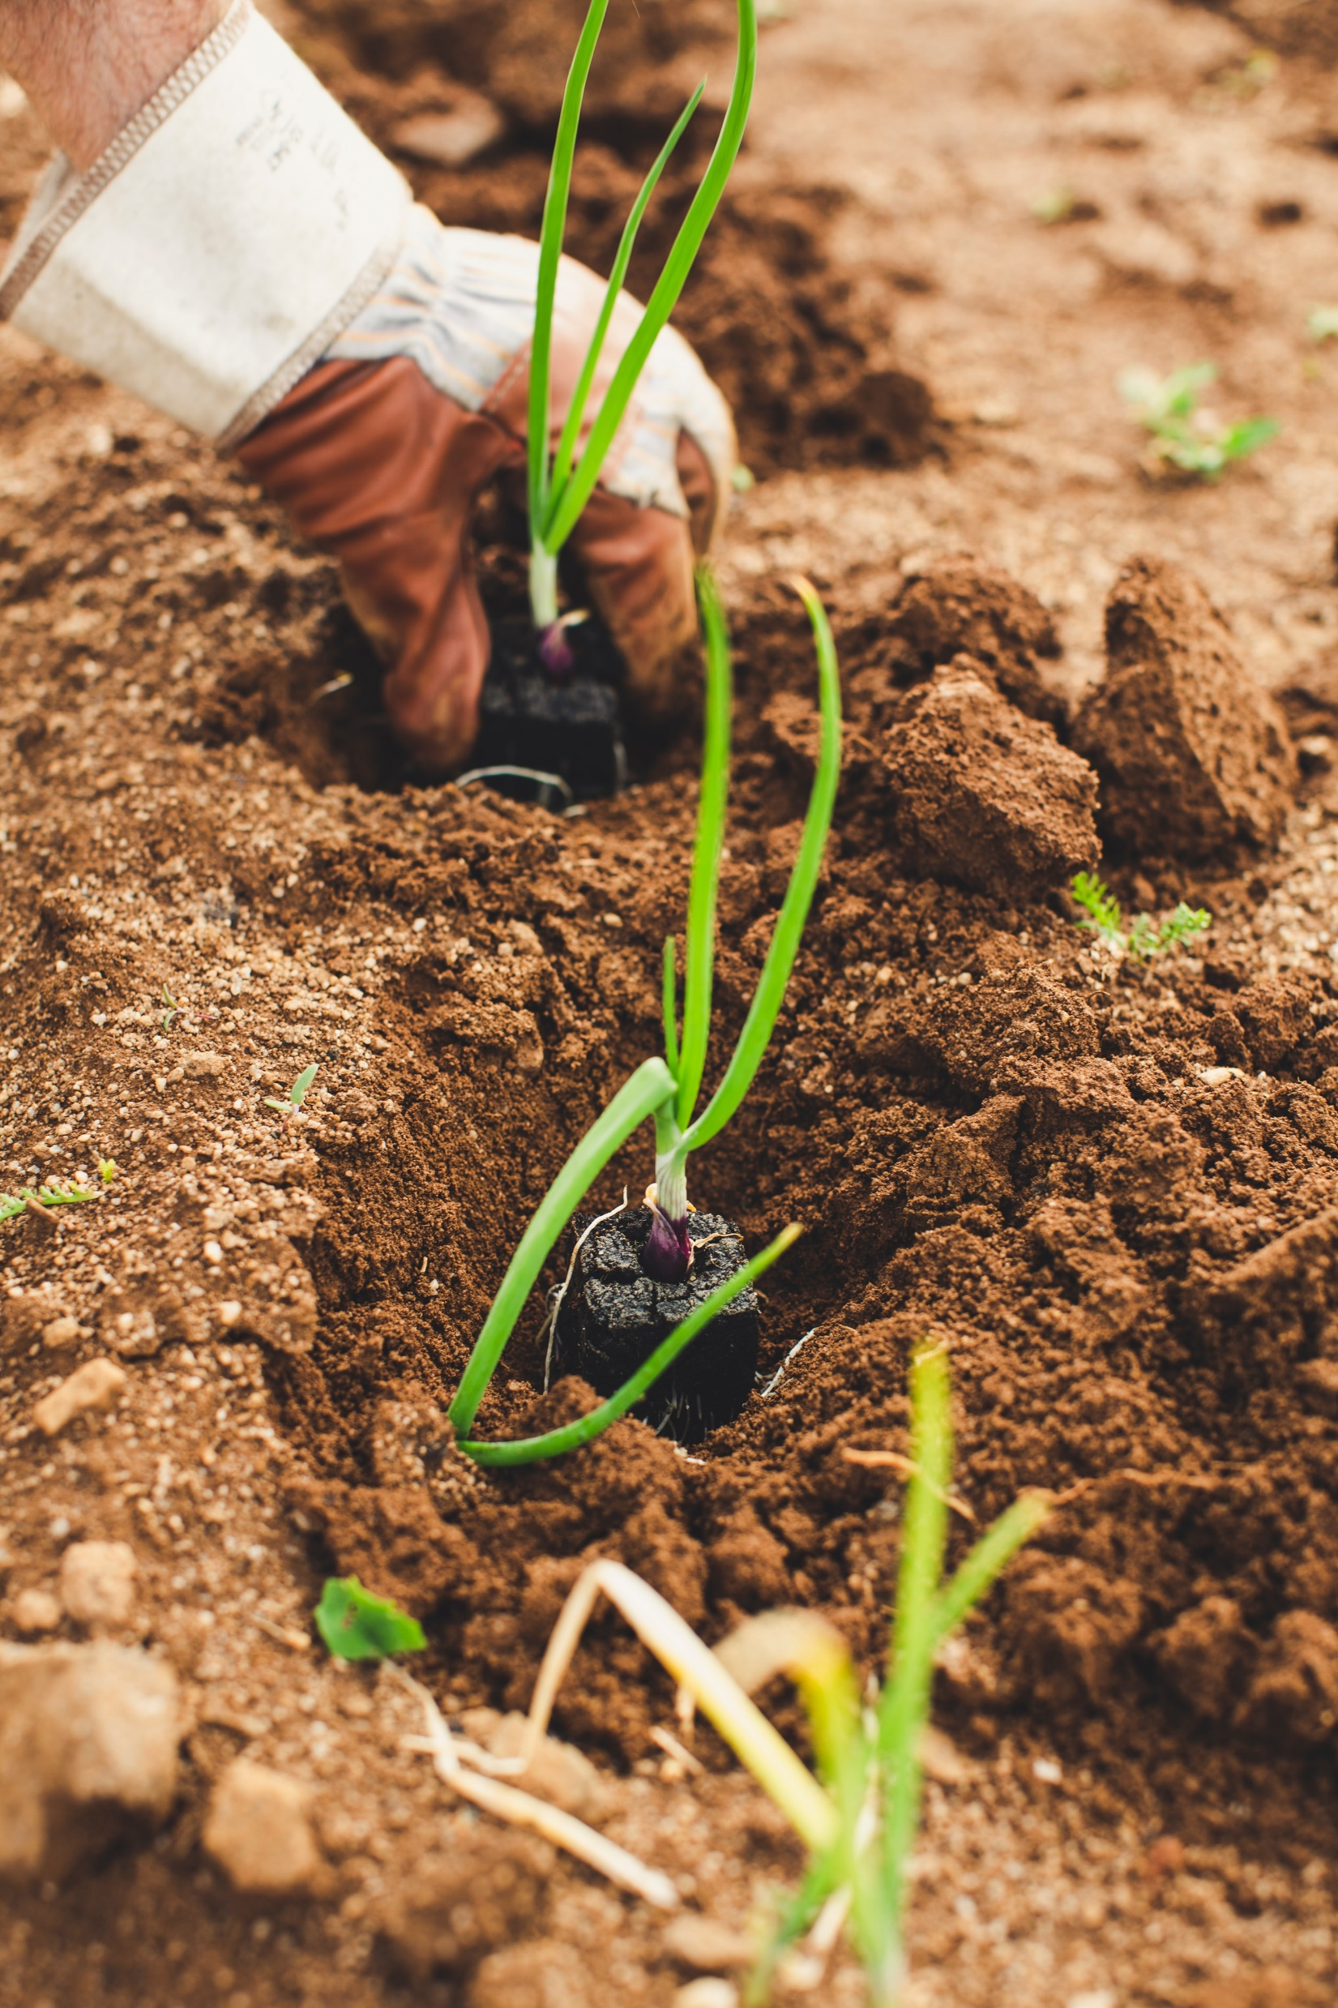
Low-cost Ways of Eating Healthy
Grow your own vegetables (Indoor/outdoor)
Cook at home
Replace meat with other proteins (soy, beans)
Stretch recipes by adding ingredients
Plan your meals in advance
Bulk purchasing of non-perishables
Notes:
Facilitator notes:
This slide shows additional suggestions to support the ideas that the groups generated
You can read out loud the ones that were not shared by the groups.
Say:
Thank you group 1 for sharing your suggestions on low cost ways of eating healthy
Let’s explore some of these points more:
There are different ways for growing your own vegetables
For example, XX, XX vegetables are very easy to grow and do not need a lot of space.
Cooking at home can often help with spending less, while eating healthier
Transport costs to a restaurant and time can all make going out to eat more expensive than finding something already in the home
Sometimes meat products can be quite expensive.
There are other cost-effective substitutes that still offer the same benefits, in our area these include… XX……
Stretching recipes is another good one, for example adding pasta sauce or gravy to left over meat or vegetables
Planning meals in advance at the beginning of the week for example is a great way to reduce impulse grocery shopping
Sometimes when we can plan our meals in advance it allows us to purchase our groceries in bulk thus reducing the cost and time of repeated grocery shopping
Remember eating healthy does not need to be expensive
Ask:
Does anyone have any examples of these topics they can share? Do you stretch your ingredients? Plan your meals?

Slide 18
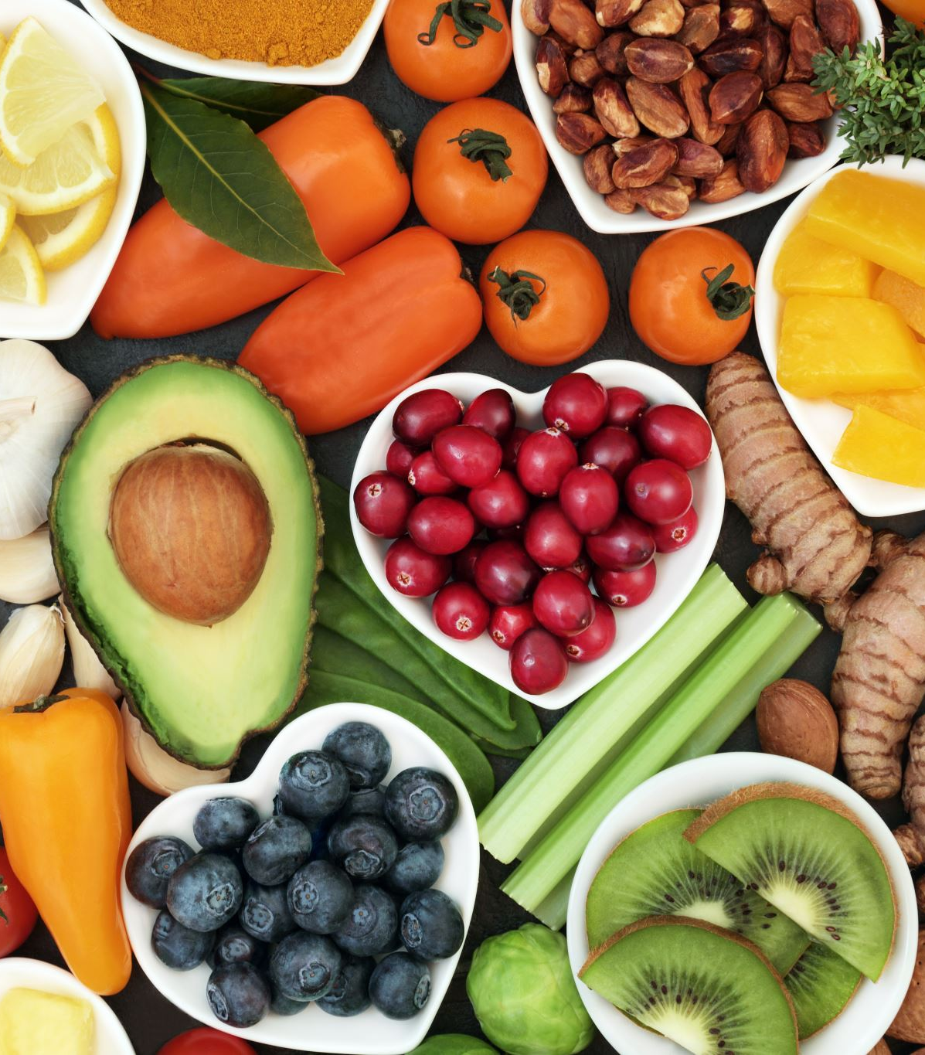
Managing Food Preferences
Eat meals together to model healthy eating
Encourage exploration/play with new foods
Introduce new foods with very small portions
Balance new and familiar foods on the plate
Keep trying (can take 10 to 15 times before a new food is liked)
Have family members help in preparing meals
Limit using desert or other foods as a reward for eating
Notes:
Facilitator notes:
This slide shows additional suggestions to support the ideas that the groups generated
You can read out loud the ones that were not shared by the groups.
Say:
Thank you group 2 for sharing your suggestions on how to manage individuals with strong food preferences and still support healthy eating.
A few additional ideas are:
Add anything from the slides that was not said by the group
Remember to keep trying and explore new ways to support integration of healthy foods

Slide 19
Creating Time for Making Healthy Meals
Create meals in advance
Cook once for the week
Choose meals you can easily prepare when you don’t have a lot of time
Double recipes and store remainder in the freezer
Make a food shopping list
Use leftovers
Allow family members to help
Have healthy snacks easily accessible
Notes:
Facilitator notes:
This slide shows additional suggestions to support the ideas that the groups generated
You can read out loud the ones that were not shared by the groups.
Say:
Thank you group 3 for sharing your suggestions on how to create time for making healthy meals
A few additional ideas are:
Add anything from the slides that was not said by the group
Remember healthy snacks can be quick and easy here are some ideas for healthy snacks from the SO Fit-5 guide- (a copy of this can be found in your materials):
Apple slices dipped in peanut butter
Low-fat unsweetened yogurt with berries
Low-fat cottage cheese with tomatoes
Carrots or peppers dipped in hummus
Celery topped with peanut butter and raisins.

Slide 20

Other Easy Wins
Reducing salt intake
Choose products with lower sodium content
Limit condiments, processed or ready-made foods
Reducing sugar intake
Choose healthy snacks over sugary snacks
Limit sugary snacks, candies and sugar-sweetened beverages
Notes:
Say:
In addition to the ideas we have already shared, reducing salt and sugar are 2 other ways that we can easily have more healthy meals.
Highly processed foods are increasingly becoming more available and more affordable.
People around the world are consuming more foods that are high in saturated fats, sugars and salt.
According to the World Health Organization, most people consume too much salt
Any product with more than 10% sodium is considered a significant amount of sodium.
Excessive salt intake corresponds to increases in blood pressure, and increased risk of cardiovascular disease, stroke or heart attack
There are easy ways to reduce our salt intake:
Checking labels and reducing use of condiments with high sodium
Keeping salt away from the table during meals
Cooking with less or no salt
Limiting consumption of salty snacks, processed or ready made foods
For sugar there also easy ways to reduce our sugar intake
Limiting or reducing our consumption of sugary drinks – swap out juice for water
Snacking on more fresh fruit and vegetables than sugary or sweet snacks
Ask:
Are these suggestions helpful? Do you have other ideas of reducing salt and sugar intake?

Slide 21

Strategies to Try at Home
Eat more fruits & vegetables every day
Keep snacks healthy
Mix 2 food groups for snacks.
Watch the amounts of food you put on your plate
Reduce sugar intake
Reduce sodium intake
Eat meals together to model healthy eating
Involve family members in all aspects of food preparation and cooking
Notes:
Say:
Before we leave today, we want to make sure that we are taking everything we have talked about today and applying it to our everyday lives
Here is a brief list of some strategies that we can try at home to have more healthy meals
These are some ideas to try
Next we are going to give a bit of time for each of you to think about your own strategies to have more healthy meals at home.

Slide 22
Individual Reflection
How can we have more healthy meals?
What is one strategy that you can realistically try to get more nutrients in your meals?
Consider the following:
  Schedule/time
  Budget
  Family involvement
Notes:
Say:
Everybody please take 7 minutes to think about 1 strategy that you can realistically do to have more healthy meals.
Decide on one strategy that you can do for the next month and will commit to doing.
Think about what works best for you and your family.
It does not have to be something very big, what is important is that it is realistic and doable
Once you have thought about a strategy to commit to for the first month, you can complete the individual reflection in your workbook. This can be found on page___
Ask:
Would anyone like to share their strategy to get more nutrients in their meals?
Note:
Facilitator can start of by sharing their strategy.

Slide 23
Healthy Eating Quick Tips
Variety is key
eat a variety of fruits, vegetables, and lean proteins
Balance is key
some foods have more benefits than other foods find the balance that works for you
Half & Half
eat half whole grains and half refined grains
Healthy can be affordable
More fruits & vegetables
eating healthy doesn’t have cost money
have more fruits and vegetables throughout the day
Cooking together
Show & tell
model health eating for others in the family
engage the whole family in meal preparation and cooking
Notes:
Say:
Here is a quick reminder of the key messages on healthy eating – this is also in your workbook
We encourage you to pull this out and stick it somewhere the whole family can see
Eat a variety of foods
Eat half whole grains and half refined grains
Have more fruits and vegetables
Involve family members in cooking and meal preparations
Find the balance that works for you and your family
Eating healthy does not have to cost more money
Model healthy eating for others in the family

Slide 24

Questions
Notes:
Say:
Before we close, let’s have some time for questions and discussions.
Ask:
Does anyone have any questions or outstanding challenges?
Notes:
This is the time to address any outstanding questions or concerns from participants
Start off by responding to the challenges and questions that participants shared at the beginning of the session.
Remember to answer as thoroughly as possible
If relevant you can also ask other participants if they have suggestions to share
Leverage your community partners, and /or topic experts to help you respond to questions.
If there are questions you are not able to respond to, be honest and if feasible do the following:
Refer individuals with that concern to community partners – have names and contacts for these referral partners
Take note of the question and tell the participants you will inquire about the answer and get back to them (be sure you have the capacity to do this follow up)

Slide 25
Thank You!
SO Program Team
Contact Us:
Name:
Tel:
Email:
Other
Contact Us:
Name:
Tel:
Email:
Other
Contact Us:
Name:
Tel:
Email:
Other
Contact Us:
Name:
Tel:
Email:
Notes:
Notes:
To close the meeting, thank participants for their participation and attendance
Share contact information for participants to ask further questions or to learn more
Include contacts for the Special Olympics program staff as well as for nutrition partners in the community
This may be a good time to invite community partners to share a bit about their services and how attendees can access them.

