Slide 1

Healthy Eating
for the Family
Topic Guide

Slide 2
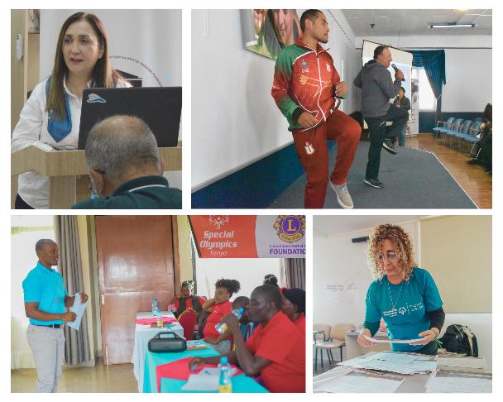
Learning Objectives
Forum at a Glance
This topic guide aligns with the Healthy Eating PowerPoint presentation. It highlights key materials, notes, and resources to support facilitation.
The aim of this Forum on Healthy Eating for the Family to introduce the topic of Healthy Eating for families. At the end of this Forum, participants will:
understand what healthy eating means
learn strategies for addressing barriers to healthy eating
create a plan for having healthy meals at home
Facilitators
Possible facilitators include community partners, coaches, staff, and parents with experience in nutrition and/or working with families of people with intellectual disabilities (ID). Programs may also identify other qualified individuals to lead the Forum.

Slide 3
Agenda
Slide 6
The following is a general agenda for the Forum and the topics covered.
The Forum is estimated to take 1 hour and 30 minutes to complete.
  Welcome and Introductions
  Overview of Family Health Forums
  Welcome Reflection
  Understanding MyPlate
  The Food Benefits Game
  Finding the Balance: Making Meals Healthier
  Activity: Having more Healthy Meals
  Reflection: action planning
  Q&A
  Closing: Key Takeaways
Materials
The following materials will be helpful for facilitation and planning of the Forum:
PowerPoint presentation on Healthy Eating
Printed copies of participant workbook or access to virtual copy
Writing/drawing materials
Timer/stopwatch to track time spent during activities
Ball or item to pass around during introductions
Box or basket to collect questions or comments from participants

Slide 4
Important Notes
Slide 6
Review the PowerPoint Presentation in advance:
  There is a suggested script in the notes section of the presentation. Reviewing it in advance will allow you to be comfortable with the presentation and reduce reading the script. Make wording changes to support the flow of the presentation.
Adaptation of the Forum Materials:
  Include local recommendations and resources for healthy eating in your community. You can collaborate with local service providers for this and if possible, also invite them to the Forum
  Adjust the script and images to suit your community and participants.
  This forum discusses food and meals. Adapt the examples used to reflect local foods and culture around food. For example, the images in the Food Benefits Game on slide 9 and Making Meals Healthier Activity on slide 15 can be adapted to use examples of local foods/meals.
  Include relevant hands-on activities around food, such as cooking demonstrations, building a recipe book, planting a garden.
  Review existing national or regional guidelines related to nutrition in your area. Integrate these additional resources for participants.
Encourage engagement, sharing and asking questions:
  For an in-person Forum, you can have optional paper or cards for participants to write/draw their name.
  During discussions, allow time for participants to share their personal experiences. Facilitators can encourage discussions by sharing their experiences first..
  Make time or be available for participants to ask questions to further support families after the Forum.
4. Responding to Questions:
  Do your best to fully answer the questions. If someone in the group has a helpful experience, invite them to share.
  Leverage community partners or topic experts to help answer questions.
  If you’re unable to answer any questions, refer to a community partners or expert when feasible, or notate the question and follow up with an answer as soon as possible.

Slide 5


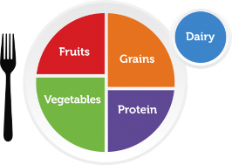






Helpful Resources
 | WHO Global Dietary Guidelines Guidelines on a healthy diet for communities around the world.
 | My Plate A symbol of the 5 food groups representing what to eat from each of the food groups throughout the day.
 | Fit 5 Guide Fit 5 is based on the three simple goals of exercising 5 days per week, eating 5 total fruits and vegetables per day and drinking 5 water bottles of water per day.
 | Special Olympics Washington Healthy Food & Beverage Toolkit Nutrition guidelines focused on reducing processed foods, salt, sugary beverages and increasing fruits, vegetables and whole grains.
 | World Health Organization Healthy Diet Key Facts Overview of healthy eating for adults and children. Including practical advice on maintaining healthy eating.
Slide 34
Slide 36

Slide 6
My Notes
Slide 34
Slide 36

Slide 7


Family Health Forums, part of Special Olympics Health, are made possible through the generous support of our funders.
This work was supported by Award Number NU27DD000021, funded by the Centers for Disease Control and Prevention. Its contents are solely the responsibility of the authors and do not necessarily represent the official view of the Centers for Disease Control and Prevention or the Department of Health and Human Services.

Slide 8
Some helpful Tips
Size 12 font is great for printed materials. Size 24 (at a minimum) is good for the body copy on PowerPoints.
Bold and colorful text is helpful to bring attention to a point or topic.
Titles can go in the bar above. To add interest and variety in slide, feel free to use the slide layout with the bars on the side and bottom. That layout is great if you have extra room on the slide and feel like you need to fill up space.
Utilize the icon library and high-quality photos to keep PowerPoints engaging!
Don’t be afraid of white space, it helps the reader digest information easier.

Slide 9








































































