Slide 1



Family Health Forum
Healthy Eating
This work was supported by Award Number NU27DD000021, funded by the Centers for Disease Control and Prevention.
Its contents are solely the responsibility of the authors and do not necessarily represent the official view of the Centers for Disease Control and Prevention or the Department of Health and Human Services.
Notes:
Note:
This slide deck is to guide the facilitator in the presentation and activities for the FHF, Healthy Eating.
Notes and commentary for facilitators are indicated in this section on all of the slides
Be sure to adapt the slides, language, text and images to better suit your context
Remember to collaborate with local nutrition experts in adaption of the content to ensure adherence to appropriate nutrition guidelines/recommendations for your context
Say: housekeeping and norms
Before we get started a few housekeeping needs:
Location of toilets/washrooms
Snacks or drinks
Other logistics

Slide 2

Introductions
2
Notes:
Say: Welcome
Welcome to our Family Health Forum! we are looking forward to talking about healthy eating
Let’s get to know each other a little bit and play a memory game where we introduce ourselves.
For this game we will pass around this ball and each person must say their name and their favorite food item. The person speaking throws the ball to someone else and this person must say their name and their favorite food as well as the previous speakers’ names and favorite foods.

Slide 3
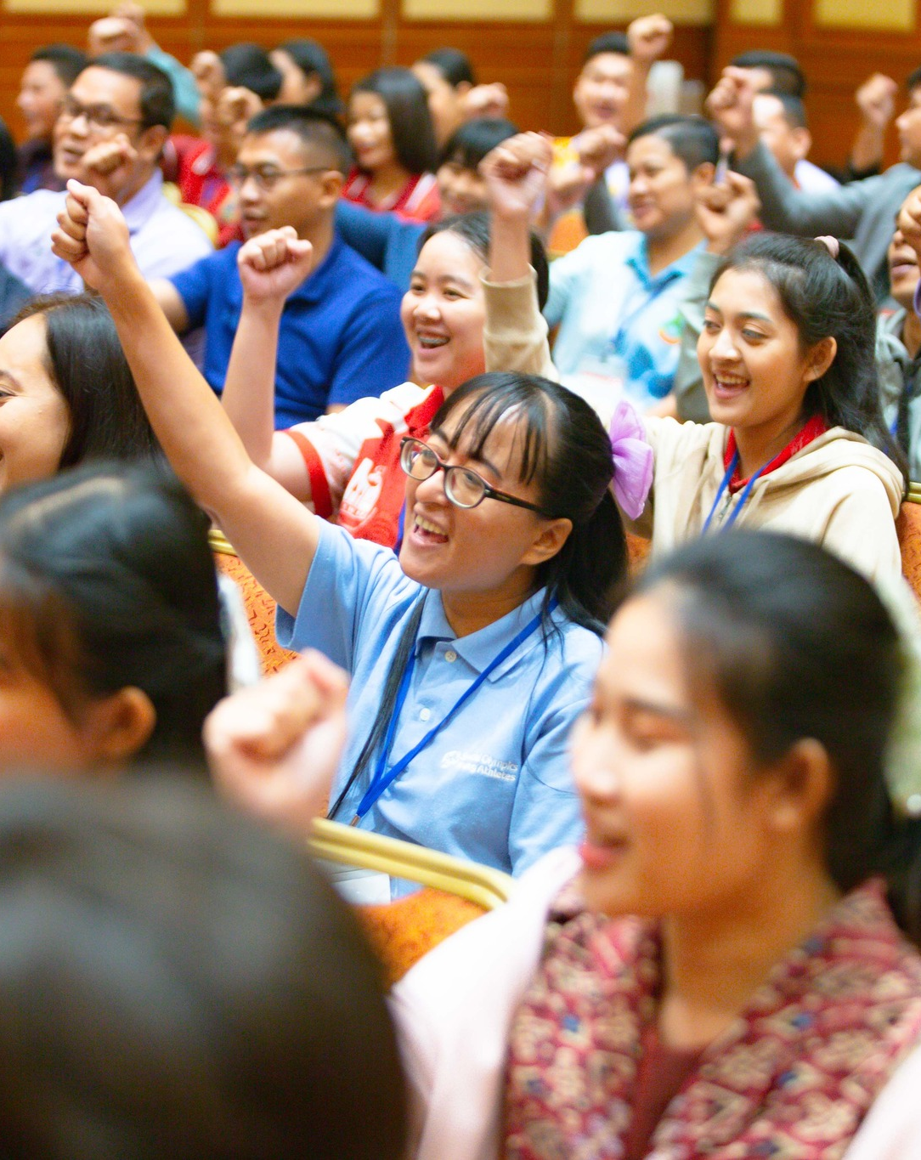
Family Health Forums:
Family Health and Well Being
FHFs focus on the whole family
Build connection with other families
Build connection with service providers
Our ways of working:
Respect
Active listening
Judgement free zone
Confidentiality
3
Notes:
Say:
The goal of Family Health Forums is to reduce the health disparities for people with intellectual disabilities.
To do this well, we must support the whole family!
This space is for families to support each other’s health and wellbeing.
We focus on all the members of your family.
Together, we’ll learn about different health challenges and how families can work together to stay healthy.
We also bring families together to establish support networks each other and service providers in our community
To make this a welcoming space, there are four principles to guide our time together:
We RESPECT each other’s opinions and recognize that we may be at different stages in our own journey.
We use ACTIVE LISTENING to be fully present and give each other our undivided attention.
This is a JUDGEMENT-FREE zone – we recognize that we each bring our own unique experiences.
We believe in CONFIDENTIALITY – What’s shared and discussed here should be kept private.
We are here to learn with and from each other. Feel free to ask questions at any time, to the group or on the cards provided.
Before we begin today’s topic, let’s talk about why health is important for our athletes and their families.

Slide 4
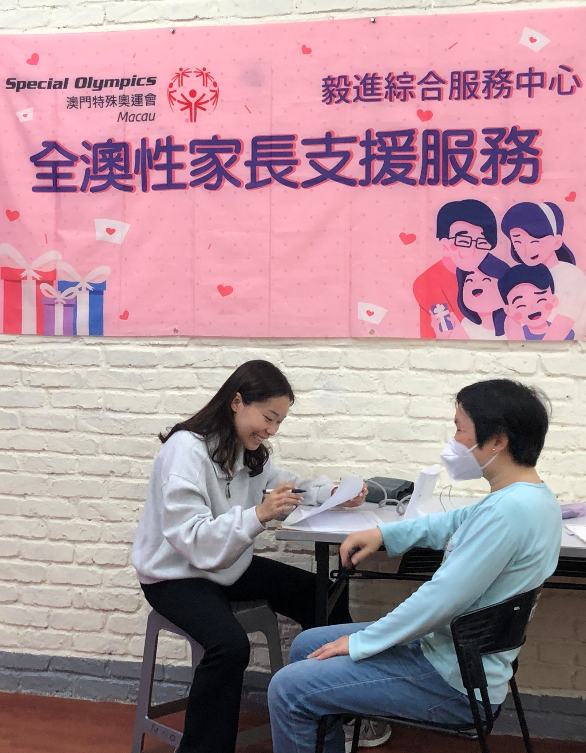
Did you know?
Individuals with intellectual disability…
Have limited access to critical health services and resources to improve their health.
Are 2 times more likely to be obese
More likely to experience premature death from preventable health conditions.
Have higher rates of chronic health conditions like obesity, diabetes, asthma, and cardiovascular disease.
4
Notes:
Say:
Family Health Forums are important because health has a big impact on the quality of life for people with intellectual disability and their families.
Recent data from Special Olympics athletes helps us understand this better.
Here’s what we know:
Special Olympics adult athletes are two times more likely to be obese compared to adults without intellectual disability.
Individuals with intellectual disability have as many chronic health conditions at 20+ years old as individuals in the general population do at 50+ years old.
Lastly, people with intellectual disability often do not have access to critical health services and resources to improve their health and die 16 to 20 years sooner than people without intellectual disabilities due to preventable health conditions.
Health affects how well athletes train, compete, and live their daily lives.
Special Olympics recognizes the importance of supporting the health and wellbeing of athlete’s families.
Family Health Forums help you learn, connect, and take care of the whole family’s health and well being.

Slide 5
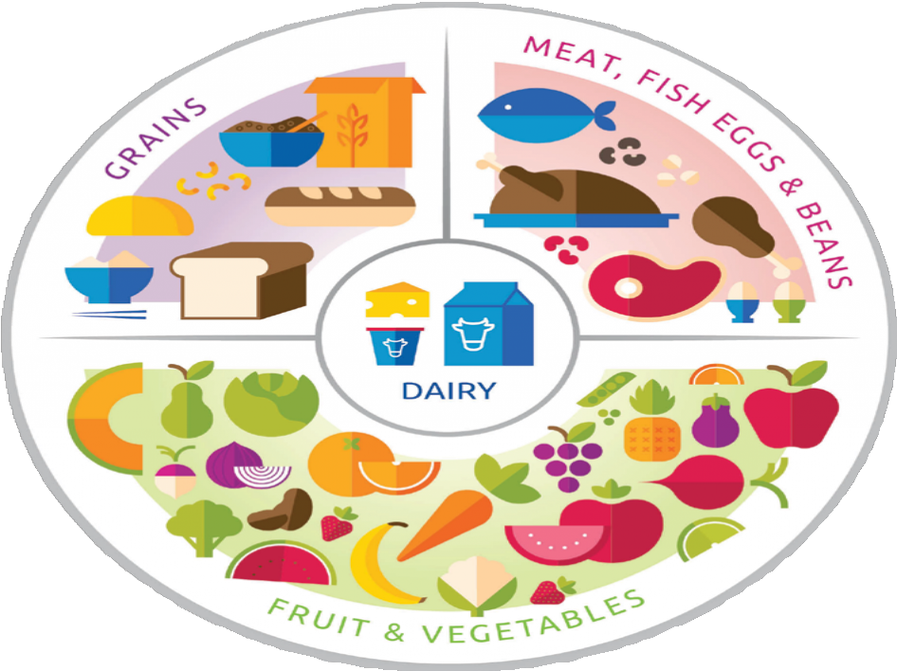
Overview of the Forum
Understanding what healthy eating means
Strategies for healthier meals at home
Action planning for greater access to healthy meals
5
Notes:
Say:
Today we are going to discuss healthy eating for the family
This session will take about 1 hour and 30 minutes to cover the following objectives:
Discuss what healthy eating means and the benefits of different foods
Explore strategies for healthier meals at home
And finally, we will create realistic action plans for us to have greater access to healthy meals
We will have a mix of activities, discussion and presentations
We all have something valuable to share and we are here to learn from each other experiences as well.
Feel free to share any questions or comments you may have as we go along.

Slide 6
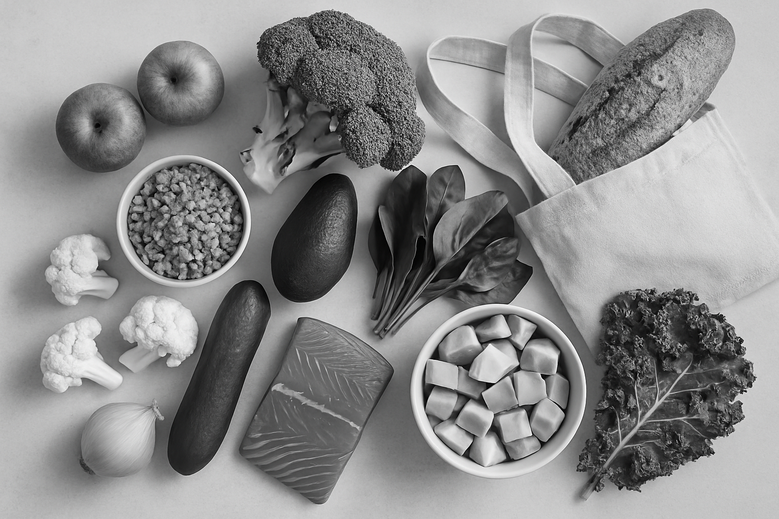

Reflection
What has worked well for you regarding healthy eating?
What are your challenges or areas of concern relating to healthy eating?
6
Workbook page 3
Notes:
Say:
Before we begin, please take a moment to write down what has worked well for you regarding healthy eating as a family and what has been challenging.
Turn to your participant workbook to record your thoughts.
Ask:
After a few minutes, ask participants to volunteer to share their responses

Slide 7









Healthy Eating Quick Tips
Variety is key
Balance is key
eat a variety of fruits, vegetables, and lean proteins
some foods have more benefits than other foods find the balance that works for you
Half & Half
Healthy can be affordable
eat half whole grains and half refined grains
eating healthy doesn’t have cost money
More fruits & vegetables
Show & tell
have more fruits and vegetables throughout the day
model health eating for others in the family
Cooking together
Hydration
engage the whole family in meal preparation and cooking
Drink 5 bottles of water every day
7
Notes:
Say:
Throughout the session we will highlight the following key messages
(Optional) Ask:
Is there a volunteer who would like to read out the first key messages?

Slide 8
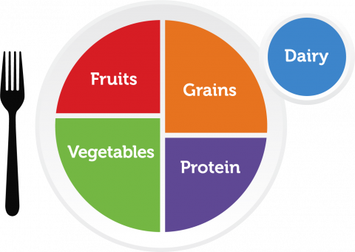
Understanding MyPlate
MyPlate shows us how much of each food group we should eat
8
Workbook page 4
Notes:
Ask:
Is anyone familiar with this picture of a plate? What do you think it is about? You are welcome to also record your responses in your participant workbook.
Say:
This image of a plate is a helpful way for us to think about healthy eating
It shows us generally how much of each food group is recommended
You can see that vegetables are the largest section of the plate followed by grains
Together, fruits and vegetables fill half of the plate while proteins and grains fill up the other half.
Milk and dairy products are also included

Slide 9


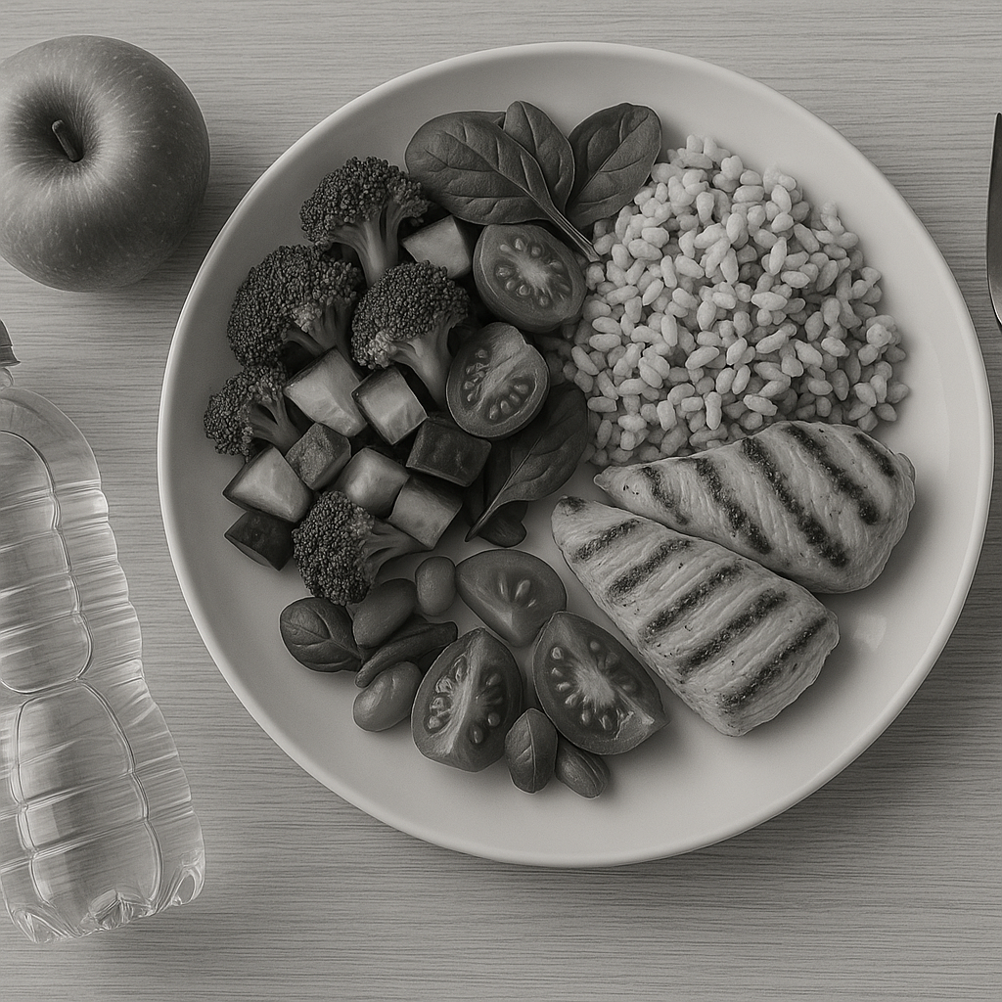
Activity: The Food Benefits Game
Can you guess the benefits of your favorite foods?
9
Workbook page 4
Notes:
Say:
Let’s quickly refresh ourselves about the benefits of some of our common foods
In groups, we are going to play the Food Benefits Game
The aim of this game is to guess the benefits of the food group shown in the picture
I will show each picture on the screen for 1 minute.
In your groups you will have 1 minute to guess the benefits of that food group.
The three pictures are also in the participant workbooks. Your group can record your list of benefits there.
See how many benefits you can record in 1 minute.
When you have completed all three food groups, the benefits can be read in the back of your workbooks – see how may benefits were correct!
Facilitator Note for Virtual Presentations:
For virtual Forums, keep participants in one group and discuss the food benefits as a whole group.

Slide 10
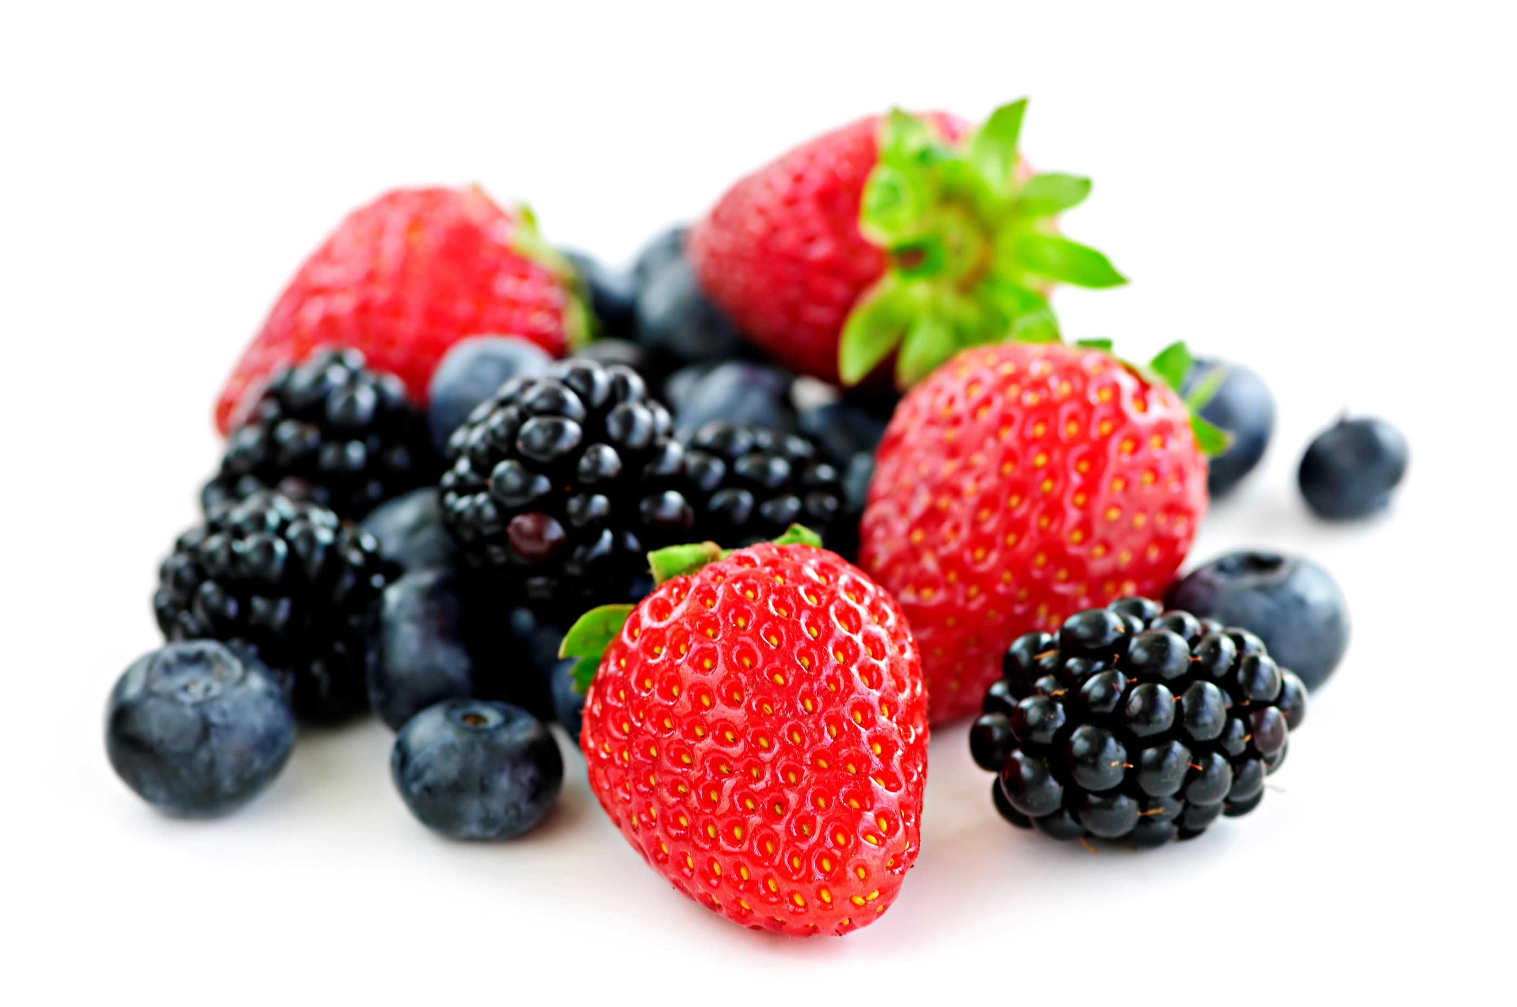
10
Workbook page 4
Notes:
Say:
The first picture is berries, representing the fruits category
Ask:
Are you ready?
Write down as many benefits as you can
Timer starts, now
Say:
Time is up.
Save this and we will go on to the next picture

Slide 11
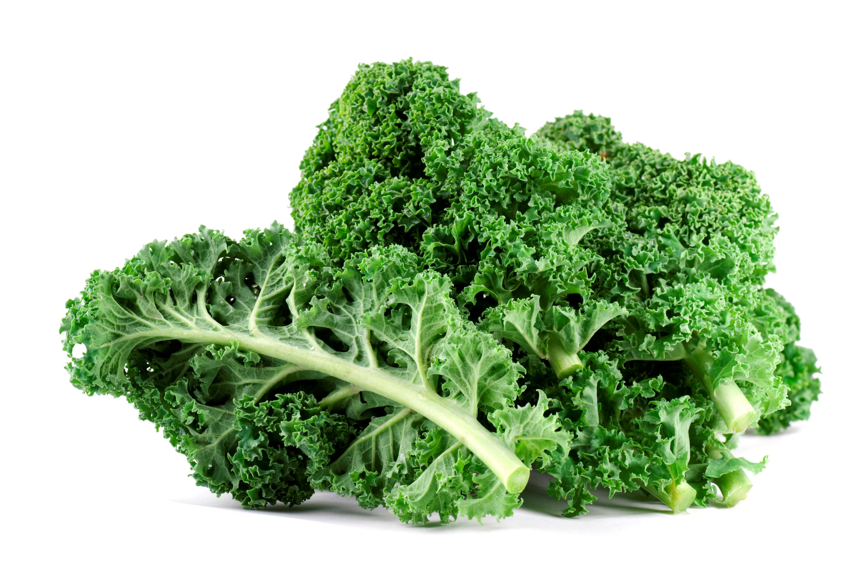
11
Workbook page 4
Notes:
Say:
The second picture is kale, a leafy green representing the vegetables category
Ask:
Are you ready?
Write down as many benefits as you can
Timer starts, now
To do:
Set timer for 1-minute
Say:
Time is up.
Save this and we will go on to the last picture

Slide 12
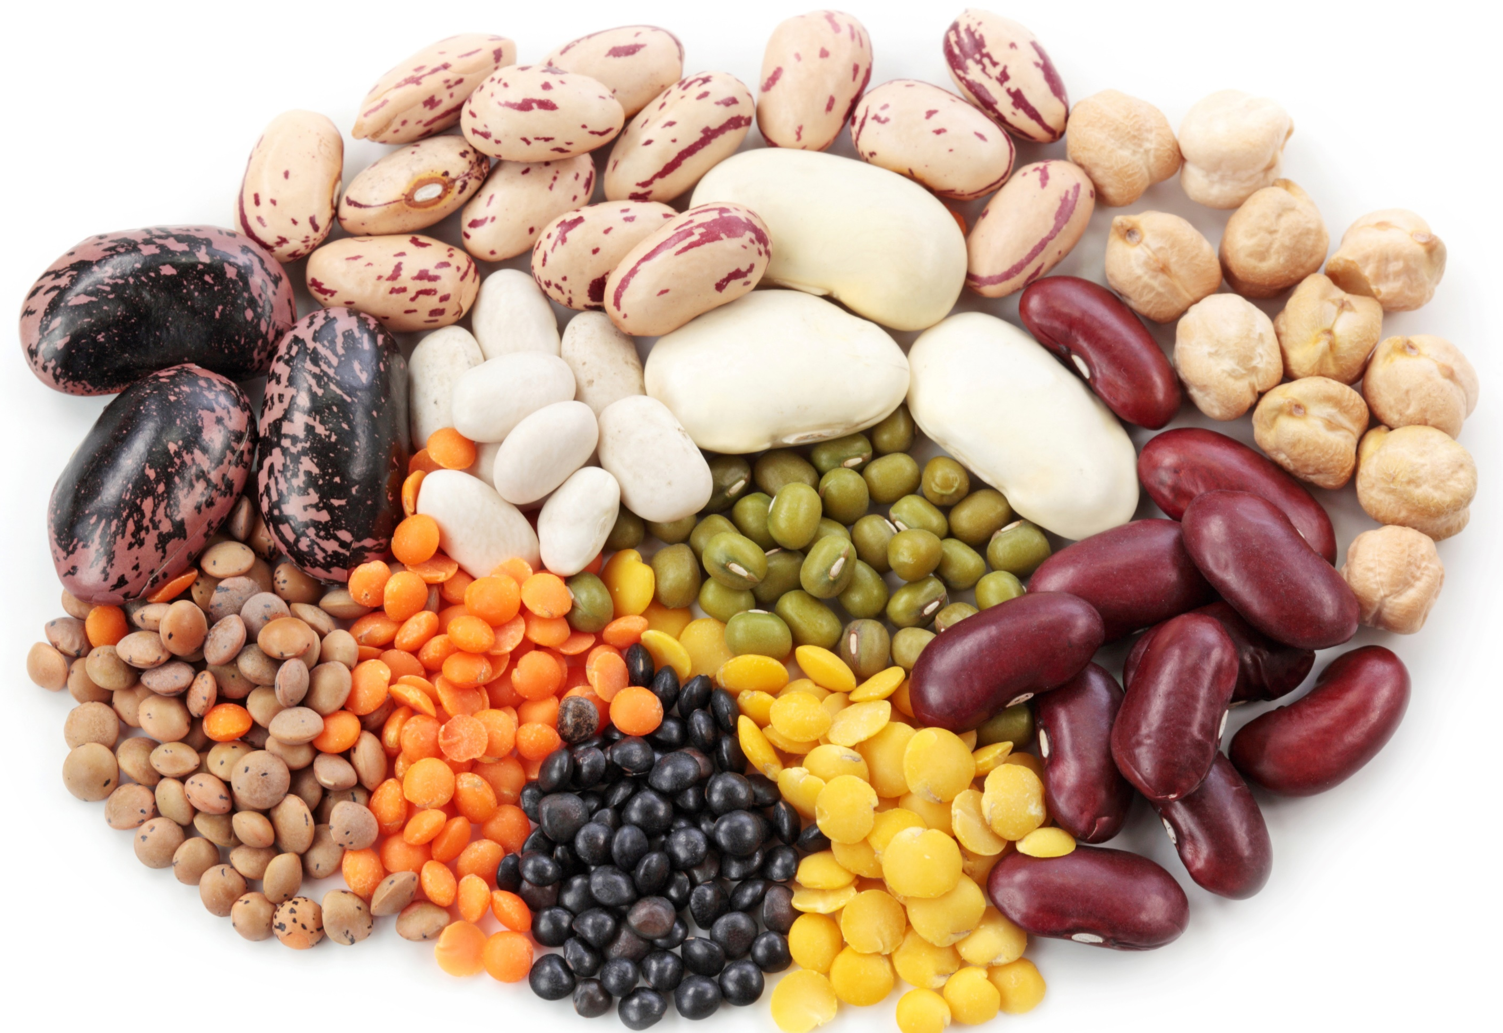
12
Workbook page 4
Notes:
Say:
Our last picture is a mix of beans and lentils, representing the proteins category
Ask:
Are you ready?
How many benefits of proteins can you recall?
Say:
Timer starts, now
To do:
Set timer for 1-minute
Say:
Time is up.
Now that you have finished, turn to page XX of your participant workbooks and read together the benefits of the food groups presented.
After 3 minutes:
Say:
We will move on, but you have in your workbooks a list of benefits for all of the food groups. Feel free to review them in your own time.

Slide 13
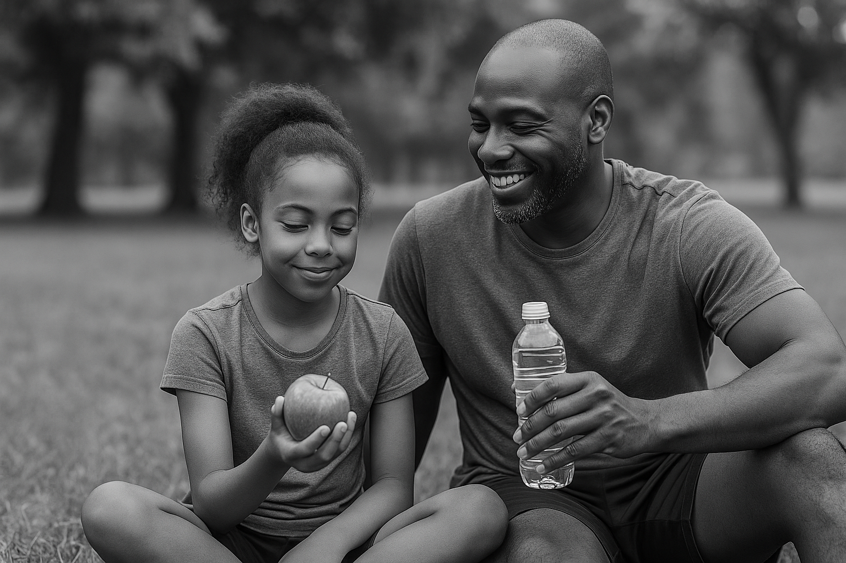
Recommendations for Healthy Eating
Eat a variety of fruits and vegetables
Consume a variety of proteins (including lean protein)
Eat half whole grains and half refined grains
Use unsaturated vegetable oils
Have more low fat or non-fat dairy options
13
Notes:
Facilitator note:
After The Food Benefits Game the following slides can be used to highlight recommendations of different foods
Say:
Thanks for playing the game, I hope we all have an idea now about the benefits of different foods.
Key things to remember is to eat a variety of foods across the food groups
Whole, sliced and pureed fruit is always a great choice – watch out for juice, unless it is 100% fruit it can have a lot of added sugar that reduces its health benefits
In your participant workbooks you will see a list of local foods across all these categories. Have a look at it when you have time and see which ones you already knew of and which ones are new.
To do:
Collaborate with your local nutrition partner to identify a list of locally available foods across all food groups for the participant workbooks

Slide 14
Small Group Activity: Build a Plate
Discuss in small groups which foods go into each category
As a small group create your own ‘Plate’ with materials provided
14
Workbook page 4
Notes:
Say:
Now that we are familiar with the benefits of different foods, we are going to work together in small groups to build a meal together across all the food groups.
In your small groups, build your plate, remember to ensure there are as many minerals and nutrients as possible. Remember to use common foods that are easily available
After you have made your plate, each group will share their plate with the larger group.
For this activity we are going to use the general guidelines of the MyPlate template, these are similar to the global guidelines for a healthy diet by the World Health Organization.
When you have time, you can review the global healthy diet guidelines which can be found in your participant workbooks.
Note:
Divide participants into their small groups
Guide participants to the MyPlate template in their workbooks.
Show participants the page in their workbooks for the global guidelines for a healthy diet by the World Health Organization.
Facilitator Note for Virtual Presentations:
For virtual Forums, build a plate as a whole group. Share the MyPlate template on screen (or direct participants to the version in their workbook).
Say: Now that we’re familiar with the benefits of different foods, we’re going to build a healthy plate together using common foods from across all the food groups. We’ll use the MyPlate template.
Let’s work together to fill the plate! Type your suggestions in the chat or raise your hand to share aloud:
- What fruits should we add?
- What vegetables?
- What protein?
- What grains?
- What could be our dairy or calcium-rich food?
As participants share, write their suggestions on the shared MyPlate (if using screen-sharing), or call out what’s being added.
Materials:
Drawing/writing materials – different colors
Participant workbook with blank template of MyPlate for participants to draw/write in their foods

Slide 15
Activity: Finding the balance
Making meals healthier
Let’s see what happens to our plate when we swap out certain foods and beverages!
15
Workbook page 5
Notes:
Facilitator note:​
This activity takes place after participants have shared their ‘Plates’​ in Slide 14
​
Say:​
Now that we have made our ‘Plates’ let’s explore how we can make some meals healthier​
For this activity – turn to page in your workbooks. You have 3 meals pictured there. In your groups discuss how you can you make these meals healthier?​
Can you replace the protein to one with more nutrients/benefits​
Can you change how something was prepared to make it healthier?​
Each group will have the opportunity to present their new ‘Plates’ and tell us how they are keeping their overall meal healthy​
​
Facilitator Note for Virtual Presentations:​
For virtual Forums, discuss as a whole group.​
​

Slide 16




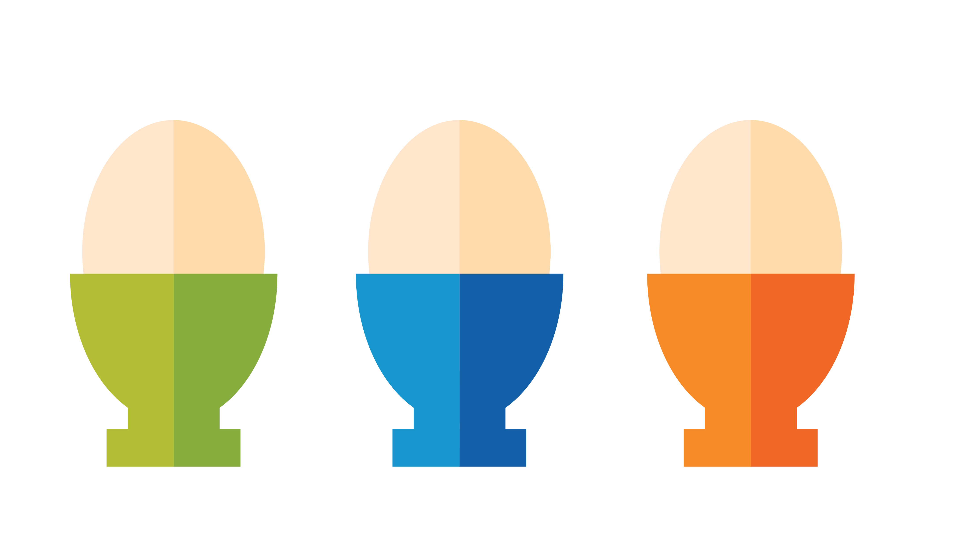
Finding the Balance
There are no ‘good’ or ‘bad’ foods
Some foods have more benefits than other foods
We can mix up the foods on our plate
Some foods we need to eat daily, some we eat occasionally
16
Notes:
Say:
Thank you for sharing your strategies to make meals healthier
As we can see, healthy eating is a balance.
Remember there are no good or bad foods, rather, some foods have more benefits that others
We don’t always have to eat meals that maximize minerals and nutrients. It is ok to mix it up.
Foods with a lot of vitamins and minerals are called nutrient dense.
We can mix foods on our plate and meals throughout the day so that we have an overall balance of nutrient dense foods and other foods.
Some foods we need to eat daily like fruits because they have a lot of vitamins and minerals, they are nutrient dense.
Some foods we eat occasionally like sweet and high fat foods because they have little vitamins and minerals.
What is important is to find the balance that works best for you and your family.
Ask:
What are some ways you mix foods with more and less minerals?

Slide 17
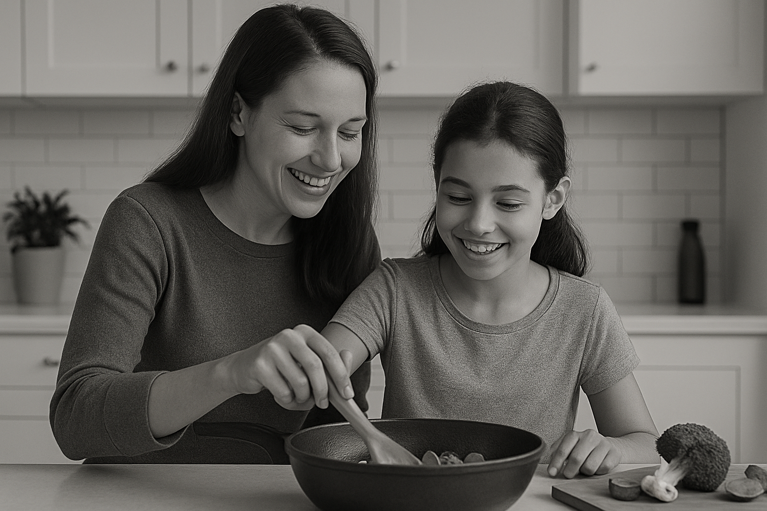
Activity: Having healthier meals
Group 1:
What are 5 low-cost ways of eating healthy?
Group 2:
What are 5 ways to support healthy eating among individuals with food preferences?
Group 3:
What are 5 ways to create time for making healthy meals?
17
Workbook page 5
Notes:
Say:
Next, we are going to explore how to have more healthy meals in our everyday lives
Each group will have 5 minutes to put together some responses to their prompts
After the 5 minutes each group will share what they have agreed on.
Notes:
Split participants into their 3 groups
Guide participants to the group questions in the participant workbook.
Facilitator Note for Virtual Presentations:
For virtual Forums, discuss each question as a whole group.
Materials:
Timer
Writing/drawing materials

Slide 18
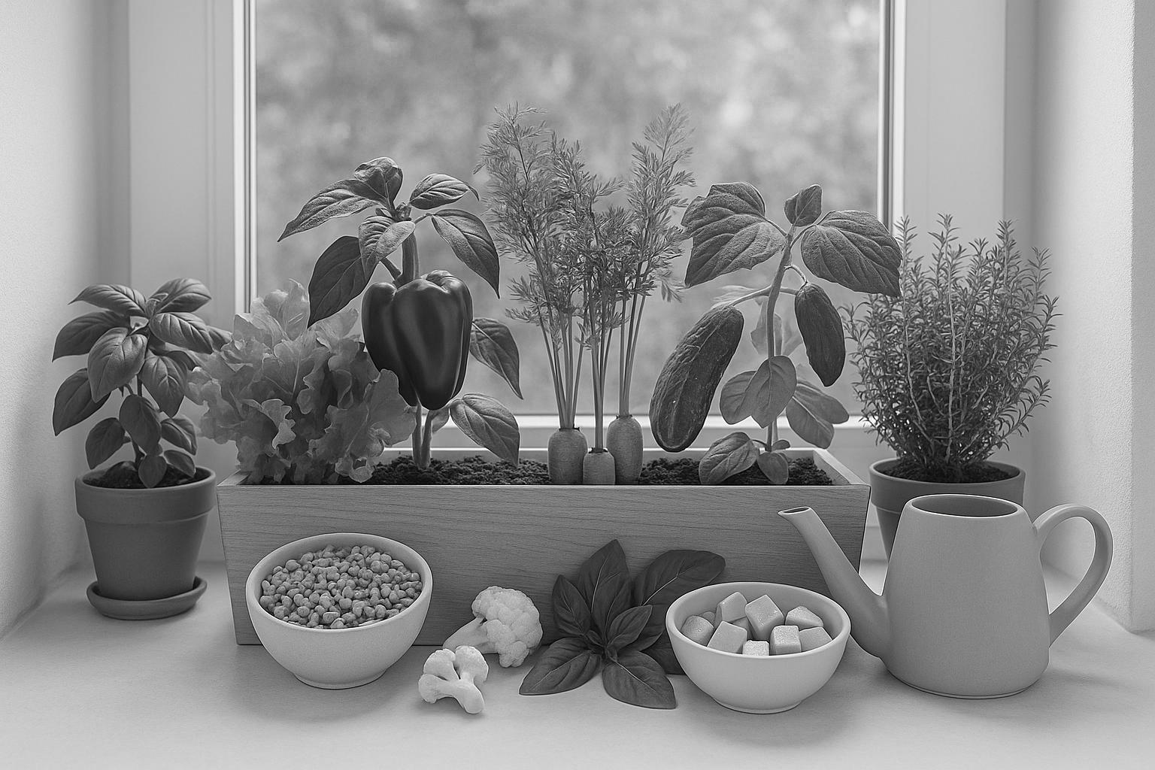
Low-cost Ways of Eating Healthy
Grow your own vegetables (Indoor/outdoor)
Cook at home
Replace meat with other proteins (soy, beans)
Stretch recipes by adding ingredients
Plan your meals in advance
Bulk purchasing of non-perishables
18
Notes:
Facilitator notes:
This slide shows additional suggestions to support the ideas that the groups generated
You can read out loud the ones that were not shared by the groups.
Say:
Thank you group 1 for sharing your suggestions on low-cost ways of eating healthy
Let’s explore some of these points more:
There are different ways for growing your own vegetables
For example, XX, XX vegetables are very easy to grow and do not need a lot of space.
Cooking at home can often help with spending less, while eating healthier
Transport costs to a restaurant and time can all make going out to eat more expensive than finding something already in the home
Sometimes meat products can be quite expensive.
There are other cost-effective substitutes that still offer the same benefits, in our area these include… XX……
Stretching recipes is another good one, for example adding pasta sauce or gravy to left over meat or vegetables
Planning meals in advance at the beginning of the week for example is a great way to reduce impulse grocery shopping
Sometimes when we can plan our meals in advance it allows us to purchase our groceries in bulk thus reducing the cost and time of repeated grocery shopping
Remember eating healthy does not need to be expensive
Ask:
Does anyone have any examples of these topics they can share? Do you stretch your ingredients? Plan your meals?

Slide 19
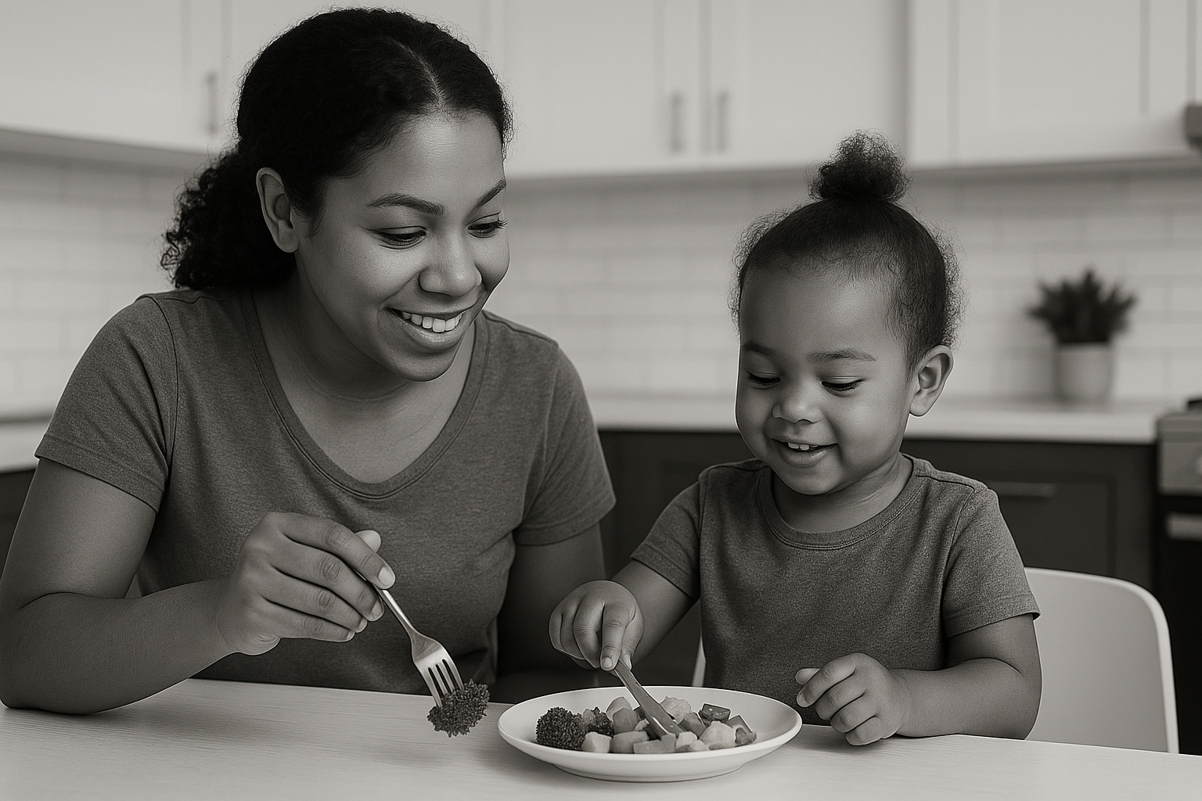
Managing Food Preferences
Eat meals together to model healthy eating
Encourage exploration/play with new foods
Introduce new foods with very small portions
Balance new and familiar foods on the plate
Keep trying (can take 10 to 15 times before a new food is liked)
Have family members help in preparing meals
Limit using desert or other foods as a reward for eating
19
Notes:
Facilitator notes:
This slide shows additional suggestions to support the ideas that the groups generated
You can read out loud the ones that were not shared by the groups.
Say:
Thank you group 2 for sharing your suggestions on how to manage individuals with strong food preferences and still support healthy eating.
A few additional ideas are:
Add anything from the slides that was not said by the group
Remember to keep trying and explore new ways to support integration of healthy foods

Slide 20
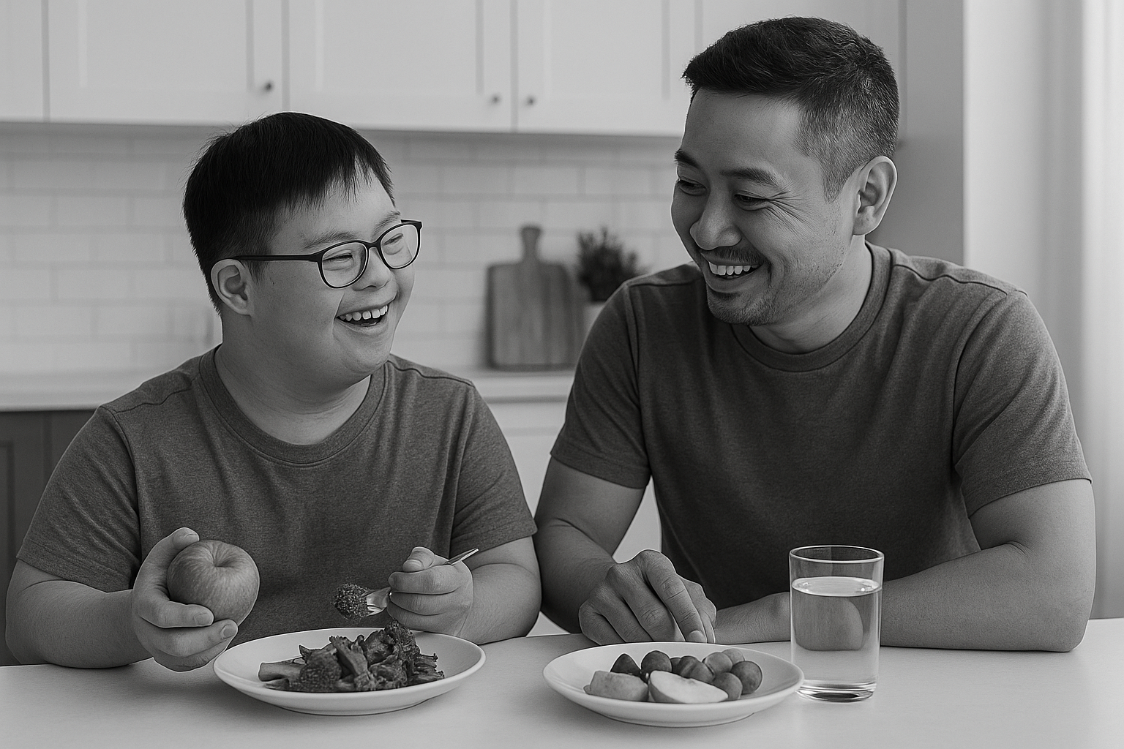
Creating Time for Making Healthy Meals
Create meals in advance
Cook once for the week
Choose meals you can easily prepare when you don’t have a lot of time
Double recipes and store remainder in the freezer
Make a food shopping list
Use leftovers
Allow family members to help
Have healthy snacks easily accessible
20
Notes:
Say:
Thank you group 3 for sharing your suggestions on how to create time for making healthy meals
A few additional ideas are:
Add anything from the slides that was not said by the group
Remember healthy snacks can be quick and easy here are some ideas for healthy snacks from the SO Fit-5 guide- (a copy of this can be found in your materials):
Apple slices dipped in peanut butter
Low-fat unsweetened yogurt with berries
Low-fat cottage cheese with tomatoes
Carrots or peppers dipped in hummus
Celery topped with peanut butter and raisins.

Slide 21

Other Easy Wins
Reducing salt intake
Choose products with lower sodium content
Limit condiments, processed or ready-made foods
Reducing sugar intake
Choose healthy snacks over sugary snacks
Limit sugary snacks, candies and sugar-sweetened beverages
21
Notes:
Say:
In addition to the ideas we have already shared, reducing salt and sugar are 2 other ways that we can easily have more healthy meals.
Highly processed foods are increasingly becoming more available and more affordable.
People around the world are consuming more foods that are high in saturated fats, sugars and salt.
According to the World Health Organization, most people consume too much salt
Any product with more than 10% sodium is considered a significant amount of sodium.
Excessive salt intake corresponds to increases in blood pressure, and increased risk of cardiovascular disease, stroke or heart attack
There are easy ways to reduce our salt intake:
Checking labels and reducing use of condiments with high sodium
Keeping salt away from the table during meals
Cooking with less or no salt
Limiting consumption of salty snacks, processed or ready made foods
For sugar there also easy ways to reduce our sugar intake
Limiting or reducing our consumption of sugary drinks – swap out juice for water
Snacking on more fresh fruit and vegetables than sugary or sweet snacks
Ask:
Are these suggestions helpful? Do you have other ideas of reducing salt and sugar intake?

Slide 22
Strategies to Try at Home
Eat more fruits & vegetables every day
Keep snacks healthy
Mix 2 food groups for snacks.
Watch the amounts of food you put on your plate
Reduce sugar intake
Reduce sodium intake
Eat meals together to model healthy eating
Involve family members in all aspects of food preparation and cooking
22
Notes:
Say:
Before we leave today, we want to make sure that we are taking everything we have talked about today and applying it to our everyday lives
Here is a brief list of some strategies that we can try at home to have more healthy meals
These are some ideas to try
Next, we are going to give a bit of time for each of you to think about your own strategies to have more healthy meals at home.

Slide 23
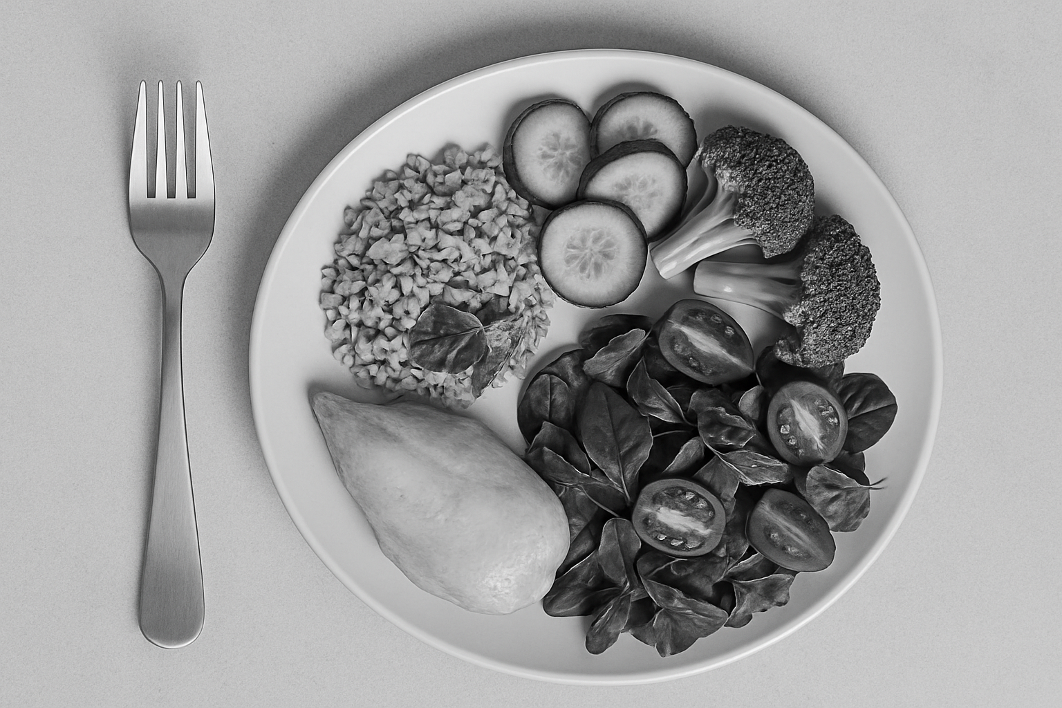
Reflection
How can we have more healthy meals?
What is one strategy that you can realistically try at home, to have more nutrients in your meals?
Schedule/time
Budget
Family involvement
23
Workbook page 6
Notes:
Say:
Everybody please take 3-5 minutes to think about 1 strategy that you can realistically do to have more healthy meals.
Decide on one strategy that you can do for the next month and will commit to doing.
Think about what works best for you and your family.
It does not have to be something very big, what is important is that it is realistic and doable
Once you have thought about a strategy to commit to for the first month, you can complete the individual reflection in your workbook. This can be found on page___
Ask:
Would anyone like to share their strategy to get more nutrients in their meals?
Note:
Facilitator can start of by sharing their strategy.

Slide 24
Healthy Eating Quick Tips
Variety is key
Balance is key
eat a variety of fruits, vegetables, and lean proteins
some foods have more benefits than other foods find the balance that works for you
Half & Half
Healthy can be affordable
eat half whole grains and half refined grains
eating healthy doesn’t have cost money
More fruits & vegetables
Show & tell
have more fruits and vegetables throughout the day
model health eating for others in the family
Cooking together
Hydration
engage the whole family in meal preparation and cooking
Drink 5 bottles of water every day
24
Notes:
Say:
Here is a quick reminder of the key messages on healthy eating – this is also in your workbook
We encourage you to pull this out and stick it somewhere the whole family can see
Eat a variety of foods
Eat half whole grains and half refined grains
Have more fruits and vegetables
Involve family members in cooking and meal preparations
Find the balance that works for you and your family
Eating healthy does not have to cost more money
Model healthy eating for others in the family

Slide 25

Questions
25
Notes:
Say:
Before we close, let’s have some time for questions and discussions.
Ask:
Does anyone have any questions or outstanding challenges?

Slide 26
Thank you!
SO Program Team
Contact Us:
Name:
Tel:
Email:
Community partner
Contact Us:
Name:
Tel:
Email:
Community partner
Contact Us:
Name:
Tel:
Email:
Community partner
Contact Us:
Name:
Tel:
Email:
26
Notes:
Say:
Thank you for joining us today.
Please reach out to us if you have any further needs.

Slide 27
Some helpful tips
Size 12 font is great for printed materials. Size 24 (at a minimum) is good for the body copy on PowerPoints. Bold and colorful text is helpful to bring attention to a point or topic. Titles can go in the bar above. To add interest and variety in slide, feel free to use the slide layout with the bars on the side and bottom. That layout is great if you have extra room on the slide and feel like you need to fill up space. Utilize the icon library and high-quality photos to keep PowerPoints engaging!

Slide 28


























































Icon Library

