Slide 1

Healthy Eating
for the Family
Topic Guide

Slide 2
Welcome
Dear participant, we are very happy to welcome you to the Family Health Forum on Healthy Eating for the Family. Family Health Forums provide a space for caregivers, parents, and siblings of people with intellectual disabilities to engage with health professionals, community leaders, and service providers.
People with intellectual disability are more prone to chronic health conditions than people without intellectual disability. This includes conditions such as obesity, diabetes, asthma, and cardiovascular disease. Family Health Forums are places to learn more about different health conditions, understand the available services in our communities and to connect with other families.
This forum will focus on the following:
Understanding what healthy eating means
Strategies for healthier meals at home
Action planning for greater access to healthy meals
This is your personal workbook for The Forum. It contains the agenda, worksheets, handouts, and other helpful resources related to healthy eating. During the event, your facilitator will guide you on when to use your workbook.

Slide 3

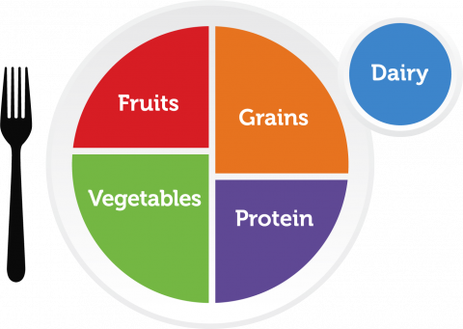
Welcome Reflection
Slide 6
Slide 6
What are your biggest successes related to healthy eating?
What are your biggest challenges or areas of concern relating to healthy eating?
Understanding MyPlate
Slide 8

Slide 4






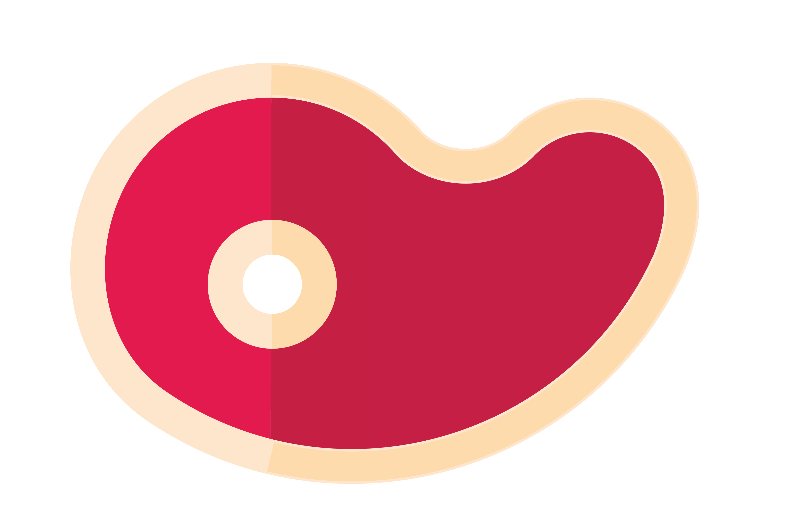

The Food Benefits Game
Slide 9
What benefits do these foods have?
Picture 1: Fruits
Picture 2: Vegetables
Picture 3: Protein
Activity: Build a Plate
Slide 14
Fruits
Grains
Vegetables
Proteins

Slide 5
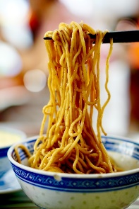
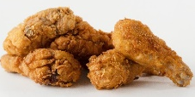
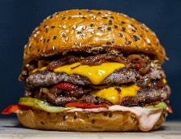
Activity: Make Meals Healthier
Slide 15
How can these meals be made healthier?
Activity: Having
Healthier Meals
Slide 17
Group 1: What are 5 low-cost ways of eating healthy?
Group 2: What are 5 ways to support healthy eating among individuals with food preferences?
Group 3: What are 5 ways to create time for making healthy meals?

Slide 6
Individual Reflection
Slide 23
What is 1 strategy that you can realistically try at home, to have more nutrients in your meals?
What is one strategy that you will try to have more healthy meals?
How will you carry out this strategy?
Who will you tell to help you achieve this goal?

Slide 7
My Notes
Slide 34
Slide 36

Slide 8




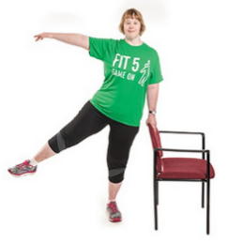


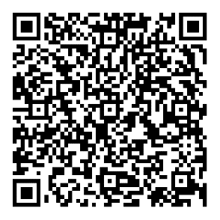

Helpful Resources
 | WHO Global Dietary Guidelines Guidelines on a healthy diet for communities around the world.
 | My Plate A symbol of the 5 food groups representing what to eat from each of the food groups throughout the day.
 | Fit 5 Guide Fit 5 is based on the three simple goals of exercising 5 days per week, eating 5 total fruits and vegetables per day and drinking 5 water bottles of water per day.
 | Special Olympics Washington Healthy Food & Beverage Toolkit Nutrition guidelines focused on reducing processed foods, salt, sugary beverages and increasing fruits, vegetables and whole grains.
 | World Health Organization Healthy Diet Key Facts Overview of healthy eating for adults and children. Including practical advice on maintaining healthy eating.
Slide 34
Slide 34
Slide 36
Slide 36

Slide 9

Family Health Forums, part of Special Olympics Health, are made possible through the generous support of our funders.
This work was supported by Award Number NU27DD000021, funded by the Centers for Disease Control and Prevention. Its contents are solely the responsibility of the authors and do not necessarily represent the official view of the Centers for Disease Control and Prevention or the Department of Health and Human Services.

Slide 10
Some helpful Tips
Size 12 font is great for printed materials. Size 24 (at a minimum) is good for the body copy on PowerPoints.
Bold and colorful text is helpful to bring attention to a point or topic.
Titles can go in the bar above. To add interest and variety in slide, feel free to use the slide layout with the bars on the side and bottom. That layout is great if you have extra room on the slide and feel like you need to fill up space.
Utilize the icon library and high-quality photos to keep PowerPoints engaging!
Don’t be afraid of white space, it helps the reader digest information easier.

Slide 11
































































