Slide 1



Family Health Forum
Fitness for the Family
This work was supported by Award Number NU27DD000021, funded by the Centers for Disease Control and Prevention.
Its contents are solely the responsibility of the authors and do not necessarily represent the official view of the Centers for Disease Control and Prevention or the Department of Health and Human Services.
Notes:
Note:
This slide deck is to guide the facilitator in the presentation and activities for the FHF on diabetes prevention and management for the whole family.
Sample script for facilitators are indicated in this section on all of the slides
Be sure to adapt the slides, language, text and images to better suit your context
Remember to collaborate with local nutrition experts in adaption of the content to ensure adherence to appropriate nutrition guidelines/recommendations for your context
Say: housekeeping and norms
Before we get started a few housekeeping needs:
Location of toilets/washrooms
Snacks or drinks
Other logistics
Planned breaks for virtual participants

Slide 2

Introductions
2
Notes:
Say:
Welcome to our Family Health Forum! we are looking forward to talking about fitness for the whole family.
Let’s get to know each other a little bit and introduce ourselves.
We will go around, and each person can say their name and show us a stretch or body movement they enjoy.
This can be raising your arms over your head, rolling your head side to side, standing up and sitting down, any movement you wish.
We will all try this movement with you.
We will repeat this until everyone has said their name and shared a movement.

Slide 3
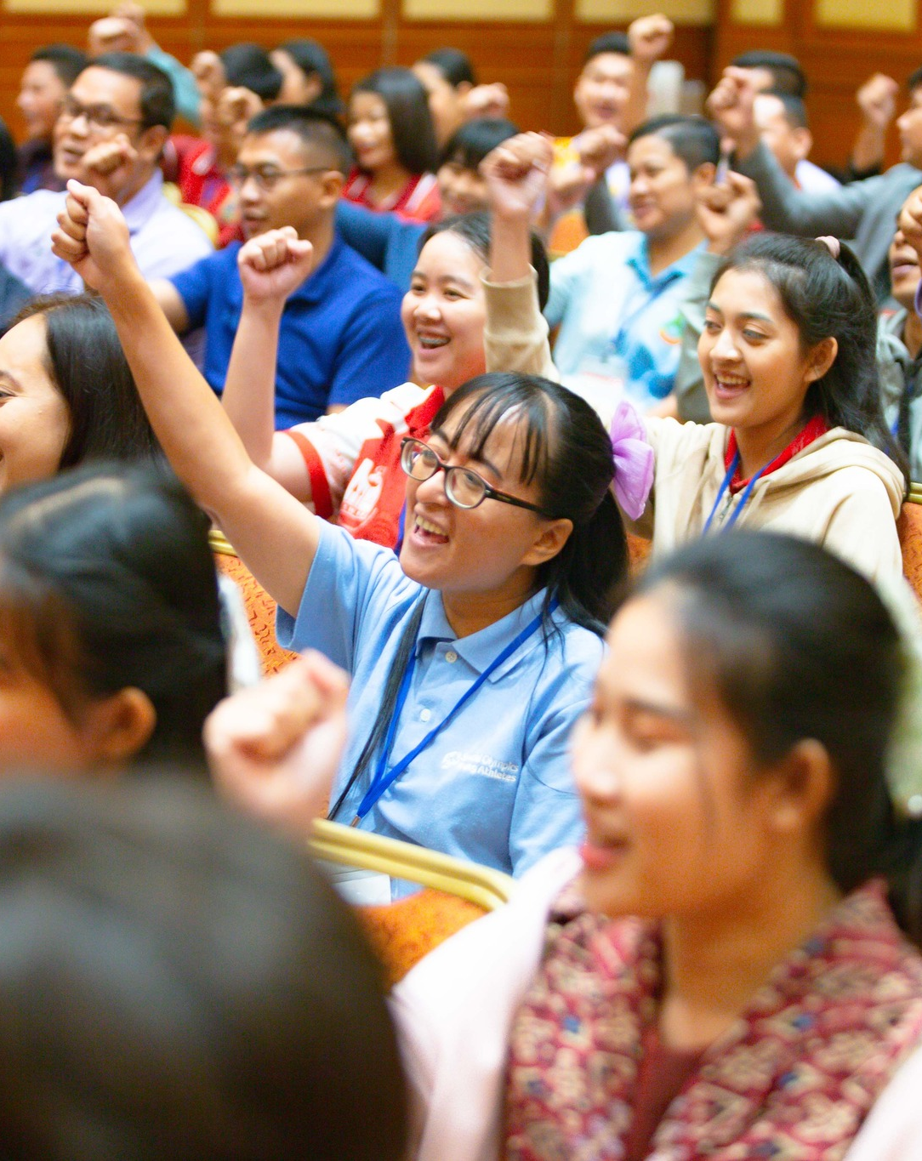
Family Health Forums:
family health & well being
FHFs focus on the whole family
Build connection with other families
Build connection with service providers
Our ways of working:
Respect
Active listening
Judgement free zone
Confidentiality
3
Notes:
Say:​
The goal of Family Health Forums is to reduce the health disparities for people with intellectual disabilities.​
We know we cannot do this without supporting the whole family!​
This space is for families to support each other’s health and wellbeing. ​
Here we focus on all the members of your family.​
Together we will learn about different health challenges and how families can work together to address them.​
We also bring families together to establish support networks with other families and with service providers in our community.​
To make this a welcoming space, there are 4 principles to guide our time together:​
1. We RESPECT each other’s opinions and recognize that we may all be at different stages of caring for ourselves and our families. ​
2. We use ACTIVE LISTENING to be fully present with each other and give each other our undivided attention.​
3. We are a JUDGEMENT-FREE zone – we recognize that we each bring our own unique experiences to this event.​
4. We believe in CONFIDENTIALITY – we agree to keep private what is shared and discussed here​
We are here to learn from and with each other – feel free to ask questions at any time. You can ask your question to the group, or you can write down your questions on the cards provided and place them in the question box.​
Before we begin our topic today let’s discuss why health is important for our athletes and their families.​

Slide 4
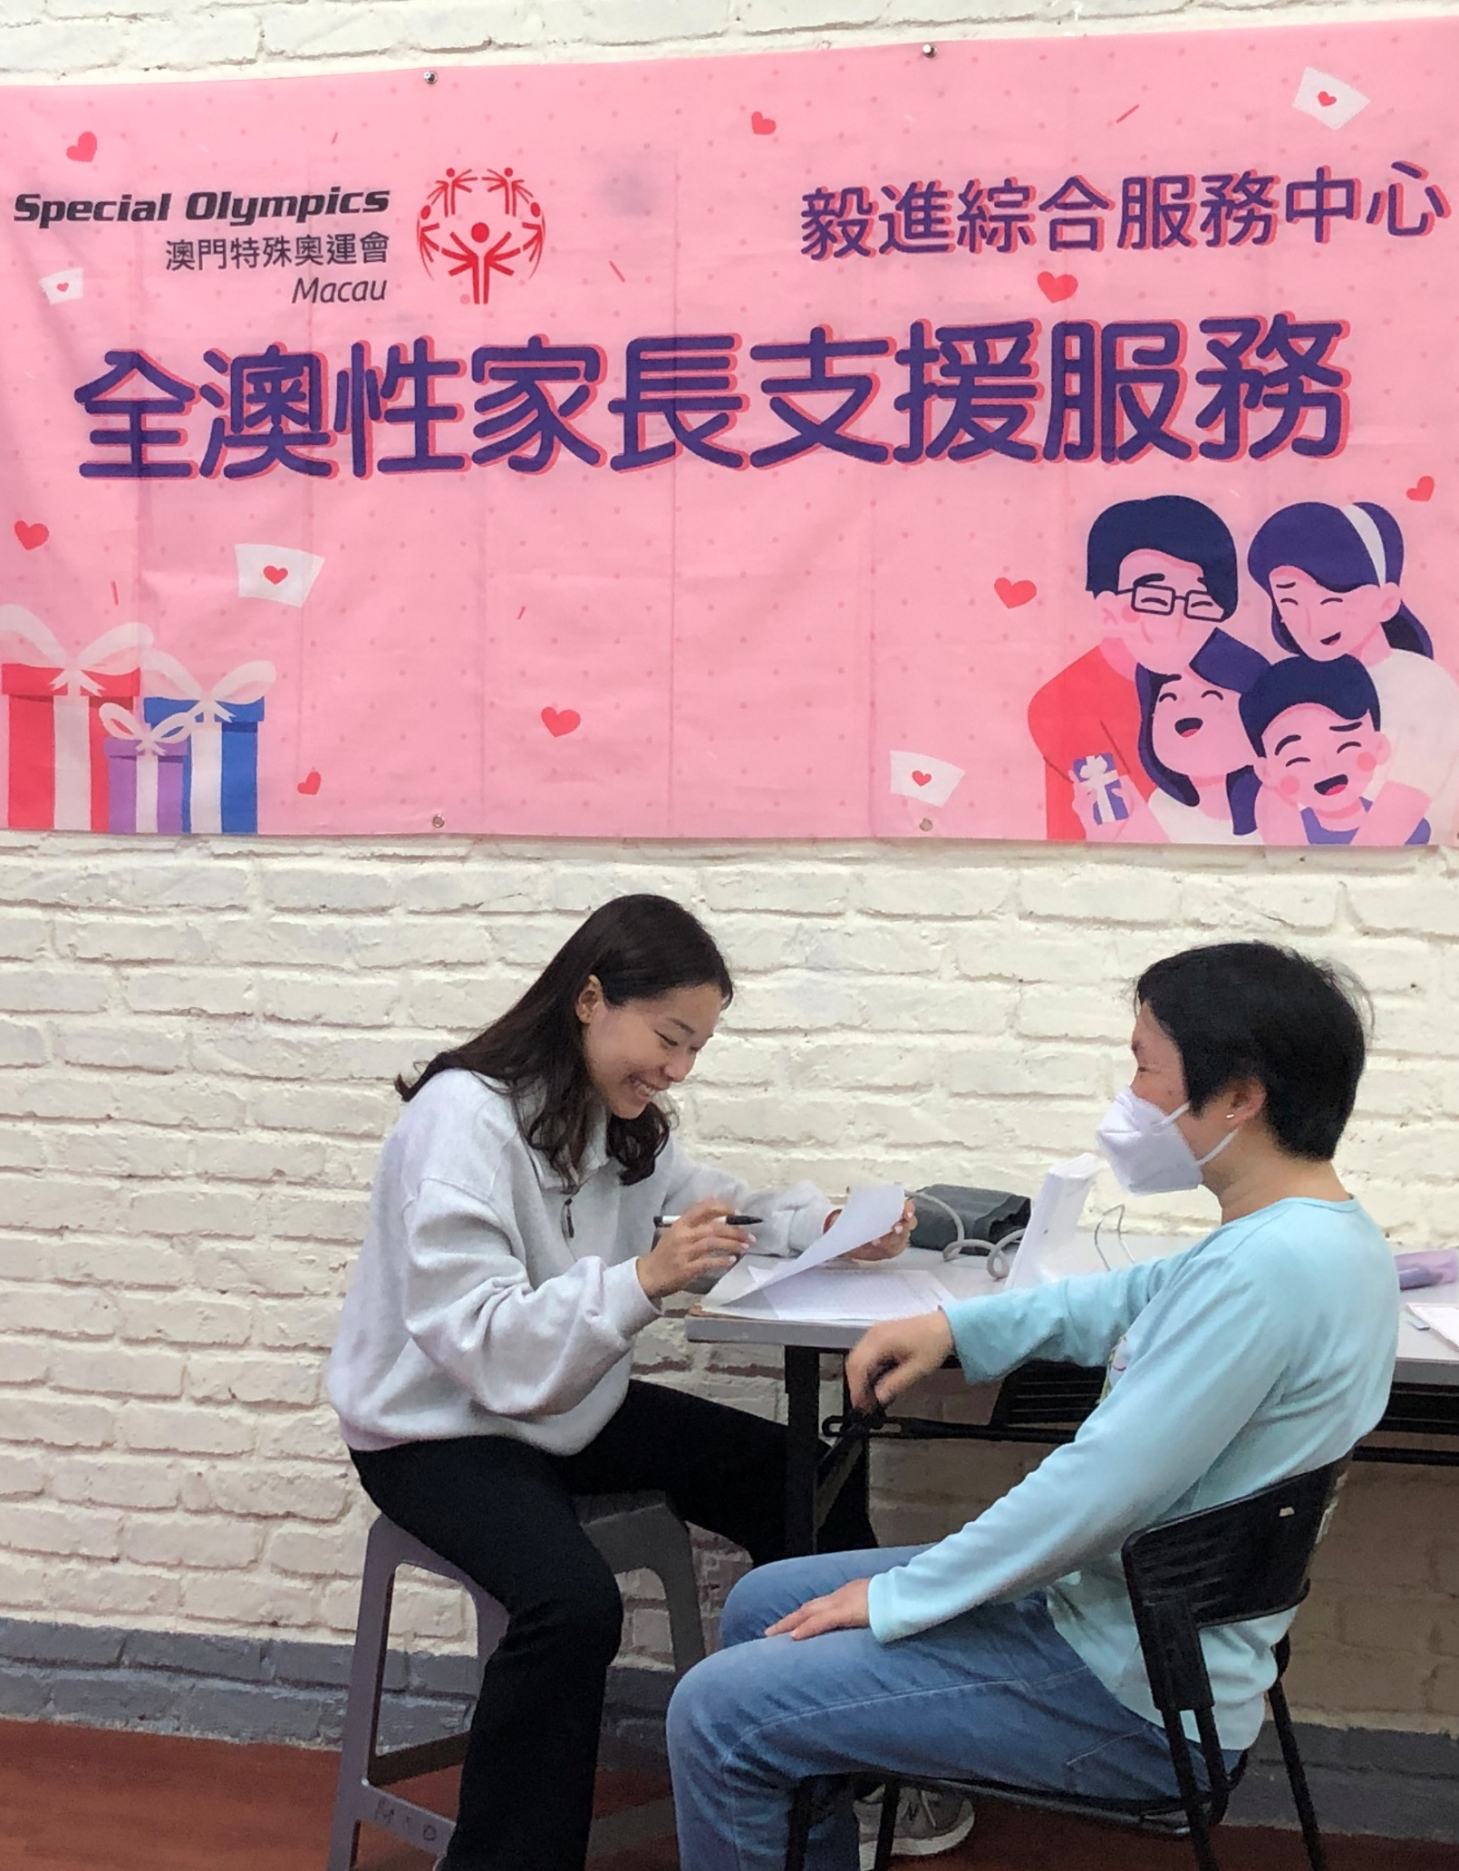
Title here
Did you know?
Individuals with intellectual disability…
Have limited access to critical health services and resources to improve their health.
Are 2 times more likely to be obese
More likely to experience premature death from preventable health conditions.
Have higher rates of chronic health conditions like obesity, diabetes, asthma, and cardiovascular disease.
4
Notes:
Say:
Family Health Forums are important because we know that health has a substantial impact on the quality of life for people with intellectual disability and their families.
Recent data from Special Olympics athletes has informed us about the health and wellbeing of people with intellectual disability.
We know that Special Olympics adult athletes are two times more likely to be obese compared to adults without intellectual disability.
Also, individuals with intellectual disability have as many chronic health conditions at 20+ years old as individuals in the general population do at 50+ years old.
Lastly, people with intellectual disability often do not have access to critical health services and resources to improve their health and die 16 to 20 years sooner than people without intellectual disabilities due to preventable health conditions.
Health affects each Special Olympics athlete’s ability to train and compete in sports effectively.
Special Olympics recognizes the importance of supporting the health and wellbeing of athlete’s families.
Family Health Forums are one way that Special Olympics works to engage family members and provide tools and resources to support whole family health and wellbeing.

Slide 5

Title here
Overview of the Forum
Understanding fitness and its importance to our health and performance
Learning about strategies to increase fitness for the whole family
Action planning to integrate fitness into our family routines
5
Notes:
Say:
Today we are going to discuss fitness for the family.
Staying fit keeps us healthy and it reduces our chances of developing chronic health conditions like diabetes, obesity and cardiovascular disease.
This is important for everyone, but especially for people with intellectual disabilities.
This session will take about 1 hour, and we are going to cover the following topics
First, we will discuss what fitness means and its importance for our health and performance in sport, at work and everyday
We will also explore strategies to increase fitness for the whole family
And finally, we will create realistic action plans for us integrate fitness activities into our family routines.
We will have a mix of activities, discussion and presentations
We all have something valuable to share and we are here to learn from each other’s experiences as well.
Feel free to share any questions or comments you may have as we go along.

Slide 6

Title here
Reflection
6
Workbook page 3
Notes:
Say:
Now we will take a moment to reflect on your family fitness activities.
For this reflection, turn to page 4 in your participant workbook and complete the table.
For each category, nutrition, hydration and physical activity, there are a few activities.
Please indicate in the table if your family engages in the activity always, usually, sometimes or never.
You do not need to spend too much time thinking about each activity, whatever comes to mind quickly.
You will have 5 minutes for this activity.
Ask:
After a few minutes, ask participants if the instructions are clear or if anyone has any questions on the task
Say:
Thank you for rating your family’s fitness activities. We will come back to our scores before we close the Forum.

Slide 7

Activity: Fitness Trivia Challenge
7
Workbook page 5
Notes:
Say:
Now we are going to play a game to learn all about fitness!
I will present a multiple-choice question on the screen.
When you think you have the answer raise your hand and respond
You can also follow the questions in your participant workbook
At times, we will stop for a Healthy Habits Challenge and to discuss what we’ve learned.

Slide 8

What is one benefit of fitness?
a)
Decreases your energy levels
b)
Being healthy and living longer
c)
Increasing your stress level
8
Workbook page 4
Notes:
Ask:
Here is our first question.
What are the benefits of fitness?
Say:
Your options to answer are:
A, decreases your energy levels
B, being healthy and living longer
C, Increasing your stress level

Slide 9






Title here
Fitness
B
Fitness is important for many reasons:
Perform better in sport
Increase your energy levels
Feel happier
Improve your quality of sleep
Fitness helps us stay healthy and live longer
Achieve a healthy weight
Be healthy and live longer
9
Reduce your stress level
Workbook page 4
Notes:
Say:
The correct answer is B.
There are many reasons why fitness is important.
Fitness can help you:
Perform better in sport
Increase your energy levels
Feel happier
Improve your quality of sleep
Achieve a healthy weight
Be healthy and live longer
Reduce your stress level
If you are fit, you feel good and have lots of energy because your body is strong and healthy

Slide 10

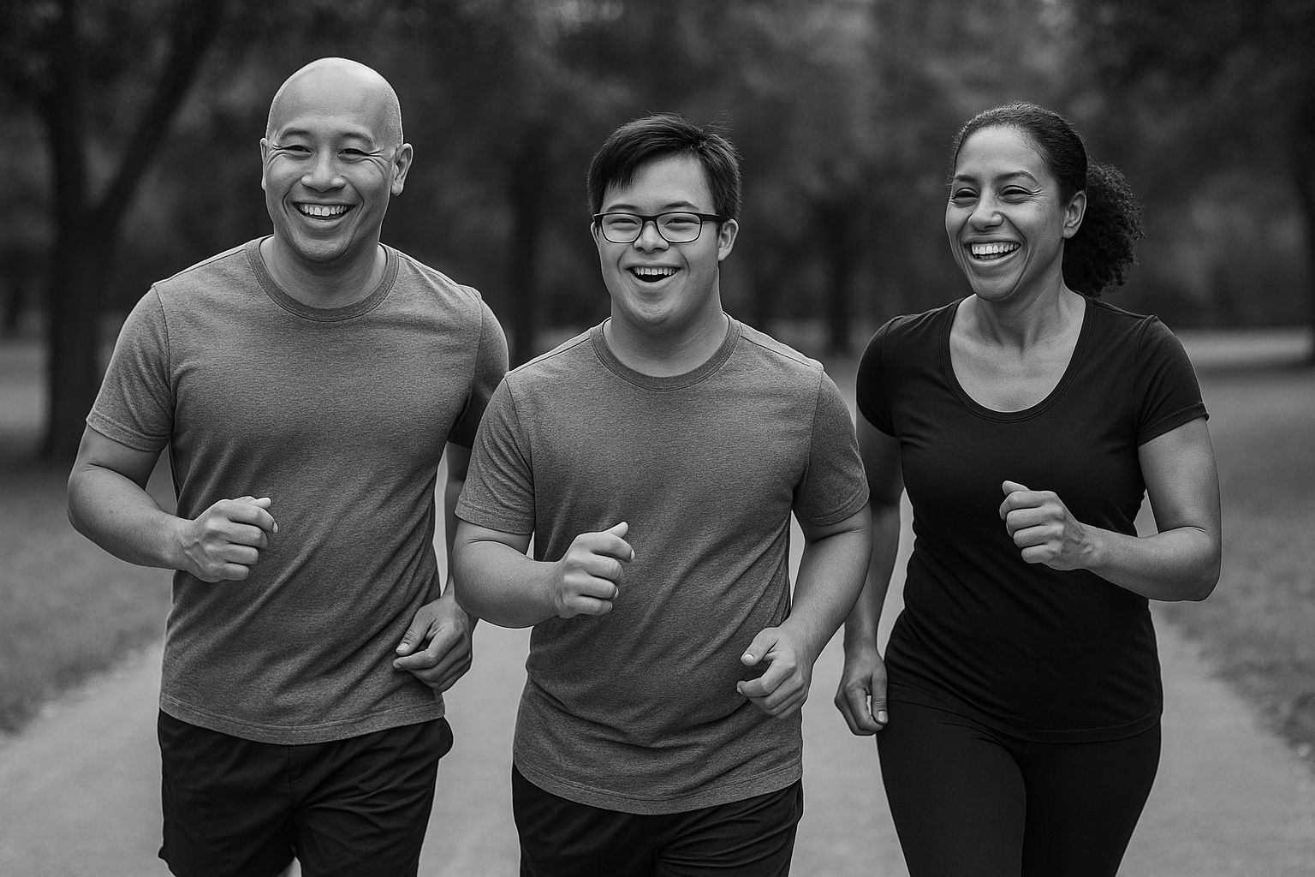



Title here
Fitness
NUTRITION
HYDRATION
Fitness includes 3 key areas:
PHYSICAL ACTIVITY
10
Workbook page 4
Notes:
Say:
Fitness is made of three things:
1) Nutrition. Our healthy eating habits.
2) Hydration. What we drink
3) Physical Activity: Engaging in movement or exercise at least 5 days a week
We will talk about each of these areas.

Slide 11

Healthy Habits Challenge:
Walk & Watch
Let’s take a mindful walk around your space.
11
Workbook page 4
Notes:
Say:
For the first Healthy Habits Challenge, we are going to do a short walking and movement activity
We are going to take a moment and move around the room.
As you walk, pay attention to what you see, smell, hear, or feel.
What did you notice? What did you see? What did you smell? What did you touch?
Virtual participants:
Take a few minutes to move around your space or sit and observe your environment

Slide 12
What is a healthy plate?
a)
A plate filled with 5 food groups.
b)
A plate that contains only fruits and vegetables.
c)
A plate with no carbohydrates or fats.
12
Workbook page 4
Notes:
Ask:
Our next question is, what is a healthy plate?
Say:
A, A healthy plate is filled with 5 food groups.
B, A healthy plate is one that contains only fruits and vegetables.
C, A healthy plate is the absence of carbohydrates and fats.

Slide 13
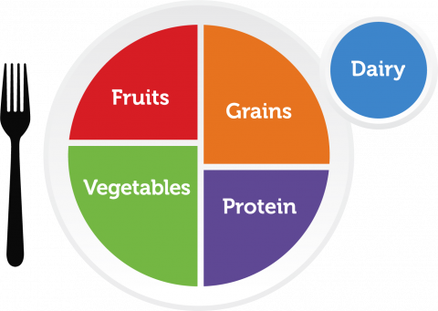
Title here
Healthy Eating
A
A healthy plate is filled with 5 food groups
13
Workbook page 4
Notes:
Say:
The correct answer is A.
A healthy plate is filled with 5 food groups.
It contains a variety of healthy foods like fruits, vegetables, grains, protein and dairy or calcium rich foods such as spinach if you do not consume dairy so that your body has what it needs to grow and be healthy.
Healthy eating means eating nutrient dense foods.
Nutrient dense foods are foods that contain a high level of vitamins, minerals such as iron, calcium, vitamins D, C and A.
These nutrients are important for our healthy development
Choosing the right foods at the right time, can ensure our athletes and all our family members have the energy we need every day for sports, for work, for caring for each other and for taking care of our homes.

Slide 14






Title here
Healthy Eating Quick Tips
Make half your plate fruits and vegetables every day
Make half your grains whole grains
Eat different types of proteins, like meat, seafood, beans, eggs, & nuts
Eat less salt, fat, and sugar
A healthy plate is filled with 5 food groups
Drink water instead of sugary drinks
14
Notes:
Say:
Eating healthy food is important for the whole family. It gives the family energy to move, maintain healthy weights, and perform at their best, at school, at work, in sports and in everyday life.
We can all take steps towards eating healthy
Some quick tips are to:
Make half your plate fruits and vegetables
Make half your grains whole grains (like brown rice, or brown bread)
Eat different types of protein foods like meat, seafood, beans, eggs and nuts)
Reduce salt, fat and sugar
Drink more water instead of sugary drinks like soda, energy or sports drinks
Remember there are no good or bad foods, rather, some foods have more benefits that others
Foods with a lot of vitamins and minerals are called nutrient dense.
We can mix foods on our plate and meals throughout the day so that we have an overall balance of nutrient dense foods and other foods.
Some foods we need to eat daily like fruits because they have a lot of vitamins and minerals, they are nutrient dense.
Some foods we eat occasionally like sweet and high fat foods because they have little vitamins and minerals.
What is important is to find the balance that works best for you and your family.

Slide 15

Healthy Habits Challenge:
Creating Healthy Meals
What barriers or challenges does your family have creating healthy meals?
15
Workbook page 4
Notes:
Say:
Thank you for your answer. For the second Healthy Habits Challenge, we are going to discuss creating health meals.
Ask
Thinking about your own family, do you have any challenges with creating healthy meals?
Some barriers some families face are the cost of healthy meals, busy schedules and limited access to healthy ingredients.
What are the challenges your family has faced if any?

Slide 16
What does it mean to be hydrated??
a)
Your body has too much water
b)
Your body has too little water
c)
Your body has enough water
16
Workbook page 5
Notes:
Say:
Thank you for sharing your experiences, now, we will move to our next trivia question.
Ask:
Our next question is what does it mean to be hydrated?
Say:
Your options to answer are:
A, Hydrated means your body is retaining excessive amounts of water
B, Hydrated means your body has enough water
C, Hydrated means your body has too much water

Slide 17





Title here
Hydration
C
Drink 5 bottles of water every day
Don’t wait until you are thirsty for a drink
Limit sugary drinks
Hydrated means your body has enough water
Eat foods with high water content
Watch for signs of dehydration
17
Workbook page 5
Notes:
Say:
The correct answer is C.
Hydrated means our body has enough water
Water helps to keep our bodies working properly.
We lose water when we go to the bathroom, sweat, exercise, or even breathe.
If we lose too much water without drinking more, our body will not work as well.
This is called dehydration.
When we are hydrated, we can focus better at work, school and on the field.
We will have more energy and be in a better mood.
Our hydration quick tips are:
To drink at least 5 bottles of water every day
Don’t wait until you are thirsty for a drink. Drink water throughout the day, and before, during, and after movement activities.
Watch out for signs of dehydration.
The signs of dehydration are:
Feeling thirsty, tired or sluggish
Having a headache
Having a dry mouth
Having urine that is dark yellow or brown

Slide 18



Healthy Habits Challenge:
Water Break
What fruits or vegetables do you add in your water?
18
Workbook page 5
Notes:
Say:
Let’s complete third and final healthy habits challenge.
Remember hydration is important for the whole family!
We are going to take a water break and practice staying hydrated throughout the day.
Ask:
Do you ever add fruits or vegetables into your water for a different taste?
What fruits or vegetables do you add to your water?
Facilitator Note for Virtual Presentations:
Say:
Let’s make water fun! I’ll name some options of ingredients you can add to your water.
If it’s something you like, show me a quick movement on camera. You can clap, do a dance move, stretch, or give a thumbs up. Ready?
Lemon – clap your hands
Cucumber – stretch your arms
Strawberry – spin in a circle
Mint – wave your hands
Orange slices – thumbs up

Slide 19
What does physical activity
mean?
a)
Focusing on weightlifting and muscle building
b)
Drinking energy drinks and supplements to enhance performance.
c)
Any movement that our body makes.
19
Workbook page 5
Notes:
Ask:
Our last question is, what does physical activity mean?
Say:
A, focusing on weightlifting and muscle building
B, drinking energy drinks and supplements to enhance performance
C, any movement that our body makes.

Slide 20


Title here
Physical Activity
C
Physical activity includes exercise, sports and regular movement like walking, doing chores, or gardening.
Physical activity is any movement our body makes
Schedule time for physical activity every day.
20
Notes:
Say:
The correct answer is C.
Physical activity is any movement our body makes
It is produced by our muscles and uses energy.
When you do physical activity, you get stronger, faster, and healthier so you can handle all kinds of challenges.
Physical activity includes exercise, sports, and regular movement like walking, dancing, doing chores or gardening.
The more you move, the fitter you will be.
Our goal is to do some type of physical activity everyday.

Slide 21
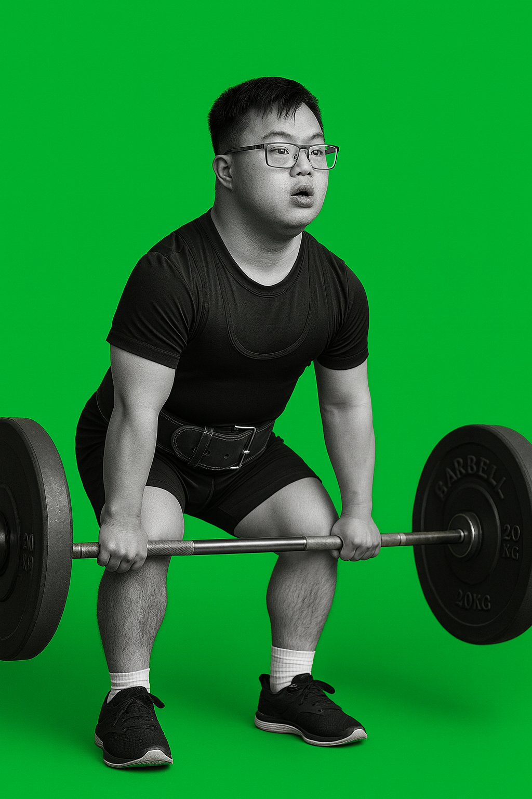
Title here
Physical Activity Recommendations
Youth:
60 minutes/day
Muscle strengthening: 3 days/week
Bone strengthening: 2 days/week
Adults:
Moderate activity:150 minutes/week
Vigorous activity: 75 minutes/week
Muscle strengthening: 2 days/week
21
Notes:
Say:
The recommendations for physical activity are different for youth and adults
Youth, people under 17 years old are encouraged to do 60 minutes/day
Adults are encouraged to do 150 minutes of moderate to vigorous activity or 75 minutes of vigorous activity every week.
It is also important for both youth and adults to get muscle and bone strengthening activities in.
Muscle strengthening activities include things like squats or push-ups
Bone-strengthening activities include things like running or jumping.

Slide 22

Title here
Physical Activity
Strength
Strength is the ability of our body to do work
22
Notes:
Say:
Strength is the ability of your body to do work.
Strength can help you to jump, throw farther and sprint faster
Building strength is important because it helps improve muscle mass, bone density, and overall physical function.
Strong muscles support proper posture and alignment, reducing our risk of injury and chronic pain.
Let’s all practice 1 strength movement together
You can improve your strength by doing activities that work your muscles like climbing, push ups, squats, lifting weights and body weight exercises.
Note:
Provide one easy example of strength for participants to try together.

Slide 23

Title here
Physical Activity
Endurance
Endurance is the ability to keep your body moving for long periods of time.
23
Notes:
Say:
Endurance is the ability to keep your body moving for long periods of time.
Endurance can help you run farter distances without stopping and practice longer with fewer breaks.
Endurance also helps to increase our energy levels, improve our mood, and reduce the risk of chronic diseases such as heart disease, diabetes, and obesity.
Endurance also helps boost our thinking and enhances our ability to perform daily tasks with ease.
Let’s all practice 1 endurance movement.
Note:
Provide one easy example of endurance for participants to try together.

Slide 24
Title here
Physical Activity
Flexibility
Flexibility helps the body to move easily in all directions
24
Notes:
Say:
Flexibility helps your body to move easily in all directions.
Being flexible makes it easier to do sports.
In life, being flexible also helps us prevent injuries to our muscles and joints.
Stretching is a great way to improve flexibility and balance. There are different types of stretches that you and your family can do before and after physical activities.
Static stretches are when you hold a stretch position for a certain period of time without moving, like child's pose.
Dynamic stretches are moving your body through a full range of motion like leg swings.
Yoga is also a good way to improve flexibility and balance.
Let’s practice one together.
Note:
Provide one easy example of flexibility for participants to try together.

Slide 25

Title here
Physical Activity
Balance
Balance is the ability of your body to stay upright or stay in control of your movements.
25
Notes:
Say:
Balance is the ability of your body to stay upright or stay in control of your movements.
Balance helps you to stay in control and helps you avoid falls.
There are two types of balance.
Static balance and dynamic balance.
Static balancing is when you keep your body stable in a balanced position without any movement, like tree pose.
Dynamic balancing is when you keep your body stable while in motion such as walking in a line or changing directions.
Improving your balance strength and coordination supports greater independence and quality of life as we age.
Balancing activities can be done anywhere, and you can do them together with all family members.
Let’s all practice 1 balance movement.
Note:
Provide one easy example of balance for participants to try together.

Slide 26

Healthy Habits Challenge:
How many strategies?
How many strategies can you list for:
Healthy eating
Hydration
Movement
26
Workbook page 5
Notes:
Say:
Split into 3 groups. Each group will have 5 minutes timed to list as many different strategies as possible.
Group 1 will work on strategies for healthy eating
Group 2 will work on strategies to stay hydrated
Group 3 will work on strategies for more regular movement.
After the 5 minutes are up, each group will share their list with everyone
Facilitator Note for Virtual Presentations:
For a virtual forum, keep the group together.
Set a timer for 1 minutes for each strategy.
Ask participants to type in the chat or speak their strategies.

Slide 27





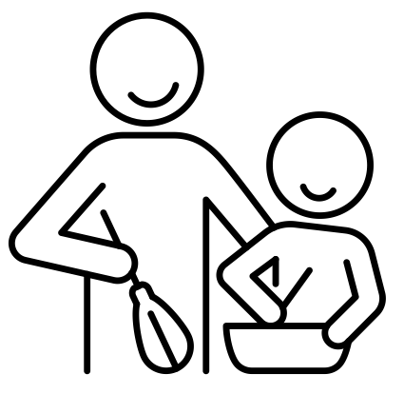



Title here
Healthy Eating Quick Tips
Make a food shopping list together
Save less healthy food like deserts, chips, and sodas for special occasions
Prepare meals in advance together
Healthy eating can be affordable
More fruits & vegetables
Save and reuse leftovers
Grow and care for a vegetable garden
Cook together
Double recipes and store the remainder
Have your favorite healthy snacks easily accessible
27
Notes:
Say:
Thank you for sharing your strategies, here a few additional ideas for healthy eating, hydration, and physical activity.
Remember healthy snacks can be quick and easy here are some ideas for healthy snacks from the SO Fit-5:
Apple slices dipped in peanut butter
Low-fat unsweetened yogurt with berries
Low-fat cottage cheese with tomatoes
Carrots or peppers dipped in hummus
Celery topped with peanut butter and raisins.
Special Olympics has a lot of additional tips in Fit 5 and the Snack Zone resource guide.
A link for this can be found in the appendix of your participant workbook.
Ask:
What are your favorite snacks?
Can we have a few volunteers to share their favorite snacks?
Now we will move on to strategies for staying hydrated.

Slide 28





Title here
Hydration Quick Tips
Drink out of a reusable water bottle
Drink sparkling water as an alternative for soda
Carry your water bottle around with you throughout the day
Save sugary drinks like sodas, sports and energy drinks for special occasions
Flavor your water with natural fruits or herbs
28
Notes:
Say:
As we have talked about water is an important fuel for sports and life.
Drinking the right amount of water is important for your health and performance in sports and life.
Our goal is to drink 5 bottles of water every day.
Here are a few strategies to keep hydrated.
Drink out of a reusable water bottle. This can help to track how much water you are drinking throughout the day.
Drink a glass of water when you wake up, with every snack/meal and before and after exercise.
Flavor your water with natural fruits or herbs, for example, cucumber, mint, orange or lemon slices
Drink sparkling water as an alternative for soda
Save sodas, juice and energy drinks for special occasions only
Carry your reusable water bottle throughout the day.

Slide 29





Title here
Physical Activity Quick Tips
Set specific goals
Mix it up
Find activities you enjoy
Listen to your body
Schedule regular workouts
29
Notes:
Say:
As you have shared, supporting regular exercise can be a challenge.
Here are some additional strategies for regular exercise
Set Specific Goals.
Define what you want to achieve through exercise, whether it's weight loss, muscle gain, improved flexibility, or overall health. Setting specific, measurable goals helps keep you motivated and focused on your progress.
Find Activities You and your family will enjoy.
Experiment with different types of exercise until you find activities that you genuinely enjoy. Whether it's swimming, hiking, dancing, or weightlifting, incorporating activities you love into your routine makes exercise more enjoyable and sustainable in the long run.
Schedule Regular Workouts
Treat exercise like any other important appointment by scheduling regular workout sessions into your weekly calendar. Consistency is key to seeing results and making exercise a habit.
Mix It Up
Avoid getting bored or hitting plateaus by varying your exercise routine. Incorporate a mix of cardiovascular activities, strength training, flexibility, balance exercises, and recreational activities to keep your body challenged and engaged.
Listen to Your Body
Pay attention to how your body feels during and after exercise. Push yourself to challenge your limits but also learn to recognize when you need rest or modifications to prevent injury. After a workout, your body needs time to rest. Getting 7 to 9 hours of sleep and taking a break from exercise are great ways to get more rest.

Slide 30

Reflection: Healthy Habit Scorecard
What is one thing from your Healthy Habit Scorecard that you would like your family to improve on?
What may get in the way of engaging in this activity?
How will you address the barriers of engaging in this activity?
30
Workbook page 6
Notes:
Say:
Now that we have explored strategies for enhancing fitness, let’s look again at our Family fitness scorecard.
Please turn to page 6 of your workbook and record your responses to the questions there.
Ask:
The first question is what is one area from the healthy habit scorecard that you would like your family to improve on?
The next question is what may get in the way of you and your family engaging in this activity? For example, time, costs?
The last question is how will you address the barriers of engaging in this activity?

Slide 31

Make it a habit
We will work on ______ activity from the scoresheet
To learn more about this activity we will:
  Review SOI fitness resources
  Ask a doctor or health professional
  Ask my coach or Other
  Other
We will try this activity on (date/time) _____
We will ask _____ to help us schedule it into our routine
31
Workbook page 6
Notes:
Say:
Now that we have found an activity to try with our families, we can create family fitness plans for this activity
Turn to page 6 of your participant workbook and follow the prompts there to create your family fitness plan.

Slide 32

Questions
32
Notes:
Say:
Before we close, and while we have our community partners with us let’s have some time for questions.
Ask:
Does anyone have any questions or concerns about anything we have discussed today?

Slide 33
Thank you!
SO Program Team
Contact Us:
Name:
Tel:
Email:
Community partner
Contact Us:
Name:
Tel:
Email:
Community partner
Contact Us:
Name:
Tel:
Email:
Community partner
Contact Us:
Name:
Tel:
Email:
33
Workbook page #
Notes:
Say:
Thank you for joining us today.
Please reach out to us if you have any further needs.

Slide 34
Some helpful tips
Size 12 font is great for printed materials. Size 24 (at a minimum) is good for the body copy on PowerPoints.
Bold and colorful text is helpful to bring attention to a point or topic.
Titles can go in the bar above. To add interest and variety in slide, feel free to use the slide layout with the bars on the side and bottom. That layout is great if you have extra room on the slide and feel like you need to fill up space.
Utilize the icon library and high-quality photos to keep PowerPoints engaging!

Slide 35
















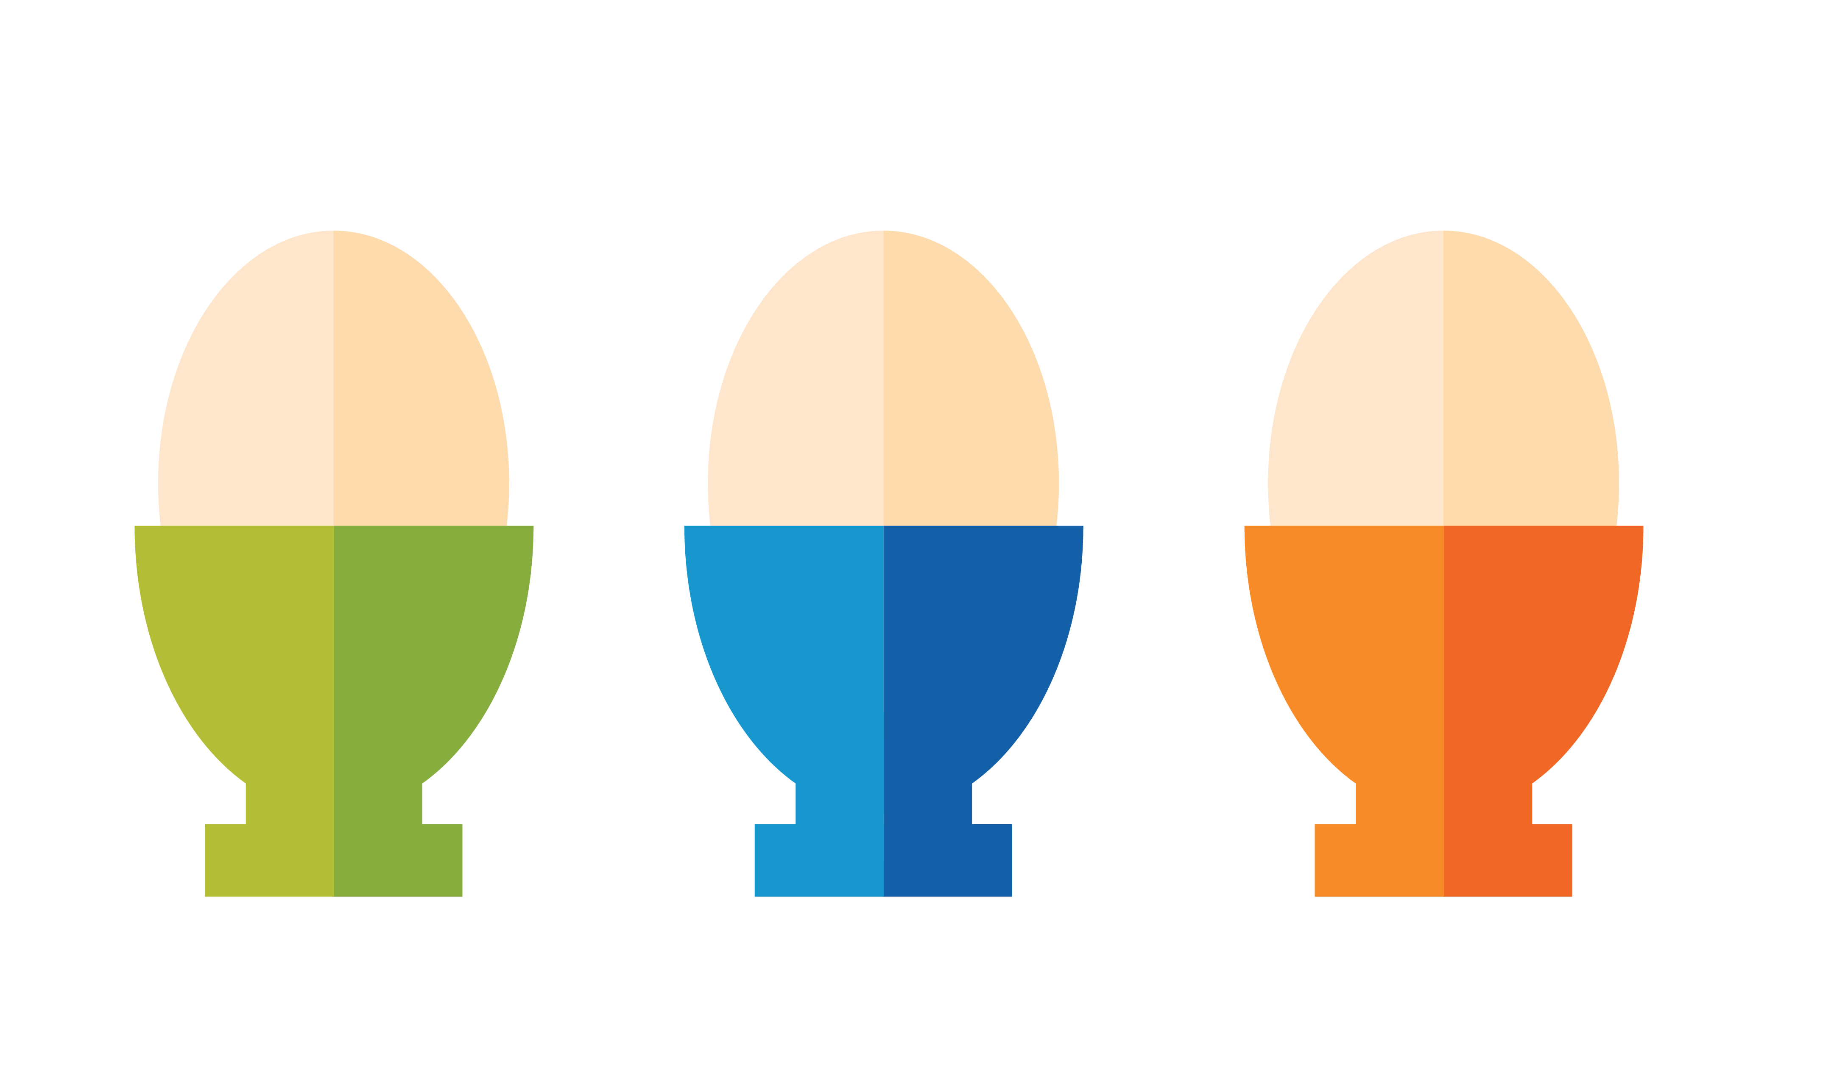










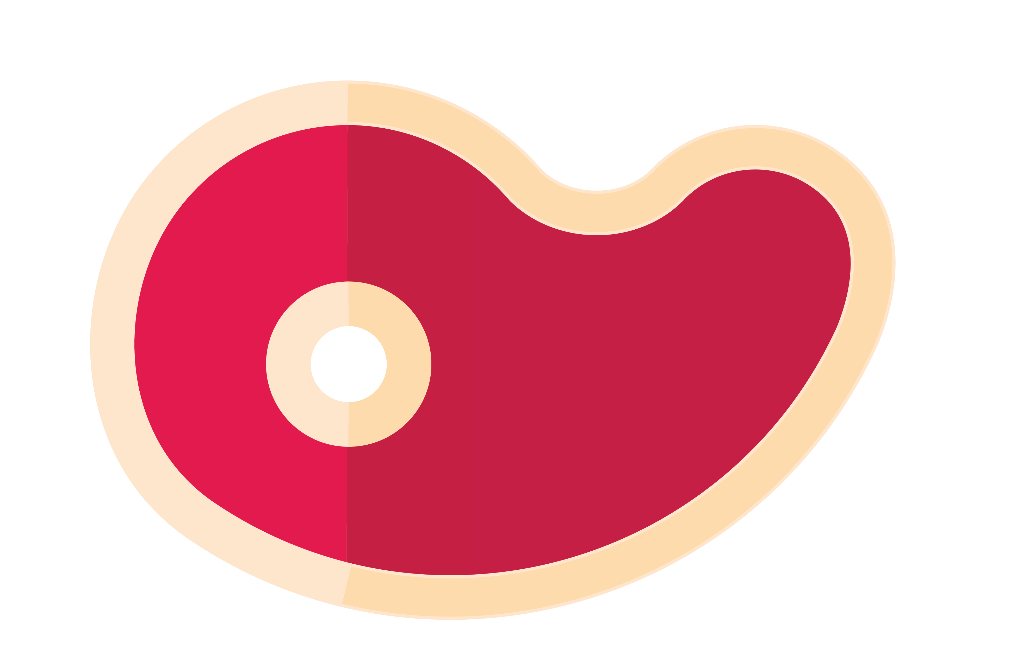



































Icon Library

