Slide 1

Diabetes Prevention and Management
Topic Guide

Slide 2
Learning Objectives
Forum at a Glance
This topic guide aligns with the Diabetes Prevention and Management PowerPoint presentation. It highlights key materials, notes, and resources to support facilitation.
The aim of this Family Health Forum is to introduce the topic Diabetes Prevention and Management. At the end of this Forum, participants will:
Understand what diabetes is and why it is important for people with intellectual disabilities and their families.
Explore strategies for prevention and management of diabetes through healthy eating, physical activity and managing stress.
Learn about community resources for prevention and management of diabetes.
Agenda
The following is a general agenda for the Forum and the topics covered.
The Forum is estimated to take 1 hour and 30 minutes to complete.
Welcome and Introductions
Overview of Family Health Forums
What is diabetes?
Activity: Type 2 diabetes True and False Game
Strategies for Prevention and Management of Type 2 Diabetes
Reflection: Barries to Physical Activity
Activity: Strategies for Prevention and Managements of Type 2 Diabetes
Reflection: Family Scorecard Action Planning
Activity: Meet our Diabetes Community Partners
Q&A
Facilitators
Possible facilitators include community partners, coaches, and parents with experience in type 2 diabetes and/or working with families of people with intellectual disabilities (ID). Programs may also identify other qualified individuals to lead the Forum.

Slide 3
Materials
The following materials will be helpful for facilitation and planning of the Forum:
PowerPoint presentation on Caregiver Stress & Building Resilience
Printed copies of participant workbook or access to virtual copy
Writing/drawing materials
Timer/stopwatch to track time spent during activities
Ball or item to pass around during introductions
Box or basket to collect questions or comments from participants

Slide 4
Important Notes
Review the PowerPoint Presentation in advance:
There is a suggested script in the notes section of the presentation. Reviewing it in advance will allow you to be comfortable with the presentation and reduce reading the script. Make wording changes to support the flow of the presentation.
Adapt Forum Materials:
Include local recommendations and resources for diabetes related services in your community. You can collaborate with local service providers for this and if possible, also invite them to the Forum.
Adjust the script and images to suit your community and participants.
Encourage engagement, sharing and asking questions:
For an in-person Forum, you can have optional paper or cards for participants to write/draw their name
During discussions, allow time for participants to share their personal experiences. Facilitators can encourage discussions by sharing their experiences first.
Make time or be available for participants to ask questions to further support families after the Forum.
Responding to Questions:
Do your best to fully answer the questions. If someone in the group has a helpful experience, invite them to share.
Leverage community partners or topic experts to help respond to questions
If you’re unable to answer any questions, refer to a community partners or expert when feasible, or notate the question and follow up with an answer as soon as possible.

Slide 5
Important Notes
Identify community resources and partners in advance:
For this forum it is important for participants to walk away with specific information about health providers and or related services to support chronic health challenges like diabetes.
Collaborate with community partners to identify and invite service providers to participate in this forum by sharing about their services at the end of the Forum.
Examples of service providers for diabetes are; health professionals; nutrition specialists; fitness specialists; diabetes counselors.
Prediabetes Risk Test:
There is a Prediabetes Risk Test included in the PowerPoint presentation and the participant workbook. This is an optional activity that can be done during or as a take home resource for families.
If you use this resource, remind participants that only a health care provider can diagnose diabetes and if they have any concerns about the Prediabetes Risk Test, they can contact their relevant health care workers.

Slide 6
My Notes

Slide 7
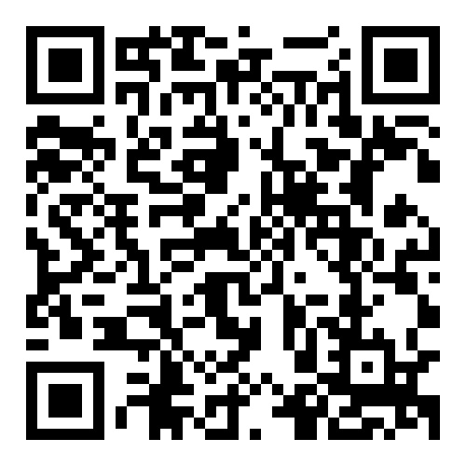

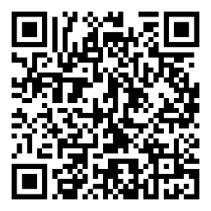

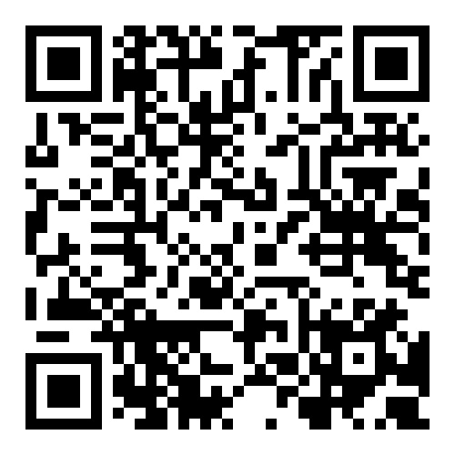

Helpful Resources
 | World Health Organization Diabetes Fact Sheets Key facts about different types of diabetes
 | CDC Prediabetes Risk Test A person with a high score on the risk test (5 or higher) is at significant risk for having prediabetes. However, only a blood test by a medical provider can determine an official diagnosis.
 | Fit 5 Guide & Fitness Cards Fit 5 is based on the three simple goals of exercising 5 days per week, eating 5 total fruits and vegetables per day and drinking 5 bottles of water per day.

Slide 8
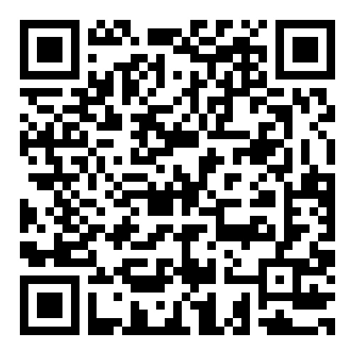


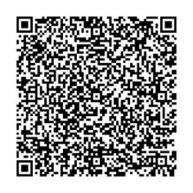
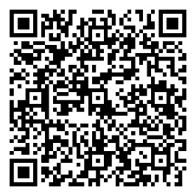

Helpful Resources
 | School of Strength Snack Zone This nutrition education campaign helps athletes learn about the nutritional benefits of choosing healthier snacks and how healthy snacks can fuel them to feel stronger on the playing field.
 | Special Olympics Strong Minds An interactive learning activity focused on developing adaptive coping skills.
 | CDC Diabetes Prevention Program: Lifestyle Change Program Information about the United States Center for Disease Control and Prevention (CDC) National Diabetes Prevention Program lifestyle change program.

Slide 9

Family Health Forums, part of Special Olympics Health, are made possible through the generous support of our funders.
This work was supported by Award Number NU27DD000021, funded by the Centers for Disease Control and Prevention. Its contents are solely the responsibility of the authors and do not necessarily represent the official view of the Centers for Disease Control and Prevention or the Department of Health and Human Services.

Slide 10
Some helpful Tips
Size 12 font is great for printed materials. Size 24 (at a minimum) is good for the body copy on PowerPoints. Bold and colorful text is helpful to bring attention to a point or topic. Titles can go in the bar above. To add interest and variety in slide, feel free to use the slide layout with the bars on the side and bottom. That layout is great if you have extra room on the slide and feel like you need to fill up space. Utilize the icon library and high-quality photos to keep PowerPoints engaging! Don’t be afraid of white space, it helps the reader digest information easier.

Slide 11








































































