Slide 1



Family Health Forum
Diabetes Prevention and Management
This work was supported by Award Number NU27DD000021, funded by the Centers for Disease Control and Prevention.
Its contents are solely the responsibility of the authors and do not necessarily represent the official view of the Centers for Disease Control and Prevention or the Department of Health and Human Services.
Notes:
Note:
This slide deck is to guide the facilitator in the presentation and activities for the FHF on diabetes prevention and management for the whole family.
Sample script for facilitators are indicated in this section on all of the slides
Be sure to adapt the slides, language, text and images to better suit your context
Remember to collaborate with local nutrition experts in adaption of the content to ensure adherence to appropriate nutrition guidelines/recommendations for your context
Say: housekeeping and norms
Before we get started a few housekeeping needs:
Location of toilets/washrooms
Snacks or drinks
Other logistics
Planned breaks for virtual participants

Slide 2

Introductions
2
Notes:
Say: Welcome
Welcome to our Family Health Forum! we are looking forward to talking about diabetes prevention and management.
Let’s get to know each other and introduce ourselves.
Each person can share their name and something that someone would not know about themselves.
I will go first.

Slide 3

Family Health Forums:
Family Health and Wellbeing
FHFs focus on the whole family
Build connection with other families
Build connection with service providers
Our ways of working:
Respect
Active listening
Judgement free zone
Confidentiality
3
Notes:
Say:​
The goal of Family Health Forums is to reduce the health disparities for people with intellectual disabilities.​
We know we cannot do this without supporting the whole family!​
This space is for families to support each other’s health and wellbeing. ​
Here we focus on all the members of your family.​
Together we will learn about different health challenges and how families can work together to address them.​
We also bring families together to establish support networks with other families and with service providers in our community.​
To make this a welcoming space, there are 4 principles to guide our time together:​
1. We RESPECT each other’s opinions and recognize that we may all be at different stages of caring for ourselves and our families. ​
2. We use ACTIVE LISTENING to be fully present with each other and give each other our undivided attention.​
3. We are a JUDGEMENT-FREE zone – we recognize that we each bring our own unique experiences to this event.​
4. We believe in CONFIDENTIALITY – we agree to keep private what is shared and discussed here​
We are here to learn from and with each other – feel free to ask questions at any time. You can ask your question to the group, or you can write down your questions on the cards provided and place them in the question box.​
Before we begin our topic today let’s discuss why health is important for our athletes and their families.​
​

Slide 4
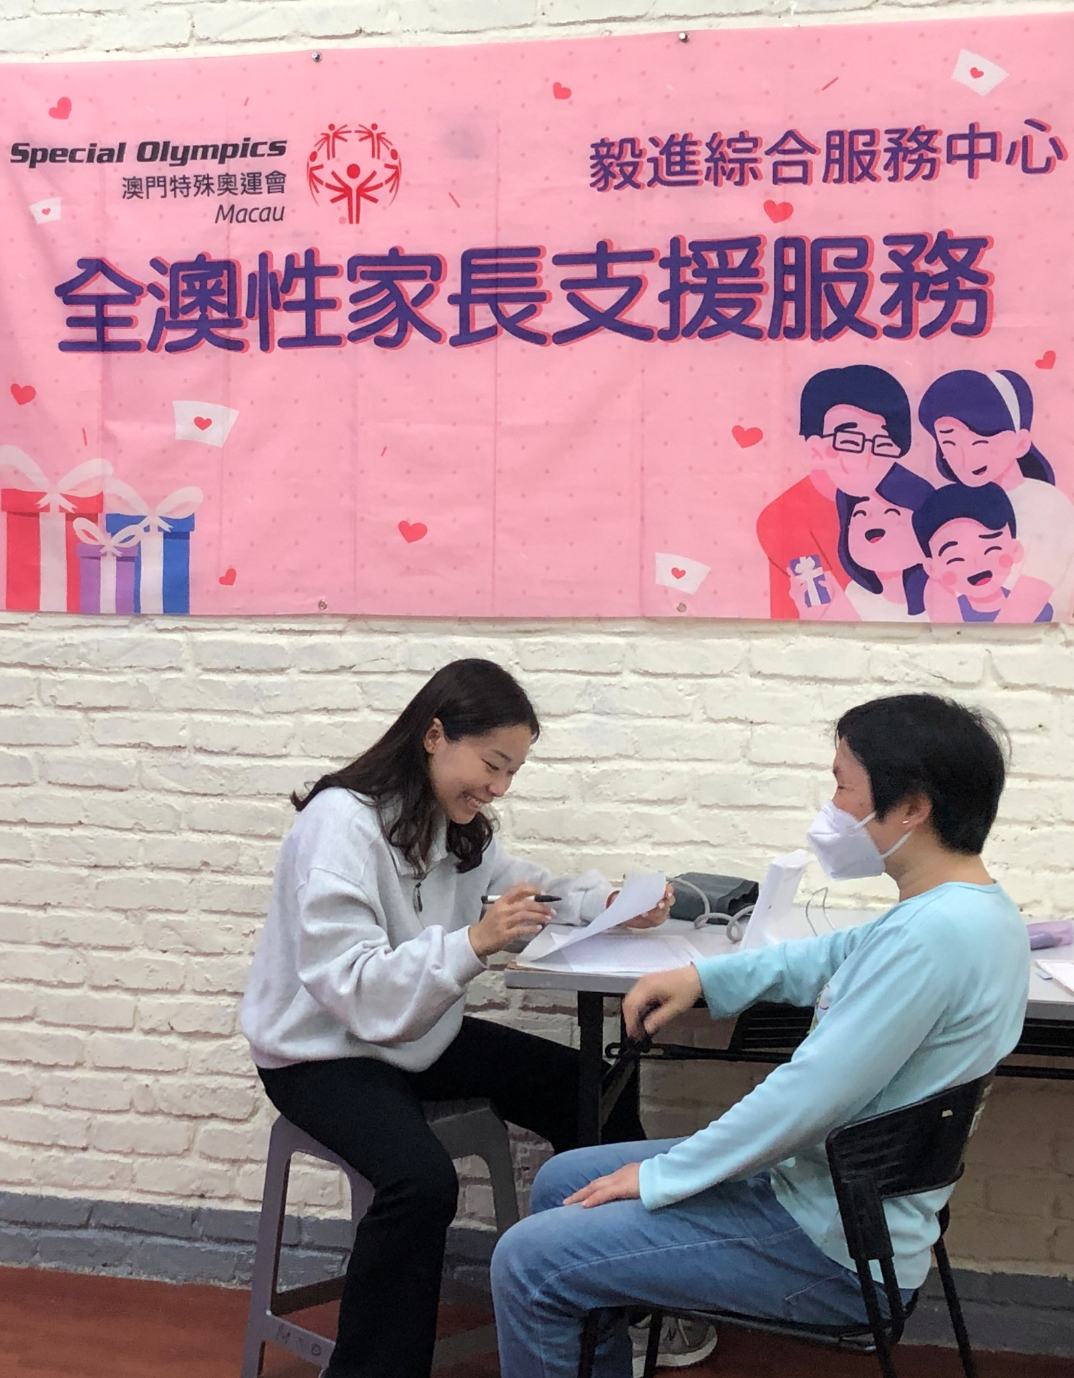
Did you know?
Individuals with intellectual disability…
Have limited access to critical health services and resources to improve their health.
Are 2 times more likely to be obese
More likely to experience premature death from preventable health conditions.
Have higher rates of chronic health conditions like obesity, diabetes, asthma, and cardiovascular disease.
4
Notes:
Say:
Family Health Forums are important because we know that health has a substantial impact on the quality of life for people with intellectual disability and their families.
Recent data from Special Olympics athletes has informed us about the health and wellbeing of people with intellectual disability.
We know that Special Olympics adult athletes are two times more likely to be obese compared to adults without intellectual disability.
Also, individuals with intellectual disability have as many chronic health conditions at 20+ years old as individuals in the general population do at 50+ years old.
Lastly, people with intellectual disability often do not have access to critical health services and resources to improve their health and die 16 to 20 years sooner than people without intellectual disabilities due to preventable health conditions.
Health affects each Special Olympics athlete’s ability to train and compete in sports effectively.
Special Olympics recognizes the importance of supporting the health and wellbeing of athlete’s families.
Family Health Forums are one way that Special Olympics works to engage family members and provide tools and resources to support whole family health and wellbeing.

Slide 5

Health & Intellectual disability
Have you or your family members ever experienced challenges with obesity, diabetes, asthma or heart problems?
5
Notes:
Ask:
Have you your family members ever experienced challenges with chronic health conditions?
Say:
We created the Family Health Forums for us learn more and share about health and supporting the health of people with intellectual disabilities and their family members.
This is why we have these events.
They are spaces to learn more about these conditions and service providers in our community and to connect with families.
Note:
Consider changing the discussion question for each FHF
Other questions:
What experiences have you had with health services in our community?
Have you had challenges or positive experiences accessing health services?

Slide 6
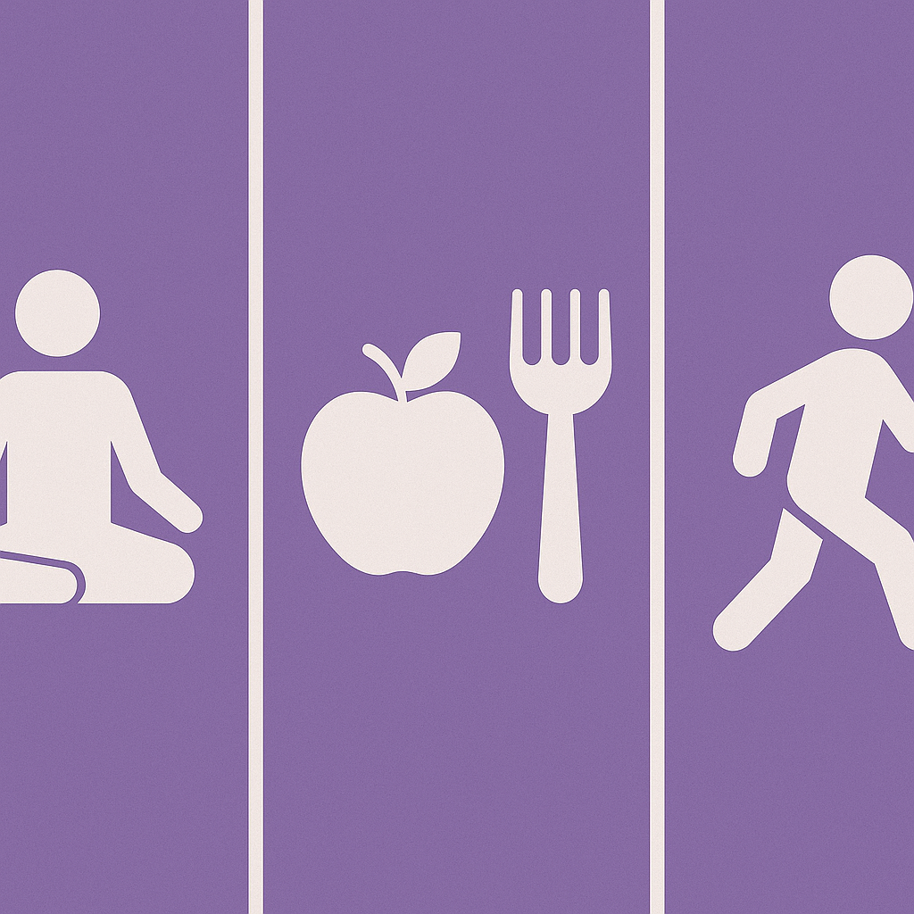
Overview of the Forum
Understand what diabetes is and why it is relevant for people with intellectual disabilities.
Explore strategies for preventing type 2 diabetes.
Learn about community resources for prevention and management of type 2 diabetes.
6
Notes:
Say:
Today we are going to discuss diabetes prevention and management for the family
This session will take about 1 hour, and we are going to cover a few key topics
First, we will discuss what diabetes is and why it is relevant for people with intellectual disabilities
We will also explore strategies for nutrition and physical activity for the whole family to manage and prevent diabetes.
And finally, we will learn about community resources that support a healthy lifestyle, diabetes screening, and prevention and management.
We will have a mix of activities, discussion and presentations
We all have something valuable to share and we are here to learn from each other experiences as well.
Feel free to share any questions or comments you may have as we go along.

Slide 7

Our bodies are like a plant
7
Notes:
Say:
Before we begin, let’s imagine your body is like a plant in a garden.
A healthy plant grows strong with green leaves and flowers.
But if it gets too much water or not enough sunlight, problems start inside the roots before we notice outside changes.
This is like diabetes; our bodies can have too much sugar for a while without obvious signs.
That’s why regular check-ups are so important, just like checking on our plants.
Ask:
Have you ever discovered a problem only after going for a check-up?
Say:
Thank you for sharing.
Now, we’ll talk more about diabetes and what it is.

Slide 8

What is diabetes?
Diabetes means you have too much sugar in your blood
It is a chronic disease that affects how your body turns food into energy
8
Workbook page 3
Notes:
Say:
Diabetes means you have too much sugar in your blood
It is a long-lasting disease that affects how our bodies turns food into energy.
When our blood sugar is high, it signals to our body to release a chemical called insulin.
This happens when your body doesn’t make enough of insulin.
Let’s learn a little bit more about this process in our bodies.

Slide 9





How sugar travels in the body
We need insulin, for the sugar to get into our cells.
Without insulin, sugar builds up in our blood stream.
This can cause health problems
The body takes food we eat and turns it into sugar called glucose.
Insulin carries the sugar in our blood and moves it into the cells in our bodies.
9
Notes:
Say:
Our bodies take the food we eat and turns it into sugar called glucose.
Our bodies need sugar to give us energy.
Insulin carries the sugar in our blood and moves it into the cells in our bodies
Without insulin, sugar can’t get into our cells.
Instead, it builds up in our blood.
Overtime this buildup of sugar in our blood stream can cause serious health problems like heart disease, vision loss, and kidney disease.

Slide 10



3 Types of Diabetes
Type 1
Gestational Diabetes
Type 2
Autoimmune condition
Body does not make enough insulin
No cure, can be treated
Develops during pregnancy
Goes away after pregnancy
Increased risk of developing type 2
Body does not use insulin well
Can be prevented or delayed with healthy lifestyle changes
10
Notes:
Say:
With diabetes our bodies either do not make enough insulin or our bodies cannot use insulin as well as it should.
There are three main types of diabetes
Type 1 diabetes, gestational diabetes and type 2 diabetes.
Type 1 diabetes is where the body does not make enough insulin.
There is no cure for type 1 diabetes, but it can be managed. Type 1 diabetes is usually diagnosed in childhood.
Gestational diabetes is a type of diabetes that can develop during pregnancy in women who have never had diabetes.
Gestational diabetes usually goes away after the baby is born.
Someone with gestational diabetes has an increased risk of developing type 2 diabetes later in life.
With type 2 diabetes the body does not use insulin well and cannot keep the level of sugar in our blood at normal levels.
Fortunately, type 2 diabetes can be prevented or managed with healthy lifestyle changes.
Today we will focus on type 2 diabetes because it is more common among people with intellectual disabilities.

Slide 11
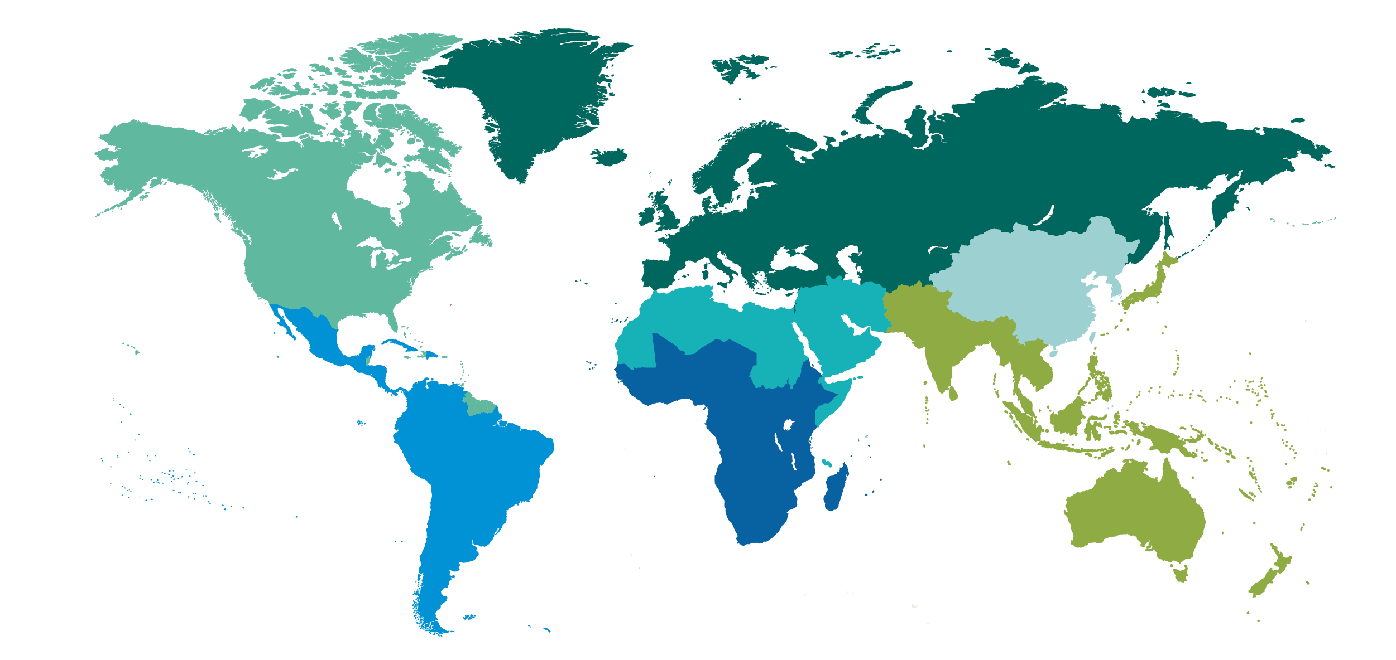
537 million adults are living with diabetes around the world
11
One in two people with diabetes do not know they have diabetes
Notes:
Say:
Did you know that there are 537 million adults living with diabetes around the world today?
Most of these people have type 2 diabetes, approximately 11.19% adults.
Unfortunately, many people with type 2 diabetes do not know that they have it.
Young people are increasingly developing type 2 diabetes.
Remember, type 2 diabetes is preventable, that’s why we are focusing on it today.

Slide 12








Common symptoms of diabetes
Frequent urination
Excessive thirst
Slow healing
Tingling/
Numbness
Feeling tired
Blurred vision
Dry skin
Frequent infections
12
Notes:
Say:
While some people do not experience symptoms with diabetes, here are a few common signs to watch for.
Using the restroom a lot, especially during the night.
Felling thirsty all the time, even after drinking fluids.
Always feeling tired, even after getting enough rest.
Changes in your vision, such as blurry vision.
Cuts and injuries may take longer to heal than usual.
Infections happening more often.
Tingling, numbness, or pain in the hands, feet, or legs.
Feeling hungry even after eating enough food.
Dry skin and itching.
If you think you have diabetes, seek support from a health professional.
Health care workers use a blood test to tell if someone has diabetes.
This is a simple test called the A1c test. And it measures how much sugar has been in your blood in the past 3 months.

Slide 13
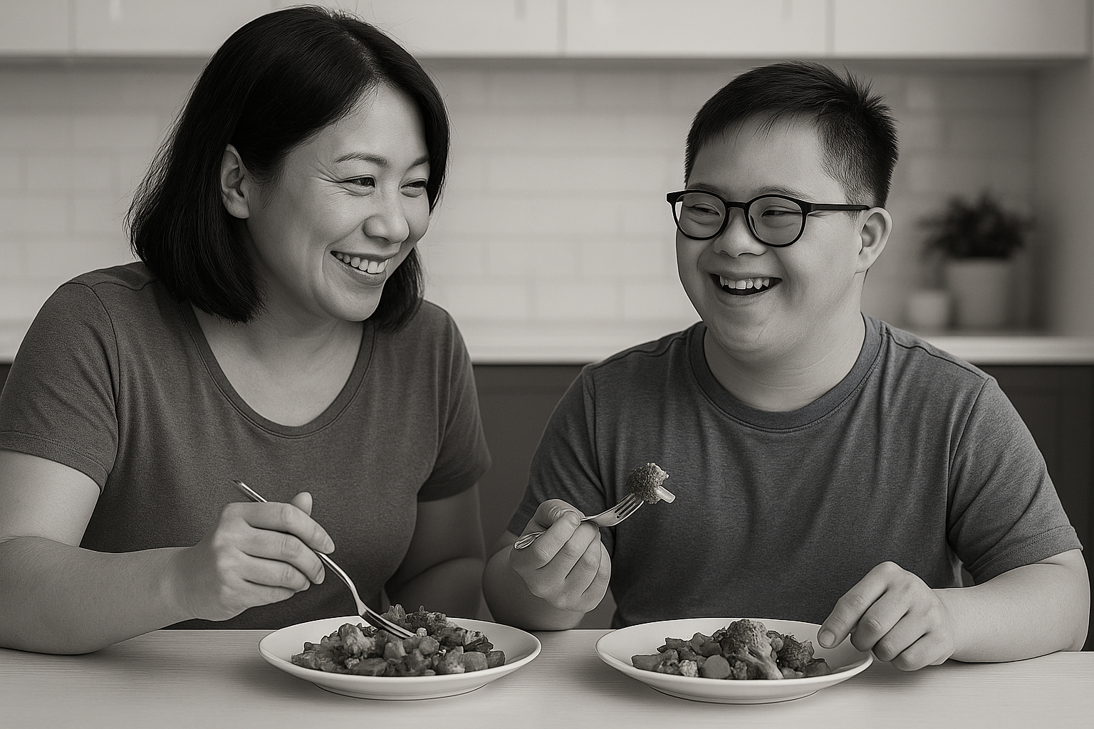
How many people with intellectual disabilities have diabetes?
5-15%
20-30%
40-50%
60-70%
13
Workbook page 2
Notes:
Say:
With the increase in number of people with diabetes, it is important for everyone to know about it.
It is also very important for people with intellectual disability and their families to know about diabetes.
Ask:
What is your guess?
How many people with intellectual disability do you think have diabetes?

Slide 14
People with disabilities and 3 times more likely to have diabetes
Health Condition | With disability | Without disability
Be Obese | 38.4% | 24.4.%
Smoke | 30.3% | 16.7%
Have High Blood Pressure | 41.7% | 26.3%
Be Inactive | 36.3% | 23.9%
20-30%
of people with intellectual disability have diabetes
14
Notes:
Say:
Thank you for playing that game.
20 to 30 % of people with intellectual disabilities have diabetes.
This is compared to 10% of people without intellectual disability globally.
So, if you selected 20 to 30% you are correct.
Additionally, people with disabilities are 30 to 40% more likely to be obese, have high blood pressure, smoke and be inactive than people without disabilities. These conditions can lead diabetes and other health problems such as heart disease, stroke, and cancer.
This is why this is an important topic for our Family Health Forums.
We want to help reduce the trend of people with intellectual disabilities having diabetes.

Slide 15
Activity: Type 2 Diabetes True or False
15
Workbook page 3
Notes:
Say:
Now we are going to play a game to learn more about type 2 diabetes!
Split up into small groups.
Each group will work together to answer the 3 true or false questions about diabetes.
The questions can be found on page 3 of your workbooks
Facilitator Note for Virtual Presentations:
For virtual Forums, complete the activity as a whole group. For True or False questions, participants can:
Show a thumbs up or thumbs down on video
Use the thumbs up/down reactions/emojis
Type their answer in the chat

Slide 16
Activity: Type 2 Diabetes True or False
Age is the only risk factor for developing type 2 diabetes
16
Workbook page 3
Notes:
Ask:
True or false, only older people can get type 2 diabetes?

Slide 17
Age is the only risk factor for developing diabetes
Age is one of 5 risk factors for developing diabetes
Type 2 diabetes is more common in adults
People of any age can develop type 2 diabetes
17
Workbook page 3
Notes:
Say:
This statement is false.
Age is one of 5 main risk factors for developing diabetes.
While it is more common in adults, even kids and teenagers can develop type 2 diabetes, especially if they're overweight or have a family history of diabetes
Let’s look at the risk factors for diabetes

Slide 18





Risk factors for type 2 diabetes
Family history
Obesity
Unhealthy eating
Lack of physical activity
18
Age
Workbook page 3
Workbook page 3
Notes:
Say:
The 5 main risk factors for type 2 diabetes are family history or genetics, obesity or being overweight, unhealthy eating, lack of physical activity and age.
Having a family history of Type 2 diabetes increases a person's risk of developing the condition themselves.
While having a family history of diabetes does not guarantee that a person will develop the condition, it does increase their risk, especially if combined with other risk factors such as obesity or a lack of physical activity
Eating too much unhealthy food, especially those high in sugar, unhealthy fats, and calories, can lead to weight gain and obesity, increasing the risk of type 2 diabetes.
Being overweight or Obese is another risk factor.
Excess body weight increases the risk of developing insulin resistance, leading to type 2 diabetes
Not getting enough exercise or being physically inactive can make your body less sensitive to insulin.
Additionally, lack of physical activity is often associated with other risk factors for Type 2 diabetes, such as obesity and unhealthy diet.
As we mentioned already. Age is one of the risk factors.
The risk of Type 2 diabetes increases with age, particularly after the age of 45.
Also, older adults may be more likely to have other risk factors such as obesity or a sedentary lifestyle, further increasing their risk of developing Type 2 diabetes.

Slide 19
Activity: Type 2 Diabetes True or False
People with type 2 diabetes cannot eat sweets
19
Workbook page 3
Notes:
Ask:
True or false, people with type 2 diabetes cannot eat sweets?

Slide 20
People with diabetes cannot eat sweets
Sweets in moderation are ok for people with diabetes
Managing type 2 diabetes:
A healthy lifestyle
Regular monitoring of blood sugar levels
Managing medications
Finding support
20
Workbook page 3
Notes:
Say:
This statement is false.
People with diabetes can eat sweets in small amounts
Having a healthy lifestyle is very important for people living with diabetes.
People living with diabetes also have to check their blood sugar levels often.
They may also have to take medicine and follow up with their doctor.
Finding support from other people in the community can help you and your family connect with others and learn more about diabetes.
Some countries have diabetes education programs that families can go to.
If this does not exist in your community, talk to health care providers.

Slide 21
Activity: Type 2 Diabetes True or False
You can prevent type 2 diabetes by eating healthy and exercising regularly
21
Workbook page 3
Notes:
Ask:
True or false, you can prevent type 2 diabetes by eating healthy and exercising regularly.

Slide 22
You can prevent type 2 diabetes by eating healthy and exercising regularly
Type 2 diabetes can be prevented by living a healthy lifestyle
Living a healthy lifestyle helps reduce some of the risk factors for type 2 diabetes
22
Workbook page 3
Notes:
Say:
This statement is true.
Some risk factors for type 2 diabetes cannot be changed, such as age and family history, but fortunately there are some that can, such as, being overweight, eating unhealthy food, and being inactive.
Living a healthy lifestyle can help us to reduce these risk factors so they can prevent or delay type 2 diabetes and improve our overall health.
Let’s explore this more

Slide 23
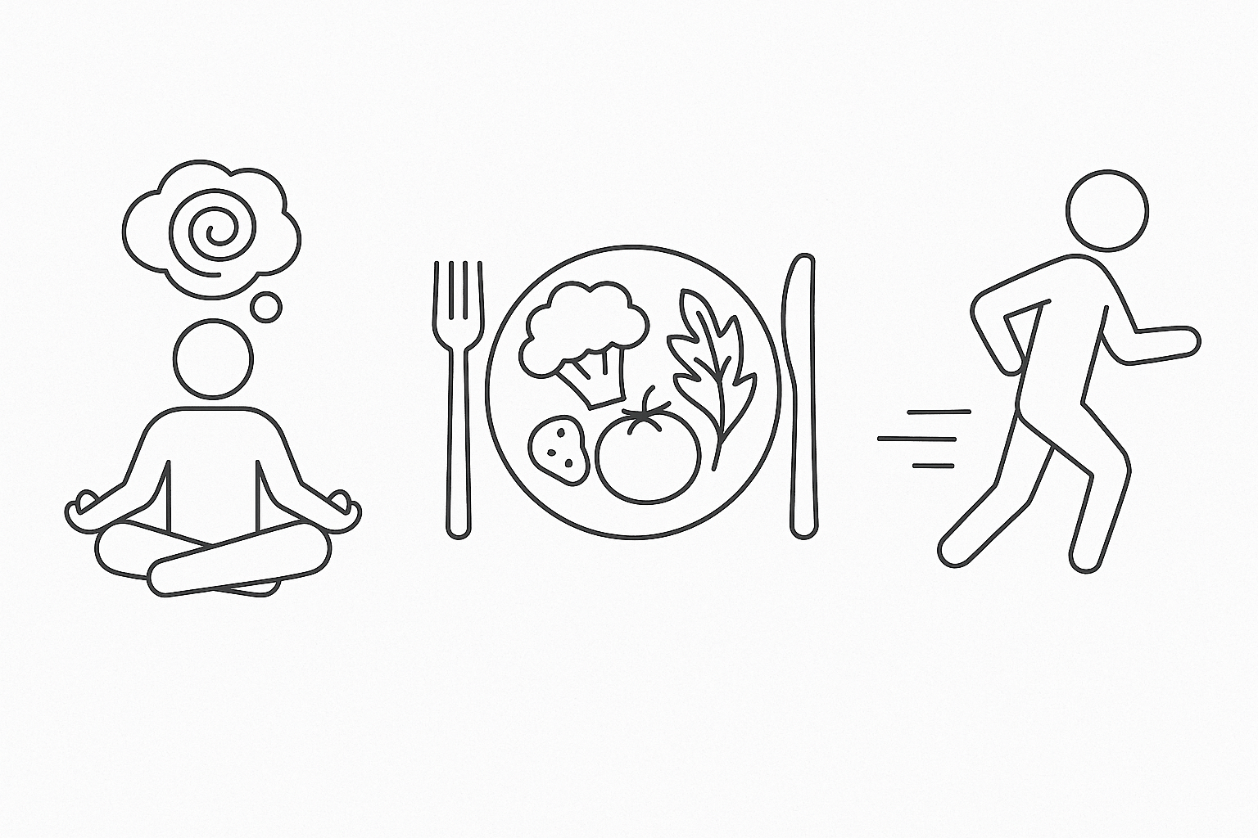
Strategies for Prevention & Management of Type 2 Diabetes
Being active
Healthy eating
Managing stress
23
Notes:
Say:
Now we are going to look more at prevention of type 2 diabetes.
It is important to remember that these prevention tips are also helpful for management of diabetes.
Being physically active can improve our brain health, manage our weight, strengthen our bones and muscles.
It helps to reduce our risk of diseases like diabetes and improves our ability to do everyday activities.
A healthy diet is important for good health and nutrition.
It protects us against many health problems, such as heart disease, diabetes and cancer.
Eating a variety of foods and consuming less salt, sugar, and fats helps us stay healthy.
Managing stress helps us have better mental, physical, and emotional health.

Slide 24

Recommendations for Physical Activity
Physical activity is anything that gets your body moving
Recommendations for adults:
150 minutes (2.5 hours) of physical activity weekly
2 days of muscle strengthening
Recommendations for children & youth:
60 minutes or more of physical activity everyday
24
Notes:
Say:
Physical activity recommendations for adults are to do at least 150 minutes of moderate intensity activity.
This is anything that gets your heart beating faster like walking, running, or dancing.
Adults also need activities that make their muscles and bones strong, like lifting weights, or doing push-ups, at least two days a week.
For children and young people, it is recommended to do at least 60 minutes of physical activity everyday.
Physical activity is one of the most powerful tools to prevent diabetes.
It helps to maintain a healthy body weight, promotes positive mental health and reduced our risks for other health challenges.

Slide 25
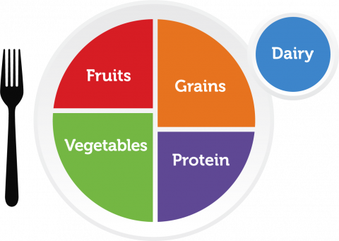
Recommendations for Healthy Eating
Follow the “MyPlate” meal plan
Make half your plate fruits and vegetables
Make half your grains whole grains
Vary your protein routine
Eat low fat/fat free products
Reduce salt and sugar
Reduce solid fats and fried foods
25
Notes:
Say:
The MyPlate meal plan shown here has recommendations on healthy eating.
The first is to make half of our plate's fruits and vegetables.
The recommendation is to focus on whole fruits rather than 100% fruit juice.
For vegetables it is recommended to eat a variety of vegetables, such as dark green, red and orange; beans, peas, and lentils, starchy and other vegetables.
The other half of the MyPlate meal plan is grains and proteins.
For grains the recommendation is to make half of the grain's whole grains, such as whole wheat bread.
MyPlate recommends eating a variety of proteins such as beans, peas, eggs, meat, poultry, seafood, nuts, seeds, soy products and low fat or fat free milk.
It is also recommended to reduce salt, sugar, fats and fried foods.
We will talk more about ways to do this as a whole family.

Slide 26

Recommendations for Managing stress
Set regular routines
Open communication
Limit overcommitment
Quality family time
Set boundaries
Seek support
Practice relaxation techniques
26
Notes:
Say:
Creating daily routines for meals, bedtime, and other activities can help reduce stress for both children and adults.
Creating safe spaces where all family members feel comfortable expressing their thoughts and feelings, and actively listen to one another can encourage open communication.
An example of this is to have a weekly family meetings,
Avoid overscheduling and overcommitting to activities and obligations.
Prioritize activities that are meaningful and enjoyable for the family and say no to those that add unnecessary stress.
Schedule regular quality time together as a family without distractions from work, school, or electronic devices.
This includes, playing games, going for walks, or cooking together.
Establish clear boundaries around work, school, and personal time.
Encourage downtime and relaxation by limiting work-related activities and screen time during evenings and weekends.
Encourage family members to seek support from one another and others in the community when needed.
This may include talking to friends, family members, or mental health professionals for guidance and support.
Teach and practice mindfulness and relaxation techniques as a family, such as deep breathing exercises, meditation, or yoga.
These techniques can help alleviate stress and promote relaxation.
In your participant workbook is a link to some SO resources for managing stress

Slide 27

Individual Reflection
What is stopping your family from participating in physical activity healthy eating, and managing stress?
27
Workbook page 4
Notes:
Say:
We know that being physically active, eating healthy, and managing stress is important, so why don’t we do this more?
Many people say they struggle with motivation, costs, making time and knowing what to do.
Turn to your participant workbook and record your thoughts.
Ask:
When you think about your family, what are 3 reasons keeping your family from being more physically active?
How do you think you can solve this and become more active as a family?

Slide 28


Small Group Activity
10 family strategies for prevention and management
of type 2 diabetes
28
Workbook page 4
Notes:
Say:
Would anyone like to share one of the reasons keeping their family from being more physically active?
After some responses have been shared?
Say:
Transitioning into or maintaining a healthy lifestyle as a family can be very challenging.
We know that making time, costs, motivation, breaking old habits and access to resources are barriers to living a healthy lifestyle.
In your groups we would like you to explore this further
After you have made your lists, each group can share their responses
Ask:
Can you list 10 family strategies for a healthy lifestyle?
Can you think of strategies that are realistic and doable for families in our community.
Record your responses on page 5 of your workbook
Facilitator Note for Virtual Presentations:
For a Virtual Forum, discuss the 10 family strategies as a whole group. As you discuss, create a shared list of the top 10 strategies and post the final list in the chat as a takeaway for participants.

Slide 29
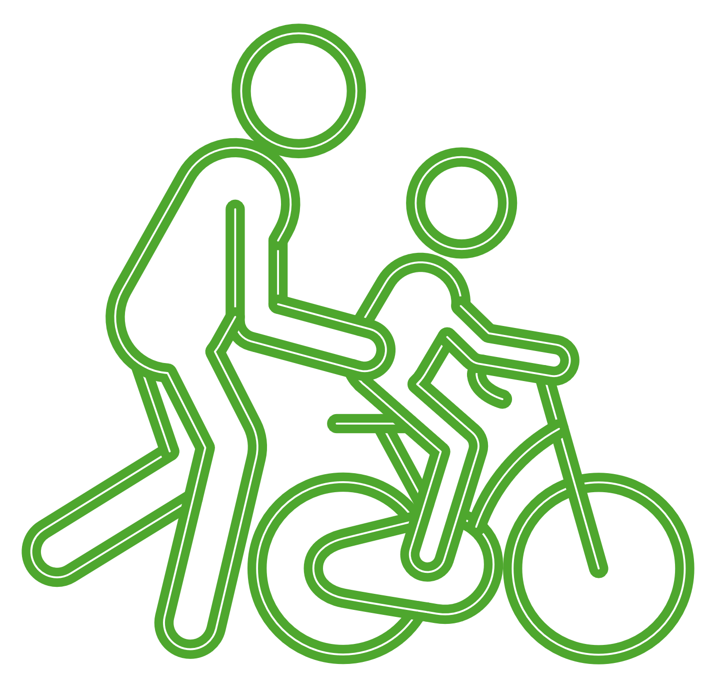

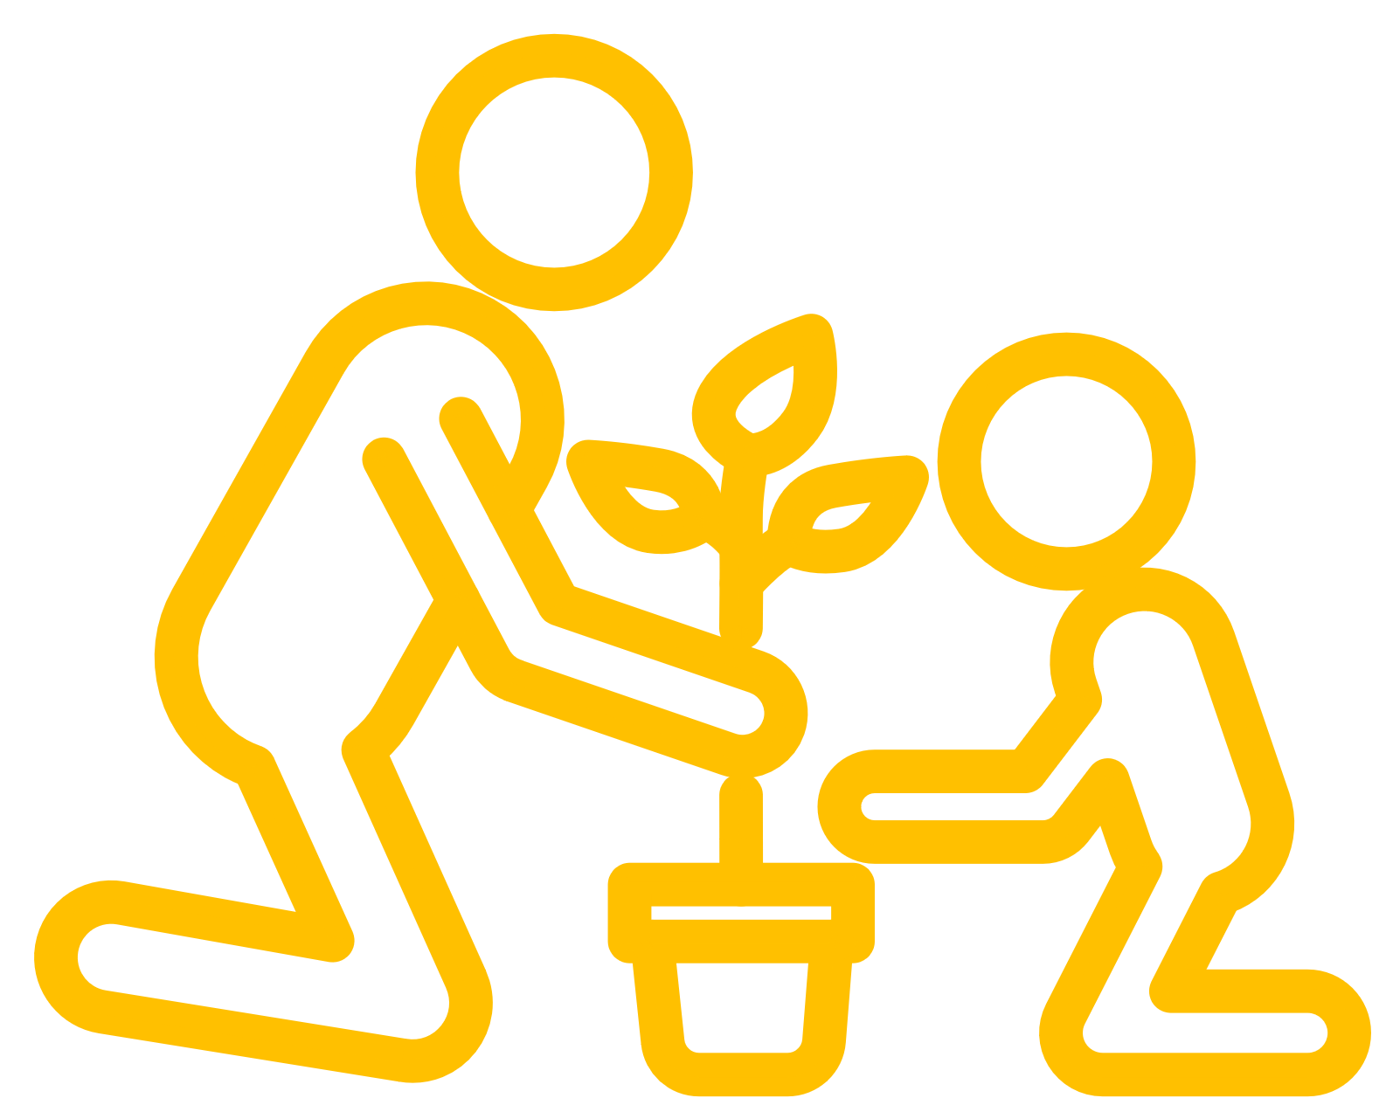
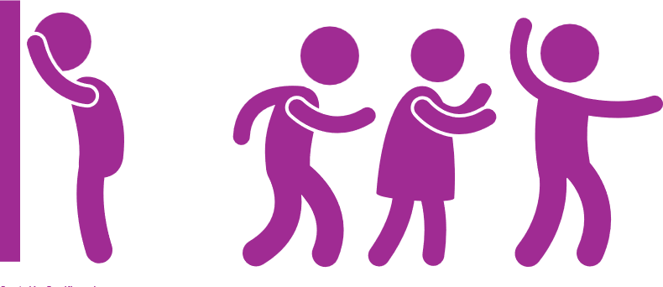
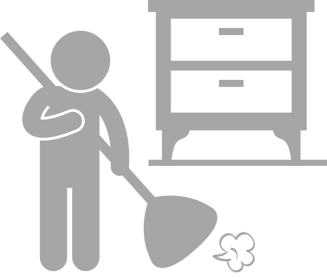




Physical activity suggestions for the whole family
Family walks or bike rides
Gardening
Active outings
Active playtime
Active chore time
Outdoor games
Family sports night
Join the family fitness challenge
Dance party
29
Workbook page 5
Notes:
Say:
Encourage active playtime for children, such as playing tag, hide and seek, or kicking a ball around.
Adults too can join in the fun and make it a family activity.
Set some simple obstacle courses or relay races or create some outdoor games.
Start a family garden together.
Gardening involves physical activity like digging, planting, weeding, and watering, and it is also a great way to teach children about healthy eating and where food comes from.
Turn household chores into opportunities for physical activity. Assign tasks that involve movement, such as vacuuming, sweeping, or washing the car, and do them together as a family.
Have random dance parties at home.
Put on some music and let loose with dancing.
Play games with turning the songs on and off and allow each family member to have a turn picking the song to move to
Plan outings that involve physical activity, such as exploring the town, visiting a zoo, park, museum, or other place where there's plenty of walking involved.
Pick a night each week for a different sport to play together as a family.
Rotate between sports like, football, tennis, running, dodge ball or other activities.
Allow each family member to have a turn with their preferred sport.
Set screen free time that can be replaced with everyone doing something together like a walk or game.
Check out the SO family fitness challenge or create your own family competition game.
For example, who can do the most jumping jacks, push-ups, or sit-ups in a minute.
Keep track of progress and celebrate achievements together.
Record your own suggestions on page 5 of your workbook.

Slide 30
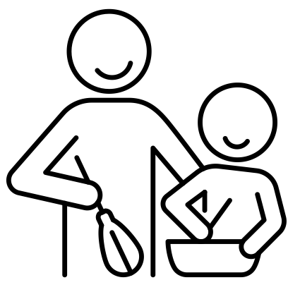





Healthy Eating suggestions for the whole family
Save sugary drinks for special occasions
Plan & cook meals together
Eat meals together
Flavor water with fruits and vegetables
Keep fruits & vegetables accessible
Eat smaller portions, slow down & enjoy food
30
Workbook page 5
Notes:
Say:
Thank you for sharing your suggestions, here are additional suggestions for healthy eating for the whole family
Plan meals together.
Involve everyone in the family in selecting meals and adapting the meals to be healthy.
For example, each family member can have a day where they are in charge of selecting the fruits and vegetables for each meal
Cook and eat meals together
Encourage cooking and eating meals together.
This can help all family members learn about healthy meal preparation and modeling of healthy eating and making mealtimes enjoyable.
Keep fruits and vegetables easily accessible
Wash, cut and store them in the fridge so family members can reach for them as quick snacks
Limit sugary drinks
Save sugary drinks for special occasions. This can be family rule to follow
Flavor water with fresh fruit or vegetables. This can be a substitute for sugary drinks like soda and fruit juice.
For example, keep a jug of flavored water available and change the flavor each week.
Practice portion control.
We know that we almost always eat more food when offered larger portions.
Eating smaller portions, allows us to slow down and eat less food.
Set goals together as a family and celebrate achievements along the way
Record your own suggestions on page 5 of your workbooks

Slide 31






Stress Management suggestions for the whole family
Build support networks of friends and family
Read a book together as a family
Create a family gratitude journal
Spend time together in nature
Schedule time for regular family meetings and activities
Practice stress management techniques together
31
Workbook page 5
Notes:
Say:
Thank you for sharing your suggestions, here are additional suggestions for healthy eating for the whole family
Build support networks for friends, family, and/or community members.
Practice stress management techniques together, like deep breathing exercises, or meditation
Schedule time for regular family meetings, check-ins, or game nights.
Read a book together as a family and talk about it.
Spend time together in nature, exploring the environment together.
Create a gratitude journal and share things you are thankful for.
Record your own suggestions on page 5 of your workbook

Slide 32

Small Group Activity
The Healthy Lifestyle Game
For prevention and management of type 2 diabetes
32
Workbook page 6
Notes:
Say:
Now that we have talked about strategies for living a healthy lifestyle, we are going to play a healthy lifestyle game
We are going to split up into 3 groups
Each group will be given a short story about a person at risk of developing type 2 diabetes.
For each of these stories the group will have 2-4 minutes to think of realistic strategies that person can do to live a healthier lifestyle.
Each group will be sharing their responses after the activity
Facilitator Note for Virtual Presentations:
For a virtual Forum, keep participants in one group and go through all three scenarios together.
Read each scenario aloud or display it on the screen.
Pause after each scenario to allow time for discussion.
Encourage participants to unmute and share, type in the chat, or use reactions.
If time allows, aim to spend about 3 minutes on each scenario to stay on schedule.

Slide 33
Situation 1: Peter
Peter’s father and grandparents all had diabetes.
Peter is 45 years old. He is worried about his risk for diabetes as he gets older because of his family history.
What can Peter do to prevent or delay type 2 diabetes?
33
Workbook page 6
Notes:
Say:
Group 1 will have the following situation about Peter.
Please read it together and discuss the question in your group.
You can record your responses in your participant workbook and share back with the group.

Slide 34
Situation 2: Sofi
Sofi is a student with an intellectual disability. When she is not studying, she is watching TV or playing video games inside. She also eats a lot of sweets.
Sofi is worried her habits place her at risk for developing type 2 diabetes.
How can Sofi add physical activity and healthy eating
during her day?
34
Workbook page 6
Notes:
Say:
Group 2 will have the following situation about Sofi.
Please read it together in your groups.
Remember, you can record your responses in your participant workbook on page 7 and share back with the group.

Slide 35
Situation 3: Lena
Lena has a son with an intellectual disability.
She is worried about her son’s risk of developing type 2 diabetes and wants to have a healthier lifestyle for her family.
What can Lena do to support her family to
live a healthy lifestyle?
35
Workbook page 6
Notes:
Say:
Group 3 will have the following situation about Lena.
Please read it together in your groups.
Remember, you can record your responses in your participant workbook on page 7 and share back with the group.

Slide 36

Individual Reflection
Family Scorecard
Rate your family’s level of participation in key activities that can help to maintain a healthy lifestyle
Healthy Eating
Physical Activity
Stress Management
36
Workbook page 7
Notes:
Say:
Thank you for playing that activity.
We now have options to explore when we think about supporting our families to have a healthier lifestyle.
Next, we are going to do a reflection
For this reflection, please turn to your workbooks
Have a look at the activities listed under the categories of healthy eating, physical activity and self care.
Think about your family, and rate where you are for each of these activities.
Once you have rated your family’s engagement with each activity, look at which area(s) you have lower engagement
From here we will move into action planning with this in mind.

Slide 37
Take Home Task
Healthy Lifestyle Action Planning
What will we do?
Where will we do it?
How long will we do it?
What challenges might we face?
What ways will we cope with these challenges?
37
Workbook page 8
Notes:
Say:
In your workbook, there is a guide for you and your family to develop an action plan for a healthy lifestyle.
Please take some time after this forum to sit together and create your family healthy lifestyle action plans.
Follow the prompts and tasks in your workbooks to create 3 healthy lifestyle goals for you and your family.
You can stay in touch with us as you develop this and share your progress.
Ask:
Do you have any questions or concerns?

Slide 38
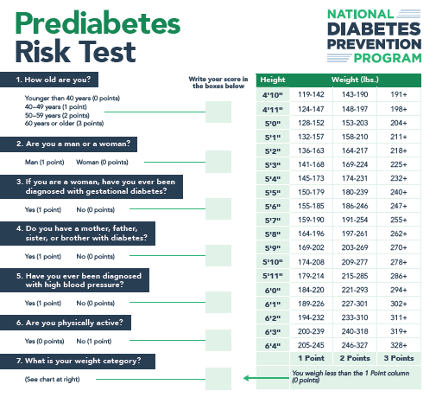
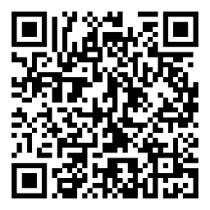
Prediabetes Risk Test
38
Workbook page 9
Notes:
Say:
Before we get to questions, please note that in your workbooks is a prediabetes risk test, feel free to take it at your own time.
This test can help provide some information if you are at risk for having prediabetes and a higher risk for having type 2 diabetes.
Remember only a doctor can tell for sure if you have prediabetes or type 2 diabetes. Contact your health provider if you have concerns.

Slide 39

Questions
39
Notes:
Say:
Before we close, and while we have our community partners with us let’s have some time for questions.
Ask:
Does anyone have any questions or concerns about anything we have discussed today?

Slide 40
Thank you!
SO Program Team
Contact Us:
Name:
Tel:
Email:
Community partner
Contact Us:
Name:
Tel:
Email:
Community partner
Contact Us:
Name:
Tel:
Email:
Community partner
Contact Us:
Name:
Tel:
Email:
40
Notes:
Say:
Thank you for joining us today.
Please reach out to us if you have any further needs.

Slide 41
Some helpful tips
Size 12 font is great for printed materials. Size 24 (at a minimum) is good for the body copy on PowerPoints.
Bold and colorful text is helpful to bring attention to a point or topic.
Titles can go in the bar above. To add interest and variety in slide, feel free to use the slide layout with the bars on the side and bottom. That layout is great if you have extra room on the slide and feel like you need to fill up space.
Utilize the icon library and high-quality photos to keep PowerPoints engaging!

Slide 42
















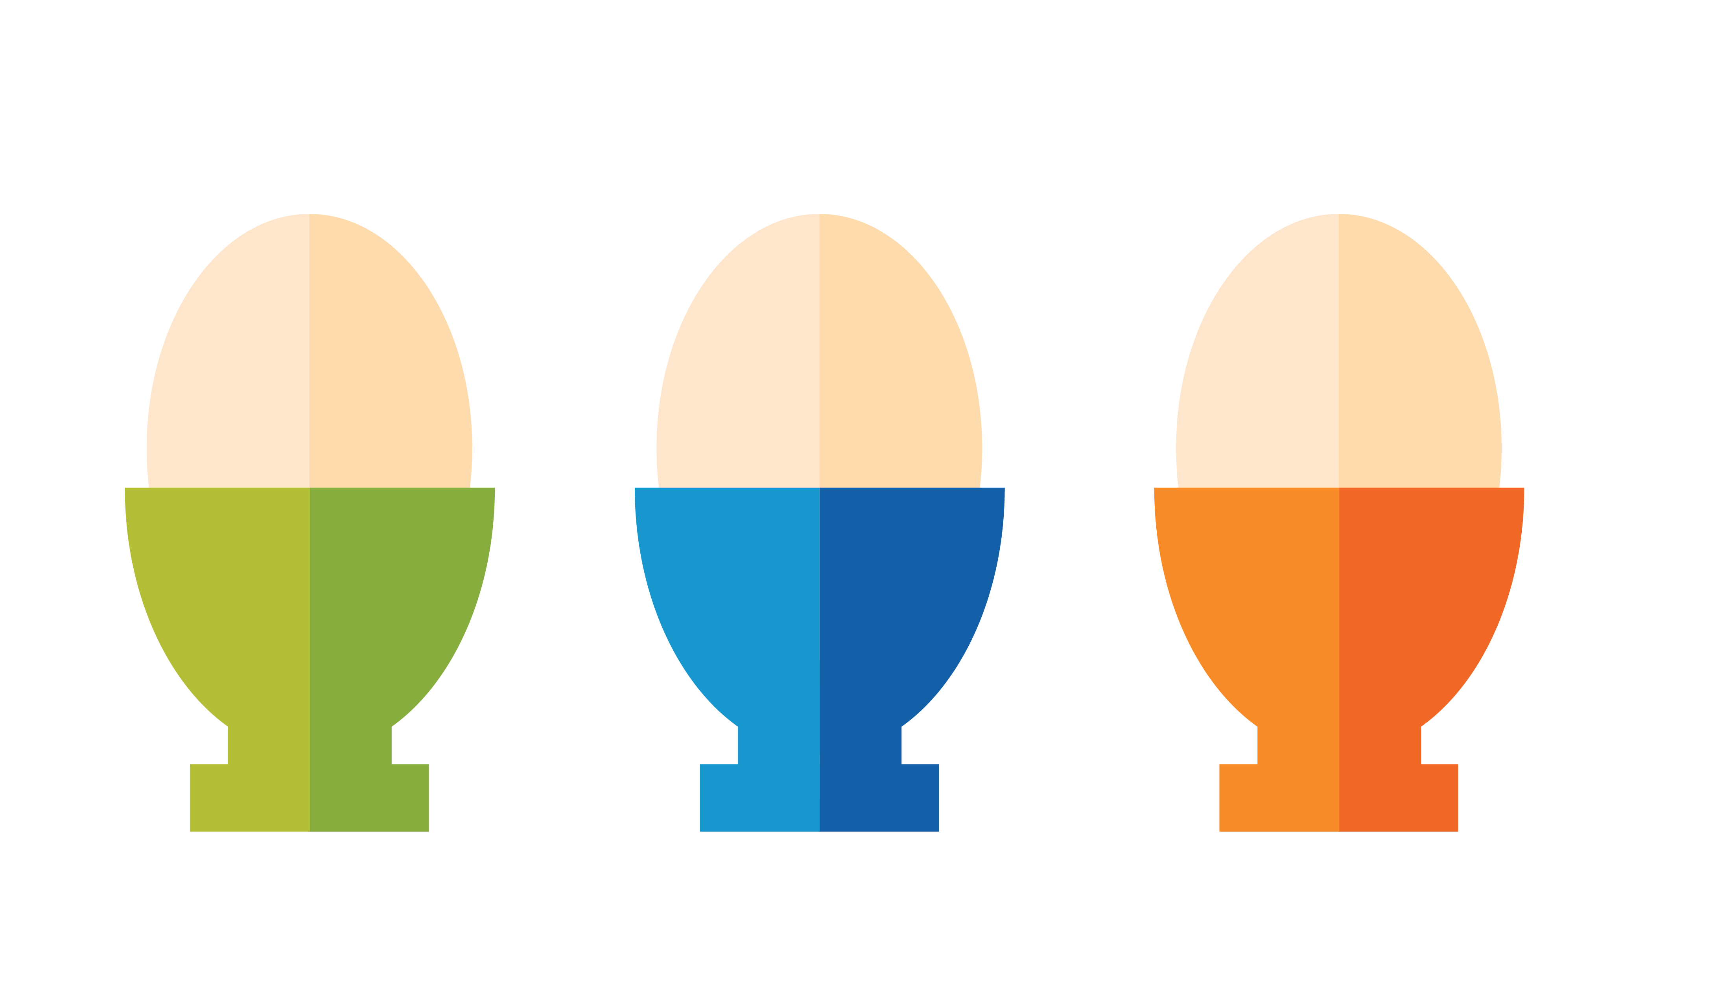








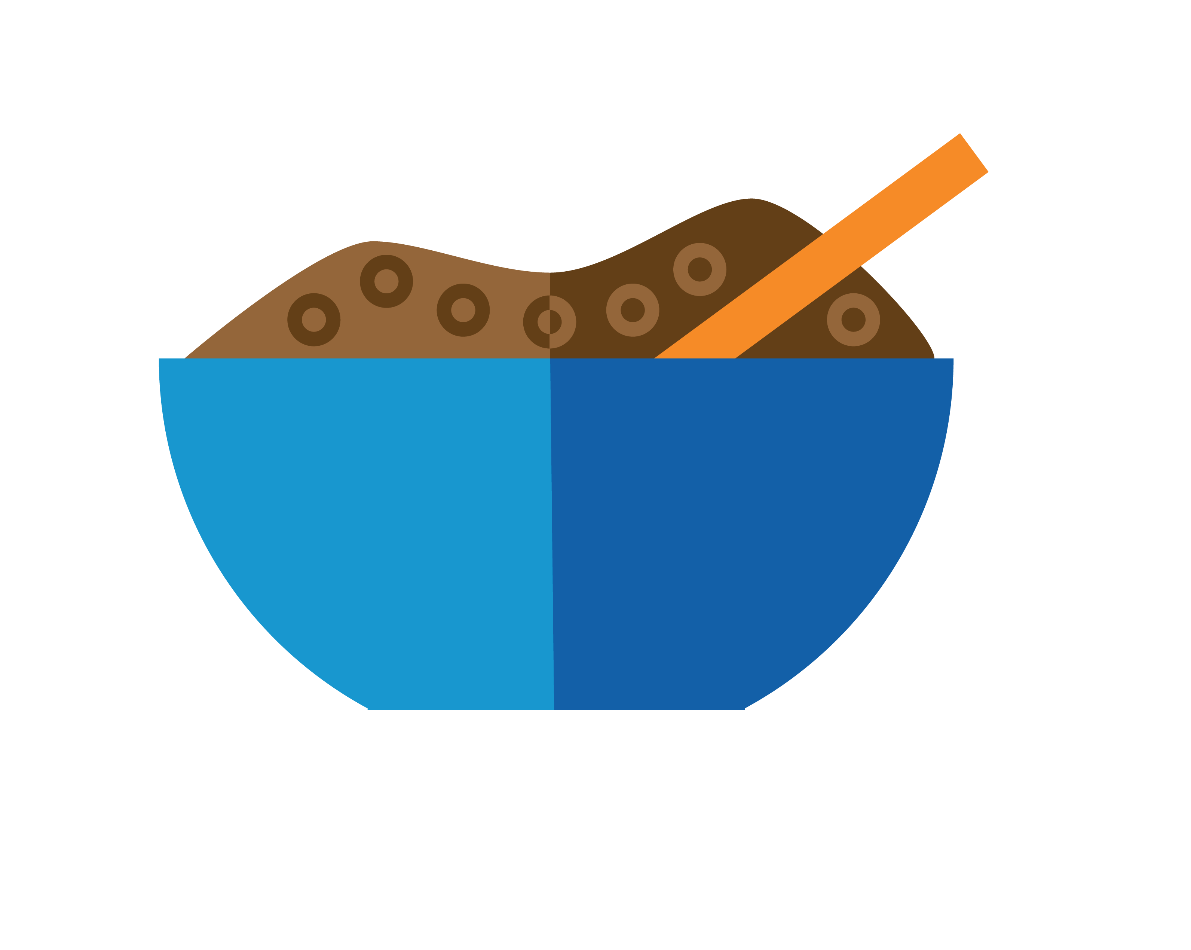

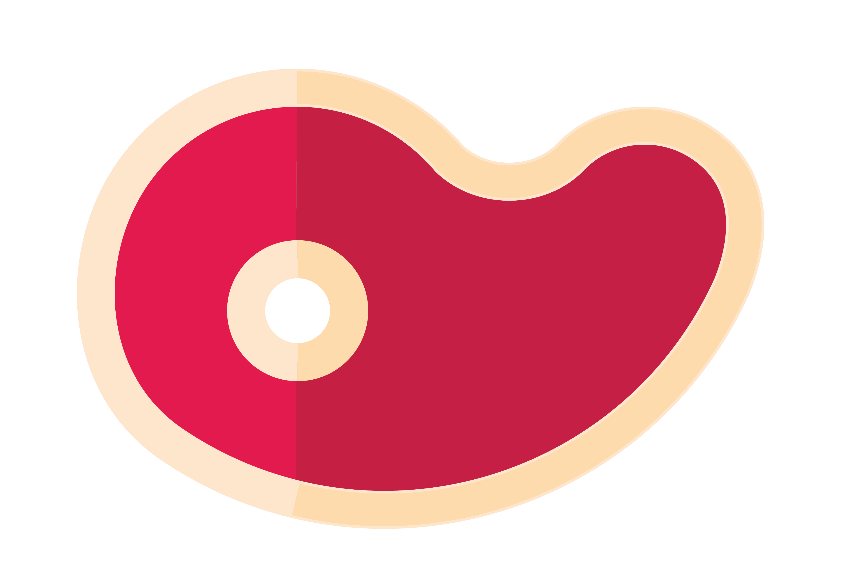








































Icon Library

