Slide 1

Diabetes Prevention and Management
Participant Guide

Slide 2

Welcome
Dear participant,
we are very happy to welcome you to the Family Health Forum on Diabetes Prevention and Management. Family Health Forums provide a space for caregivers, parents, and siblings of people with intellectual disabilities to engage with health professionals, community leaders, and service providers.
People with intellectual disability are more prone to chronic health conditions than people without intellectual disability. This includes conditions such as obesity, diabetes, asthma, and cardiovascular disease. Family Health Forums are places to learn more about different health conditions, understand the available services in our communities and to connect with other families.
This forum will focus on the following:
  Understanding what diabetes is and why it is relevant for people with intellectual disabilities.
  Exploring strategies for preventing type 2 diabetes.
  Learning about community resources for prevention and management of type 2 diabetes.
This is your personal workbook for The Forum. It contains the agenda, worksheets, handouts, and other helpful resources related to living a healthy lifestyle for prevention and management of diabetes. During the event, your facilitator will guide you on when to use your workbook.
DISCUSSION:
WHAT IS DIABETES?
What’s your guess?
How many people with intellectual disabilities have diabetes?
Slide 8
Slide 13
5-15%
20-30%
40-50%
60-70%

Slide 3
Activity: True or False
Type 2 Diabetes
Slide 15
This activity will help us to learn more about diabetes.
Instructions:
There are four true or false statements for you to respond to.
Record your responses in the space provided and make any notes or comments that arise during the discussion.
Age is the only risk factor for developing type 2 diabetes.
True
False
People with Type 2 diabetes cannot eat sweets.
True
False
You can prevent type 2 diabetes by eating healthy and exercising regularly.
True
False

Slide 4
Individual Reflection
Slide 27
What is stopping your family from having physical activity every day?
What is stopping your family from healthy eating every day?
Activity: 10 Strategies for Prevention
& Management of Type 2 Diabetes
Slide 28
1
6
2
7
3
8
4
9
5
10

Slide 5



Prevention & Management
of Type 2 Diabetes
Slide 29
Instructions:
Record your own suggestions for a healthy lifestyle below.
Physical Activity suggestions for the whole family
Healthy eating suggestions for the whole family
Stress management suggestions for the whole family

Slide 6
Activity
The Healthy Lifestyle Game
Slide 32
Instructions:
Each group will be given a description about a person at risk of developing type 2 diabetes.
For each of these descriptions, discuss in your group what strategies that person can do to live
a healthier lifestyle.
SITUATION 1: PETER
Peter’s father and grandparents all had diabetes. Peter is 45 years old. He is worried about his risk for diabetes as he gets older because of his family history. What can Peter do to prevent or delay type 2 diabetes?
SITUATION 2: SOFI
Sofi is a student with an intellectual disability. When she is not studying, she is watching TV or playing video games inside. She also eats a lot of sweets. How can Sofi add more physical activity and healthy eating into her day?
SITUATION 3: LENA
Lena has a son with an intellectual disability. She is worried about her son’s risk of developing type 2 diabetes and wants to have a healthier lifestyle for her family. What can Lena do to support her family to live a healthy lifestyle?

Slide 7
Individual Reflection
Family Scorecard
Slide 36
Instructions:
Rate your family by placing a design in the box to show how often your family performs the activities.
Activity |  | Always | Usually | Sometimes | Never
HEALTHY EATING
1 | Eat green leafy vegetables every day
2 | Eat 5 servings of fruits and vegetables every day
3 | Eat from all 5 food groups every day (grains, protein, dairy, fruits, vegetables)
4 | Drink at least 2 bottles of water per day
5 | Limit sugary drinks like soda, sport drinks and juice
PHYSCICAL ACTIVITY
6 | Move for 60 minutes or more 5 days a week
7 | Practice activities that build endurance (brisk waling, biking, dancing)
8 | Practice activity that build strength (pushups, curl ups, chair squats)
9 | Practice stretches to build flexibility (butterfly stretch, arm stretch, hamstring stretch)
STRESS MANAGEMENT
10 | Practice mindfulness (slowing down, being present, body scan, exploration walk, attending to breath)
11 | Regular sleeping routine
12 | Connect with others (Identify people that support you or that you support. Kindness has health benefits and makes the world a less stressful place)
13 | Practice stretches to build flexibility (butterfly stretch, arm stretch, hamstring stretch)
14 | Other

Slide 8
Healthy Lifestyle
Action Planning
Slide 37
Instructions:
  Review the sections marked sometimes/never in the scorecard above.
  Select 3 actions to enhance your family’s activity in these areas.
  Complete the table below.
 | Action 1 | Action 2 | Action n3
What will we do?
Where will we do it?
How long will we do it?
Challenges we might face?
Ways to cope with these challenges

Slide 9
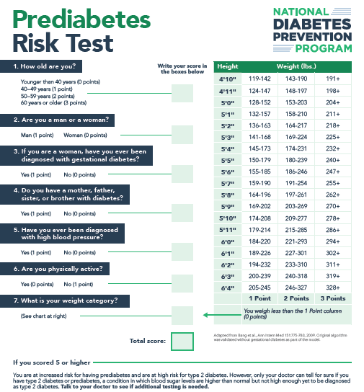
Action planning for a healthier lifestyle
CDC Prediabetes Risk Test
Slide 38
This Prediabetes Risk Test is from the American Diabetes Association (ADA). It provides a list of health characteristics that people would know about themselves such as age, height, and weight.
A person with a high score on the online risk test (5 or higher) is at significant risk for having prediabetes and a higher risk of having type 2 diabetes. However, only your doctor can tell for sure if you have prediabetes or type 2 diabetes. Contact your health provider to see if additional testing is needed.
Take the rest online: Online Prediabetes Test

Slide 10
My Notes
Slide 43
Slide 34
Slide 36

Slide 11
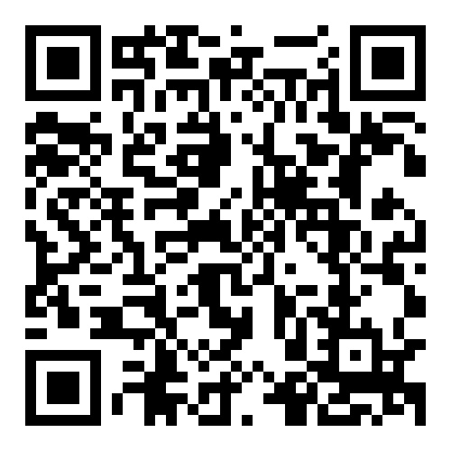

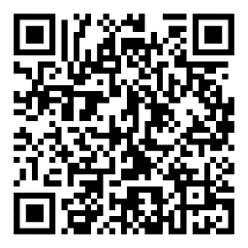

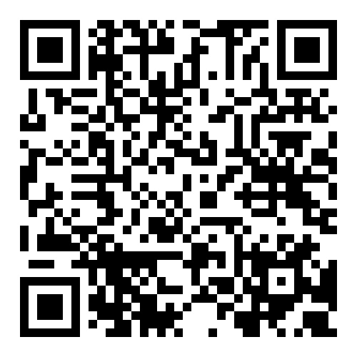

Helpful Resources
 | World Health Organization Diabetes Fact Sheets Key facts about different types of diabetes
 | CDC Prediabetes Risk Test A person with a high score on the risk test (5 or higher) is at significant risk for having prediabetes. However, only a blood test by a medical provider can determine an official diagnosis.
 | Fit 5 Guide & Fitness Cards Fit 5 is based on the three simple goals of exercising 5 days per week, eating 5 total fruits and vegetables per day and drinking 5 bottles of water per day.

Slide 12
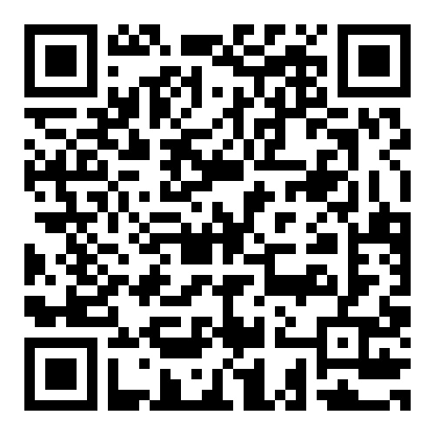


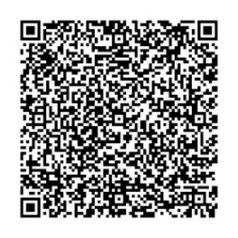
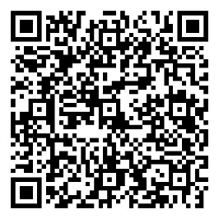

Helpful Resources
 | School of Strength Snack Zone This nutrition education campaign helps athletes learn about the nutritional benefits of choosing healthier snacks and how healthy snacks can fuel them to feel stronger on the playing field.
 | Special Olympics Strong Minds An interactive learning activity focused on developing adaptive coping skills.
 | CDC Diabetes Prevention Program: Lifestyle Change Program Information about the United States Center for Disease Control and Prevention (CDC) National Diabetes Prevention Program lifestyle change program.

Slide 13
Some helpful Tips
Size 12 font is great for printed materials. Size 24 (at a minimum) is good for the body copy on PowerPoints.
Bold and colorful text is helpful to bring attention to a point or topic.
Titles can go in the bar above. To add interest and variety in slide, feel free to use the slide layout with the bars on the side and bottom. That layout is great if you have extra room on the slide and feel like you need to fill up space.
Utilize the icon library and high-quality photos to keep PowerPoints engaging!
Don’t be afraid of white space, it helps the reader digest information easier.

