Slide 1
Virtual Strong Minds
(insert Clinical Director name here)
Special Olympics (insert state/country here)
Notes:
Athlete Supplies needed:
Stress ball or alternative (stuffed animal, rolled up pair of socks)
Virtual Strong Minds Worksheet
Pen
Clinical Director Supplies Needed:
Stress ball or alternative (stuffed animal, rolled up pair of socks)
Virtual Strong Minds Worksheet
Pen
Favorite photo/picture
Favorite song
Pre session evaluation: https://www.dropbox.com/sh/c96r0wpdkm1rdv5/AABRGlYruIi8n4XzWF8n1-Nma?dl=0 (please share in the chat if athletes haven’t completed in advance)

Slide 2
Notes:
Welcome to Strong Minds! My name is ____________ and I am a Strong Minds Clinical Director
Athletes work on training their minds, as well as their bodies, in order to be calm and focused for competitions.
There are many things you can do to keep a strong mind, like connecting with other, getting enough sleep, staying active, eating healthy food, asking for help when needs, and lastly using Strong Minds strategies
Today, I’m going to show you 5 Strong minds strategies
Before we get started, I would like everyone to complete a quick survey, please use the link in the chat to answer a few questions (INSERT LINK IN CHAT:https://app.smartsheet.com/b/form/3a173b64a2bb4bb499d5eb792fedfa5e
.

Slide 3
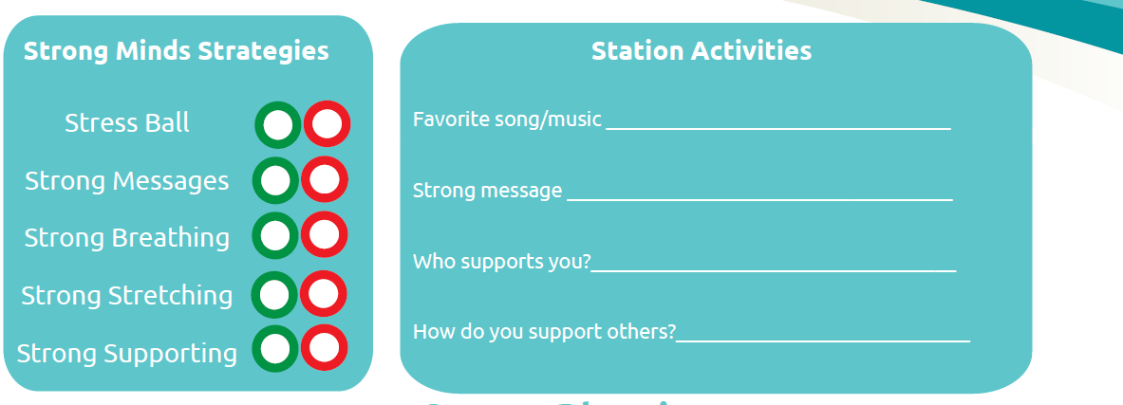
Worksheet
Notes:
(OPTIONAL SLIDE)
As we go through each station, I will be referring to the Worksheet. Please have this printed for today or use the fillable version. I’m including the link the fillable version in the chat (https://www.dropbox.com/sh/c96r0wpdkm1rdv5/AABRGlYruIi8n4XzWF8n1-Nma?dl=0)

Slide 4
Using a stress ball
If you are feeling stressed or overwhelmed, try squeezing a stress ball for a few minutes. Squeeze the ball for 3 seconds, release the ball slowly, and then repeat 5 to 10 times for 1 minute.
Notes:
Let’s start by talking little bit about stress and then show you one of the ways you can help yourself feel better when you’re stressed out. Everyone feels stressed out sometimes. Stress is not always a bad thing as it makes us prepare for exams or competitions, it also helps keep us safe. Sometimes when stress is too much it can work against us and get in the way of us doing well.
A person who’s “stressed out” is usually feeling strong emotions (like sadness, or worry, or feeling mad) that are really uncomfortable. We can also experience stress in our bodies and have feelings of being dizzy, difficulty breathing, our heart beating faster, or upset stomach. Stress can also make your body really tense – making it harder and harder to feel calm and relaxed. For a lot of us, we have to calm our bodies before we can calm our feelings.
Even though we may not be able to control what stresses us out, we can do things to help ourselves feel better when we’re stressed. This stress ball is one way you can use your body to get rid of stressful feelings.
Go ahead and squeeze the ball for about 3 seconds – 1..2…3..there you go! Great! Now release your grip. Feel anything? Can you tell that your hand is more relaxed after you squeeze the ball? (HAVE ALL PARTICIPANTS PRACTICE TOGETHER WITH YOU ABOUT 5 TIMES)
What’s nice is that you can do these stress exercises anywhere – with our without the stress ball.
Now on your worksheet- you will see the stress ball with a green and red circle. If you think you would use the stress ball in the future select green, if not select red.

Slide 5
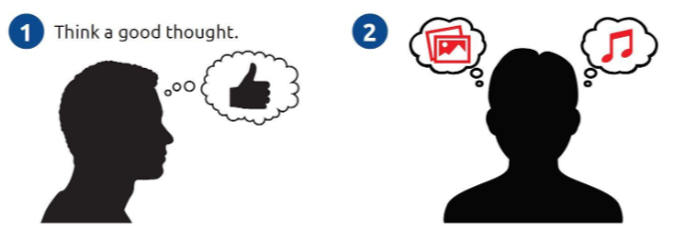
Strong Messaging
We all find our inspiration from different places and it’s important to find what works for you. Many people feel more calm by listening to their favorite music. Other people have a list of encouraging words to read or pictures to look at – kind like of a pep-talk to yourself.
Notes:
Let’s move on to our second strategy, thinking positive thoughts. We’re going to talk about personal ways you can keep your mind strong when you are under stress. We all find our inspiration from different places and it’s important to find what works for you.
Many professional athletes get themselves calm and focused for competition by listening to their favorite music, other people use music to relax.. If you listen to really encouraging, positive music, you will feel more confident and strong.
For example, when I listen to ________________________________________ (PLAY A FEW SECONDS OF A SONG). Think about what kind of music – or what songs- make you feel powerful? Anytime you need to give your brain a positive boost, try listening to music that makes you feel good…it will really help your confidence! If you want add that song/music to your worksheet
Another strategy is to look at your favorite photo and think positive thoughts. Are there people or places or things you’d like to have pictures of – that would make you feel good just to look at? (SHOW AN EXAMPLE OF A PHOTO)
Sometimes it’s helpful to have a written list of encouraging statements you can read or look at – kind of an individual pep-talk to yourself. Let’s take a moment to write down a few things you could say to yourself to stay positive and focused. On your worksheet, please take a few moments to write a positive statement that you could say to yourself (PROVIDE A FEW EXAMPLES) . (Ask participants to give their positive statements in the chat or share verbally with a smaller group)
Now on your worksheet- you will see the words strong messaging with a green and red circle. If you think you would use the strong messaging in the future select green, if not select red.

Slide 6
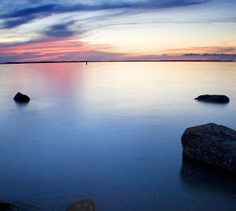
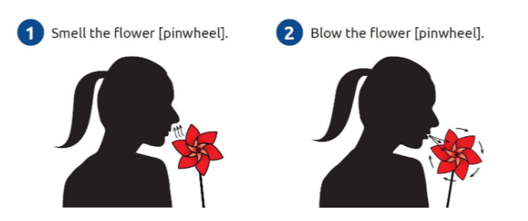
Strong Breathing
5-5-5
Doing deep breathing can help you feel more relaxed and calm. Pretend you are smelling a flower, by breathing through your nose slowly. Then, pretend you are blowing out a candle slowly.
Notes:
Now onto Deep Breathing. Breathing is our best tool for calming ourselves down. It is always with us – and it’s something we do naturally; but it’s also something we can learn to do better.”
When we’re calm, we usually breathe softly, gently, calmly…like the wind in this picture. See how it just moves the water a little.”
When we’re feeling flooded – when feelings are strong and big – our breath can become fast and rough…like the wind in this picture.”
The more you breathe fast and rough, the worse you feel. So if you can catch yourself breathing like in a storm , you need to change the way you’re breathing so you can get to here
Let’s practice our strong breathing together (CLICK FOR WATER IMAGES TO BE REMOVED)
What I’d like for you to do is to take a long deep breath – pull in the air so much that you can feel your stomach move outward – and then breathe out towards. Try using the 5-5-5 method. Breathe in slowly for 5 seconds, hold it for 5 seconds, slowly release it for 5 seconds (PRACTICE WITH THE GROUP 5 TIMES)
Scientists have shown that 3 deep breathes, from your belly, can actually bring you a feeling of calm, especially if you do it slowly by pulling air in through your nose and out through your mouth. Have you ever noticed that when you’re stressed out or nervous, your breathing can get kind of fast and shallow. Simply slowing down your breathing, and making it deep and slow and long can send your body the message that you are okay…that you are calm…it's a great tool that you can use anywhere.”
Even though it seems kind of simple, it actually takes some practice. Try putting your hand on your stomach and see if you can feel your belly move outwards as you pull the breath in, then…slowly release it and feel your belly go back inwards. Or…you can lay on the floor and put a yoga block on your stomach to help you to see your own breathing. (demonstrate).
Now on your worksheet- you will see the words strong breathing with a green and red circle. If you think you would use the strong breathing in the future select green, if not select red.

Slide 7
Strong Stretching
Stretching can help your body feel more relaxed and calm. Try a few different simple stretches or yoga positions, but remember to start slowly and gently!
Notes:
Our fourth strategy is Strong Stretching. I’m going to show you a few simple ways you can move your body to get tense, tight, stressful feelings out.
There are lots of different ways to stretch and you may already have a few favorites. I’m going to take you through some of the moves we like for getting stress out of our bodies. It’s always important to start slowly and gently – don’t strain yourself and don’t go too quickly…stretching is supposed to be a gentle, relaxing activity.
(DEMONSTRATE 2-3 DIFFERENT STRETCHES FROM THESE HANDOUTS:)
https://media.specialolympics.org/resources/health/disciplines/strongminds/Strong-Minds-Yoga-Hand-Out.pdf?_ga=2.249546631.1828151211.1586188599-982982183.1561052415
https://dotorg.brightspotcdn.com/4a/7a/e35aa7124d429498c6f18dbe6e51/strongminds-exercise-handout.pdf
Think about how you feel after you have stretched. Anything feel lighter? Looser? More calm?
Some people like to stretch at a regular time every day – like when they get up in the morning or right before bed. Some people only stretch right before or right after they exercise. Find a time that you will do some of these stretches each day.
Now on your worksheet- you will see the words strong stretching with a green and red circle. If you think you would use the strong stretching in the future select green, if not select red.

Slide 8
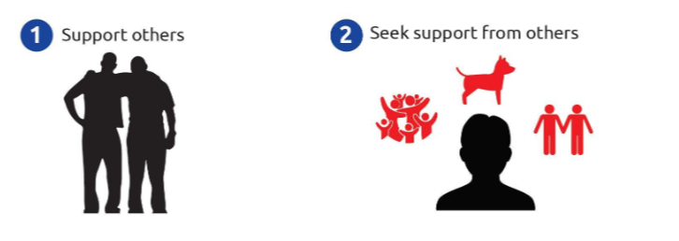
Strong Supporting
Other people can be really helpful to us when we are feeling stressed or upset. Talking to people you trust can help, like your friends and family.
Give others a smile instead of a high five.
Notes:
Our last strategy is Strong Supporting. This station is called “Strong Supporting” because – it turns out – supporting other people that you care about helps reduce your stress. Scientists have found that when we help other people, our immune systems get stronger, and – sometimes – we feel calmer. So, kindness is good for your health!
Who are people that support you, or show you kindness (PROVIDE EXAMPLES). Write the response on your worksheet or in the chat/verbally
And how to you support other people? (PROVIDE EXAMPLES). Write the response on your worksheet or in the chat/verbally
It’s also important to remember that other people can really be helpful to us when we are feeling stressed or upset. Let’s take a moment to think about who you can rely on to be supportive. Who can you go to for support if you’re feeling nervous or stressed out?
Now on your worksheet- you will see the words strong supporting with a green and red circle. If you think you would use the strong supporting in the future select green, if not select red.

Slide 9
Strong Planning
Notes:
Now that we have been through all 5 strategies, lets talk about how we can make a plan for using 1 or more of these strategies in the future. By setting a strong goal we will be more likely to use these strategies in the future and find ways to feel more relaxed.
Let’s start by picking your favorite strategy: Was it: using the stress ball, thinking positive thoughts, deep breathing, stretching, or getting support?
Now let’s think about a time where we might want to use this strategy? Maybe a time we feel stressed or overwhelmed? For example, before bed, in the morning, when I watch or see the news
Finally, who is someone that can support us with this goal. Is it a friend, family member, coach, or someone else?

Slide 10
Thank you
Notes:
Thank you so much for taking the time to go through Strong Minds Virtually. I encourage you all to set reminders for yourself to practice these skills and work on your new Strong Minds goal. To end the session today, I would like to ask all of you to complete a quick survey. I will again put the survey link in the chat. (ADD SURVEY TO CHAT: https://app.smartsheet.com/b/form/fcf64e4026764539875d46121dd16301

