Slide 1
Strong Minds 2.0 Training Webinar
Jenna Lebersfeld, PhD
Sr. Clinical Program Manager

Slide 2
Outline
Introduction
Healthy Athletes 2.0
HAS Form
Referral Guidelines
Clinical Director Training
Q&A
Please save questions until the end unless necessary for accessibility or related to a specific clinical aspect of the form that is being reviewed

Slide 3
Introduction
Discipline Manager of Strong Minds and Healthy Young Athletes
Licensed Clinical Psychologist
Pediatric Clinical Neuropsychologist
Expertise in IDD, autism, ADHD, learning disability
strongminds@specialolympics.org

Slide 4
Healthy Athletes 2.0

Slide 5
Healthy Athletes 2.0
Reviewed and updated content, HAS forms, and resources
Access to HAS forms and resources
Sent directly to Programs hosting early events
Will be added to resources page within the month
https://resources.specialolympics.org/health/strong-minds
Strong Minds 2.0 main changes:
Mental health screening measures (CORE-LD30, Warwick Wellness)
More robust referral guidelines

Slide 6
HAS Form

Slide 7
HAS Form Introduction
Review general layout
Importance of registration for accurate post-event digitization
Filling out the form correctly
Circle = choose one answer only
Square = select all that apply

Slide 8
Station 1: Check In
No major changes
Athlete demographic info
Mood surveillance questions
Vignette (now optional/based on athlete need/CD preference)
Baseline coping strategies

Slide 9
Station 2: CORE-LD30
Clinical Outcomes in Routine Evaluation – Learning Disability
Search for measures: No self-report broad mental health screening tools by and for people with IDD exist
CORE-LD30 researchers partnered with people with IDD to develop and refine the items
Items address mental health broadly
Caveat: Developed to track therapy progress (not screen for mental health)
© CORE System Trust, CoRG and City of Edinburgh Council Bonnington Symbol System

Slide 10
Station 2: CORE-LD30
30 items
Item examples:
“Have you felt like crying?”
“Have you felt like you have no energy to do anything?”
“Have you attacked someone?”
Athlete answers:
“Not at all,” “Sometimes” or “Always/A lot”
© CORE System Trust, CoRG and City of Edinburgh Council Bonnington Symbol System

Slide 11

Station 2: CORE-LD30
Visual support for answer choices:
© CORE System Trust, CoRG and City of Edinburgh Council Bonnington Symbol System

Slide 12
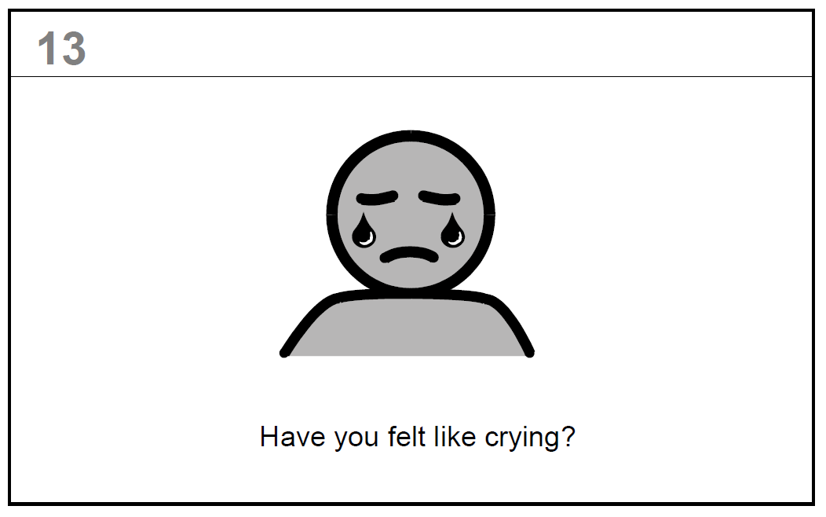
Station 2: CORE-LD30
Visual supports are available for each item:
© CORE System Trust, CoRG and City of Edinburgh Council Bonnington Symbol System

Slide 13
Station 2: CORE-LD30
Administration:
1 volunteer to 1 athlete
Use partitions to create semi-private spaces
Clinical Volunteers:
Must have experience with health questionnaire administration
Can be clinicians or advanced clinical students
Can be students in a mental health field (e.g., psychology, social work) or allied profession (e.g., med students, PA students, nursing students)
© CORE System Trust, CoRG and City of Edinburgh Council Bonnington Symbol System

Slide 14
Station 2: CORE-LD30
Scoring:
It needs to be scored during the screening
Certain item totals → referral guidelines
© CORE System Trust, CoRG and City of Edinburgh Council Bonnington Symbol System

Slide 15
Station 3: Warwick Wellness Scale
Warwick-Edinburgh Mental Wellbeing Scale Intellectual Disability Version
Developed as an assessment measure
Focuses on wellbeing instead of mental health challenges
14 items
Has 2 practice questions
“I watched sports on TV” and “I ate rotting food”
Warwick-Edinburgh Mental Wellbeing Scale (WEMWBS) © University of Warwick 2006, all rights reserved

Slide 16
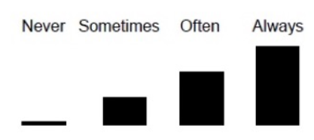
Station 3: Warwick Wellness Scale
Athlete answers: “Never,” “Sometimes,” “Often,” “Always”
Item examples:
“I deal with problems well”
“I was interested in new things”
Warwick-Edinburgh Mental Wellbeing Scale (WEMWBS) © University of Warwick 2006, all rights reserved

Slide 17
Station 3: Warwick Wellness Scale
Administration and Clinical Volunteers:
Same as CORE-LD30
Scoring:
Scoring onsite not required for this measure
Warwick-Edinburgh Mental Wellbeing Scale (WEMWBS) © University of Warwick 2006, all rights reserved

Slide 18
Station 4: Check Out
Screening results reviewed with athlete
Make referral recommendations, if needed
Clinical Volunteer:
Clinical Director or experienced mental health clinician working closely with the CD
1 volunteer to 1 athlete
Use partitions to maintain privacy and confidentiality

Slide 19

Strong Minds Stations and Activities
Station 1: Check In
Station 2: CORE-LD30
Station 3: Warwick Wellness Scale
Station 4: Check Out
Activity 1: Stress and You
Activity 2: Strong Messages
Activity 3: Strong Breathing
Activity 4: Strong Stretching
Activity 5: Strong Supporting
Station 5: Review of Activities

Slide 20
Activities
No changes to the activities themselves
More leniency/creativity encouraged
Activities must address the core goal and introduce the underlying coping strategy principle
Alternative options are in the Clinical Director manual
Please email me about any other ideas
strongminds@specialolympics.org

Slide 21
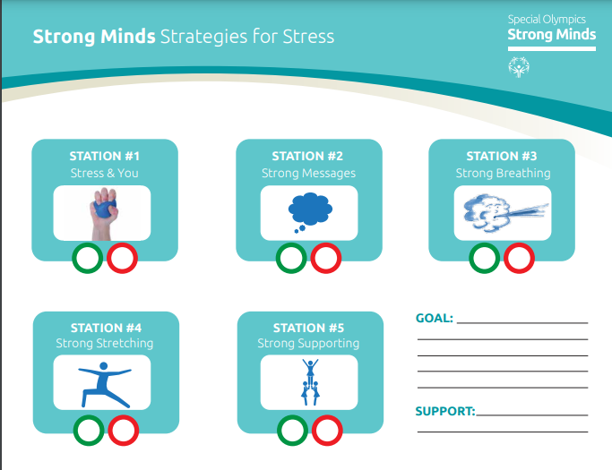
Strategies for Stress Worksheet

Slide 22
Activities
Activity 1: Stress and You
Discuss stress with athletes
Introduce tense-and-release exercise using stress ball
Activity 2: Strong Messages
Show that positive thoughts, music, and photos can help with stress

Slide 23
Activities
Activity 3: Strong Breathing
Introduce deep breathing and discuss how it can help with stress
Activity 4: Strong Stretching
Introduce stretches to help release tension and stress in the body
Activity 5: Strong Supporting
Emphasize that giving and receiving social support helps reduce stress

Slide 24
Station 5: Review of Activities
Same as the previous “Check Out” station from Strong Minds 1.0
Review Strategies for Stress Worksheet
Choose their favorite coping strategy
Make a plan to use it in competition or in their daily life

Slide 25
Referral Guidelines

Slide 26
Referral Guidelines
Based on surveillance question from Check In and CORE-LD30 responses
CORE-LD30 Scoring Guide
Surveillance question:
“Are you currently receiving counseling or therapy from a mental health professional?”
If yes and not urgent → Routine referral
Ultimately CDs clinical decision making within referral guidelines

Slide 27
Referral Guidelines
Provider and resource directory
Needs to be developed in conjunction with Program Health Staff and CDs
For local events – should be specific to the local area
For larger events – will need to have broader, wide-reaching resources
If athlete lives in remote area where the Program Health Staff and CD are unable to identify local providers, refer to PCP

Slide 28
Clinical Director Training

Slide 29
Clinical Director Training
New CDs must be licensed mental health professionals
Current CDs who are not licensed mental health clinicians:
Will be grandfathered in
However, new co-CDs who are licensed mental health clinicians will need to be recruited and co-run Strong Minds 2.0 events

Slide 30
Clinical Director Training Modules
Strong Minds 2.0 Clinical Director Training Module is live on the LMS
New CDs will be assigned this training automatically.
Current CDs trained on Strong Minds 1.0 will need to complete this training prior to implementing Strong Minds 2.0.
Can be accessed in the currently assigned courses on the LMS. Please note that while it may appear that the course has already been completed, they can restart/retake it at any time.
Contact Kelsey Sparks for LMS assistance (ksparks@specialolympics.org)

Slide 31
Q & A Email: strongminds@specialolympics.org

