Slide 1
Virtual Special Smiles Self Assessment Poll
Allen Wong, DDS, EdD, DABSCD Global Clinical Advisor, Special Olympics Special Smiles Program Professor and Director AEGD Program Director Hospital Dentistry Program awong@pacific.edu
Steven Perlman, DDS, MScD, DHL (hon) Global Clinical Director and Founder, Special Olympics Special Smiles Clinical Professor of Pediatric Dentistry Boston University School of Dental Medicine
sperlman@bu.edu

Slide 2
Welcome
Thank you for attending and participating in this Special Smiles event! This is a voluntary event.
This will be an interactive session where you’ll have the opportunity to answer polling questions.
There will be one question per slide and 29 questions in total
The session may be recorded for learning/ training to improve the program
It is important that we go through this together, so please wait for me to read each question before you respond.
Do not submit your response until instructed at the end.
Are there any questions?
Let’s begin! Please follow my instructions to get set up……

Slide 3
Setting up your screen
You will see my presentation and we set up your screen together
We need to change the View of the Participants.
On the video view, please find the top bar of the View of the Participants
Choose the second middle bar with 2 lines so that you see one person
Notes:
If you cannot see the whole screen…
If the Poll comes off and on again in the middle of your screen, just move it again to the right side.

Slide 4
Setting up your screen
Now you will Click on the top bar of the View of Participant
Move the View to the Bottom Right corner of the Screen
It should look like the bottom slide.
Notes:
If you cannot see the whole screen…
If the Poll comes off and on again in the middle of your screen, just move it again to the right side.

Slide 5
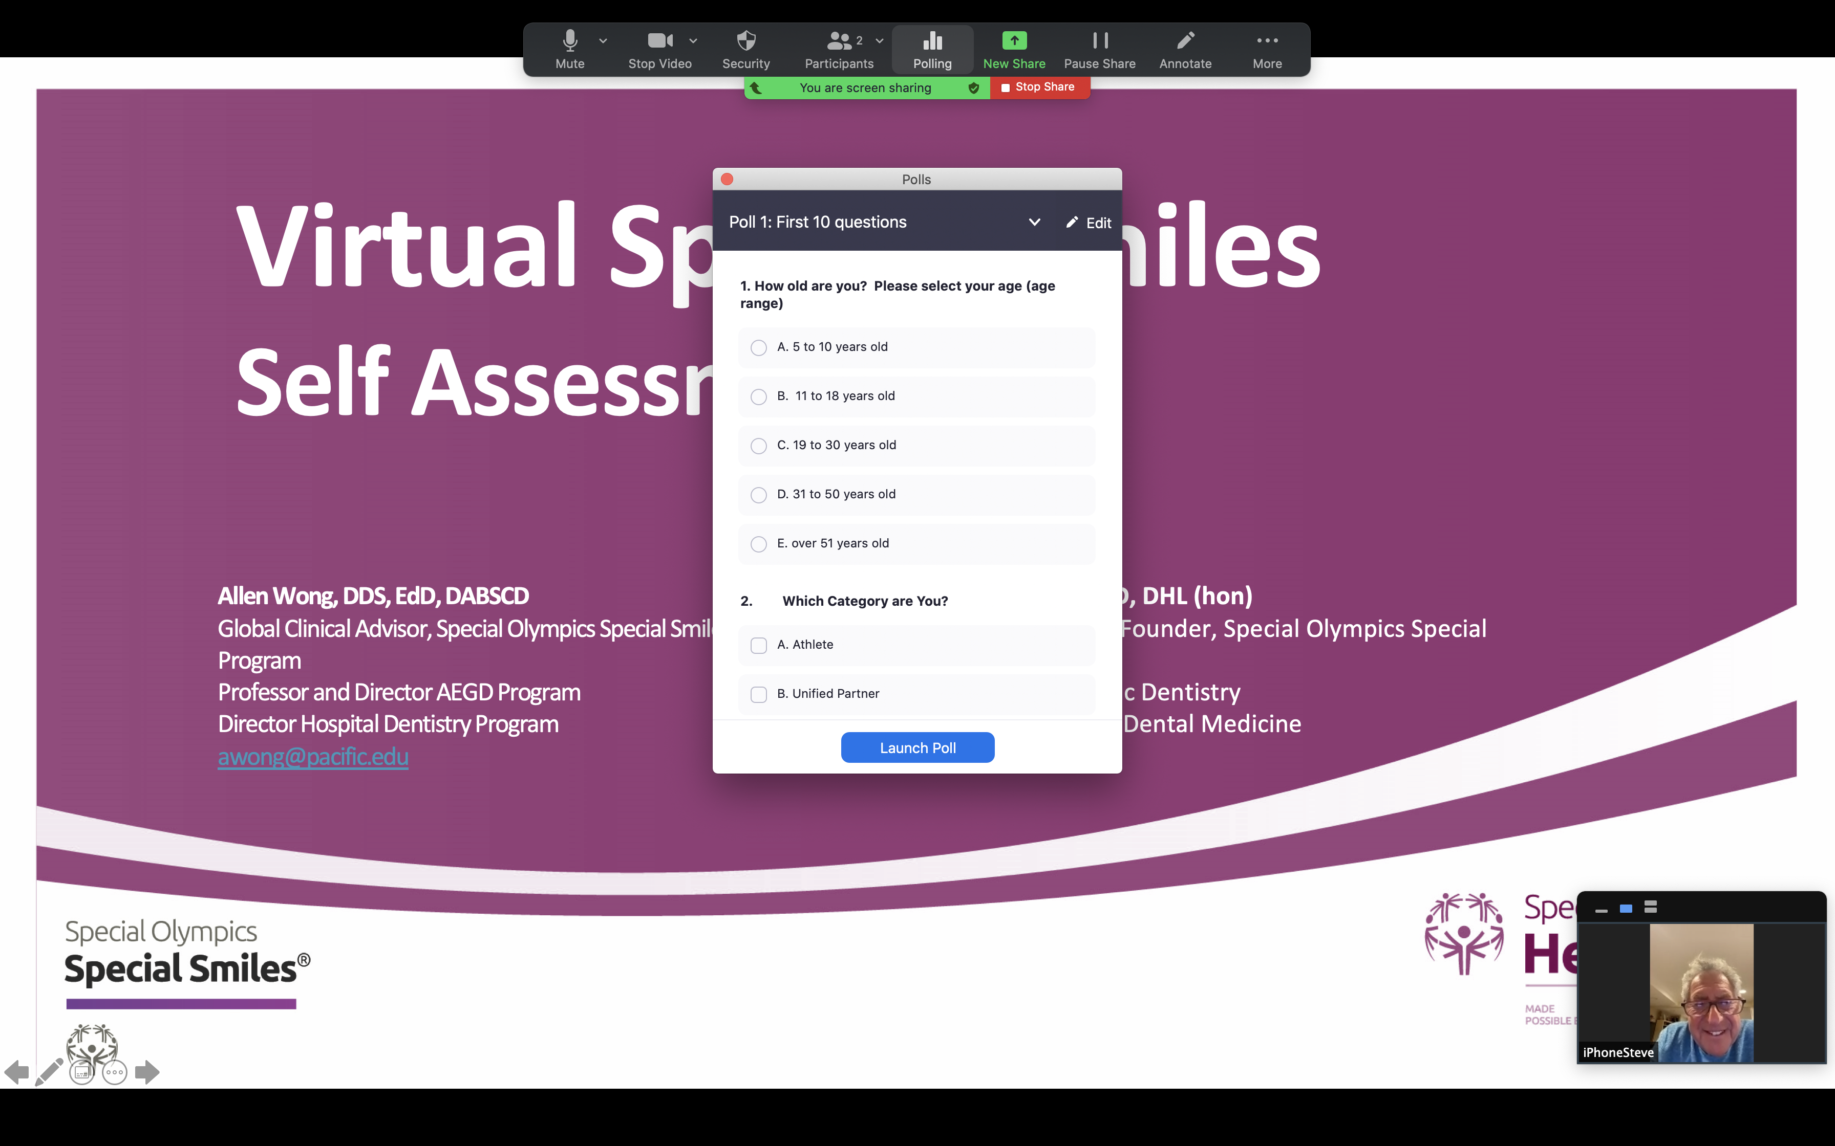
Setting up your screen
You will see the Poll in the middle of the Screen
We will be moving the Poll
Notes:
If you cannot see the whole screen…
If the Poll comes off and on again in the middle of your screen, just move it again to the right side.

Slide 6
Setting up your screen
Click on the Poll header bar
Move the Poll to the Upper Right part of your screen but not farther than you can see the Entire Poll
Now we should see the Background with the “Virtual Special Smiles”; the Upper Right has the Poll and the Lower Right has the View of one participant
Reminder: Stop and check that everyone is together
Let’s Begin

Slide 7
Question 1
How old are you?
Please select your age (age range) next to poll question 1
5 to 10 years old
11 to 18 years old
19 to 30 years old
31 to 50 years old
Over 51 years old

Slide 8
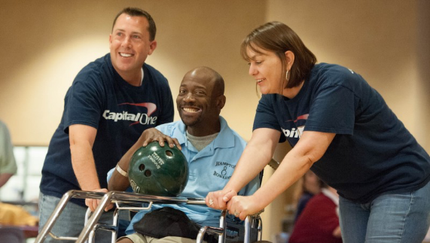
Question 2
Which category are you? ( Check All that apply )
Athlete
Unified Partner
Coach
Clinical Director/ Volunteer
Parent/ Family member
Support person/Caregiver/ Direct Support Person
Educator/ Teacher

Slide 9
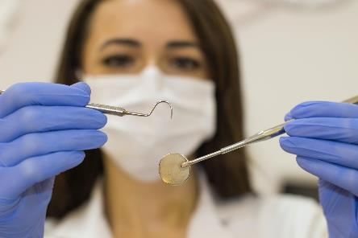
Question 3
Do you have a local dentist or oral health professional?
Yes
No
Not sure
Everyone should have a dental home that you visit regularly to check on your oral health. Good oral health means that you are free of pain and disease, like cavities and gum problems. Oral health means you can smile, chew, swallow, talk and breathe easily.

Slide 10
Question 4
How often do you visit the dentist/oral health professional?
Once a year
Twice a year
More than twice a year
Only when needed
Never
You should visit your dentist or oral health team on a regular basis. Most people should see their dental team every 6 months or more frequent depending on your needs

Slide 11
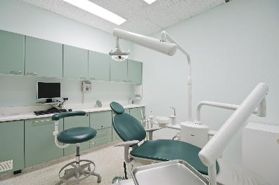
Question 5
Have you ever had trouble finding oral health care or finding a dentist?
Yes
No
Not sure
At Special Olympics, we are trying to help those needing oral care to receive care, especially if there is pain, swelling or bleeding when you brush your teeth. Let us know if we can help you.

Slide 12
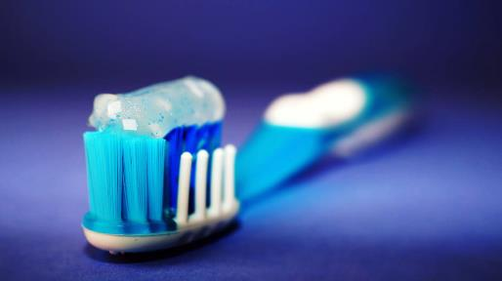
Question 6
How often do you clean your mouth?
(Brush, floss, wipe or other ways you clean your teeth, gums and mouth)
Once or more a day
2 to 6 times per week
Once per week
Less than once per week
When we eat, we leave food behind for bacteria to eat and make acids. Acids make our teeth soft and may lead to cavities. We need to brush and floss to clean our mouths regularly to be healthy.

Slide 13
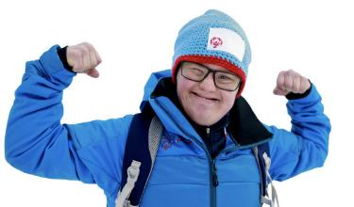
Question 7
Do you have teeth?
Yes
No
Even if you don't have teeth, you still need to go to the dentist or oral health team.
They will make sure your mouth is clean and healthy.
They will also check the fit and function of the denture or partial denture if you have those.

Slide 14
Question 8
Do you wear dentures, partial dentures, “plates” or wear braces (orthodontics)?
Yes
No
Sometimes
Anything else in the mouth can increase hiding areas for bacteria and food remains. It can make cleaning your mouth more difficult.
Make sure to clean these items every day.

Slide 15
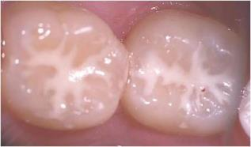
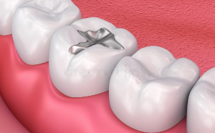
Question 9
Have you ever had a filling or sealants? (silver, white, gold)(as child or adult)
Yes
No
Not sure
Sealant
Filling
Having fillings in the past means that we need to help give you tips on preventing the need for more fillings.
Sealants help keep bacteria out of deep grooves in our teeth so that there is less chance of a cavity forming.
Notes:
Talk about Fluoride Varnish

Slide 16
Question 10
Which statement is true?
Chewing tobacco is harmless
E-cigarettes are safe
Vaping is safe
Second-hand smoke is safe
Smoking can be harmful
All smoking items have risk. Any smoke increases the chances of lung problems/ disease including cancer and heart disease. Even chewing tobacco can contribute to cancer.

Slide 17
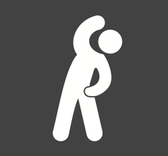
Please submit your poll Review first ten questions Poll change Take a stretch break!

Slide 18
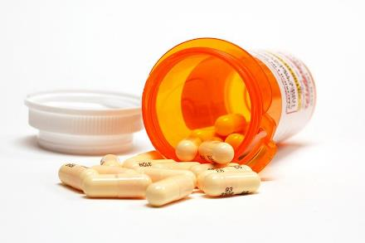
Question 11
Do you take daily medications?
Yes
No
Not sure
Medicines are good for you, but sometimes they can have side effects. Make sure your dentist knows all the medications you take.

Slide 19
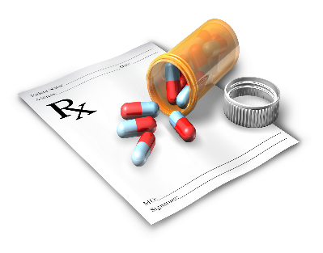
Question 12
Do you take medicine for ANY for the following: Blood pressure, seizures, allergies, constipation, mood, asthma?
Yes
No
Not sure
Medication side effects can make the mouth feel more dry or cause upset stomach. If you answer yes, you need to be seen more often at the dentist or oral health team to check for any changes in your mouth.

Slide 20
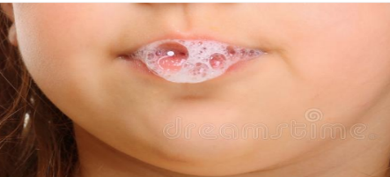
Question 13
Is your saliva (spit) more like?
Thin like water
Bubbly or foamy
Thick, ropey...like syrup
Not sure
If your mouth feels dry, or your saliva is thicker than water, you may have extreme cavity risk. Good saliva helps to neutralize the acids. You can make enough saliva by drinking plenty of water.

Slide 21
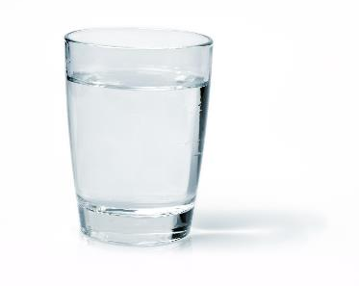
Question 14
Do you drink more than 1 liter or 5 glasses of water a day?
Yes, every day
Sometimes
No, not usually
Not sure
Hydration (drinking water) is very important for our overall health. Drinking plenty of water will help our body to produce the 1-2 liters of saliva we need each day.

Slide 22
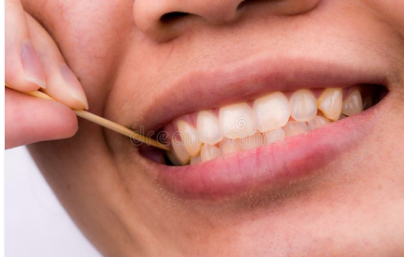
Question 15
How often does food get stuck between your teeth?
Often
Sometimes
Rarely
Food getting trapped between your teeth may be trouble areas for gum disease and cavities. Have your dental team teach you how to floss or get those areas clean.

Slide 23
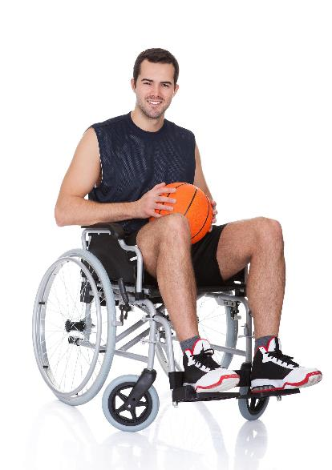
Question 16
Do you play a sport that has contact with other players? Like basketball, wrestling, soccer and others.
Yes
No
Contact sports can be fun until someone accidentally gets hit in the mouth or falls.
A mouth guard helps protect teeth from hitting each other and prevents concussions.

Slide 24
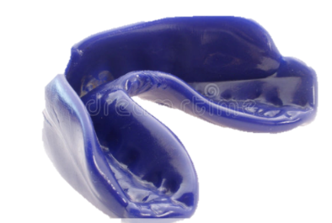
Question 17
If you play a sport that has contact with other players, do you wear a mouth guard?
Always
Sometimes
Never
I don’t have one
I don’t play contact sports
It is important to have a good fitting mouth guard that is comfortable to wear.

Slide 25
Why Did We Ask About Dental/Oral Risk?
(Cavities Gum Disease or Trauma) Questions 8 through 17
Knowing what is increasing any risk for disease is important.
By you knowing what risks are, you can help make good choices to lessen the chance of problems in the future.
Early signs: sensitivity, pain, bleeding or looseness of teeth.
Early conditions: not enough quality or quantity of saliva, history of fillings, wearing oral appliances (braces, dentures, partials), some medications, and dry mouth are possible risks for problems.
Avoiding trauma to the face or concussion by using a mouthguard is important.

Slide 26
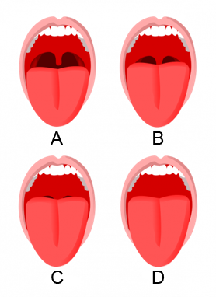
Question 18
ACTIVITY
When you look in a mirror and open your mouth, which picture looks like yours?
Do you see the back of your mouth?
Upper left
Upper right
Lower left
Lower right
Can’t see/ Not sure
Sometimes our tongue or jaw position can make breathing a challenge and could contribute to snoring ….
Especially the bottom two choices ( C and D ).

Slide 27
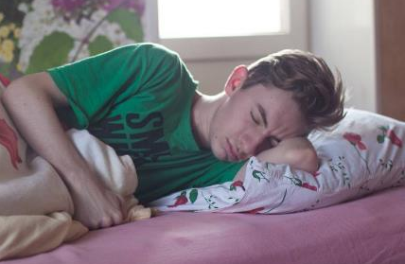
Question 19
Do you experience any of the following?
(check all that apply)
People tell me I snore loudly
I breathe loudly
I am sleepy throughout the day
I often find it difficult to concentrate
Not sure
None
These could be early signs of sleep apnea. Sleep apnea can contribute to high blood pressure, diabetes, strokes, non restful sleep, obesity, stress.... If you experience these, you may need to see your physician to evaluate.

Slide 28
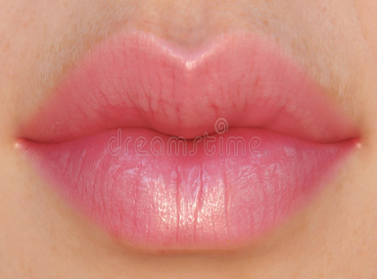
Question 20
ACTIVITY
Is it easy to put your lips together and breathe through each nostril? (Put your lips together, close off one nostril gently and breathe, then try the other nostril)
Easy on both sides
Not easy on one or both sides
Not sure
Mouth breathing or blocked nostrils can be contributing to sleep apnea and increasing the risk of cavity risk.

Slide 29
Health Risks : Questions 18 through 20
Getting proper rest is important to be alert and energetic
If we cannot breathe easily, it may be causing or contributing to other health concerns as well as poor rest
Snoring, loud breathing, difficulty in breathing from your nose can be a concern that a physician needs to be aware to make proper suggestions for improvement

Slide 30
Please submit your poll Review second ten questions Poll change Take a stretch break!

Slide 31
Question 21
Do you want to learn how to have and keep a healthy smile?
Yes
No
Maybe
A healthy smile also helps to keep your body healthy.
Smiling reduces stress and makes others happy as well.

Slide 32
Question 22
Do you experience pain in your mouth, especially during or after eating?
Yes
No
Not sure
Pain can be a sign that something is wrong. We want to make sure you are free of pain and able to chew, eat, swallow, breathe and sleep without difficulty.

Slide 33
Question 23
Do you have pain inside your mouth? Tell me more.
(check all that apply)
Pain in teeth
Pain in gums
Pain in stomach after eating
Other
None
If you are experiencing pain, you should see your dentist or oral health team.
The sooner they know about the problem, the easier it should be to fix.

Slide 34
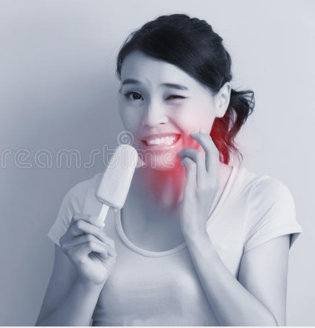
Question 24
Do ANY of your teeth feel sensitive to cold, hot or sweet foods or liquid?
(check all that apply)
Yes, upper tooth/teeth
Yes, lower tooth/teeth
No
Not sure
Sensitive teeth can be early signs of cavities or gum disease (recession)

Slide 35
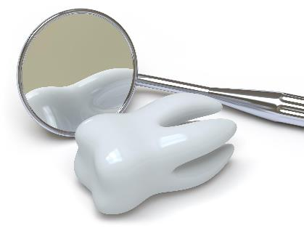
Question 25
Do you have difficulty chewing?
No
Yes
I have no teeth
I have too many missing teeth
My teeth don’t touch when I chew
If you answer any response other than A….
Let you dentist or oral team know to see if they can help you

Slide 36
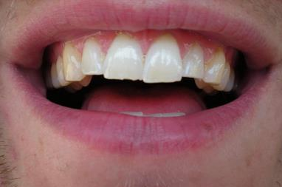
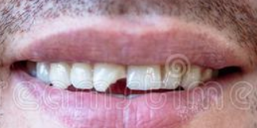
Question 26
Look at your front top teeth in the mirror, do you have any chips or broken edges of your teeth?
Yes
No
Not sure
Chipped teeth may mean that your teeth are at risk for more problems like cavities, lip biting, or cracked teeth.
See your dentist or oral health team to check if you may need a mouth guard or need to fix the chip.

Slide 37
Question 27
Do you see signs of bleeding from your
mouth when you Brush, Floss or Rinse?
Is it reddish/pink in the sink?
Yes
Sometimes
No
Not sure
Keeping gums healthy is important.
Bleeding gums is a sign of poor hygiene that can be easily treated by your dentist/ oral health provider.
Schedule an appointment with your dentist/oral care provider to see if you need treatment or help with brushing/ flossing.

Slide 38
Dental Urgency: Questions 22 through 27
There are times where you should not wait to seek care.
If you answered YES to ANY of the last 5 Questions, you SHOULD seek advice and/ or treatment from a Dentist/ Oral Health Care team as soon as possible.
Let someone, who helps you (family member, coach, care provider) know that you need to find help.

Slide 39
Question 28
Did you learn something new today?
Yes
No

Slide 40
Question 29
If you could have a “One to One” Zoom (virtual) consult to ask a dentist or oral care provider a question, would you be interested?
A. Yes
B. No
C. Maybe
Topics can be expanded:
how often change brush,
how to choose a tooth brush,
how to floss
First appointments fears. ( especially Pandemic times)
Loose teeth?

Slide 41
Question 30
How many times have you participated in the Virtual Special Smiles Poll?
A. First time
B. 2-5 times
C. 6 or more
D. Cannot remember

Slide 42
Please submit your POLL now If you would like to ask a question one on one, please email me at : (fill in email address) with the subject: “One on One Request”
Do YOU have ANY questions? Type them in the chat/ question & answers section or proceed to optional breakout rooms for questions
Thank you for participating!

Slide 43
Colors: Questions
Purple Information 1 - 7, 21, 28, 29
Green Caries risk 8 - 14
Orange Periodontal risk 15
Blue Health (sleep apnea) risk 18-20
Light blue Trauma risk 16 - 17
Yellow Urgency 22 - 27
Red Stop and review

