Slide 1
Special Olympics Lions Clubs International Opening Eyes Introduces: Eye-Connect

Slide 2
Agenda
Why Eye-Connect (OE Eye-Connect)?
What does OE Eye-Connect bring to the SO athletes?
How will OE Eye-Connect be delivered?
What are the limitations of OE Eye-Connect?
What role does the program and CD play in bringing OE Eye-Connect to the athletes?
Where do we begin?
Q&A

Slide 3
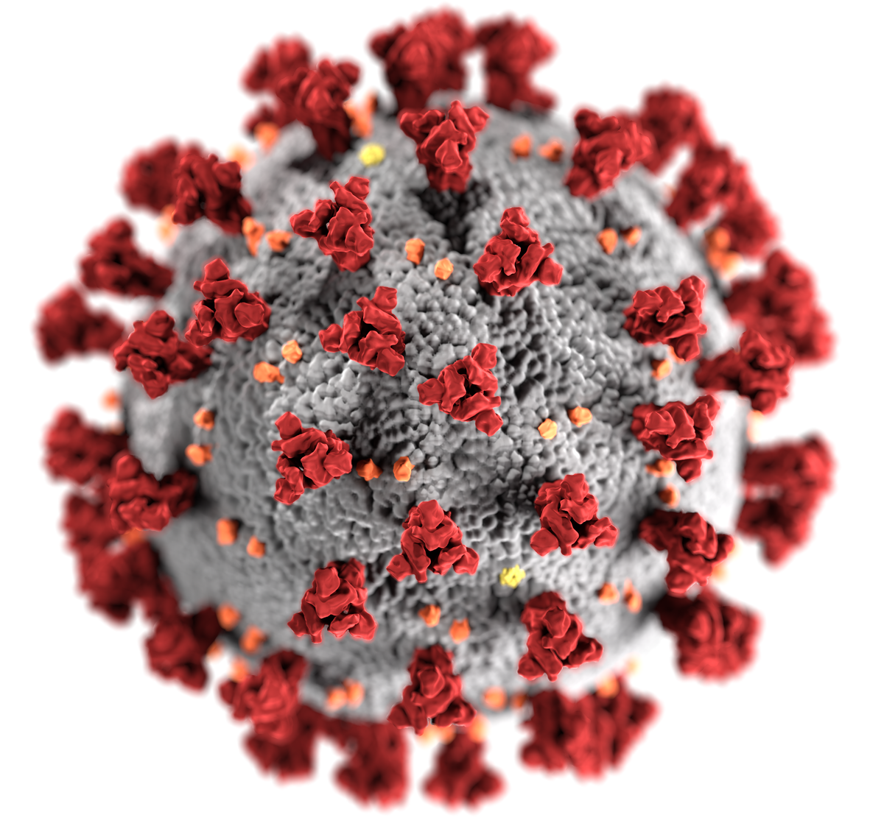
Why Opening Eyes Eye-Connect? COVID-19 pandemic has affected all of us !
COVID-19 has been shown to target vulnerable populations.
The data shows that people with disabilities are at higher risk and may be more seriously affected by the virus.

Slide 4
Why Opening Eyes Eye-connect? In response to the changing environment we launched OE Eye-Connect
Since March 2020 all events were suspended that involved physical interactions.
Athletes therefore had no access to in-person services of SOLCIOE, specifically, new eyeglasses, education, and an assessment of eye health.
The OE team wants to ensure that the athletes are able to access as many resources from SOLCIOE as possible.
As a short-term solution, we developed Opening Eyes Eye-Connect.

Slide 5
What does OE Eye-connect bring to SO athletes?
OE Eye-Connect is a way to offer a modified Opening Eyes Program to Athletes by utilizing virtual technology.
The program could include:
triaging of impending eye problems
follow up on those athletes that have been seen at an Opening Eyes event in the past year (2019).
health promotion and prevention education on vision and eye health topics
The best means to address these consultations will be an athlete and eye doctor conversation - one on one with a parent or guardian.

Slide 6
Strengths & Limitations of OE Eye-Connect
!
Continue to offer OE to athletes
Opportunity to educate on importance of Vision and Eye Health
Follow up and feedback from athletes
Virtual consultations are limited in scope by the fact that clinical examinations can not be conducted, diagnosis made and treatment initiated
The consultation will provide proper referrals when appropriate based on the athletes concerns
Limitations are to over the counter (OTC) recommendations.
Sometimes the problems are more complicated and need a full eye exam.
We do rely on only what the athlete shares with us.

Slide 7
Process of OE Eye-Connect
SO Programs and CD’s will be invited to participate in a local OE Eye-connect program.
SO programs will determine the type of OE Eye-connect: triage, health promotion or follow-up design.
SO program will reach out to their athletes to assess interest or need.
Athletes need to understand that this does not replace an exam or a visit to the Opening Eyes venue.

Slide 8
Process of OE Eye-Connect
Once an athlete has agreed to participate in the OE Eye-Connect program, the SO program will need to obtain informed consent and assent from the athlete’s legal guardians and from the athletes!
One of the goals of the program is to demonstrate the value by collecting data regarding participation. This may be used for research purposes (publications) anonymously.

Slide 9
Process of OE Eye-Connect
Prior to the virtual OE Eye-Connect, the local SO program will need to obtain complete demographic information and the reason for the athlete to participate.
At this time, the SO program will determine if the athlete needs assistance with the technical requirements (Internet access etc.).

Slide 10
Process of OE Eye-Connect
The SO program will need to locate the previous HAS data for the CD to review prior to the OE Eye-Connect if the program chooses the follow-up path.
SO program, the CDs and the athlete will agree upon a time for the OE Eye-Connect to take place .
SO program will provide the virtual platform for the OE Eye-Connect.

Slide 11
Role of the SO Program
SO Program needs to be aware of what topics and issues can be addressed through OE Eye-Connect.
GCAs can provide a list of topics that can be covered. Some examples include:
Athlete received a pair of glasses – how are they working for the athlete?
An athlete complains of a red, itchy eye – what should they do?
The athlete has vision problems that interfere with their school work and how do I figure out what to do?
The athlete has diabetes – do they need an eye exam?
Topics that are not appropriate FOR OE Eye-Connect:
New reports of double vision, eye discharge, or other urgent problems.
THESE NEED TO BE REFERRED IMMEDIATELY FOR CARE

Slide 12
Role of the SO Program
Coordinate with your CD to ensure processes are understood, identify suitable times that are convenient for all parties, schedule appointments with athlete and CD.
SO program should provide HAS data from past OE events to CD for athletes with appointments.
Limitations of this virtual format needs to be understood, acknowledged and respected – a virtual connection can not treat many vision and eye health conditions!
The SO program should have a willing provider list of ECP´s in case a referral for further examinations/treatment.

Slide 13
Role of the Clinical Director
The SO program will have already ensured that the athletes understands and agrees to the virtual format (including legal and ethical issues) and the informed consent and assent forms will have been signed.
The CD should reinforce the limitations of this format that we are working to answer their questions but we can not treat eye conditions in this virtual design!
New forms to collect the results of the interactions have been developed for OE Eye-Connect. Please review the forms prior to speaking with the athletes. It is mandatory that each interaction be fully documented.

Slide 14
Role of the Clinical Director
The purpose of the virtual meeting will determine the next steps.
If triage is chosen, a thorough case history needs to take place and appropriate recommendations including referral if you feel it is appropriate.
If a follow-up of the previous visit to an OE event is chosen – a review of the HAS data from the athlete’s last visit should be discussed with the athlete including comfort with new glasses, whether the athlete followed –up with recommendations, or if the path for health promotion was chosen – a short presentation on the topic of choice with a time for questions should take place.
Complete the OE Eye-Connect data form and return the form to the SO program
If the athlete reports good vision with the glasses received at a recent Opening Eyes event and the glasses are either broken, damaged or lost, there is a possibility that they can be replaced. In some situations the same frame may still be available. If it is that there is a possibility to replace the glasses. The replacement glasses will be identical to the last pair provided by the Opening Eyes program.

Slide 15
Next steps for programs
Review OE Eye-Connect concept and data collection forms and provide feedback.
Develop communication to both the CDs and the athletes incl. consent forms.
Schedule athletes that request assistance with the CD, set up the platform (Zoom or other platforms).
Locate HAS information from past events (if available) so that the CD is able to discuss previous referrals with the athletes, for example pull HAS information for athletes that were referred for (urgent) additional care. Inquire whether the athlete had completed that process. Request those that did not to participate in an OE Eye-Connect event.
Identify all athletes that received new glasses and ask them to participate to see how well they are doing with their glasses.

Slide 16
Addendum for replacement glasses
Determine if the glasses need to be replaced due to damage or loss.
Confirm eyewear was prescribed by SOLCIOE events in 2019.
Confirm that there is no other option to receive new pair of glasses at a local optometrist (e.g. lack of insurance, access or funding).
Consider VSP or Lions for glasses.
Otherwise locate most recent lab order for that pair of glasses.
Contact OE manager for frame availability, include SP#, login & password for Essilor’s Changing Life Through Lenses portal.
Provide mailing address for glasses to be returned to program.
Please note that the order will be processed only if a duplicate frame is available. Notification will be sent to the program.
Please be advised that Essilor Vision Foundation labs currently have limited access for processing orders which may create a delay in processing.

Slide 17
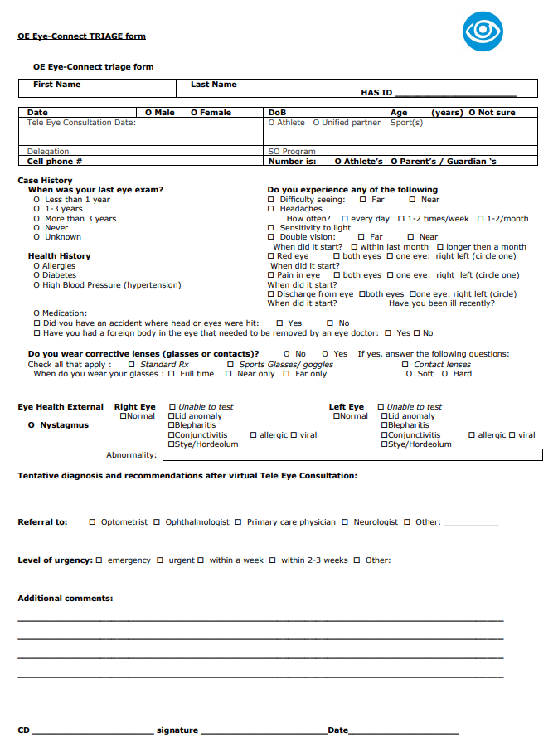
Recording form OE Eye-connect triage

Slide 18
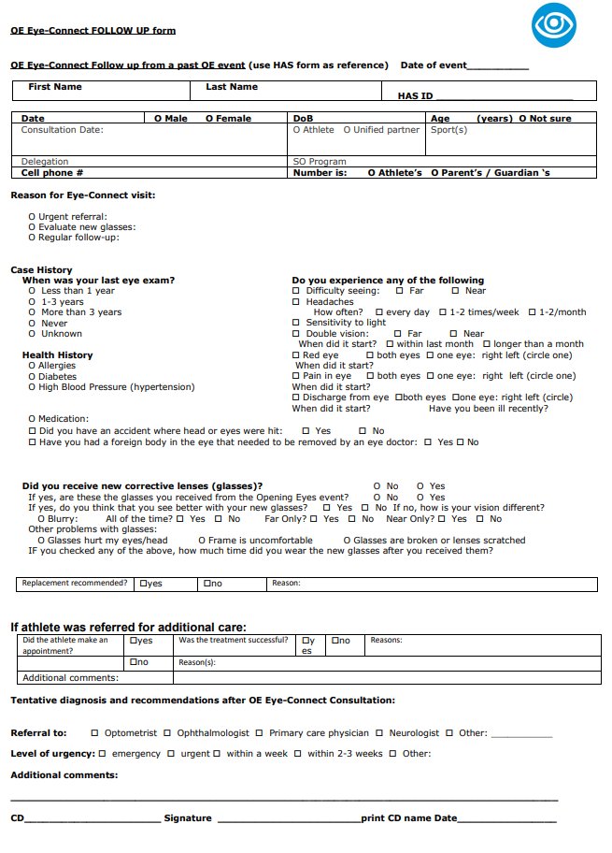
Recording form follow up

Slide 19
Health promotion topics to consider:
Consider virtual group sessions
Does diabetes affect my vision?
Vision and learning
Taking care of my glasses
Uncorrected vision (refractive error)
Protecting my eyes during sports
What to do if you have a red eye?
Does my vision change as I grow older?

Slide 20
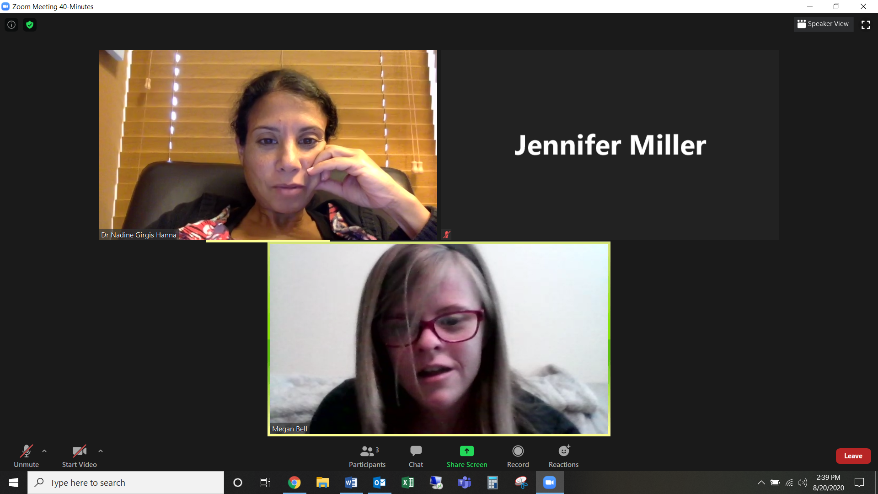
Examples and best practices
Session with athlete Megan Bell
Dr. Nadine Girgis Hanna (OE CD SOFL) asked her how she was doing in the pandemic, if she was working etc. Megan said she is getting married next year and showed off her ring.
Megan’s mom was also on the call. Her mom mentioned that she has a tumor that pushes against her optic nerve. Nadine asked when the last time she went to her doctor and her mom said before the pandemic. She had a question about the frequency of seeing her ophthalmologist during the pandemic. Nadine said not to put off her appoints for more than 6 months and to make her next appointment soon.
Nadine asked if her eyes every got crusty and she said every now and then. Nadine suggested she take baby shampoo and use that to wash her eye lashes so the soap will not hurt her eyes. She said she could make it part of her shower routine every day.
Nadine also asked about how her glasses are working and if they fit. Megan said they came in the mail so they didn’t fit perfectly and would sometimes fall down on her nose. Nadine said to go to a place to get them fitted properly.

Slide 21
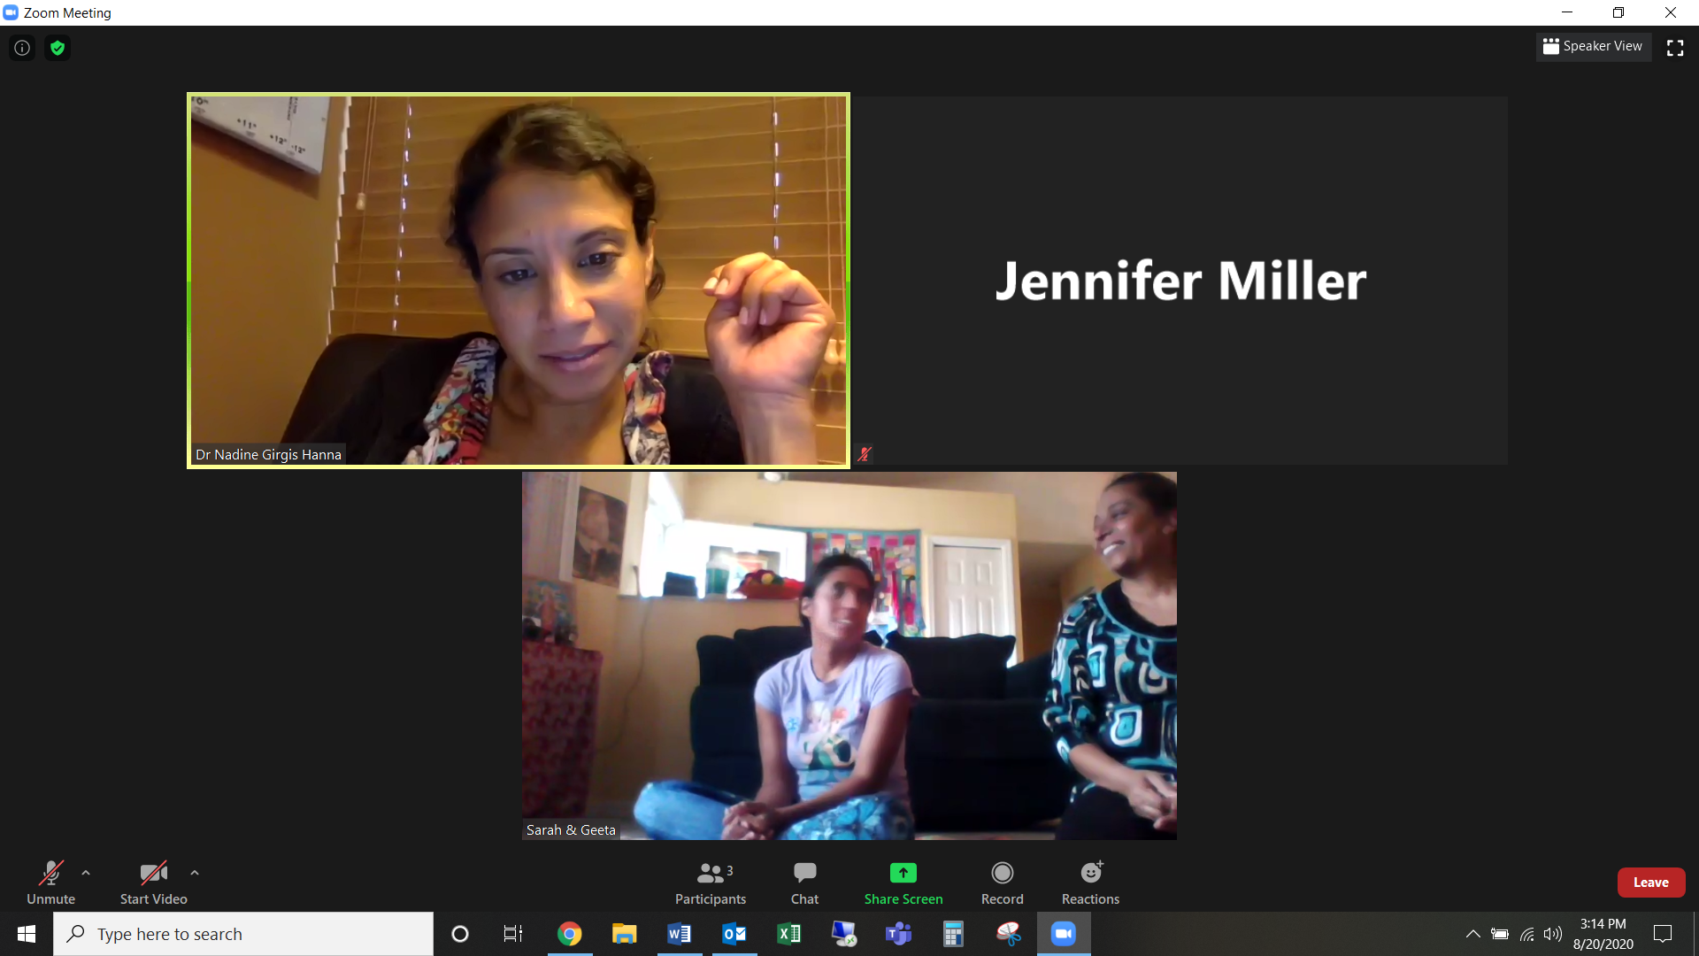
Examples and best practices
Sarah Laloo Session –
Sarah was very quiet and nervous to talk so her mom was there to help. Dr. Nadine Girgis Hanna (OE CD SOFL) noticed she had a princess on her shirt so she asked her about who her favorite it. Nadine was asking Sarah questions about her eyes and if she ever has problems, including itchy watery eyes. Her mom mentioned she has allergies and is on medication. Nadine suggested some drops, then the mother asked if she could show her the drops she bought and if they are good. When her mom left to go get the drops, Nadine asked more about the princesses and other movies Sarah likes. When the mother returned, she had two sets of drops and Nadine pointed out the one they should use.
Sarah mentioned that she sometimes gets headaches when she uses her phone or watches tv for long periods of time. Nadine suggested she takes breaks from the screen and to only be in front of a screen for 20 mins at a time.

Slide 22
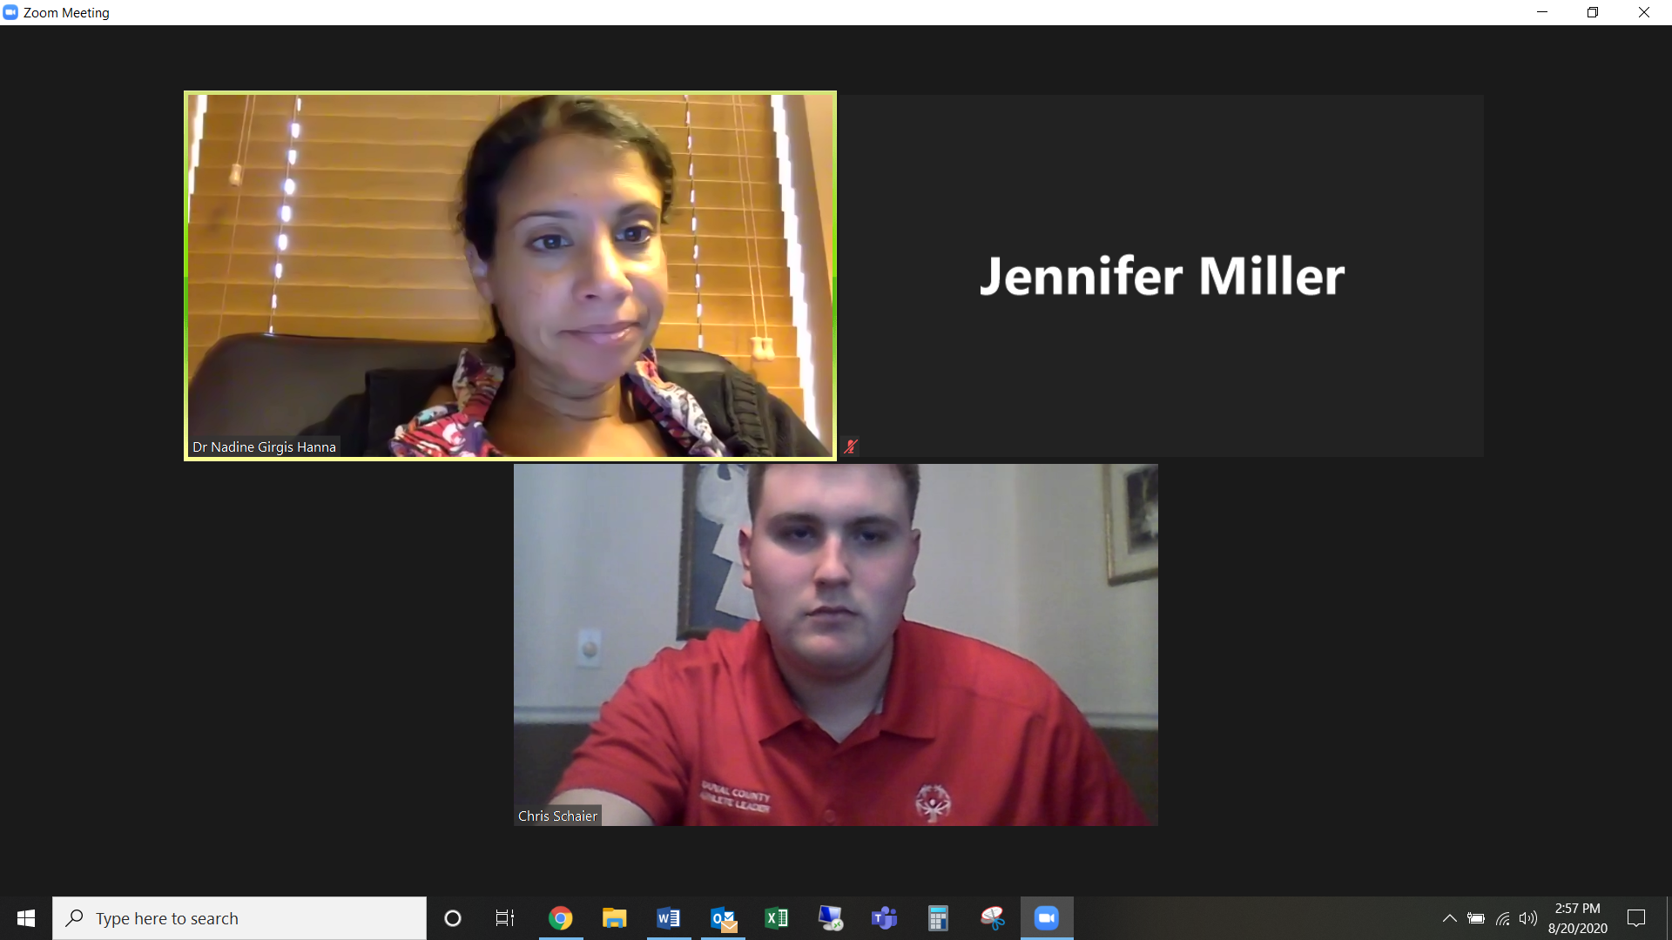
Examples and best practices
Fletcher Schaire Session –
Dr. Nadine Girgis Hanna (OE CD SOFL) continued to be friendly with Fletcher and asked about how he is doing during the pandemic. She asked about what sports he plays and if he would be returning with golf or tennis, which will begin in September. She also asked if he was in school, Fletcher said he was going to culinary school. Nadine asked about his favorite foods.
Fletcher’s mom had some questions about family history of glaucoma and immaculate degenerative eye disease. She is worried about fletcher when he gets older.
Nadine said that you cannot really prevent those things other than eating leafy greens. Also having a well-balanced diet. Nadine joked about the foods he mentioned as his favorite before and said to now include leafy greens.

